Slide 1
A USER-CENTRIC approach to implementing fluid
SESSION 2008
17th October 2017

Slide 2
presenter
Chris Hay
Functional Consultant (Student Systems)
University of Cambridge
chris.hay@uis.cam.ac.uk
Notes:
Admissions & User Interface Lead
Over 12 years in HE/FE sector
Over 9 years at Cambridge working with Campus Solutions and Moodle

Slide 3
UNIVERSITY OF CAMBRIDGE

Slide 4
OUR HISTORY

Slide 5
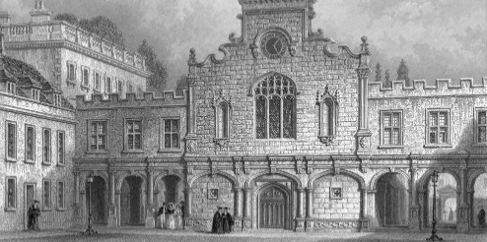
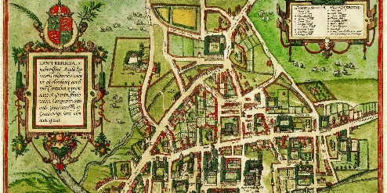
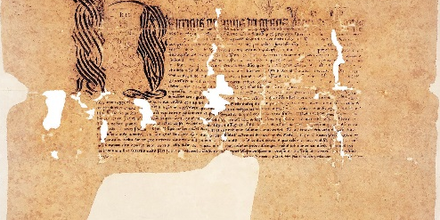
THE BEGINNINGS
1209
Groups of scholars gather in Grentebrige (or Cantebrigge)
1284
Peterhouse, the first college is founded by the Bishop of Ely
1326-
13 more Colleges are founded in Cambridge
1583
1584
Henry VIII issues patent to allow Cambridge University Press to start publishing
Notes:
Go over quickly

Slide 6
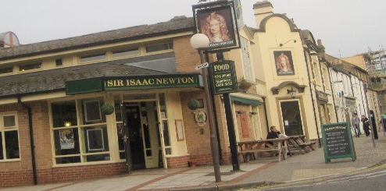
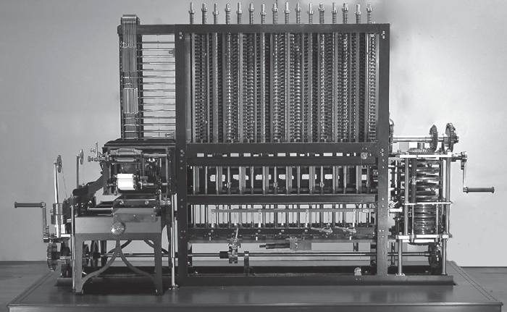
NOTABLE DISCOVERIES
1687
Isaac Newton publishes ‘Principia Mathematica’, establishing the fundamental principles of modern physics
1812
Charles Babbage has his first ideas for a ‘difference engine’ – the basis for the modern computer
1934
Frank Whittle is sent to Cambridge by the RAF where, encouraged to pursue his idea of jet propulsion, the jet engine was born

Slide 7
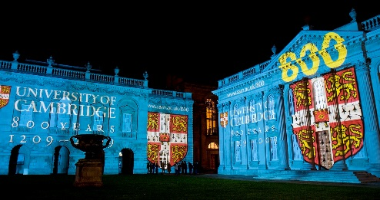
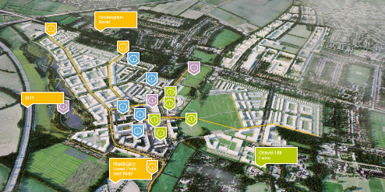
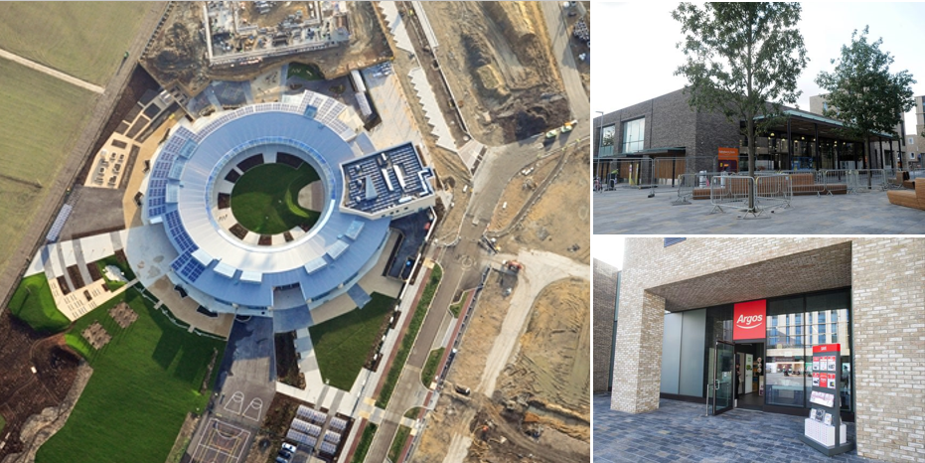
MORE RECENTLY
2009
The University celebrates its 800th anniversary
2015
Construction of a new district in north-west Cambridge known as ‘Eddington’ commences
2017
A Sainsbury’s supermarket and an Argos opens in Eddington

Slide 8
CAMBRIDGE FACTS AND FIGURES
31
Autonomous Colleges
Over
100 Departments, Faculties, Schools & Non-School
Institutions
11,000+
people employed directly by the University
26,000+
Students
82-80
record in the
Cambridge vs Oxford Boat Race
One
Bear
stayed in Lord Byron’s
College room
98
Nobel Prize Winners
There are
More bikes in Cambridge than in Oxford

Slide 9
Peoplesoft AT
Implemented from 2001
Campus Solutions 9.2
Image 5
PeopleTools 8.55.16

Slide 10
PEOPLESOFT AT
We started our implementation journey in 2001
31 Colleges and over 100 Departments/Faculties
Rolled out to Applicants, Staff and Students
Upgraded to CS 9.2.005 and PT 8.55.16 May 2017
Major work on the CamSIS Improvement Programme

Slide 11
Camsis IMPROVEMENT PROGRAMME
“A partnership between the Academic Division and UIS, running until Summer 2018 …”
Aimed at improving:
Student administration processes for staff and students
The way we work as a Collegiate University
The functionality in CamSIS
- The overall User Experience
Notes:
CamSIS - explain

Slide 12
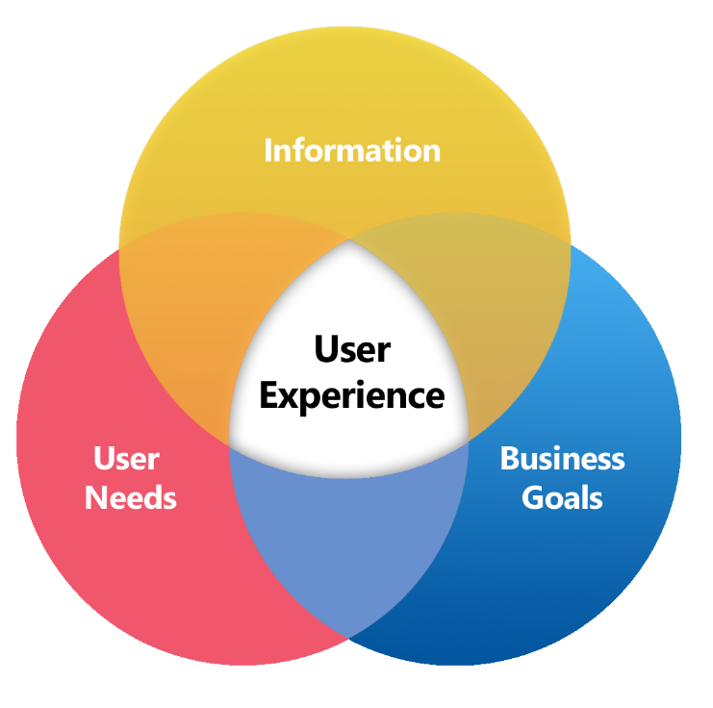
Improving the user experience
How we’re going about it:
- Reduce the level of customisations and bespoke functionality
- Improve the audit and allocation of roles/permissions
- Upgrade the system
- Improve the provision of training and education
- Improve the Academic Structure
- Improve the User Interface

Slide 13
USER EXPERIENCE, INTERFACES AND USABILITY

Slide 14
A GOOD UI SHOULD ENHANCE UX

Slide 15
DEFINING USABILITY NEILSEN NORMAN GROUP – LEMES, SMEEL, LEEMS, MEELS …
Satisfaction
Learnability
Errors
Efficiency
Memorability
https://www.nngroup.com/articles/usability-101-introduction-to-usability/
Notes:
Learnability: How easy is it for users to accomplish basic tasks the first time they encounter the design?
Efficiency: Once users have learned the design, how quickly can they perform tasks?
Memorability: When users return to the design after a period of not using it, how easily can they reestablish proficiency?
Errors: How many errors do users make, how severe are these errors, and how easily can they recover from the errors?
Satisfaction: How pleasant is it to use the design?

Slide 16
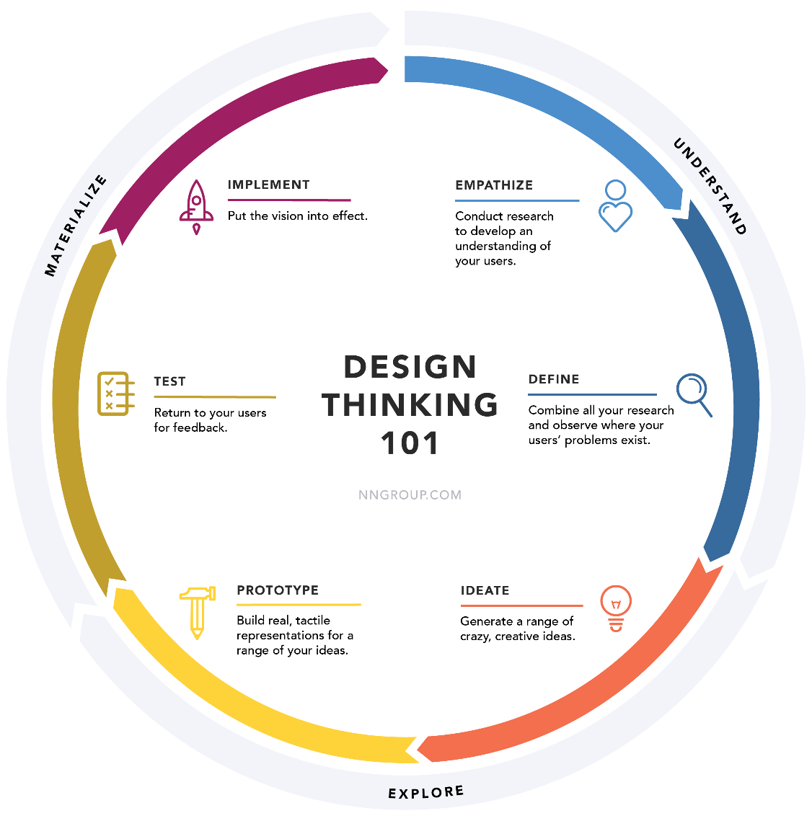
DESIGNING USABILITY NEILSEN NORMAN GROUP – Design thinking 101
https://www.nngroup.com/articles/usability-101-introduction-to-usability/

Slide 17
FLUID AT

Slide 18
FLUID IN NUMBERS
4
New Fluid Homepages
225
College Tutorial users using Fluid on a daily basis
3
redesigned
Navigation Collections
50
more users about to use Fluid to track student status changes
Initially a
3
month window from prototype design to launch
7
Pivot Grids with related actions
126
Departmental users using Fluid on a daily basis
Ongoing
Plans
to migrate more users to Fluid over the next year and beyond
Notes:
4 groups of users
Critical of what we do

Slide 19
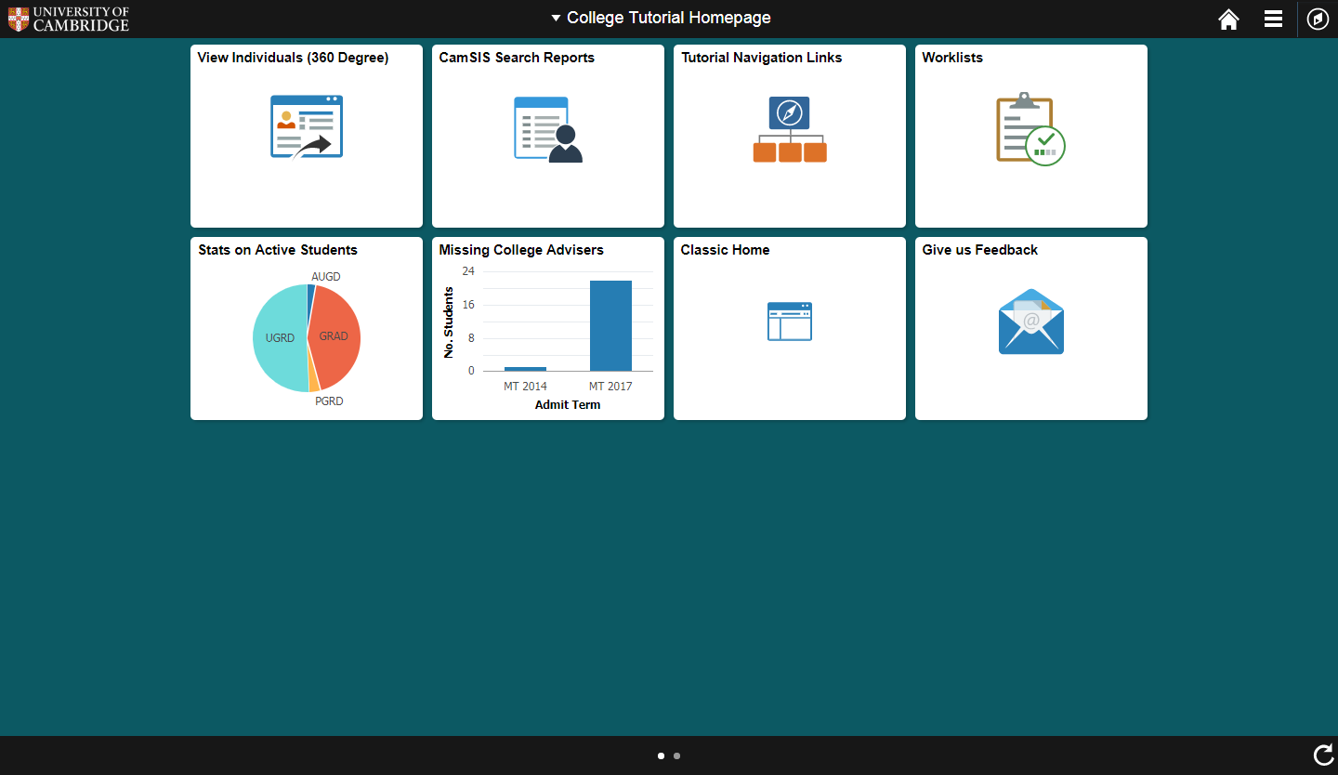
EXAMPLE HOMEPAGE - Desktop

Slide 20
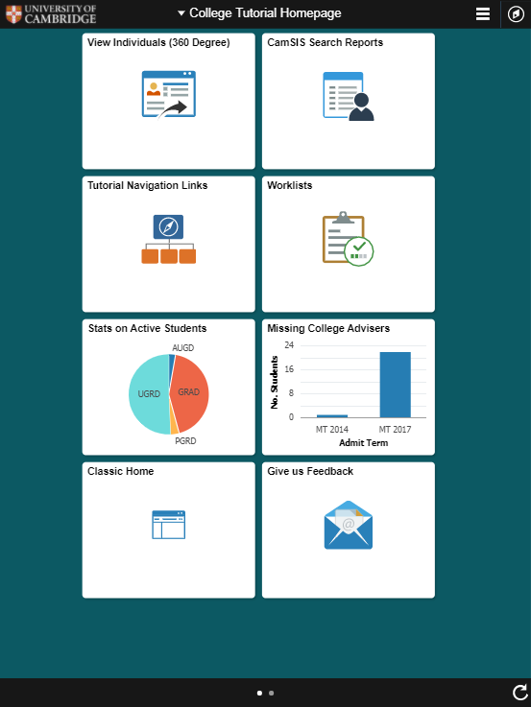
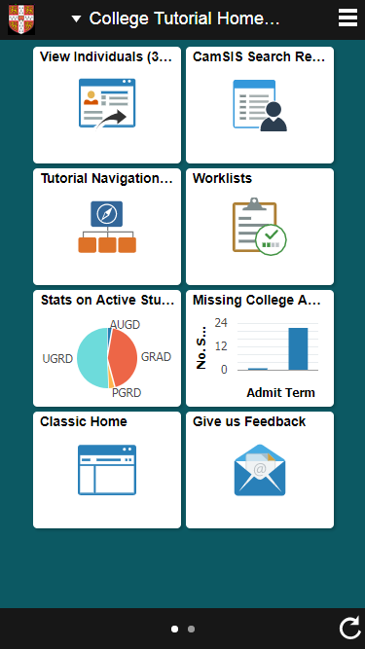
EXAMPLE HOMEPAGE – TABLET & MOBILE

Slide 21
Starting from scratch
1
3
USER-LED
Assume nothing
FEEDBACK
Gather and act upon it
2
PROTOTYPE
Build, test, repeat
Notes:
Anybody can do this!
If you have team or can recruit an expert in UX then do it

Slide 22
User-Led

Slide 23
DESIGNING USABILITY NEILSEN NORMAN GROUP – Design thinking 101
https://www.nngroup.com/articles/usability-101-introduction-to-usability/

Slide 24
ESTABLISH THE USER TEAM
- Identify a Business Lead or Champion
- Involve different types/levels of user at all stages
- Assume nothing
- Conduct interviews, observe people, start focus groups
- User involvement leads to success

Slide 25
COMMUNICATION
- Tell users about the project – get them excited
- Let them know how valuable they are
- Address any rumours straight away
- Give them every opportunity to get involved

Slide 26
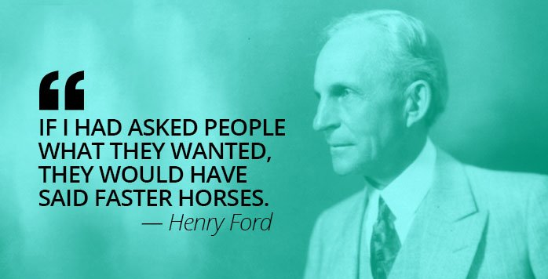
DESIGNING & PrototypING

Slide 27
DESIGNING USABILITY NEILSEN NORMAN GROUP – EXPLORE THE OPTIONS
https://www.nngroup.com/articles/usability-101-introduction-to-usability/

Slide 28
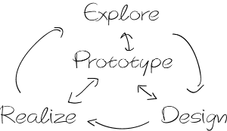
THE PROTOTYPING STAGE KICK OFF AND PREPARATION
- Time limitations meant we had to hit the ground running
- Engagement with our partner, CY2
- Use the user research and past experience
- Wireframes, planning, progressing to working prototypes

Slide 29
THE PROTOTYPING STAGE CREATING WIREFRAMES AND EARLY WORKING PROTOTYPES

Slide 30
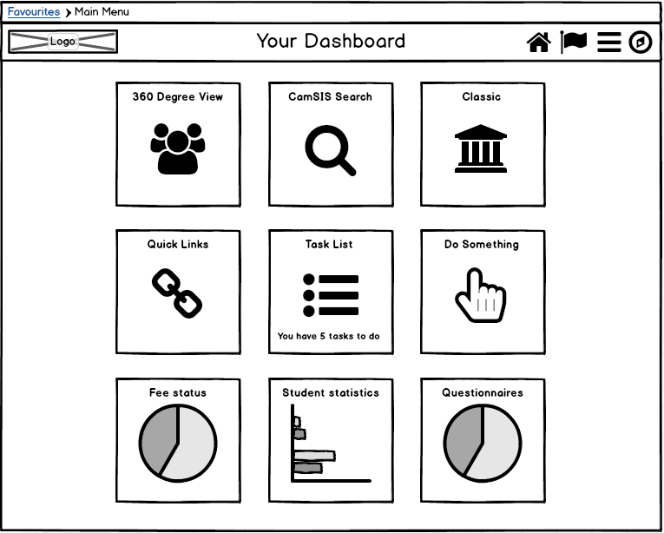
THE PROTOTYPING STAGE CREATING WIREFRAMES AND EARLY WORKING PROTOTYPES

Slide 31
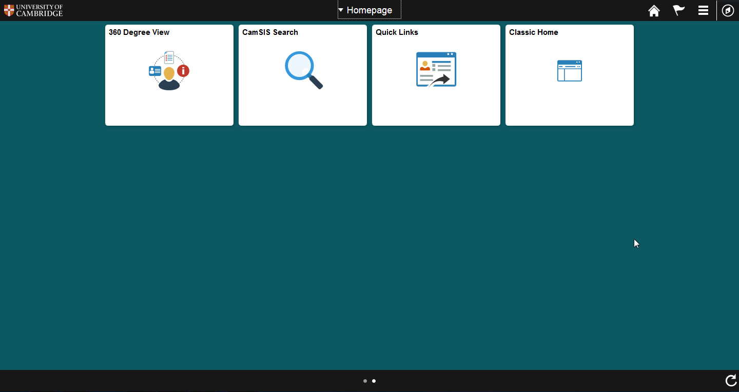
THE PROTOTYPING STAGE CREATING WIREFRAMES AND EARLY WORKING PROTOTYPES

Slide 32
DESIGNING USABILITY NEILSEN NORMAN GROUP – TESTING AND IMPLEMENTING
https://www.nngroup.com/articles/usability-101-introduction-to-usability/

Slide 33
TESTING OUT THE PROTOTYPES GROUP WORKSHOPS
Asking questions about functionality:
- What are your first impressions?
- What do you think you can do?
- Where do you think you can go?
- Do the names make sense?
- Do the images make sense?
- What improvements can be made?
- Is there anything missing?

Slide 34
EXAMPLE HOMEPAGE - Desktop

Slide 35
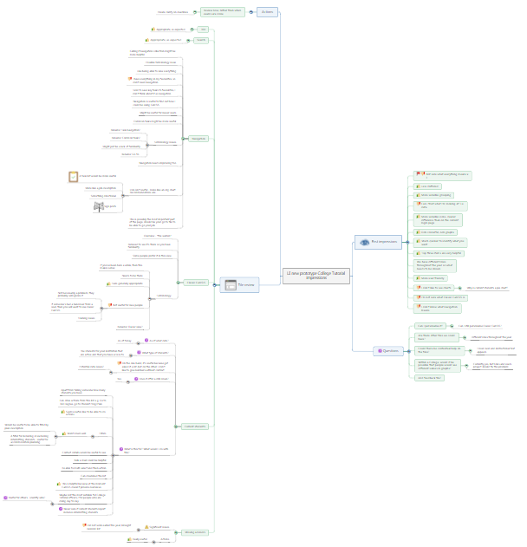
TESTING OUT THE PROTOTYPES GROUP WORKSHOPS – COLLATING THE DATA WITH ‘MINDJET’
Sample first impressions:
“More user friendly”
“Ooh colourful, ooh graphs”
“Can I personalise it?”
“Can I trust it?”
“Why is that a pie chart?”
“What is ‘Navigation’?”

Slide 36
DESIGNING USABILITY NEILSEN NORMAN GROUP – Design thinking 101
https://www.nngroup.com/articles/usability-101-introduction-to-usability/

Slide 37
COLLECTING Feedback

Slide 38
COLLECTING FEEDBACK CONSIDERING OUR OPTIONS FOR POST-IMPLEMENTATION
- When will we collect it?
- How will we collect it?
- How often will users want to provide it?
- What will we ask?
- How will we analyse it?
- When will we act on it?

Slide 39
COLLECTING FEEDBACK WHAT DID THE USERS THINK?
- A revelation!
- Bought into the value
- Collect it whenever the user wants to provide it
- Some want it to be anonymous
- They are busy, so make it easy

Slide 40
COLLECTING FEEDBACK OPTIONS We CONSIDERED
- A simple Google form survey
- Qualtrics survey form
- Fluid Forms & Approvals builder
- Page Composer
- Developed pages
… all linked from a Free-text tile

Slide 41
COLLECTING FEEDBACK OUR CHOSEN OPTION – GOOGLE FORM
Asking:
What works well?
What doesn’t?
How can we improve it?
Simple and reportable
Device agnostic

Slide 42
COLLECTING FEEDBACK ACTING ON IT AND DEMONSTRATING PROGRESS
- Fix the bugs straight away
- Resolve the quick wins
- Give yourself room to improve
- Involve the users in analysing the feedback
- Users plan for the next iterations

Slide 43
COLLECTING FEEDBACK THINGS WE’re LEARNING ALREADY
- Users still get hung up on the number of clicks
- Users want more tiles
- Users love Pivot Grids, and they want to personalise them
- Users still value their own Favourites
- Users see the potential
- No-one has hit the roof

Slide 44
Concluding thoughts
ANY QUESTIONS?

Slide 45
OTHER SESSIONS OF INTEREST
A Functional Approach to Implementing Fluid
Chris Hay (University of Cambridge)
What’s the Perfect Job for Me?
Simon Nicol & Steven Smee (University of Cambridge)
Brand Your Student Self-service Fluid Homepage
Stefan Liempt (CY2)
all Alliance presentations will be available for download from the Conference Site

Slide 46
presenter
Chris Hay
Functional Consultant (Student Systems)
University of Cambridge
Chris.Hay@uis.cam.ac.uk
all Alliance presentations will be available for download from the Conference Site

Slide 47
THANK YOU!

