Slide 1
What’s the Perfect Job for Me?
16th October 2017
Notes:
Thank you for coming
Today we are going to talk you through the work we have been doing at Cambridge to improve our user access request process for users and for us in central IT.

Slide 2
What’s the Perfect Job for Me?
Simon Nicol
Functional Consultant, University of Cambridge
Working with Campus Solutions for 12 years
Stephen Smee
Junior Functional Consultant, University of Cambridge
Working with Campus Solutions for 8 months
Notes:
I have worked for the University for about 13 years, 12 of which have been spent either as an end user of campus solutions, or supporting and developing the system.
That means I have had 12 years of referring to our Campus Solutions deployment as CamSIS (the Cambridge Student Information System) so I apologise if I do so today, but it is a hard habit to break!

Slide 3
What’s the Perfect Job for Me?
The following is intended to be pretty vague. We're sure it has a purpose of some sorts, although do not hold us to that. We have problems with commitment, or do we, maybe not, perhaps it’s safer not to rely too much on what we say when making your own decisions. The development, release, and timing of any features or functionality we have described could well be fictional but where they are not they remain at the sole discretion of us.
Notes:
Today we are going to show you some of our custom development that we have put in place to support our user access request process.
Obviously, this is how we have chosen to approach the issues we have experienced, and our solutions might not suit everyone, but hopefully there is something that you will be able to take away.
As I mentioned I have had 12 years of referring to our Campus Solutions deployment as CamSIS (the Cambridge Student Information System) so I apologise if I do so today, but it is a hard habit to break!

Slide 4
What’s the Perfect Job for Me?
Introductions
Background
Work to date
Demonstration
Where next?
Q and A
AGENDA

Slide 5
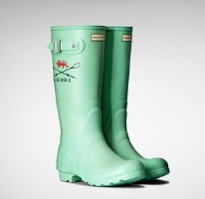
What’s the Perfect Job for Me?
University
founded
1209
Aztec empire begins
1428
Trinity College founded
1535
The first Boat Race
1829
RCD Espanyol founded
1900
1284
Peterhouse founded
1450
Universitat de Barcelona founded
1812
Charles Babbage develops Difference engine
1899
FC Barcelona founded
2009
University celebrates its 800th year
Notes:
Easily beaten according to Wikipedia – but that was clearly written by oxford…

Slide 6
What’s the Perfect Job for Me?
Over 100
Departments
98 Nobel
Laureates
25 Santa Hats
Left on
Buildings
Approx. 11,000
Staff
Approx. 26,000
Students
31 Colleges

Slide 7
What’s the Perfect Job for Me?
Implemented Campus Solutions 8.0 in 2004 as CamSIS (Cambridge Student Information System)
Current architecture
Campus Solutions 9.2
IMG 005
PeopleTools 8.55.16
Cambridge and Campus

Slide 8
What’s the Perfect Job for Me?
Introductions
Background
Work to date
Demonstration
Where next?
Q and A
AGENDA

Slide 9
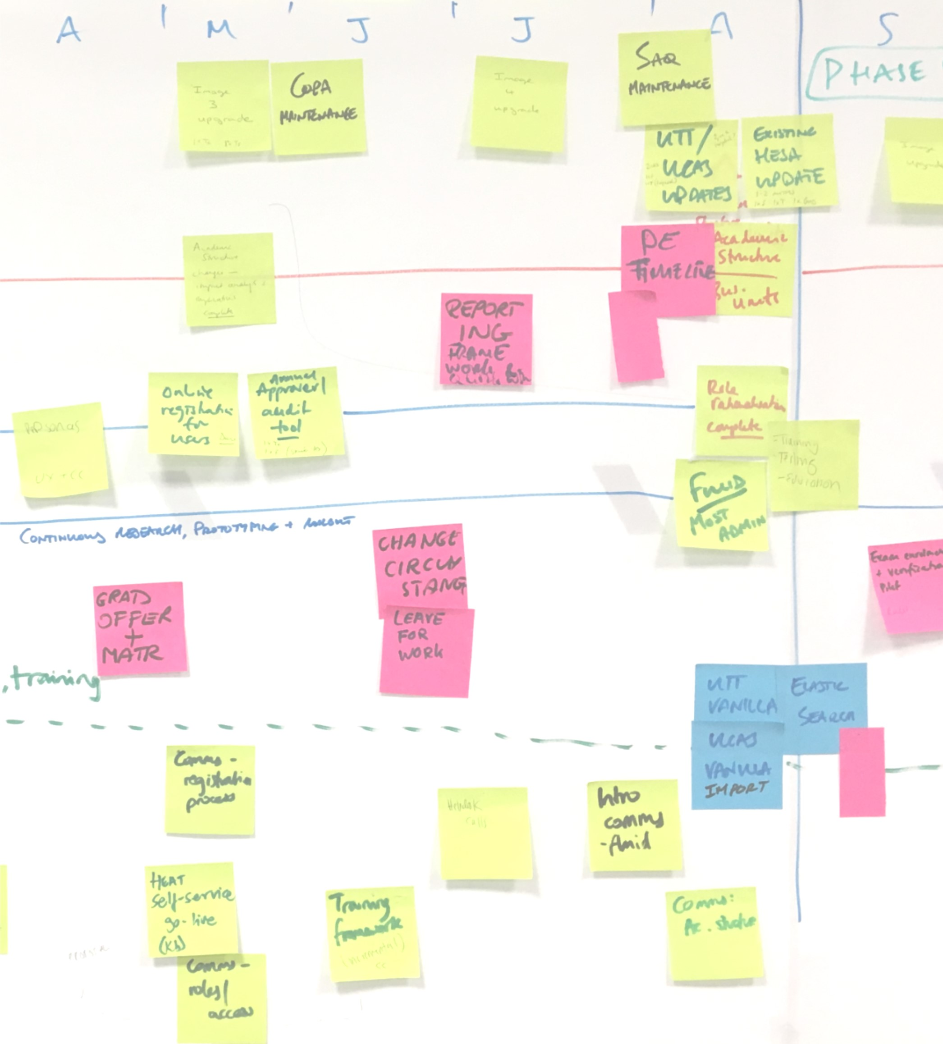
What’s the Perfect Job for Me?
CamSIS Improvement Programme
2 year programme of work:
Foundational improvements
Campus 9.2 upgrade
PeopleTools 8.55 upgrade
Reduction of customisation
Improvements to user experience
User Interface (Fluid)
Business processes
Enhanced functionality
Notes:
Mention programme start dates – started in August 2016 and due to finish in August

Slide 10
What’s the Perfect Job for Me?
Have you ever asked yourself the following questions?
‘Why do we spend so much time setting up user accounts?’
‘How have we ended up with users still on the system that have left the institution?’
‘How do our users know what they have access to?’
‘I wonder when audit will next look at our user access processes?’
‘How can we implement fluid if we don’t know who our users are?’
Notes:
We found ourselves asking these questions.
Probably the most worrying of these was how have we ended up with users still in the system that have left the university, and one of the most pertinent to the programme was how can we implement fluid.
We had decided very early on during our review of fluid, that we would not want a 'big bang' release and we would want to target specific users to get the most benefit.

Slide 11
What’s the Perfect Job for Me?
Difficult for users to request, and central IT to administer.
Time consuming process (even when dealing with straight-forward requests).
The process was making the system less secure.
Notes:
Talk thought the old process
Talk about the scope – admin users, roles and row level

Slide 12
What’s the Perfect Job for Me?
Users didn't know what access they had.
Users didn't know what access to request.
Complex account maintenance required expert knowledge (2nd line support).
Inconsistent request process depending on access requested.
Difficult to fit new functionality into the inconsistent security model.
Difficult
Notes:
Talk thought the current process - separate slide
Over 290 active roles
Users in the same office with a different view of the system
User configuration determined by IT helpdesk
Users had to find a fax machine

Slide 13
What’s the Perfect Job for Me?
Requests were often ambiguous.
Bespoke access per user.
Account creation took approx. 30 mins each (changes approx. 20 minutes, and removals approx. 5 minutes).
Had to establish if issues were security related or system issues.
Time Consuming

Slide 14
What’s the Perfect Job for Me?
Lack of confidence in the process.
User accounts left open when staff left.
Access often determined by central IT.
Introduced cloning to accelerate the registration process.
We didn’t know who our users were.
No facility for The University to audit users.
Insecure

Slide 15
What’s the Perfect Job for Me?
Introductions
Background
Work to date
Demonstration
Where next?
Q and A
AGENDA

Slide 16
What’s the Perfect Job for Me?
We created a new business role of Approver.
Approvers are responsible for:
Approving or declining requests made for access to their organisation’s data.
Auditing their list of users every 6 months.
We identified Approvers within each organisation in the University.
Approvers

Slide 17
What’s the Perfect Job for Me?
​Jobs were to be a collection of existing page permissions, based on the business role that a user is carrying out.​
Jobs are:​
Meaningful​
Standardised​
Designed through cooperation with users.
Jobs

Slide 18
What’s the Perfect Job for Me?
We performed a full audit of our users.
The Approvers indicated which Job users should have.
Approvers also indicated which users should no longer have access to their organisation's data.
Audit

Slide 19
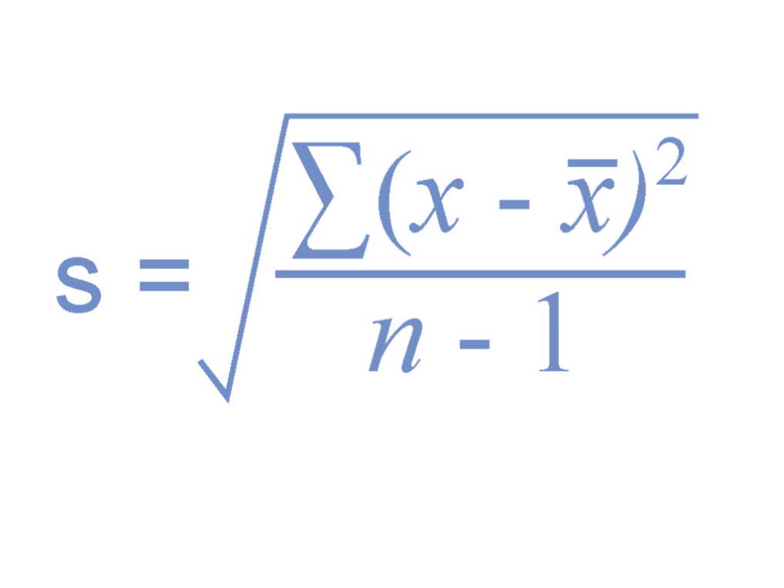
What’s the Perfect Job for Me?
Users with the same Job were collectively analysed.
These Job designs were agreed with user representatives throughout the University.
Analysis

Slide 20
What’s the Perfect Job for Me?
The Audit Tool allows approvers to view all users with access to their organisation’s data.
Auditors can easily either approve the continuation of that access, or request access to be removed
Audits are required twice a year
Audit Tool

Slide 21
What’s the Perfect Job for Me?
User representatives were each assigned a set of new standardised users to test.
This went through several iterations until the jobs performed as expected.
Simultaneously we internally tested the functionality of the audit tool.
Testing

Slide 22
What’s the Perfect Job for Me?
Using Excel to Component Interfaces (CIs) we created 82 jobs.
Using CIs we added approximately 3,600 jobs to users.
Spot tested a selection of users.
Approximately 1 hour.
Implementation

Slide 23
What’s the Perfect Job for Me?
We had an application process that was difficult and time consuming. And we had no good way to audit that access.
New process is straightforward.
New process is efficient.
New Process is secure.
Benefits

Slide 24
What’s the Perfect Job for Me?
Introductions
Background
Work to date
Demonstration
Where next?
Q and A
AGENDA

Slide 25
What’s the Perfect Job for Me?
Demonstration uploaded separately

Slide 26
What’s the Perfect Job for Me?
Introductions
Background
Work to date
Demonstration
Where next?
Q and A
AGENDA

Slide 27
What’s the Perfect Job for Me?
New online access request system.
Integration/automation of new online request process with Campus Solutions.
Transition of approved requests to 1st line support.
Improving Processes
Notes:
Balance between clear lines of responsibility requested by auditors

Slide 28
What’s the Perfect Job for Me?
Continued refinement of newly released Jobs.
Review and removal of permissions that exist outside of a Job.
Rationalisation of existing permission lists.
Refining Security

Slide 29
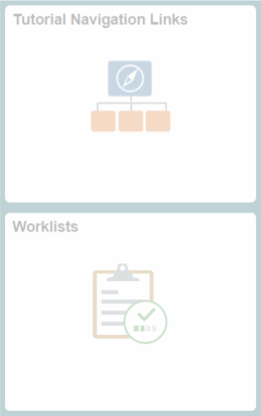
What’s the Perfect Job for Me?
Able to identify a distinct set of users performing a specific business role.
Able target Fluid deployment, ensuring that users see real benefits from Fluid homepages.
Able to analyse similar users to identify cohorts where Fluid could be deployed more quickly.
Getting Fluid Flowing
Further information on Cambridge's approach on implementing fluid:
​A Functional Approach to Implementing Fluid​
Mon 16/10 14:30 – 15:30
​A User-centric Approach to Implementing Fluid
Tue 17/10 10:10 – 10:40

Slide 30
What’s the Perfect Job for Me?
Introductions
Background
Work to date
Demonstration
Where next?
Q and A
AGENDA

Slide 31
What’s the Perfect Job for Me?
Simon Nicol
simon.nicol@uis.cam.ac.uk
Stephen Smee ​
stephen.smee@uis.cam.ac.uk​
Further information on Cambridge's approach on implementing fluid:
​A Functional Approach to Implementing Fluid​
Mon 16/10 14:30 – 15:30
​A User-centric Approach to Implementing Fluid
Tue 17/10 10:10 – 10:40

