Slide 1
Fluid Forms and Approval Builder
Instructor:
Wouter de Bruin
Lukas Degens
17-10-2017
Session #2035 Room: Atria 1

Slide 2
Presenters
Wouter de Bruin
Partner of CY2 (wouter@cy2.nl)
Current Projects at:

Slide 3
Presenters
Lukas Degens
Consultant at CY2 (lukas@cy2.nl)
Current Project at:

Slide 4
Topics
Introduction
Short Demo
Prerequisites
Fluid Approvals – Setup
Hands on – Demo
Tips & Tricks

Slide 5
About CY2
Results through collaboration, guidance and advice, with an eye for your culture
Dutch roots, EMEA footprint, World outlook
Dedicated to Campus Solutions & Oracle Student Cloud
Over 200 projects in more than 13 countries
Providing expert consultancy to support strategic decision making and solution implementation
Active in development, maintenance, training and support services

Slide 6
Some CY2 references
Notes:
Different formats, different countries, different scales,
MORE then IT (processes, new functionalities)

Slide 7
What is it?
Configurable data entry form
Guided step by step navigation
Ready to go, without technical support
Reduce unnecessary emails
Replace paper based approval flows
Example:

Slide 8
Examples discussed at other institutions
Use extra words in final paper
Request for extra time
Apply for scholarship
Approval for internship
Support from student guidance counsil
Approval for Extra-curricular course
….

Slide 9
The workflow:
Student
Supervisor
Faculty Approver
Short Demo

Slide 10
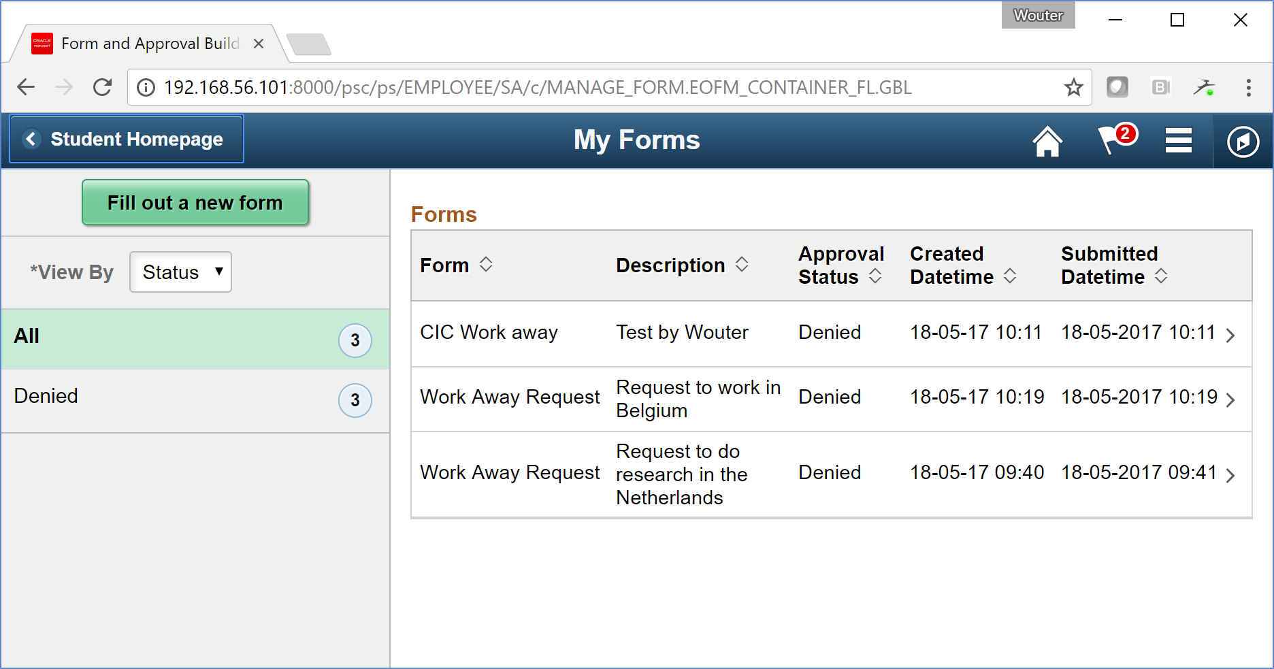
Request done by student

Slide 11
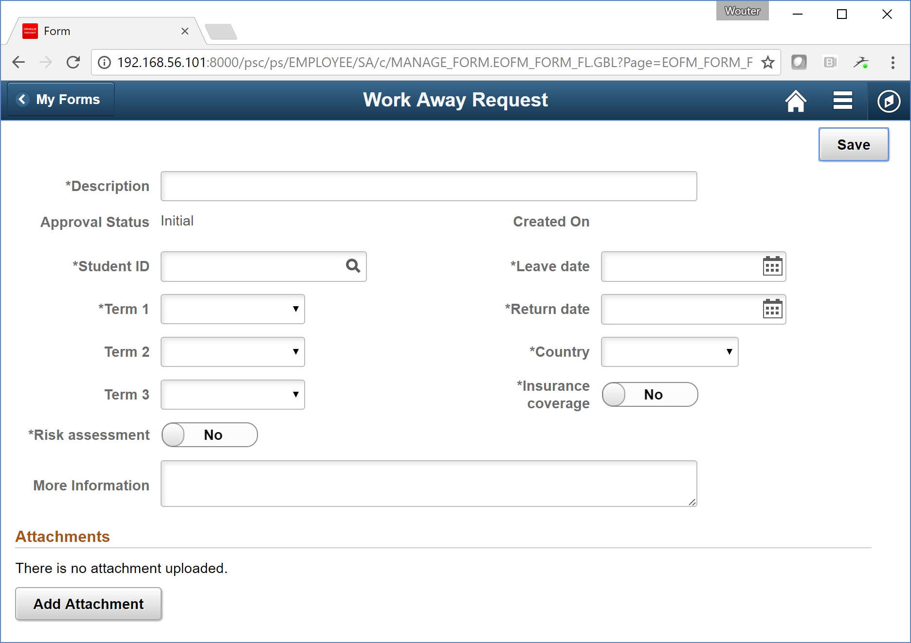
Request done by student

Slide 12
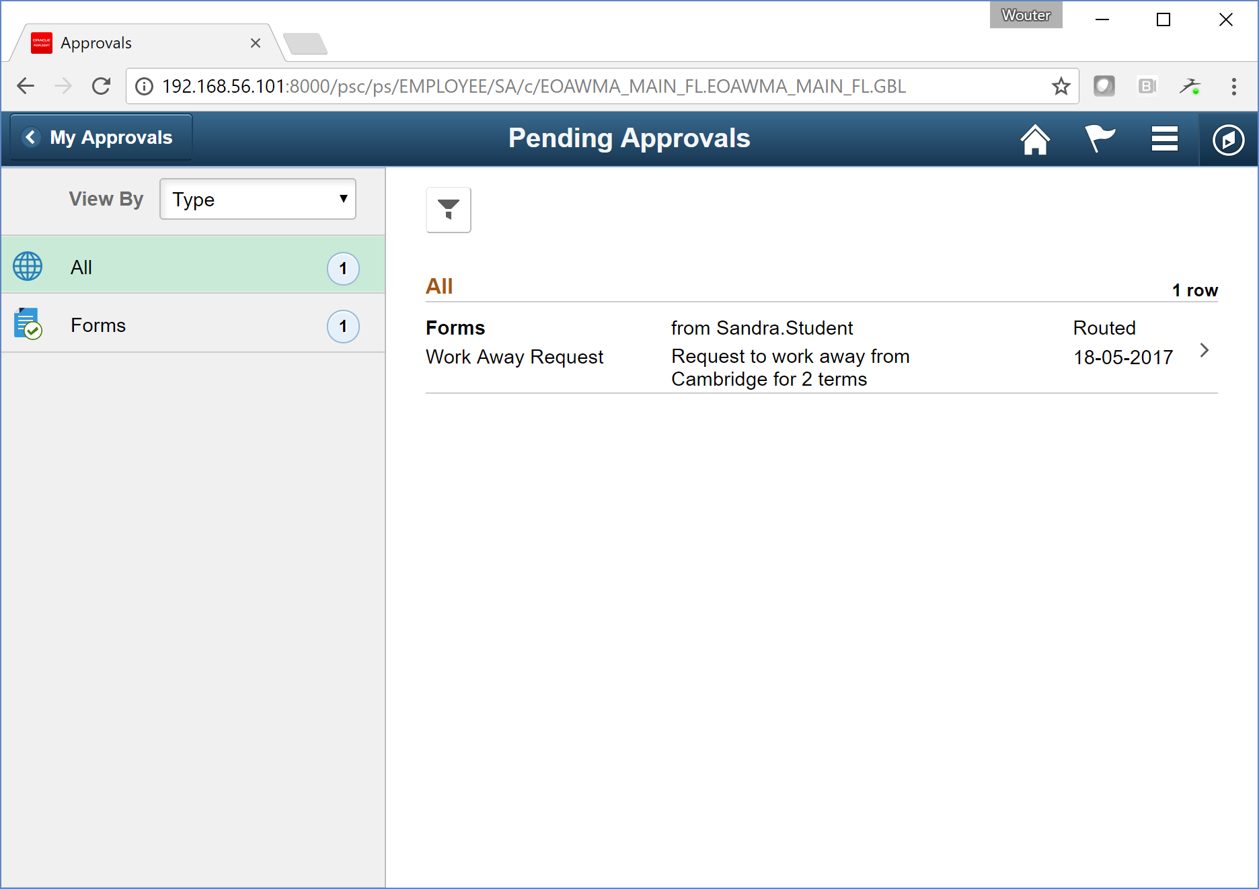
Supervisor needs to approve

Slide 13
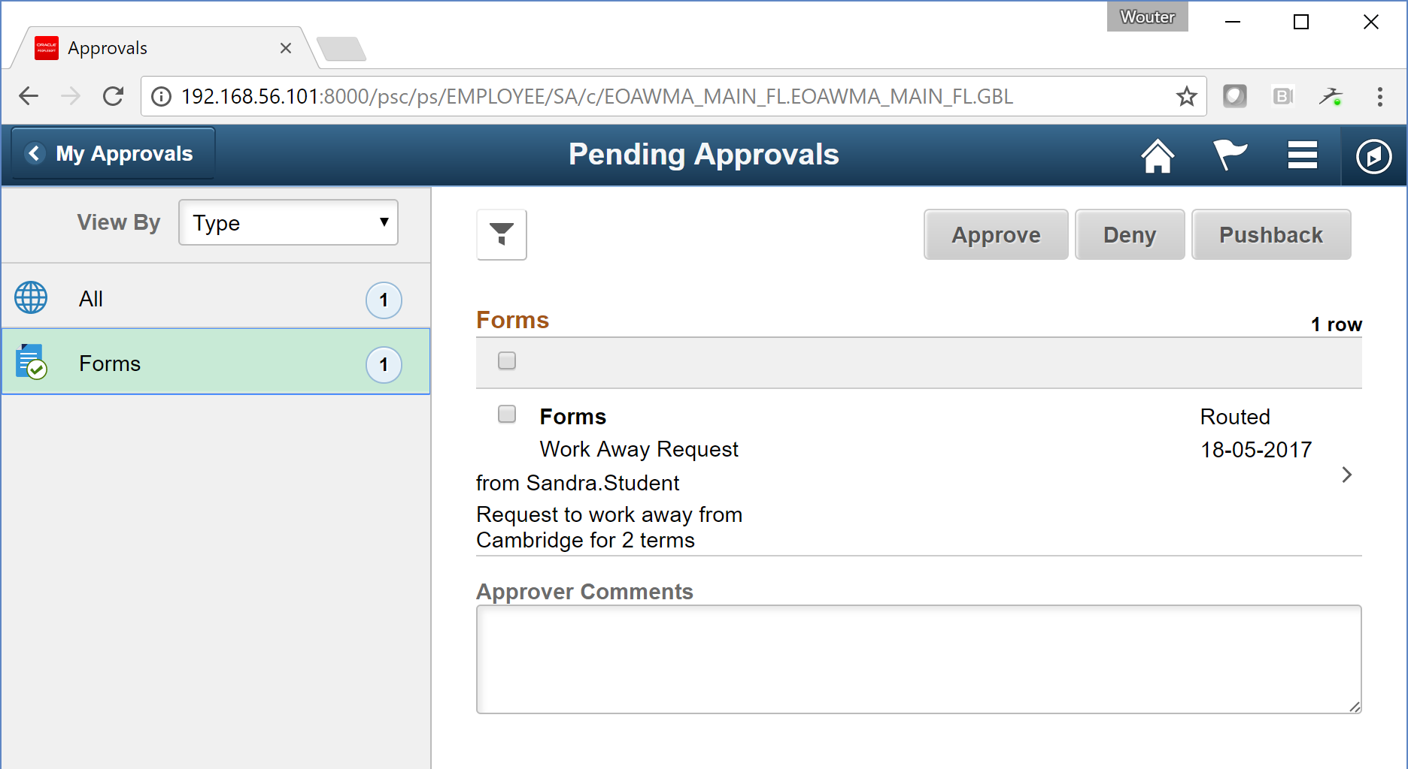
Supervisor is able to pushback or mass approve

Slide 14
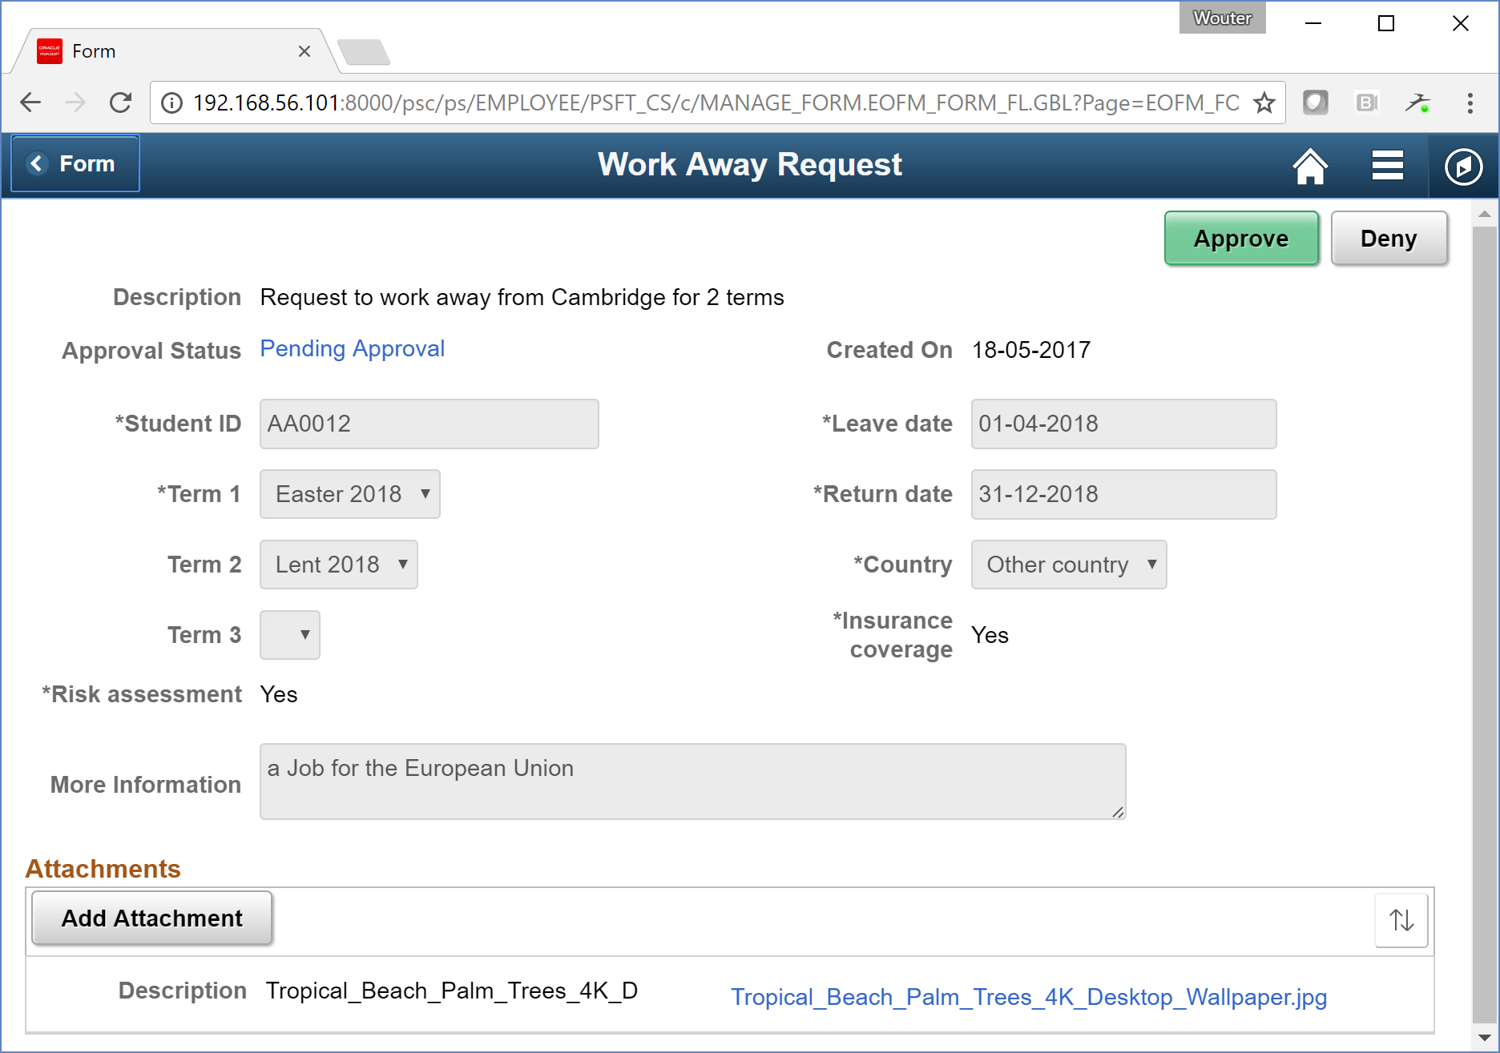
Supervisor needs to approve

Slide 15
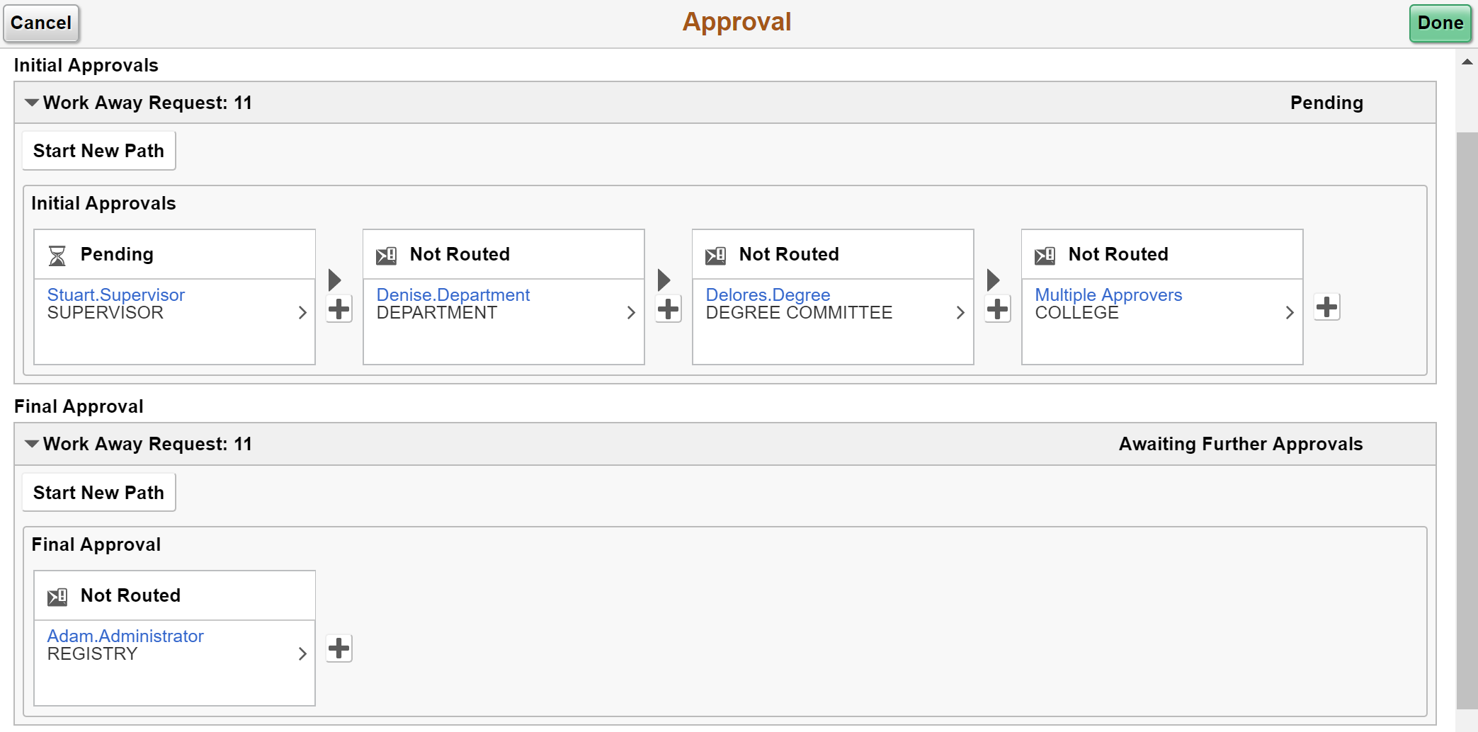
Workflow overview

Slide 16
Prerequisites

Slide 17
Prerequisites
PUM Image #4 or higher (Current image: #6)
PeopleTools 8.55.14 or higher
Place tiles on homepage
Define functional workflow
Role FORM_USER and/or FORM_ADMINISTRATOR
Role FORM_DESIGNER to design forms
Create a user list
Select prompt records
Draft Form content

Slide 18
Technical overview
Rules Engine
Fluid User Interface
Notification Framework
Form to CI mapping
PeopleCode event mapping
Approval Workflow Engine
Approval Process Definition
Defines approvers necessary at each Stage, Path and Step based on User lists
Original Transaction
User Lists
Approval Component
Routes to next Approvers and tracks approvals
Approval User Monitor

Slide 19
AWE Datamodel
FORM
Basic form info
E.g. Description, subject, status, priority, owner, date created, date last change, last change by, submited by
FORM_AW
Used for cross-referencing, connecting FORM records to the EOAW_STEP_VW
FORM_SD
Contains all saved values of the form
Contains information on attachments;
FORM_ATTCH
Only has data when an attachment is uploaded.
EOAW_STEP_VW
View for an overview of steps and corresponding status

Slide 20
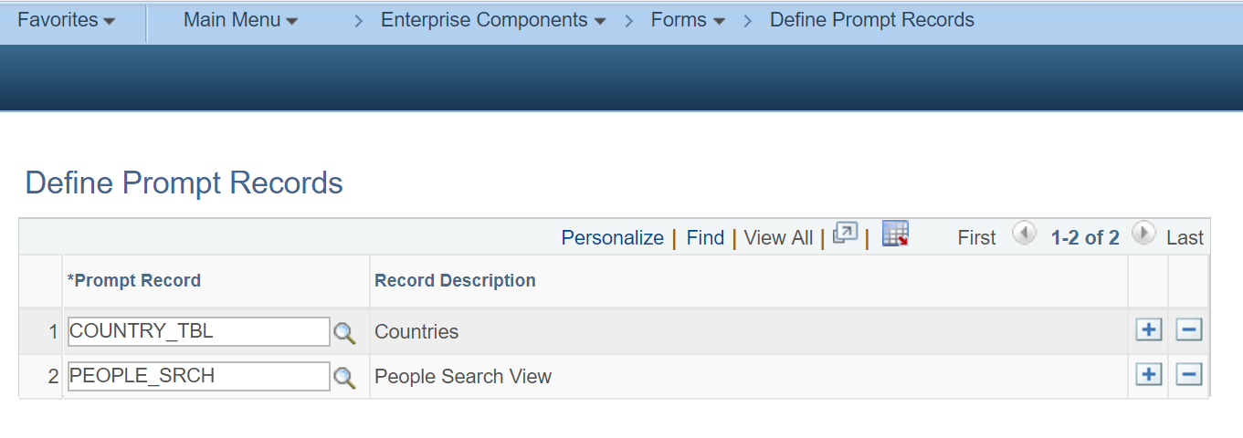
Setup in traditional AWE -> Prompt records

Slide 21
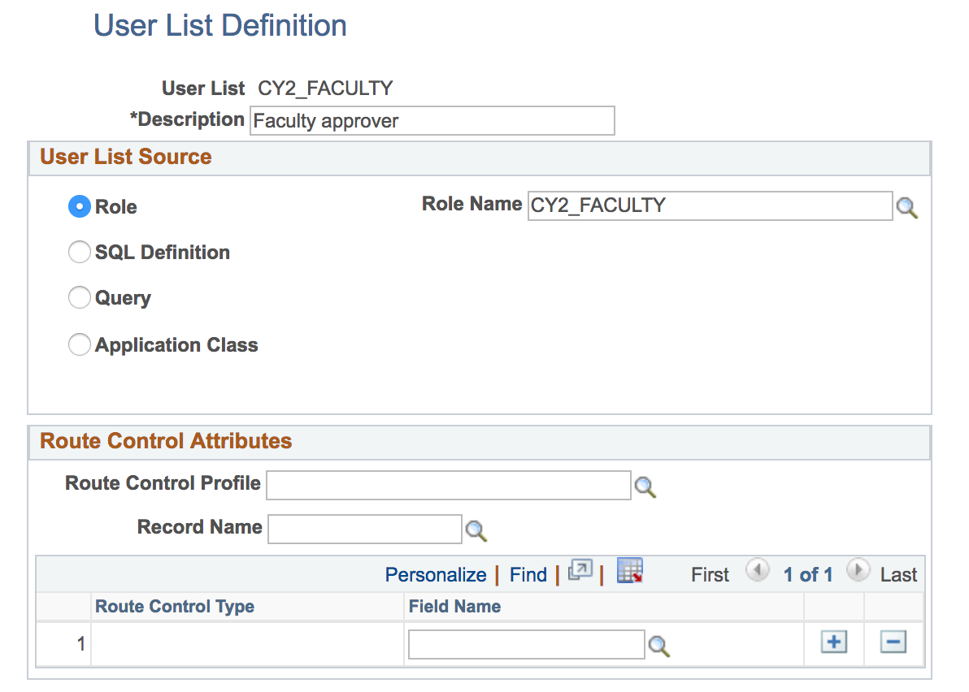
Setup in traditional AWE -> User List Definition
Enterprise Components > Approvals > Approvals > User List Setup

Slide 22
Fluid approvals – SETUP

Slide 23
Fluid Approvals – Functional Setup
1) Workflow example with at least one approver
2) Add tiles to homepage
3) Five steps to design new form
4) Go-live and smile

Slide 24
Workflow
Student places a request
The request is reviewed by the supervisor
When the supervisor approves the request, the request is routed to the faculty approver for final review
Our Example
Student
Supervisor
Faculty Approver

Slide 25
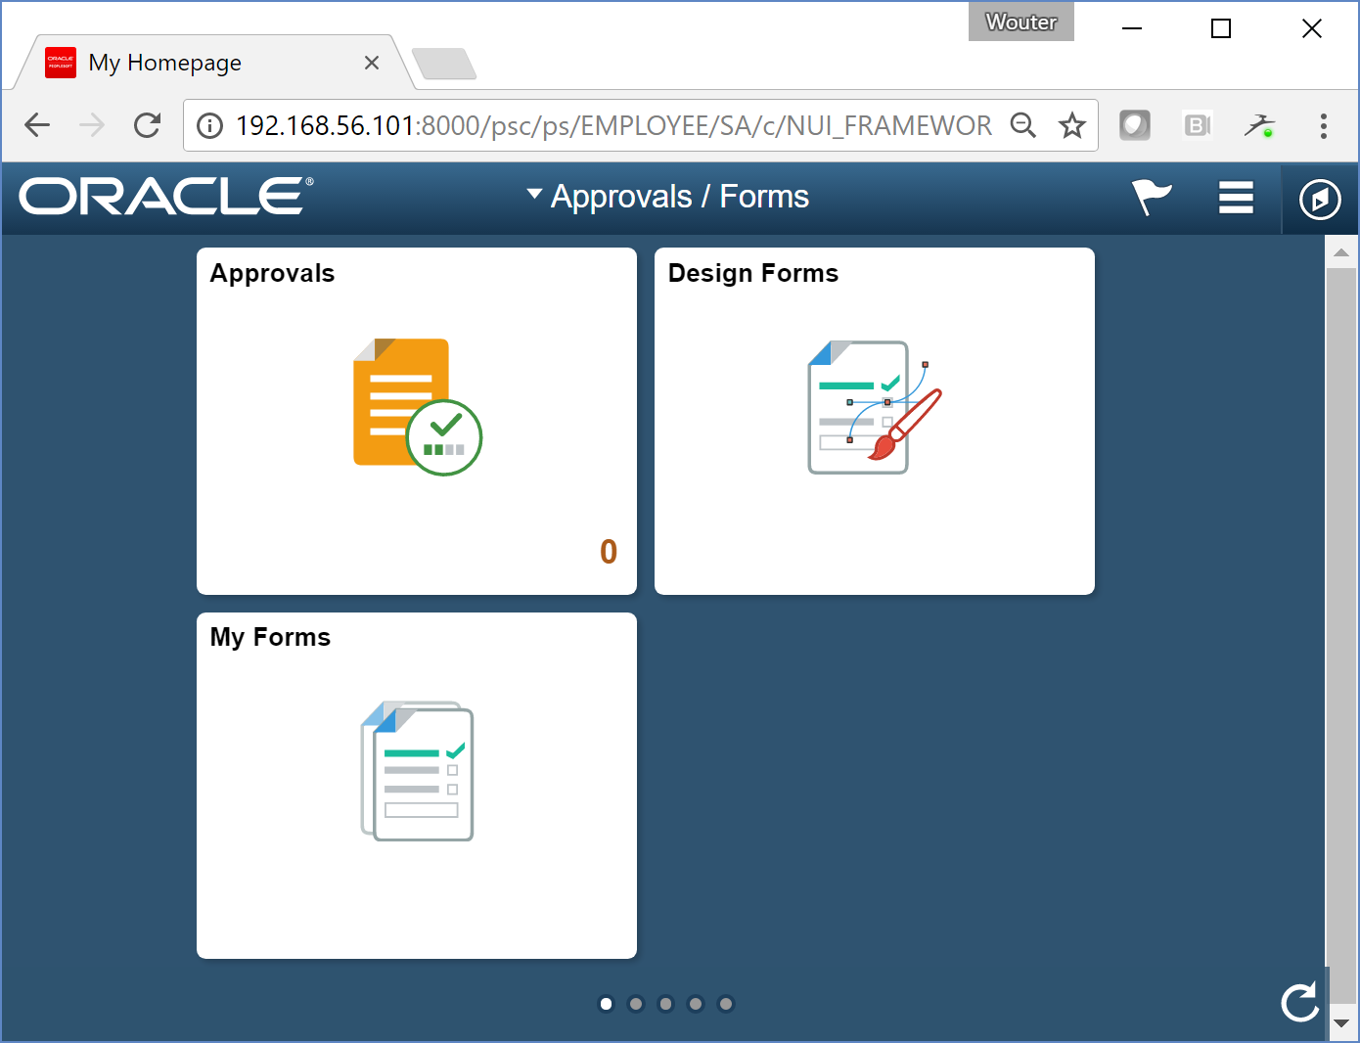
Add ‘design forms’ tile to homepage
Notes:
To be able to add Design Forms tile you need the role FORM_DESIGNER

Slide 26
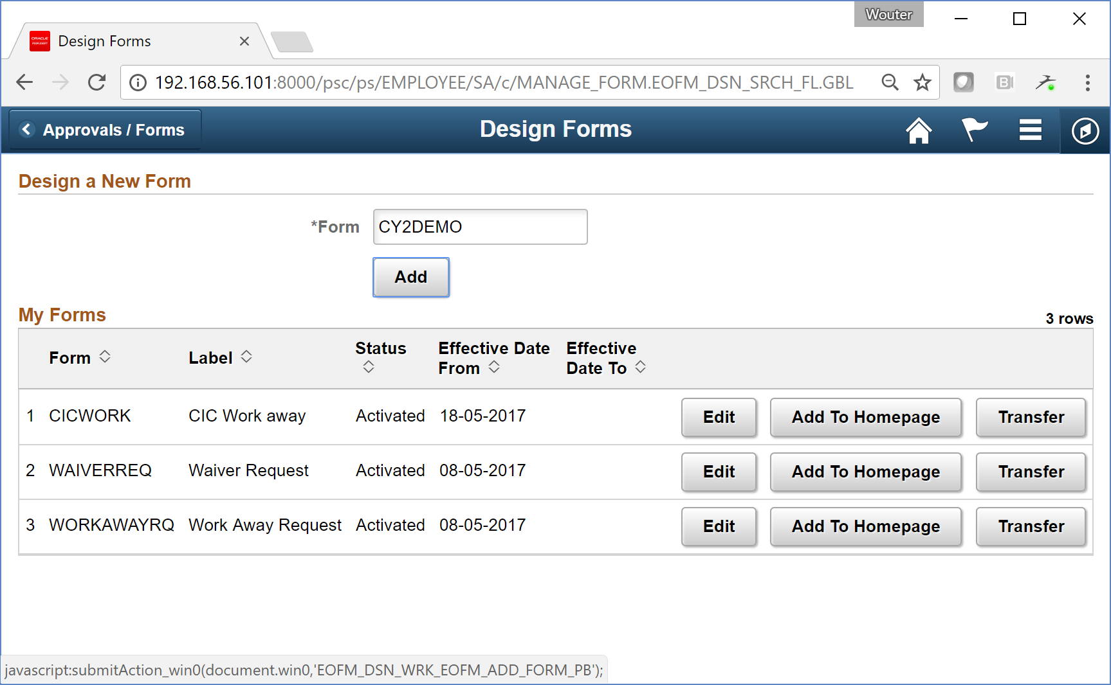
Create new form

Slide 27
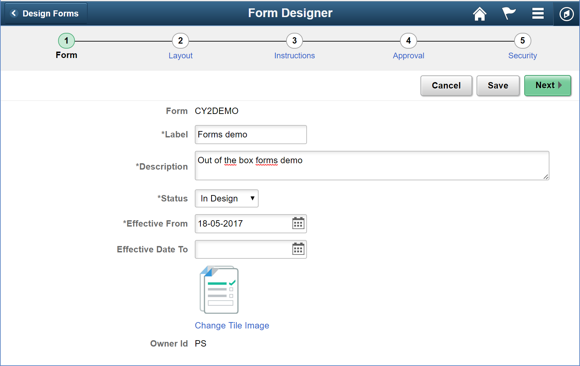
Create new form – step 1

Slide 28
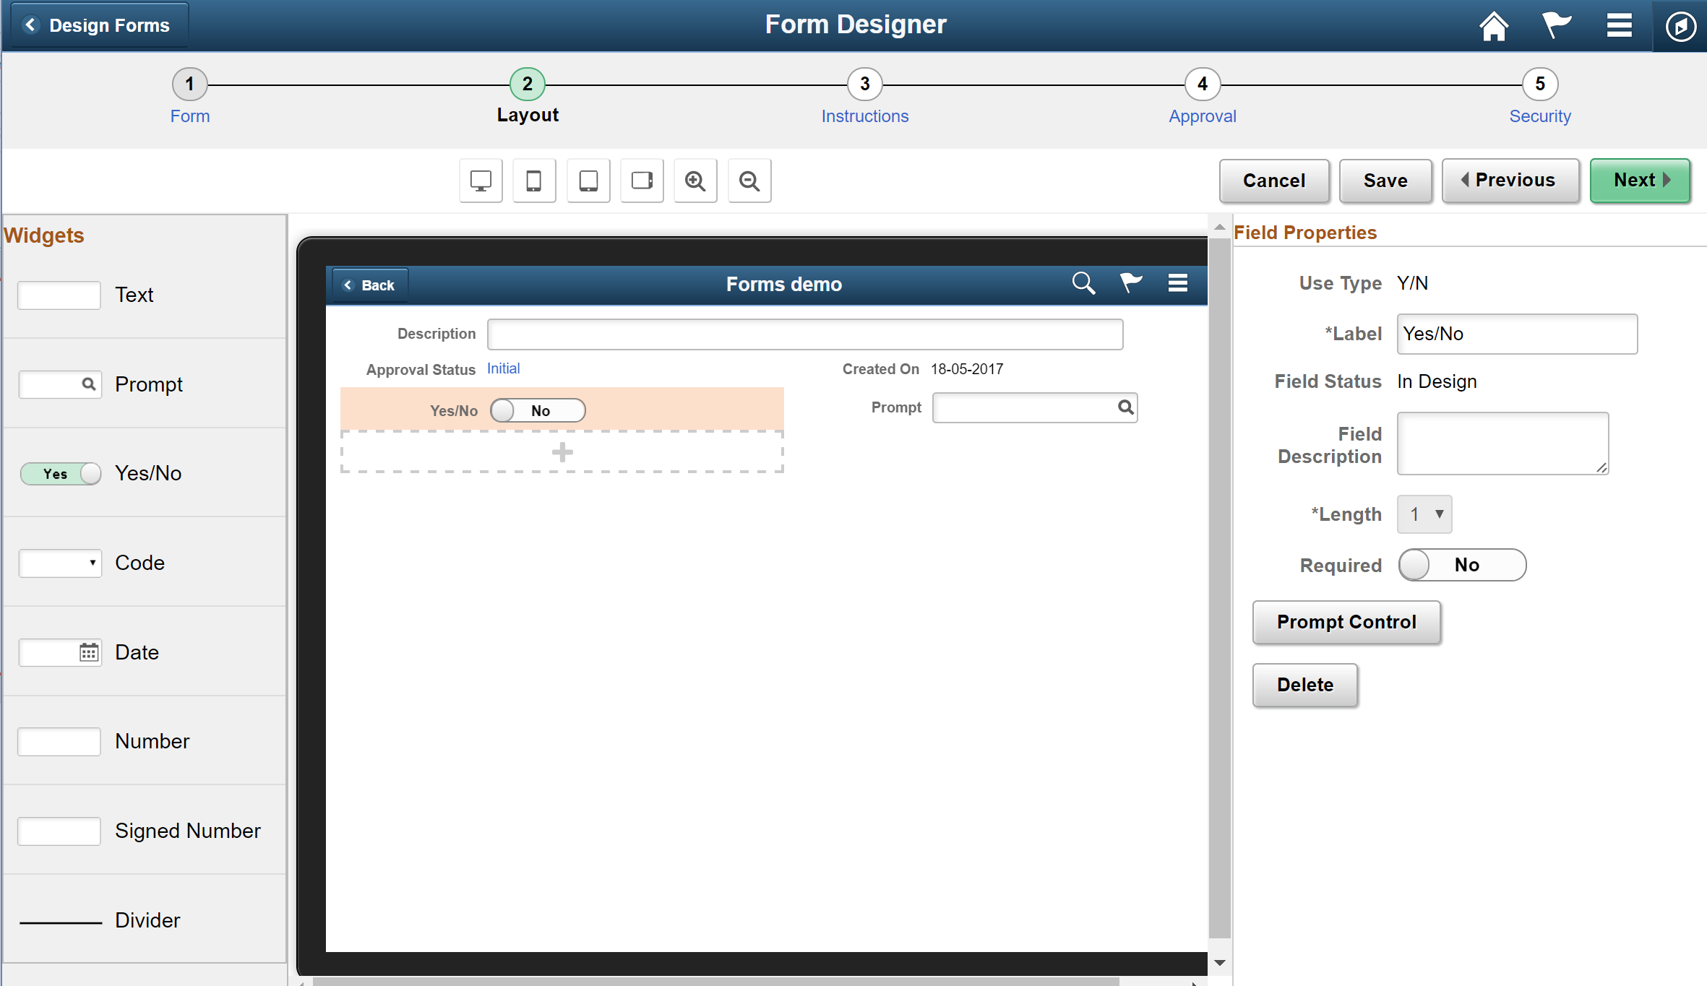
Create new form – step 2

Slide 29
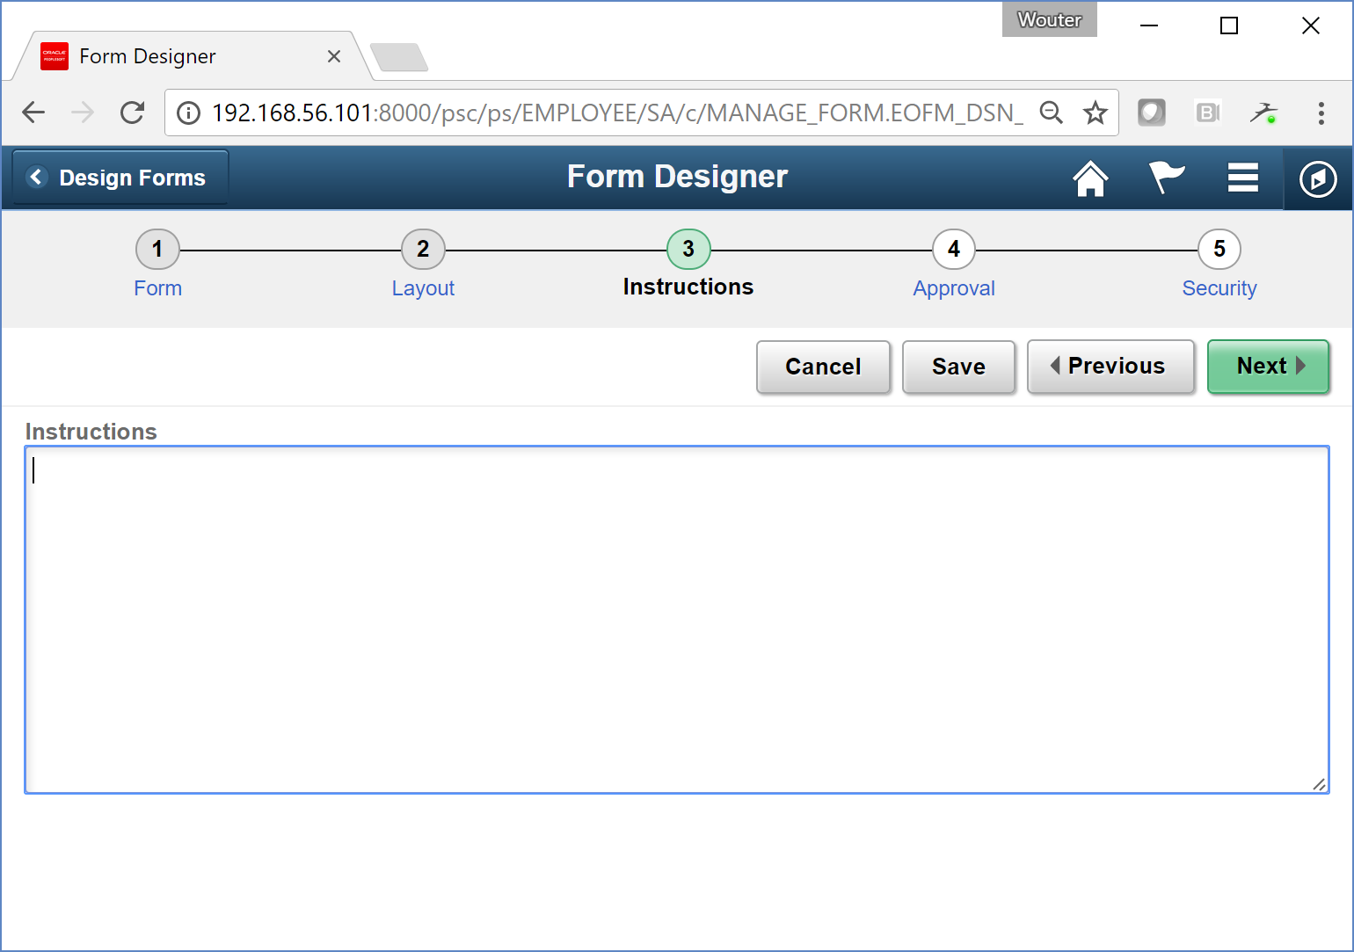
Create new form – step 3

Slide 30
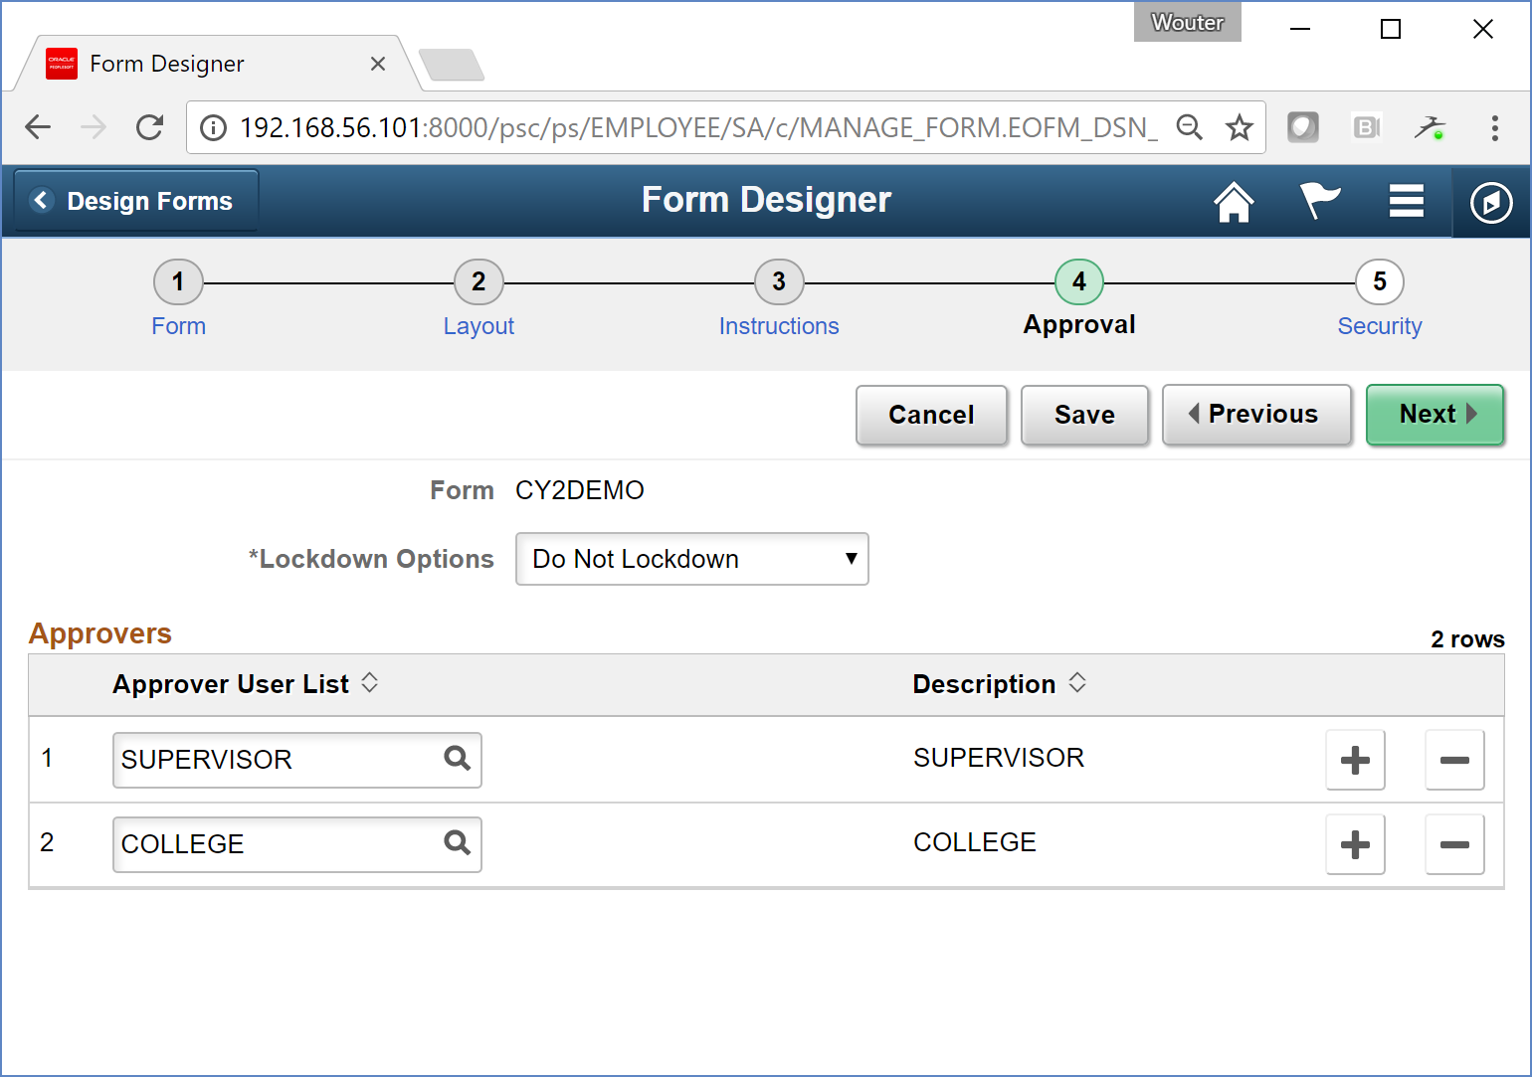
Create new form – step 4

Slide 31
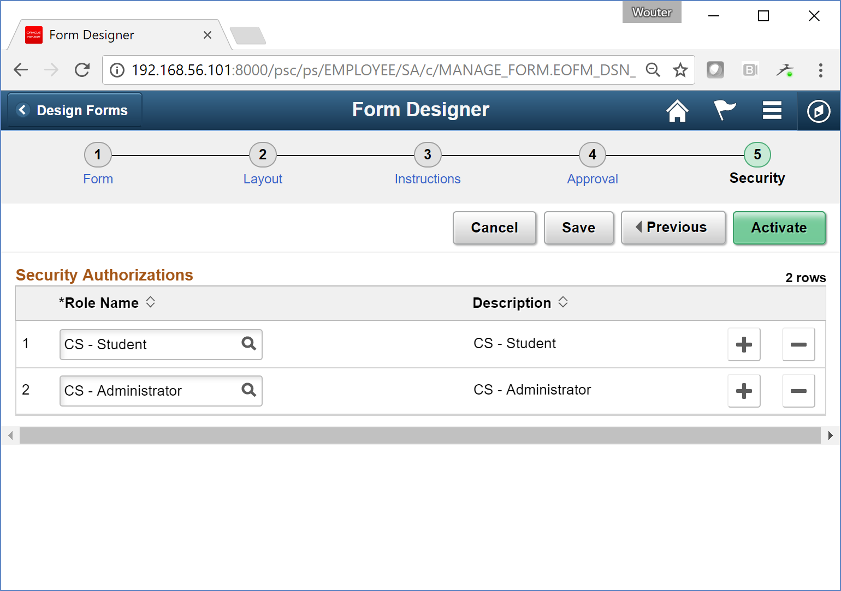
Create new form – step 5

Slide 32
Let’s create an example together

Slide 33
Summary
Pro
Con
Out-of-the-box
Easy configuration
File attachments
Data stored in Campus Solutions datamodel
Integration with rules engine + notification framework
No defaults
No contextual data e.g. show student name.
No data validation
Suitable for complex forms???

Slide 34
Tips & Tricks

Slide 35
Inactive Webservice
When you see the following Error message when you click on the “My Forms” tile;
Make sure that service operations EOFM_MENU and EOFM_LIST are activated.
Service Operation EOFM_MENU is inactive. Sync request aborted.
EOFM_FL.Model.ContainerModel.OnExecute Name:loadMenu PCPC:587 Statement:14
Called from:EOFM_FL.Controller.ContainerController.OnExecute Name:loadMenu Statement:317
Called from:EOFM_FL.Controller.ContainerController.OnExecute Name:postBuild Statement:68
Called from:EOFM_CONTAINER_FL.GBL.PostBuild Statement:2

Slide 36
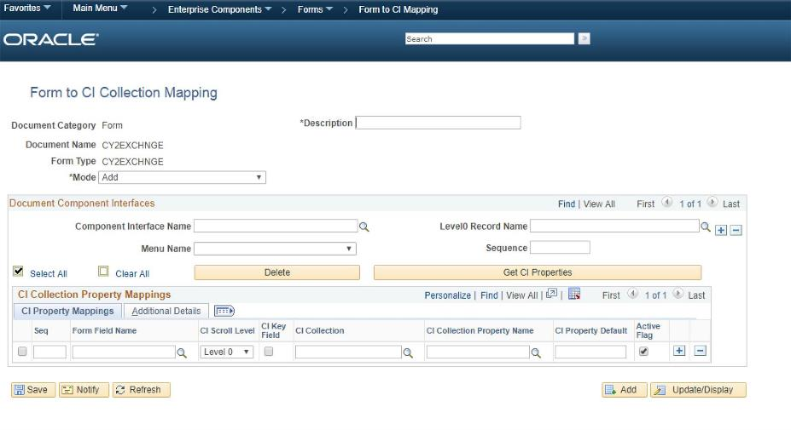
Form to CI mapping

Slide 37
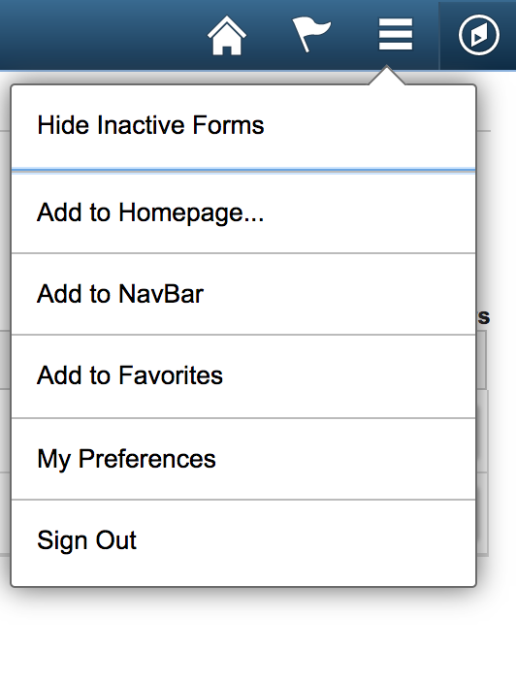
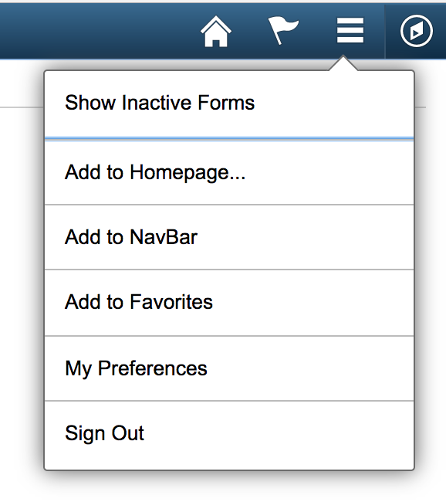
Inactive forms
Can be shown or hidden using the menu at the top-right

Slide 38
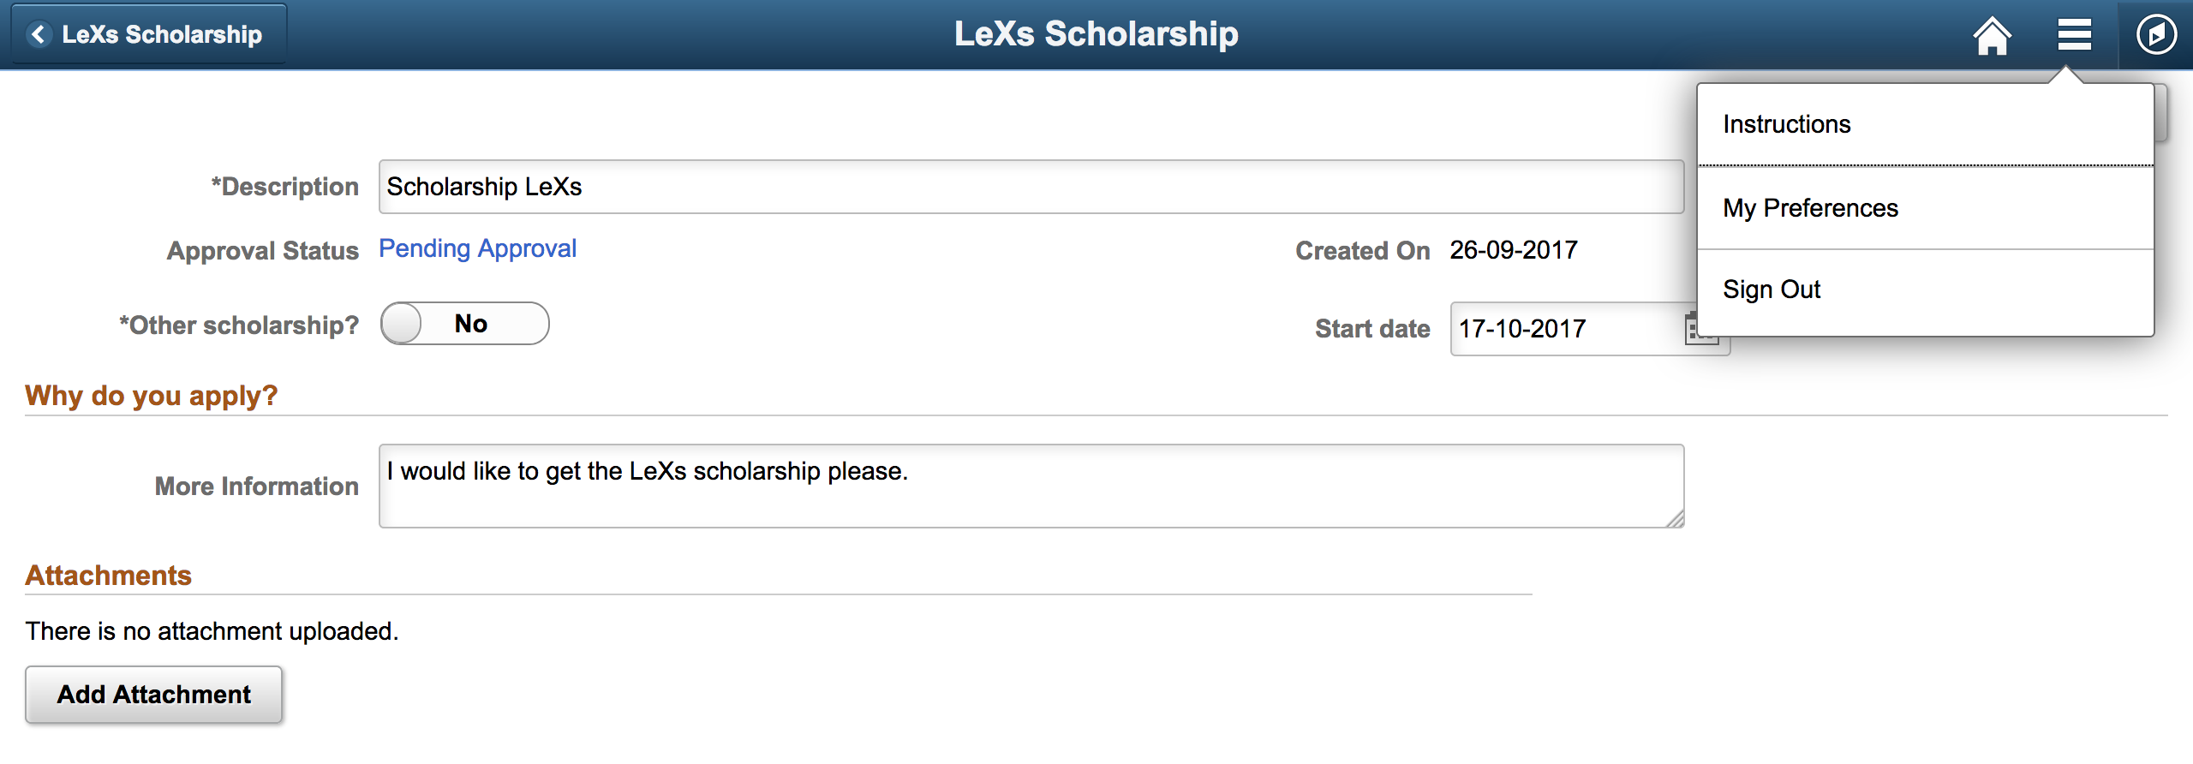
Instructions - Student
The student can find instructions (as described in step 3 of the form builder) using the menu at the top-right while viewing the form.

Slide 39
Further documentation
Oracle docs:
http://docs.oracle.com/cd/E77219_01/cs92pbr2/eng/cs/eccs/task_UsingFormsInPeopleSoftFluidUserInterface.html
https://www.youtube.com/watch?v=PAMHwhH1Kbs
Forms + PeopleCode event mapping:
https://leanitdesigns.wordpress.com/2017/06/25/enhancing-fluid-forms-with-peoplecode-event-mapping/
Oracle Policy Automation:
http://www.oracle.com/us/industries/education-and-research/oracle-opa-higher-ed-ds-461334.pdf
Tables used by Approvals & AWE:
http://www.peoplesoftpages.com/WordPress/awe-approval-workflow-engine-tables/

Slide 40
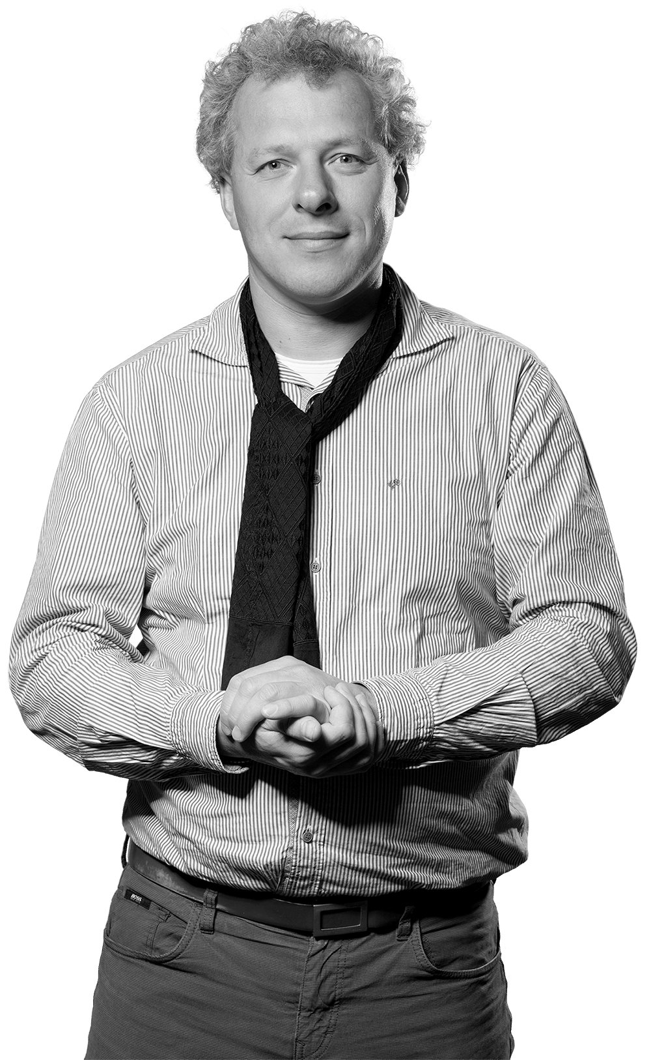
Other sessions by CY2
Privacy and what's already available in your Campus Solutions environment October 17th: 10:10am – 10:40am
What’s new in Tools 8.56 October 17th : 11:10 AM – 12:10 AM
Elmer Mackor & Lukas Degens
Ernst La Haye

