Slide 1
Utilizing the Academic item Registry to publicize continuing Education Programs
SESSION: 6025
Wednesday, November 14
01:00 PM – 02:00 PM
Room 9-213

Slide 2
presenters
Jody Benders
Erwin Veugelers
Team Lead, Registration and Information Services
School of Continuing Education, MacEwan University
bendersj0@macewan.ca
Senior Manager
Web Architecture and Development, MacEwan University
veugelerse@macewan.ca
B. Ed from University of Alberta (in Outdoor Education for some reason)
Began at MacEwan in 2010 in Admissions
Has been with the School of Continuing Education since Spring of 2017

Slide 3
Macewan university
Founded in 1971 as a community college, MacEwan University now offers more than 65 programs including undergraduate degrees, applied degrees, diplomas, certificates and continuing education

Slide 4
Peoplesoft Campus Solutions 9.2
MacEwan University went live with PeopleSoft in 2010. Currently operating on Campus Solutions 9.2

Slide 5
School of Continuing Education
Continuing Education became its own School at MacEwan in 2014.

Slide 6
Academic Item Registry (AIR) and the School of Continuing Education
1
3
SECTION 1 OUR HISTORY:
Why SCE courses and programs are different
SECTION 3 TECHNICAL:
Technical aspects of AIR
2
4
SECTION 2 Academic Item Registry:
How SCE uses AIR
SECTION 4 CONCLUSION:
What worked and what didn’t

Slide 7
OUR History
How the School of Continuing Education programs, courses, and applications are different

Slide 8
History of SCHOOL OF CONTINUING EDUCATION
Continuing Education at MacEwan University was formerly spread out amongst various faculties at schools
In 2013 a project was undertaken to consolidate those offerings under the umbrella of the School of Continuing Education
The School of Continuing Education now offers credit and non-credit programming with 14 certificate programs and over 200 courses from Business & Management, Art & Design, English as an Additional Language, University Preparation, and Corporate Training
Over 8,000 students currently enrolled
Notes:
The School of Continuing Education offers non-credit programming from English as an Additional Language and University Preparation, and International Professional Development Programs (Program Management, Business Analysis). It also offers professional development certificates, corporate training and various other personal development course-work
Previously, these offerings were provided as non-credit course work through different Schools and Faculties at MacEwan
In 2014, a project was undertaken to combine all non-credit course work into one faculty called the School of Continuing Education
After much deliberation, the School of Continuing Education chose to utilize the existing PeopleSoft Campus Solutions system as it’s registration and information system.

Slide 9
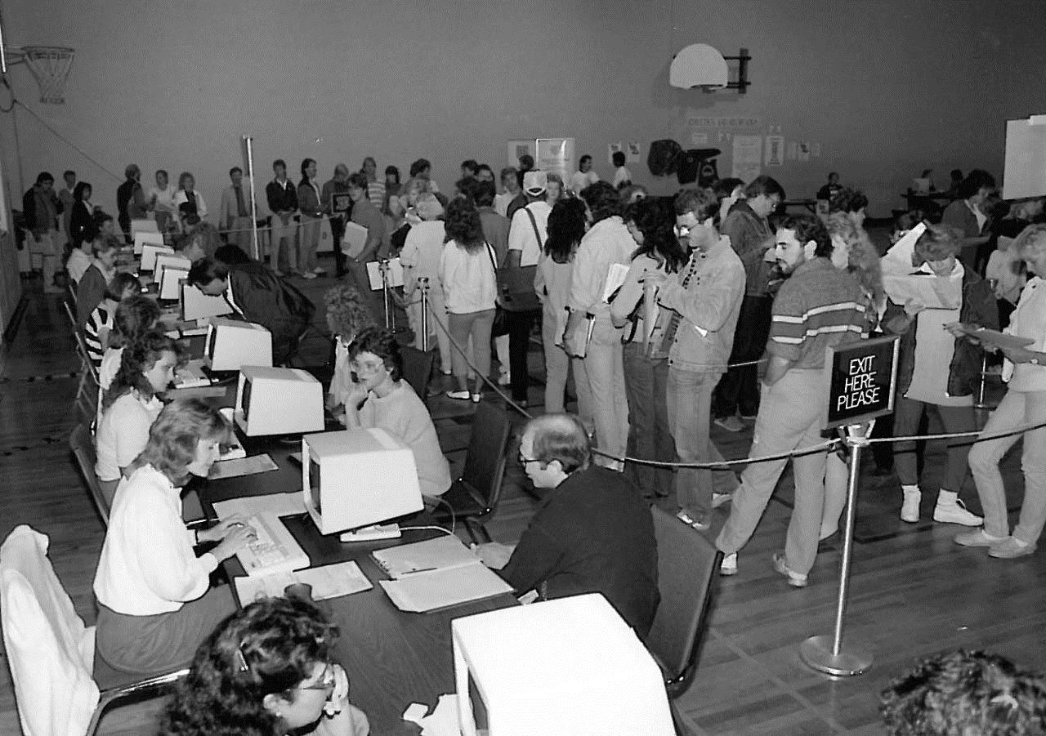
How to get them in
Continuing Education is unlike other programming offered at MacEwan
Solution needed to be efficient for students and staff
Continuing Education is constantly changing, staff needed to be able to update and add offerings quickly
Notes:
Initially, most programming at the School of Con Ed was essentially an single non-credit class or group of classes
Outside of our English as an Additional Language and University Preparation offerings, there was no application necessary and most classes did not have a prerequisite
Likewise, new and returning students did not have access to our Student Service Center in Campus Solutions, which our Undergraduate students used to enroll in classes
We needed a way for our students to find a class or program on our website easily. Likewise, they need to be able to enroll into these classes with as little hassle as possible
Likewise, unlike our undergraduate programming, our courses and offerings were constantly changing based on market demand. We didn’t operate on annual cycles in the same way that our credit programming did. Instead, if one of our program areas wanted to create a new course, professional development series or even a whole new program, we need to be able to create it and have students enroll within weeks. Likewise, if a program or offering was no longer viable, we needed to be able to remove it or alter it at the same speed.
Part of this meant that our usual processes, like funneling web content through our web services team wasn’t feasible.
We needed to own and manage this content ourselves, at least as much as possible.
So, how do we do that within the existing framework of Campus Solutions?

Slide 10
Academic Item Registry
What is the Academic Item Registry and how does the School of Continuing Education use it?

Slide 11
What is Academic Item Registry
“Academic Item Registry (AIR) is an educational model where students must complete a strictly defined set of courses towards their academic objective in a specified sequence” ( PeopleBooks 9.2)
Provides ‘canned’ program options through courses, course lists, and programs.
Curriculum Management > Academic Item Registry > Academic Item Registry (AIR)
Notes:
PEAM (Program Enrollment and Activity Management) rolled out in Campus Solutions 9.0. Provides the option to use program enrollment as opposed to traditional program structures and advising, and to facilitate student activity and completion tracking. We are not using PEAM for either program enrollment or activity management, but are using one component of PEAM, the academic item registry, to manage curriculum objects such as programs and course lists.
The issues we needed to solve were:
Most continuing education programs are part of a single con.ed. Program in the Psft CS foundation tables. Con.Ed. Needed a way to define program information for programs that were not technically individual Psft programs.
The only place in traditional CS to build course lists is in Academic Advisement, something that Con.Ed. does not use, for various reasons.
The academic item registry allows us to bot h define program objects, including descriptions etc, and create course lists, which in turn can be referenced by the program objects. Course objects are created by using the built-in copy function to copy data from the course catalog to the academic item registry. Once a course object is created in AIR, it is now managed independent of the course catalog object.
I’ll perhaps get Erwin to talk a little bit more about how Academic Item Registry is intended to be used at other institutions since, to be honest, I’m really only familiar with how we use it at the School of Continuing Education.
So the quote here is from PeopleBooks, which states that the Academic Item Registry (AIR or PEAM) is an educational model where students must complete a strictly defined set of courses towards their academic objective in a specified sequence.
Essentially, what the academic item registry allows users to do is add courses to create a course list. This course list can then be attached to a program, or in our case a certificate. The course lists can be defined as required or optional.

Slide 12
How does School of Continuing Education use Academic Item Registry
1
3
Courses and Course Lists
Attributes
2
4
Programs
Applications

Slide 13
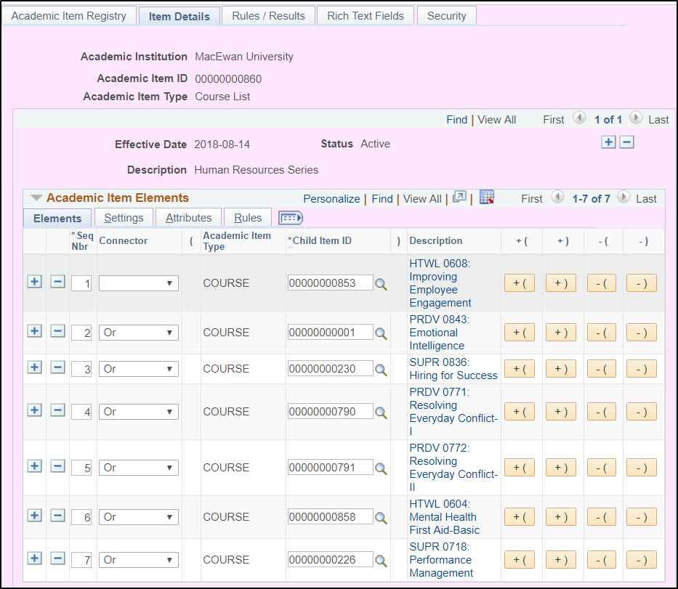
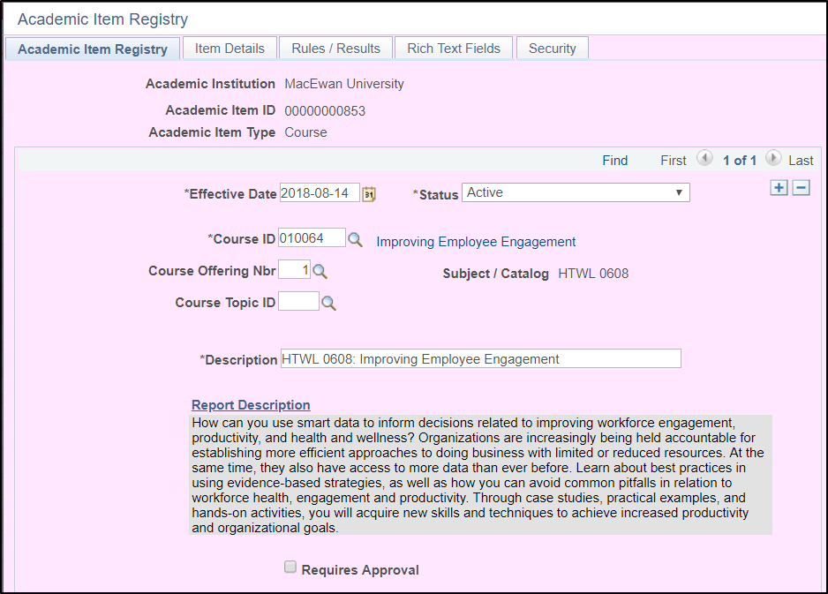
Courses and Course Lists
Notes:
So you can see in this first picture that we first create a course in AIR. Really, we are jut attaching an existing course to the academic item type.
Once the courses have been created, we can create a course list of available courses

Slide 14
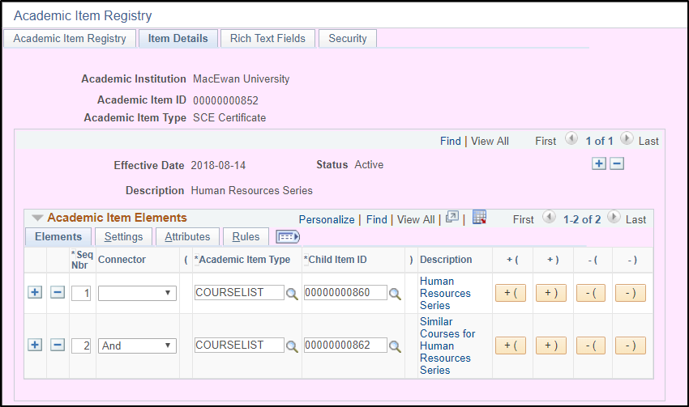
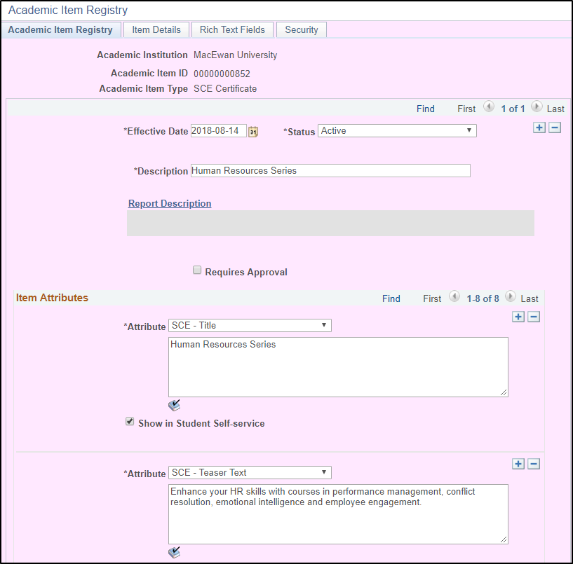
programs
Notes:
Once we have a course list or lists, we can create the program to attach it too.
The piece that is interesting from a functional perspective is that we can configure Attributes which will dictate what appears on the website.
As you can see in this screen shot, we’ve configured a number of attributes which appear on the website. We have items from Program Title, Teaser Text (which appears on the search page) and outline. However, we also have items for admissions requirements, fees
However, we also have other attributes which dictate items such as ‘cloud words.’ These are items such as ‘communications’ or ‘art’ or ‘project management’ that website users can search for or select on our main page.
Likewise, we’ve also created attributes which can control things such as whether or not a certificate requires an application. If it does, an apply now button will appear on the website.
Any of the attributes can be update by our office at any given time without having to wait for web services or IT or specific change management windows for the updates to appear on the Con Ed website.

Slide 15
Technical Aspects
How does Campus Solutions talk to the Website?

Slide 16
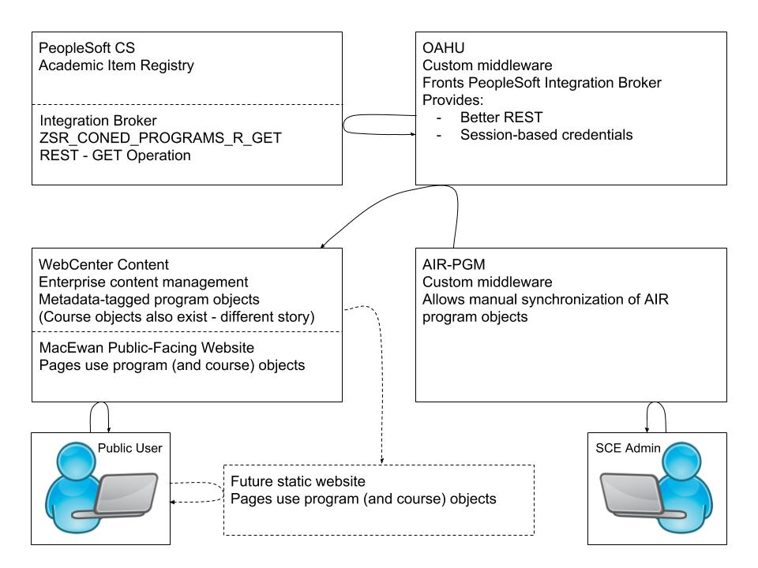
Making programs available to the macewan website
Notes:
Continuing Education users manage program objects in PeopleSoft AIR.
Continuing Education administrative user uses custom middleware web application to trigger object synchronization to WebCenter Content.
Web pages server through WebCenter Content use synchronized objects to display program data.
In the near future, the website moves to a static website delivery model. WebCenter Content will trigger an additional synchronization step that publishes updated program information to the static website servers.
There are additional synchronization patterns for synchronizing other PeopleSoft data to WebCenter Content, such as the course catalogue, as well as scholarships, awards, and bursaries.

Slide 17
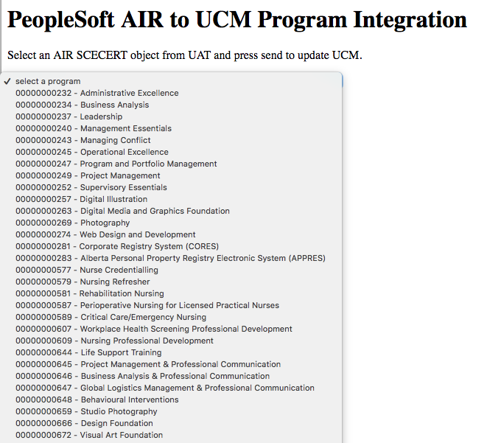
AIR-pgm
Notes:
AIR-PGM is the custom middleware user interface that is used to trigger the synchronization of content between PeopleSoft CS and WebCenter Content.
Select environment (DEV / UAT / PRD)
Select program to synch
Click “Send to <env>” to synchronize data with WebCenter Content
AIR-PGM uses OAHU REST to retrieve data from PeopleSoft, then uses SOAP to check new version into WebCenter Content.

Slide 18
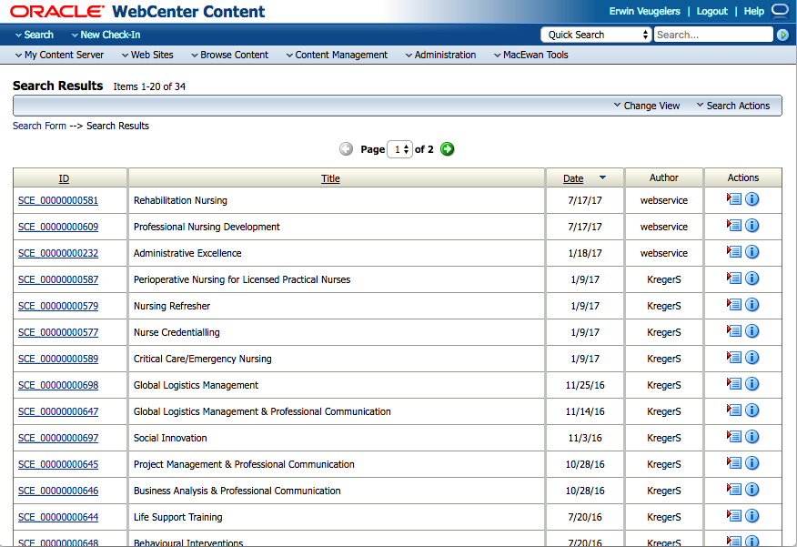
Webcenter content - list
Notes:
Each program object becomes a content object in WebCenter Content. WebCenter Content is MacEwan’s core content management system. It currently is used also to publish our public website, although this is changing.

Slide 19
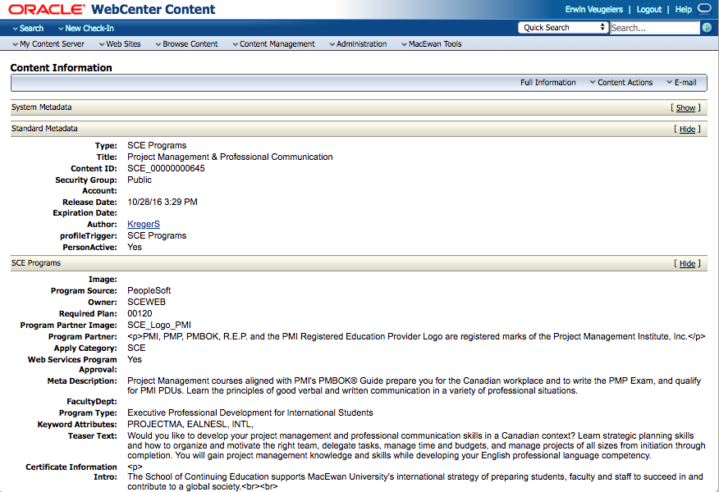
Webcentre content - detail
Notes:
Each object is marked up with metadata describing the object, and the content item is a data file in JSON format with the complete data set, including details about each course in the attached course list(s).

Slide 20
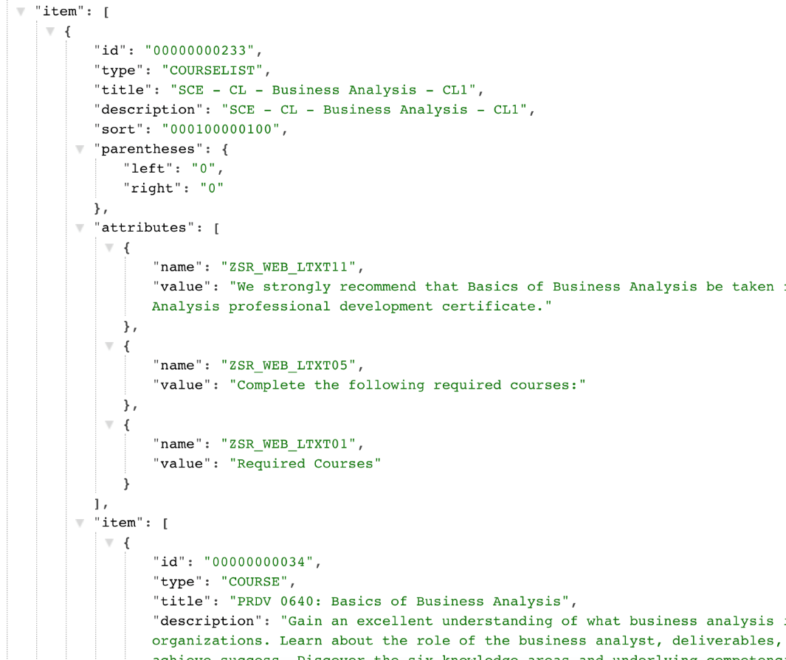
Webcentre content - detail
Notes:
Each object is marked up with metadata describing the object, and the content item is a data file in JSON format with the complete data set, including details about each course in the attached course list(s).
Example object: SCE_00000000234

Slide 21
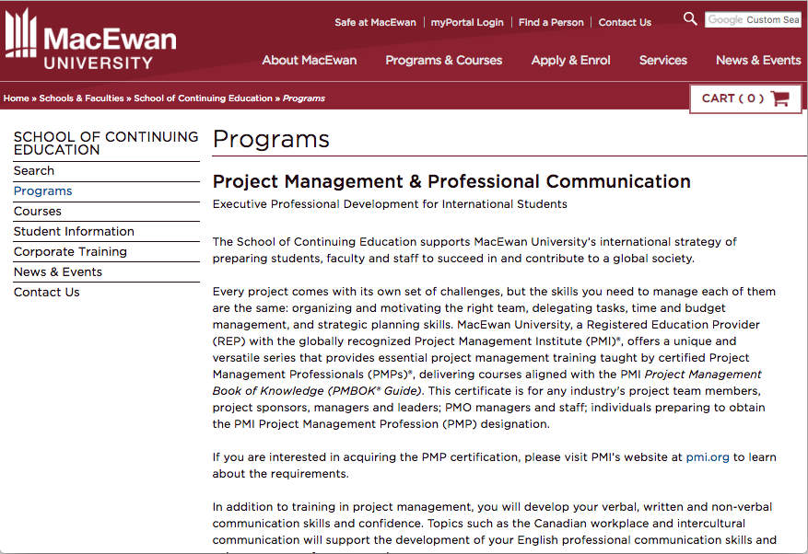
Use on Public Website

Slide 22
Lessons Learned
What worked and what didn’t?

Slide 23
The Good
Create New Programming Quickly
Update Existing Programming and Course Lists
Structure

Slide 24
The OK (but still pretty good)
Templates
Structure
HTML

Slide 25
Concluding thoughts
ANY QUESTIONS?

Slide 26
presenters
Jody Benders
John Doe
Team Lead, Registration and Information Services
School of Continuing Education, MacEwan University
bendersj0@macewan.ca
Sr. Manager, Web Architecture
Architecture and Application Management Development, MacEwan University
veugelerse@macewan.ca
all Alliance presentations will be available for download from the Conference Site

Slide 27
THANK YOU!

