Slide 1
PeopleSoft campus solution my umn - LECTURES PAYROLL MODULE
SESSION ####
Singapore
14-15 November 2016

Slide 2
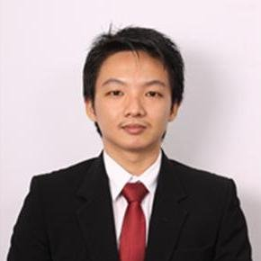
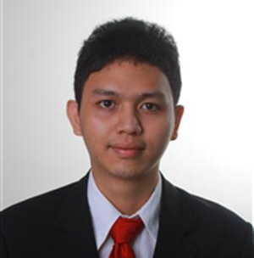
presenters
M. Shobri (as a primary presenter)
PS Programmer
Universitas Multimedia Nusantara, Indonesia
shobri@umn.ac.id
Peoplesoft Techno-Functional Consultant, Programmer and Developer PHP CI Framework.
Danry Ray (as co-presenter)
PS Programmer
Universitas Multimedia Nusantara, Indonesia
Programmer and currently working as IT Programmer Coordinator.
Gregorius Dennis (as co-presenter 2)
PS Programmer
Universitas Multimedia Nusantara, Indonesia
Programmer and currently working as IT Programmer.

Slide 3
Universitas multimedia nusantara (umn)
UMN is a higher education institution locate at Tangerang (Indonesia). UMN was established at 2007 and we are using PS Oracle since 2014.

Slide 4
Campus solution peoplesoft oracle
Database:
Oracle Database - Enterprise Edition - 11.2.0.4
Campus Solution Bundle:
CS 9.0 Bundle #34
HRMS bundle:
HRMS and Campus Solutions 9.00.00.380
PeopleTools:
8.53.13

Slide 5
Brief Summary
1
3
PS Campus Solution Delivered
Lecturers Payroll Module
2
UMN Requirements

Slide 6
SECTION 1 PS Campus Solution Delivered
UMN develops Lectures Payroll and Reporting Module

Slide 7
Campus solution delivered
PeopleSoft Campus Solution is the system of record for academic and personnel administration at UMN, but it does not have lecturers payroll module that accommodate UMN business process.
PS Campus Solution Module
Campus Community
Recruiting & Admissions
Student Records
Student Financials
Campus Self Service

Slide 8
SECTION 2 UMN Requirements
UMN need an integration module than can calculate and generate lecturers payroll.

Slide 9
UMN requirements
UMN need a lecturers payroll module that can be integrated with Academic Management in PS Campus Solution.
Attendance System
Academic Management
Lecturers Payroll
Self Services (Lecturers )

Slide 10
1.1 UMN Attendance System
Attendance System
Database
Academic Management
UMN Attendance System is built up with RFID and integrated with the academic information system. The data produced from the RFID later will be used as an input for Lecturers Payroll Module to process the payroll.
When the lecturer and the students attend the class, they will both tap their id card to mark their presence as the starting time and later when the class finished, the lecturer will validate the student presence and save it to be marked as the end time of the class.

Slide 11
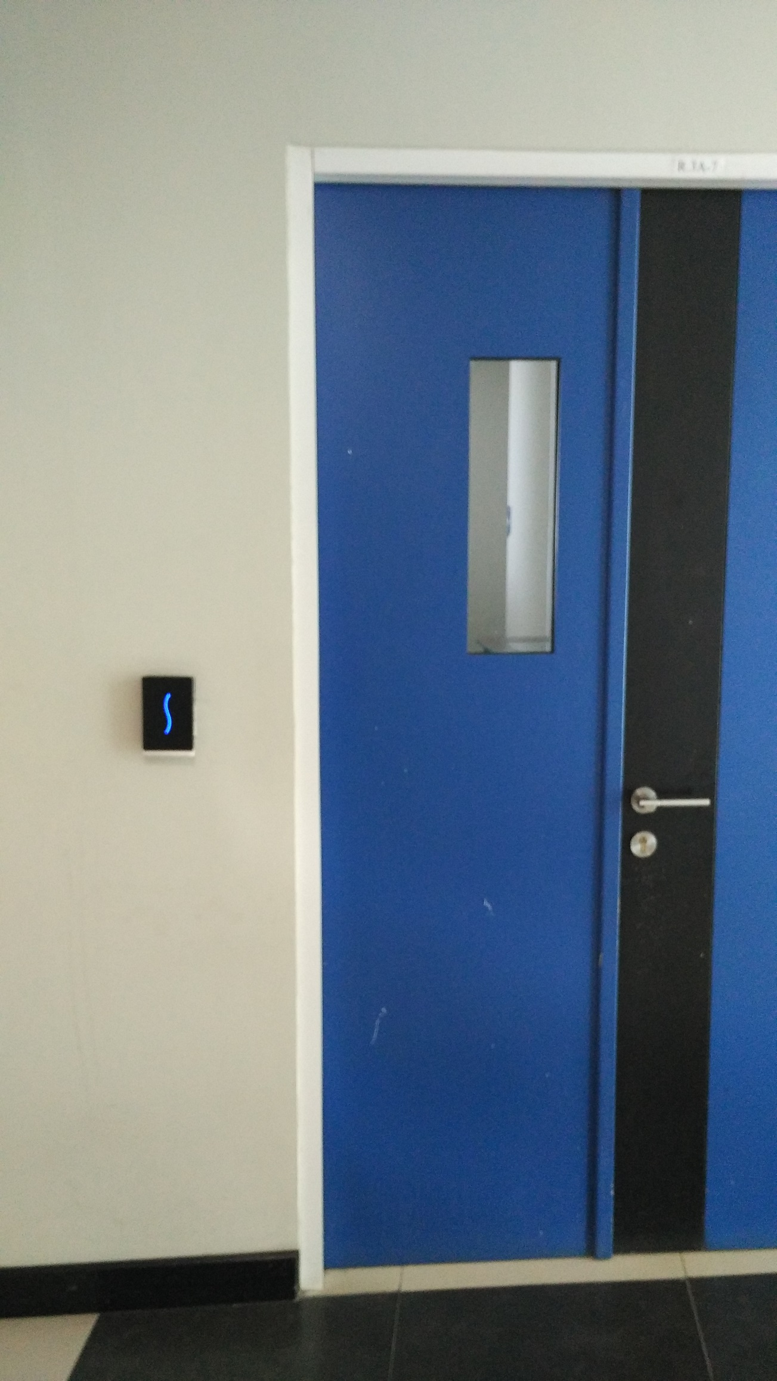
UMN - RFID Attendance
RFID device attached to every class room
Students and lecturers will tap their ID card before class is started

Slide 12
UMN Attendance flow
TAPPING
√ ACCEPTED
X REJECTED

Slide 13
UMN Attendance flow (cont’d)
SUMMARIZE TEACHING CONTENT
FETCHING RFID TAPPING
LECT. & STUDENT ATTENDANCE RECORDED
SAVE

Slide 14
1.2 Academic Management
Evaluation Lecturers Attendances.
Assign Lecturers to get Component Lecturers Fees.
Approval Lecturers Attendances.
Creating Report Lecturers Fees to Human Resources (HR) Department.

Slide 15
1.3 Lecturers Payroll
Managing The Lecturers Fees Setup.
Managing The Approval Fees.
Managing The Approval Payroll.
Reporting Lecturers Payroll and Withholding tax slip.
Processing Component Lecturers Fees

Slide 16
1.3 Self Services (Lecturers)
Lecturers have a page to see the history of his salary.
Lecturers can track their Payroll.
Lecturers can download their payroll report.

Slide 17
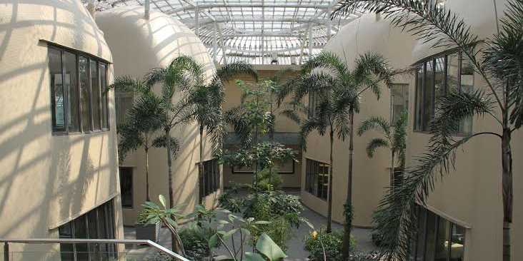
SECTION 2 LECTURES PAYROLL module
UMN develops Lectures Payroll and Reporting Module

Slide 18
Lecturers PAYROLL Module
Lecturers Payroll Module receives attendance or others information from Academic Management and Human Resource (HR) Department. Major Features within Lecturers Payroll Module are :
Managing the Lecturers Fees Setup
Processing Component Lecturers Fees
Processing Calculate Fees
Managing the approval fees
Managing the approval payroll
Tracking Lecturers Payroll
Self Services Lecturers Payroll
Reporting Lecturers Payroll, eSPT and Withholding tax slip
Processing Payroll Payment

Slide 19
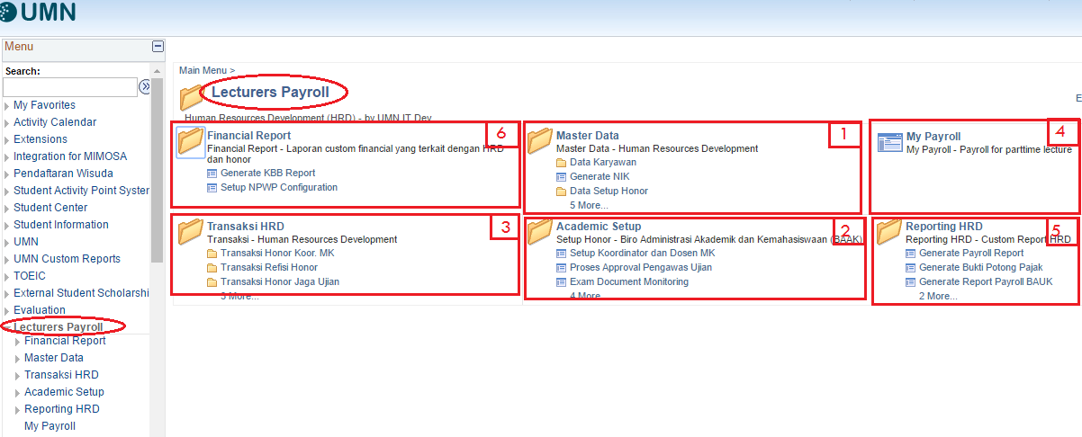
Structure and Content
Managing the Lecturers Fees Setup ( HR Department )
Managing the Lecturers Fees Setup ( Academic Department )
Processing Calculate Fees, Managing the approval fees, Managing the approval payroll and Tracking Lecturers Payroll
Self Services Lecturers Payroll
Reporting Lecturers Payroll and Withholding tax slip
Processing Payroll Payment

Slide 20
3.1 Managing the Lecturers Fees Setup
Lecturers Fees Setup
Academic Department
HR Department
Processing lecturers attendance approval,
Processing lecturers others fees approval.
Printing report to HRD.
Creating lecturers master fees,
Creating lecturers tax criteria,
Creating lecturers fees component.

Slide 21
3.2 Processing Component Lecturers Fees
Attendances Fees
Transportation Fees
Coordinator Subjects Fees
Correcting Student Exam Scores Fees
Invigilator Fees

Slide 22
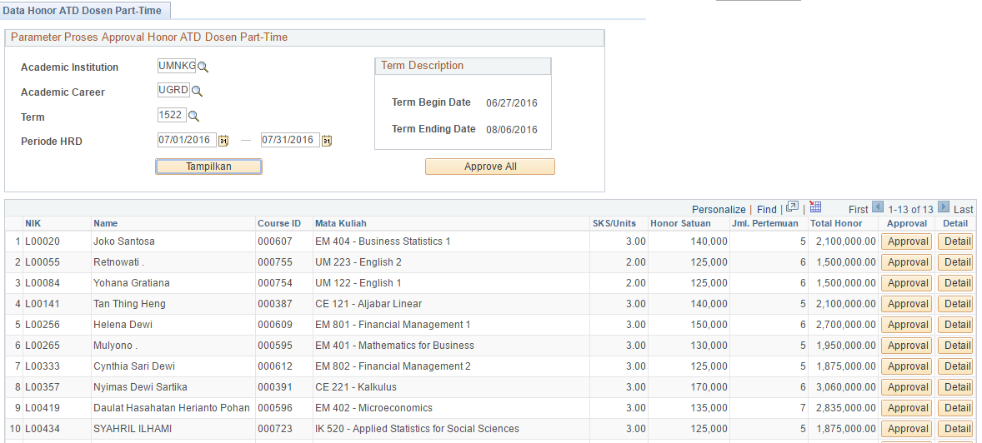
3.3 Processing Calculate Fees
Lecturers Fees Setup
Calculate Fees
Review Transactions

Slide 23
3.4 Managing the approval fees
Review Transactions
Processing Approval

Slide 24
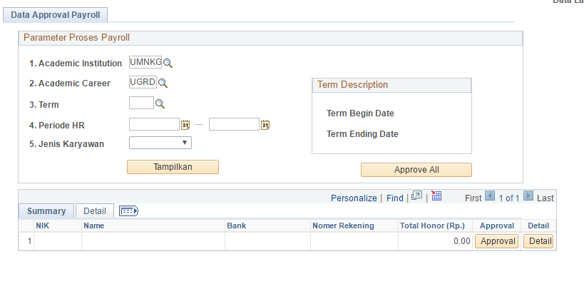
3.5 Managing the approval payroll
Processing approval payroll based on parameter :
Academic Institution
Academic Career
Term
Payroll Periode
Employe Type (Fulltime and Parttime)
Lecturers Approved Fees ( Net Tax )
Approval Payroll
Tax Costs

Slide 25
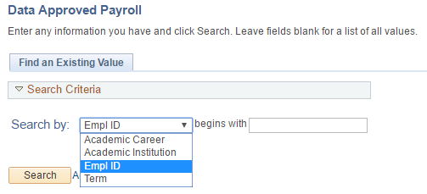
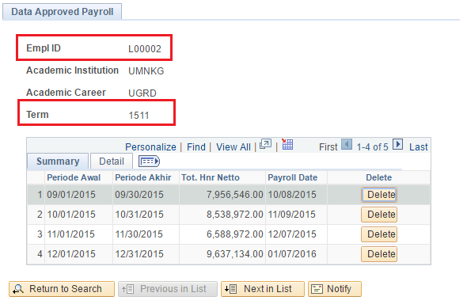
3.6 Tracking Lecturers Payroll
Lecturers Payroll Module provides our admin users the ability to search the several payroll transactions histories based on lecturer ID and payroll Term.

Slide 26
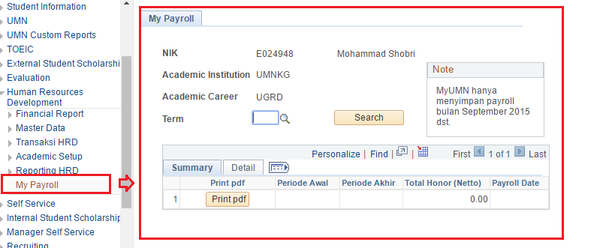
3.7 Self Services Lecturers Payroll
Lecturers Payroll Module provides our lecturers the ability to search the several payroll transactions histories based on payroll Term.

Slide 27
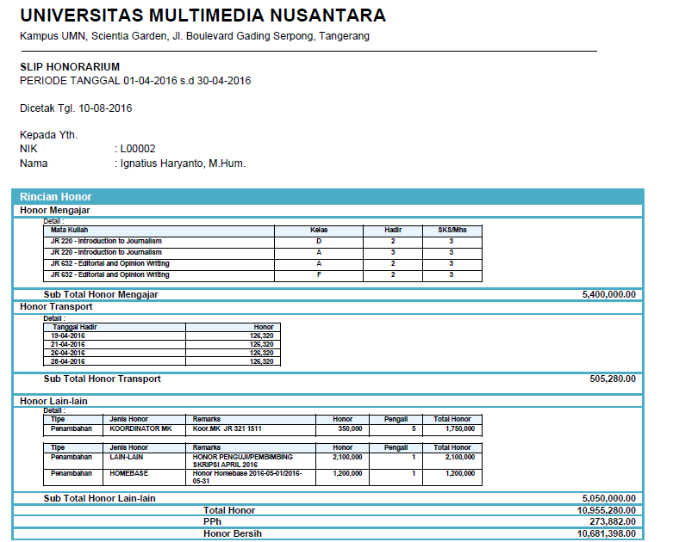
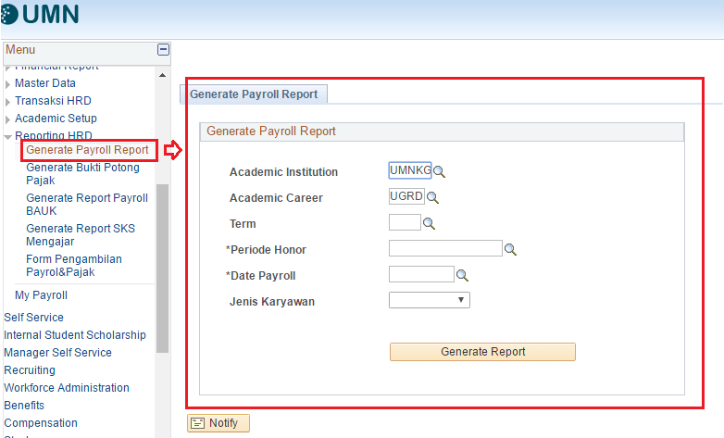
3.8 Reporting Lecturers Payroll, e-spt and Withholding tax slip …(1)
1. Reporting Lecturers Payroll

Slide 28
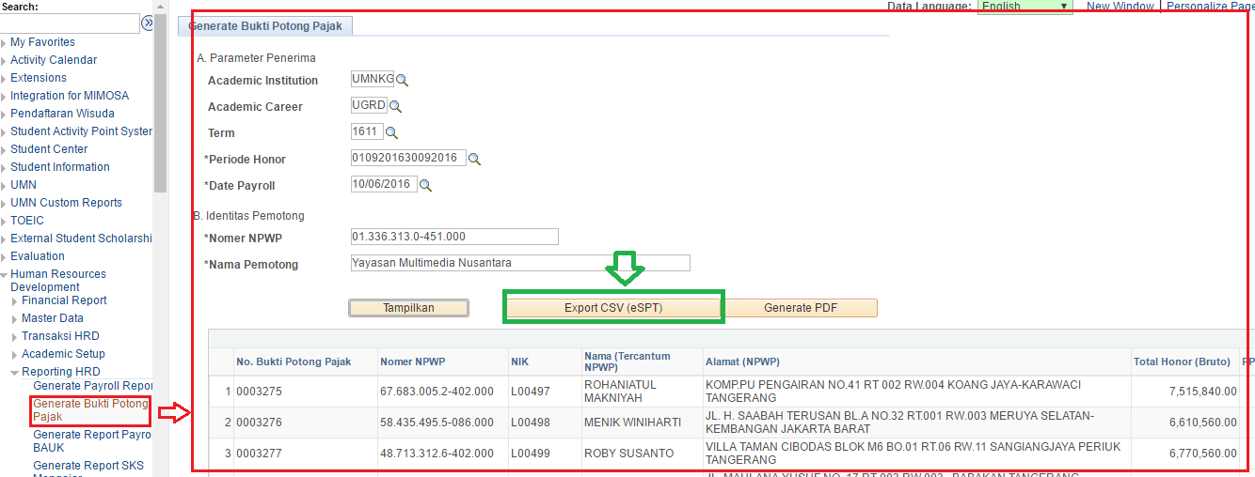
3.8 Reporting Lecturers Payroll, e-spt and Withholding tax slip …(2)
2. E-SPT (Annual Tax Return) …(1)
E-SPT (Annual Tax Return) is used to report or calculation and payment of taxes, taxes and or not to tax and or assets and liabilities, according to the provisions of tax legislation.

Slide 29
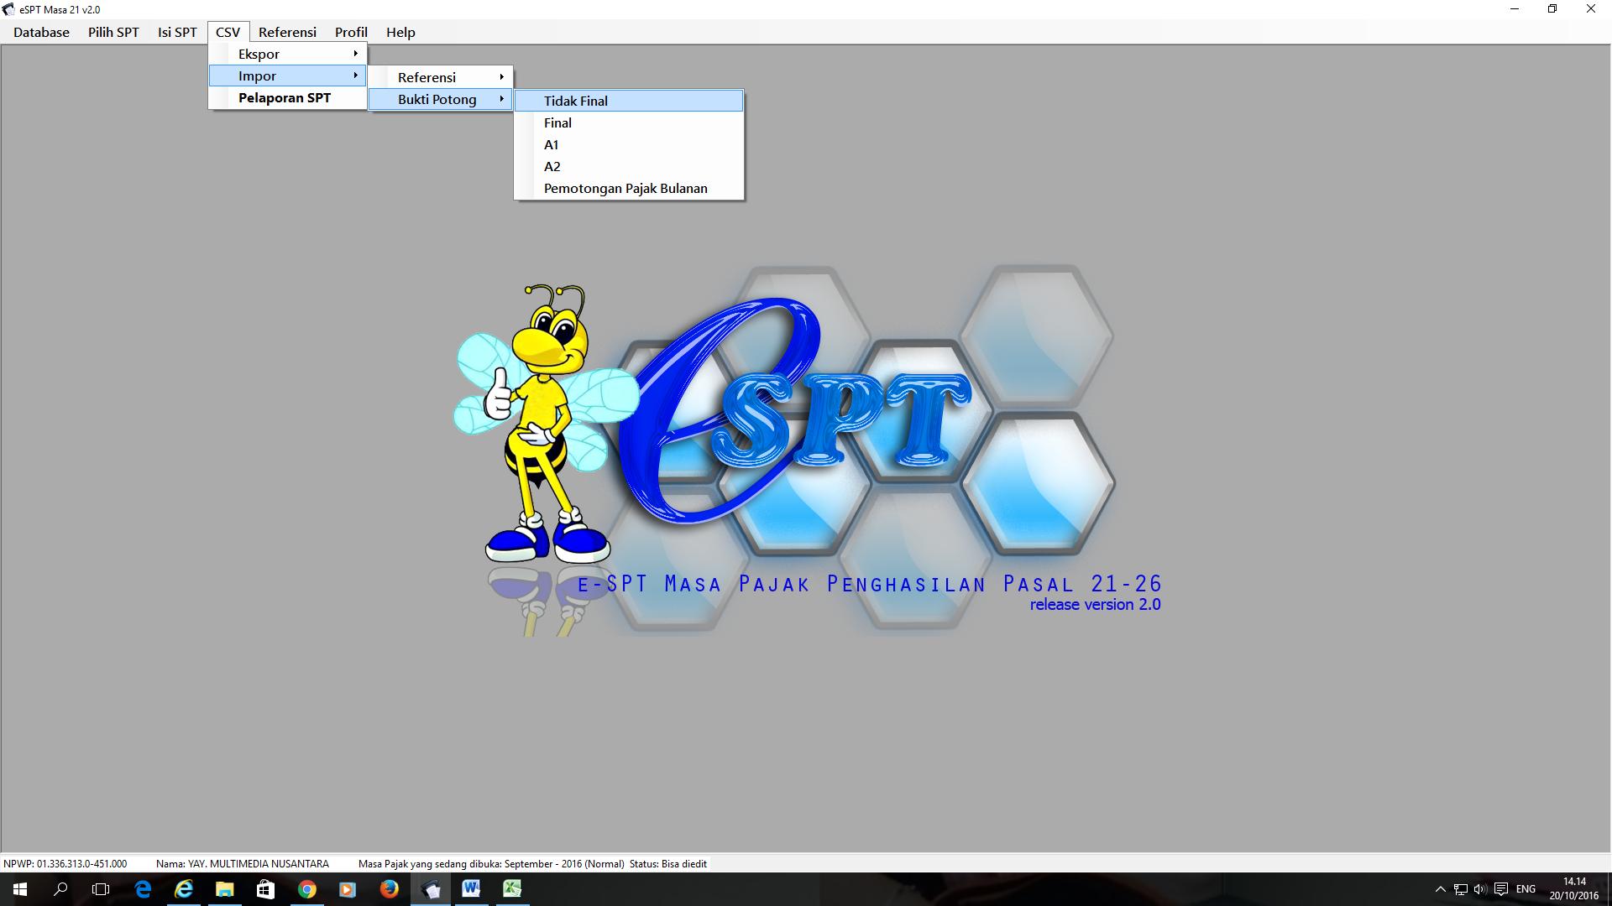
3.8 Reporting Lecturers Payroll, e-spt and Withholding tax slip …(3)
2. E-SPT (Annual Tax Return) … (2)
Upload this file (csv file) into e-SPT application that has been provided by the government.

Slide 30
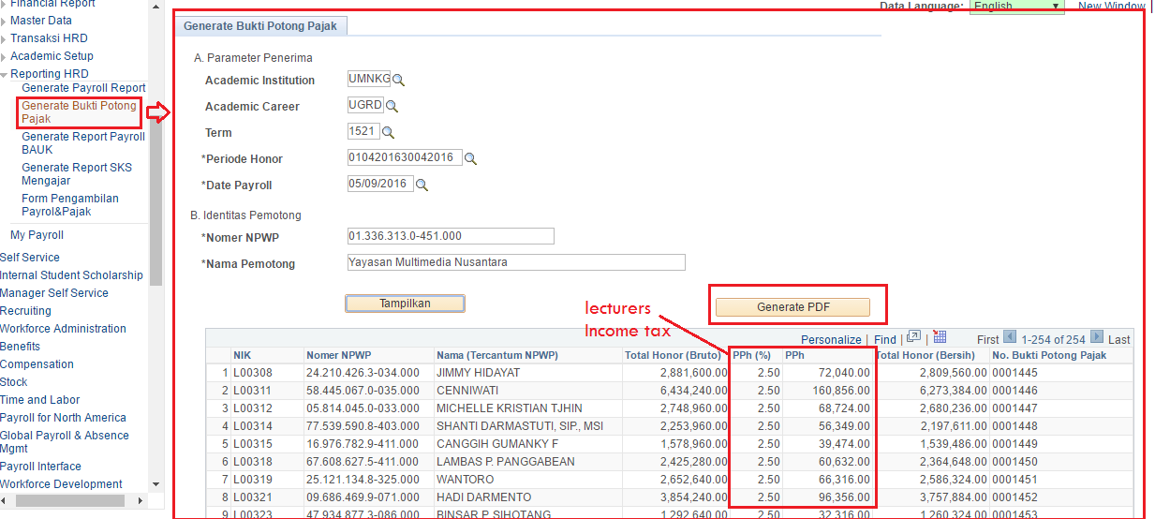
3.8 Reporting Lecturers Payroll, E-spt and Withholding tax slip …(4)
2. Reporting Withholding tax slip
A withholding tax, also called a retention tax, is a government requirement for the payer of an item of income to withhold or deduct tax from the payment, and pay that tax to the government.

Slide 31
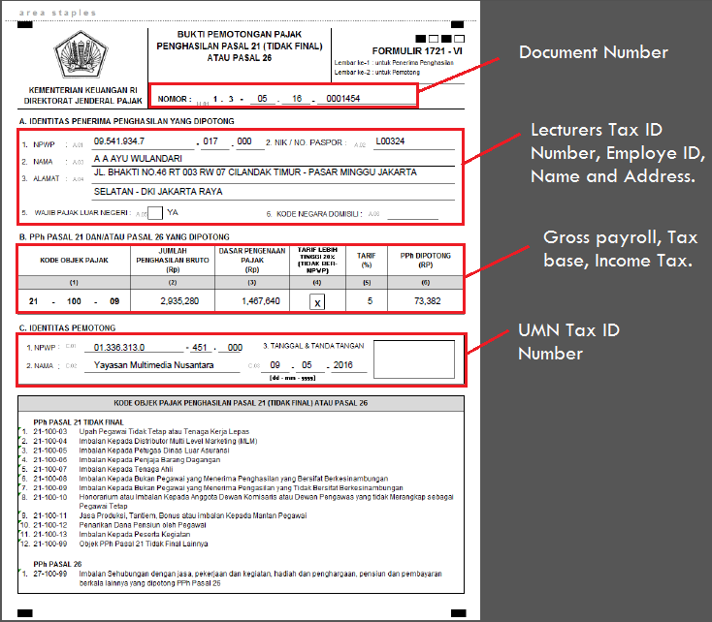
Withholding tax slip

Slide 32
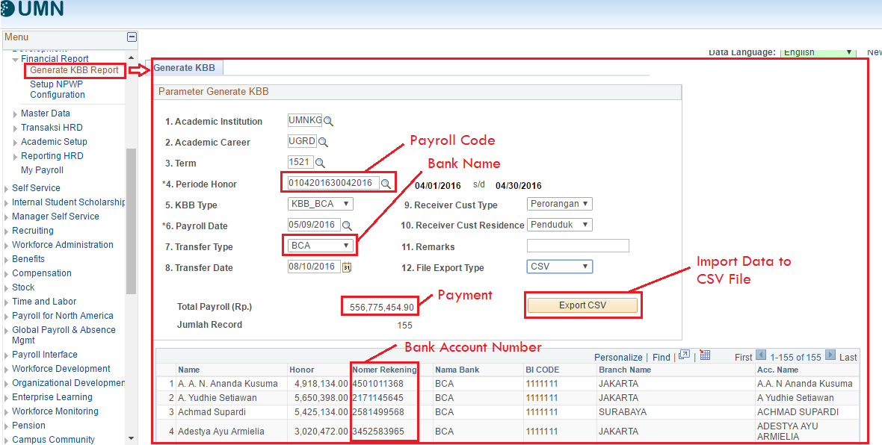
3.9 Processing Payroll Payment
Generate the direct deposit file and forward to the bank or upload this file into banking application. Contact the bank and ensure it is appropriately received, and verify the amount received

Slide 33
Concluding thoughts
PS Campus Solution Module
Campus Community
Recruiting & Admissions
Student Records
Student Financials
Campus Self Service
Lecturers Payroll
ANY QUESTIONS?

Slide 34
SUMMARY
Lecturer Payroll Module is an innovative solution that had been deployed to complement PS Campus Solution to support UMN's needs.
Technically, the implementation of the Lecturers Payroll Module in PS Campus Solutions is not so difficult because PS Campus Solutions provides convenience for data integration, reporting tool and updating menu with application designer.

Slide 35
presenter
M. Shobri
PS Programmer
Universitas Multimedia Nusantara, Indonesia
shobri@umn.ac.id
all Alliance presentations will be available for download from the Conference Site

Slide 36
THANK YOU!

