Slide 1
Nested PeopleSoft Security
October 2017 - ASR Security Team
Notes:
Good Afternoon. Thank you for attending this session discussing some aspects of PS security.

Slide 2
Agenda
Background
Building Blocks of Security
Row Level Security
Institution Set
Academic Org Security
Instructor Enrollment Security
Questions
Notes:
We are going to briefly review the components of PeopleSoft security and row level security
Security overview incorporating general analysis of PeopleSoft Security. Details about each layer of security as well as, touching on security changes from Campus Solutions PeopleSoft 9.0 to 9.2.
Security in PeopleSoft 9.0 or above is like a set of Nesting Dolls. Complementary layers support each other to develop an access profile for each user. We will discuss each layer beginning with Permission Lists and ending with the unique way we are using to request access for staff.

Slide 3
Presenter
Carolyn Davidson - Business Analyst
20+ years of PS Security experience/responsibility
Additional CS Functional Security Team Members
Deb Brown (Student Finance)
Nancy Killian (Student Records)
Notes:
This is the Group tasked with understanding security requirements for University staff. The unique composition of the group allows us to bring knowledge of different business processes as relating to security.

Slide 4
Overview of Responsibilities
Setup of access framework
Production support of access issues
Liaison with Supervisors and Access Provisioning Department
Notes:
Security was redesigned during our upgrade from 8.9 to 9.0 and this team supports the design, addresses production support of access issues. We work closely with our provisioning partners to address gaps in access that were not previously identified, new security, and changes for staff when their job duties are re-aligned.

Slide 5
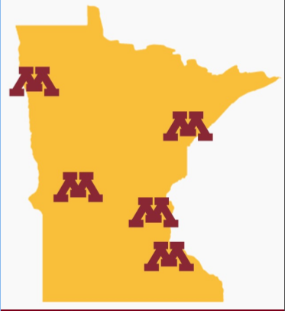
University of Minnesota
Founded in 1851
Five Campus Locations
Enrollment: 67,480
51,580 on Twin Cities Campus
Alumni: >400,000
Notes:
Few facts about our campuses.

Slide 6
Systems
Campus Solutions: 9.2, Image 6
Upgraded September 2017, phase 1
Human Capital Management 9.2
Image 23 (pending October 2017)
Financial Systems 9.2
Image 18 + Select Updates
PeopleTools 8.55.17
Notes:
Current system configuration. We also have a Portal System that is the repository for security info for all systems as well as a content provider to users.

Slide 7
Users
University users who exist in Campus Solutions:
Will have some level of security based on their role(s)
Staff/Faculty (78,321)
Access can vary from view to update/correction
From HR, FIN, and CS
Students: (518,603)
Have a Student Self Serv role
Example: need to register for classes
Notes:
Speaker: So, the audience Carolyn and I are dealing with are those who have access in Campus Solutions - mainly two groups: our staff and faculty, and then our students. Each of these groups have multiple levels of needs, and need to be able to accurately request access - or, in the case of some faculty, have that access automatically assigned - and I’m thinking grades access here. So, how do users let PAR know what access is needed?

Slide 8
What’s a BA to do??!
There are several reasons for a BA to work on security
Dealing with an issue and security has an impact
Working on a SDLC/new page that will require access
9.2 upgrade changes
Questions about security can be submitted to sfhelp@umn.edu
Will provide analysis for resolution for questions
If a new page is involved, can help as to where to provide access in our security structure
If it’s NEW security, it migrates through the
instances, so may take several months !
Notes:
Talking point: Many of our BA’s have little experience with peoplesoft security but, they are a valuable addition for testing access, creating new pages, working with end users with problems. This talk was originally designed to introduce security terminology to the BA’s in our organization. Also introduced the methodology currently being used to migrate security changes. Previous methodology allowed for ‘security changes on the fly’. We now create all security in our DEV environment, and migrate through 2 testing instances and implement in Production usually once a month.

Slide 9
Building Blocks of Security
Like nesting dolls - security starts small and builds up
Permission Lists > Roles > Security Groups > Profiles
Notes:
There are the four areas we will address related to PS security. Additionally I will be highlighting some of the automated processes we have created to autopopulate key row level security fields for all users.

Slide 10
Permission Lists
Definition: Collection of pages
Have pre-selected actions (Display, Update, Add, Correction)
May be used in multiple business processes
Users will have multiple permission lists
Where the auditors look! Their concern is with Correction access
Notes:
Current design has permission lists created very granular usually limited to one or 2 pages. This allows for flexibility in security design. This is delivered functionality.

Slide 11
Roles
Definition: Collection of one or more permission lists
Use roles interchangeably to denote a full business process/activity
Example: UM CS Student Self-Serv vs. UM CS CC Student Data Inquiry
Notes:
Role is comprised of one to many permission lists. Some roles are created to support a specific business process others are created in a more generic fashion so, they can be combined within security groups with other roles. This is delivered functionality. Our current design has a standard beginning to role names = UM CS. The next 2 characters represents the module where the pages and functionality reside.

Slide 12
Role Name Standards
UM CS AA = Academic Advisement
UM CS CC = Campus Community/SEVIS
UM CS AD = Admissions
UM CS FA = Financial Aid
UM CS SF = Student Financials
UM CS SR = Student Records
UM CS PT = PeopleTools
Roles without identifiers are usually self-serv

Slide 13
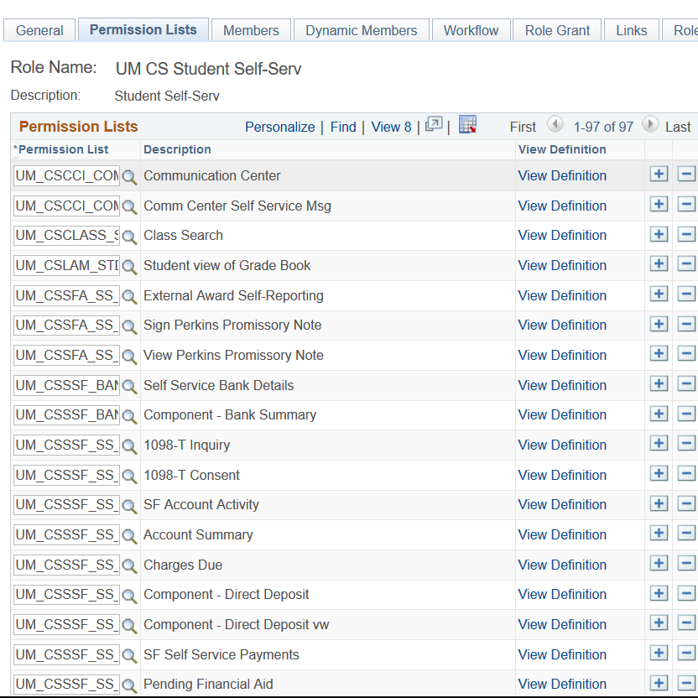
Student Self-Serv
Notes:
Example of Student Self-Service role. The permissions lists in this role were created using our bolt-on security tool. It provides the permission list name and usually only includes one or two pages per permission list.

Slide 14
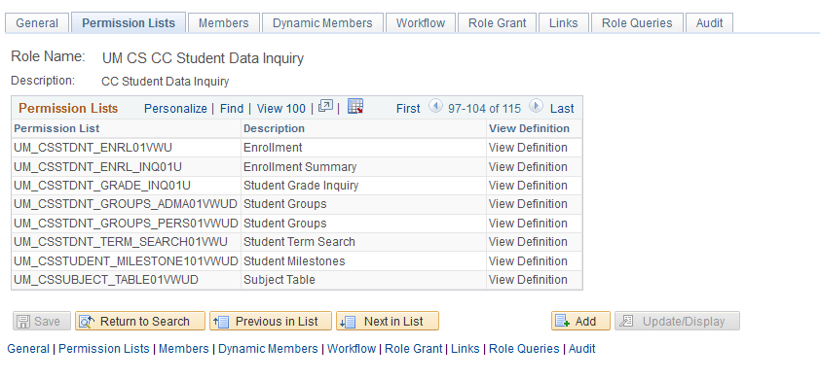
CC Student Data Inquiry
Notes:
Student Data Inquiry is the role that we require all users accessing CS PeopleSoft to be trained on. This is used as our foundation to build other access. SDI is a view role. Many of the other roles are designed as transaction (update) roles. The last letters on the permission list indicate what authorized actions can be performed with that permission list.

Slide 15
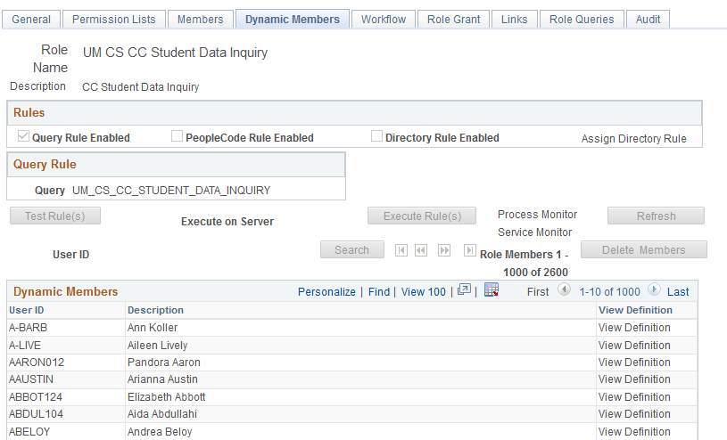
Roles, cont.
Roles are associated with queries > dynamic role assignment
Notes:
While dynamic role assigning has been around a long time UM did not invest in this technology until we upgraded to 9.0. Now every role is assigned via dynamic role queries.

Slide 16
Security Tool
New with 9.0
Vendor bolt-on to PeopleSoft
Delivers full security functionality
Creates permission lists and roles
Builds security groups
Provides pages to help in validating access and answering security questions
Notes:
This is the tool that allows us to build roles and security groups, dynamically assign access to users. This tool designs permission lists when we build a role thus making this also an automated process. If any of you are familiar with native peoplesoft design we rarely design a permission list or role outside of this builder tool. Exception is some of the query roles we have built.

Slide 17
Security Groups
Definition: collection of one or more roles related to a business process
Benefit: ease of granting access to multiple roles
Can assign users to a security group via the Security Tool
Are built in DEV; need to be migrated via PFM
Notes:
Security groups allow us to define the collection using business process names or familiar phases making it simpler to describe. If you remember native PS we had limited characters to describe permission lists and roles making it difficult sometimes to communicate with PAR and users. Security groups are a mixture of business process specific or function specific (example if SF Collector vs 3C User).

Slide 18
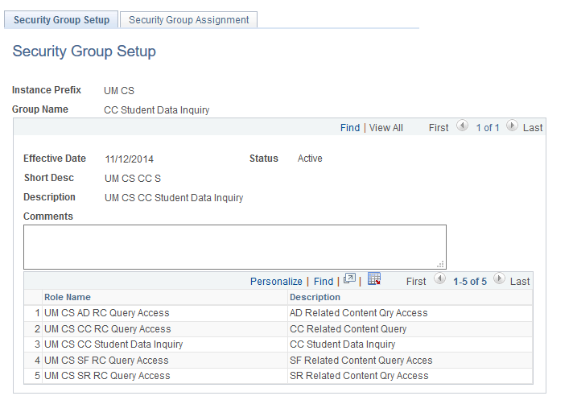
Security Groups
Example: Student Data Inquiry
Notes:
This example of security group is the combination of student data inquiry (role staff are trained on) and the role with query tree we use to convey related content. Yes, we have a query tree specifically addressing related content if the content is using a query. What this design contains are the tables used by each module for related content. If the user does not have the page you build related content on then it is just in their background not really accessible. If they do have the page then related content can be displayed. This flexible design allows us to not track each user and related content.

Slide 19
Profiles
Definition: collection of identifiable access needs related to business processes or groups
Consistent application access for staff within a unit
Supervisor can review staff access
Consists of PeopleSoft security groups as well as other systems (for example, Perceptive Content, ITGC, SIA, APAS)
Training and approvals still apply
Notes:
Speaker: continuing with the nesting dolls image, Profiles are the last building block of our security framework. Actually, this is a PAR (Provisioning and Requests) project to identify collections of identifiable access needs for a group. The intent here is to bundle access needs, so that a group doesn’t need to fill out multiple ARF’s. As an example, the security team met with the lead for Academic Advisement Module to to discuss her group’s profile needs - not only what PeopleSoft access was needed, but also for systems such as Image Now, Quality Center and ITGC. Once the profile is created and approved by the business lead we send the information to provisioning to incorporate in the request process. We provide documentation back to the lead to confirm the access and present information on how to request the access. Why? One of the biggest question from our unit is how do I request access how do I know what my new worker needs verse my experienced staff that may have additional access by virtue of being around a longer time.

Slide 20
Row Level Security
Notes:
Add all four dolls in color

Slide 21
Row Level Security
Definition: defines an action on a page
Example: Institution
By User ID or by Permission List
“I can give you access to a page, but without
ROW LEVEL SECURITY
you can’t do anything on it!”
Notes:
Speaker: two level security system, allows you to make some access more unique for an individual

Slide 22
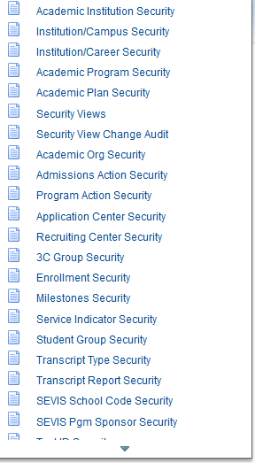
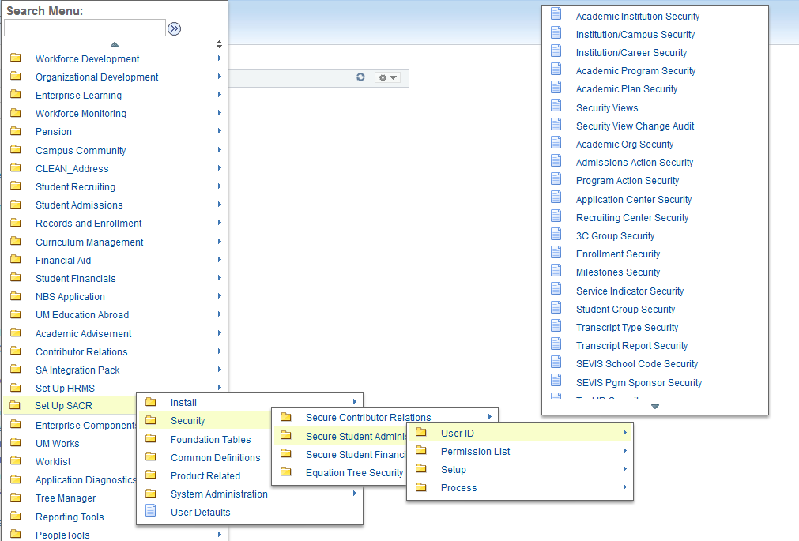
Row Level Security
Based on User ID
Notes:
Example of drilling down to row level security for the Academic Institution; ASR BA’s have access to these pages to facilitate their work with system campuses; PAR does the initial setup based on the ARF, but only does what someone asks them; BA can troubleshoot using these pages

Slide 23
Institution Set
All UM students need to have this value
Custom Process updates when student is granted access to self-service
Table: OPR_DEF_TBL_CS
Removed if student goes into collections.
Notes:
Allows students to access the financial tab inside of Student Services Center. They can see their bill and hit the button ‘pay my bill’.

Slide 24
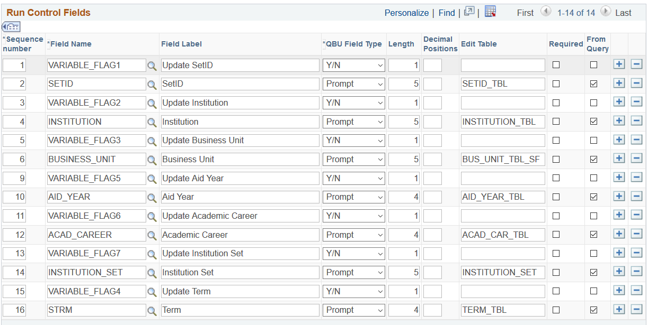
Values from Table

Slide 25
Where to check for value
Populate:
SetUp SACR > Security > Secure Student Financials > User ID >
Institution Set
One value used = UMN
Notes:
If there are problems reported BA’s and one stop counselors can navigate to this page and review that the student has the appropriate Institution Set. Again, reminding that the value is removed if the student goes into collections.

Slide 26
Remove Institution Set
If Student is in collections, Institution Set is removed - halting access to self-service account info
Requires Student to work with Collectors to set up payment plan
Remove Institution Set by Equation Engine

Slide 27
Equation To Remove UMN
UPDATE PS_OPR_DEF_TBL_CS A
SET A.ISET_OVRD = ' ',
A.INSTITUTION_SET = ' '
WHERE EXISTS
(SELECT 1
FROM PS_OPRDEFN2 B
WHERE ( B.OPRID = A.OPRID
AND EXISTS (SELECT 'X'
FROM PS_SRVC_IND_DATA C, PS_SERVICE_IMPACT D
WHERE D.INSTITUTION = C.INSTITUTION
AND D.SRVC_IND_CD = C.SRVC_IND_CD
AND D.EFFDT =
(SELECT MAX(D_ED.EFFDT) FROM PS_SERVICE_IMPACT D_ED
WHERE D.INSTITUTION = D_ED.INSTITUTION
AND D.SRVC_IND_CD = D_ED.SRVC_IND_CD
AND D_ED.EFFDT <= SYSDATE)
AND D.SERVICE_IMPACT = 'SFACT'
AND C.EMPLID = B.EMPLID) ) )

Slide 28
Acad Org Assignment for Instructors
All Instructors need to have Acad Org assigned to access class data
Run a Query to identify teaching staff without Acad Org assignment, based on PS_CLASS_TBL and PS_CLASS_INSTR
Notes:
We are a multi-institution University so, instructors need to be associated with their teaching campuses.

Slide 29
Query To Identify
Query Select to find missing SCRTY_TBL_ACAD values (for all institutions)
SELECT DISTINCT A.STRM, A.INSTITUTION, B.EMPLID, B.INSTR_ROLE, C.OPRID
FROM PS_CLASS_TBL A, PS_CLASS_INSTR B, PSOPRDEFN C
WHERE ( A.CRSE_ID = B.CRSE_ID
AND A.CRSE_OFFER_NBR = B.CRSE_OFFER_NBR
AND A.STRM = B.STRM
AND A.SESSION_CODE = B.SESSION_CODE
AND A.CLASS_SECTION = B.CLASS_SECTION
AND C.EMPLID = B.EMPLID
AND A.STRM >= ‘1173’
AND B.EMPLID <>’’
AND NOT EXISTS (SELECT DISTINCT ‘X’
FROM PS_SCRTY_TBL_ACAD D
WHERE D.OPRID = C.OPRID
AND ( D.ACAD_ORG = A.INSTITUTION
OR D.ACAD_ORG , ‘U’
OR D.ACAD_ORG = ‘UOFMN’)))
ORDER BY 2, 3
Equation Engine logic

Slide 30
Equation to Update
Example: - Equations are un for each Campus with unique values
Equation Engine logic for UMNDL insert
INSERT INTO PS_SCRTY_TBL_ACAD
SELECT DISTINCT C.OPRID, ‘UMNDL’,’Y’, TO_DATE(‘10-06- 2015’; ‘MM-DD- YYYY’), 55555549, 492063433
FROM PS_CLASS_TBL A, PS_CLASS_INSTR B, PSOPRDEFN C
WHERE A.CRSE_ID = B.CRSE_ID
AND A.CRSE_OFFER_NBR = B.CRSE_OFFER_NBR
AND A.STRM = B.STRM
AND A.SESSION_CODE = B.SESSION_CODE
AND A.CLASS_SECTION = B.CLASS_SECTION
AND C.EMPLID = B.EMPLID
AND A.STRM >= ‘Term’,;
AND B.EMPLID <>””
AND A.INSTITUTION = ‘UMNDL’
AND NOT EXISTS (SELECT ‘X’
FROM PS_SCRTY_TBL_ACAD D
WHERE D.OPRID = C.OPRID
AND (D.ACAD_ORG = ‘UMNDL’
OR D.ACAD_ORG <’U’))
Notes:
We don’t run anything to remove this access. Teaching staff need to continue to be able to access class information until their internet id is no longer valid in the system.

Slide 31
Instructor Access
Grade Roster Access provided by Enrollment Access ID
Primary Instructor
Secondary Instructor
Teaching Assistant
Proxy
Levels of access to grade roster
Approve
Grade
Blank
Notes:
We designed this access in 8.9 but, it was revised and upgrade when we went to 9.0. Grade roster access is driven by enrollment access ids.
High level process:
Instructor assigned by deparmental schedulers and central staff. Added onto the PS_class_instr tbl.
Instructor assigned a specific role.
Instructor assigned a specific grade roster access value.
Process runs 4 times a data and based on a specific term(s), looks for any emplie id in the ps_class_instr table that doesn’t have an enrollment access assigned. Then the process assigned enrollment access id based on the values.

Slide 32
Queries to Validate
Query by Emplid Grade Roster Access
SELECT A.CRSE_ID, A.CRSE_OFFER_NBR, A.STRM, A.SESSION_CODE, A.CLASS_SECTION, A.CLASS_MTG_NBR, A.INSTR_ASSIGN_SEQ, A.EMPLID, A.INSTR_ROLE, A.GRADE_RSTR_ACCESS, B.SESSION_CODE, B.INSTITUTION, B.SUBJECT, B.CATALOG_NBR
FROM PS_CLASS_INSTR A, PS_CLASS_TBL B
WHERE ( A.EMPLID = :1
AND A.CRSE_ID = B.CRSE_ID
AND A.CRSE_OFFER_NBR = B.CRSE_OFFER_NBR
AND A.STRM = B.STRM
AND A.SESSION_CODE = B.SESSION_CODE
AND A.CLASS_SECTION = B.CLASS_SECTION)
Notes:
Provides course ID, term, sessions, the role the staff member has, what grade roster access and the subjects. We have Specific instructors roles that must be attached to staff members to

Slide 33
Queries
Verify Instructor’s Job Status
SELECT A.EMPLID, TO_CHAR(A.EFFDT,'YYYY-MM-DD'), A.EFFSEQ, A.DEPTID, A.JOBCODE, A.EMPL_STATUS, A.HR_STATUS, A.ACTION, A.LOCATION, TO_CHAR(SYSDATE,'YYYY-MM-DD'), TO_CHAR(SYSDATE,'YYYY-MM-DD')
FROM PS_CURRENT_JOB A, PS_EMPLMT_SRCH_QRY A1
WHERE ( A.EMPLID = A1.EMPLID
AND A.EMPL_RCD = A1.EMPL_RCD
AND A1.OPRID = 'XXXX’'
AND ( A.EFFDT =
(SELECT MAX(A_ED.EFFDT) FROM PS_CURRENT_JOB A_ED
WHERE A.EMPLID = A_ED.EMPLID
AND A.EMPL_RCD = A_ED.EMPL_RCD
AND A_ED.EFFDT <= SYSDATE)
AND A.EFFSEQ =
(SELECT MAX(A_ES.EFFSEQ) FROM PS_CURRENT_JOB A_ES
WHERE A.EMPLID = A_ES.EMPLID
AND A.EMPL_RCD = A_ES.EMPL_RCD
AND A.EFFDT = A_ES.EFFDT)
AND A.EMPLID = :4 ))
Notes:
Provides confirmation and department information about staff involved in the grade process.

Slide 34
Row Level Security
Service Indicators/Student Groups
Notes:
Speaker: Last but not least I wanted to mention the mods we made to service indicator and student groups. We added the ‘all access’ button so BA’s could easily be associated with all of these values.

Slide 35
Multiple Layers of Security
Notes:
Speaker point: everyone has multiple ones such as on the system campuses where staff wear multiple hats

Slide 36
Goals for the Security Team
Process
Review current access levels
Compare users within a unit
Meet with supervisor to discuss/confirm access
Contact PAR with access revisions and ARF updates
Expected Goal
Review all access areas/administrative users
Create profiles to assist supervisors in requesting access
Notes:
Speaker:As I stated this presentation was also for our BA’s tp enhance their understanding of security and know that there are security go to people within our unit. these are the goals we are working toward. This facilitates some succession planning develops broader security knowledge within ASR.

