Slide 1
Peopletools 8.55 – utilising the new navigation
SESSION 36008
Thursday, November 10th, 2016

Slide 2
presenters
Michelle Nunn
Ky Jones
Senior Business Analyst, Projects
Federation University
mc.nunn@federation.edu.au
Consultant
Federation University
ky.jones@federation.edu.au

Slide 3
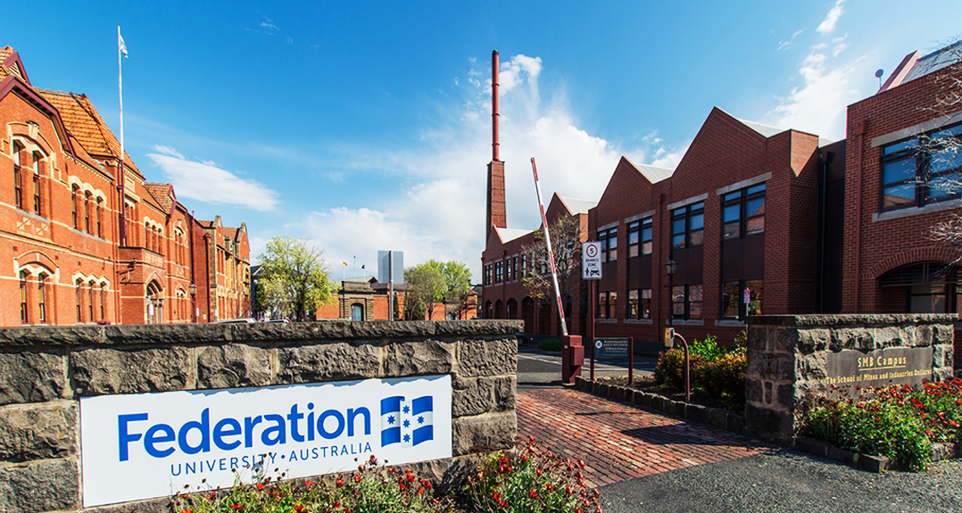
Federation university australia
We offer access to higher education, TAFE, secondary schooling and research opportunities. With campuses in Ballarat, Gippsland and the Wimmera, our programs are also delivered online and via a range of partner institutes across Australia and around the globe. We have approx. 23,000 International and domestic students.

Slide 4
Federation university & ORACLE
PeopleTools: In the process of upgrading from 8.53 to 8.55
Bundle: 34
Version: Due to upgrade from 9.0 to 9.2 in 2017

Slide 5
SECTION 1 What are our plans?
9.2 upgrade
PeopleTools 8.55

Slide 6
What are our plans?
1
3
Currently on version 9.0
Upgrade to version 9.2 in 2017
2
Upgrade to PeopleTools 8.55 in November 2016
Campus Solutions
Finance
Contributor Relations

Slide 7
Overall Peopletools upgrade
Standard project structure
7 ½ month timeframe
Removal of Crystal functionality
1 x Contributor Relations delivered crystal report (Grads to Alumni)
1 x Campus Solutions customised crystal report (Enrolment Verification)
100’s x Financials delivered crystal reports (Over 70+ in utilisation)
PeopleSoft Financials de-scoped

Slide 8
Issues logged with oracle
External URL generated incorrectly from Tile Wizard
Unable to save Tile as a favourite by default
Unable to display image/icon if Tile type = Free Text
Warning Messages cannot be cleared in Google Chrome
Home/Back button selection does not prompt Save

Slide 9
SECTION 2 why fluid?
Our options

Slide 10
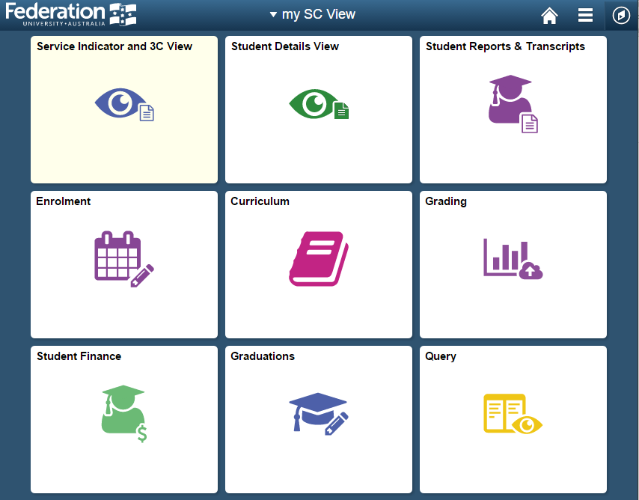
Why fluid navigation?
Not mandatory – can turn on ‘Classic Home’
Business were excited
Eager to create their “own” navigation interpretation
Easy introduction to fluid
Tile Wizard and Configuration is a Functional effort

Slide 11
SECTION 3 homepage design
How did we design our homepages?

Slide 12
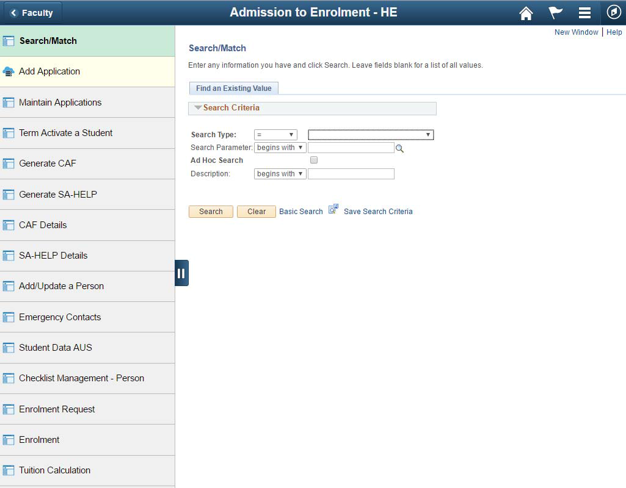
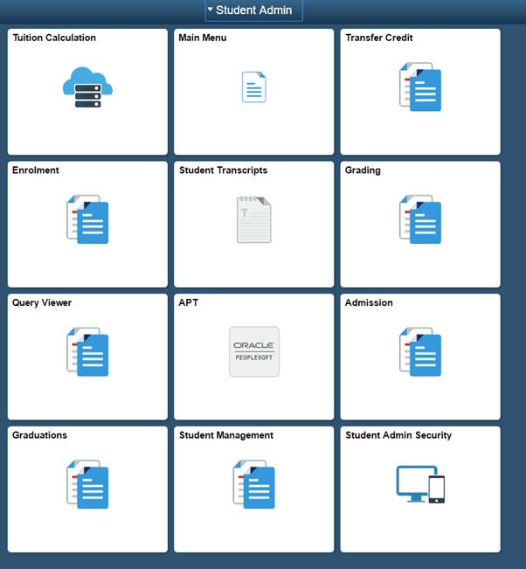
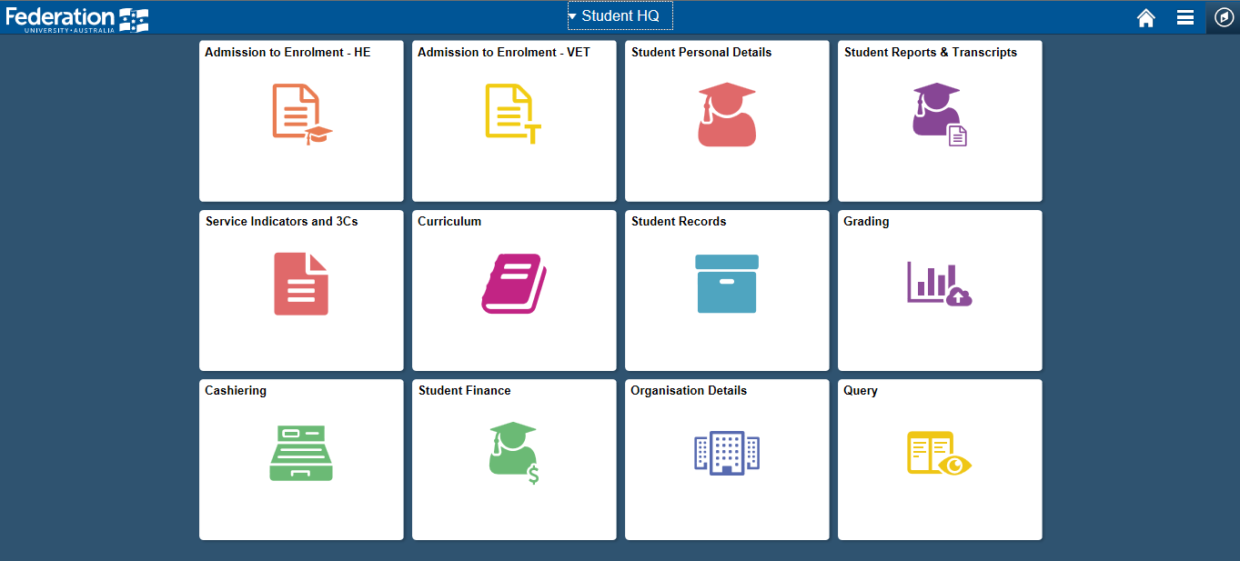
DESIGN
Module based vs Business Process based

Slide 13
FINAL homepages
BUSINESS AREA | HOMEPAGE NAME
Admission, Retention and Success | Admissions
Alumni | Alumni
Cashier | Cashier
Faculty Administration Staff | Faculty
Foundation | Foundation
Graduations | Graduations
Research | HDR Candidate Management
Partner Providers | Partner Provider
CUP | CUP
Planning | Planning
Program Management and Compliance | Program Management
BUSINESS AREA | HOMEPAGE NAME
Scheduling - Timetabling and Exams | Scheduling
Scholarships | Scholarships
Student Finance | Student Finance
Access Administration and Student Research and Solutions Team (ITS) | System Support
Student Administration | Student HQ
Academic Staff Higher Education | My Academic HE
Academic Staff TAFE | My Academic VET
View Only Staff | My SC View
Alumni | My Alumni
Student | My Student Centre

Slide 14
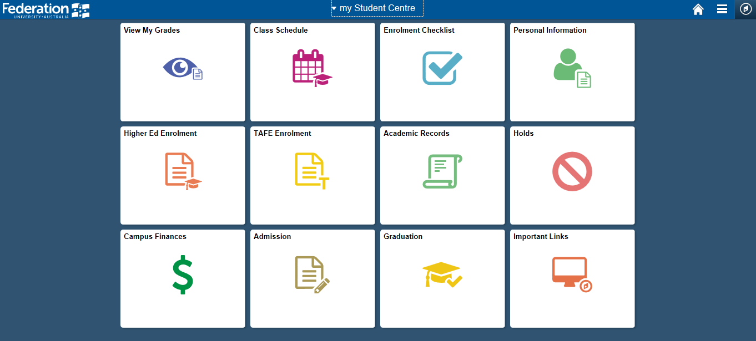
Custom tile

Slide 15
SECTION 4 branding
Re-branding navigation bar and login page

Slide 16
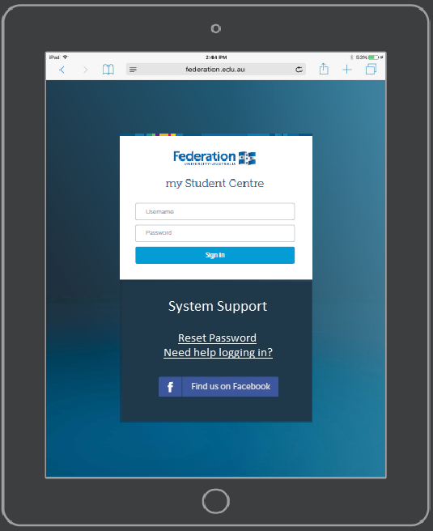
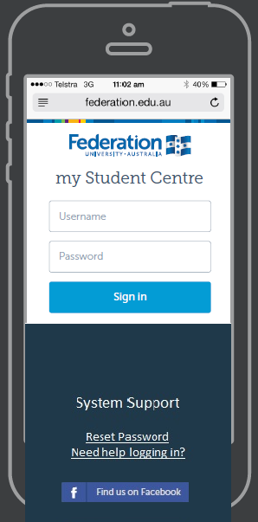
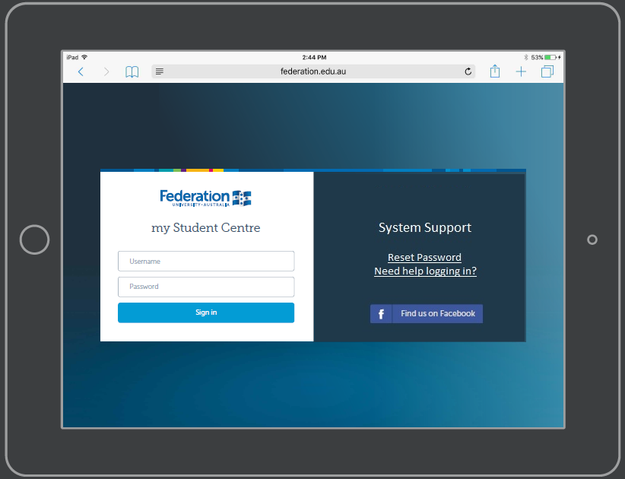
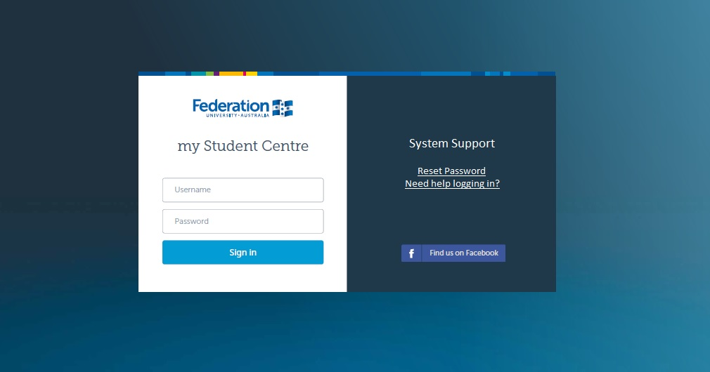
LOGIN pages

Slide 17
Banner branding

Slide 18
SECTION 5 Security
Restricting homepage personalisation and assigning homepages

Slide 19
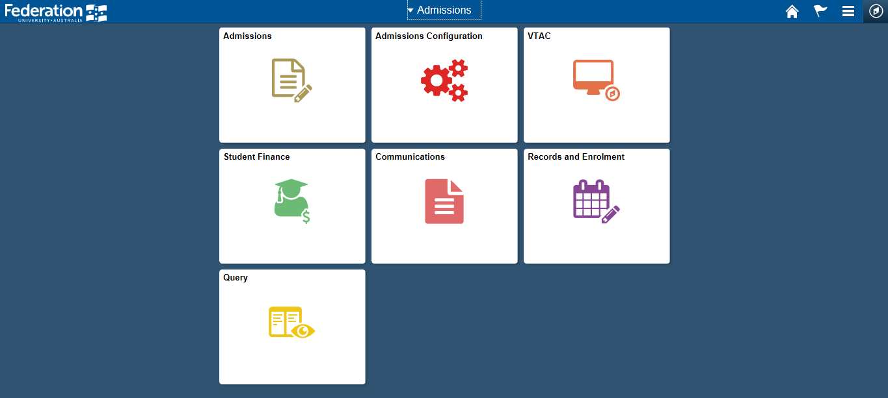
security
User: JBROWN Business Title: Admissions Coordinator
Security Role: UB HP Admissions

Slide 20
CONCLUSION
Areas of concern for users
Lack of breadcrumb trails for navigation
New Fluid pages do not contain the ‘New Window’ feature
Go Live
Scheduled for 30 November

Slide 21
presenters
Michelle Nunn
Ky Jones
Senior Business Analyst, Projects
Federation University
mc.nunn@federation.edu.au
Consultant
Federation University
ky.jones@federation.edu.au
all Alliance presentations will be available for download from the Conference Site

Slide 22
THANK YOU!

