Slide 1
Merging the Old and the New Cloud Deployment and Accelerating Your 9.2 Upgrade
SESSION #5037
Monday, November 6th
1:30 – 2:30pm

Slide 2
presenter
Chris Voutsis
Team Lead, Enterprise Application Services
University of Waterloo
cvoutsis@uwaterloo.ca
Chris Voutsis has over 15 years of experience in PeopleSoft applications, joining as a developer for the University of Waterloo's Campus Solutions implementation in 2001. He has development experience in both Campus Solutions and Human Capital Management Oracle PeopleSoft applications, as well as Oracle's User Productivity Kit and Sun Identity Management software. Today he serves as a PeopleSoft Applications Administrator, sharing technical responsibility for all of the University of Waterloo's Oracle PeopleSoft environments.

Slide 3
University of Waterloo
31,380 undergraduate, 5,290 graduate students
17% undergraduate and 37% graduate students are international
1,000-acre main campus in Waterloo, 100+ buildings

Slide 4
Waterloo & ORACLE
CS 9.0/8.53
HCM 9.1/8.55

Slide 5
Campus Solutions DEtail
Project initiated in 1997, implementation completed in 2001.
Last major “big splashes”:
PT - 2013
Bundles - 2014
Current:
- CS Bundle 33 & HR Bundle 19 – not split
- PeopleTools 8.53.28
Post-Upgrade:
- CS Update Image 5 (approx. 10 bundles)
- PeopleTools 8.55.19 (October CPU)

Slide 6
Agenda
Starting with the upgrade process, we will look at Waterloo’s implementation and how we were able to accelerate our 9.2 upgrade by leveraging new technologies as well as tried and tested techniques.
BACKGROUND A quick look at the traditional upgrade method
WATERLOO AND 9.2 Waterloo’s established implementation meets Deployment Packages
BRINGING IN THE NEW Of course we had a few stumbles…
ACCELERATING YOUR UPGRADE How Waterloo used compare reports to save on work

Slide 7
1. BACKGROUND
A quick look at the traditional upgrade method

Slide 8
UpgradeS: A Quick Look
Install New Release Demo
Take a copy of Production
Perform Initial Pass
Test and apply fixes
Take a new copy of Production
Perform Move to Production
Test and apply fixes
Take a new copy of Production
…

Slide 9
Waterloo’s Environments
15+ environments
Production support stream (Dev, Test, PreProd)
Major projects stream (Dev, Test, PreProd)
Tuition Calculation support
Integration development and support
Government Count Date copies for Ontario ministries
Major Competing Projects
Unable to truly freeze until very late in the iterations (“slushy freeze”)
Multi-Step Upgrade (to PUM 5)
Certified upgrade path is to PUM 3
MTP source is static PUM 3 image after which tools and PUM 5 are applied

Slide 10
UpgradeS REVISITED: Waterloo
ONE UPGRADE PASS
Upgrade Tools (8.55.10)
Upgrade PUM 3
Freeze MTP source here
Update Tools (8.55.14)
Update to PUM 5
Update Tools (8.55.19)

Slide 11
Upgrades: Another Quick Look
Upgrade the Middleware
Process Scheduler Servers
Application Servers
Web Servers
Strategies to reduce work:
Shared disk
Centralized installation with distribution
Scripting and configuration management tools (CFEngine, Puppet, SaltStack, etc.)

Slide 12
Waterloo’s architecture
Many servers in Production
6-8 web servers load balanced
6-8 application servers (1:1 to web)
Distinct Query and IB hosts
Distinct WebLogic administration console
Distinct file transfer hosts
Failover configuration for databases and accompanying process schedulers
Non-Production
2 web servers load balanced
Shared App Server
Distinct-but-shared IB host
Distinct-but-shared process scheduler (no failover)

Slide 13
Waterloo’s implementation
BUILD ONCE, DEPLOY MANY
Compartmentalized components:
Config Home
App Home
PeopleTools (PS Home)
PIA
Binaries
Java, Cobol, Tuxedo, WebLogic, Verity, Elastic
Advantages
Replace individual components
Distribute only what is needed, only where it is needed
e.g. a Web Server needs PIA, WebLogic, Java

Slide 14
2. Waterloo and 9.2
Waterloo’s established implementation meets Deployment Packages

Slide 15
From 8.53 to 8.55
A SHORT LIST OF THINGS…
64 bit on the client
Mobile Application Framework and Fluid pages
Materialized Views
PSADMIN enhancements
PUM Dashboard and Change Assistant
WLS 10.3 → 12
Tuxedo 11 → 12
Elastic Search (we skipped SES)
Oh, and Deployment Packages
Reminder: Our last major application upgrade was in 2014 (CS 9.0 B33).

Slide 16
IT CAN BE HARD TO find the time
ESTABLISHED = IMMOVABLE?
Technical debt
Solaris to Oracle Linux transition
Disaster recovery implementation
Manual administrative procedures
“Classic” method of building (or patching) a demo environment makes it harder to present new features in a sandbox
Down-timing – many peak periods
Many modules, many peaks:
Tuition calculation
Course registration
Marks publication
Leads to less than timely application
External system considerations

Slide 17
DEPLOYMENT PACKAGES into the mix
✓ A pre-packaged environment
Rapidly deploy source environments and demo environments
✓ Highly configurable (Puppet and YAML)
Can be deployed in a compartmentalized manner
But for Waterloo, it may be “re-inventing the wheel”
We already have a methodology for updating many, discrete-function servers in a single pass from a single source
What we don’t have is single package for all our binaries
PUM is also new (for us!)
At this point, however PUM is a “select all”. We have yet to get selective about updates.
The burden of down-timing and testing remains

Slide 18
3. Bringing in the new
Of course we had a few stumbles…

Slide 19
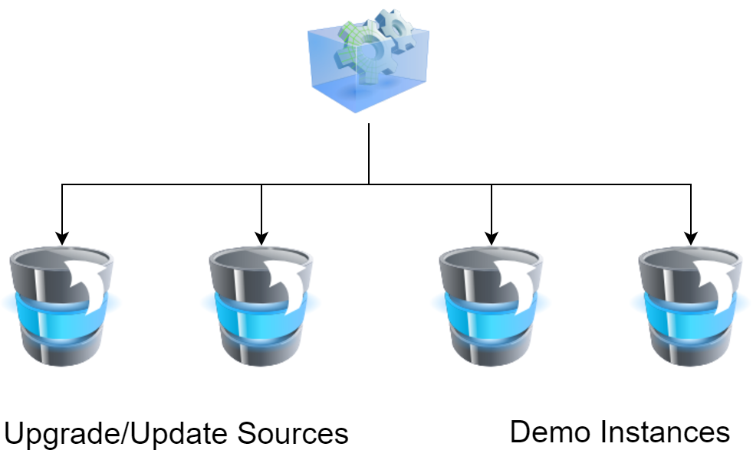
Adopting deployment packages
Use custom YAML to mimic our existing compartmentalization
Distribute from deployment host to build master host
Quickly establish update and demo instances for functionals
Co-opt automation into our build master where advantageous to do so: silent installs, wlst

Slide 20
GOTCHAS: Deployment Packages
Deployment
Versions of WebLogic (12.1.3), Tuxedo and Java are not necessarily current
SR 3-15438009321
“Tuxedo, WebLogic and Java do not get updated as part of the DPK patching efforts. They must all be downloaded and applied manually. See E-INSTALL Can Tuxedo And WL Patching Be Done Using DPK's. ( Doc ID 2238263.1 ).”
General
Upgrade source is always Unicode - need to be wary of encoding
Non-Unicode environments (like Waterloo) must create the upgrade source demo using classic method
MOS Doc ID 2104833.1
This may change in 8.56
WebLogic silent install seems to reset domain level configuration each time
Not present on interactive install – rewrites weblogic.xml and setenv.sh
Always make your domain-level modifications at the end if you are creating multiple sites
Different tolerance of special characters between interactive and silent modes
Changes to deployment targets between WLS 10.3 and WLS 12
If you configure deployments, in WLS 12 you must configure a deployment target for “/”.

Slide 21
4. ACCELERATING YOUR UPGRADE
How Waterloo used compare reports to save on work

Slide 22
Mini-agenda
Manual Stop for Review
The “UPGCUST” Project
Accelerating our analysis of UPGCUST
Leveraging Demo Databases
Leveraging Compares with SQL
Benefits Realized
By the numbers
By the hours
Gotchas: Application Upgrade
Final Experiential Lessons

Slide 23
Manual stop for review
WE’VE COVERED
Waterloo
Our Infrastructure
Some growing pains of DPK
Now let’s look at the database upgrade process.
Very early in an initial pass, there is a “manual stop” step…
Change Assistant asks us to “Review the New Release Changes” – this brings us to the UPGCUST project.

Slide 24
The UPGCUST Project
CREATED DURING INITIAL PASS
UPGCUST is a PeopleSoft project that contains all your institution’s customizations.
In other words, everything in your environment that was updated by somebody other than “PPLSOFT”.
It’s a chance to get your customizations into the upgrade source demo.
Anything you don’t take you need to manually review and retrofit*.
Note:
Resource intensive to review and retrofit
The “Move to Production” takes everything – anything you miss, you must fix in the next iteration
How resource intensive?

Slide 25
REAPPLYING CUSTOMIZATIONS
UPGCUST initial count:
40923 objects

Slide 26
Accelerating our Analysis
FILTERING THE NOISE
Some are Waterloo or GreyHeller bolt-ons
Some are customizations to delivered objects that haven’t changed in the application upgrade
Some are legitimate cases to review and retrofit

Slide 27
LEVERAGING DEMO DATABASES
WHAT WE USED
Pre-upgrade demo (CS 9.0 B33)
Post-upgrade demo (CS 9.2 PUM 3)
Target environment
WHAT WE DID
Compare demo-to-demo
Export PSPROJECTDEFN, PSPROJECTITEM
Import PSPROJECTDEFN, PSPROJECTITEM into our target environment
Write SQL to select from the demo-to-demo project tables and selectively flag UPGCUST project items that are valid for upgrade
Partially automate the “Reviewing New Release Changes” step

Slide 28
LEVERAGING COMPARES with SQL
LEVERAGING COMPARES WITH SQL
The logic:
Is it in the demo-to-demo compares?
If not, it hasn’t been re-delivered (or is 100% custom) so we can safely take the customization
If it is, is the last updated stamp of their change newer than the last updated stamp of our change?
If not, we customized it after they re-delivered it so we can safely take the customization
If it’s in the demo-to-demo compares with a newer last updated stamp…
No getting around it: we have to review and retrofit.

Slide 29
BENEFITS REALIZED – By the numbers
“Review and retrofit” final count:
251 objects

Slide 30
Benefits realized - By the hours
Having done the review, we engaged Oracle Consulting Canada to perform the reapplication.
Based on copies of our demo environments, our custom SQR’s and compare reports, they estimated 221 hours.
Their actual hours spent were ~ 150, approximately 60% of budget.

Slide 31
GOTCHAS: APPLICATION UPGRADE
False Positives in UPGCUST
Last modified by [Internal PeopleSoft users that are not PPLSOFT] cause false positives in UPGCUST
Missing Permission Lists
Glasgow and Waterloo have both noticed that custom Permission Lists appear to be missing custom Components and Pages post-upgrade. Even though both the permission lists and the items are custom, they appear to have been dropped.
Pre-upgrade to post-upgrade environments can be compared to find such occurrences (PSAUTHITEM table).
Type Control configuration
Glasgow and Waterloo have noticed that Type Control configuration table gets reset during the upgrade and custom configuration has to be manually reapplied. According to a report from Santa Clara university, this also occurs during maintenance application (e.g. PUM 6).
Navigation: Set Up SACR > Common Definitions > Self Service > Type Control
Navigation Tab configuration
Waterloo has noticed that Tab Navigation is reset during the upgrade.
Navigation: Set Up SACR > Common Definitions > Self Service > Navigation Tabs
Recurrences preventing future Run Dates on processes
Derby and Waterloo have noticed that Run Date is greyed when a Recurrence is selected
MOS ID: 2137395.1

Slide 32
Gotchas: Application Upgrade 2
Integration Broker XML message configuration
Waterloo has noticed that custom message configuration appears to be garbled post-upgrade.
Navigation: PeopleTools > Integration Broker > Integration Setup > Messages
Default Primitive is set to (invalid value)
Target namespace prefix is cleared
Element prefix is cleared
Node type is set to attribute
No explanation for how this came about -- yet.

Slide 33
Final Experiential Lessons
THE HUMAN FACTOR
We have benefitted from:
Complimentary skill sets
Sysadmin with developer skills
Project Manager with a background in systems
Testing coordinator with in-depth product and tools knowledge
Waterloo’s SEIF and outreach
Staff International Experience Fund
University of Glasgow, United Kingdom
University of Derby, United Kingdom
Strength of functional resources
strong grasp of both business and product
prioritizing the testing of core, critical elements that will be used shortly after go-live

Slide 34
presenters
Chris Voutsis
Team Lead, Enterprise Application Services
University of Waterloo
cvoutsis@uwaterloo.ca
all Alliance presentations will be available for download from the Conference Site

Slide 35
THANK YOU!

