Slide 1
Use of the Notification Framework
SESSION 5314
Nov 18, 2015

Slide 2
presenters
Jim Dijks
Functional Consultant
SaNS Expertise Centre
jim.dijks@sans-ec.nl
Jim has a background in teaching and consultancy and works since 2012 for the SaNS Expertise Centre

Slide 3
SaNS Expertise Centre
Shared PeopleSoft
Campus Solutions Maintenance and Development

Slide 4
What is SaNS?
SaNS: ‘Collaboration for a New SIS’
4 Universities in the Netherlands:
University of Amsterdam (Research Un.)
Hogeschool van Amsterdam (Un. Appl. R.)
University of Leiden (Research Un.)
University of Tilburg (Research Un.)
120.000 students
10.000 faculty users
1000 administrative users

Slide 5
Expertise Center
Joint effort of the 4 SaNS-Universities
Responsible for
Hosting of the Infrastructure & Technical Maintenance
Application Maintenance
Application Development and Customization
Servicedesk, support, testing, set up
12 FTE employees
Support (3), development (2), technical (2) and functional (3)
Hosting and technical maintenance outsourced to MCX

Slide 6
SaNS: Situation on Oracle
PeopleSoft Campus Solutions 9
Bundle #37
Modules in use:
Campus Community
Student Records
Academic Advisement
(Recruitment and) Admission
(Student Finance)
Student Self Service
Heavily customized application (NL Higher Ed): ‘CampusHO’
PeopleTools 8.54.13
Infrastructure and Database:
Oracle 11g
35 CS-environments (5 per SaNS-institution, 10 for EC, 5 POC)
50 Physical servers, no VM

Slide 7
Overview
Current situation
Real-time Notifications
Batch Notifications
Pros and Cons
Bonus material

Slide 8
Notification framework

Slide 9
NTF
Notifications:
Email
SMS
Alert
Worklist
Push Notifications
Announcements
Real-time or batch
Integration Broker
No Integration with COMGEN

Slide 10
Current Situation

Slide 11
Comunication Customization
Petition Requests
Enrollment Requests
Results

Slide 12
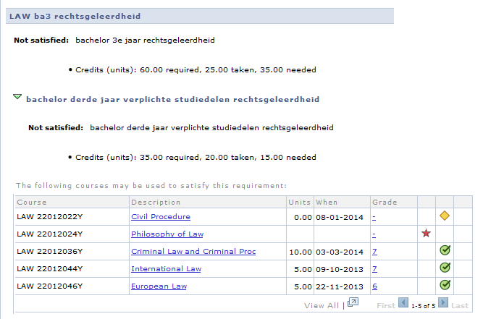
My academics

Slide 13
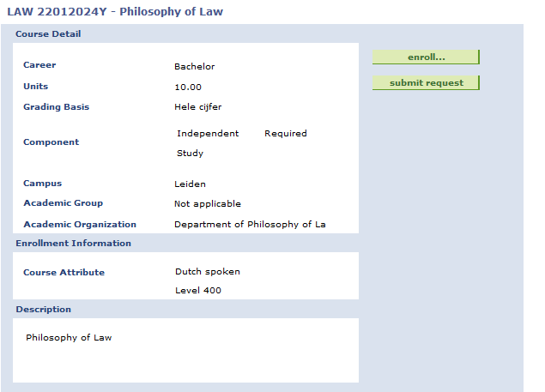
Petition request

Slide 14
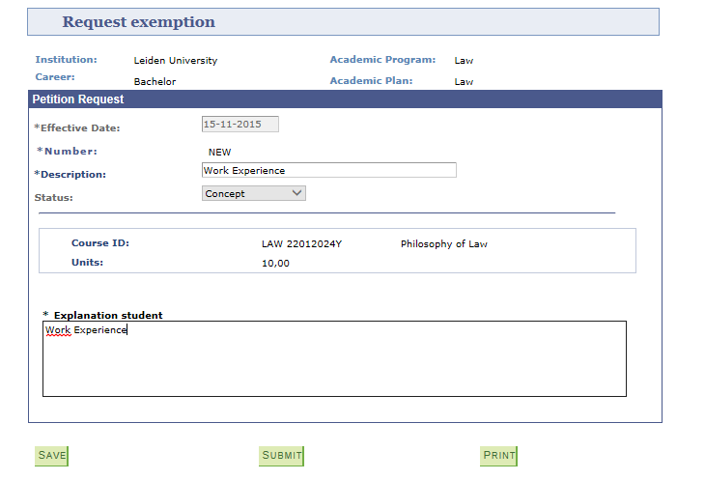
Student exceptions

Slide 15
E-mail

Slide 16
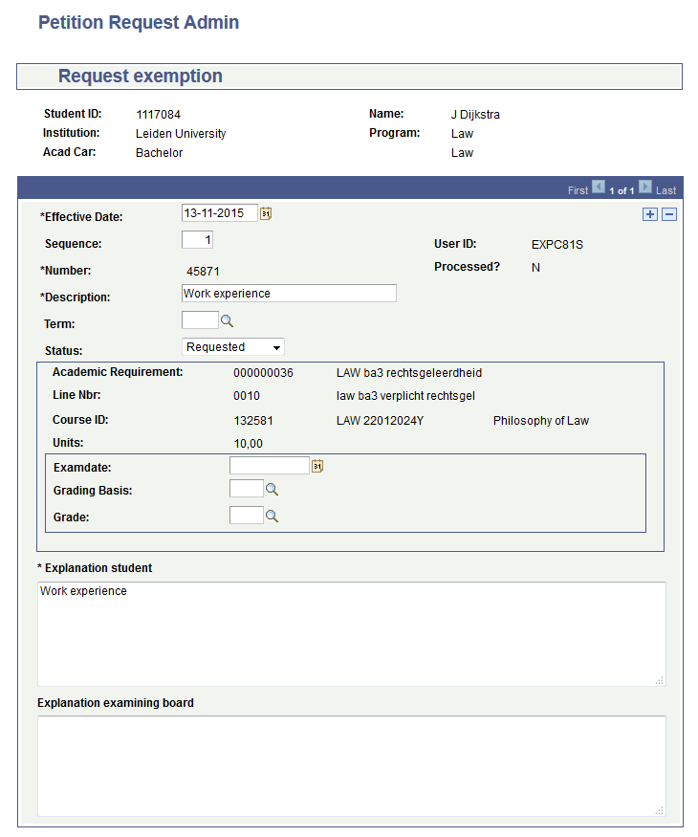
Petition request admin

Slide 17
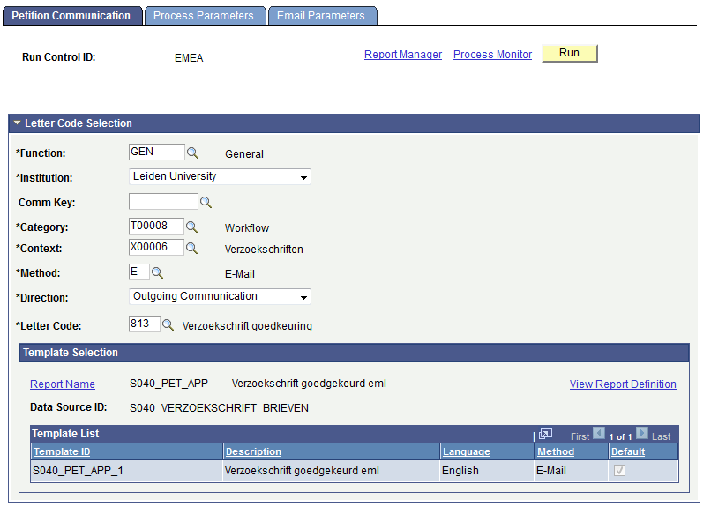
Petition communication

Slide 18
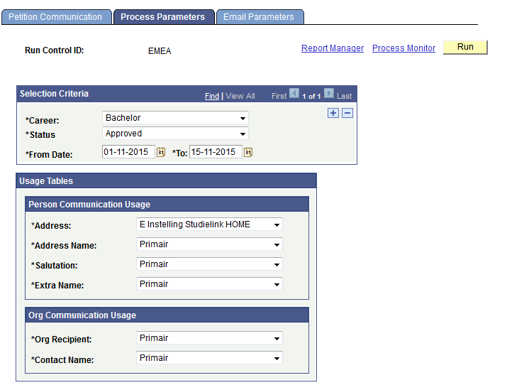
Process Parameters

Slide 19
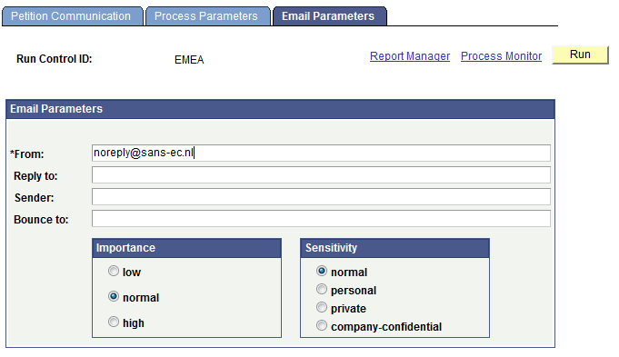
Email parameters

Slide 20
Notification framework

Slide 21
Notifications
Real Time
Petition Request (Student Self Service)
Enrollment Request (Student Self Service)
Batch
Petition Request (Admin)
Enrollment Request (Admin)
Grade Rosters (Not Approved)

Slide 22
notification framework
Generic Template
Notification
Notification Consumer
Event
Service Operation
Service
Queue

Slide 23
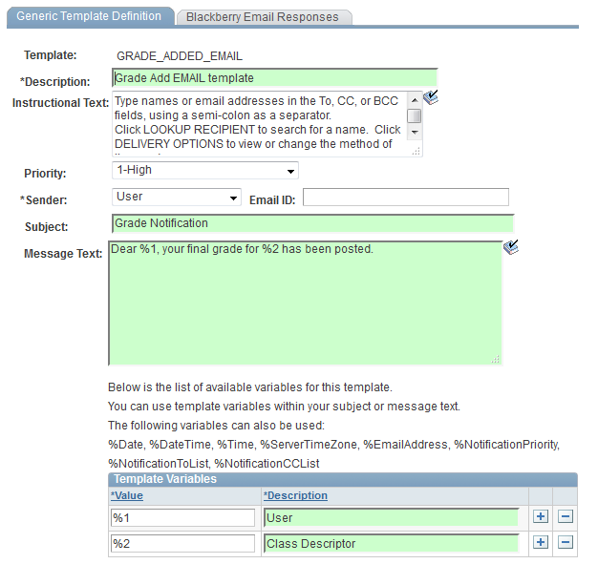
Generic templates PeopleTools > workflow> notifications> generic templates

Slide 24
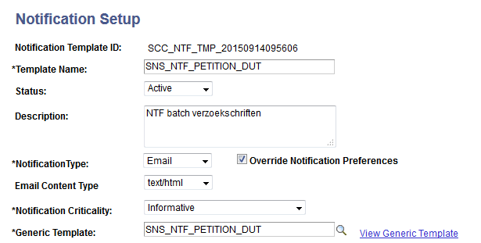
Notification setup Set up sacr> system administration > utilities > notifications > notifications setup

Slide 25
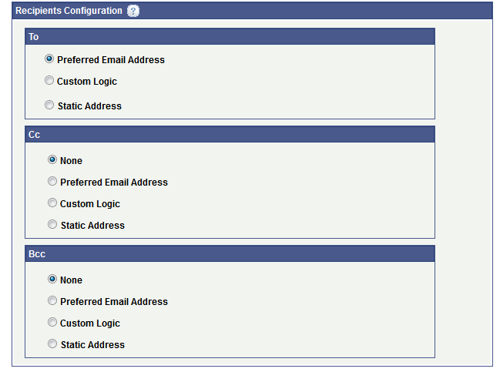
Recipients configuration

Slide 26
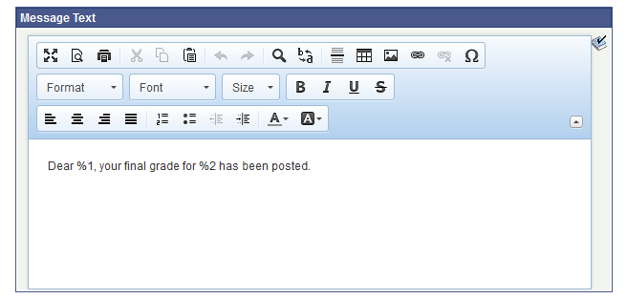
Message text

Slide 27
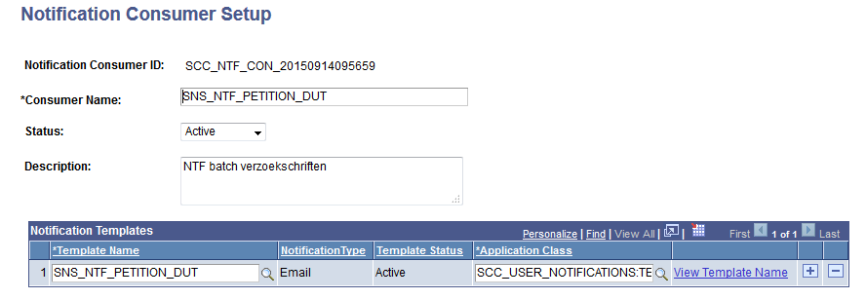
Notification consumer setup Set up sacr> system administration > utilities > notifications > notifications consumer setup

Slide 28
Application Class
Bericht bestaat?
Nee
Ja
Geen bericht
Statuswijziging

Slide 29
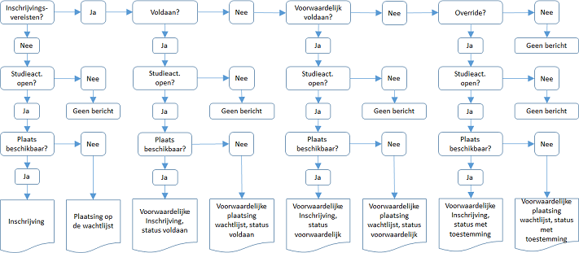
Application Class

Slide 30
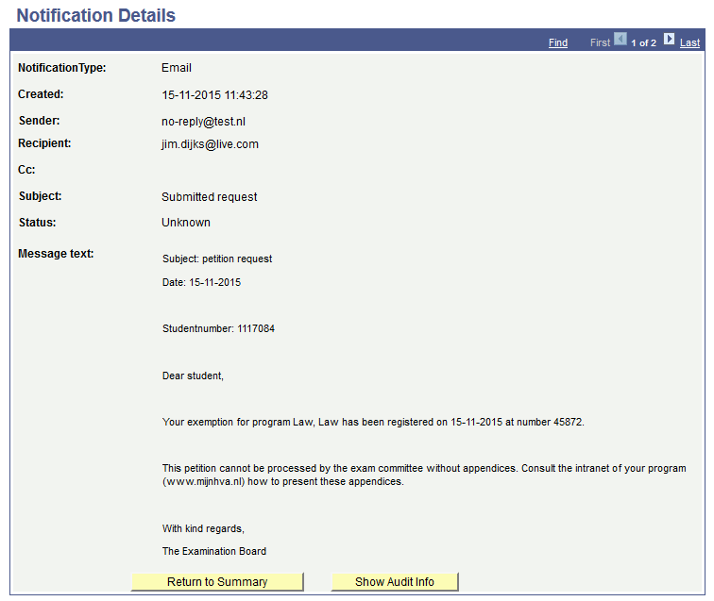
email

Slide 31
Notification framework
Batch Notifications

Slide 32
Notifications
Real Time
Petition Request (Student Self Service)
Enrollment Request (Student Self Service)
Batch
Petition Request (Admin)
Enrollment Request (Admin)
Grade Rosters not Approved

Slide 33
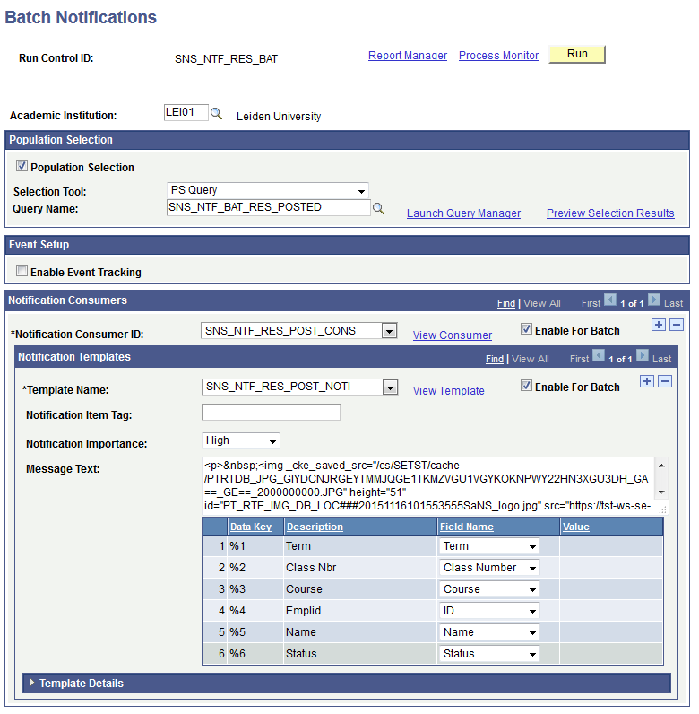
Batch notifications

Slide 34
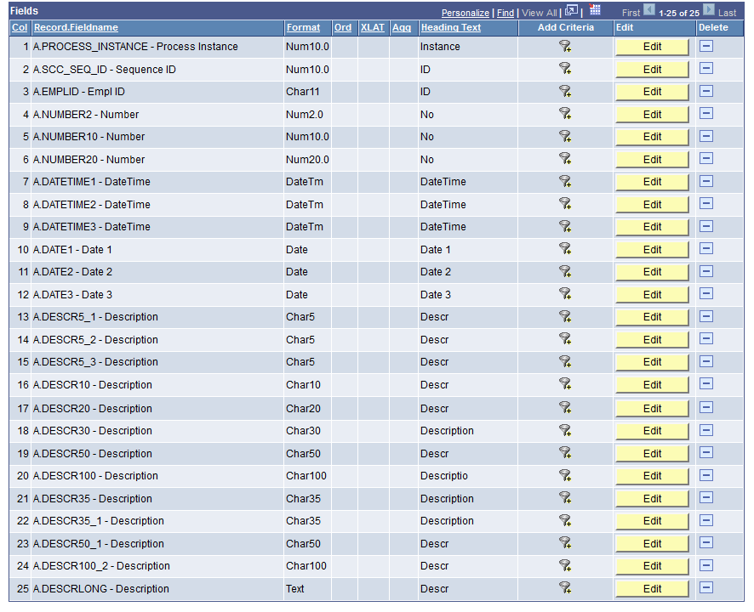
Scc_bat_ntf_TGT

Slide 35
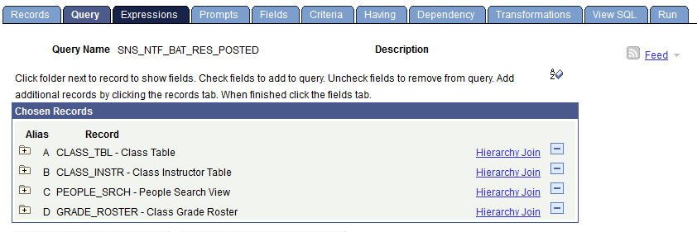
query

Slide 36
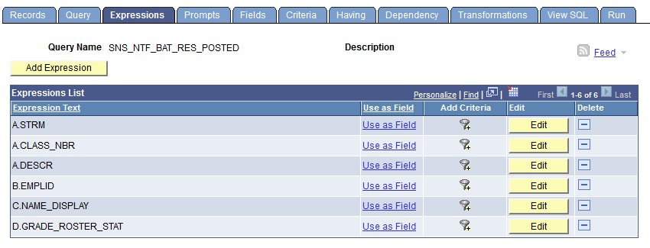
Expressions

Slide 37
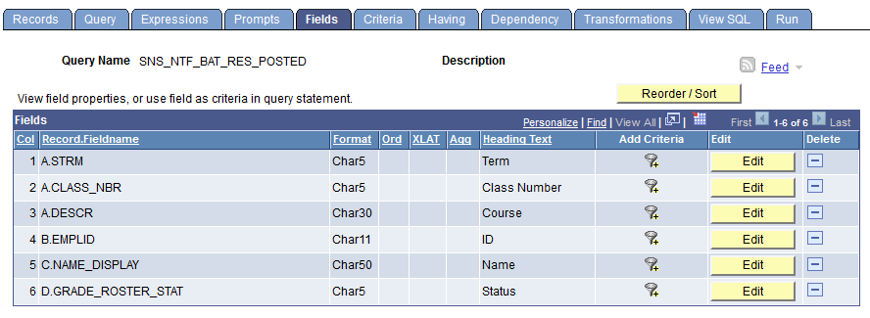
fields

Slide 38
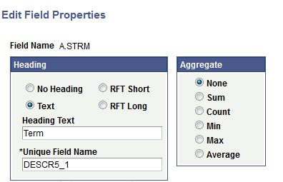
Fields properties

Slide 39
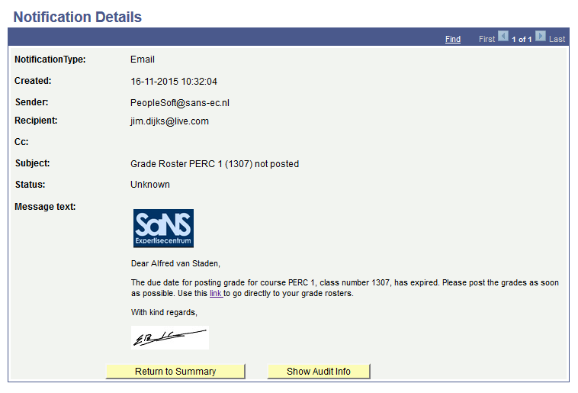
Email

Slide 40
Concluding thoughts
ANY QUESTIONS?

Slide 41
Pros and cons
PRO | CON
Less Customization Flexible Variables Easy to Use One Action No BI Publisher Stored Notification | No Communication Outcome Multi-Language Limited Number of Variables

Slide 42
Bonus material

Slide 43
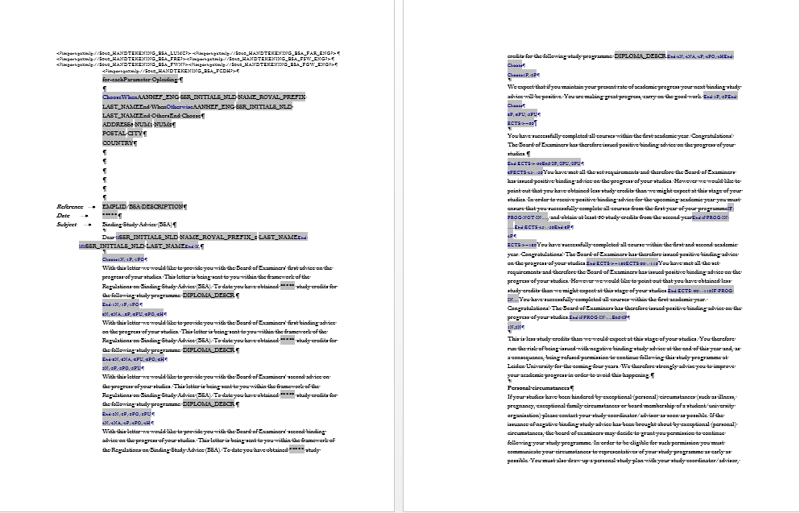
Mail merge

Slide 44
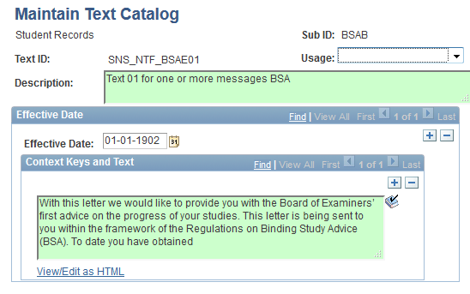
Text catalog

Slide 45
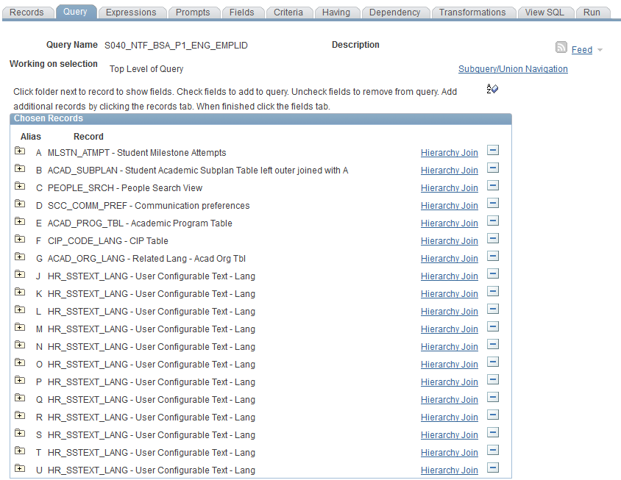
query

Slide 46
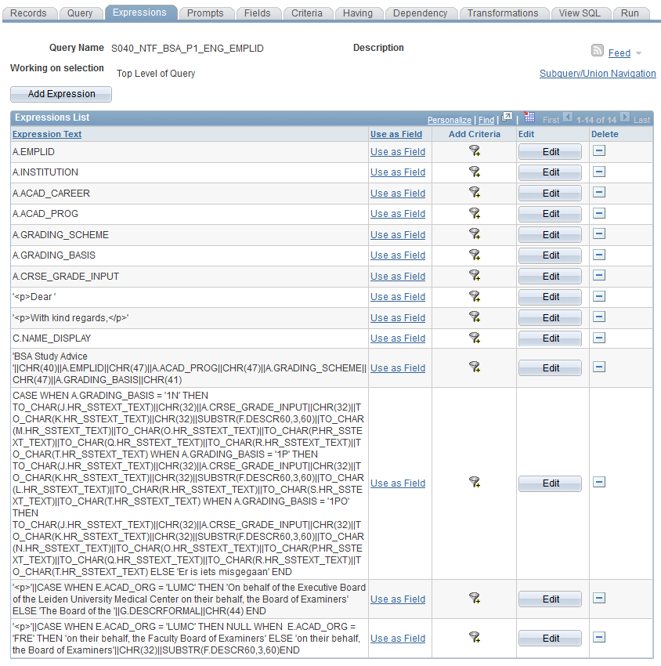
expressions

Slide 47
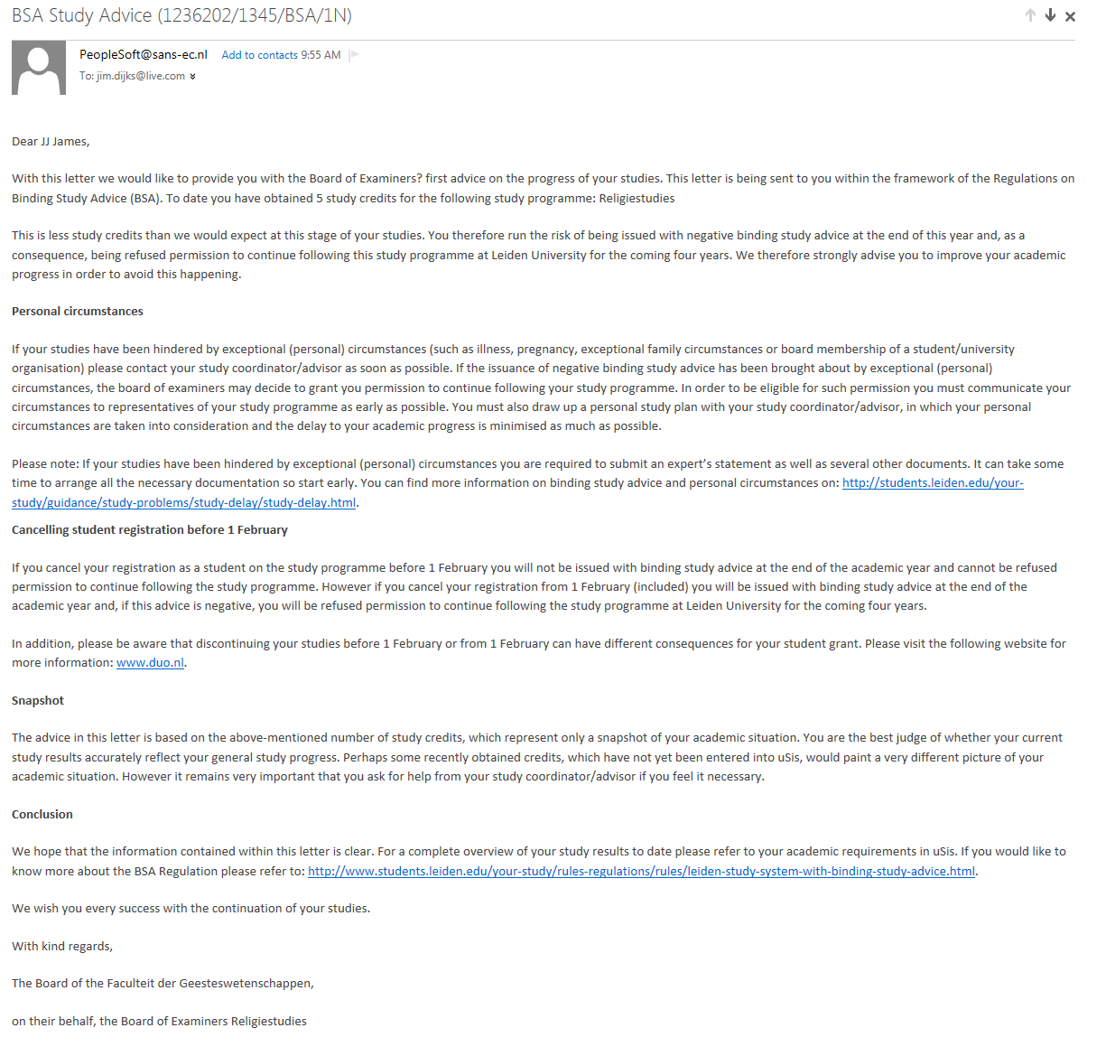
email

Slide 48
presenters
Jim Dijks
Consultant
SaNS Expertise Centre
jim.dijks@sans-ec.nl
all Alliance presentations will be available for download from the Conference Site

Slide 49
THANK YOU!

