Slide 1
PeopleSoft Navigation Tips & Tricks
CS 5011
November 6, 2017

Slide 2
presenters
Toni Tessari
Business Analyst
NAIT
tonit@nait.ca

Slide 3
Folder vs Links in Navigation

Slide 4
Navigation & Field Tips

Slide 5
Navigation Collections

Slide 6
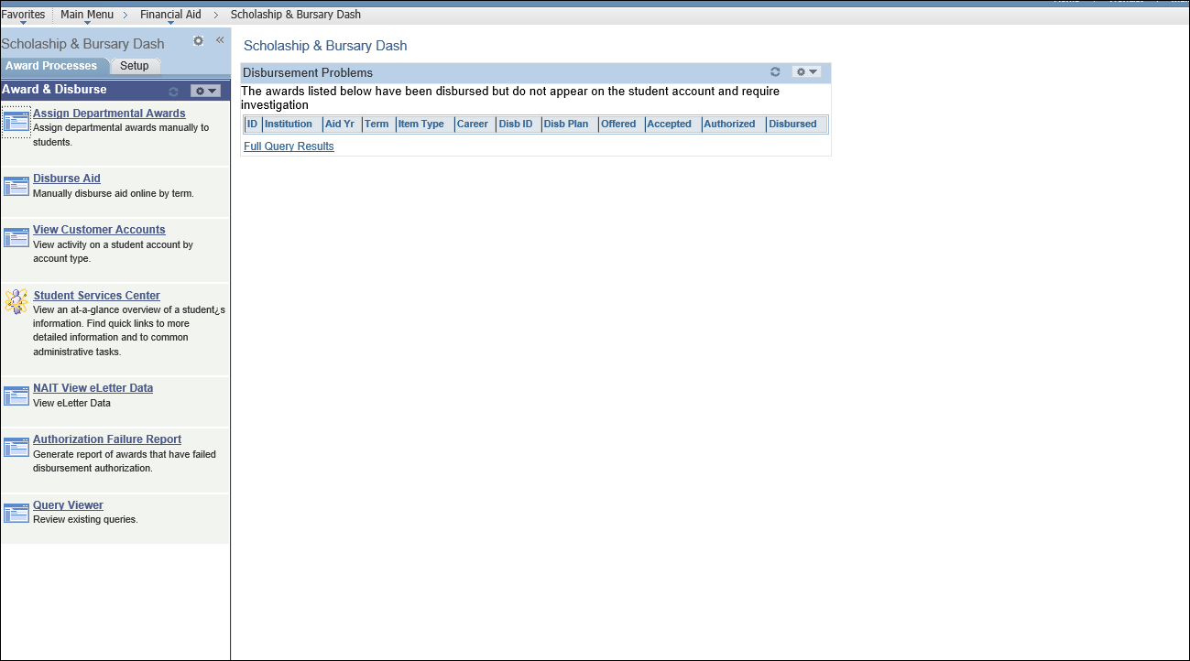
Dashboards & Workcenters

Slide 7
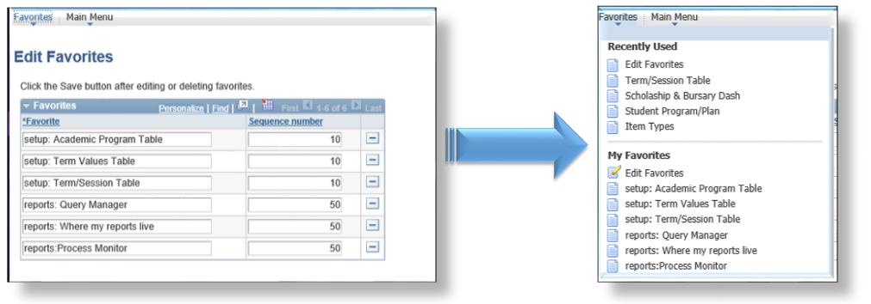
Group and order your Favorites

Slide 8
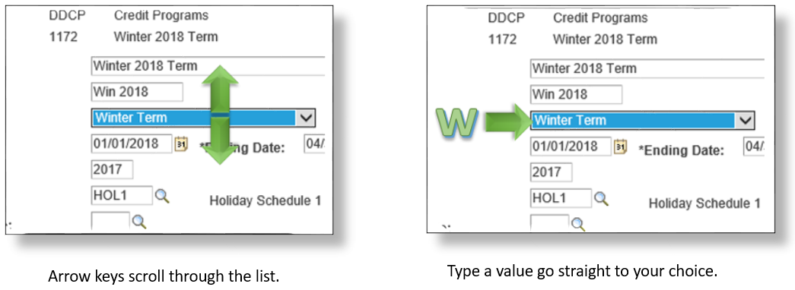
Drop Down Lists

Slide 9
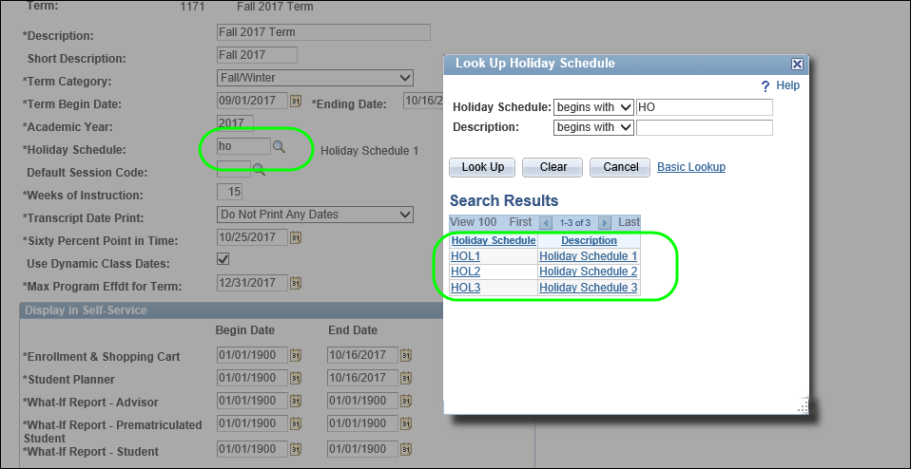
Partial Field Search

Slide 10
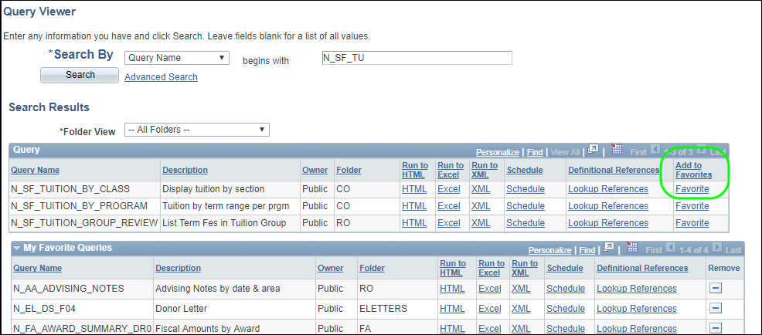
Query Favorites

Slide 11
T is for Today

Slide 12
Page Tips

Slide 13
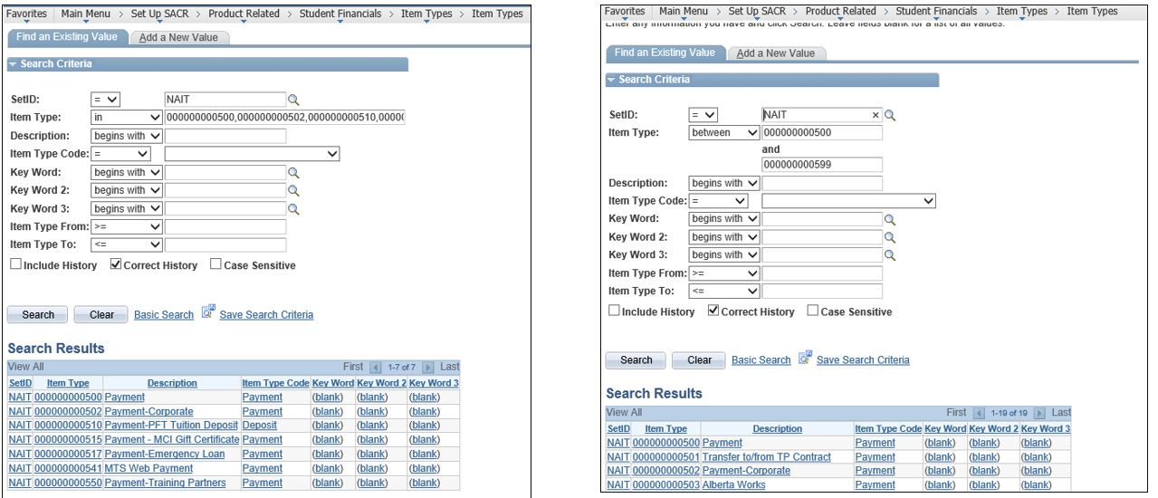
Search in and Between Values

Slide 14
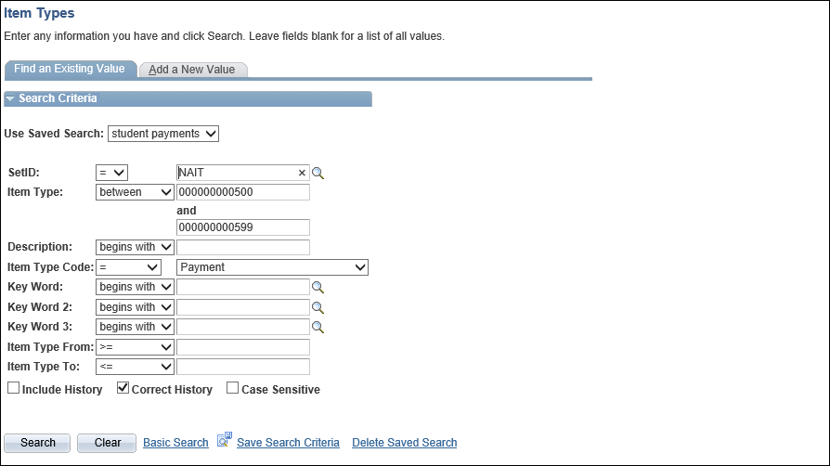
Save Search Criteria

Slide 15
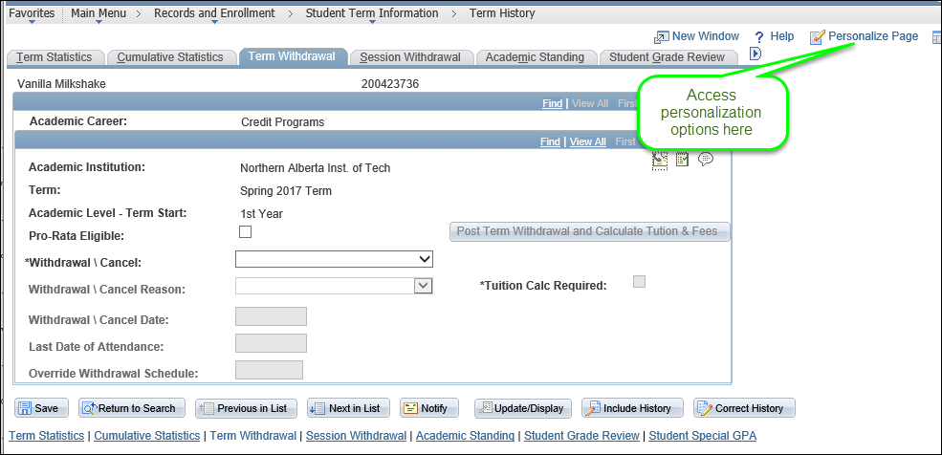
Page Personalization

Slide 16
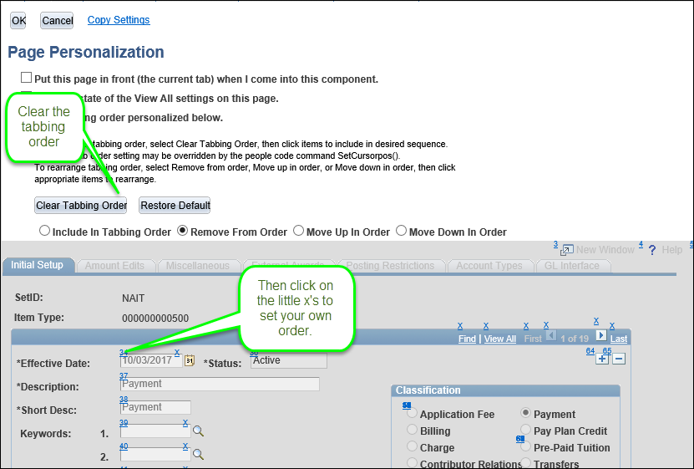
Tab Order

Slide 17
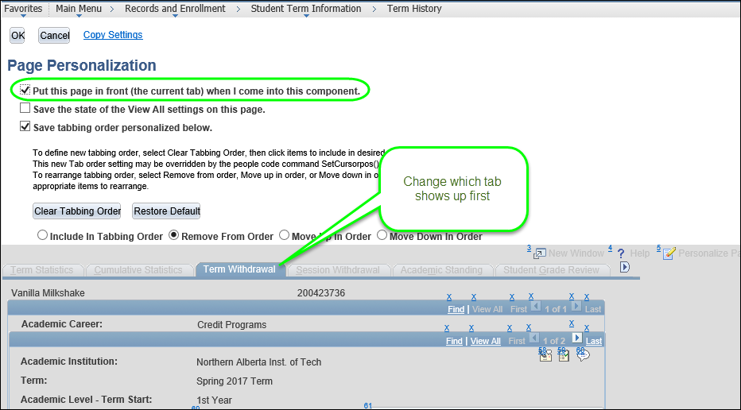
Page in Front

Slide 18
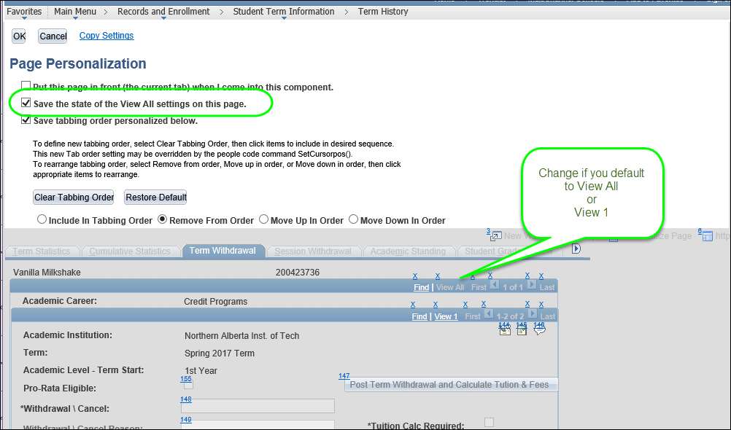
View All Settings

Slide 19
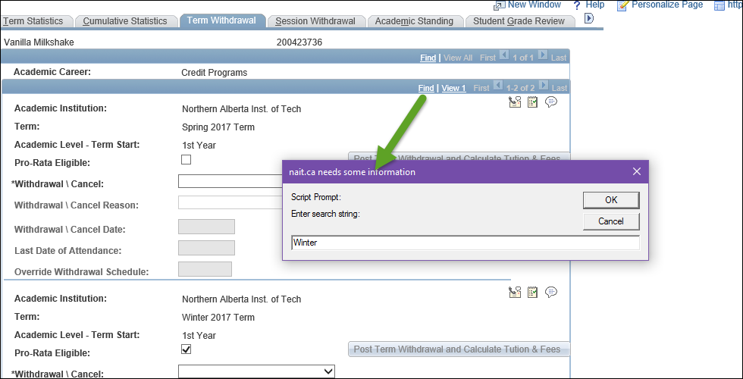
Find

Slide 20
Grids

Slide 21
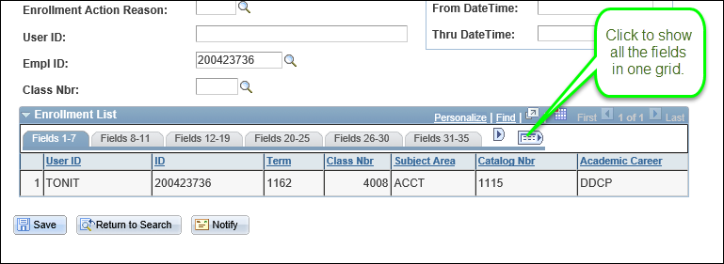
Show All Columns

Slide 22
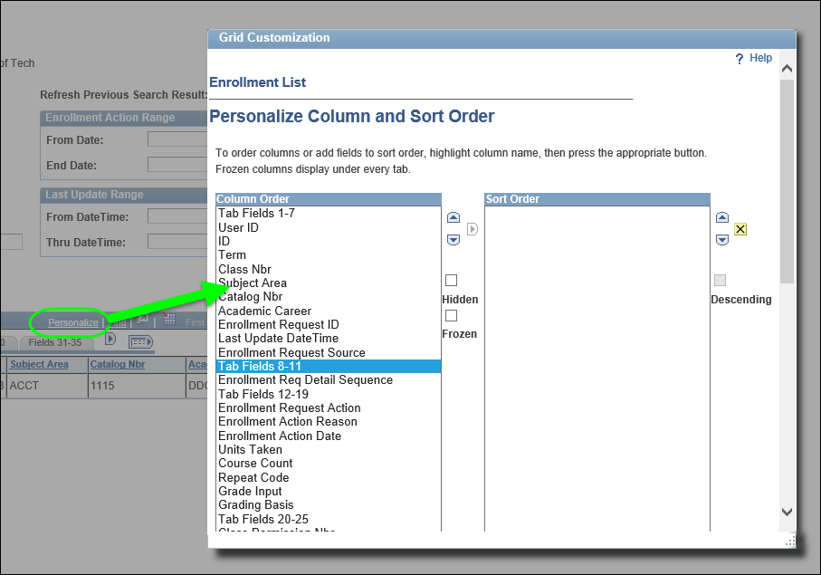
Change Column & Sort Order

Slide 23
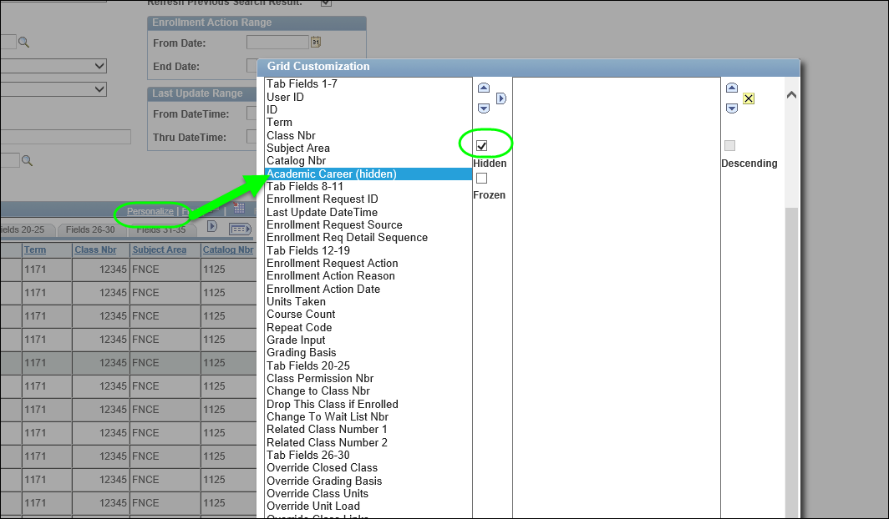
Hide Columns

Slide 24
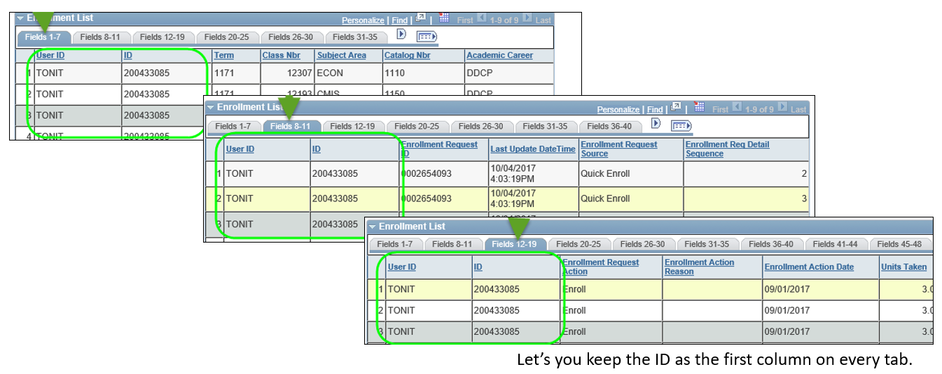
Freeze Columns

Slide 25
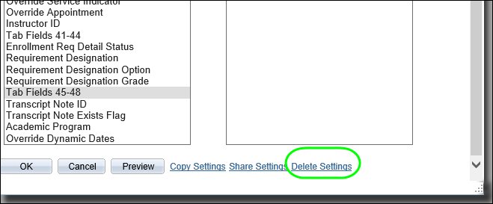
Return to Default Settings

Slide 26
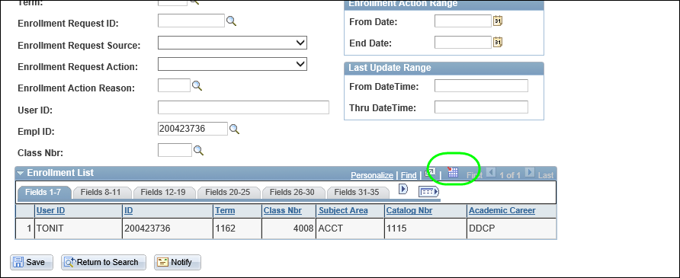
Download to Excel

Slide 27
Keyboard Shortcuts

Slide 28
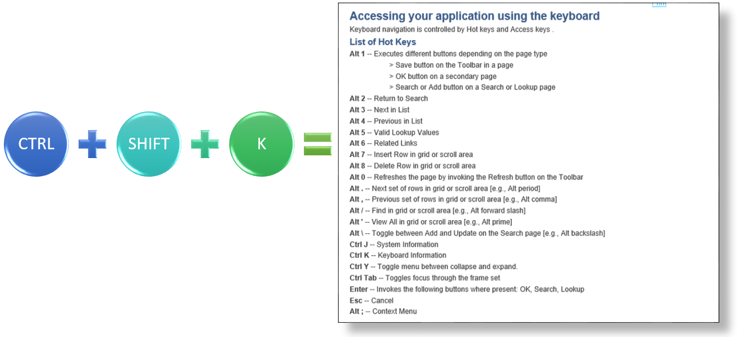
Shortcut Keys

Slide 29
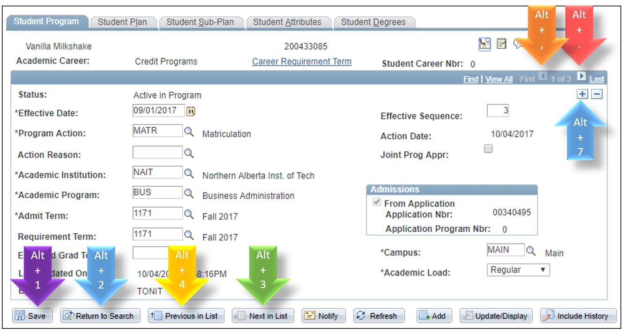

Slide 30
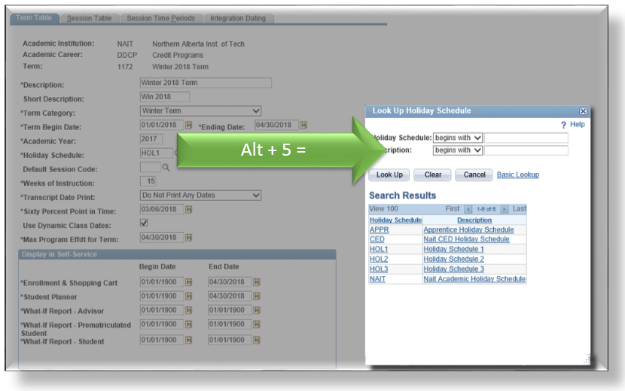
Alt + 5: Lookup Values

Slide 31
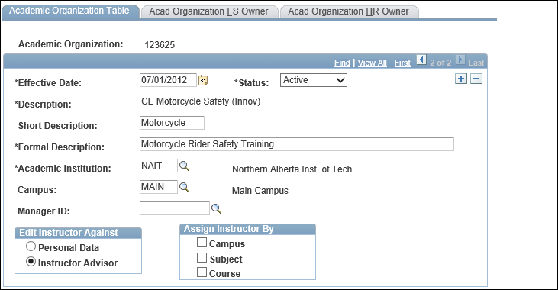
Alt + . :Scroll Right
… and move back with Alt + .

Slide 32
Other Stuff

Slide 33
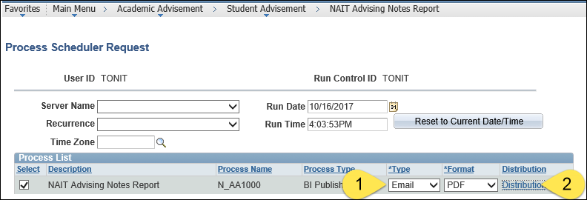
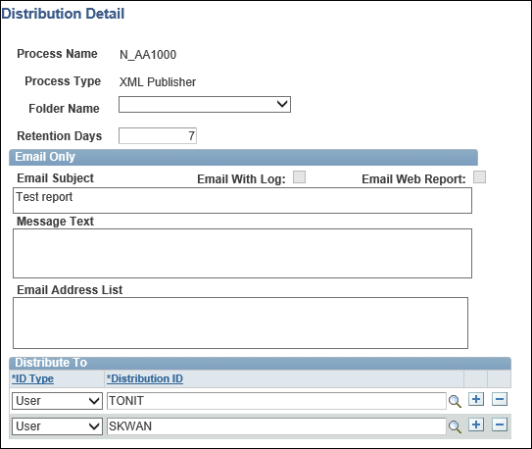
Email Distribution

Slide 34
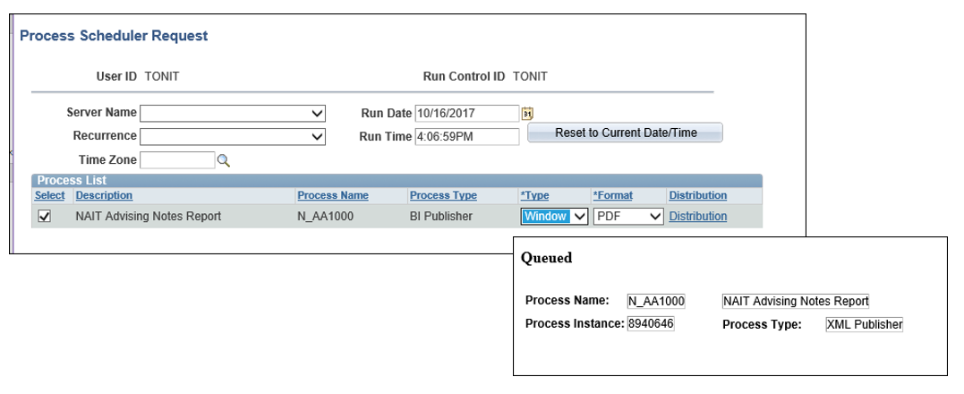
Run to Window

Slide 35
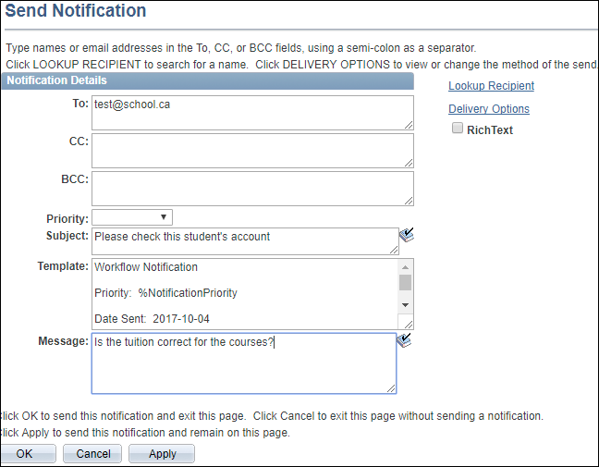
Notify

Slide 36
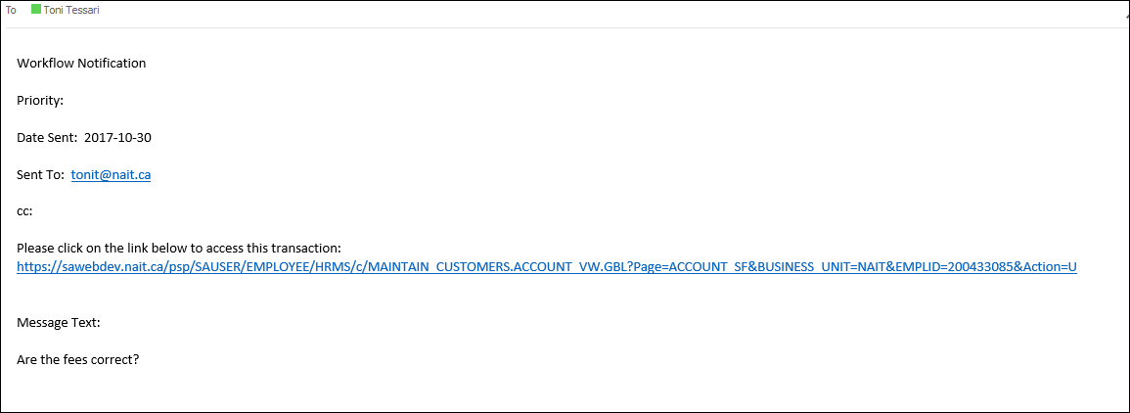
Notify

Slide 37
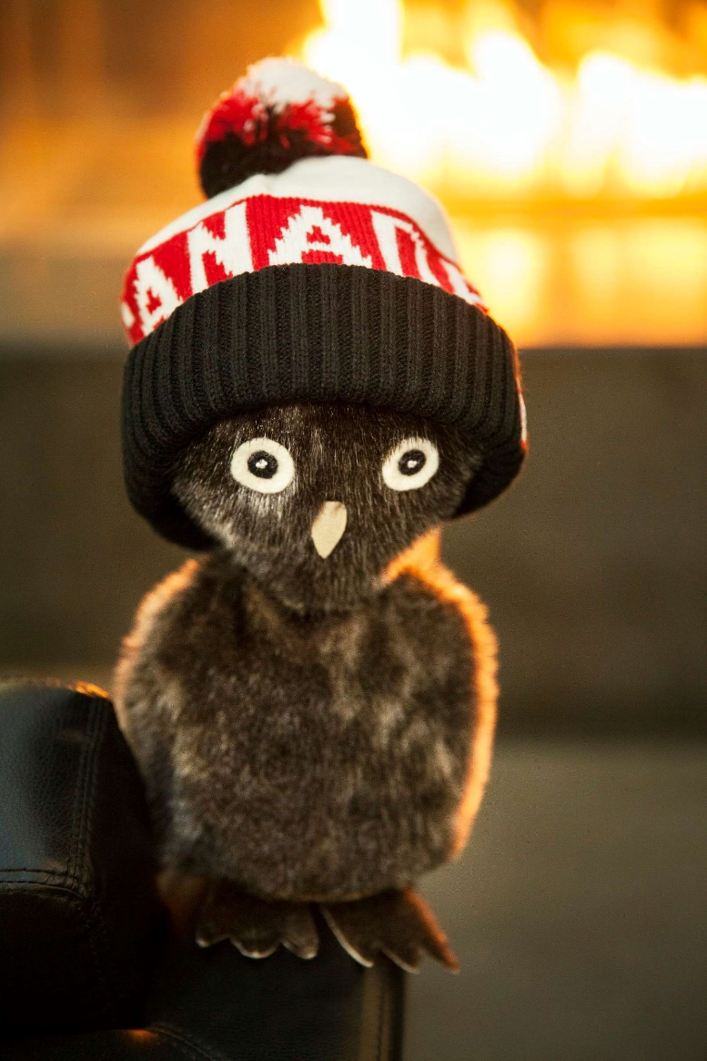
Questions?
Notes:
Ookpik: an Inuit toy. It is a small, souvenir owl with large head and big eyes, a beak, and small black talons.

Slide 38
THANK YOU!

