Slide 1
Usability 2.0: How to create advanced workcenters, dashboards and pagelets without AppDesigner
SESSION 2024
17 October 2017

Slide 2
presenters
Mark van der Molen
Carolien ten Oever
Functional Application Manager
University of Amsterdam
m.vandermolen@uva.nl
Functional Application Manager
University of Amsterdam
c.a.m.tenoever@uva.nl

Slide 3
100.000 students
10.000 faculty staff
1.001 administrative users
CS 9.0 (9.2 fall 2018)
PT 8.55.17
#41 (ML)

Slide 4
University of amsterdam
Since 1632 Athenaem Illustre
60.500+ appliciations
40.500+ enrolments
7 faculties
60 bachelor programmes
122 master programmes
151 Non Degree programmes
5000+ employees

Slide 5
AGENDA
WorkCenters Functional
WorkCenter Technical
Pagelets
Branding Objects
Customization
Security
9.2 & Fluid
Q&A

Slide 6
WORKCENTERS

Slide 7
Workcenters

Slide 8
Workcenter types
Navigation only One or more navigation collections without student specific criteria
Worklists One or more pagelets with ‘to-do actions’ for students for certain criteria.
Process workflow Support a simple or complex process where students ‘move’ from pagelet to pagelet depending on their ‘state’ in the process. Basically an advanced form of the Worklist type.
Workplace A single pagelet with links depending on prefilled student data.
Information only Single pagelet with information. Dashboard style, no left panel

Slide 9
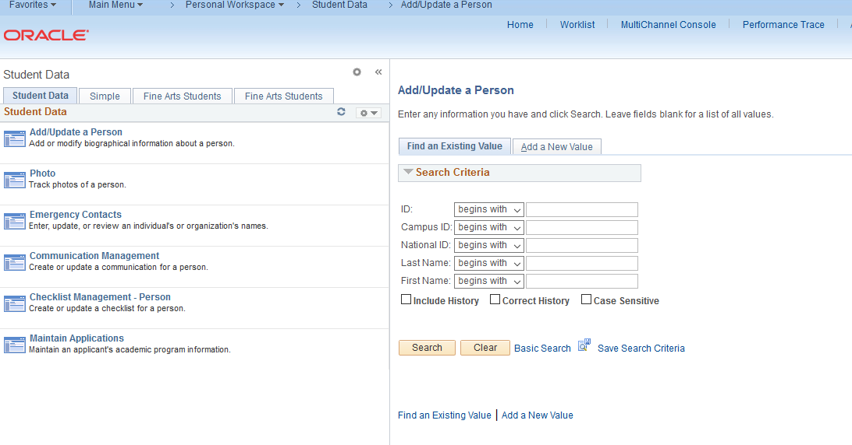
Navigation Only
A single navigation collection with links
Useful for simplifying navigation, for example to put different related menu items together from different menus.

Slide 10
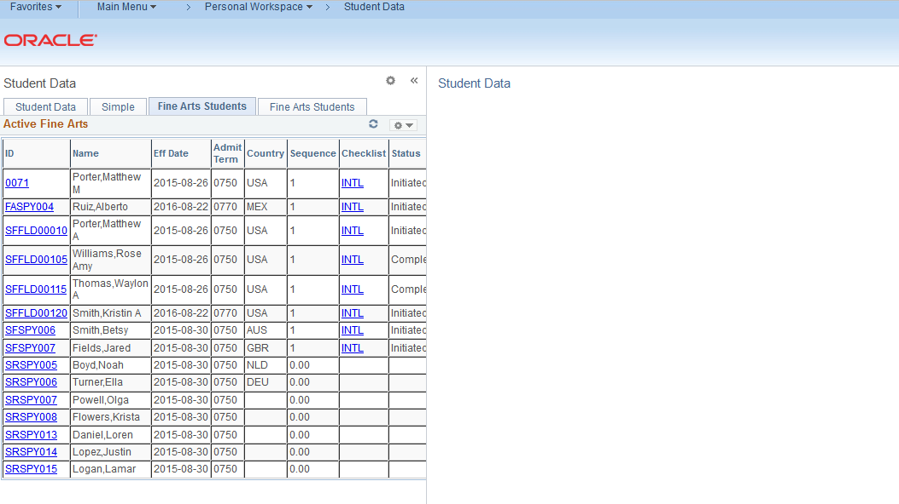
Worklists
One or more pagelets with ‘to-do actions’ for students for certain criteria. For example students with open checklists.

Slide 11
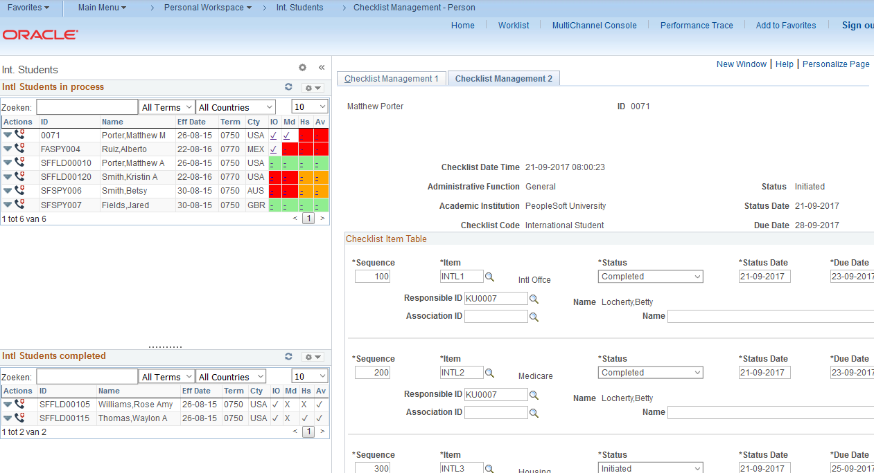
Process workflow
Support a simple or complex process where students ‘move’ from pagelet to pagelet depending on their ‘state’ in the process.
You can use Inter Window Communication to automatically refresh pagelets.

Slide 12
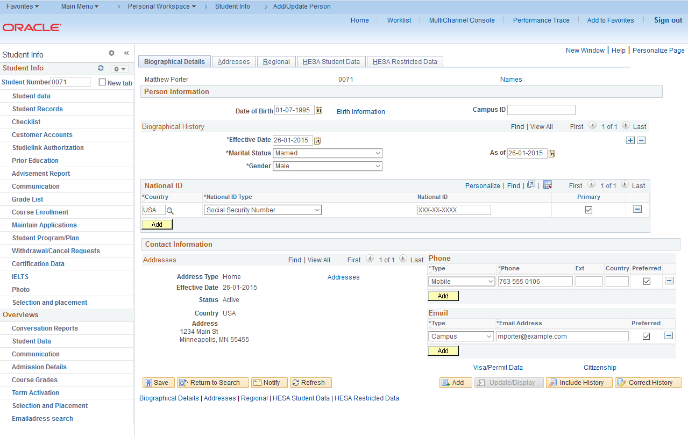
Workplace
A single pagelet with links depending on prefilled student data.

Slide 13
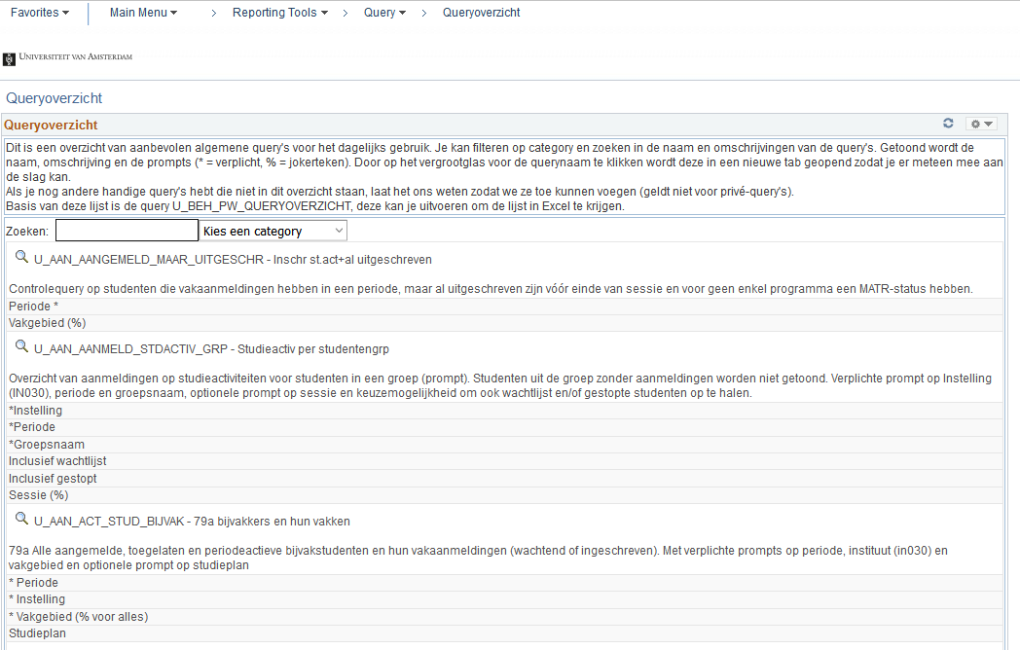
Information only
Single pagelet with information.
Dashboard style, no left panel

Slide 14
Customize pagelets
Why you want to customize your pagelets:
Default workcenter
Simple layout: table or list
Links under each column, what if you want more links and you have run out of columns to put them on?
All the blue underlines items, how can you remember what link goes where?
Sorting? Only the query sort is available.
Searching? You can create a prompt in your query but setting it every time in the pagelet is not very user friendly.
Max. number of items. If you display for example all 1000+ results your screen will explode.

Slide 15
Customize pagelets
Why you want to customize your pagelets:
Custom xsl
Unlimited layout options
Create clickable icons.
Use mouse-overs to give additional info for links.
Using custom JavaScript components you can do online sorting, searching, pagination, etc.

Slide 16
TECHNICAL

Slide 17
Workcenter basics: types
WorkCenters
Left navigation, right components/query output
Existing menu item
Instead of the component a WorkCenter page will be opened, the component is displayed in the transaction area. Always in WorkCenter layout, no way of only showing the component anymore.
Link of existing menu item
A WorkCenter page will be opened when using the new menu item. The default menu item remains unchanged. After opening, the component is displayed in the transaction area.
WorkCenter dashboard page
A WorkCenter page will be opened when using the new menu item. After opening, the a blank dashboard page is displayed in the transaction area which can have pagelets in up to three columns.
Dashboard
One big empty page, no left menu area. One, two or three columns for pagelets.

Slide 18
Workcenter basics: Configuration
Create Workcenter Dashboard page (optional)
Create Workcenter
Create query’s/nav. collections
Create pagelets
Configure workcenter tabs

Slide 19
pagelets: Tips and tricks
PeopleTools > Portal > Pagelet Wizard
First, create a standard pagelet based on a query
Six step wizard
1. ID and Title
2. Datatype and Datasource
3. Prompts and Variables
4. Display Format
5. Display Options
6. Publishing options and Security

Slide 20
Demo

Slide 21
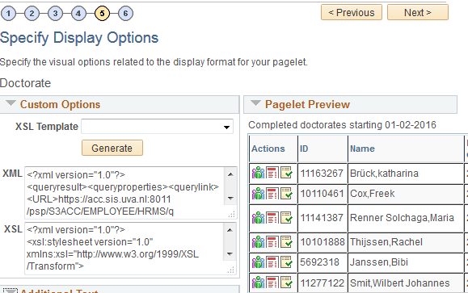
pagelets: Custom XSL
We are using the custom option on the Select Display Option tab so we are able to use custom xsl to generate the layout we desire.
There are a few pre-delivered xslt templates but you can also write your own to get a generic look and feel across all your pagelets.

Slide 22
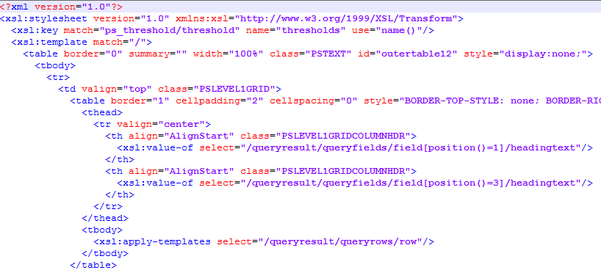
pagelets: Custom XSL

Slide 23
pagelets: Tips and tricks
Use position based query field access in stead of name based:
<xsl:value-of select="querydata[position()=1]/text"/>
<xsl:value-of select="querydata["EMPLID"]/text"/>
Both methods have advantages and disadvantages.
Position based: when you change the field order in the underlying query, you have to change the numbers in your pagelet.
Name based: when using expressions you need to include the whole expression as the name. With complex expressions and line breaks this is not working well. Also, when a table alias changes the field name changes.

Slide 24
pagelets: Tips and tricks
Set the Display Format to Custom, this gives you the possibility to write custom xsl code. Tip: first keep the standard ‘Table’ option on Step 4 of the wizard, use the Customize button at the bottom of the page in Step 5. If you choose ‘Custom’ in step 4 you won’t be able to use Thresholds in Step 5.
Use Branding Options to store the custom JavaScript code and css stylesheet.
Use weblibs to include branding and images in the pagelet.
The PeopleSoft xsl parser is rather strict so some code which works in other parsers might not work in PeopleSoft.
Escape ampersand (&) with “&amp;” in links.
Use xslt 1.0 coding, unfortunately the xsl parser is not fully xslt 2.0 compatible (yet?).
Make sure the xsl and html is complete, no missing close tags, etc.

Slide 25
BRANDING OBJECTS
Via PeopleTools > Portal > Branding > Branding Objects it is possible to store custom JavaScript, CSS and images in PeopleSoft.
You can use these in your customized pagelets via script includes (standard PeopleSoft weblibrary calls).
The images are multi-lingual if needed.
They are secure, only when you have access to the weblibs you can use them.
They are cached until changed. The weblib will automatically cache the item when first called or when it has been changed.

Slide 26
Branding OBJECTS
WEBLIB_PTBR.ISCRIPT1.FieldFormula.ISCRIPT_GET_CSS loads a css stylesheet from the system.
<xsl:element name="link"> <xsl:attribute name="rel">stylesheet</xsl:attribute> <xsl:attribute name="href"> /psc/ps/EMPLOYEE/SA/s/WEBLIB_PTBR.ISCRIPT1.FieldFormula.IScript_GET_CSS?ID=U_TABLES_CSS </xsl:attribute> </xsl:element>
WEBLIB_PTBR.ISCRIPT1.FieldFormula.ISCRIPT_GET_JS loads a JavaScript file from the system.
<xsl:element name="script"> <xsl:attribute name="src"> /psc/ps/EMPLOYEE/SA/s/WEBLIB_PTBR.ISCRIPT1.FieldFormula.IScript_GET_JS?ID=U_TABLES_CFG </xsl:attribute> &#160; </xsl:element>
Make sure all the xsl codes within the attribute tags are on one line without carriage returns or additional white spaces.
Also the &#160; code is necessary for to get the link working for JavaScript includes via the xsl parser.

Slide 27
pagelets: Javascript & CSS
You can use JavaScript and css within your custom component xsl.
Some tips and tricks:
When using inline javascript, create complex code might not work well with the PeopleSoft xsl parser. For example, some characters can not be used like:
html characters (specially < or >)
ampersand (&), this need to be replaced by &amp;
unbalanced quotes
Workaround: create a JavaScript include file, upload it via Branding Options and include it in your pagelet xsl code.
When using multiple JavaScript includes, page loading order does matter. Most of the time, putting them in the correct order in the xsl will solve this. If not, other techniques need to be used (using JQuery page loading events for example).
For css, you can use it as inline code or via including a custom stylesheet. Preferably the last as you can reuse it in other pagelets to get a common look & feel.

Slide 28
pagelets: Images
Custom and standard PeopleSoft images can be used in your pagelets as well.
WEBLIB_PTBR.ISCRIPT1.FieldFormula.IScript_GET_IMAGE gets an image form the system.
<img border="0" alt="Some mouse over text">
<xsl:attribute name="src">/psc/ps/EMPLOYEE/SA/s/WEBLIB_PTBR.ISCRIPT1.FieldFormula.IScript_GET_IMAGE?ID=PS_WCS_ROOT_ICN</xsl:attribute>
</img>
This will display the image
The list of available standard images can be found on any component where you can choose an image, for example the navigation collection setup page. You can also use your own images, they can be uploaded in the branding component.

Slide 29
pagelets: Dynamic Query Links
Using custom xsl you can link to a query from a link or image click
<xsl:element name="a">
<xsl:attribute name="href">
/psc/ps/EMPLOYEE/SA/q/?ICAction=ICQryNameURL=PUBLIC.MY_QUERY_NAME&amp;BIND1=12345678
</xsl:attribute>
<xsl:attribute name="title">My query displays a lot of data</xsl:attribute>
My query
</xsl:element>
This will generate a link ‘My query’ with a mouse over text and executes the query ‘MY_QUERY_NAME’ with a prompt variable with the value 12345678. This can be for example the EMPLID.
The value of the prompt can be variable form your query data as well so you can have a custom link on each row of data.
Try to avoid using private query’s in workcenters as they might not be accessible to all users.

Slide 30
pagelets: Dynamic Component Links
<xsl:element name="a">
<xsl:attribute name="href">
/psc/ps/EMPLOYEE/SA/c/CC_BIO_DEMO_DATA.SCC_BIO_DEMO.GBL?EMPLID=<xsl:value-of select="querydata[position()=1]/text"/>
</xsl:attribute>
<xsl:attribute name="title">Personal Data</xsl:attribute>
<img border="0" alt="Personal Data">
<xsl:attribute name="src">/psc/ps/EMPLOYEE/SA/s/WEBLIB_PTBR.ISCRIPT1.FieldFormula.IScript_GET_IMAGE?ID=PT_WF_PERSON</xsl:attribute>
</img>
</xsl:element>
This will generate an image with a link to the Personal data component. The value of the prompt is dynamically generated for each student from the query result.
Use the full component specification, not the CREF.
You can specify which tab to show:
&amp;Page=MY_PAGE_NAME
And even switch Correct history on:
&amp;Action=C

Slide 31
pagelets: Mouse Overs
This will generate a fixed text mouse over popup on a field.
<div style="width:100%;" title="Career">
<xsl:value-of select="querydata[position()=6]/text"/>
</div>
This will generate a variable text mouse over popup on a field.
<div style="width:100%;">
<xsl:attribute name="title">
<xsl:value-of select="querydata[position()=38]/text"/>
</xsl:attribute>
<xsl:value-of select="querydata[position()=6]/text"/>
</div>

Slide 32
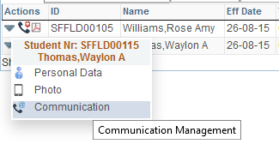
pagelets: Images
You can create a clickable image combining the code of the previous slides.
<xsl:element name="a">
<xsl:attribute name="href">
/psc/ps/EMPLOYEE/SA/c/CC_BIO_DEMO_DATA_STDNT.SCC_BIO_DEMO.GBL?EMPLID=<xsl:value-of select="querydata[position()=1]/text"/>
</xsl:attribute>
<xsl:attribute name="title">Personal Data</xsl:attribute>
<img border="0" alt=" Personal Data">
<xsl:attribute name="src">
/psc/ps/EMPLOYEE/SA/s/WEBLIB_PTBR.ISCRIPT1.FieldFormula.IScript_GET_IMAGE?ID=PS_WCS_ROOT_ICN
</xsl:attribute>
</img>
</xsl:element>
Combine several clickable images in a
single table cell to save space and to
get rid of all the ugly blue underlined
standard links.

Slide 33
pagelets: Tresholds
As with normal pagelets, you can set thresholds to apply row or cell colors based on field values in the query.
There is a cave-eat, when you have complex expressions in your query the threshold settings are not always working via the standard functionality, this is a bug and there is no workaround except writing your own threshold coding (see next slide). This also applies to normal uncustomized pagelets.
Make sure when you have a custom xslt the standard threshold xslt parts are included in your code, if not, the thresholds will not work.

Slide 34
pagelets: Custom Tresholds
With custom pagelets you can even highlight data or cells based on fields not displayed in the grid.
<td> <xsl:choose> <xsl:when test="querydata[position()=37]/text='C'"> <xsl:attribute name="style"> background-color:red; </xsl:attribute> </xsl:when> <xsl:when test="querydata[position()=37]/text='S'"> <xsl:attribute name="style"> background-color:orange; </xsl:attribute> </xsl:when> <xsl:otherwise/> </xsl:choose>
Tip: use the query to do complicate calculations and return a simple code to set the format. For example: if you want all enrollments between 1 jan and 31 aug without a specific checklist to be red, create an expression in the query which returns Y or N.

Slide 35
pagelets: Custom Components
You can use custom JavaScript components which you can download from the internet. A few things you have to keep in mind:
Put the JavaScript and css inside PeopleSoft, do not link to an external website. For security, availability and performance reasons.
Make sure the component has decent support and development and a active community.
When using a custom sorting/ordering component, set the MAXROWS in the pagelet wizard to 99999 to make sure all data is available.

Slide 36
pagelets: Custom Components
We are using a custom JavaScript component to enhance the standard pagelet usability. This adds the possibility to sort, filter, paginate, etc. the data. We are using DataTables, this is a free open source project with a decent development team.
https://www.datatables.net/
DataTables comes with a JavaScript and a css stylesheet, customizations and overrides are done in a separate file. Also this component needs a newer version of JQuery so this is included via a branding option as well.

Slide 37
Pagelet: Information only
Single pagelet with information.
Preferably placed in a dashboard style without left panel
Can be based on static data, i.e. a HTML table or dynamic data, for example query output

Slide 38
Pagelet: Information only
For this example we are using Datatables format, grouping and search functionality.
> Create a custom xsl pagelet. For static data put it in the xsl directly, for dynamic data use the query output.
> Format the table containing the data, hide unwanted columns for example.
> Write JavaScript code to implement the search and grouping functionality.
> Create a dashboard page to put the pagelet on and place it in the menu.

Slide 39
RUNNING BI Publisher from a Pagelet
As of PeopleTools 8.55 it is also possible to generate a BI Publisher report on the fly.
You need to set up the BI Publisher REST webservice for this to get it working (see PeopleBooks).
<xsl:element name="a">
<xsl:attribute name="href">
/PSIGW/RESTListeningConnector/BIPRunReport.v1/P_GRADES/P_GRADES_1?format=PDF&amp;langcd=ENG&amp;prompts=EMPLID,<xsl:value-of select="querydata[position()=1]/text"/>,INSTITUTION,IN030
</xsl:attribute>
<xsl:attribute name="title">Gradelist pdf</xsl:attribute>
<xsl:attribute name="target">_new</xsl:attribute>
<img border="0" alt=“Gradelist pdf">
<xsl:attribute name="src">/psc/ps/EMPLOYEE/SA/s/WEBLIB_PTBR.ISCRIPT1.FieldFormula.IScript_GET_IMAGE?ID=MAP_ICON_PDF</xsl:attribute>
</img>
</xsl:element>
This will create an clickable image to a pdf report for a student which opens in a new tab.

Slide 40
RUNNING BI Publisher from a Pagelet
/PSIGW/RESTListeningConnector/BIPRunReport.v1/P_GRADES/P_GRADES_1?format=PDF&amp;langcd=ENG&amp;prompts=EMPLID,12345678,INSTITUTION,IN030
Explanation of the link
/PSIGW/RESTListeningConnector/BIPRunReport.v1 Link to the BI Publisher REST webservice
/P_GRADES Report Definition Name
/P_GRADES_1 Report Template Name
?format=PDF Requested format (pdf, rtf, xls, html)
&amp;langcd=ENG Language
&amp;prompts=EMPLID,12345678,INSTITUTION,IN030 Query prompts with values. Comma separated
The BI Publisher REST service needs to be accessible to the user, this might needs additional configuration to set this up in a way only authorized users have access as by default the standard PSIGW gateway is used which might be inaccessible to normal users.

Slide 41
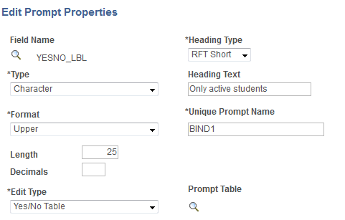
RUNNING BI Publisher from a Pagelet
Addition to the PeopleBooks:
If you have a prompt on unique field, for example EMPLID, you need to use the Field Name EMPLID=1234568.
If you have multiple prompts with the same underlying field, for example you have 2 checkbox prompts based on field YESNO_LBL, you need to use the Unique Prompt Names (‘BIND1’).

Slide 42
Navigation Collection
It is possible to execute a query directly from a navigation collection. To make this work you need a generic menu entry for query executing. The query and prompts can be added in the navigation collection entry.
Via Structure and Content: add a menu item somewhere in the menu, you can put it in a hidden folder to hide it from normal navigation.
URL Type: PeopleSoft Generic URL
Portal URL: q/?
In the navigation collection > Add/Edit Link:
Menu Item: Use the above menu item
Additional Parameters: ICAction=ICQryNameURL=PUBLIC.MY_QUERY_NAME
Override Label: this is the name for the link
Override image/description if you want an image or a long description

Slide 43
STRUCTURE AND CONTENT
Some tips
For organizing your workcenter you can create one or more specific folders (menu items) in your menu.
For organizing your pagelets you can create different pagelet folders
Root > Portal Objects > Pagelets
For Fluid homepage tiles you can create a specific category to store your workcenter tiles.
Root > Fluid Structure Content > Fluid Pages

Slide 44
SECURITY
Four levels of security (depending on pagelet type)
Query security (for query based pagelets)
Pagelet security (via Pagelet wizard step 6)
WorkCenter Dashboard security (via WorkCenter Dashboard)
Menu folder security (via Structure and Content)
Some tips:
When you don’t have access to a pagelet it will not be displayed on your workcenter. If it is the only pagelet in a workcenter tab, the tab itself unfortunately is still displayed (a blank tab). There is no way to put security on a workcenter tab.
Setting the ‘Valid to date’ in the past on the CREF will disable direct access to a workcenter via a tile or menu item.

Slide 45
Workcenters: 9.2
In 9.2 Enterprise Components will give you a new type of WorkCenter and new types of pagelets:
My Work: a list with to-do items. Needs a custom PeopleCode component to work
Links: Links to components
Queries: list of query’s
Reports/Processes: list of reports
Items can be added centrally or by the user.
Filter/Scope options gives the functionality to set default values, runcontrols, etc. for the pagelet items. These can be grouped in sets to switch easily to another set of prompt values.
Available for classic workcenters and fluid. In classic they can be combined with other pagelets, in fluid you just have the new Enterprise Components pagelets.
Fluid workcenters: basically this needs a lot of custom PeopleCode to get it working. Only the standard Enterprise Component pagelets are out-of-the-box available.

Slide 46
Workcenters: Fluid
Basically this needs a lot of custom PeopleCode to get it working as there are no pre-delivered Campus WorkCenters and no tools to make them via the front end like classic workcenters.
Only the standard Enterprise Component pagelets are out-of-the-box available.
Lots of navigation quirks… Jumping out of the workcenter to a transaction page in the same window, or sometimes in a new tab, sometimes in classic, sometimes in fluid, etc.
Fluid is portable device optimized and not very handy on a normal PC or laptop, waste of screen space due to the big font size and additional spaces between items.
Try it for yourself? Financials PUM does have them to play with.

Slide 47
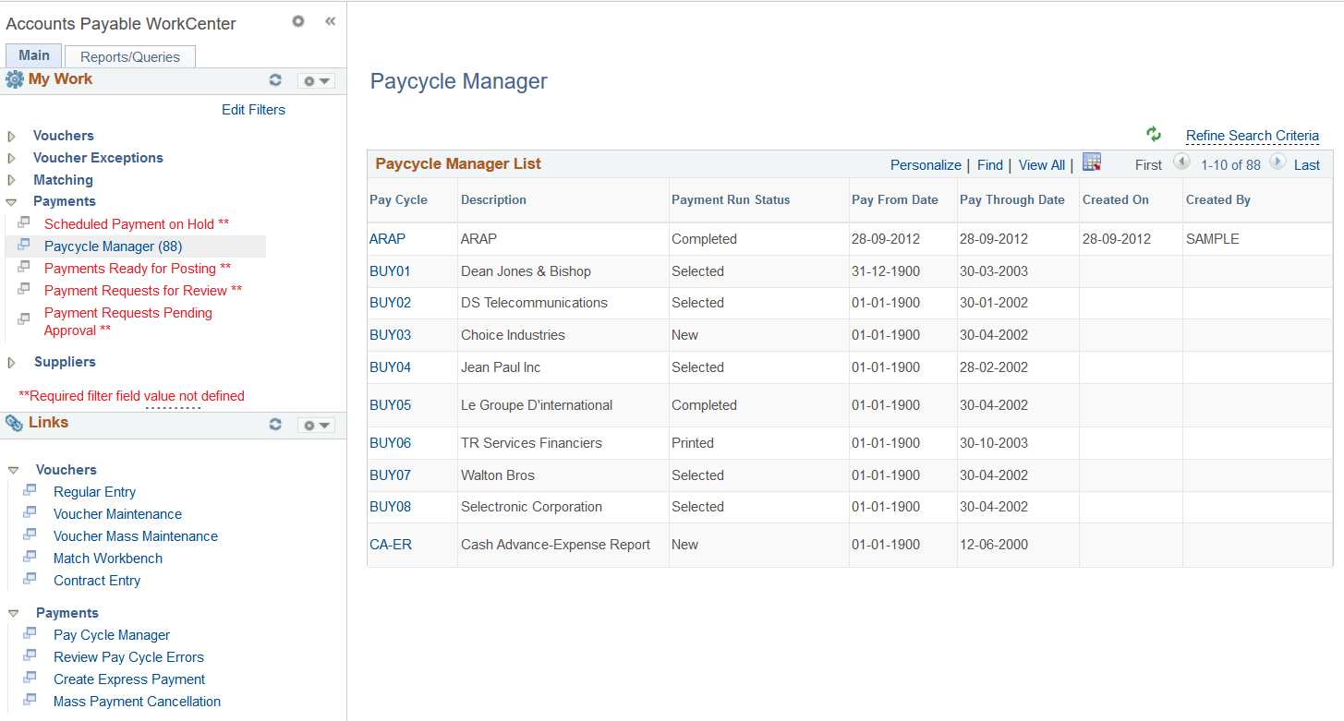
9.2 Classic Workcenter

Slide 48
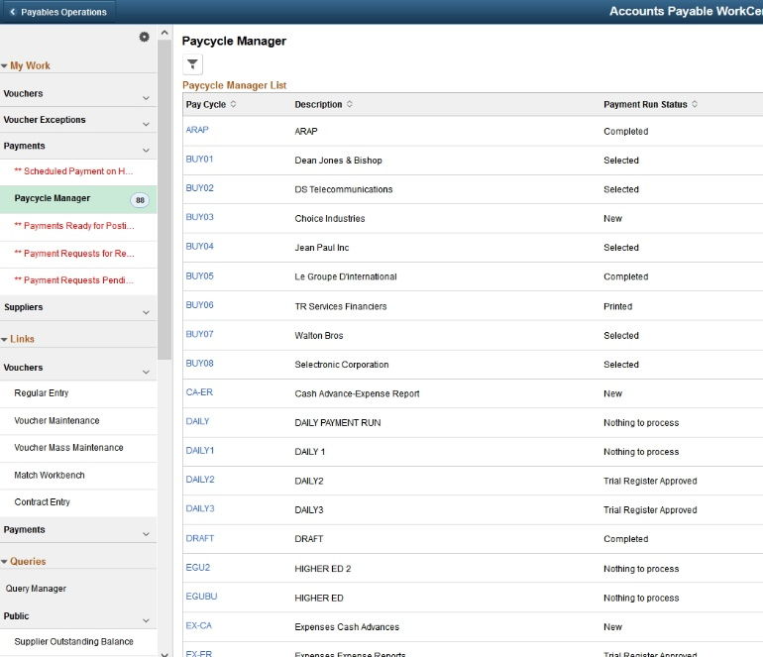
9.2 Fluid Workcenter

Slide 49
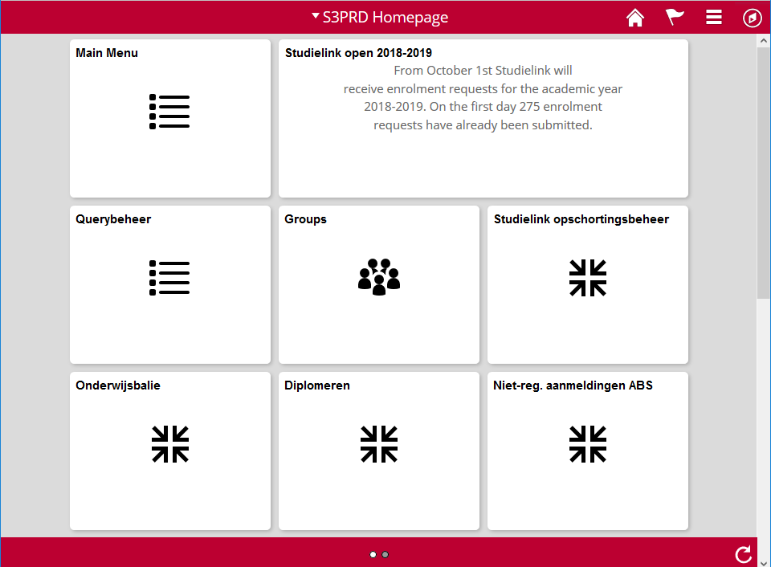
Fluid Homepage
Use tiles on your fluid homepage to directly go the workcenters. Users can add or remove tiles if needed.

Slide 50
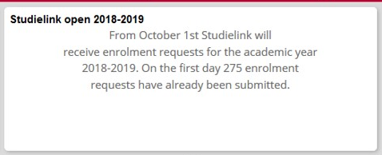
Fluid Homepage: Dynamic tiles
Dynamic content on home page tiles.
This can be done via the tile wizard, but lot of issues… For example, tile wizard is not multi-language, to access static content tiles created via the tile wizard you need way too much authorization roles, etc.
Workaround
Create a pagelet and put it on a tile!
Via a custom xsl pagelet you can get all the data on a tile you ever wanted.

Slide 51
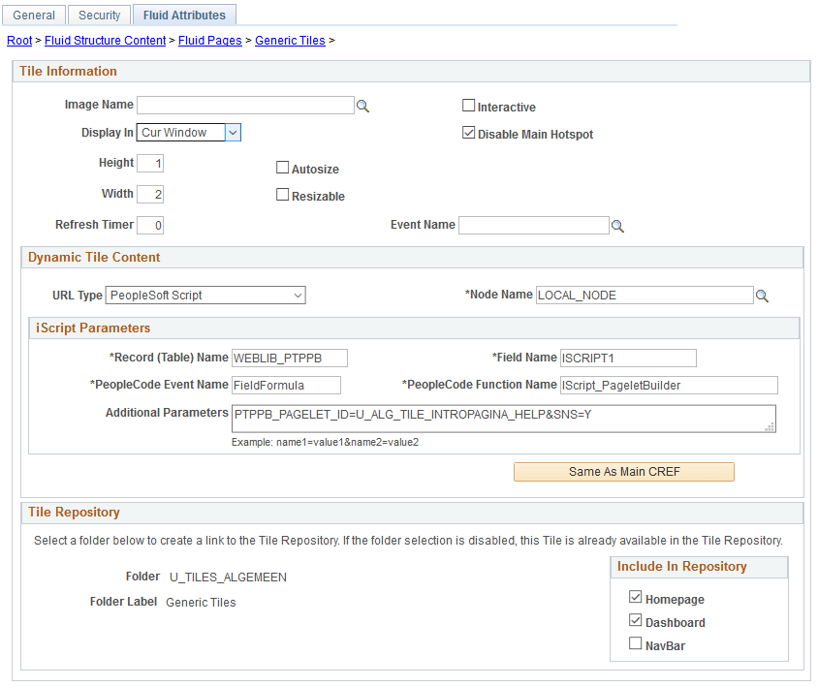
Fluid Homepage: Dynamic tiles

Slide 52
Workcenters: SUMMARIZE
Using the basic pagelet functionality you can make usable workcenters but...
... with a little knowledge of PS Query, Navigation collections, HTML, xsl, xml, css and JavaScript you can really enhance the usability.

Slide 53
Usefull menu items
Main Menu > PeopleTools > Portal >
> Branding > Branding Objects
> WorkCenter
> Portal Utilities > Navigaion Collections
> Pagelet wizard
> Structure and Content
> Inter Window Communication

Slide 54
Questions & DISCUSSION
Questions?
Other ideas?
Your examples?

Slide 55
presenters
Mark van der Molen
Carolien ten Oever
Functional Application Manager
University of Amsterdam
m.vandermolen@uva.nl
Functional Application Manager
University of Amsterdam
c.a.m.tenoever@uva.nl
all Alliance presentations will be available for download from the Conference Site

Slide 56
THANK YOU!

