Slide 1
Gender-related information
in PeopleSoft Campus Solutions 9.2, PUM 006 Criss Laidlaw | Williams College | claidlaw@williams.edu
HEUG EMEA, October 2017

Slide 2
Gender-related information items available in PUM 6
Birth Gender select from a list of birth genders
Gender Identity select from a list of identities or optionally specify Other and enter identity
Sexual Orientation select from a list of orientations or optionally specify Other and enter orientation
Personal Pronouns select from a list of pronouns or optionally specify Other and enter pronoun
Up to 9 additional attributes

Slide 3
Capabilities as of PUM 006
Configuration of information items to collect, store & display
Self-service page for use by students
Storage in a delivered database table, with effective dates
Data entry & maintenance by administrative staff, with page security
Query access by authorized administrative staff

Slide 4
Planned capabilities
Support for loading gender information from other sources, e.g. Admission
Class rosters
???
How else would we in higher education want to use this information?
Let the Campus Community AG know what your instutition needs

Slide 5
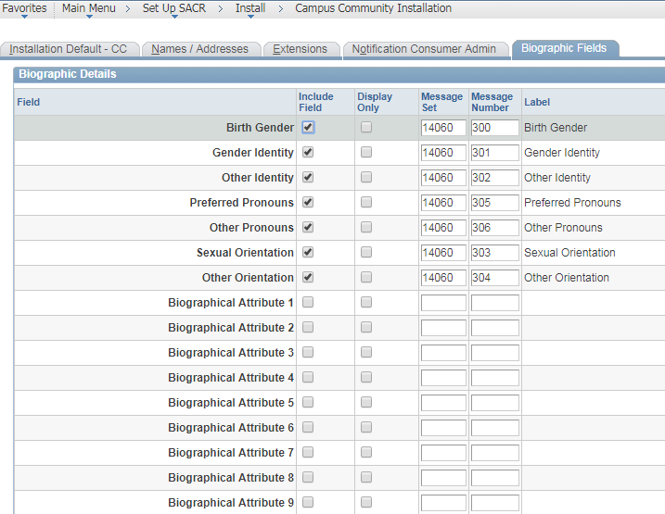
Configuration

Slide 6
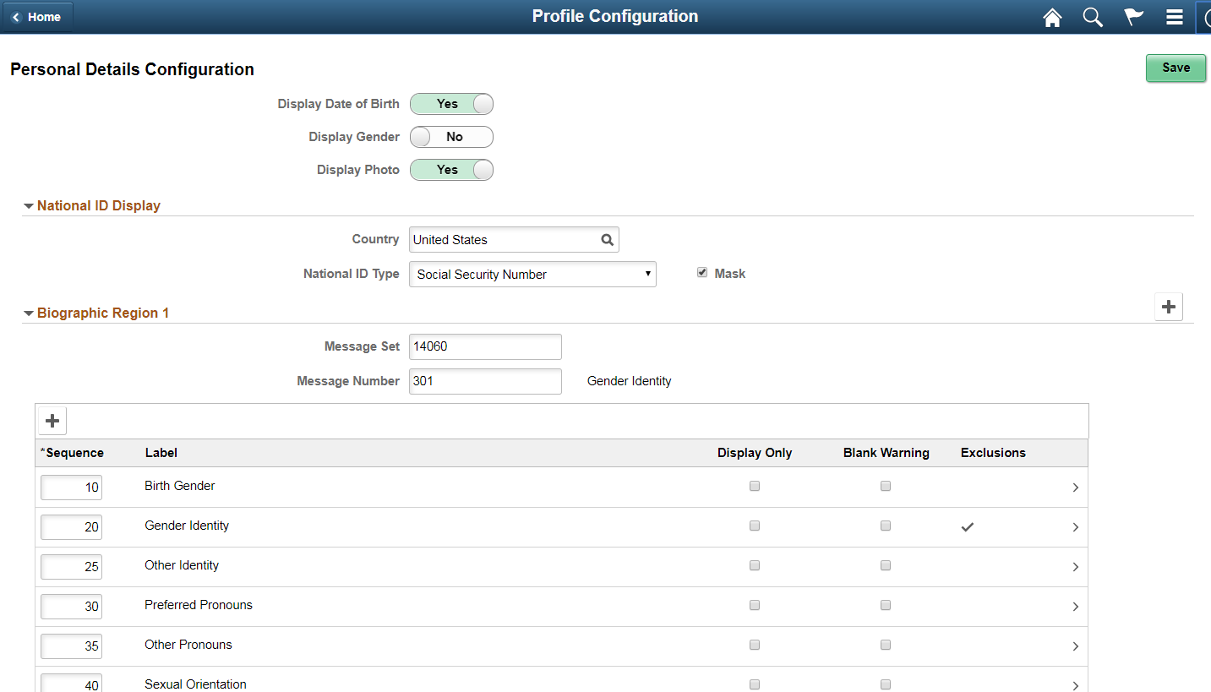
Configuration (Self-Service)
Set Up SACR>Common Definitions>Self-Service>Campus Community>Personal Details Configuration

Slide 7
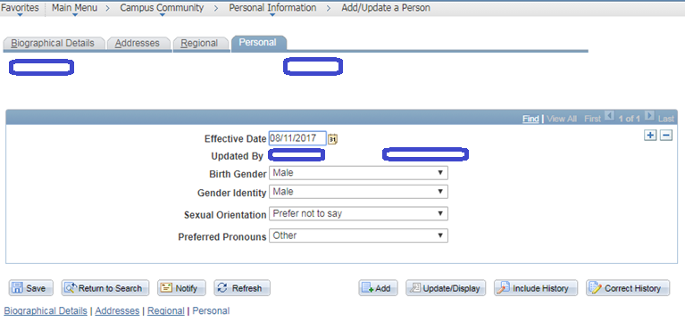
Administrative Office Access

Slide 8
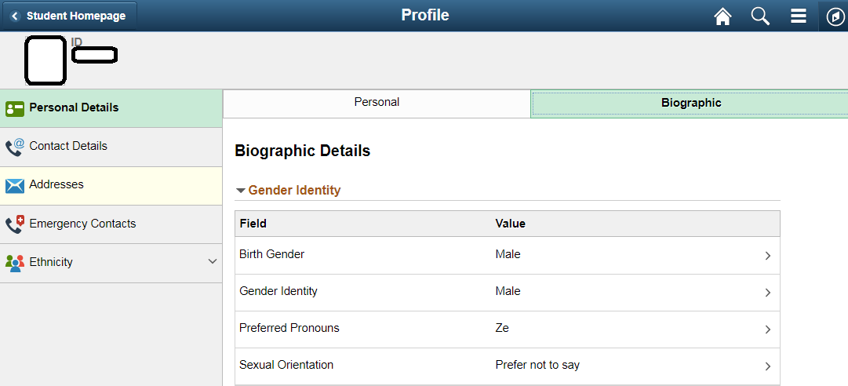
Student Self-Service

Slide 9
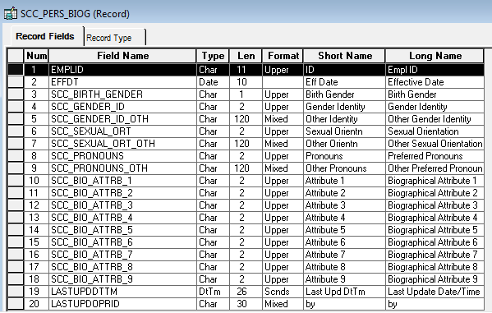
SCC_PERS_BIOG Table

Slide 10
Discussion items
Is collecting and using gender-related information of interest?
What information items are worth collecting?
Notes:
Initial discussions at my institution centered around what information to collect and store in PS; what to feed in from admission (we collect some gender identity information on our application); how to allow opt-in/opt-out capabilities for use cases such as LGBTQ group mailing lists; PS class rosters; LMS class rosters; housing surveys; How do we define/use existing SEX field?

Slide 11
Discussion items
How will information be used?
Must be clearly documented in light of GDPR
Who will have access, to what, and when?
How will we inform students of usage & access?
Should we extend information collection & use to include faculty & staff?
Notes:
Initial discussions at my institution centered around what information to collect and store in PS; what to feed in from admission (we collect some gender identity information on our application); how to allow opt-in/opt-out capabilities for use cases such as LGBTQ group mailing lists; PS class rosters; LMS class rosters; housing surveys; How do we define/use existing SEX field?

Slide 12
Definitions (from PeopleBooks documentation)
Birth Gender
Select a birth gender from the list of values, if permitted. The field label is defined as message text on the Biographic Fields page.
Gender Identity
Select a gender identity from the list of values, if permitted. The field label is defined as message text on the Biographic Fields page. If you select Other, and the Other Identity field is included, the Other Identity field appears.
Other Identity
Enter a description with a maximum of 120 characters. The field label is defined as message text on the Biographic Fields page.
This field appears if Gender Identity is included on the page and is set to Other, or if Other Identity is included but Gender Identity is not. However, if an Other Identity value is saved and Gender Identity is not included on the page, the Gender Identity value in the underlying record is set to Other (OT).

Slide 13
Definitions, continued
Sexual Orientation
Select a sexual orientation from the list of values, if permitted. The field label is defined as message text on the Biographic Fields page. If you select Other, and the Other Orientation field is included, the Other Orientation field appears.
Other Orientation
Enter a description with a maximum of 120 characters. The field label is defined as message text on the Biographic Fields page.
This field appears if Sexual Orientation is included on the page and is set to Other or if Other Orientation is included but Sexual Orientation is not. However, if an Other Orientation value is saved and Sexual Orientation is not included on the page, the Sexual Orientation value in the underlying record is set to Other (OT).
Preferred Pronouns
Select preferred pronouns from the list of values, if permitted. The field label is defined as message text on the Biographic Fields page. If you select Other, and the Other Pronouns field is included, the Other Pronouns field appears.

Slide 14
Definitions, continued
Other Pronouns
Enter a description with a maximum of 120 characters. The field label is defined as message text on the Biographic Fields page.
This field appears if Preferred Pronouns is included on the page and is set to Other or if Other Pronouns is included but Preferred Pronouns is not. However, if an Other Pronouns value is saved and Preferred Pronouns is not included on the page, the Preferred Pronouns value in the underlying record is set to Other (OT).
Attribute Label 1 through 9
Select a value from the list of values, if defined. Field labels are defined on the Biographic Fields page.

Slide 15
Configuration Details
Access the Biographic Details page (Set Up SACR > Install > Campus Community Installation > Biographic Fields).
Access the Personal Details Configuration page (Set Up SACR > Common Definitions > Self Service > Campus Community > Personal Details Configuration).
Translate values of Other, Prefer not to say and Unknown are delivered for:
Birth Gender (SCC_BIRTH_GENDER)
Gender Identity (SCC_GENDER_ID)
Sexual Orientation (SCC_SEXUAL_ORT)
Preferred Pronouns (SCC_PRONOUNS)
Institutions can create their own values to meet their data capture requirements. The Biographical Attribute fields (SCC_BIO_ATTRIB_1 to 9) are delivered with a single translate value Unknown. To use a Biographical Attribute field, institutions should add their own translate values as required and define a message catalog entry to be used as the field label.

