Slide 2
Agenda
Introduction to PeopleSoft nVision (PS/nVision)
Basics of PS/nVision
Question and Answers

Slide 3
Introduction to PeopleSoft nVision (PS/nVision)
Powerful and flexible spreadsheet based financial reporting tool that can be used with PS applications:
PS/nVision combines the mathematical and formatting features of Excel with advanced reporting features such as scope and variables;
Using of this tool helps you to analyze results rather than summarizing and entering data to spreadsheet;
helps you see the big picture, explore details, and make decisions.

Slide 4
Introduction to PeopleSoft nVision (PS/nVision)
Interface and Extraction of Information
Interface is similar to web browser, with buttons and displays that can be customized as per requirement;
PS/nVision selects data from your PeopleSoft database using ledgers, trees, and queries;
Ability to expand and collapse report details based on the grouping structured stored in trees.
FMS Query
nVision Layout
Report Request
Report Output

Slide 5
Introduction to PeopleSoft nVision (PS/nVision)
Additional traits of PeopleSoft nVision :
Drill down capabilities can be incorporated to move from the summarized report to underline details;
Multiple output files (reports) may be created from a single report request;
Reports may be scheduled to run in groups or individually at a predefined time from a dedicated PC.

Slide 6
Basics of PeopleSoft nVision (PS/nVision)
Time Spans and PS/nvision :
Used to easily select and retrieve ledger balances for a specific time period or a range of time;
Controls the period of time for which data is extracted from the ledger table. List of some commonly used time spans is as follows:
PER Activity from the period selected
PER+1 Activity from the next period selected
PER-1 Activity from the prior period selected
YTD Year-to-date amounts for the items selected
BAL Current amounts for balance sheet accounts
BAL-1YR Current amount last year
BEGBAL Beginning balance

Slide 7
Basics of PeopleSoft nVision (PS/nVision)
Trees and PS/nVision :
Tree is a graphic representation of the hierarchical relationships of data in the database;
provides a way to organize related data in a logical manner;
gives a visual summary of the tremendous amount of detailed data the system stores
Continues….

Slide 8
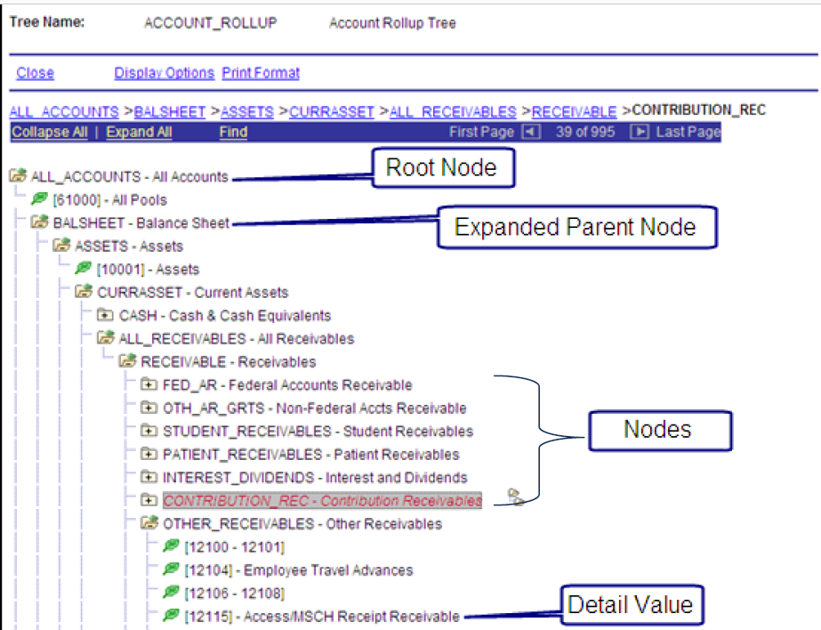
Basics of PeopleSoft nVision (PS/nVision)
Trees and PS/nVision:
Continues….

Slide 9
Basics of PeopleSoft nVision (PS/nVision)
Tree Elements
Name | Description | nVision Example
Node | Summarizes a group of detail values or nodes | Balance Sheet
Detail Values | Lowest field attached to node | Accounts under cash node
Relationship
Parent | Tope post node | Balance Sheet
Child | Subordinate to parent node | BALSheet child to All Accounts
Sibling | Node at same level | Cash and Receivables

Slide 10
Basics of PeopleSoft nVision (PS/nVision)
Report Layouts :
A layout is a template, which defines how the report will look and what type of information will go into the cells of the spreadsheet ;
It does not contain financial data from the database, only references to retrieve the financial data when the report is run;
There are two types of PS/nVision layouts:
Matrix, layout have data selection criteria associated with columns and rows;
Tabular, layouts used with PeopleSoft query to retrieve and display data.
Continues….

Slide 11
Basics of PeopleSoft nVision (PS/nVision)
Matrix Layout Criteria Understanding:
Worksheet
Column
Row
Cell
Continues….

Slide 12
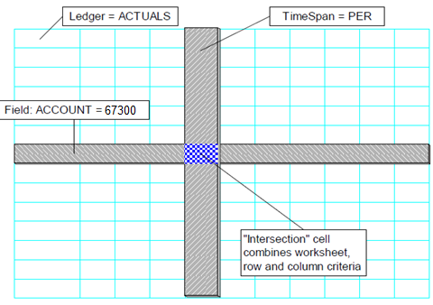
Basics of PeopleSoft nVision (PS/nVision)
Matrix Layout Criteria Understanding:
Continues….

Slide 13
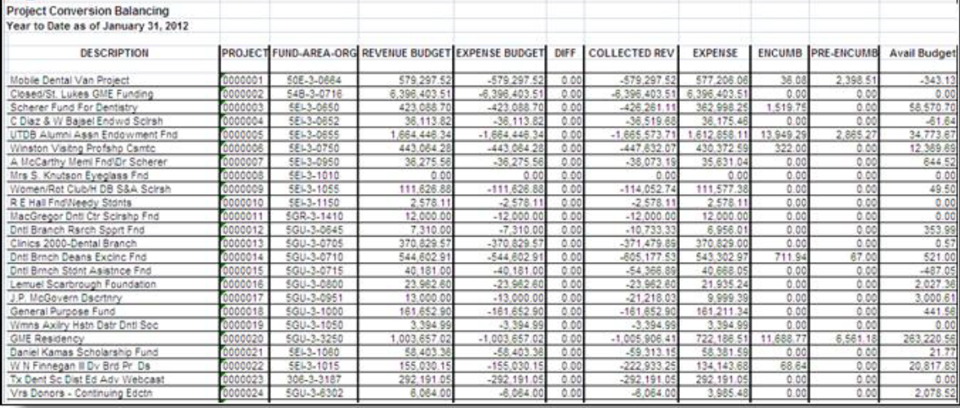
Basics of PeopleSoft nVision (PS/nVision)
Matrix Layout output Example:
Continues….

Slide 14
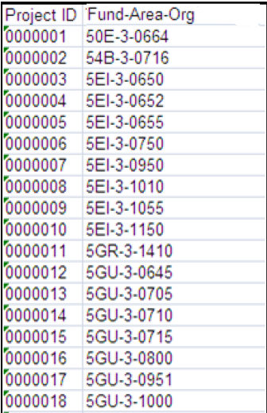
Basics of PeopleSoft nVision (PS/nVision)
Tabular Layout:

Slide 15
Basics of PeopleSoft nVision (PS/nVision)
Producing Report Labels :
with PS/nVision, you can have the system automatically produce row and column labels for your report;
Report labels work in conjunction with criteria. When a row or column containing a report label definition intersects a column or row containing field criteria, a report label is placed in that cell ;
Things to remember:
Labels are entered as row or column criteria, NEVER as cell or worksheet criteria
If your report data is displayed in columns, set up your corresponding text labels in rows and vice versa;
DO NOT place label criteria on a row or column that already
contains criteria.
Continues….

Slide 16
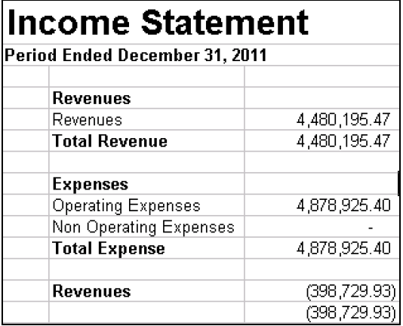
Basics of PeopleSoft nVision (PS/nVision)
Report Labels Example :
Manual Label
Come from Tree Definition

Slide 17
Basics of PeopleSoft nVision (PS/nVision)
Understanding nPlosion :
Used to create individual columns for the detail values summarized by the tree node;
Can be used for multi-period time span;
Helpful to show the underlying detail balances and their corresponding labels;
Reason for using nPlosion:
provides the ability to expand and collapse detail after the report is run, using Excel’s outlining feature;
allows a single report to replace multiple reports
Continues….

Slide 18
Basics of PeopleSoft nVision (PS/nVision)
Understanding nPlosion :
nPlosion Types
To bottom of tree
To Specified Level
To Immediate Child
To Details Only
None
Continues….

Slide 19
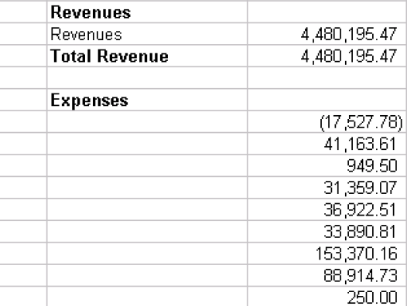
Basics of PeopleSoft nVision (PS/nVision)
nPlosion Example :
Continues….

Slide 20
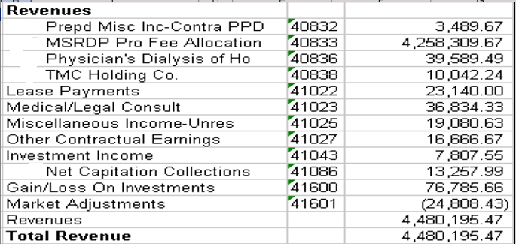
Basics of PeopleSoft nVision (PS/nVision)
nPlosion with Labels Example :

Slide 21
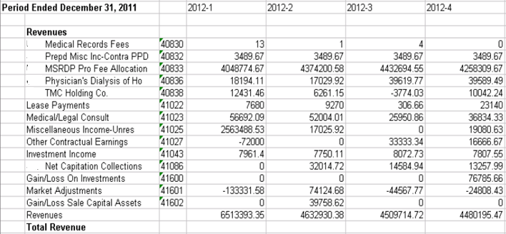
Basics of PeopleSoft nVision (PS/nVision)
nPlosion of timespans Example :

Slide 22
Basics of PeopleSoft nVision (PS/nVision)
Using PS/nVision Variables:
allows you to insert variables in your layouts for heading information that might change from report run to report run;
This is useful for heading information that might change. For example, the As of Date variable may be used to automatically print the date from the request on the report instance so you do not have to enter it every time you run the report;
Variables are represented by codes consisting of three letters bracketed by percent sign (%) characters ;
Types of Variables:
Report Request Variables;
Date and Time Period Variables;
Scope related variables
Continues….

Slide 23
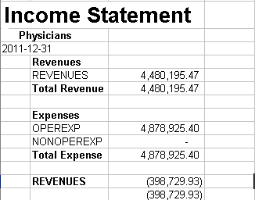
Basics of PeopleSoft nVision (PS/nVision)
Using PS/nVision Variables Example

Slide 24
Basics of PeopleSoft nVision (PS/nVision)
Using Scopes in PS/nVision:
helps to create multiple instances of a report based on specific values for a field, such as instances for each business unit, department, or product;
on combining layout with scope, one report request automatically produces multiple reports for these specific field values;
allows departmental managers to see reported results for their own areas of responsibility.
Continues….

Slide 25
Basics of PeopleSoft nVision (PS/nVision)
Using Scopes in PS/nVision:
IS BU01
nVision Layout
Income Statement
Report request with scope
IS BU02
Scope
BU01,BU02,BU03
IS BU03

Slide 26
Basics of PeopleSoft nVision (PS/nVision)
DrillDown in PS/nVision:
way to automatically generate supporting detail behind any amount on a report;
DrillDown enables you to select a cell in your report (XLS file) and expand it according to new criteria contained in the “child layout.”;
several DrillDown layouts that are standard with PeopleSoft:
BU by Period
BU by account
Account by period
Account by department
Department by account
Journal Lines and so on
Continues….

Slide 27
Basics of PeopleSoft nVision (PS/nVision)
DrillDown in PS/nVision example:
Account and Period

Slide 28
Basics of PeopleSoft nVision (PS/nVision)
Report Books in PS/nVision:
To group PS/nVision reports for specific Run Control IDs. These can be run and scheduled through the Process Scheduler without having to run each report individually;
Report Books give you the options of:
Running a group of reports using a single Process Scheduler request
Turn off reports not needed but keep them in the Report Book
Running all reports using the same As of Date and Tree dates
Continues….

Slide 29
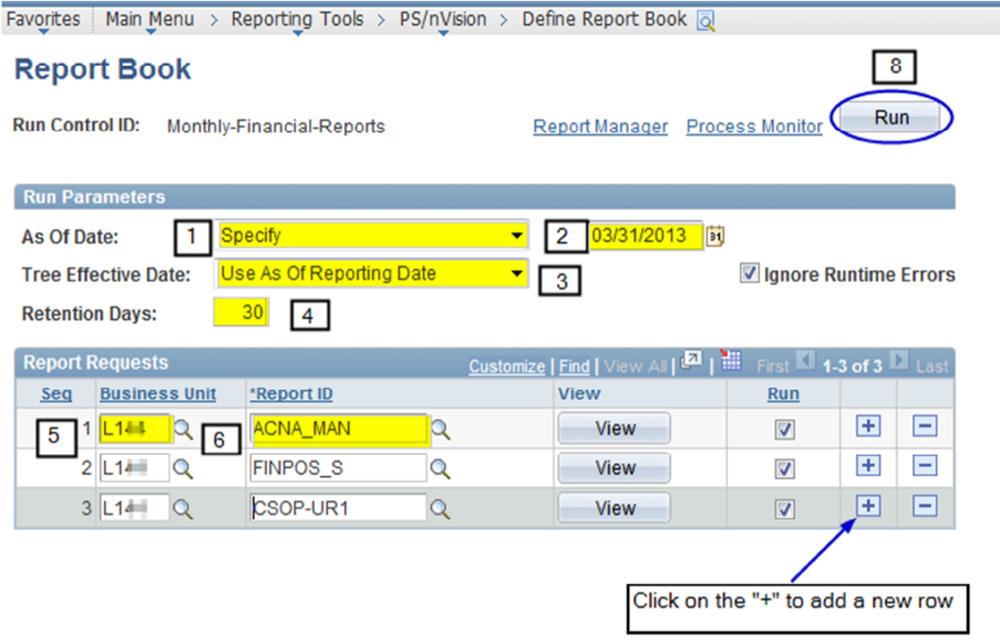
Basics of PeopleSoft nVision (PS/nVision)
Report Books in PS/nVision setting up example:

Slide 30
Questions ?

Slide 31
Thank You

