Slide 1
EVENT MANAGEMENT – MOVING OUR OPEN DAY PROCESS INTO CRM
SESSION 37016
Wednesday 12th October 2016

Slide 2
presenters
James Leigh
CRM System Support & Development Manager
University of Derby
j.leigh@derby.ac.uk

Slide 3
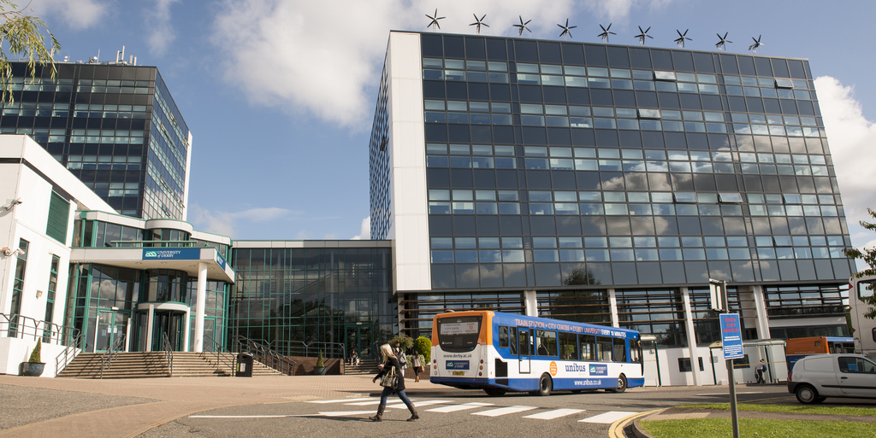
UNIVERSITY OF DERBY
UK based HE Institution 24,000 + students (UK, International & Partners)

Slide 4
UNIVERSITY OF DERBY & ORACLE
Peoplesoft Campus 9.0
Peoplesoft CRM 9.2
Peoplesoft Financials 9.2

Slide 5
AGENDA
WHY MOVE OPEN DAYS?
WHAT WE DID
TEETHING PROBLEMS

Slide 6
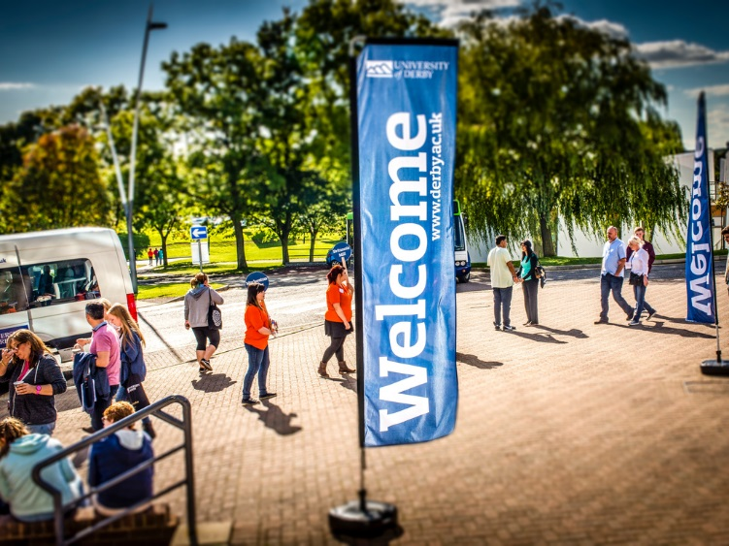
WHY MOVE OPEN DAYS?

Slide 7
THE EXISTING PROCESS (T4 TO PS CAMPUS)
Notes:
Existing Form built in Terminal Four (T4) data then uploaded into Campus.
T4 is our web content management system.

Slide 8
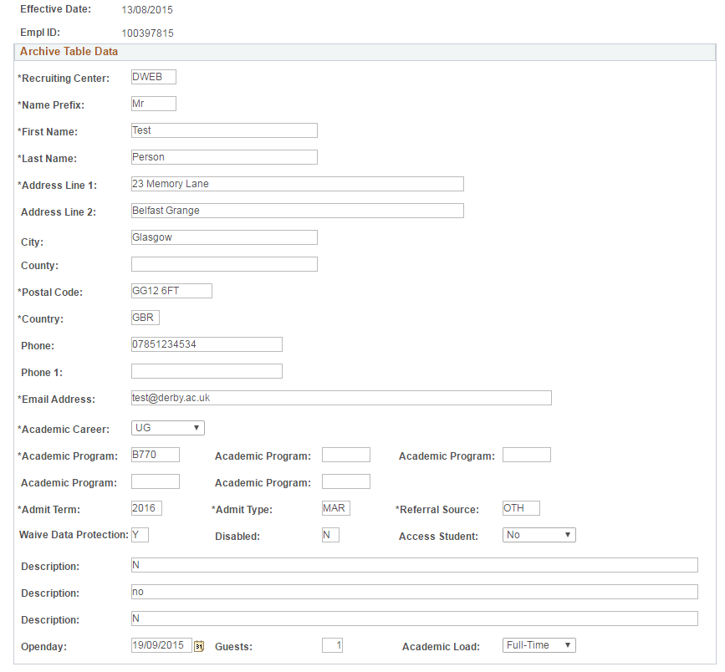
THE EXISTING PROCESS (T4 TO PS CAMPUS)
Customised UoD upload process places individual records into Campus, assigning a Status Flag of ‘D’ or ‘E’…..
D = No match found in CS, prospect data created, EMPLID is assigned and the info messages into CRM.
E = Match found in CS, assigns EMPLID to the record. However where multiple matches are found the process simply assigns the EMPLID based on the first match it comes to. None of this information messages across into CRM.
As a result, Open Day data in both systems compromised, a new solution was needed…..
Notes:
UoD development, limitations on Search / Match in terms of assigning first EMPLID where multiple matches are found.
Data compromised as you have now way of knowing if the correct EMPLID in Campus has been assigned and only half your data in CRM. Those who do go across to CRM, no way of flagging them as Open Day anyway.
Put into Campus so we could join the data to University structures and actually log attendance, so we had their programme of interest we could then tie this to College / Department thus create better transaction reporting.

Slide 9
Event Management - bENEFITS
Allows for a single system solution
More accurate matching of data – Defined Search / Match rules
Interaction captured within 360
Tracking from Enquirer to Applicant
Notes:
Single system solution – End to End – You have the form, you hold the Event in CRM where you can monitor no. of attendees, registrations on the day (who has attended, who hasn’t attended) you can do your transactional reporting, and also any type of E-Mail communication with attendees
More accurate data matching – Having much more confidence that where matches are found that’s the correct person being matched to, Very important in terms of regular transactional reporting, and BI.
Tracking from Enquirer to Applicant – Easier to track in terms of people who attend an Open Day and do they subsequently apply to us.

Slide 10
WHAT WE DID

Slide 11
Event Management – setup
Notes:
Setup is quite long, follows standard CRM protocol, create an Event, you then attach Dialog to that Event, and create numerous documents.
For example, the Registration Form, confirmation pages, e-mail reminder,

Slide 12
EVENT MANAGEMENT - SETUP
Notes:
Standard dialog flow with customised step

Slide 13
EVENT MANAGEMENT – UOD CUSTOMISATIONS
Lots of new Profile Fields…
Form Profiles Audience / Merge Content Profiles
Notes:
Form Profiles – Needed creating in order to make selectable fields on the actual form
Audience – If you want tot target by specific event (can see that info here)

Slide 14
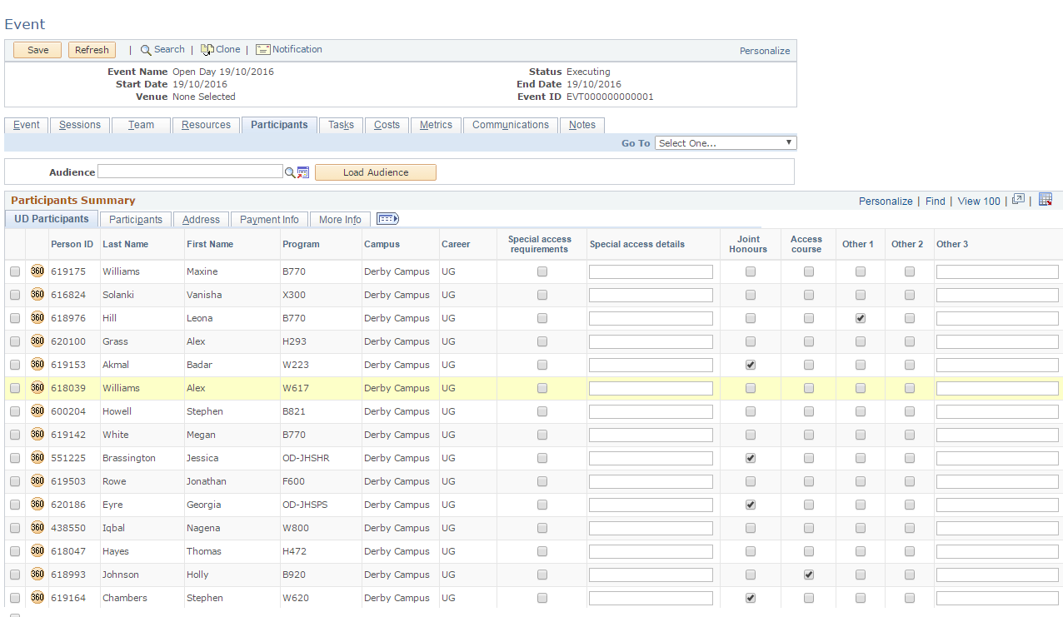
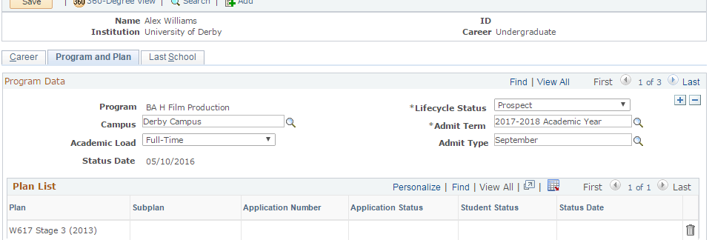
EVENT MANAGEMENT – UOD CUSTOMISATIONS
Additional Information in Participants Summary
Landing of key information in Academics area
Notes:
Delivered under customised UD tab, delivered tabs gave only limited information
Land information in Academics as this is the key driver for our general Enquirer Comms

Slide 15
EVENT MANAGEMENT – THE FORM
HTML, and jQuery work required in order to replicate the look and feel of the existing Open Day Form
Certain aspects of the code could simply be copied from the existing form thus saving time
Notes:
In terms of what CRM spits out, relatively basic.
We have resource within the team where we can use a mix of HTML, and jQuery in order to replicate the look and feel of our existing form. Also helped that we could lift a lot of the code from the existing form.

Slide 16
EVENT MANAGEMENT – THE FORM

Slide 17
TEETHING PROBLEMS

Slide 18
THINGS TO BE AWARE OF….
One resolved, and three outstanding Oracle SRs;
3-10914291941 – OLM Matching Rules
3-12974311561 – Search Match Case Sensitive
3-13298567651 – Inbound Phone Interaction
3-13457067671 – Last row updated, data inconsistency
Form better suited to single event setup
Setup time can be considerable for regular users – Use copy function where possible!
Any questions??
Notes:
Initial issue – Country ID not populating properly
Search/Match – OLM Matching Rules / OLM Global Options these are where the problem lies…
Data Inconsistencty – BO_BASIC_IND stamped with last row loast updated date, this is difference to what comes up in the XML message that comes across
Trying to manage variables within a form proved quite difficult, so for example our applicant day process has multiple sessions but each one of these has a number cap, unfortunately the sub-sessions are within an event does not allow me to apply caps, thus attendance would have to be manually monitored. Variants setup as sub-sessions. Alternative would be to have individual form for each individual variant, work intensive and lacks flexibility.

Slide 19
presenters
James Leigh
CRM System Support & Development Manager
University of Derby
j.leigh@derby.ac.uk
all Alliance presentations will be available for download from the Conference Site

Slide 20
THANK YOU!

