Slide 1
Turning Purchase Orders from Internal Campus Vendors in Jaggaer/sciQuest into Journal Entries
SESSION 6015
November 14, 2018

Slide 2
presenter
Albert (Ab) Birch
Director, Financial Systems
Western University
puraab@uwo.ca
20 years PeopleSoft experience from version 6 – 9.2
GL, Procurement, AP, Billing & AR, Expenses, Commitment Control, Reporting
Integration (HR, CS, CR, Jaggaer, Avantis)
Security Administrator

Slide 3
Western University
Located in London, Ontario
30,500 full-time enrolment
4,000 Full-time Staff
Western Mustangs

Slide 4
Western University & ORACLE
Implemented PSoft in 1998
Finance, HR, CS, CRM
Finance 9.2 Image 22
PTools 8.55.12

Slide 5
AGENDA
BACKGROUND Existing processes, Requisition Approval Workflow, “Speedcodes”, Delegated Signing Authority, In-person counter sales, Tri-Agency Audits,
JAGGAER INTERNAL VENDOR Adding a new Facility Form, using a default commodity code, entering a revenue cost centre, submitting a requisition, new “J-PO” number wheel
MODIFIED PO MESSAGE Added logic to insert data to new journal accounting line table where PO number started with “J”, and later modified again to specify the journal generator template based on “Revenue Speedcode”
SUMMARY and DEMONSTRATION Review Jaggaer Form, Requisition Process, PO Auto Close, PeopleSoft Accounting Entry Definition, Journal Generator Template, Journal

Slide 6
Background
Life Before Jaggaer

Slide 7
Existing journal entry processes
Many Internal Campus Vendors with variety of billing processes
Sophisticated Point-of-Sale systems - e.g. Bookstore, Computer Store
In-person Counter Sales – Chemistry Stores for lab supplies, chemicals
Ordering Facilities – Graphic Services
Custom shops with variable rates – Physics, Engineering, Animal Care
Variety of Journal upload processes
FTP – both manual and automated
Online Journal Entry
Journal Import from a flat file
Journal Import from a template – with both flat file conversion and Excel formatting
Loose or non-existent workflow approval processes
Notes:
WorkCenters are:
Designed for specific roles or for specific areas of work for end users to access key PeopleSoft components and pages to perform their daily tasks.
Goal of increasing productivity by
- grouping access to related transactions in one area – like links to components, queries, reports, and processes, which reduces time to navigate menus and highlights items requiring attention via alerts and task lists in the My Work section

Slide 8
Tri-agency audits, pre-approval
Western had received an unfavourable audit from the Tri-Agency Councils
Lack of pre-approval for research expenditures including expense claims and Internal Vendor sales
No simple way for a PI to delegate authority to another person
SciQuest implementation (now Jaggaer) had just been completed, and a new Delegation of Signing Authority Table (DOSA) had been created for workflow approval rules to be messaged from PS to SciQuest
Researchers could delegate research spending authority in writing to another person – e.g. Grad Students
Departments could delegate Operating spending authority up to $50,000 (Board Policy max)
SciQuest workflow rules would be created for every dollar value limit of delegated authority
Notes:
WorkCenters are:
Designed for specific roles or for specific areas of work for end users to access key PeopleSoft components and pages to perform their daily tasks.
Goal of increasing productivity by
- grouping access to related transactions in one area – like links to components, queries, reports, and processes, which reduces time to navigate menus and highlights items requiring attention via alerts and task lists in the My Work section

Slide 9
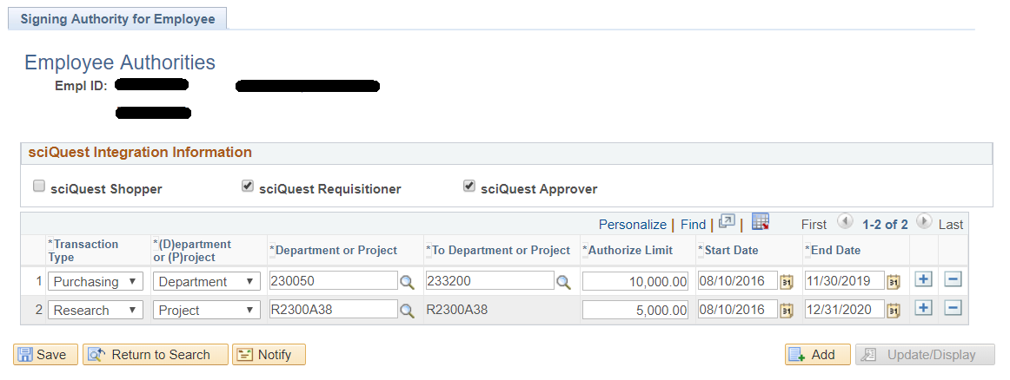
Delegation of signing authority
Captures delegations by Operating or Research fund
Notes:
WorkCenters are:
Designed for specific roles or for specific areas of work for end users to access key PeopleSoft components and pages to perform their daily tasks.
Goal of increasing productivity by
- grouping access to related transactions in one area – like links to components, queries, reports, and processes, which reduces time to navigate menus and highlights items requiring attention via alerts and task lists in the My Work section

Slide 10
Speedcodes and card-swipe access
Speedcodes had been created long ago using SpeedCharts (Procurement Options, Effective dated) and SpeedTypes (Design Chartfields, no effective date)
4-digit Speedchart represents all chartfield combinations except ACCOUNT
SQR process creates or deletes SpeedTypes nightly based on active Speedcharts
Western coined the term “Speedcode”
Speedcode (4 digits) plus Account (6 digits) = 10 digit string – same as before PS
Made initial conversion to PeopleSoft from former MVS system easier for billing units
A card swipe utility had been created to allow for online counter sales
Uses employee ID to validate the speedcode and amount – can either swipe an employee ID card or manually type in the user’s Western Account or Employee number
Local app on the POS system uses a web service to process a query to Query in PS passed the Speedcode through the Delegation of Signing Authority Table to determine if the speedcode lies within the user’s range of Departments or Research Grants
A message is sent back from to indicate Y/N authority and flag if a Research transaction
Addressed the audit findings from Tri-Agency
Notes:
WorkCenters are:
Designed for specific roles or for specific areas of work for end users to access key PeopleSoft components and pages to perform their daily tasks.
Goal of increasing productivity by
- grouping access to related transactions in one area – like links to components, queries, reports, and processes, which reduces time to navigate menus and highlights items requiring attention via alerts and task lists in the My Work section

Slide 11
Jaggaer internal vendors
Next steps

Slide 12
Using sciquest for journals?
One small internal vendor was struggling with their antiquated billing system and needed an easier way to deal with both in-person counter sales and orders that came in via email or phone
The new card swipe system worked well for verifying Requisitioning authority for counter sales but not when there was no authority
The card swipe system did nothing to assist with creating an internal journal transaction between the vendor and the customer
Sales orders via email or phone needed to be approved and billed
Started to investigate the possibility of creating a special “Internal Vendor” within SciQuest
Use requisition workflow rules for authority validation
Send the PO to PeopleSoft but convert the data into a Journal Entry
Notes:
WorkCenters are:
Designed for specific roles or for specific areas of work for end users to access key PeopleSoft components and pages to perform their daily tasks.
Goal of increasing productivity by
- grouping access to related transactions in one area – like links to components, queries, reports, and processes, which reduces time to navigate menus and highlights items requiring attention via alerts and task lists in the My Work section

Slide 13
New internal vendor form
Created a new vendor called “Internal Vendor” in SciQuest
Created a new Form for use by the Campus Unit only
Customers would continue to place orders as before – no changes
The Campus Unit already had a Billing and Inventory system
Used the Catalogue # Field for the Internal Vendor’s revenue distribution cost centre that consisted of Speedcode + Account
Added a Product Description Field that initially contains the name of the Billing Unit but is usually changed at the time of order to reflect the order details
Added a Charge Amount field
Currency fixed at CAD
Commodity code fixed at “Z999 – Procurement use only”
No HST tax implications as this in only an internal transaction
Included the Add Attachments functionality
Notes:
WorkCenters are:
Designed for specific roles or for specific areas of work for end users to access key PeopleSoft components and pages to perform their daily tasks.
Goal of increasing productivity by
- grouping access to related transactions in one area – like links to components, queries, reports, and processes, which reduces time to navigate menus and highlights items requiring attention via alerts and task lists in the My Work section

Slide 14
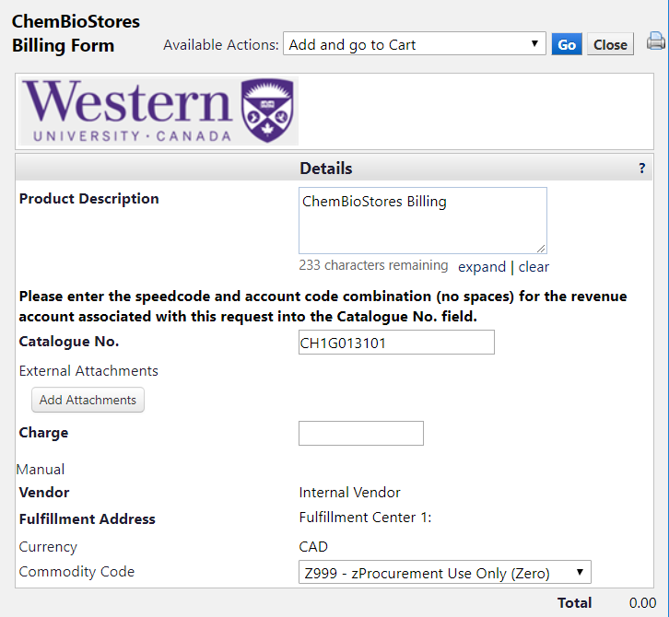
New internal vendor form
Product Description Field has the name of the Campus Vendor but can be changed
Catalogue No. field contains revenue Speedcode CH1G plus Account 013101
Charge Field contains the total amount of the order
Internal Vendor, Currency, and Commodity Code are defaulted
Notes:
WorkCenters are:
Designed for specific roles or for specific areas of work for end users to access key PeopleSoft components and pages to perform their daily tasks.
Goal of increasing productivity by
- grouping access to related transactions in one area – like links to components, queries, reports, and processes, which reduces time to navigate menus and highlights items requiring attention via alerts and task lists in the My Work section

Slide 15
New internal vendor form
After completing the Form, the Internal Vendor adds it to their Cart
Can submit multiple orders to a single Cart
Once all orders are in the Cart, the Internal Vendor can proceed to Checkout
Following the Checkout process, a Requisition is created
The Campus Vendor adds the customer’s speedcode and account
Once the Requisition is complete, the Internal Vendor submits it
This essentially creates an “order” to the Internal Vendor for the goods that the customer requires, and generates workflow approval routing according to the speedcode and amount that was entered on the Requisition
Once the Requisition has been fully approved, it becomes a PO with a PO number starting with the letter “J”
The PO is sent to the external system (PeopleSoft)
The PO is then closed in SciQuest using an Auto-Close workflow rule
Notes:
WorkCenters are:
Designed for specific roles or for specific areas of work for end users to access key PeopleSoft components and pages to perform their daily tasks.
Goal of increasing productivity by
- grouping access to related transactions in one area – like links to components, queries, reports, and processes, which reduces time to navigate menus and highlights items requiring attention via alerts and task lists in the My Work section

Slide 16
PO message Modifications
Changes to App Class
Turning a PO into a Journal

Slide 17
Peoplesoft modifications
As part of the SciQuest integration, Western had already cloned the delivered PeopleSoft objects for PO External Messaging
App Package PO_LOAD_EXT_MES
Application Class PO_LOAD_EXT
PO Staging Tables
A new accounting line table was created for SciQuest journals
Loosely based on the delivered record JGEN_ACCT_ENTRY
PeopleCode modified in the App Class
Added new logic to look for PO number starting with “J”
If found, extract data to the new accounting line table
Use the PO number for the journal line reference field
Extract the Revenue Speedcode and Account from the Catalogue No. field and insert a credit line with all chartfields and amount
Extract the Customer Speedcode and Account and insert a debit line with all chartfields and amount
Notes:
WorkCenters are:
Designed for specific roles or for specific areas of work for end users to access key PeopleSoft components and pages to perform their daily tasks.
Goal of increasing productivity by
- grouping access to related transactions in one area – like links to components, queries, reports, and processes, which reduces time to navigate menus and highlights items requiring attention via alerts and task lists in the My Work section

Slide 18
Peoplesoft modifications
Looking at the PO number to see if it starts with “J”
Notes:
WorkCenters are:
Designed for specific roles or for specific areas of work for end users to access key PeopleSoft components and pages to perform their daily tasks.
Goal of increasing productivity by
- grouping access to related transactions in one area – like links to components, queries, reports, and processes, which reduces time to navigate menus and highlights items requiring attention via alerts and task lists in the My Work section

Slide 19
Peoplesoft modification limitations
Limited number of fields to pass journal information using the PO message
No way to define a Journal Generator Template value for the field APPL_JRNL_ID
Decided to hard-code a value “WFS_SQ” for the Journal Generator Template
Catalogue No. field used for Revenue accounting line
SciQuest PO number used for Journal Line Reference
Process worked well for a single Campus Internal Vendor
More vendors wanted to use SciQuest, more Forms created
All journal lines had the same source from the single Journal Generator Template
Started to create confusion for end users looking at their GL Inquiry statements
All SciQuest J-PO transactions lumped together in one daily journal
Notes:
WorkCenters are:
Designed for specific roles or for specific areas of work for end users to access key PeopleSoft components and pages to perform their daily tasks.
Goal of increasing productivity by
- grouping access to related transactions in one area – like links to components, queries, reports, and processes, which reduces time to navigate menus and highlights items requiring attention via alerts and task lists in the My Work section

Slide 20
Peoplesoft modifications Phase 2
Needed a better mechanism for handling multiple Forms using a single Internal Vendor and Journal Generator Template
Added new PeopleCode to the Application Class that looks at the first 4 characters of the Catalogue No. field from the Form
The first 4 digits represent the Revenue Speedcode
Compare the Speedcode to the list of Journal Generator Templates
If a match is found, use the matching Journal Generator Template to populate the field APPL_JRNL_ID in the new accounting line table
If not, then use the default value WFS_SQ
When the Journal Generator process runs, it will use the accounting template from the journal accounting line table
Creates a separate journal ID and journal source for each Internal Vendor if a Journal Generator Template matches the Vendor’s Revenue Speedcode
Notes:
WorkCenters are:
Designed for specific roles or for specific areas of work for end users to access key PeopleSoft components and pages to perform their daily tasks.
Goal of increasing productivity by
- grouping access to related transactions in one area – like links to components, queries, reports, and processes, which reduces time to navigate menus and highlights items requiring attention via alerts and task lists in the My Work section

Slide 21
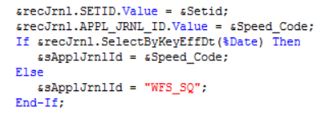
Peoplesoft modifications Phase 2
Change the value for APPL_JRNL_ID to the value for Speedcode if a match is found, else keep the value “WFS_SQ”
Notes:
WorkCenters are:
Designed for specific roles or for specific areas of work for end users to access key PeopleSoft components and pages to perform their daily tasks.
Goal of increasing productivity by
- grouping access to related transactions in one area – like links to components, queries, reports, and processes, which reduces time to navigate menus and highlights items requiring attention via alerts and task lists in the My Work section

Slide 22
Demonstration
Walk-through of both sides
Jaggaer Forms
PeopleSoft Journal Setup

Slide 23
Questions?

Slide 24
presenter
Albert (Ab) Birch
Director, Financial Systems
Western University
puraab@uwo.ca
all Alliance presentations will be available for download from the Conference Site

Slide 25
THANK YOU!

