Slide 1
Rules and student progression: an implementation journey
SESSION 5529
22 October 2019

Slide 2
presenter
Sandra Mienczakowski
Head of Academic Processes
University of Nottingham
sandra.mienczakowski@nottingham.ac.uk
Working as part of the Student Services department since August 2016, leading the Academic Processes teams and Business Lead for PEAM implementation

Slide 3
University of Nottingham
Campuses in UK, China & Malaysia
Gold Teaching Excellence Framework recognition
96 QS World Ranking 2020
19 Complete University Guide Ranking 2020

Slide 4
Overview of the University
Founded as Nottingham College in 1881
1928 moved to University Park
Granted University status in 1948
1970 opened our Medical School
1999 opened the Jubilee Campus
2000 our Malaysia campus was opened
2005 Kings Meadow Campus was purchased
2006 China Ningbo Campus opened
2007 School of Veterinary Medicine and Science opened
Approximately 46,000 students across the three campuses

Slide 5
ORGANIZATION & ORACLE
Campus 9.0 (9.2 upgrade starting)
Bundles 52 (upgrade to 54 December ‘19 and more to come)
People tools 8.55.14 (upgrade to 8.57 December ’19)
PEAM

Slide 6
Overview of CS IMPLEMENTATION
Project Transform initiated in 2014
Implementation of Campus Solutions 9.0 across all campuses
Restructure of student administration services (Aug 2016)
January 2017 Malaysia campus Go Live
April 2017 China campus Go Live
January 2019 UK campus Student Record Go Live
August 2019 UK campus Student Finance Go Live
Approx. 400 staff in Student Services, 7000 staff in total across the UK campus

Slide 7
Overview of Progression rules implementation Journey
Stream of Project to create Rules from Programme Enrolment and Activity Management (PEAM) data initiated in Autumn 2016
FDDs complete March 2017
First use in Malaysia June 2017
First use in China June 2018
Full use in Malaysia and China June 2019
Pilot use in UK June 2019
Full use in Malaysia and China including resitting students August 2019

Slide 8
Progression rules implementation journey
1
3
PROGRESSION FRAMEWORK
The starting point
CONFIGURATION
Curriculum configuration to support validation rules
2
4
FUNCTIONAL DESIGN
How UoN designed progression rules
RULES EXECUTION AND OUTPUTS
Running the Progression Framework and outputs

Slide 9
SECTION 1 progression framework

Slide 10
Starting point
Fully implementing PEAM
University Regulations
https://www.nottingham.ac.uk/academicservices/qualitymanual/assessmentandawards/studyregulationsforundergraduatecourseswef2017.aspx
Individual Programme Specifications - ‘supplementary regulations’
1307 active undergraduate and taught postgraduate plans with a plan specific program of study with defined curriculum content
Some plans share some or all POS/curriculum content
852 plans currently have students enrolled
Potentially 1000’s of rules needed

Slide 11
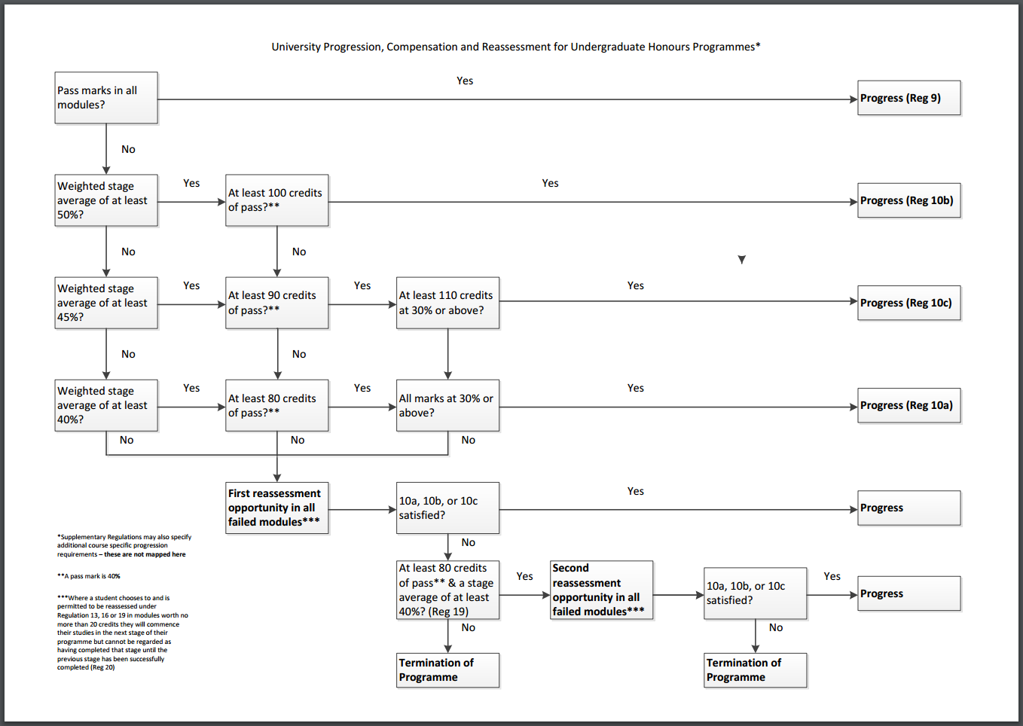
Progression Framework

Slide 12
Assumptions
Academic Standing codes will be defined by Student Records.
Student is currently active in a program and has Academic Progress Tracker (APT) attached to it.
Term will be used to search a stage that’s needs to evaluated. Hence a Term must be attached to the stage.
Calculation Rules will derive the required percentages.
Calculation Rules will be executed before Progression rules are executed.
Transfer Credits are assumed as passed modules.
Transfer Credits will be included in calculations for the Calculation of Total Credits for the Stage & the calculation of the Credit Weighted Average of the Stage.
On a per course basis the best result will be used to validate progression.
When Transfer Credit is used in the calculation the rule will use the transfer credit mark instead of the AM Result.
Zero Credit and Dropped Courses are excluded from the calculation.
Event Audit will be created as the Progression Process is run.
Overall Course marks are determined from the Individual Activity Manager (IAM) Results.

Slide 13
SECTION 2 Functional Design

Slide 14
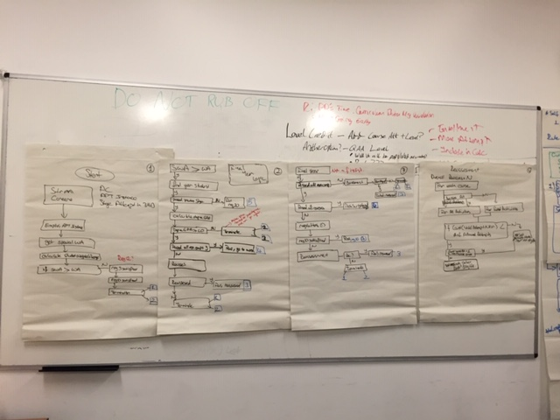
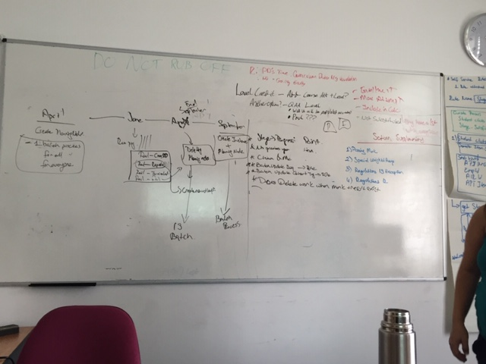
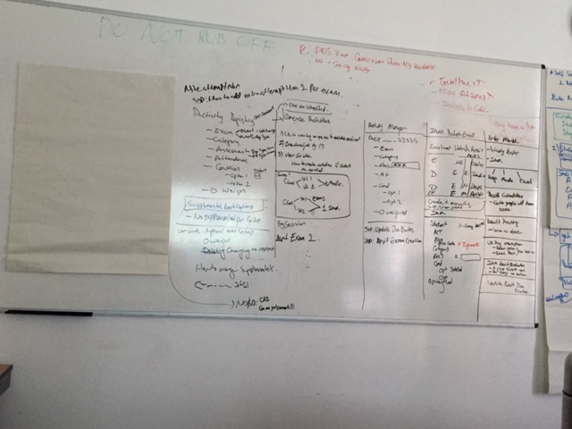
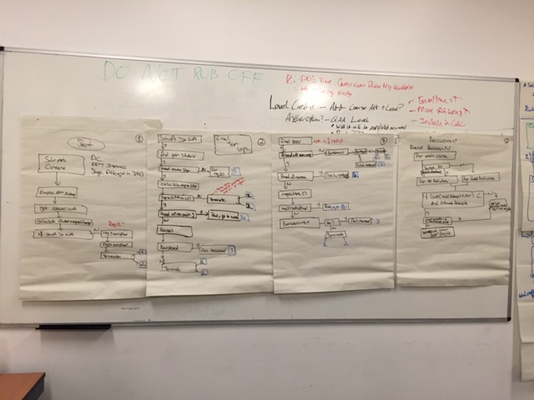
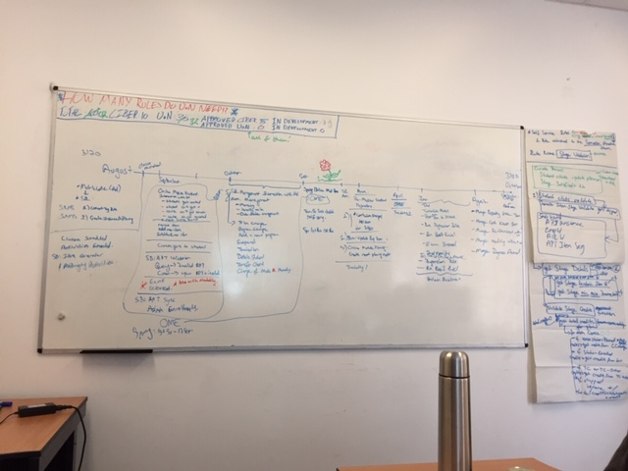
THE PEAM TEAM AND THE WHITEBOARD days (MONTHS)

Slide 15
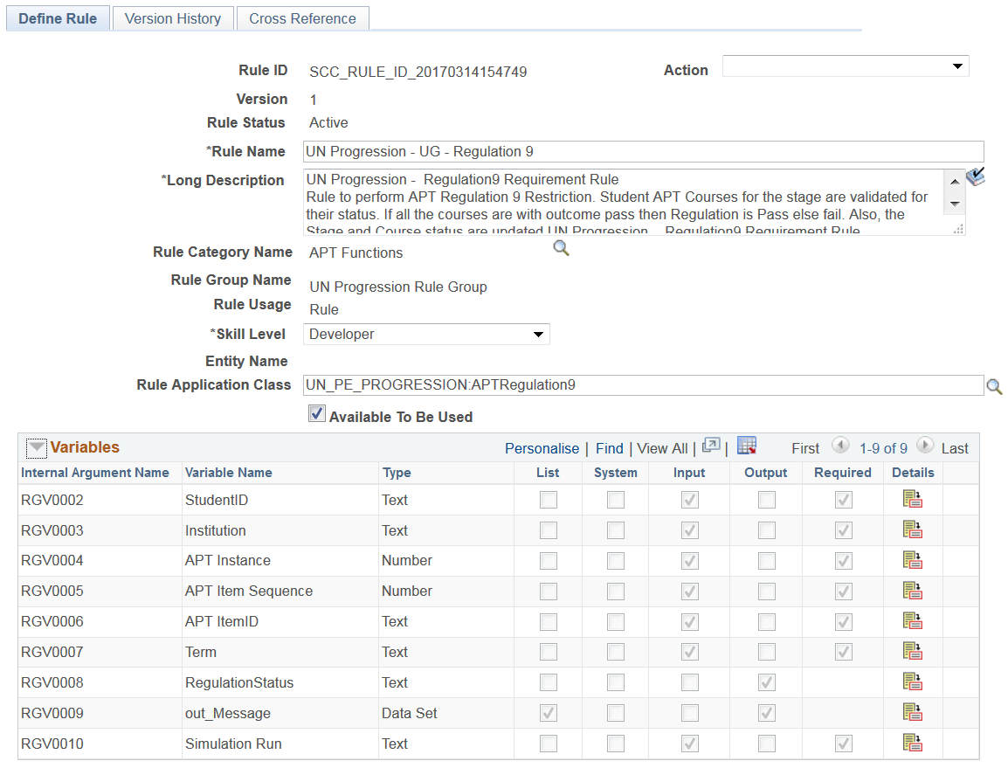
RULES ENGINE
Rules are written in Rules Engine Framework
Rule requires a Rule ID configured/developed in Rules Engine
Rules are associated with a Rule Group – in this case UN Progression Rule Group acting as a template for Rules used in the Progression Framework
Parameters are input in the Progression Framework

Slide 16
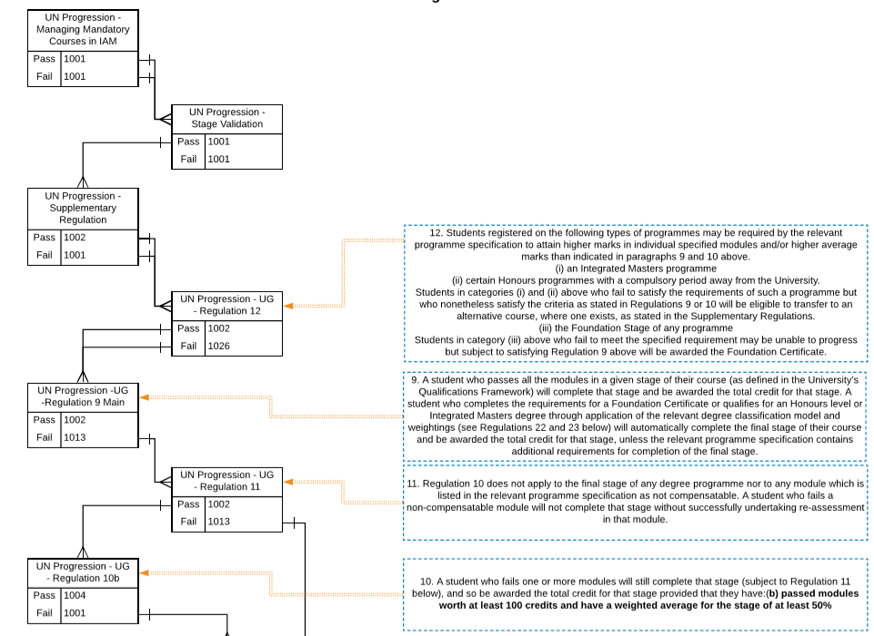
RULES for pROGRESSION – UNDERGRADUATE PROGRESSION

Slide 17
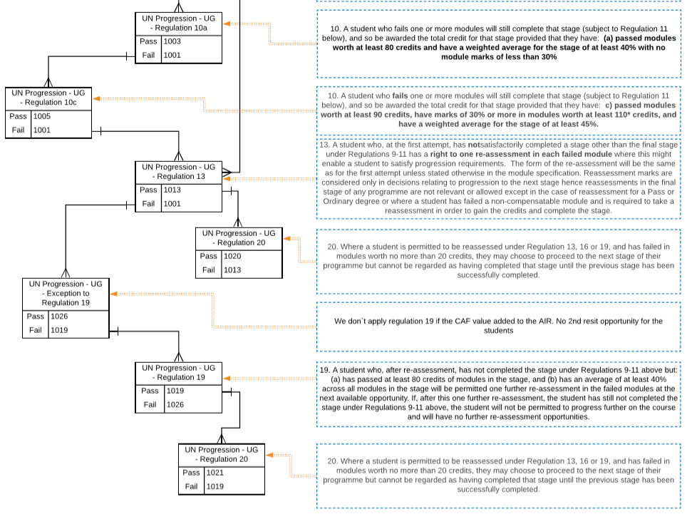
RULES for pROGRESSION – UNDERGRADUATE PROGRESSION

Slide 18
THE RULES

Slide 19
STAGE LEVEL CALCULATION RULES (Stage Validation)
Failed Stage Credits
Calculates the total amount of Failed Credit at the end of the current stage for a student’s APT
In Progress Credits
Calculates the total amount of In-Progress Credit at the end of the current stage for a student’s APT
Total Credits
Calculates the Sum of all Credit within a Stage Level Academic Item and will insert a Total Credit result in student’s APT in relevant Academic Item
Stage Passed Credits
Calculates the Total Passed Credits for an Academic Stage and inserts a total credit amount into a student’s APT at the relevant parent Stage Academic Item
Stage Credit Weighted Average
Calculates the Stage Weighted Average for an Academic Stage and inserts a total value into a student’s APT at the relevant parent Stage Academic Item

Slide 20
Supplementary Regulation

Slide 21
Special weighted average – regulation 12

Slide 22
MAIN PROGRESSION RULE – Regulation 9

Slide 23
MAIN PROGRESSION RULE – REGULATION 11

Slide 24
MAIN PROGRESSIon RULE – REGULATIONS 10a, 10b, 10c

Slide 25
MAIN PROGRESSIon RULE – REGULATIONS 10a, 10b, 10c

Slide 26
MAIN PROGRESSIon RULE – REGULATIONS 10a, 10b, 10c

Slide 27
MAIN PROGRESSION RULE – REGULATION 13

Slide 28
MAIN PROGRESSION RULE – 2nd Reassessment REGULATION 19

Slide 29
MAIN PROGRESSION RULE – 2nd Reassessment not permitted

Slide 30
MAIN PROGRESSION RULE – Proceed carrying credit regulation 20

Slide 31
SECTION 3 CONFIGURATION

Slide 32
RULES for pROGRESSION – CURRICULUM CONFIGURATION
Academic Item Registry (AIR) Stage
Special Weighted Average (Regulation 12)
Second Reassessment Exception (Regulation 19)
Minimum and Maximum Credits
Supplementary Regulation Minimum Pass Mark
Result Type Set up
AIR Courselist
Compensatable
Activity Registry – Element Level (Assessment and Exam)
Mandatory Pass required (Mandatory Fail Rule)
Weighting of Element (Supplementary Regulation Rule)

Slide 33
RULES for pROGRESSION – CURRICULUM CONFIGURATION

Slide 34
RULES for pROGRESSION – CURRICULUM CONFIGURATION

Slide 35
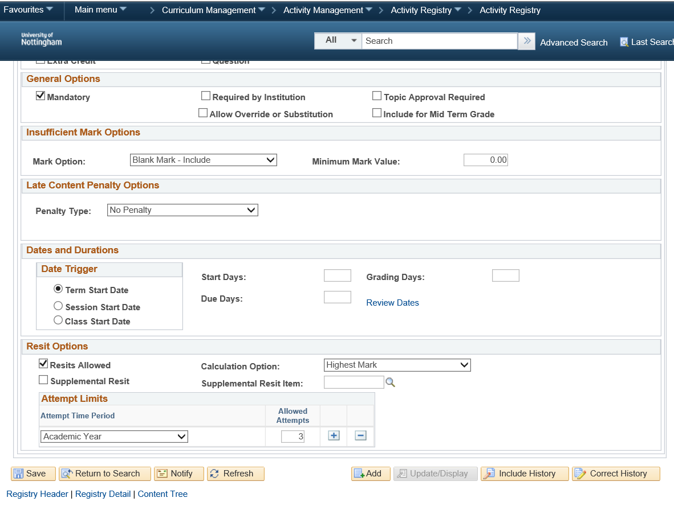
RULES for pROGRESSION – CURRICULUM CONFIGURATION

Slide 36
RULES for pROGRESSION – Student CONFIGURATION
Stage Level Calculation Rules
Failed credits
In progress credits
Passed credits
Total credits
Weighted average
Course Level
Course Result on APT
Class Enrolment on APT
APT Stage Level
Deferred
Individual Activity Manager (IAM)
Element Level Mark
Course Level Mark
Resit Level

Slide 37
RULES for pROGRESSION – Student

Slide 38
RULES for pROGRESSION – Student

Slide 39
SECTION 4 RULEs EXECUTION and outputs

Slide 40
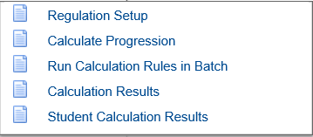
Rule execution
Rules are configured for each Academic Career
Run Calculation Rules in Batch runs smaller rules before calculating Progression
The Calculate Progression process applies the configured rules to a batch of students
The process allows selection of students based on criteria and also allows a user to run in Simulation Run
Each time the process runs successfully, high-level details are logged on the Calculate Results component with a row for each successful run for each Process Instance
Within Student Calculation Results details of the individual rules applied to a student are shown

Slide 41
Rule (Regulation) setup

Slide 42
RUN CALCULATION RULES IN BATCH

Slide 43
CALCULATE PROGRESSION

Slide 44
CALCULATion RESULTS
Exports results to Excel

Slide 45
Student CALCULATion RESULTS
Message set up in Message Catalogue

Slide 46
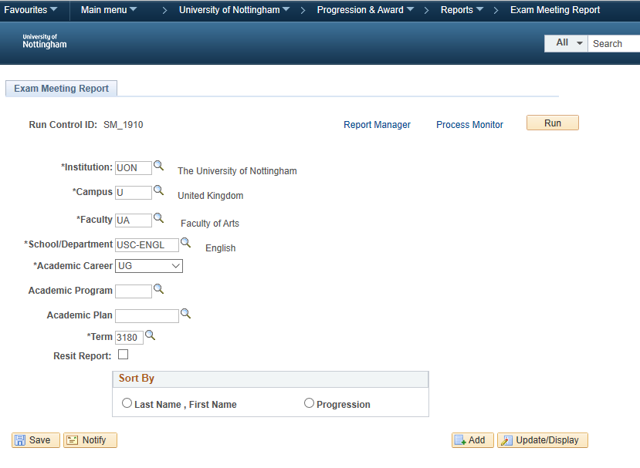
OUTPUTS – EXAM BOARD MEETING REPORT

Slide 47
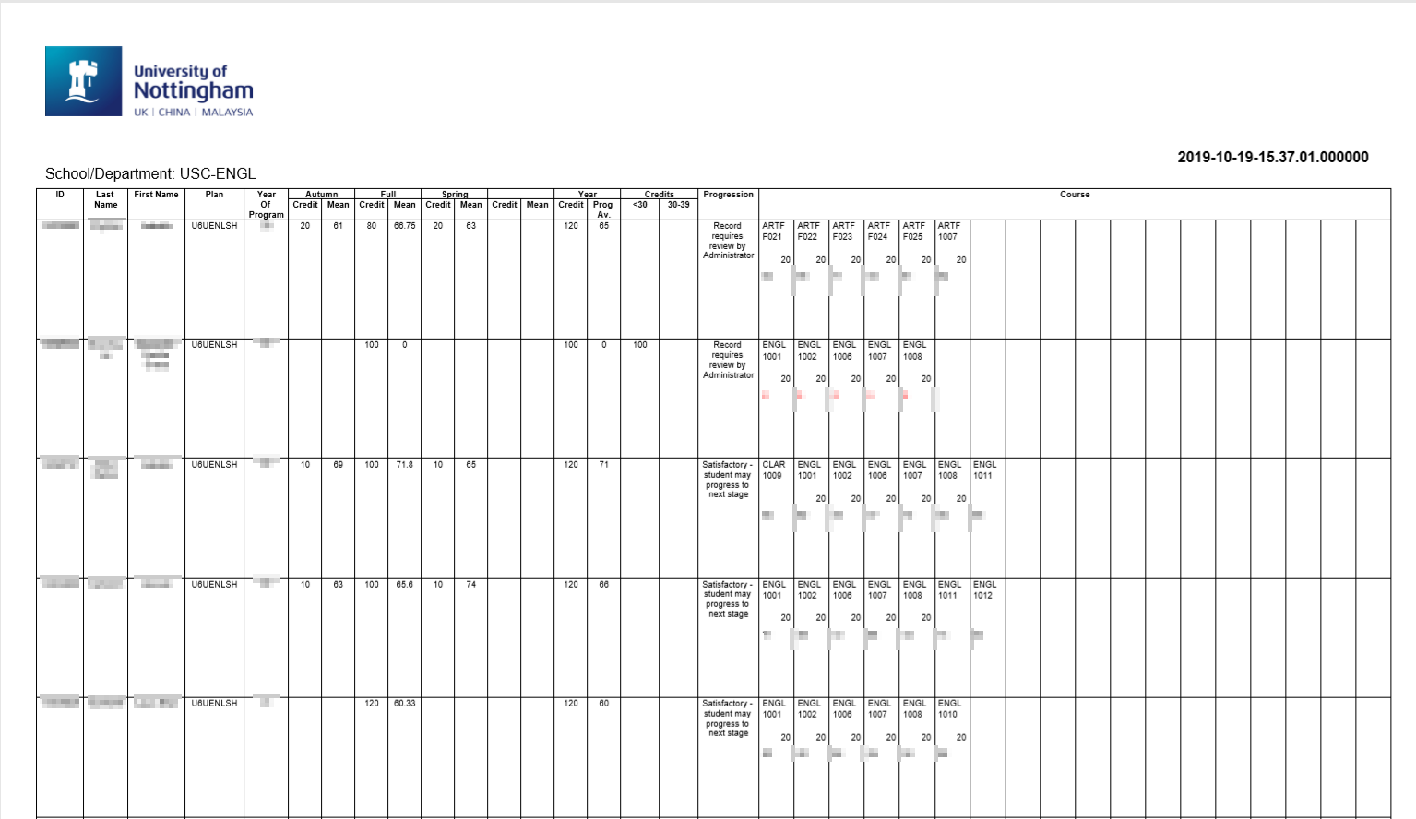
OUTPUTS – EXAM BOARD MEETING REPORT

Slide 48
ACADEMIC STANDING CODE (ASC) UPDATE

Slide 49
STUDENTS IDENTIFIED AS RESIT ALLOWED

Slide 50
ANY QUESTIONS?

Slide 51
SUMMARY
Standardisation, harmonisation and simplification before starting helps!
Logic of rules is different to written order of regulations
Benefits
Using PEAM functionality and Rules Engine has allowed 1000’s of ‘supplementary’ regulations to be reduced to 43 Rule
Increased granularity of outcome
Ability to drill down into which rules a student has passed/failed helps provide meaningful feedback to students
But it takes time …

Slide 52
presenter
Sandra Mienczakowski
Head of Academic Processes
University of Nottingham
sandra.mienczakowski@nottingham.ac.uk
all Alliance presentations will be available for download from the Conference Site

Slide 53
THANK YOU! And with SPECIAL thanks to the PEAM TEAM: Nilgun Oneren, Suat Oneren, Andrew McInDOE, Omair Iqbal, liz Annable, Paul dawson

