Slide 1
Student View of the new Fluidised Academic Registration User Interface
Session 7571
Tuesday 28 November 2023
HEUG Europe - Lille
27 - 28 November, 2023
Cité des Échanges

Slide 2
Presenter
Gerry Durning – Business Analyst
University of Glasgow
Gerry.Durning@glasgow.ac.uk

Slide 3
University of Glasgow
Our Income
Tuition income in excess of £200 million
Accommodation in excess of £25 million
Who we are
Founded in 1451
4 Colleges and 23 schools
Research Institution with over 5,000 active researchers
35,000 students across UG & PGT
7,500 staff members
Organisation & Oracle
Campus Solutions 9.2
Tools 8.59
PUM 27
www.gla.ac.uk

Slide 4
Our Portfolio

Slide 5
Our Portfolio
www.website.com

Slide 6
Our Gallery
Dat Bike, a Vietnamese startup with ambitions to become the top electric motorbike company in Southeast Asia, has raised $2.6 million in pre-Series A funding led by Jungle Ventures.
Learn More

Slide 7
Our Portfolio

Slide 8
Gallery
Expand

Slide 9
Our Portfolio
Dat Bike, a Vietnamese startup with ambitions to become the top electric motorbike company in Southeast Asia, has raised $2.6 million in pre-Series A funding led by Jungle Ventures.

Slide 10
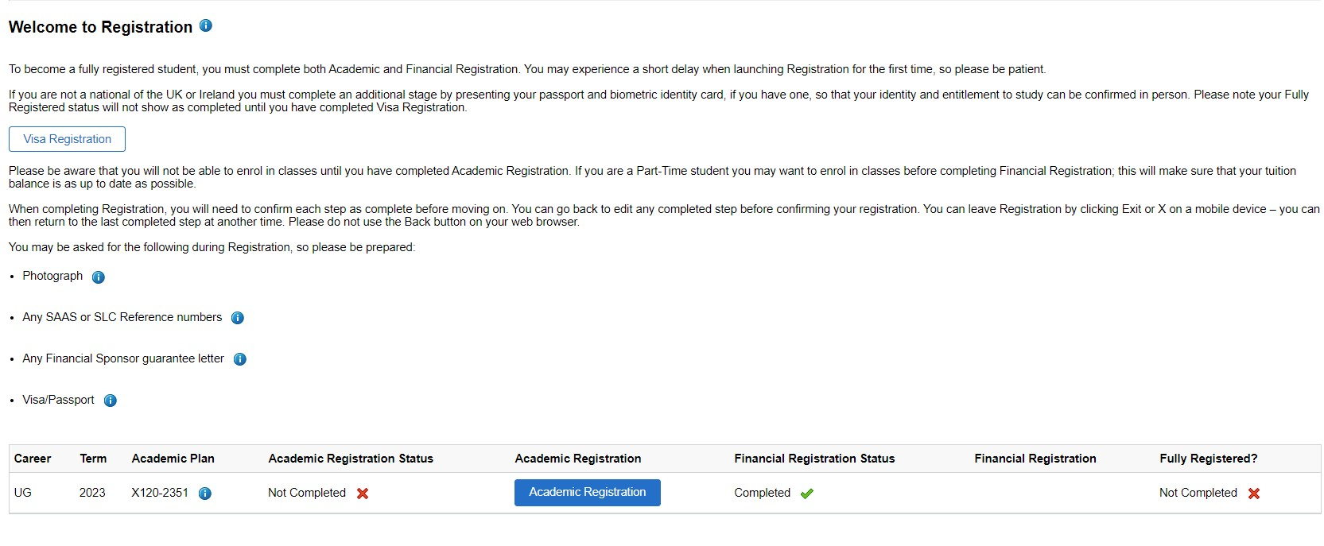
Fluid Registration Welcome Page
Classic Registration Welcome Page
Old versus New
July 2023: Roll out of an entirely revamped Registration UI
Classic Registration layout had not been updated since 2011, although content was reviewed annually and updated as required
See the difference between Classic and Fluid Welcome to Registration and Summary pages

Slide 11
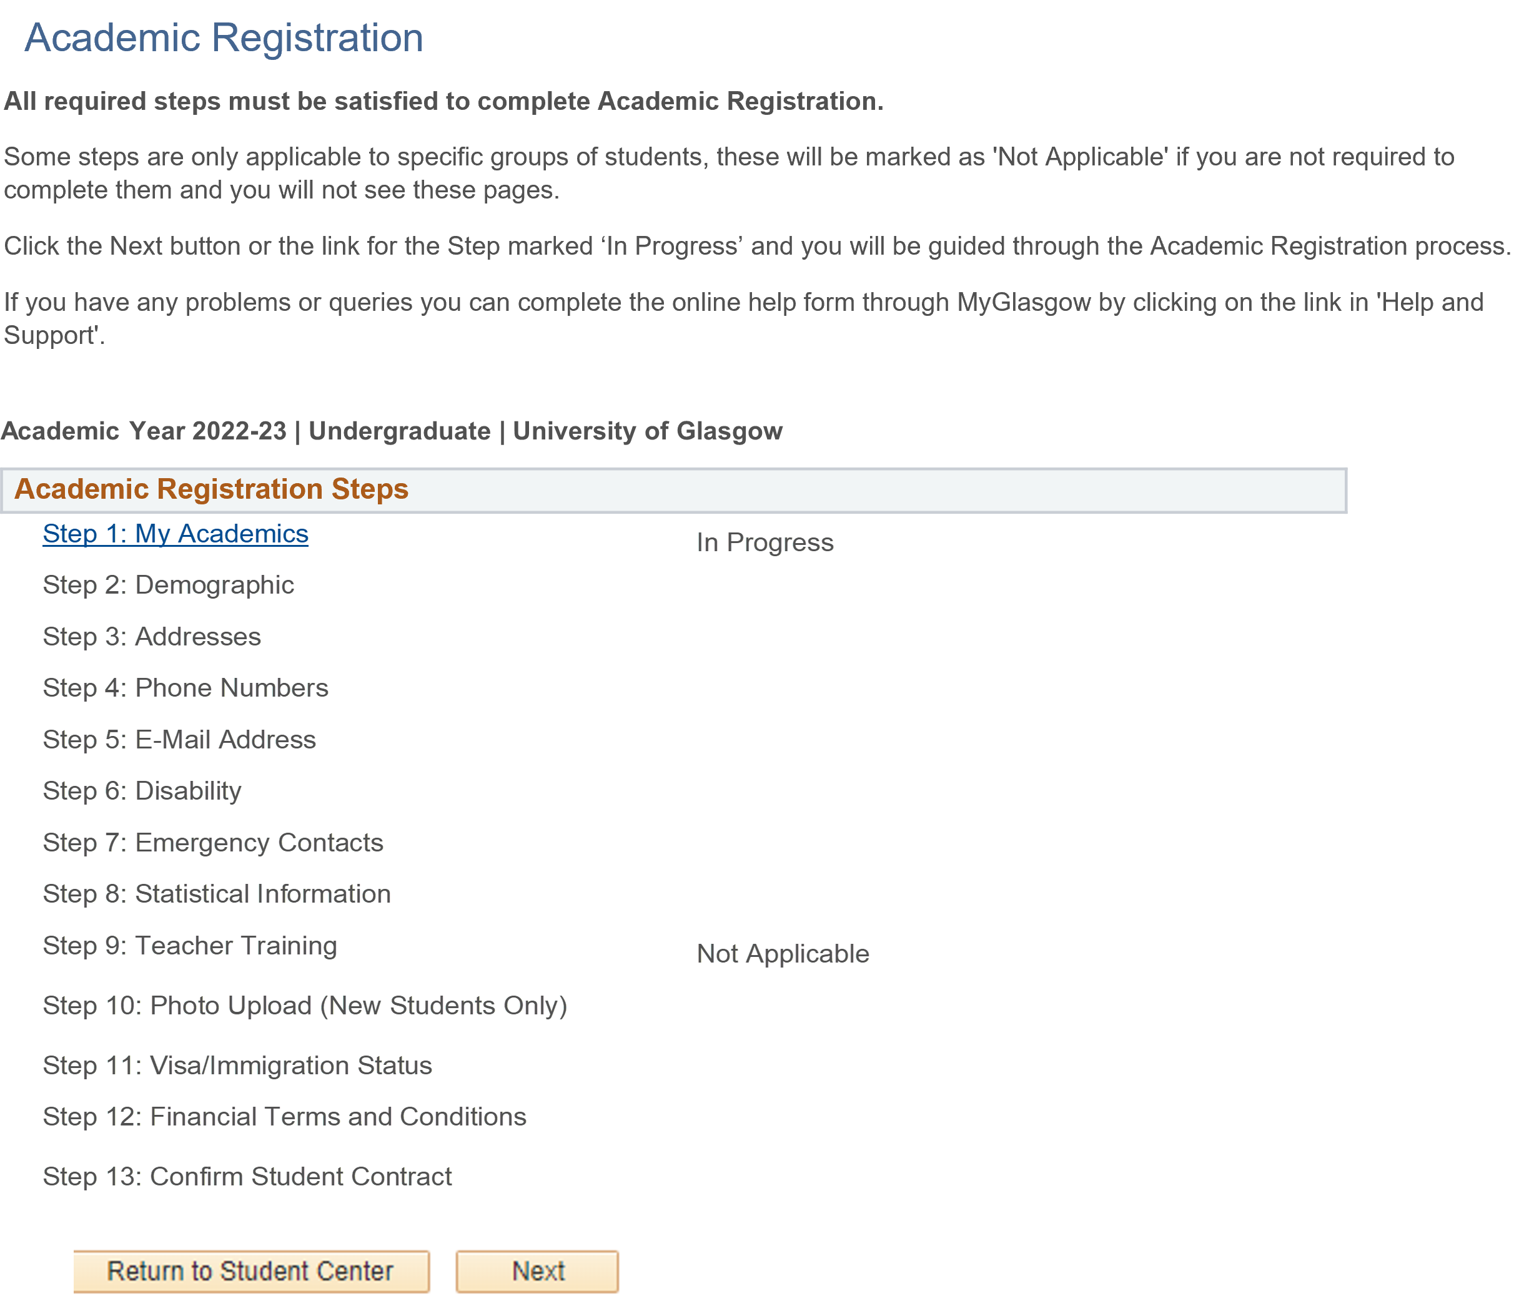
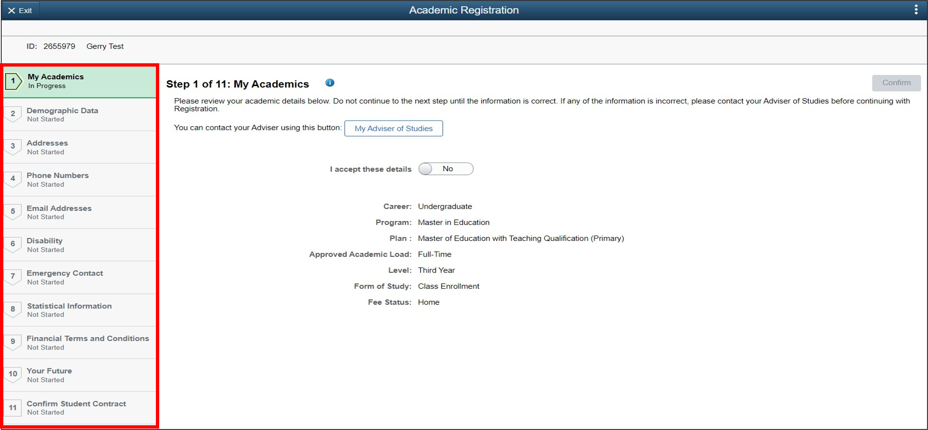
Classic Summary Page
Fluid Summary Page

Slide 12
Live Demo

Slide 13
Questions?

Slide 14
Thank You
Session: 7510 Student View of the new Fluidised Academic Registration User Interface
Gerry Durning
Business Analyst
University of Glasgow
gerry.durning@glasgow.ac.uk

