Slide 1
Implementation of Student Package in Bina Nusantara University
Breakout Session 4
Nov 9th, 2015

Slide 2
Presenters
Indrabudhi Lokaadinugroho IT Data Center & ERP Manager Bina Nusantara Group ilokaadinugroho@binus.edu | Hananto Aji Nugroho Head of SAS Software Development Center Bina Nusantara Group hnugroho@binus.edu

Slide 3
Overview
How Bina Nusantara University implements Student Package based on Block Enrollment in Oracle Campus Solutions.

Slide 4
Agenda
Bina Nusantara Profile
Student Package Implementation
Lesson Learned

Slide 5
Bina Nusantara Profile

Slide 6
Vision and Mission

Slide 7
Three Decades of Education Excellence
2010
binus square of residence
2000
binus center
2011
binus university bridging campus alam sutera
2014
binus university @ alam sutera
2001
binus international
2003
binus school simprug
2011
binus school serpong (Phase 3)
2014
RISE
2007
binus school serpong
2012
kalbis institute
1996
universitas bina nusantara
1987
Stmik bina nusantara
1974
MODERN COMPUTER COURSE
1981
Akademik Teknik Komputer

Slide 9
Organization Structure
BINA NUSANTARA
BINUS
International School
BINUS
University
BINUS
Affiliations
BINUS
Enterprises
IB Program
(International Baccalaureate)
Cambrigde Program
Undergraduate Program
Graduate Program
Learning Community
Partnership
Education Operator
BINUS Center
BINUS Square
BINUS Consulting
BINUS Creates
Simprug
Serpong
BINUS - Northumbria
Kalbis
University
International Programs
Online Learning
Doctorate Program (S3)
Graduate Program (S2)
Business School (S2)

Slide 10
Bina Nusantara University
Established in 1996
Located in Jakarta, Indonesia
32,000+ active students
82,000+ alumni
6 campus

Slide 11
Back in 2012…
“We need to have standard process of managing transfer credit”
“We need to have a single ID for any individual or organization within our system”
“It so difficult to maintain different system for different model of academic grade and program.”
“We need a system that can provide multiple academic calendar”
“Separated system does not allow our student to cross enroll.”
“We need flexibility of defining fee rules at different level”
More than 100 legacy applications
Several systems are not integrated
Many databases
Hardcoded

Slide 12
Campus Solution Implementation
Project Timeline: Apr 2013 – May 2014, Go Live in Jun 2014
Project Objectives:
To implement a real-time solution which will:
align IT objectives with University business objectives, as a first step toward BINUS ICT Roadmap 2020
help realize the goals of BINUS institutional global process
To streamline business and administrative processes and minimize overlapping processes so as to increase effectiveness and reduce redundancy
To improve operational efficiency of departments involved in managing the campus life across the University, through integration with other Bina Nusantara systems
To simplify data consolidation and reporting processes

Slide 13
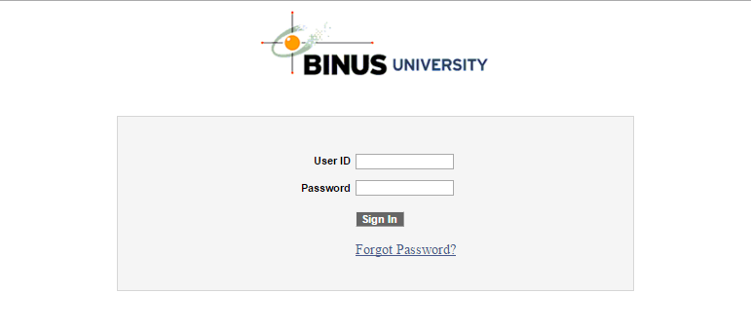
Binus Campus Solutions
We called it BCS (Binus Campus Solutions)

Slide 14
Student Package Implementation

Slide 15
What is Student Package?
Student package is a package that consist of courses and classes which are grouped according to academic program, academic plan and requirement term.
Every student in eligible semester will get a student package based on their academic requirements.

Slide 16
Background
BINUS provides students with package consists of courses. Student Package is used for academic careers:
RS1 (Undergraduate)
BAS (BINUS ASO School of Engineering)
Single degree students will have student package from semester 1 to 6
Double degree students will have student package from semester 1 to 8
SRSC (Student Registration & Scheduling Center) need to allocate students within the right package based on academic advisement inputted by ARC (Academic Resources Center).
Student Package module was created based on Block Enrollment in standard Oracle People Campus Solution.

Slide 17
Why Student Package?
In the beginning of Oracle Campus Solutions implementation, scheduling staff used Block Enrollment to do scheduling process and it took a lot of time and efforts.
Class must be created and grouped manually with Block Enrollment.
Block Enrollment does not fit perfectly with common practice in Indonesia University.

Slide 18
Term Format
For regular students, we have 3 types of term format:
Odd Semester (1410, 1510, etc)
Even Semester (1420, 1520, etc)
Compact Semester (1430, 1530, etc)
First dan second digits represent year.
Third dan fourth digits represent term type.

Slide 19
Package Code Format
Package code consists of 12 digits with the following pattern:
01 | 03 | 05 | 1 | 1 | 1 | 1 | 01
Academic Program Code | Academic Plan Code | Level of Study | Campus | Program | Shift | Semester | Running Number

Slide 20
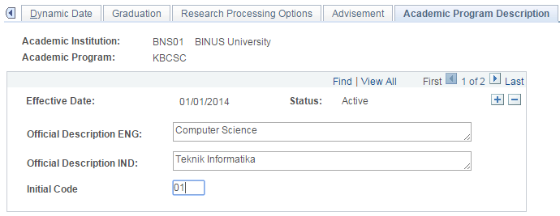
Package Code - Academic Program Code
Academic Program Code is taken from Academic Program Table
01 | 03 | 05 | 1 | 1 | 1 | 1 | 01
Academic Program Code | Academic Plan Code | Level of Study | Campus | Program | Shift | Semester | Running Number

Slide 21
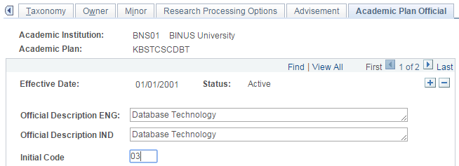
Package Code - Academic Plan Code
Academic Plan Code is taken from Academic Plan Table
01 | 03 | 05 | 1 | 1 | 1 | 1 | 01
Academic Program Code | Academic Plan Code | Level of Study | Campus | Program | Shift | Semester | Running Number

Slide 22
Package Code - Level of Study
05 is for Undergraduate programs
06 is for Master programs
07 is for Doctoral programs
01 | 03 | 05 | 1 | 1 | 1 | 1 | 01
Academic Program Code | Academic Plan Code | Level of Study | Campus | Program | Shift | Semester | Running Number

Slide 23
Package Code - Campus
1 is for CSKMG (Binus Kemanggisan)
2 is for CSALS (Binus Alam Sutra)
01 | 03 | 05 | 1 | 1 | 1 | 1 | 01
Academic Program Code | Academic Plan Code | Level of Study | Campus | Program | Shift | Semester | Running Number

Slide 24
Package Code - Program
1 is for Regular Program
2 is for Smart Program
3 is for Global Program
01 | 03 | 05 | 1 | 1 | 1 | 1 | 01
Academic Program Code | Academic Plan Code | Level of Study | Campus | Program | Shift | Semester | Running Number

Slide 25
Package Code - Shift
1 is for Regular Shift
2 is for Night Shift
01 | 03 | 05 | 1 | 1 | 1 | 1 | 01
Academic Program Code | Academic Plan Code | Level of Study | Campus | Program | Shift | Semester | Running Number

Slide 26
Package Code - Semester
Semester is based on student semester
Single degree students will have student package from semester 1 to 6
Double degree students will have student package from semester 1 to 8
01 | 03 | 05 | 1 | 1 | 1 | 1 | 01
Academic Program Code | Academic Plan Code | Level of Study | Campus | Program | Shift | Semester | Running Number

Slide 27
Package Code – Running Number
Running number will be sequential from 01 to 99
01 | 03 | 05 | 1 | 1 | 1 | 1 | 01
Academic Program Code | Academic Plan Code | Level of Study | Campus | Program | Shift | Semester | Running Number

Slide 28
Student Package Pre Requisite
Some pre requisite settings need to be done before
using Student Package.
1. Academic Plan Unit Load
2. Campus Initial
3. Class Requisite Entity Group
4. Component Initial Pattern
5. Define Requirement Groups
6. Course Component Capacity

Slide 29
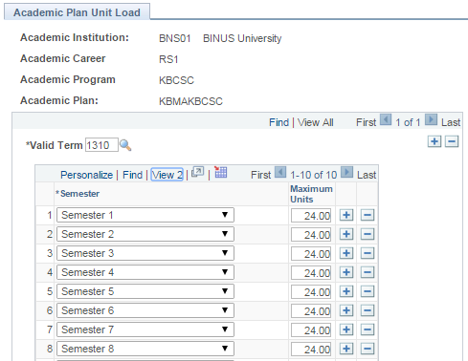
Pre Req 1: Academic Plan Unit Load
This page is used to define how many courses a student can get for each semester based on valid term.

Slide 30
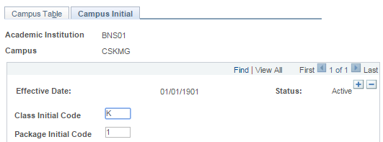
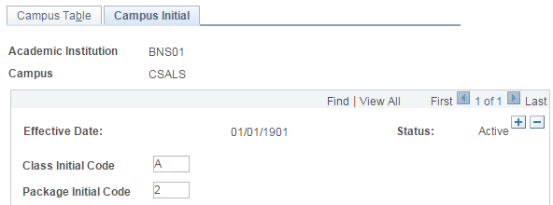
Pre Req 2: Campus Initial
This page is used to define class initial code and package initial code for every campus used in scheduling.

Slide 31
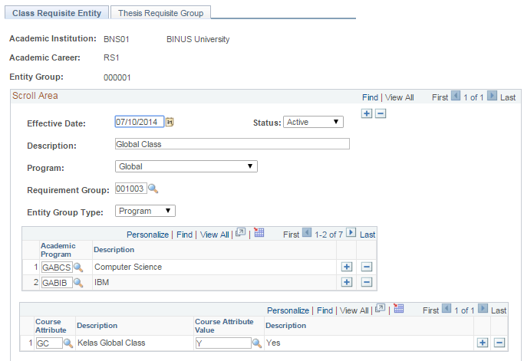
Pre Req 3: Class Requisite Entity Group
This page is used to define entity group for every program offered in
Bina Nusantara University:
Global
Regular
Smart

Slide 32
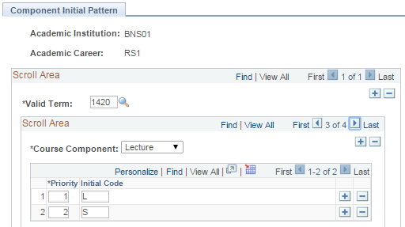
Pre Req 4: Component Initial Pattern
This page is used to define the first initial code in class section based on valid term.
For example a course with course component Lecture will be named LA01, LB01, LC01, etc.
Second digit will be from A to Z.
Third and Four digit will be from Initial Code in Academic Program Table.

Slide 33
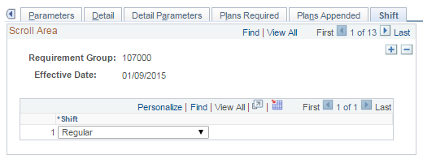
Pre Req 5: Define Requirement Groups
This page is used to define shift for every Academic Program.
Right now, there are 3 shifts:
Regular
Night
Both

Slide 34
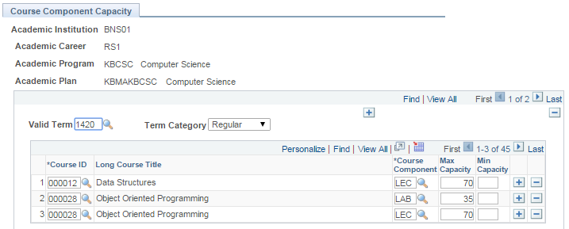
Pre Req 6: Course Component Capacity
This page is used to define minimum and maximum capacity for every course and course component based on valid term.

Slide 35
Student Package Flow Chart
Generate Open Courses
Generate Package
Upload Student Package
Generate Package Block
Mass Package Enrollment
Upload Student Package Block

Slide 36
Student Package Module
There are some pages in Student Package:
Generate Open Courses Display Open Courses Generate Package Package Result Student Package Manage Student Package Upload Student Package | Generate Package Block Display Package Class Block Display Student Package Block Manage Student Package Block Upload Student Package Block Mass Package Enrollment

Slide 37
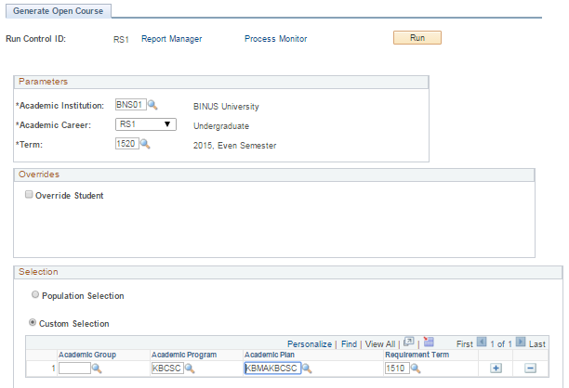
1. Generate Open Courses (1/2)
This page is used to define what courses will be opened for every term based on Academic Program, Academic Plan and Requirement Term.
Academic Advisement (Requirement Group, Academic Requirement and Course List) must be inputted correctly.

Slide 38
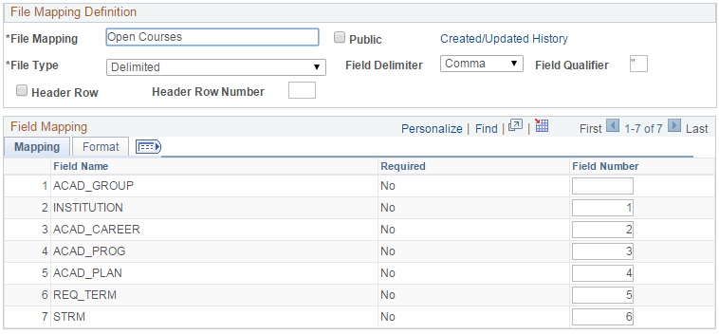
1. Generate Open Courses (2/2)
File Mapping used to generate open courses:

Slide 39
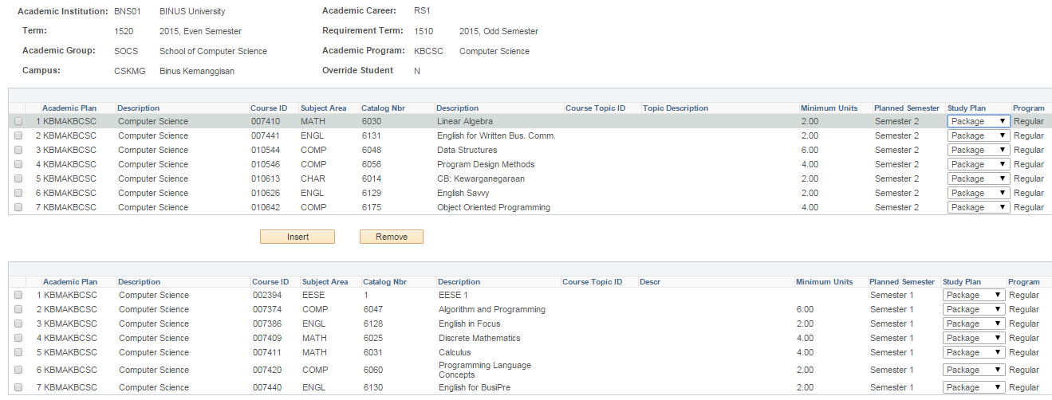
2. Display Open Courses
This page is used to display the open courses for every term based Academic Program, Academic Plan and Requirement Group.

Slide 40
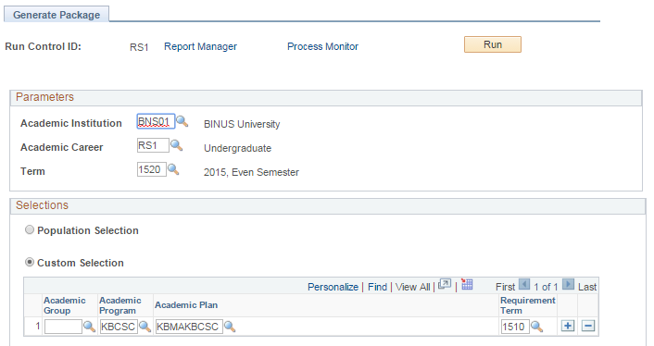
3. Generate Package (1/2)
This page is used to generate package for every term based on Academic Program, Academic Plan and Requirement Term.

Slide 41
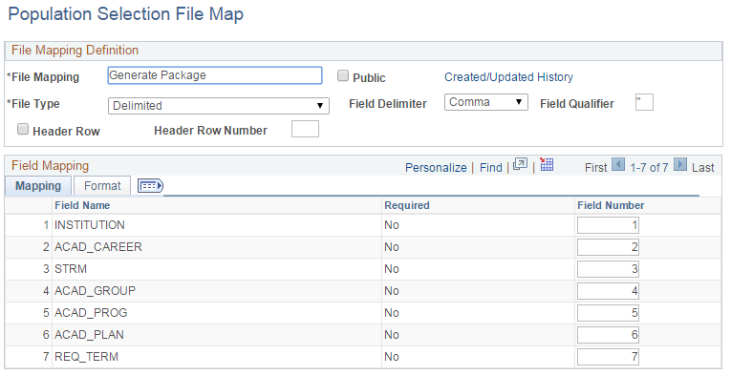
3. Generate Package (2/2)
File Mapping used to generate package:

Slide 42
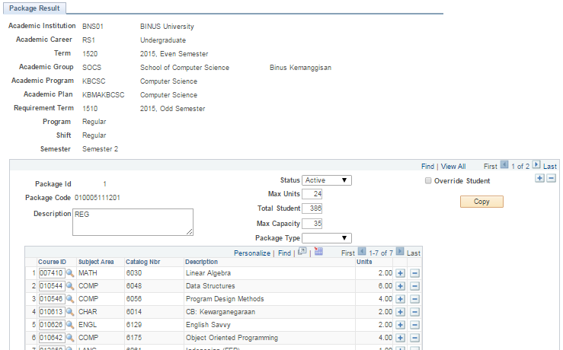
4. Package Result (1/2)
This page is used to display package. Some information shown are:
How many students in package
List of courses
Package type

Slide 43
4. Package Result (2/2)
A special package can be created for specific purpose.
For default, package type is blank.
These are some package type:
HA : High Achiever
LA : Low Achiever
DG : Downgrade
PJUR : Change Program
PJEN : Change Career

Slide 44
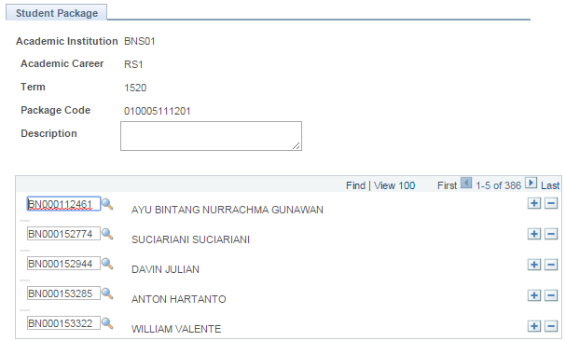
5. Student Package
This page is used to group students within same package.

Slide 45
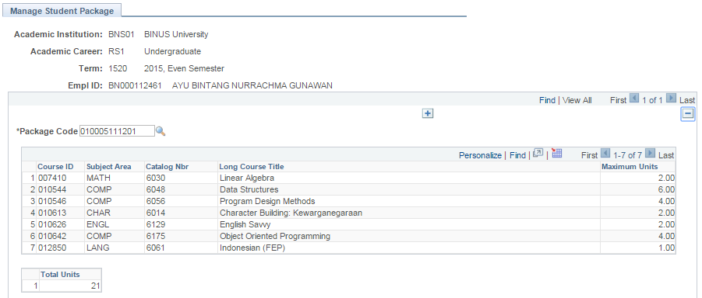
6. Manage Student Package
This page is used see the list of courses for every package assigned to students.

Slide 46
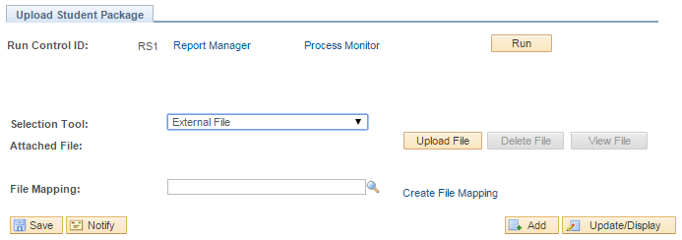
7. Upload Student Package (1/2)
This page is used to upload student package with external file.

Slide 47
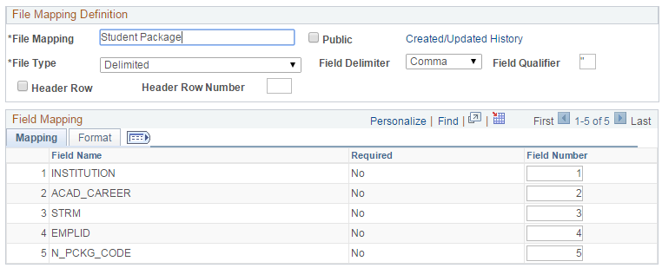
7. Upload Student Package (2/2)
File Mapping used to upload student package:

Slide 48
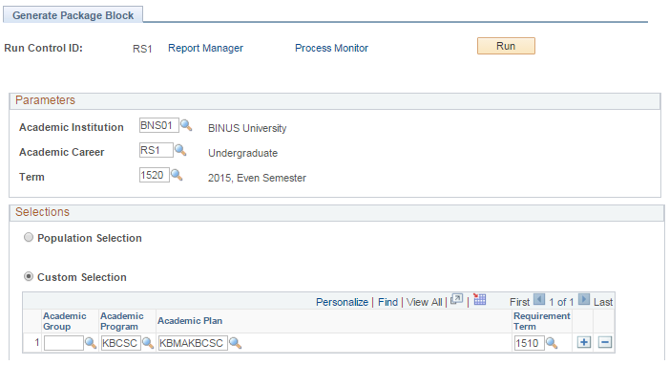
8. Generate Package Block (1/2)
This page is used to generate package block. In this step, package class will be generated for every course and course component.

Slide 49
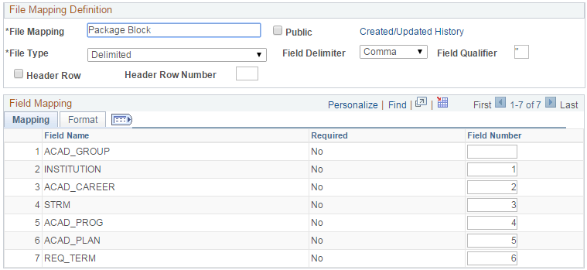
8. Generate Package Block (2/2)
File Mapping used to upload package block:

Slide 50
9. Display Package Class Block
This page is used to display every package class block with the information of total student in block, total student allocated and enrollment total.

Slide 51
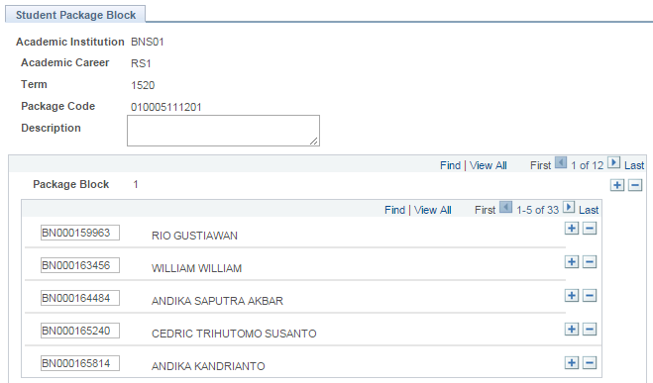
10. Display Student Package Block
This page is used to group students within same package block.

Slide 52
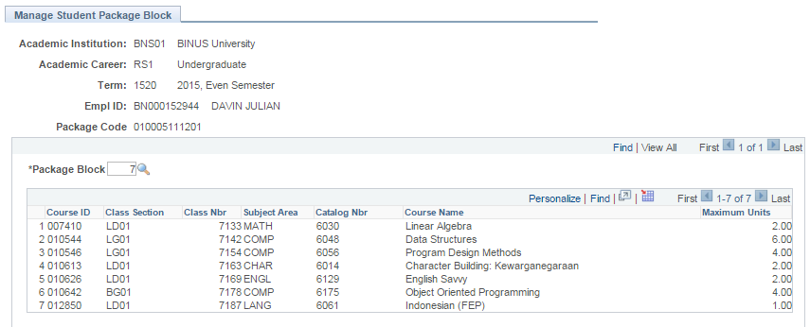
11. Manage Student Package Block
This page is used see the list of courses and classes for every package block assigned to students.

Slide 53
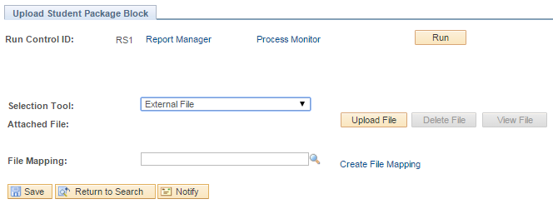
12. Upload Student Package Block (1/2)
This page is used to upload student package block with external file.

Slide 54
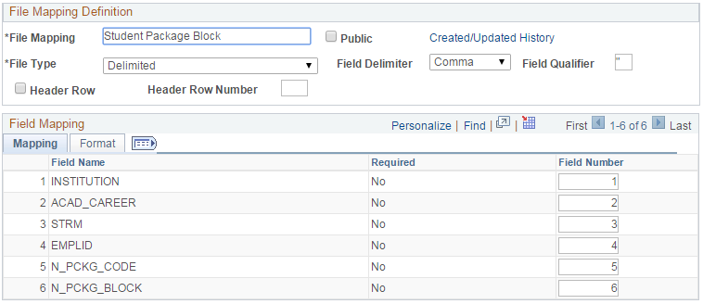
12. Upload Student Package Block (2/2)
File Mapping used to upload student package block:

Slide 55
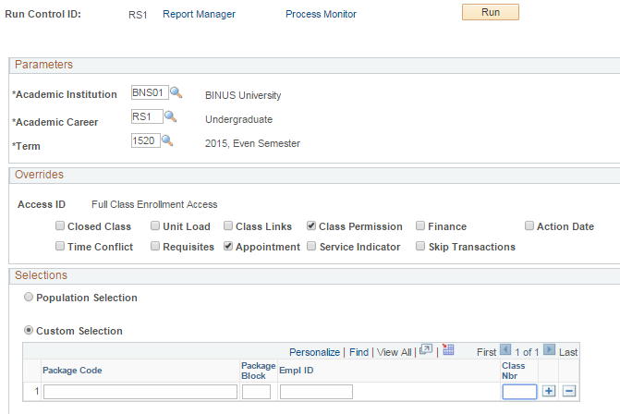
13. Mass Package Enrollment (1/2)
This page is used to enroll students.
It can be used to enroll per package or per class.

Slide 56
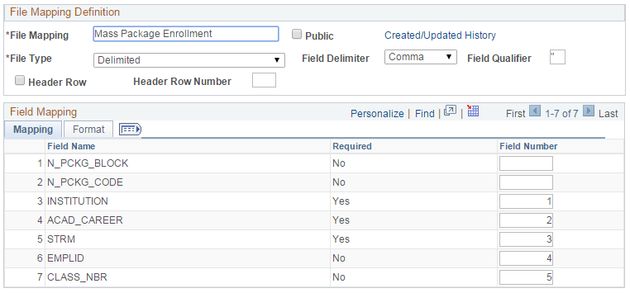
13. Mass Package Enrollment (2/2)
File Mapping used to mass package enrollment:

Slide 57
Student Package Conclusion
With student package module, scheduling staffs can reduce almost 70% of their work time.
Student package provides dynamic setting to enable users to create package based on their requirements.
Student package help staffs to track student courses and class only based on student package code and student package block.
Student package help students to get the right courses for their study plan based on academic advisement.
Student package is used to create charging for students before enrollment process.

Slide 58
Lesson Learned

Slide 59
Lesson Learned
Identify the problems and current condition to create an idea to improve business process.
Strong user requirements to make sure the deliverable is as expected.
Focus on the whole process to give the best result.
An experience to create a big module based on common practice in Indonesia University.

Slide 61
Presenters
Indrabudhi Lokaadinugroho IT Data Center & ERP Manager Bina Nusantara Group ilokaadinugroho@binus.edu | Hananto Aji Nugroho Head of SAS Software Development Center Bina Nusantara Group hnugroho@binus.edu
ALL ALLIANCE PRESENTATIONS WILL BE AVAILABLE FOR DOWNLOAD FROM THE CONFERENCE SITE

