Slide 1
Automating Online Form Accounting to Department Budget Table
SESSION 6001
NOVEMBER 13, 2018

Slide 2
presenters
Louise Percy
Brad Hurton
Joanne Nikkel
Manager, HR Process Transformation
University of Calgary
lpercy@ucalgary.ca
Senior Analyst, HR Systems & Reporting
University of Calgary
bjhurton@ucalgary.ca
Senior Analyst, HR Systems & Reporting
University of Calgary
nikkel@ucalgary.ca

Slide 3
The University of Calgary
26,200 Undergrad Students
6,100 Grad Students
5,300 Staff
Recognized as one of Canada's Best Diversity Employers
333 Sunny Days - Most in Canada!
Notes:
The University of Calgary is a global intellectual hub located in Canada’s most enterprising city. In our
spirited
, high
-
quality learning environment, students thrive in
programs made rich by research, hands
-
on experiences and
entrepreneurial thinking. Our strategy drives us to be recognized as one of Canada’s top five research universities,
engaging the communities we both serve and lead. This strategy is called
Eyes High
, inspired by the university's Gaelic
motto, which translates
as
'I will lift up my eyes.' For more information, visit
ucalgary.ca/eyeshigh

Slide 4
U of C & ORACLE
FSCM 9.2 PI 26
HCM 9.2 PI 26
ELM 9.2 PI 17
CS 9.2 PI 8??
IH 9.1 PI 3 + IntraSee
All on Tools 8.55
Oracle 12c database
AIX 7.1
8.56 Due in Nov ‘19
w/ New Infrastructure
We’re becoming old timers – original go-lives began in 2004. We’re now live with Student Admin, Finance, HCM, ELM and Integration Hub.

Slide 5
AGENDA
Background – Before Automation
Goal of Automation
Automate DBT – How We Did It
Custom Direct Retro
Lessons Learned

Slide 6
BAckground
Before Automation

Slide 7
BACKGROUND – Before AUTOMATION
Accounting was setup in numerous ways depending on employee’s job.
Places accounting was setup:
Job Data for Grads/Post Docs/Academic Sessionals
Department Budget Table
Position and/or Appointment level for AUPE/MaPS
Department level or Position level for Academic

Slide 8
BACKGROUND – BEFORE AUTOMATION
Accounting submitted on online forms:
TBH – Grad/Post Docs/Sessionals
TAM - custom form Job Opening Request
Accounting Change - custom form called Job Change
Accounting requiring setup on DBT was emailed from HR to Payroll.
In 2017 the volume of accounting setup:
4457 transactions setup
686 retro-accounting processed

Slide 9
Goal of AUTOMATION

Slide 10
GOAL OF AUTOMATION
Reduce manual entry! Create solution that automatically adds accounting from online forms to the DBT.
Simplify locating employee’s accounting. Anyone’s accounting can be found by searching DBT at Appointment level.
Simplify viewing job data. Job data now only has HR transactions and no longer used for accounting.

Slide 11
AUTOMATED DBT
HOW WE DID IT

Slide 12
Process – Online Form to DBT
Form
PeopleCode sends accounting to pre-DBT table on final approval or when form is updated to job.
Pre DBT
Custom table is central repository of all online form accounting. Users can view/add/change data using page.
DBT
Accounting from online forms added to DBT from pre-DBT table.
A process is run to update accounting to DBT.

Slide 13
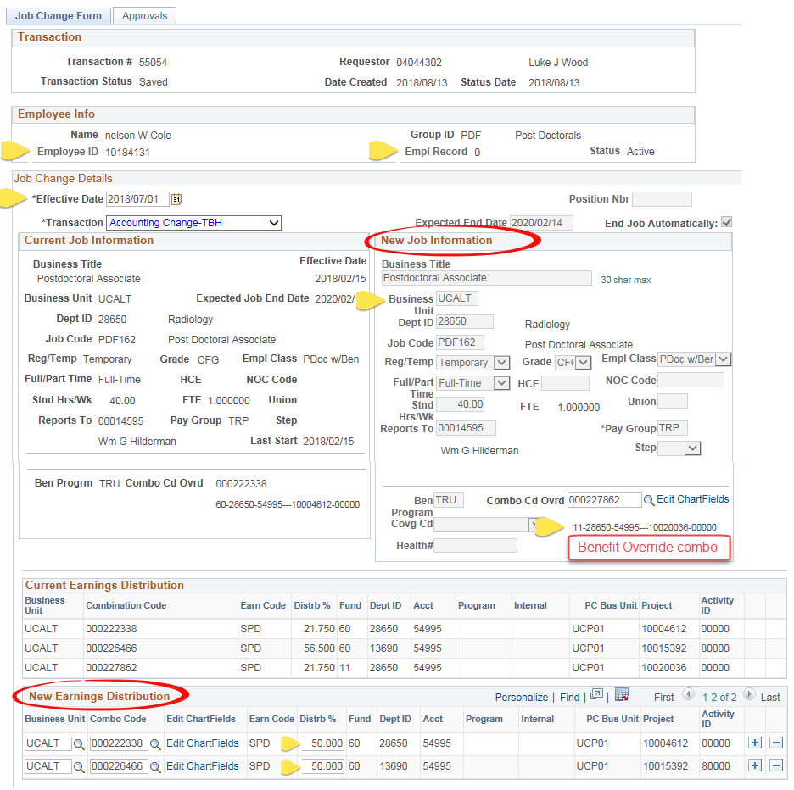
Accounting change (job change form)
Information including emplid/empl record, position, effective date, department, business unit, combo code, and distribution percent, is sent by Peoplecode to the Pre DBT table.
Form allows benefit override combo code which updates to the DBT for deductions and taxes.

Slide 14
PRE-DBT TaBLE
The Transaction Status defaults to ‘Active’. Other statuses are:
Hold
Processed
Manually Updated
Error
Notes:
Hold is set by the PeopleCode if it finds the employee (or position) has an existing ‘Active’ transaction in the pre-DBT table, OR on the DBT table with an effective date greater than the incoming transaction. Hold is also used by payroll if they want to put a transaction on ‘Hold’ and stop it from adding to the DBT.
Processed is set by the Update to DBT process when it has successfully added the transaction to DBT.
Manually Updated is if payroll added the accounting to DBT themselves.
Error is set by the Update to DBT process if it could not add the process to the DBT. Happens if either the department, business unit or position does is not the same as job or position data.

Slide 15
PRE-DBT TaBLE
The Budget Level defines the level to add to Department Budget Table
Appointment
Position
Position & Appt

Slide 16
PRE-DBT TaBLE
The Transact Type shows the type of online form.
Job Change
TAM
TBH
Other

Slide 17
PRE-DBT TaBLE
Data from online forms:
Emplid, Empl Rcd, Position Nbr,
Deptid, Effdt, Business Unit (setid for DBT)
Fields set by PeopleCode:
Fiscal Year – every effective date is added to the current Fiscal Year on DBT
The Transact Type shows the type of form:
Job Change
TAM
TBH
Other

Slide 18
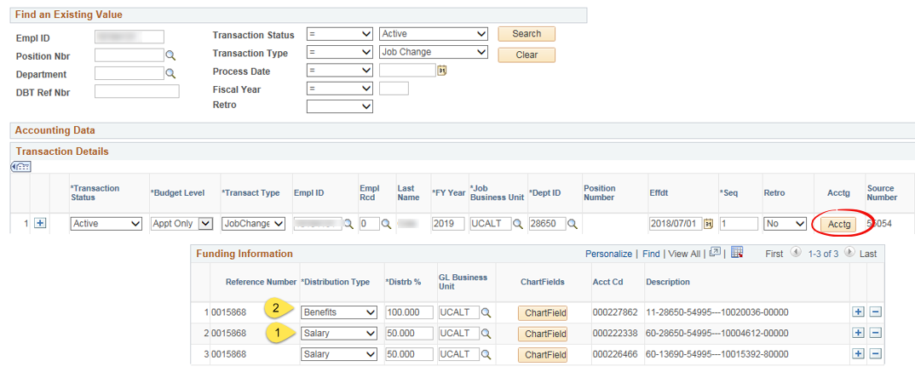
PRE-DBT TaBLE
The form’s accounting is recorded under the ‘Acctg’ link.
The Distribution Type is derived from the accounting entered on the form.
Salary tells the process to add accounting to the Earnings tab on the DBT
Benefits type adds combo code to the Deduction and Taxes
Salary&Ben type adds combo code to Earnings, Deductions, and Taxes

Slide 19
PRE-DBT TaBLE
The Transact Type shows the type of form:
Job Change
TAM
TBH
Other
Other fields:
Online Form Nbr
DBT Ref Nbr
Online form’s comments
Date updated to DBT
Retro field

Slide 20
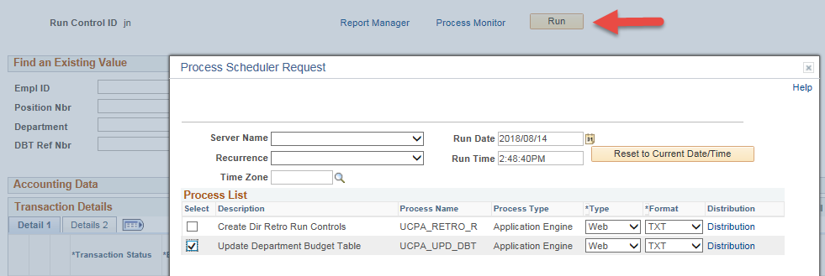
UPDATE TO DBT PROCESS
Payroll searches for transactions with status Hold.
Run query for data issues that give DBT page message “Not Eligible for Budget Definition” .
Schedule the Update DBT Process nightly. This takes the accounting from the pre-DBT table and inserts into the Department Budget Table.
Notes:
Hold transactions - Payroll determines what order to add accounting to DBT and updates the Seq Number in this table to tell the process what order to add each, OR they update transaction status to Manually Updated and add transaction to DBT themselves.
Query checks that the department, business unit, position number and effective date of transaction is valid for the job and/or position data. If any are not in sync, you are unable to add funding to the DBT.

Slide 21
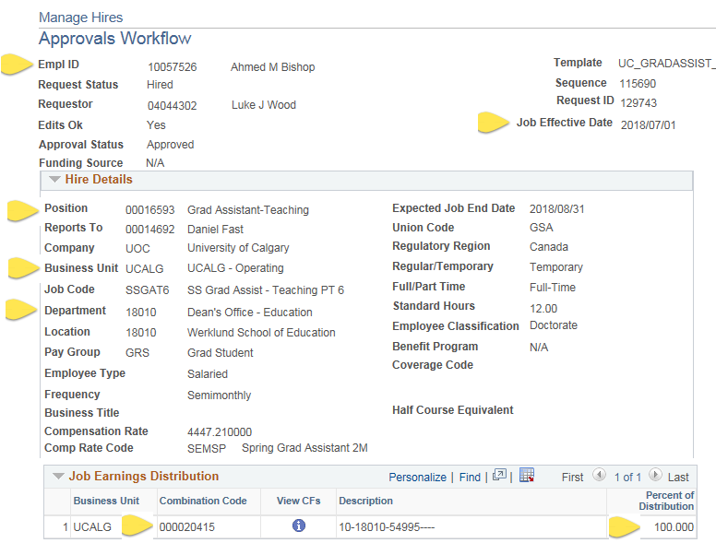
Template Based Hire
Information including start date, department, business unit, emplid, position, combo code, and distribution percent, is sent by Peoplecode to the Pre-DBT table when the form is updated to Job data.

Slide 22
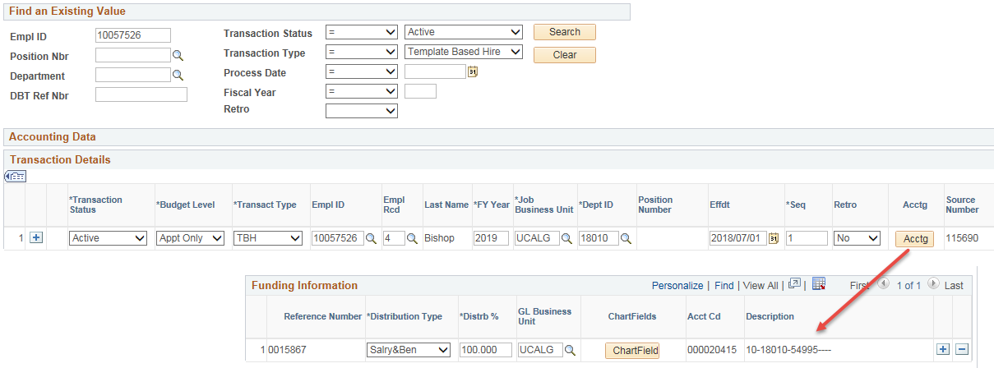
Template Based Hire
TBH accounting appears in the Pre-DBT table.

Slide 23
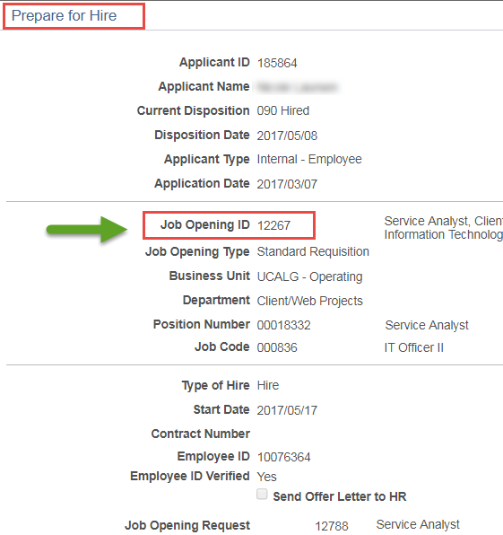
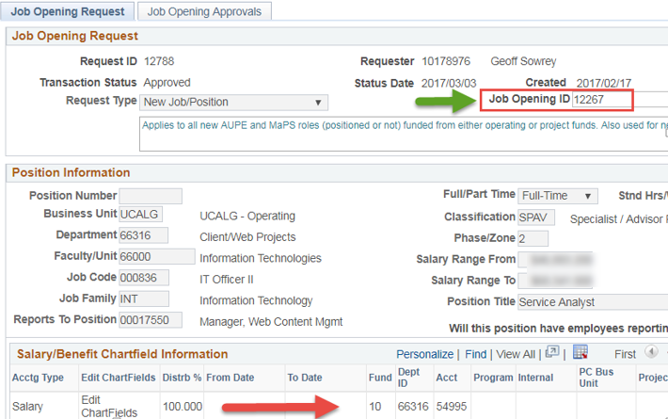
Job Opening Request
Custom form where the job and funding are approved before job is posted.
The Job Opening in TAM is linked to the Job Opening Request form which associates the TAM hire with the accounting.

Slide 24
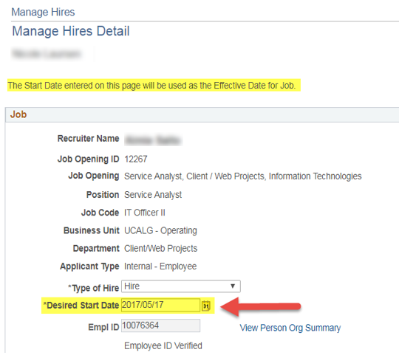
Job Opening Request
Information including start date, department, business unit, emplid/empl record, position, combo code, and distribution percent is taken from the Manage Hires detail.
Sent immediately to pre-DBT table upon saving the Job component.

Slide 25
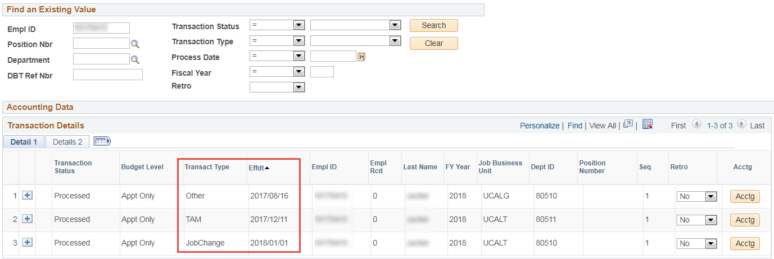
OTHER FEATURES – PRE DBT
Search fields makes for easy viewing of a person’s entire accounting history.

Slide 26
OTHER FEATURES – PRE DBT
Use the search to show the count of transactions that have been completed by Fiscal Year, Transaction Type, and/or Department.
Payroll can enter other transactions in the table, which also update to DBT.
First step in custom Direct Retro processing is initiated from this page.

Slide 27
BENEFITS – COMMENTS FROM PAYROLL
“With new process, we don’t need to keep the manual forms.”
“Save time and increase accuracy.”
“Automated DBT identifies the mismatch error with Job Data in advance, instead of finding issues when trying to add accounting to DBT.”
“We were not be able to insert comments on DBT. With automated DBT, we can put comments for each accounting transaction for future reference.”
“Increase efficiency in troubleshooting. Online forms linked to the accounting on DBT.”

Slide 28
BENEFITS – STATS
2019 Stats (April to October)
951 Accounting Change (Job Change)
848 TAM
3733 TBH
347 Other
293 Retro Distribution

Slide 29
CUSTOM DIRECT RETRO
OVERVIEW

Slide 30
OVERVIEW - Direct Retro Accounting
Pre-DBT
Search for retro accounting changes.
Process Direct Retro
Payroll runs process that auto-populates delivered Process Direct Retro run control page, AND
Review Retro
Payroll reviews results of accounting change before/after (Review Retro Distribution page or use BI Publisher report).
Run process that creates separate run controls for each transaction.
Kicks off PSJOB that runs Process Direct Retro for all run-id’s in batch.
Update Actuals
Payroll selects multiple run-ids to update actuals and kicks off PSJOB that runs delivered Update Actuals for all transactions.

Slide 31
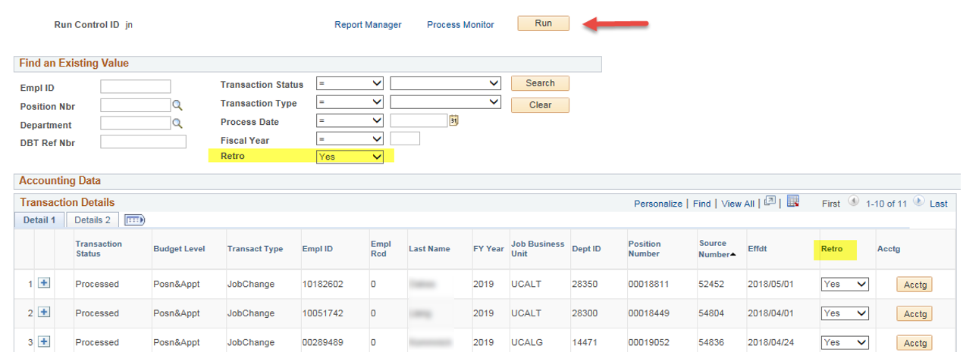
Custom Direct Retro
The Update DBT process set the Retro flag to ‘Yes’ if the transaction’s effective date was earlier than current pay period.
Payroll searches for all ‘Retro’ transactions and then runs a process that creates separate run control id’s for each transaction.

Slide 32
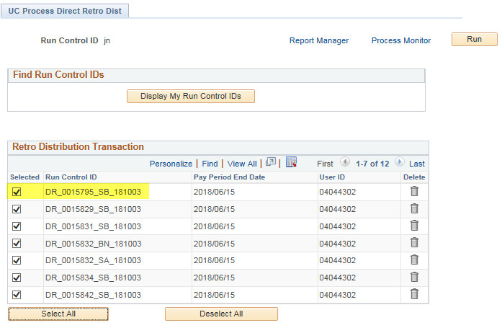
Custom Direct Retro
Run control’s created.
Payroll selects the run control id’s, and kicks off a process that
1) Populates the delivered Process Direct Retro run control page for each transaction, AND
2) Runs the delivered Process Direct Retro process, in batch, for ALL the run controls.

Slide 33
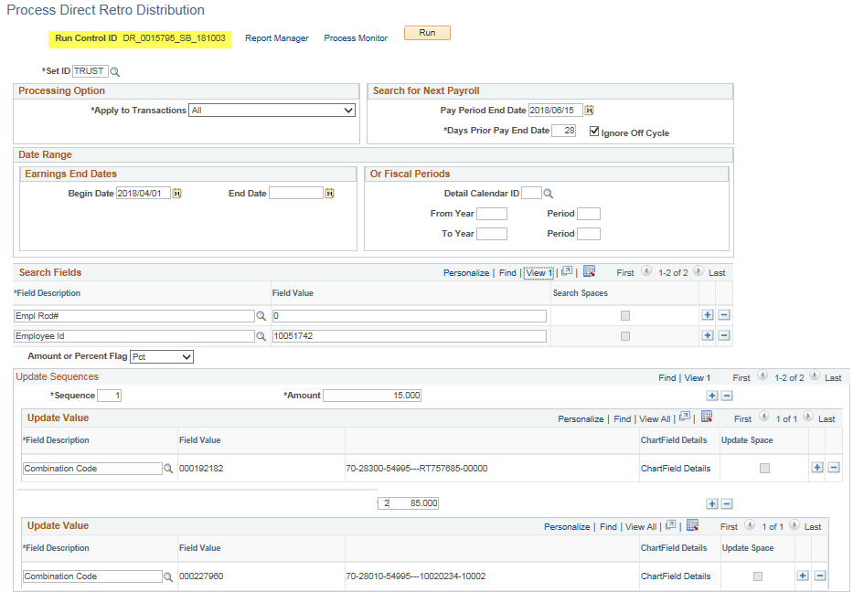
Custom Direct Retro
This page was manually filled in.
Now is now auto-populated for each transaction by customization.
Data comes from pre-DBT table.

Slide 34
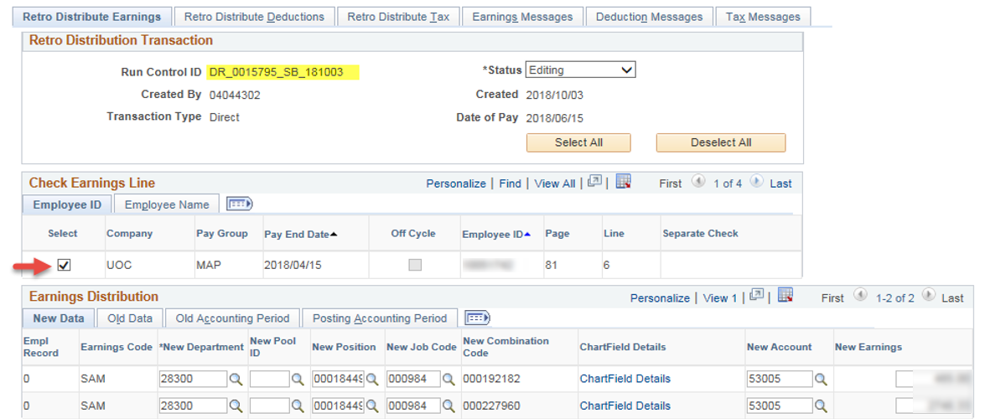
Custom Direct Retro
The process runs the delivered Process Direct Retro process, which creates the results seen in Review Retro Distribution.
Customized Process Direct Retro to default all retro to approved (or selected) by default, so that payroll doesn’t need to do this step.
Payroll reviews old/new accounting using BI Publisher report.

Slide 35
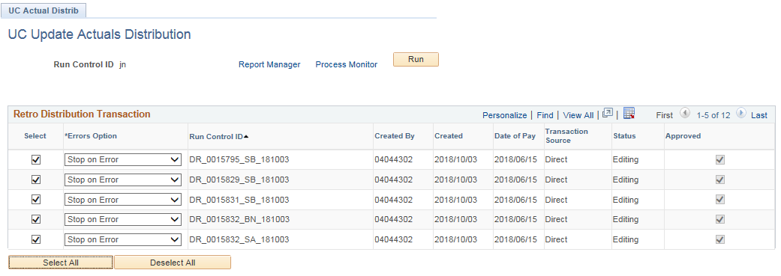
Custom Direct Retro
New page where multiple run control id’s can be selected.
When run, the process kicks off a PSJOB that runs the delivered Update Actuals Distribution process for all run control id’s in batch, one after the other.

Slide 36
LESSONS LEARNED

Slide 37
LESSONS LEARNED
Updating DBT for transaction status ‘Posn & Appt’. Ensure status set to Processed after BOTH levels have updated to DBT successfully.
Decentral users submit multiple Accounting change forms simultaneously, making difficult to determine order to updates to DBT. HOLD status utilized in these cases for manual review.
Dedicated resource and time to complete. Start and stopped 5 years. Once sponsored, took 6 months development to implementation.
Notes:
If budget level is Posn & Appt, and one of the levels had an issue being added to the DBT by, then only one half of the funding was added, while the transaction status was set to Processed. Adding logic to first check for issues BEFORE adding to DBT and setting transaction to Error status so users can verify data prior to updating DBT. Also created queries to run before running process.

Slide 38
THANK YOU!

