Slide 1
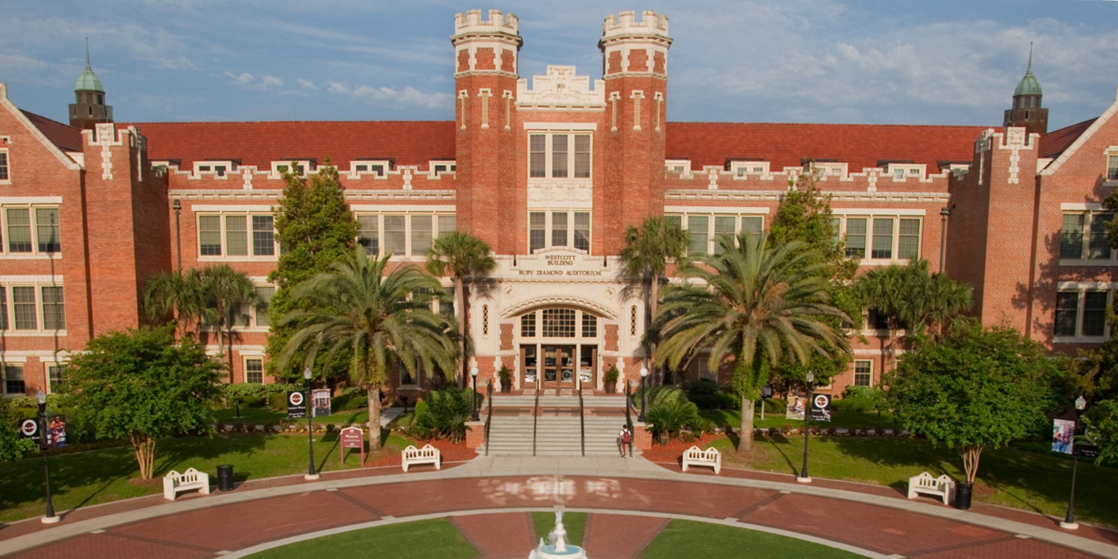
Technical ADVISORY GROUP COMMUNITY SESSION
SESSION 7151
Tue, Sept 19th, 2017

Slide 2
presenters
Sasank Vemana
ERP Analyst IV
Florida State University
svemana@fsu.edu

Slide 3
Overview
1
3
TAG MISSION
What we do
WORKING GROUPS
How we work
2
4
INTRODUCE YOUR TAG
Who we are
MINGLE
Questions, ideas, options

Slide 4
TAG mission
WHAT WE DO

Slide 5
TAG mission
Educate
Work closely with Oracle to understand new strategies and functionalities and how to best communicate them to the HEUG community
Work closely with the HEUG community to share accomplishments, best practices and learning outcomes with peers
Advocate
Communicate HEUG strategic goals and issues to Oracle resources with the goal of easing product adoption, implementation and day-to-day operations

Slide 6
Introducing the tag
WHO WE ARE

Slide 7
TAG Members
Steve Smith, University of Cambridge, Chair
Paul Matthews, University of Derby, Vice Chair
Brenda Ratliff, Duke University, Outgoing Chair
Tamara Foster, Northwestern University, Communications
Anand Vangipuram, University of Wisconsin - Madison
Maria Lindquist, University of Wisconsin – Extension
Brad Carlson, University of Minnesota
Mihaela Cornea, University of North Carolina at Chapel Hill
Josh Harmon, Texas Christian University
Cory Schanzenbach, North Dakota University System
Robert Lawson, Lone Star College
Eric Bolinger, University of Colorado
Chian Chun Lai, National University of Singapore
Nikki Gaertner Eaton, University of South Australia
Sasank Vemana, Florida State University
Kurt Schnieder, City of Raleigh
Terry Houser, University of Virginia, Board Liaison, HEUG VP of Technology
Dave Bain, Oracle Liaison, PeopleTools Product Manager
https://www.heug.org/page/advisory-groups#members

Slide 8
WORKING GROUPS
HOW WE WORK

Slide 9
Working groups
Deployments and Integrations
Life Cycle Management and Security
User Experience
Nikki, Brad, Cory, Steve, Eric, Brenda, Maria, Mihaela
Paul, Eric, Lai, Nikki, Josh, Maria, Sasank, Bob, Kurt
Tamara, Lai, Steve, Sasank, Anand

Slide 10
Communications
Tamara Foster, Communications Coordinator
Community Technical Forums: https://www.heug.org/p/fo/sc/catid=15
TAG Newsletter
TAG Blog: https://www.heug.org/p/bl/bl/blogid=1
Twitter Handle: @HEUG_TAG

Slide 11
Contact us
Post a message in the forums:Community Technical Forums: https://www.heug.org/p/fo/sc/catid=15
Email https://www.heug.org/page/advisory-groups#tbl_1505482750_8567

