Slide 1
PG Admissions Decision Automation using Peoplesoft Rules Engine
SESSION 11020
4th July 2019

Slide 2
presenters
Karen Ritchie
Versha Govind
Systems Support Consultant
University of the Witwatersrand
Karen.Ritchie@wits.ac.za
Senior Applications Developer
University of the Witwatersrand
Versha.Govind@wits.ac.za
Dept: Academic Information & Systems Unit (AISU) responsible for supporting Student Systems
PeopleSoft Applications Developer for the Student Systems

Slide 3
University of the Witwatersrand, Johannesburg
Approximately 40 000 UG and 18 000 PG students currently enrolled

Slide 4
Oracle: 12.1.3 Oracle Data base: 12.1.0.2 PeopleSoft: 9.2 Tools 8.55.27 Partners: Visions ConsulTING

Slide 5
Introduction
Using Automation for UG Admissions decisions since 90’s
Increase in number of PG applications
Require automation to speed up decisions making
Issues addressed from old Drools system
No 3rd party system
No interfacing
No additional technical skills
Project Managed
Testing
This presentation will show how Wits has setup PG Admissions Rules using the PS Rules Engine
Notes:
Automation for UG starts already with Grade 11 marks
When the matric marks do come in – all applications are processed roughly within a day
The results are uploaded and automatically evaluated to produce an Academic Pont Score (APS)
Each faculty lays out its rules in order to decide how many points gets an applicant into their programs
Because of a concerted effort on the part of Wits – PG applications are increasing
We don’t want to end up in a situation that we achieve our PG targets but fail with the admin thereof and so lose the potential students.
We have dipped out toes in the waters of PG auto before using the same 3rd party system as our UG applications but found it to be problematic.
So with the new version of Campus 9.2 we have a rules engine in PS. (SIMS)
No additional technical skills are needed – however it is going to be a steep learning curve for the functional people. (We are soon going to learn how much logic we have)

Slide 6
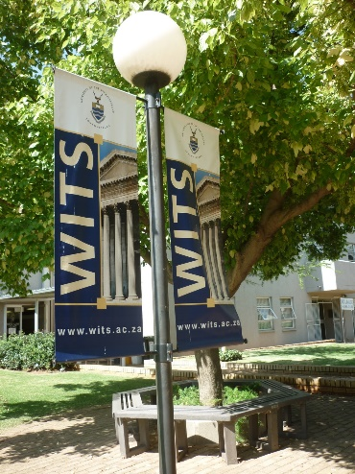
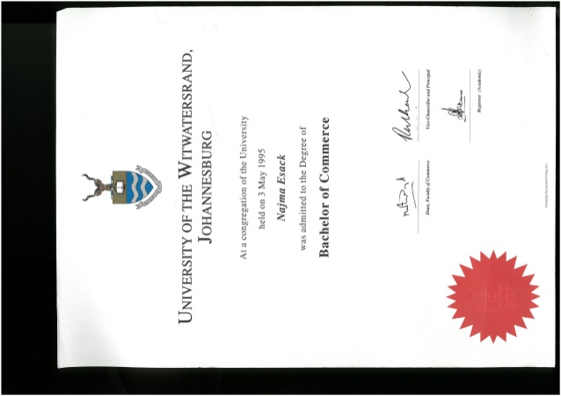
PG Automation – Pilot Project
Parameters:
Pilot PG Automation for Honours programs only
Roll out for Masters and PhD next year
For Wits enrolled students only
Application must be complete
Automation can use Mid Year and/or Final year results
Notes:
38 000 Total PG applications
13 000 Honours applications
Wits currently enrolled students only – we have access to their academic history
The first pilot of PG automation was done 2 years
Last year was our initial attempt using only Honours applications in a school
This year we are expanding it to all Honours applications
Next year we will do Masters and PhD

Slide 7
Requirements Gathering…
How do the faculties make their decisions?
What criteria do they use?
When do they make decisions?
What unique requirements do they have? Questionnaires, workshops, interviews, etc.
Common requirement: Course results or combination of courses
Notes:
From a functional perspective - This was a difficult part of the process
Thanks to a project manager – we could coordinate and track submissions
Trying to establish what criteria they use.
They have the information in their heads but cannot translate it onto paper – so would get something like must have completed all majors…………..
We developed a type of proforma to try and give them an idea of what sort of information we required.
So we really had to drag it out of “them” (either academics or support staff)
Reassuring them that we can cope with their unique requirements.

Slide 8
OTHER Requirements
Interviews (with a score)
Portfolios (with a score)
Average Mark
Year of Study
Level courses (ECON4%)
Repeat Students
Completed in MinimumTime
Limitation of offers
Ranking
Notes:
What do we call these is PS speak?

Slide 9
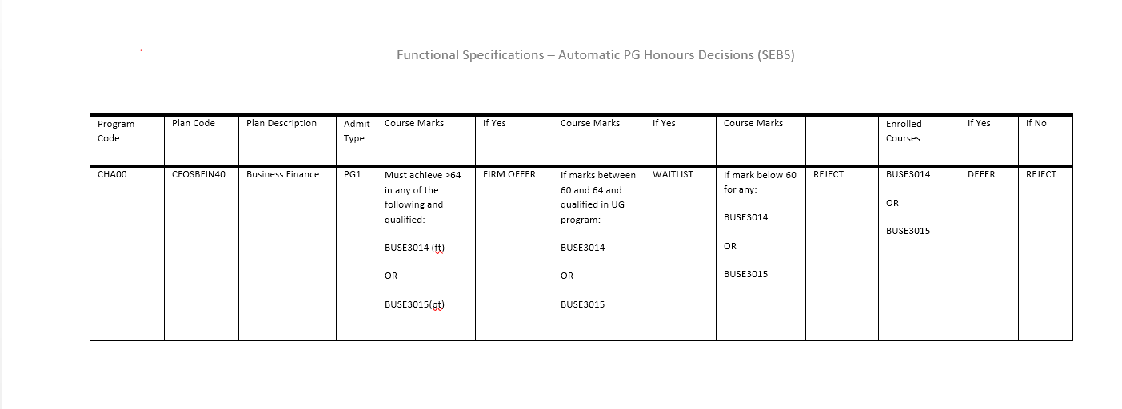
Program Requirements
Gathering Requirements

Slide 10
DEFINE your rules
Start with knowing how the overall rule looks:
Bcom Hons – Business Finance
HIGH LEVEL RULE:
Accept if mark > 64
Waitlist if mark between 60 and 64
Reject if mark < 60
Notes:
So, very briefly before we go into more detail, for setting up of the rules, you have to think a bit like a programmer, you have to create building blocks, so each requirement becomes a block of the rule that needs to be built and stacked together – you need to know what components you will need. For example, we started with defining a high level or overall rule, the one which tells you whether you can make an offer, defer or reject the application.
This is what we call the ‘OVERALL Rule’

Slide 11
DEFINE your rules
Identify and build components - courses
Some components may need further breaking down
Build ‘Get mark’ component
Return a mark or otherwise enrolment status
This rule may need to consider a mark for a single course or perhaps the best marks from a list of courses
Must identify if Mid Year or Final Result
Notes:
Next you need to define the smaller components which are really the criteria for being able to make this decision. In this case, we need to assess the course BUSE3014/3015

Slide 12
DEFINE your rules
Build Degree component – has the student qualified yet.
Build ‘Degree’ component
Build a rule which returns a value depending on whether the student is still in progress or completed qualification
Notes:
Another component we needed to build was a rule to check if the degree has been completed, i.e. did the student qualify? The system cannot make on offer to the student if for some reason the degree is not completed. This check return another flag for the degree completion status.

Slide 13
Build your rules
Data can be used from anywhere in the system, custom or vanilla. The author needs to be familiar with the record structures in PS
May be useful to get views to make the retrieval of data more efficient (requires PS developer)
Can pass parameters to the each rule you build by specifying which fields are input parameters and which are output parameters.

Slide 14
Build your rules
Notes:
This is a screen shot of how the rules need to get built. It may look a bit daunting at first, but once you get working and deepen your understanding it gets easier. Also, rules can be copied and modified so programs with similar rules are easy to setup once the first one is done and tested.

Slide 15
Build your rules
Check if student enrolled in required course/s
Course rule must check if Mid year or final result
Is the mark published
Return a status to identify each of these options
Return variables for:
Mark
Mid Year / Final result Flag
Enrolled Flag
Build ‘Get mark’ component
Return a mark or otherwise enrolment status
This rule may need to consider a mark for a single course or perhaps the best marks from a list of courses
Must identify if Mid Year or Final Result
Notes:
So lets go back, we want to build the first component, we want to check if the student has met the course requirement. We need to bear in mind that this process will be scheduled to run nightly during the admission period. So in the, interim a student may still be completing some of the courses. During this time, some faculties require that the system make a provisional decision so that at least some kind of communication goes out to the student regarding their application.
For the course requirement, we first check if the student has enrolled for the required course/s. This required us to build a ‘function’ to check for this. Now, we can use any piece of data in the system, be it vanilla or custom. So to get the student enrollment, we use the Student Enrollment table. The person setting up rules in this manner needs to be familiar with the table structures and must have a good understanding of how and where to find data.
Student Enrollment table is already defined as an Entity in the system, when you select this, it also allows you to choose all the available fields. You can also pass it variables like the emplid, term and course id. You then choose which fields it must return, in our case the enrollment status.
During the term, there may not be any published results so the function to return a mark will be blank. At this point we set a flag to indicate that the required course has been enrolled for but not yet completed. This flag will help to determine the outcome when we build the overall rule.
At the end of the year when final results are published, we can then then return the mark of the course so that a different outcome can then be assigned in the overall rule. If there are several courses to be checked, this can also be done by a writing a slightly different rule which will use multiple courses to calculate the best mark.

Slide 16
Build your rules
Check if student completed degree i.e. qualified yet?
Return
Yes/No
Build ‘Degree’ component
Build a rule which returns a value depending on whether the student is still in progress or completed qualification
Notes:
Next, we need to build a rule to check if the degree has been completed, i.e. did the student qualify? The system cannot make on offer to the student if for some reason the degree is not completed. This check return another flag for the degree completion status.

Slide 17
Put it all together
We can now determine the outcome status for the student by building the final rule using logic such as:
If there is a mark and degree completed then
If mark > 64 then ACCEPT
Else if mark between 55 and 64 then WAITLIST
Else if the mark < 55 then REJECT
If there is no mark then
If there is an enrollment then DEFER
Else REJECT (There is no enrollment for required course/s)
Notes:
Now, that we have built the components, we can put it all together to determine the outcome for the student – which we call the overall rule.
We have now calculated the best mark, or return a flag showing enrollment status
We have the degree completion flag
We can now determine if the outcome of the student by building the final rule using logic such as:

Slide 18
Put it all together
OVERALL RULE
Build ‘Get mark’ component
OUTCOME
Build ‘Degree’ component
Other components (interviews)

Slide 19
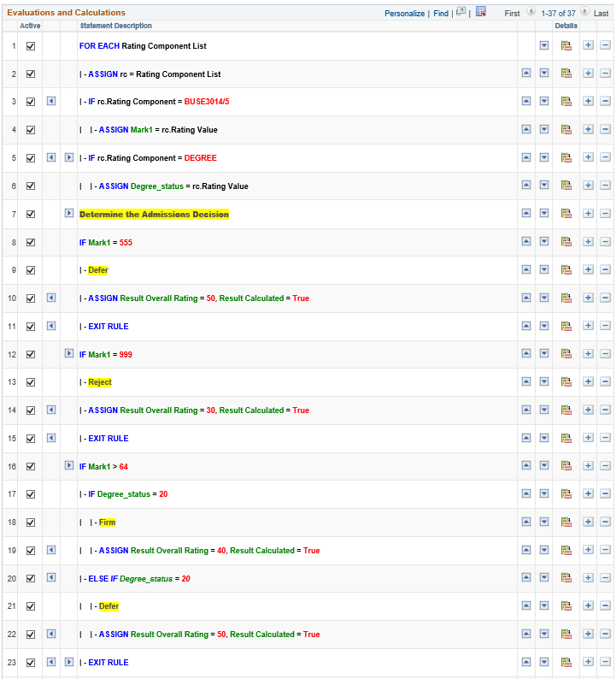
Put it all together

Slide 20
Put it all together

Slide 21
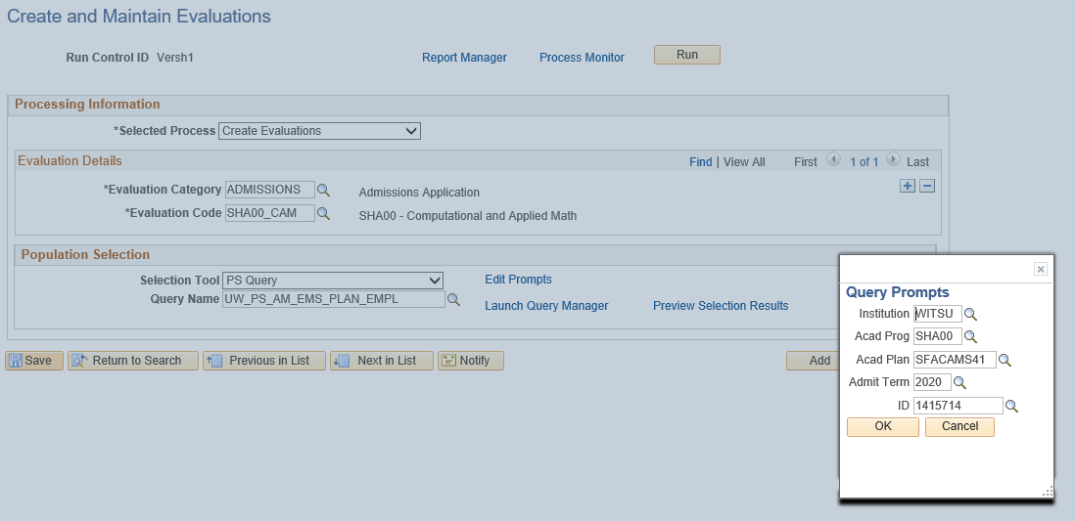
Running the process
Running the process nightly is just a matter of scheduling a run control.

Slide 22
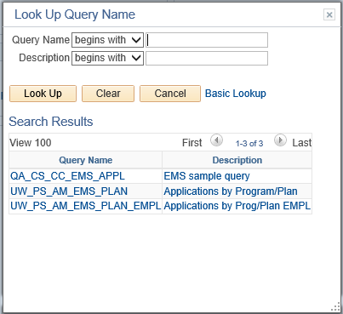
Running the process
We have setup a few queries which selects the pool of students to be assessed.
A second scheduled process runs a query which selects and interprets the final outcome and updates the Admission stack.

Slide 23
Viewing the outcome
For every component you define, you can view the outcome of each
The final outcome is evaluated as the Overall Rating. This is updated back to the admissions stack

Slide 24
Pros & Cons
There is no 3rd party system. The setup of these rules can all done via the front end – there is no PS developer required to build anything in PS Tools (apart from views for efficiency).
The building of rules requires some amount of programming logic and logical thinking skills.
Any table or view in the system can be accessed – vanilla or custom
Naming standards for both rules and variable names are a must as there are quite a number of components that will built
The components built for checking courses grows exponentially, so we are doing some customisations to avoid this.

Slide 25
Pros & Cons
There is no reporting on the rules – faculties want confirmation in a report of what requirements have been used to setup their rules. The customization is hoping to address this to some extent.
Rules can be copied and altered, which is a great feature.
Flexible, can include scores for Interviews, questionnaires, etc.
Never underestimate the testing effort required!

