Slide 1
9.2 upgrade – our story
SESSION 2051
MONDAY 16TH OCTOBER 2017

Slide 2
presenters
Sally Winfield
Functional Analyst
University of Derby
S.Winfield@Derby.ac.uk
Overall I have over 12 years experience of PeopleSoft, with the last two and half years working at the University of Derby using PeopleSoft Campus.

Slide 3
University of derby
Established 1992
No of students: 34000
No of employees: 2281
Size of SSO team: 8.8 FTE

Slide 4
UoD & ORACLE
PeopleSoft Campus 9.2.003
PeopleTools 8.55.11

Slide 5
Our team
Assistant Registrar
Senior Functional Analyst x 2
Functional Analyst x 3
Deputy Functional Analyst x 2
Senior Administrative Assistant x 1
Senior Functional Business Analyst
Notes:
Put your own notes here

Slide 6
Our team
Enhancements/Developments
Business Analysis/Project Management
Research
Query writing/training
System Security
Patch/testing co-ordination
Operational Support
System Analysts for other university wide systems

Slide 7
9.2 upgrade – our story
1
3
PREPARATION
GO-LIVE
2
4
IMPLEMENTATION
POST GO-LIVE AND LESSONS LEARNED

Slide 8
PREPARATION

Slide 9
PREPARATION
Why and when:
Up to date platform
Take advantage of fluid interface
Flexible functionality
Modern look and feel – app based
Light upgrade – we were up to date with patches
PeopleTools 8.55 at same time

Slide 10
PREPARATION
Establishing the project team
IT and Functional Leads
PeopleSoft Dev
Testers
Business Ops
Student Experience
Senior Management Team
Student Systems & Ops

Slide 11
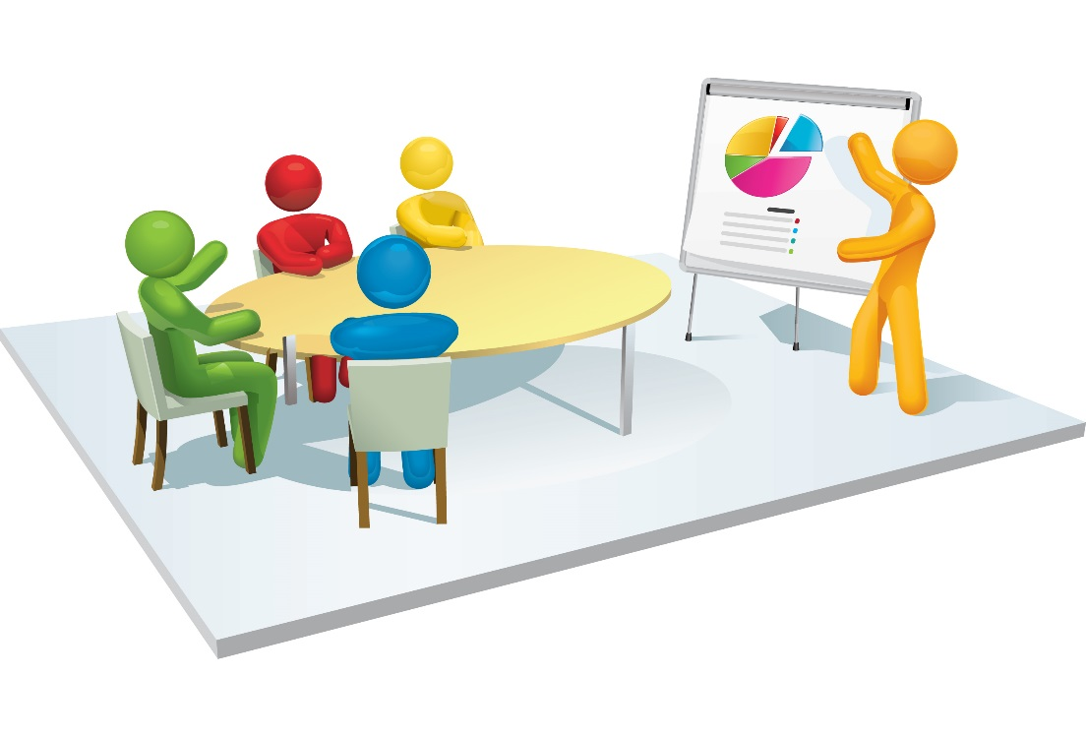
PREPARATION
Developing the project plan
Identifying key areas of change
Resource scheduling
Communication of initial plan

Slide 12
PREPARATION
Identifying the timeline
Demo
Unit Testing
Regression Testing
Nov/Dec
Jan/Feb
Mar/Apr
Apr
Code Freeze
Go live

Slide 13
PREPARATION
SSO team closed session:
Limited access to demo
Researched new functionality
Identified areas for investigation
Setup up basic fluid homepages

Slide 14
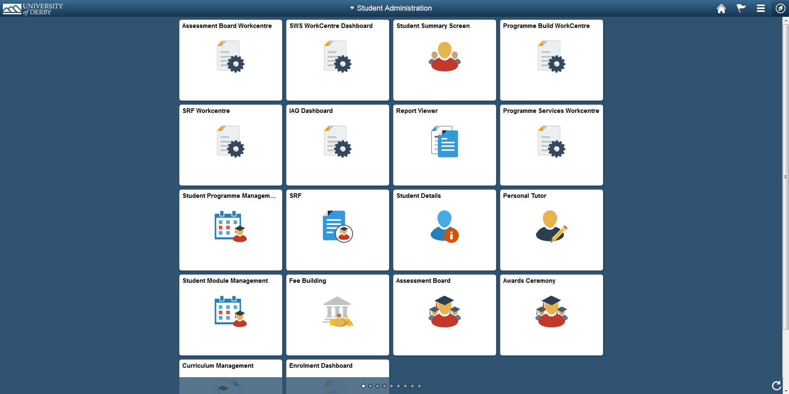
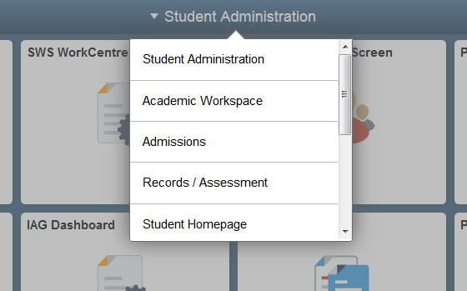
PREPARATION
Homepages and navigation
How they work
Initial setup
Classic home?

Slide 15
IMPLEMENTATION

Slide 16
implementation
Communication
Engage your users early
Workshops
Updates through internal communications
Attendance of team meetings

Slide 17
implementation
Embrace the change
Promote the positives
Theme specific homepages
New style modern navigation
Tiles
Customisable – future will choose own tiles

Slide 18
implementation
Testing
Co-ordination
Expectations
Monitoring
Feedback

Slide 19
implementation
Concerns from users
Breadcrumbs are disappearing??!!
I can’t find anything!
Menus have changed??!!
Updating user guides

Slide 20
GO-LIVE

Slide 21
Go live
Pre-empt
Note every manual change you make
Checklists for go-live weekend activities
User guides

Slide 22
Go live
The aftermath!
Issues raised during go-live week
77 issues - SSO
60 issues – IT Service desk
6 – actual issues
Since the upgrade the ….. won’t work

Slide 23
POST GO-LIVE

Slide 24
Now and the future
The aftermath!
Issues
Caching
Activity guides – deep links (nodes)
Queries – downloading to excel with URLs
Pop up windows
Base system config reset
Changes
Right Alignment
Recurrences
Page layout changes
Menu changes
Crystal reports
Drop down boxes showing long descriptions, not short (users looking for codes and seeing words)
HTML in CAFs

Slide 25
Now and the future
Things you might want to know:
Tile Wizard – interactive button resets
Dashboards – nav collection
Free text tiles – new content ref

Slide 26
Now and the future
Future developments
Tiles – feedback from user
Enhance area specific tiles
Fluid enhancements

Slide 27
Concluding thoughts
ANY QUESTIONS?

Slide 28
presenters
Sally Winfield
Functional Analyst
University of Derby
S.Winfield@Derby.ac.uk
all Alliance presentations will be available for download from the Conference Site

Slide 29
THANK YOU!

