Slide 1
personalised email in bulk
SESSION 5501
23 October 2019

Slide 2
presenter
Marije Bottinga
Functional Application Management
University of Amsterdam
m.bottinga@uva.nl

Slide 3
University of amsterdam
Largest university of the Netherlands
60,500+ applications
40,500+ enrolments
62 Bachelor’s programmes
137 Master’s programmes
151 Non-Degree programmes
3000 PhD students – 550 promotions/year
6000+ staff

Slide 4
ORGANIsATION & ORACLE
CS 9.2
PT 8.56.16
PUM 9 ML

Slide 5
Personalised email in bulk
1
3
FACTS AND NUMBERS
SUBTEMPLATES
2
4
CHOOSES
WHAT DOES IT LOOK LIKE?

Slide 6
Facts and numbers
To give you an idea

Slide 7
NUMBERS
2019-2020 | AMOUNT
NEW APPLICATIONS | 57,144
RE-ENROLMENTS | 32,290
ENROLLED | 39,983
NATIONALITIES | 170
LETTER CODES | 52
TEMPLATES | 105
EMAILS SENT FROM CS | 330.296
AVERAGE E-MAILS PER PERSON | 3.7

Slide 8
application instructions
7 Application systems
Programme specific instructions
Deadlines
→ 22 Unique application instructions
Notes:
We used to have around 17 seperate letter codes for all the new students. This is not only a lot of work, but you can easily get tangled up in your population selections.

Slide 9
SIGNATURES / common close
24 Unique signatures
6 Unique objection closes
Changes over the past 2 years:
Other names in signatures
Tone of voice
URLs
Logos
Contact info
Notes:
The people who’s name was in the signatures left the university, so you will need to put the ad interim names in it, and then later on the new managers’ name. Also we went form ‘yours sincerely’ to ‘kind regards’, the website had a make over, so the URLs with objection instructiones needed to be updated, the student service desk changed their name into central student service desks. Having to change this for up to a 105 templates is very time consuming.

Slide 10
SETTING UP YOUR TEMPLATE
A good start is half of the success

Slide 11
Letter code setup
Letter code
Data source
Report definition
Run-ID 3C for population selection
Run-ID Commgen
Notes:
This is how we set up our emails. Very straight forward and no customisation.

Slide 12
chooses
Setup in your data source

Slide 13
Welcome email - variations
GROUP | INSTRUCTIONS
New Dutch Bachelor’s students | Apply for UvA Matching
New international Bachelor | Apply for admission with foreign diploma
New Master’s students | Apply for admission for Master’s programme – 4 systems
2 Selective programmes | Apply for admission
Elective students | Submit proof of payment
7 Enrolment quota | Apply for selection procedure
Returning students | Already admissible

Slide 14
WELCOME EMAIL – similarities
Thank you for your request for enrolment
Instructions with URL
Check your student self service
Add @uva.nl to your contacts
Questions? Contact the Central Student Service Desk

Slide 15
WELCOME EMAIL – oldskool
PopSel 1 PopSel 2 PopSel 3
Thank you
Thank you
Thank you
Instructions 1
Instructions 2
Instructions 3
Check SSS
Check SSS
Check SSS
Add @uva.nl
Add @uva.nl
Add @uva.nl
Questions
Questions
Questions
Signature
Signature
Signature
Notes:
Effective? Yes
Smart? Not really, complex popsels and a lot of configuration

Slide 16
WELCOME EMAIL – chooses
Generic PopSel
Thank you
Instructions 1
Instructions 2
Check SSS
Instructions 3
Add @uva.nl
Questions
Signature
Notes:
Effective? Yes
Smart? Yes, simple popsel, and time saving with configuration

Slide 17
WELCOME EMAIL – chooses
Generic PopSel
Data source with choose values
Instructions 1
Instructions 2
Instructions 3
Thank you
Instructions 1
Instructions 2
Check SSS
Instructions 3
Add @uva.nl
Questions
Signature

Slide 18
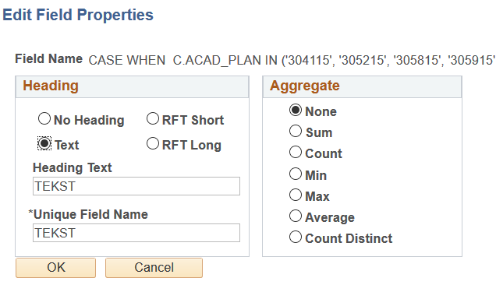
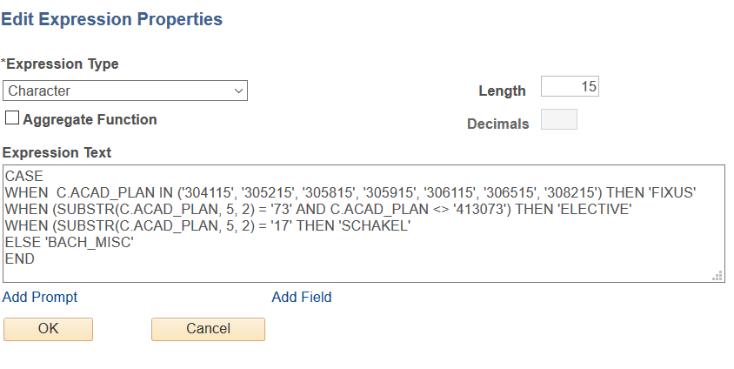
DATA SOURCE CHOOSES
Notes:
The unique fieldname is the name that you use in your template to let your choose work. It’s best to keep this the same in case you need to debug.
The expression is just a WHEN-THEN statement. You can configure this just as detailed as you like. The expression is executed top to bottom so make good use of that.

Slide 19
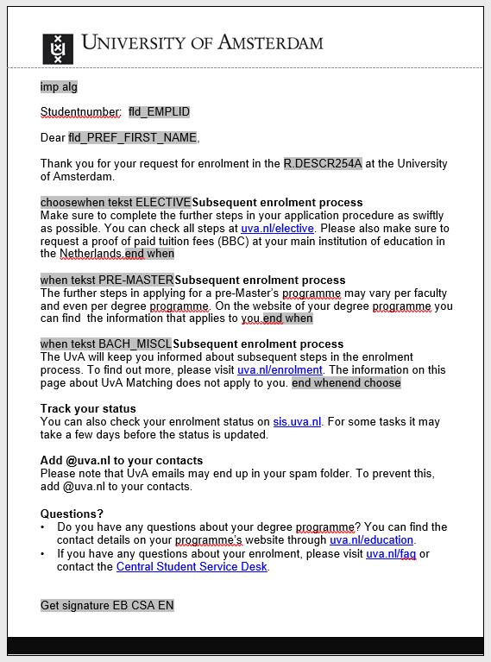
Notes:
This is what your template looks like with chooses and subtemplates. Pick unique and easy to type names, especially if the text segments are alike

Slide 20
Data source
Standard fields
Field from query
Notes:
Standard fields from your data source and fields from the query in your data source

Slide 21
‘Start’ and ‘End’ choose
Text segments within choose
Notes:
These are the chooses. The full choose needs a beginning and an end.
The text segments also need beginnings and ends.

Slide 22
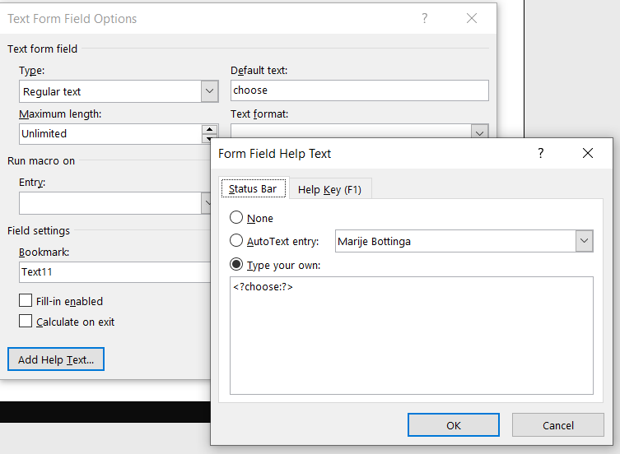
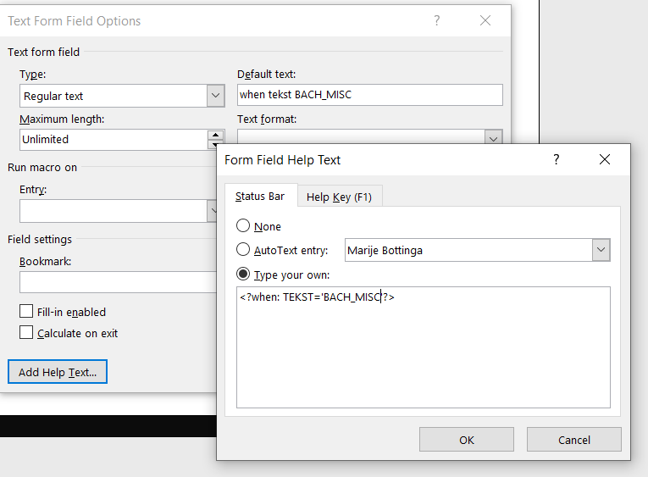
TEMPLATE CHOOSES - beginnings
Notes:
Best way is to keep these texts the same, easier to debug.
Left is the start of your ‘choose’ construction, right is the start of every text segment. The Choose construction had the ‘choose’ at the outside and the ‘when’ on the inside.

Slide 23
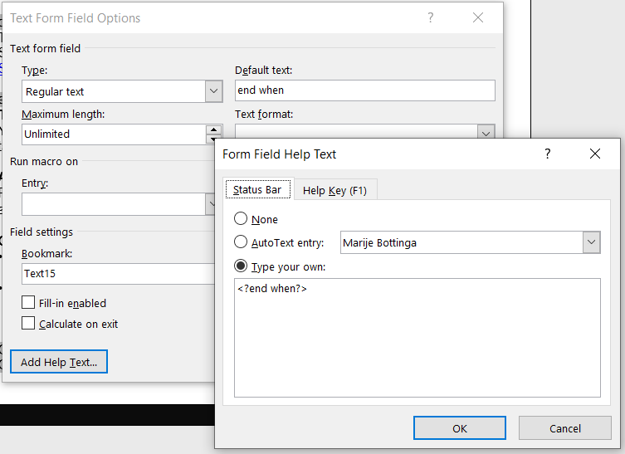
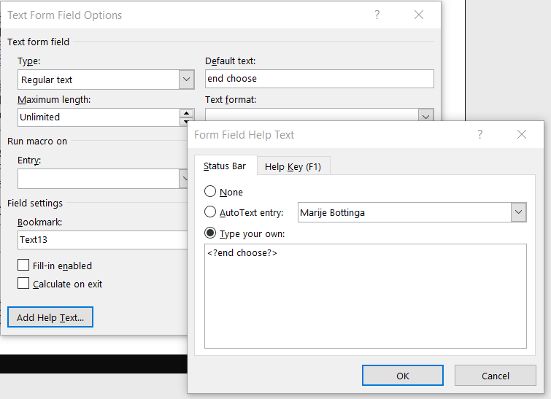
TEMPLATE CHOOSES – ends
Notes:
Best way is to keep these texts the same, easier to debug.
The end-when belong to every ‘when’ statement. And the end-choose belongs to the ‘choose’ statement. The ‘choose’ is on the outside of your construction, and the ‘when’ statements are embedded within the choose. Make sure your beginnings and ends match.

Slide 24
Tips & tricks for chooses
For every population that you can define in campus, you can use chooses:
Instructions per programme / plan / career/ organisation
Add URLs
Use it with ‘SYSDATE’ to change the text after a deadline
Start with simple texts to check if your design works
Expressions work from top to bottom

Slide 25
Sub templates
Segments you like to reuse

Slide 26
WELCOME EMAIL – sub templates
Generic PopSel
Thank you
Instructions 1
Check SSS
Add @uva.nl
Signature A
Questions
Signature B
Signature
Signature C
Signature D

Slide 27
Call sub template ID
Get specific signature

Slide 28
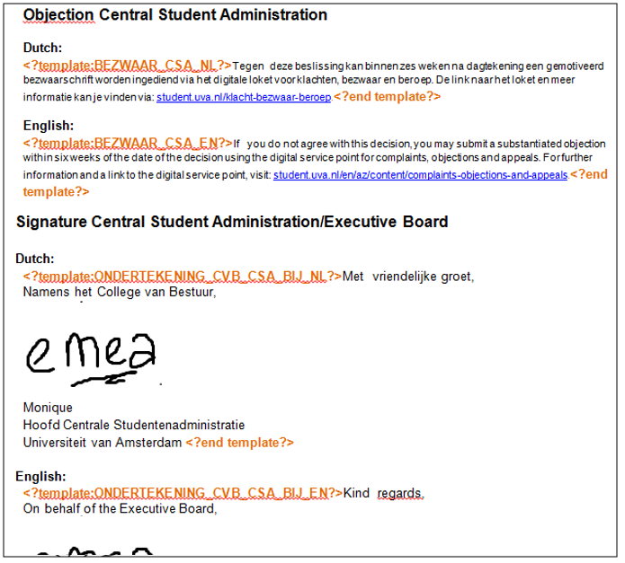
Sub template layout
Instructions
Text segment
Notes:
Everything between the orange sections is a segment you can show in your report definition template
You can use layout, images and URLs in your templates
Every segment should have unique name
The space around the segments you can use for instructions

Slide 29
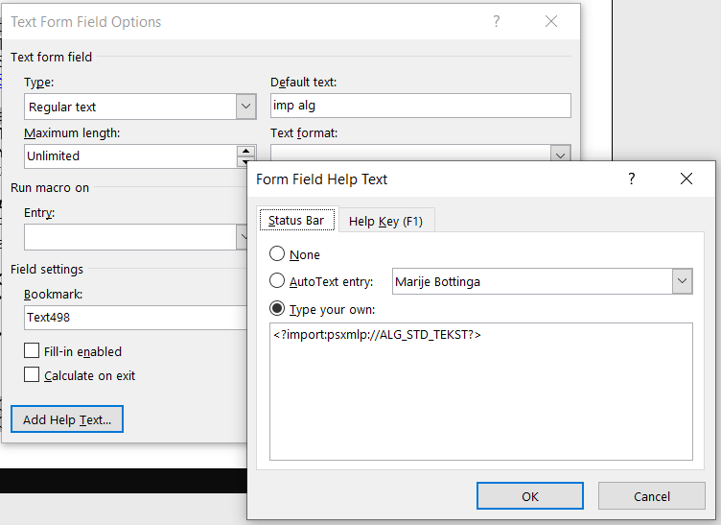
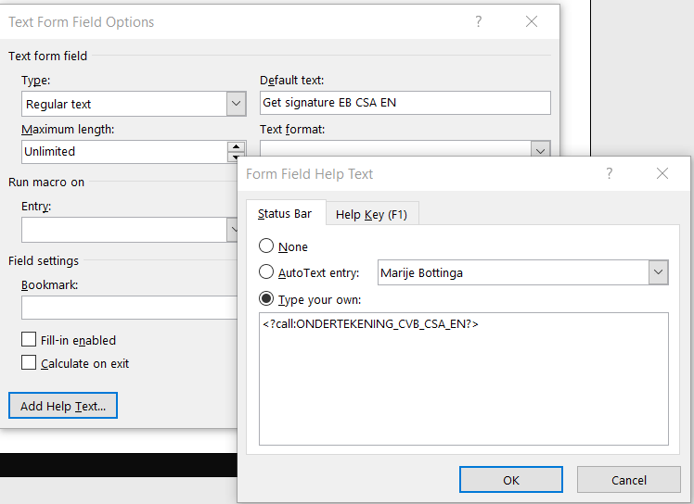
Sub template in your letter code template
Notes:
Left is at the top of your file: call the content library for that sub template ID. It will automatically select the correct version based on effective date
Right is where you want to show your text segment. You call that particular text segment. If you keep the text the same it’s easier to debug

Slide 30
Sub templates
Main menu → reporting tools → BI publisher → content library
Effective dates
Use unique names for each text segment
Multilangual (because of unique names)
Every segment has a beginning and an end
Add instructions

Slide 31
Sub templates
Main menu → Reporting Tools → BI Publisher → Content Library
Sub template ID
Sub template File v3
1-12-2019
Sub template File v2
1-7-2018
Sub template File v1
1-1-1900
Notes:
Calling the subtemplate will always refer to the ID. Within the ID Campus will find the correct file based on the effective date.
You first template should be dated to 1-1-1900, then you upload newer versions with the correct effective date (preferably tomorrow, because there is no timestamp, only a date), and you can also add future changes. So if the signatures should change as of next month, you can already go ahead and add your new sub template file.

Slide 32
Multilangual
Why and how

Slide 33
Where are the netherlands

Slide 34
Dutch speaking countries

Slide 35
Where do our applicants come from

Slide 36
languages
Base language:
English
Related language:
Dutch
Notes:
The green highlighted fields are related language fields. You can use the

Slide 37
1 letter code, 2 languages
We use:
1 Letter code
1 Data source → language proof
1 Report definition → 2 templates (Dutch and English)
1 Run-ID 3C for population selection
1 Run-ID commgen → using ‘preferred language’

Slide 38
1 letter code, 2 languages
Data source: What student information do I need?
Emplid
Preferred name
Effective date
Study programme
Academic load
Date of birth

Slide 39
1 letter code, 2 languages
Data source: What student information do I need?
Emplid
Preferred name
Effective date → 2 languages
Study programme → 2 languages
Academic load → 2 languages
Date of birth → 2 languages

Slide 40
Example datasource in 2 languages

Slide 41
Example datasource in 2 languages

Slide 42
WELCOME EMAIL – multilanguage
English Dutch
Thank you
Thank you
Instructions
Instructions
Check SSS
Check SSS
Add @uva.nl
Add @uva.nl
Questions
Questions
Signature
Signature
Notes:
English template and a Dutch template. Same content, different languages.

Slide 43
WELCOME EMAIL – multilanguage
One data source
Thank you
Instructions 1
Instructions 1
Thank you
Instructions 2
Instructions 2
Instructions 3
Instructions 3
Check SSS
Check SSS
Add @uva.nl
Add @uva.nl
Questions
Questions
Signature
Signature
Notes:
The choose functionality will give the same output. But per template you configure what segments you want to show.

Slide 44
WELCOME EMAIL – multilanguage
One subtemplate rtf
Thank you
Thank you
Instructions
Instructions
Check SSS
Check SSS
Add @uva.nl
Add @uva.nl
Signature A
Questions
Questions
Signature B
Signature
Signature
Signature C
Signature D
Notes:
You can use the same sub template file, but refer to different unique names. So you select the English signature in your English template, and the Dutch signature in your Dutch template.

Slide 45
Sub template - multilanguage
Notes:
As you can see, using the unique names in a smart way you can use 2 languages in your sub template file.

Slide 46
commgen
Notes:
You can select preferred language, or you can overrule the preferred language by selecting ‘specified’ and select the correct language in the drop down. For instance: a Dutch student needs an English declaration of enrolment for an exchange programme.

Slide 47
commgen
Notes:
You can fill in two subjects that are related to the preferred language.

Slide 48
What does it look like?
Examples

Slide 49
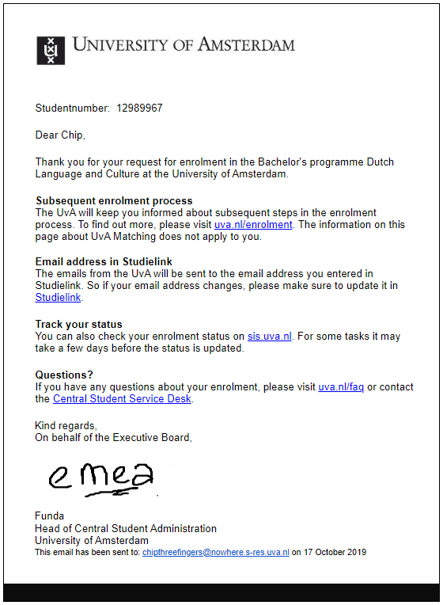
Example email
Notes:
But all the elements come from different elements.

Slide 50
Example email
Data source
Data source query
Choose
Subtemplate: signature
Subtemplate: objection
Notes:
But all the elements come from different elements.

Slide 51
Example view communication
Notes:
If you look up the e-mail in Campus Solutions, you will see the email the exact way the student receives it

Slide 52
Tips & tricks
Insert email address in communication (because there is no effective date in personal data)
Configure your communications in a unified way
Default template in English
URLs in sub template
Make your configuration future proof (not ‘signatures’ but ‘standard texts’)

Slide 53
Concluding thoughts

Slide 54
Lessons learned
If related language does not exist, there is no outcome, no communication
Outer join the Related language table and use an expression for the related language fields → no related is base language
Test thoroughly, ask others for help
Effective date is very effective
Effective date: tomorrow
Work in an organised way

Slide 55
presenter
Marije Bottinga
Functional application management
University of Amsterdam
M.Bottinga@uva.nl
Check out my blogseries: https://www.heug.org/p/bl/ar/blogaid=3635
all Alliance presentations will be available for download from the Conference Site

Slide 56
THANK YOU!

