Slide 1
Driving the business ahead SMUCAR - SMU’s BI & Analytics journey
SESSION 6013
9th November 2015

Slide 2
presenter
Vetrivillalan Vennila
Senior Manager
Enterprise Information Systems - Business Intelligence
Integrated Information Technology Services
Singapore Management University
vennilav@smu.edu.sg
Profile
Leading the BI Analytics team at SMU, with 20+ years of IT experience.
Have been practicing as business intelligence specialist for past 12 years spanning across all leading BI products.

Slide 3
Singapore Management University
Established in January 2000

Slide 4
Singapore Management University
A premier university in Asia, the Singapore Management University (SMU) is internationally recognised for its world-class research and distinguished teaching.
Home to around 9000 undergraduate, postgraduate, executive and professional, full- and part-time students.
SMU has six schools

Slide 5
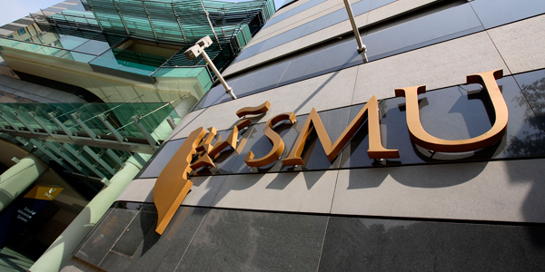
SMU& ORACLE
Integrated Student Information System
Online Access to Student Information System (OASIS)
Student Management Analytics (SMUCAR)

Slide 6
SMU & ORACLE
PeopleSoft Campus Solutions (Version 8.9) PeopleSoft Enterprise Portal (Version 8.9) PeopleTools (Version 8.49)
Academic Advisement Student Financials Admissions & Recruiting | Student Records Campus Community Campus Self Service
 | Oracle Database 11g RAC

Slide 7
Agenda Driving the business ahead SMUCAR - SMU’s BI & Analytics journey
Section 1 - Introduction
SMU Vision
Introduction to SMUCAR
Section 2 - Key Business Challenges
Key Challenges - People, Process, Technology and Data Sources,
Primary objective of SMUCAR
Section 3 - SMU BI Implementation Journey – Key Insights
Student Lifecycle Management
Student Career Management Services
Student Course Feedback Analytics
Faculty Management Dashboard
Section 4 - Key Outcome
Strategic Impact , Customer Impact & Operational Impact
Q & A

Slide 8
SECTION 1- Introduction
SMU Strategic Plan, Vision , Mission,
SMUCAR – Driving the business ahead

Slide 9
SMU Vision
To be a great and iconic global-city university in Asia that excels in tackling the world’s complexities and impacting humanity positively and producing leaders of tomorrow through its transformative education and multi-disciplinary research to provide insights in solving these problems.

Slide 10
SMU Vision
A TRANSFORMATIVE EDUCATION OF SPECIALIZED SOCIAL SCIENCES DISCIPLINES THAT PRODUCES FUTURE GENERATIONS OF GRADUATES CAPABLE OF SOLVING COMPLEX PROBLEMS AND MAKING A DIFFERENCE TO HUMANITY.
A LEADER IN CUTTING-EDGE AND LARGE-SCALE MULTI-DISCIPLINARY RESEARCH IN KEY AREAS OF EXCELLENCE THAT PROVIDES INSIGHTS AND SOLUTIONS CAPABLE OF MAKING HIGH-IMPACT CONTRIBUTION TO PEOPLE AND COUNTRIES AROUND THE WORLD.
A PRE-EMINENT AND ESTEEMED GLOBAL CITY UNIVERSITY IN ASIA

Slide 11
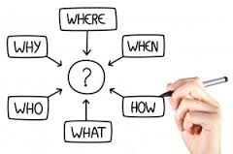
SMU Vision

Slide 12
Data is a Strategic Asset

Slide 14
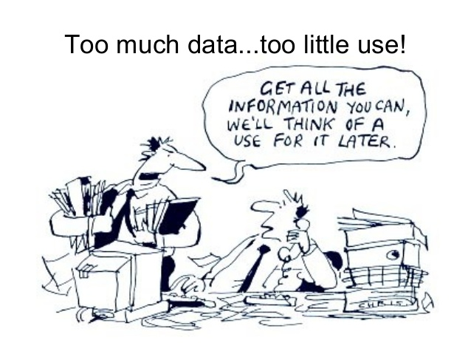

Slide 16
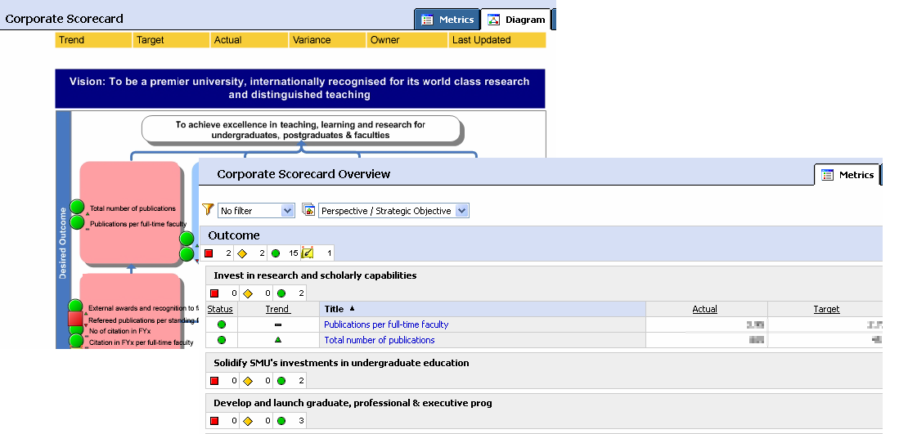
CPMS
Strategic Alignment
Corporate Performance Management System
Schools
Departments
Balance Scorecard Framework

Slide 17
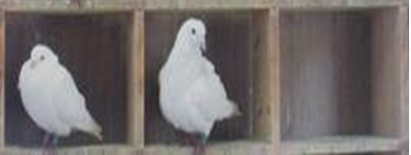
CPMS
Strategic Alignment
Corporate Performance Management System
Schools
Departments
Balance Scorecard Framework
Operational Reports
Operational Reports
Peoplesoft
SAP
Web Apps
External Files

Slide 18
KPI /
Strategy Maps
(CPMS)
Analytics
Dashboard /
Analytical Reports
(SMUCAR)
Operational Reports
(SAP, People Soft, Web)
SMUCAR
Senior / Middle Management
(President, Provost, Dean, HOD’s, Schools)
OPERATION
STRATEGY
Administrators / Operational Managers
(Managers, Admin Staffs)
Corporate Analytics & Reporting

Slide 19
SECTION 2 - Key Business Challenges
Business Challenge in terms of
People, Process, Technology and Data Sources
SMUCAR – Solution Overview

Slide 20
Key Business Challenges
Lack of ease of access to single source of truth
Long turnaround time to get the relevant information
Prone to human errors due to manual data processing efforts
Steep learning curve
Data in Silos, data integration a key challenge
Lack of analytical capabilities in reporting tools
Risk of reputation loss
1
2
3
4
5
6
7

Slide 21
Key Business Challenges
Process
Source
Inconsistent
Data
Definition
IT Governance
Disparate
Data sources
And formats
BI Strategy /
Methodology
Security and
Data Governance
Wrong
Data Entry
Source Data
Rectification
Ownership
BI Adoption
Costly
Lack of BI
Tool knowledge
Complexity
Articulating
BI Needs
Scalability
Dependency on
IT support
Steep Learning Curve
Lack of
BI Awareness
Technology
People

Slide 22
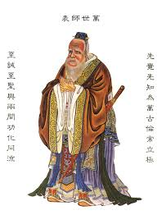
Key Business Challenges - People
“Real Knowledge is to know the extent of one’s ignorance.”
Confucius
Lack of BI
Tool knowledge
Lack of
BI Awareness
Articulating
BI Needs
Dependency on IT support

Slide 23
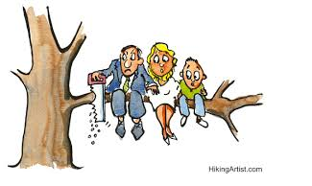
Key Business Challenges - Process
Are we sure if we have the Right Methodology / Governance ?
IT Governance
Data
Ownership
BI Strategy /
Methodology
Security and Data Governance

Slide 24
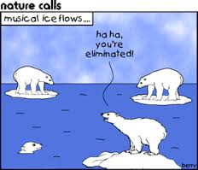
Key Business Challenges - Source
Source Data
Rectification
Inconsistent
Data
Definition
Data Source
Disparate
Data sources
And formats
Wrong
Data Entry

Slide 25
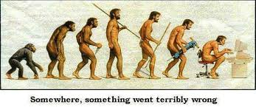
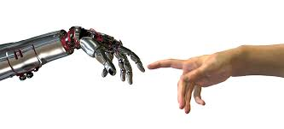
Key Business Challenges - Technology
Complexity
Scalability
Steep Learning Curve
Costly

Slide 26
Strategy Approach
People
President / Provost
Deans / HODs
Managers / Department Staff
Process
BI Strategy & Framework
BI Data Governance & Security guidelines
BI Implementation methodology
Data Management (Database / Data Marts, Operational Data Store)
BI Tools
Technology

Slide 27
Strategy Approach
People
Management Support with President as Sponsor
Process
Gap analysis of ‘AS-IS’ and ‘TO-BE’
Flexibility in formula change
Technology
Simple to use BI tool
Cost effective
Empowerment of BI users
‘Do-it-Yourself’ (DIY) model
Guided templates for requirement gathering
Detailed data discovery
Data quality / history data
BI agile development
Data security / governance
Lean learning curve
Quick to develop and deploy
Easy to integrate with existing applications
Support for mobile BI
Early adopters approach
BI awareness workshops / trainings
Technology

Slide 28
Embarked on SMUCAR Journey
A Journey that drives our business ahead….

Slide 29
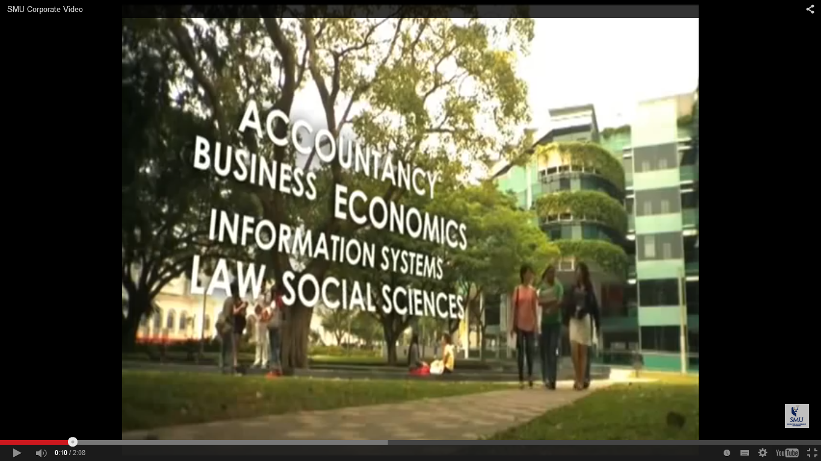
SECTION 3 – SMUCAR Implementation Journey – Key Insights
SMUCAR – Implementation Strategy
Analytics Implemented
(Student & Faculty)

Slide 30
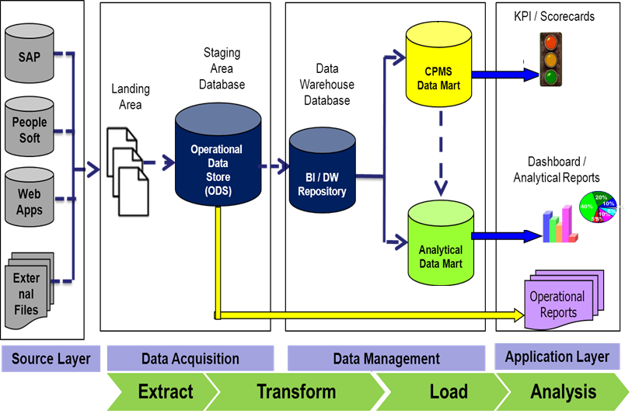
SMU Corporate Analytics & Reporting (SMUCAR) BI Architecture

Slide 31
SMU Corporate Analytics and Reporting (SMUCAR)
Notes:
SMUCAR’s target focus was on analytics related to student and faculty lifecycle management as these two user groups are the core assets of SMU
very first pilot began in Jun 2011 with Office of Undergraduate Admissions to create a dashboard for users to perform trend analysis of admissions related data across the entire admissions lifecycle ( 3 months) and subsequently expanded to Student lifecycle (7 Months)
IT Management Analytics helps the senior IT executives to track and analyze their operations effectively(4 months)
HRFAA helps users to track and analyse trends / related data pertaining to the most important assets of SMU, i.e. faculty and staff (8 months)

Slide 32
SMU Corporate Analytics & Reporting (SMUCAR)
Analytics Implemented | Period
Student Lifecycle Management Admissions Analytics Integrated Student Information System (ISIS) Analytics Career Services Analytics Course Feedback - FACETS Analytics | Jun 2011 – Aug 2011 Sep 2011 – Mar 2012 Jul 2014 – Dec 2014 Jun 2013 – Dec 2013
Faculty and Staff Life Cycle Management Faculty Management Dashboard Human Resource Faculty Admin Analytics (HRFAA) Teaching Load Analytics | Jan 2014 – Apr 2014 Oct 2012 – May 2013 Apr 2014 – Oct 2014
IT Management Analytics Learning Space Analytics Learning Management Dashboard Service Support Analytics | Jul 2012 – Oct 2012

Slide 33
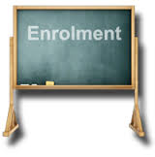
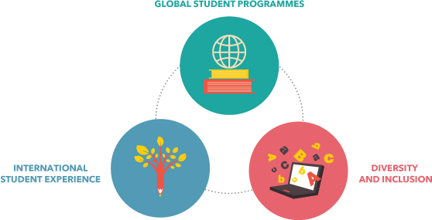
Student LIFECYCLE Management
Course Demand
COURSE
Global Exposure
Graduation

Slide 34
Admissions Analytics

Slide 35
Admissions Analytics
Application
Enrolment
…
…
…
…
Ability to track student admissions vs Target
Monitor admissions lifecycle quickly
Analyze student cohort by country, nationality, gender, grades etc.
Track the offer status effectively
Analyze applicant Intake Quality
Perform trend / correlation analysis of applicants for past years (i.e. across cohorts)

Slide 36
Admissions Analytics
Key Metrics
Offer Rate (Applied / Offered) | Yield Rate (Offered / Accepted)
Applicant to Admissions Target Ratio | Withdrawal Rate
Applicant Profiling | Admission Funnel
Applicant Intake Quality | Marketing Channel (Newspaper / Fairs / Exhibition etc.)

Slide 37
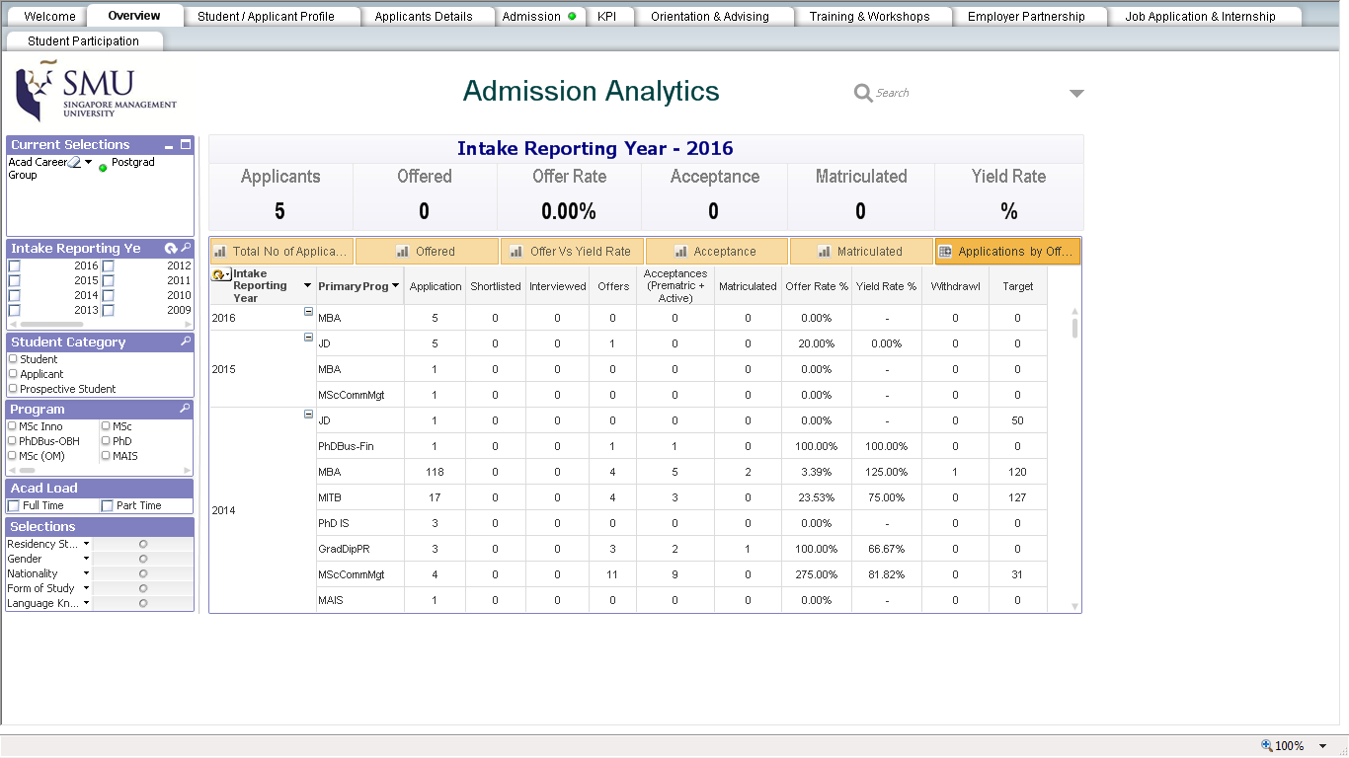
Admissions Analytics

Slide 38
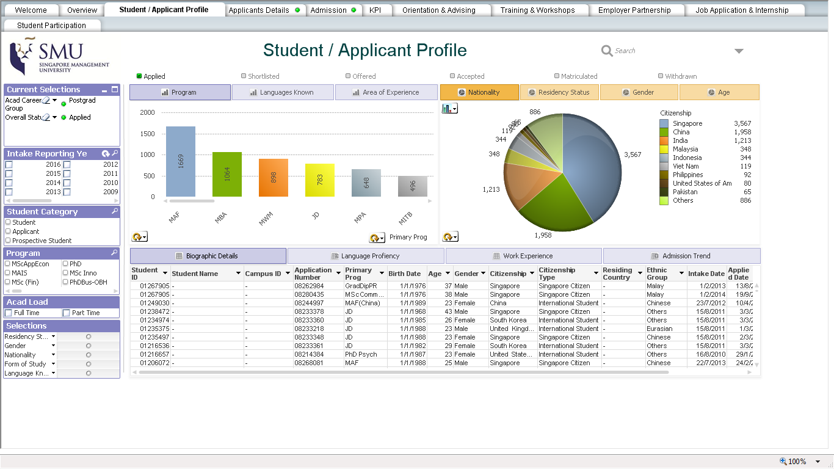
Admissions Analytics

Slide 39
Admissions Analytics

Slide 40
Admissions Analytics

Slide 41
Graduation
Integrated Student Information System (ISIS) Analytics

Slide 42
Integrated Student Information System (ISIS) Analytics
Enrolment
Graduation
…
…
…
…
Enable 360⁰ view of a student, Spanning from Enrolment to Graduation
Analyze student profiles, course enrolment, attrition, course bidding across the six schools of SMU
Identify percentage of graduates with Double Degrees / Second Majors
Ability to Forecast the number of class sections required based on course bidding / class enrolment
Trend analysis and correlation of student performance / GPA with ‘A’ level results
Track percentage of of students with (at least one) overseas exposure
Analyse exchange and internship programs, community services and CCA

Slide 43
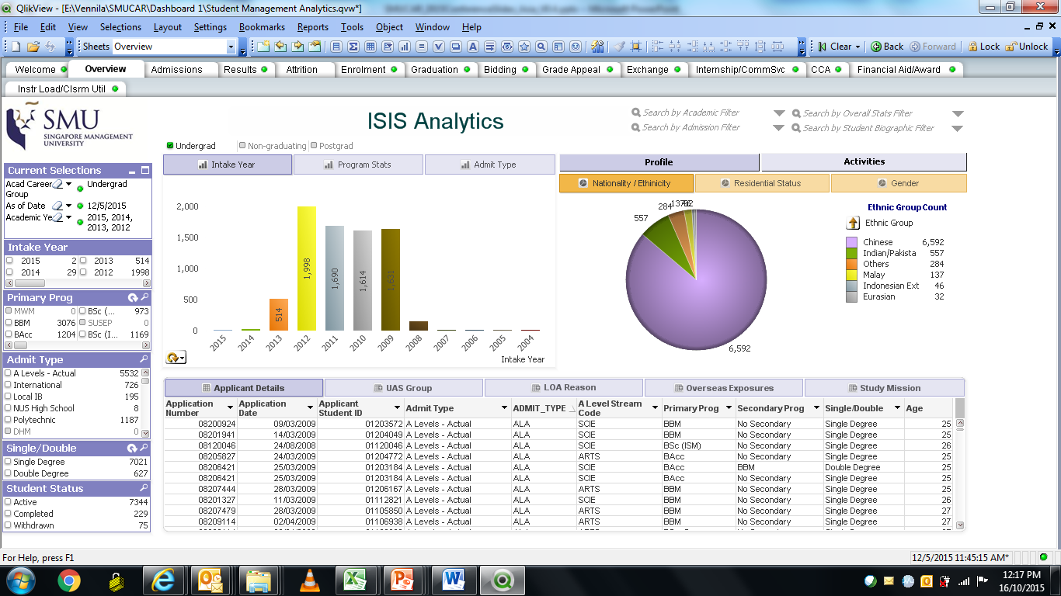
ISIS Analytics

Slide 44
Course Demand and Supply
Key Metrics
Course Enrolment to Total Cohort Ratio (Consecutive two year cohort) | Trend Adjustment Ratio
Average Course Demand | Forecasted No of Class Section
Enrolment by 1st & 2nd Major | Course Backlog by Program
Average Class Size | Course Backlog by Major

Slide 45
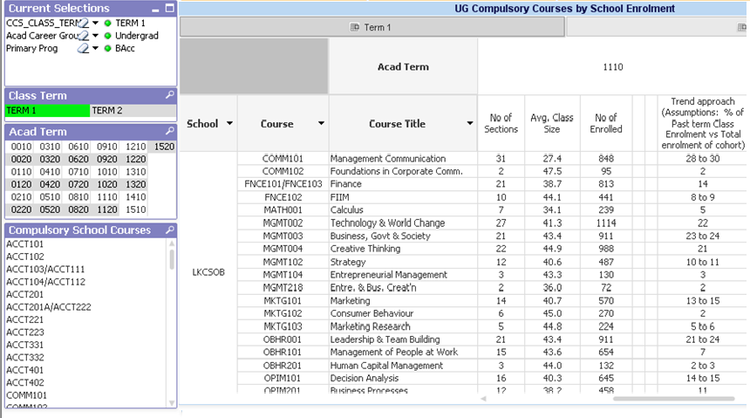
Course demand and supply

Slide 46
Global exposure
Key Metrics
Overseas Exchange Participation Rate | Incoming Exchange Students Ratio
Outbound Exchange Student Ratio | Overseas Study Mission %
Achieved Community Service Hours | Average Internship Weeks / Stints

Slide 47
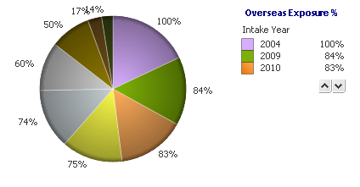
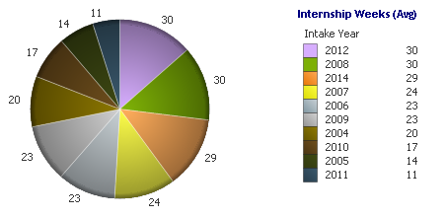
Global Exposure

Slide 48
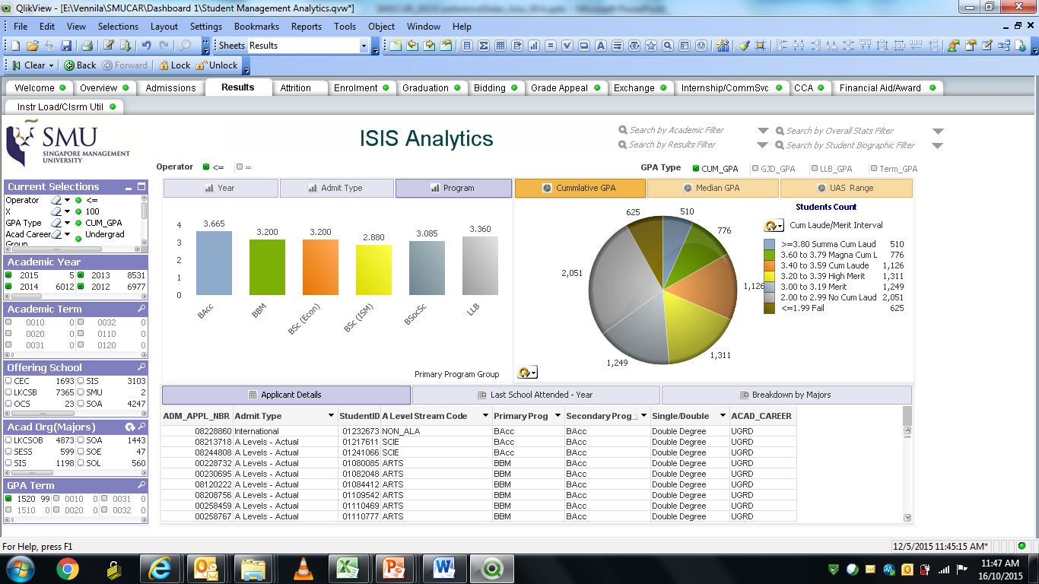
results

Slide 49
COURSE
Course Feedback Analytics

Slide 50
Course Feedback Analytics
COURSE
To be able to track the overall SMU teaching effectiveness
Analyse student feedback on undergraduate courses taught and faculty members
Comparison of school average scores for every term, course, feedback question against the overall SMU average
To be able to track individual Faculty scores over time
To analyze the course and instructor ranking based on the Average Scores

Slide 51
Course Feedback
COURSE
Key Metrics
Response Rate | School Average Scores (Overall / Core & Non-Core)
SMU Average (Overall / Core & Non-Core) | Overall Rating of the Instructor
Overall Rating of the Course | School Percentile
Instructor Ranking | Course Ranking

Slide 52
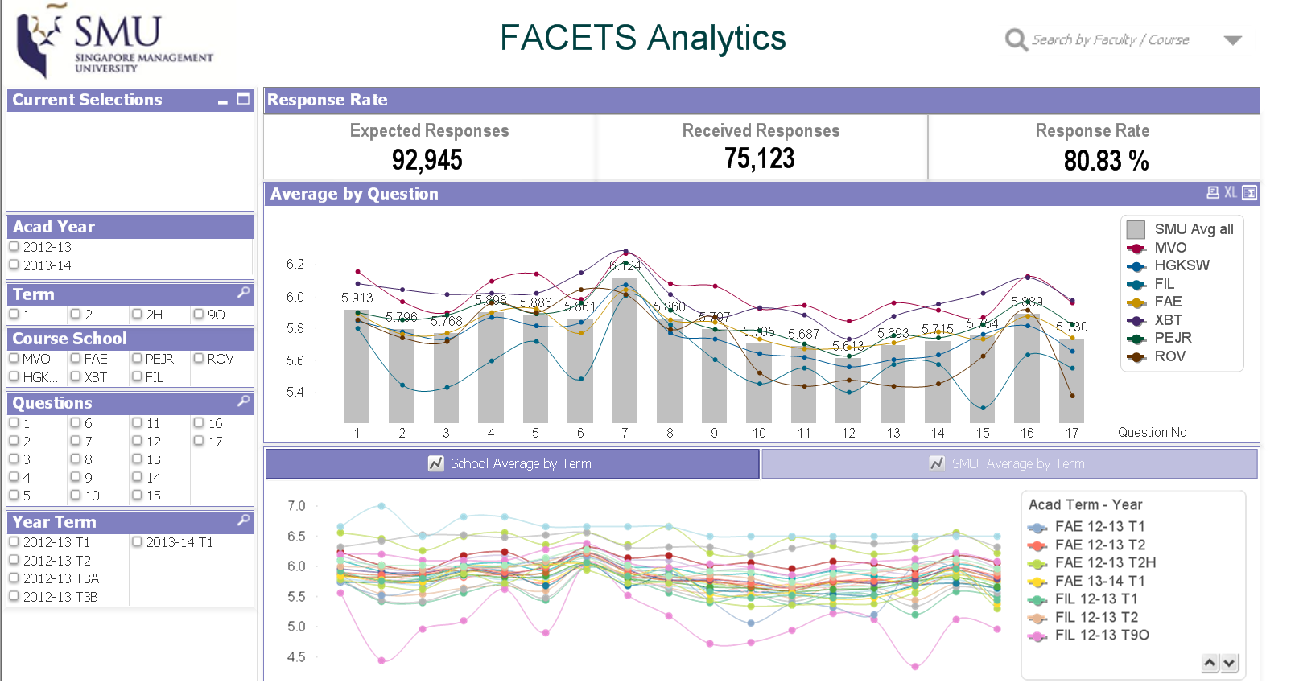
Course Feedback
COURSE

Slide 53
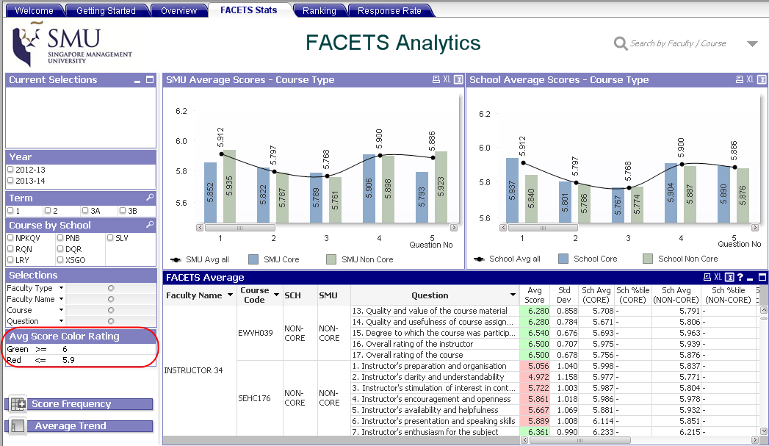
Course Feedback
COURSE

Slide 54
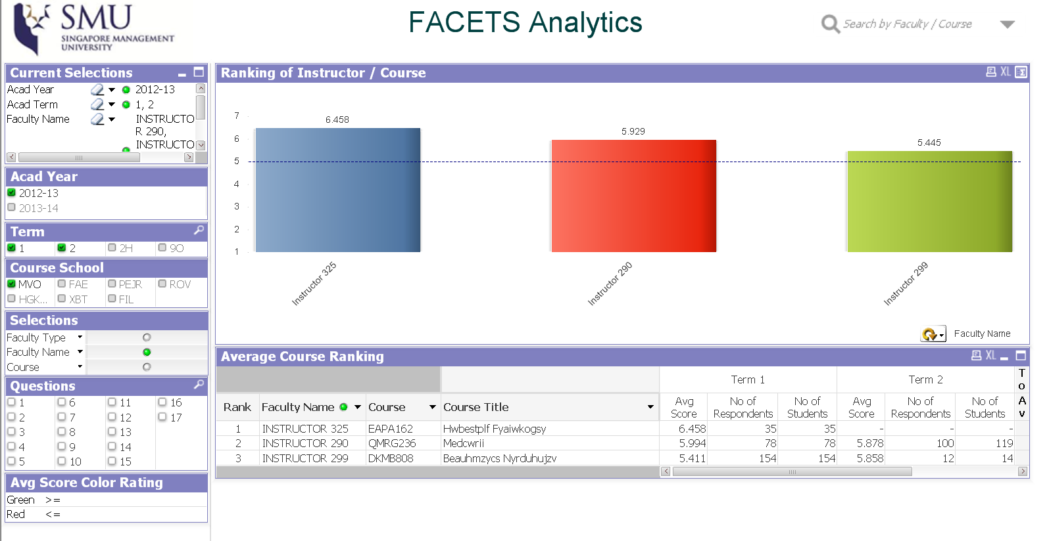
Course Feedback
COURSE

Slide 55
Career Services Analytics

Slide 56
Career Services Analytics
List of MBA students with 3-5 years of experience eligible to work in Singapore
List of students with Chinese language ability with GPA greater than 3**
Average GMAT score in MBA Full time class

Slide 57
Career Services Analytics

Slide 58
Career Services
Key Metrics
Career Services Agreement form fulfilment | Jobs Placement with in 6 months
Student to Career Advisor Ratio | Job Seeking %
Workshop Attendance % | Active Employer Partnership
Job Posting vs Placement Ratio | Job Offer Rate

Slide 59
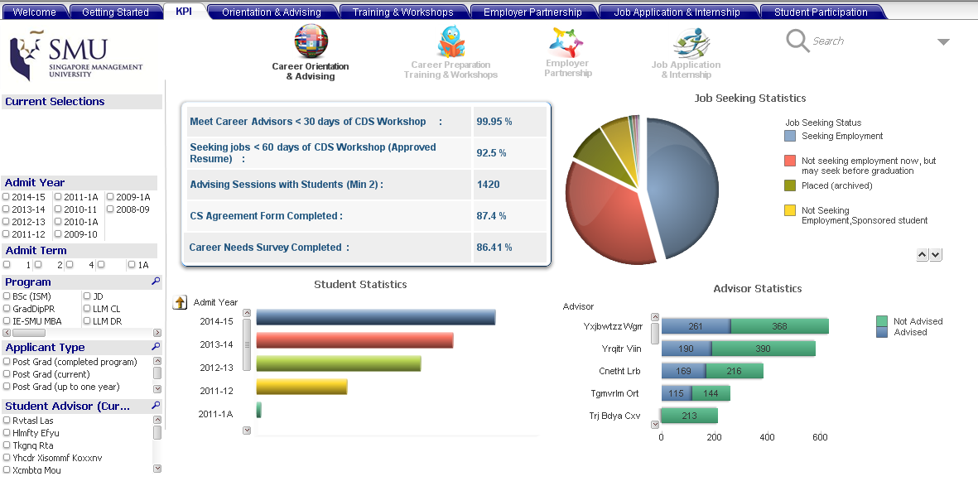
Career Services

Slide 60
Faculty Management

Slide 61
Faculty Management- Demo

Slide 62
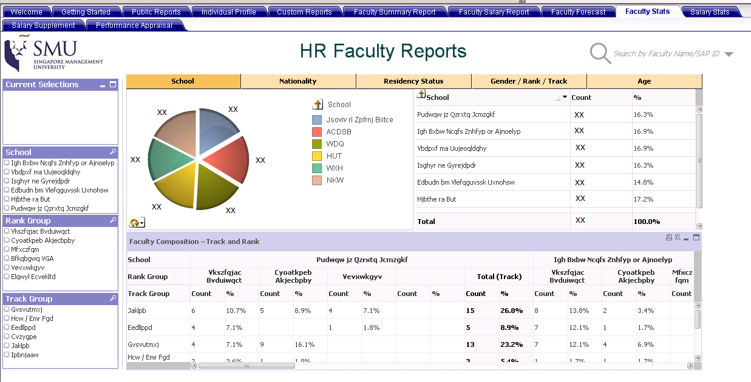
Faculty Management

Slide 63
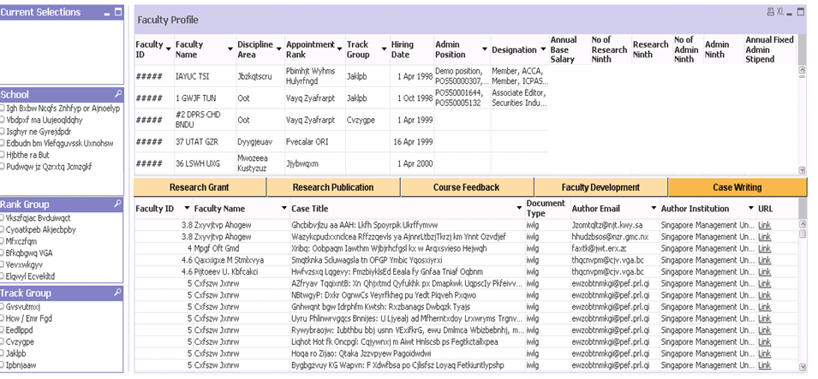
Faculty Management

Slide 64
SECTION 4 - Key Outcomes
Key Outcomes
Our Awards & Accolades

Slide 65
Strategic Impact
SMUCAR
SMUCAR has bridged the gap or “the missing link” between strategy and execution
Enabled ease of decision making more timely with evidence-based analytical capabilities
Achieved collaborative BI environment for schools/ departments and enabled knowledge sharing
Increased BI adoption rate and obtained buy-in via awareness workshop

Slide 66
Customer IMPACT
Self-help BI tool helped to achieve faster turnaround time, increased productivity
Empowered users with flexible centralized data access from a single source of truth

Slide 67
OPERATIONAL IMPACT
Reduced workload for manual data extraction and analysis by at least 50%.
Predicted the demand and supply of each program offered by SMU

Slide 68
Lessons Learned
1. Accuracy in data source
For example In Admission Analytics, Admission Program Stack must be maintained correctly.
Missing one effective –date row will result in wrong stats
Student A
1-Jan -> Applied
1 – Feb -> Offered (Missing Data)
1 – Mar – Accepted
Measures Taken:
Customization of sequence validation in the Admin Module (Maintain Applications)

Slide 69
Lessons Learned
2. Prototype Approach
Users may be unware of the requirements at the start
Start with sample prototype and elaborate
3. Master Data Management
Code masters to be synchronized across multiple systems
For example:
People Soft (Campus Solution) : Faculty ID
SAP (HR) : SAP ID
Web Apps (Course Feedback): Instructor ID

Slide 70
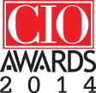
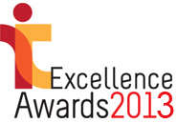
Our Awards & Accolades
SMU’s Integrated Information Technology Services (IITS) has been named CIO 100 honouree 2014 for its SMU Corporate Analytics & Reporting (SMUCAR) initiative
SMU Corporate Analytics & Reporting (SMUCAR) garnered the Finalist award in the IT Excellence Award 2013 by International Data Corporation for Best Deployment of Emerging Technology

Slide 71
Concluding thoughts
ANY QUESTIONS?

Slide 72
THANK YOU!

