Slide 1
Ontario Net Billing – 5 solutions
SESSION 5061
Tuesday November 7, 2017
11:00am

Slide 2
Net Billing – 5 solutions
What is Net Billing? – Shirley Marshall, McMaster University
5 Solutions:
McMaster University Shirley Marshall - BSA & Project Manager for Net Tuition
Queen’s University Sandy McFadden - Manager, Student Awards Office
Fleming College Kathy Hokum – Technical Business Analyst
University of Waterloo Tina Obediah – Manager, Financial Aid Systems
University of Western Ontario Valerie Sarkany – Associate Registrar, Student Financial Services

Slide 3
What is Net Billing?
Government of Ontario mandate
By 2018-19:
Each Ontario post-secondary school shall provide students with Net Tuition Billing. Through Net Tuition Billing, a student’s OSAP and institutional aid will be taken into consideration when calculating fees owed.
The implementation of Net Tuition Billing will:
Provide students with clarity and transparency about actual “out of pocket costs” owed to the institution by the student
Simplify payment process for student – payment made directly to the institution by OSAP

Slide 4
What is Net Billing?
Required elements:
OSAP aid to be applied (per term/installment): the amount of OSAP aid (loans and grants) to be remitted for a student.
OSAP aid applied to account (per term/installment): the amount of aid that was applied to a student’s account (this will be displayed after the payment has been received from the National Student Loan Service Centre).
Balance owing to institution net of OSAP aid (per term/installment): the amount that a student owes to their institution (inclusive of all costs, e.g., tuition, fees, etc.) after ‘OSAP aid to be applied’ (and any other sources of aid a student has) is taken into account.
Net Tuition (academic year): a student’s tuition (not including compulsory or other fees) less their non-repayable aid.

Slide 5
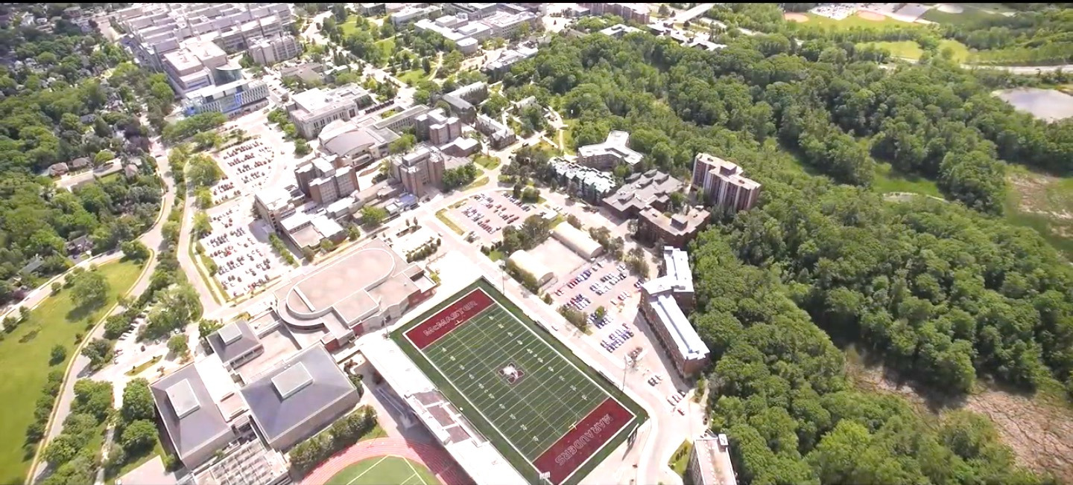
McMaster University
A medical-doctoral, research-intensive university located in Hamilton, ON Canada with total full-time student population of 28,000

Slide 6
McMaster University & ORACLE
PeopleTools 8.55
-July 2017
CS 9.0
(CS 9.2 - October 2018)

Slide 7
Challenges
Term vs. Academic Year
Potential student confusion about “Net Tuition” figure – is that what I owe?
When to show Pending OSAP? Soon vs. accurate
Display of Pending OSAP for students who are not remitting or have paid their account?
System performance - If we create a PDF version, will it affect performance?
Challenges with setting up payment files with NSLDS
Communication!

Slide 8
Solution
Separate “Net Tuition” message from actual Student Account
Use the Net Bill directive to affect a positive change in the Student Account view that students see
Show Pending OSAP as soon as the Net Cost file is available and Tuition has been applied to the Student Account
Show Pending OSAP to all students even if $0 is being remitted, to ensure student knows how much can be expected
PDF is used for details of Account Summary, on demand only, to avoid performance issues
“Quiet” launch

Slide 9
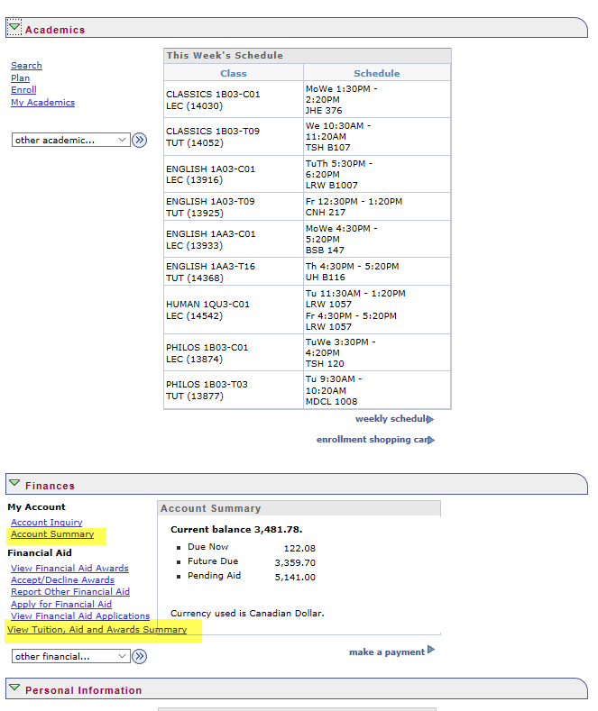

Slide 12
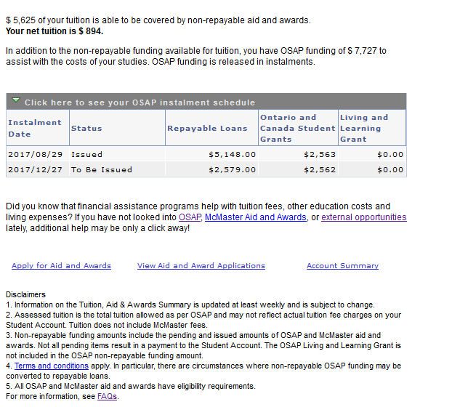

Slide 13
Delivered vs. custom
Delivered:
Pending OSAP and Paid OSAP both configured as ItemTypes
PS Query to create file of pending OSAP based on Net Cost file data, and External Award File Load (FA) to import results
External File Load (SF) to import OSAP payment files and create a Group Post
Expire Anticipated Aid using PS Query to find students who have just been paid
Custom:
New Account Summary page
New Account Detail PDF
New Tuition, Aid & Awards page
Process to load and store Net Cost file

Slide 14
since Go live
When Pending OSAP disappears and no OSAP payment appears on the student’s account (because the money went directly to the student) confusion reigns
With our current Student Account configuration, OSAP payments can appear split between terms. This also causes confusion.
At start of term, the Tuition, Aid & Awards screen is less immediately useful than the Account Summary
Net Cost file must be loaded immediately before CofE file to ensure that calculated remit amount is accurate

Slide 15
Queen’s university Kingston, Ontario
Established in 1841, Queen's offers a transformative student learning experience and is one of Canada's leading research-intensive universities.

Slide 16
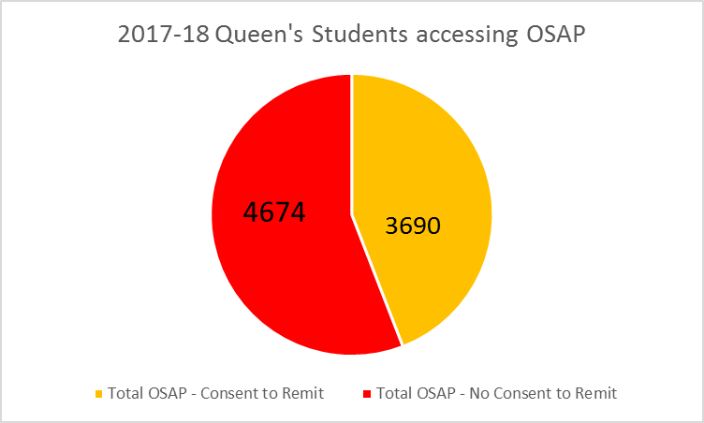
OSAP Demographics at Queen’s

Slide 17
Queen’s University & ORACLE
Version 9.2

Slide 18
OverviEW
How did Queen’s arrive at solution – Considerations
Net Cost / Net Tuition Student View
Delivered Functionality used in Solution
Challenges
Continuous Enhancements

Slide 19
Net TUITion - Considerations
Early Adopter - timeline
Where and how to display to students?
OSAP remittance - new to Queen’s and our students
Resource
requirements
Training / Staff and Student Communication

Slide 20
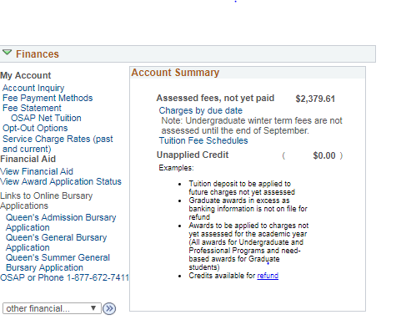
Net tuition VIEWS
Addendum to Fee Statement in PeopleSoft Student Centre
Must have OSAP assessment
Must pass all matching rules – identity, level, course load, career/program/plan
Notes:
OSAP students only
Students who have a completed OSAP application and assessment for the 2017-18 academic year will have access to the link on SOLUS. If a student’s OSAP application is on hold or incomplete, the link will not be present on the SOLUS homepage. If the student JUST applied for OSAP the link will not be available until Queen’s has received confirmation from OSAP that student has been assessed.
There will be some situations where we cannot match the information on the student’s OSAP application to the information in our student system.
Must be in “Full Time” academic load for terms associated with period of study
Must be match on ‘identity’ rules (e.g. Student ID and DOB)
Program and level of study student identified on OSAP application must match what is in PS
Student must be active in terms associated with study period on OSAP application

Slide 21
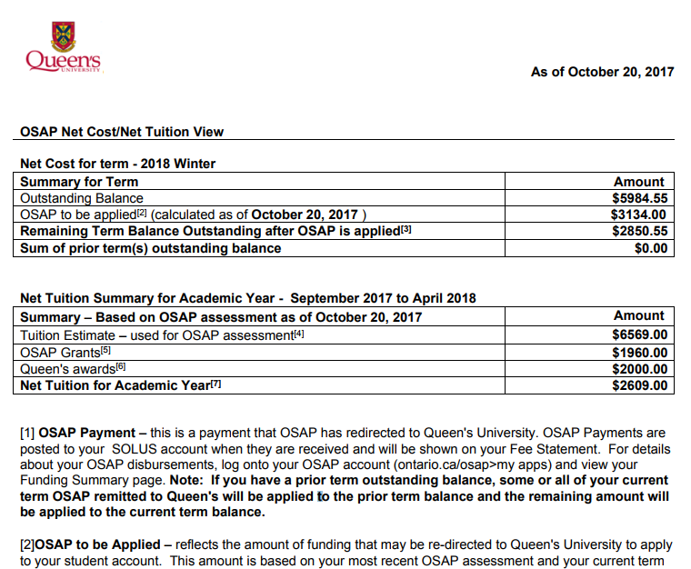
Net Cost-Net Tuition View
Net Cost / Net Tuition View is ‘snapshot’ at a point in time’
1 View to handle multiple scenarios
Use of footnotes
Notes:
There are two primary views on the Net Cost / Net Tuition View. I hope you all had a chance to take a look at this online. This is just a screen shot, and I encourage you to get familiar with accessing it.
Important to understand that the Net Cost / Net Tuition View is ‘snapshot at a point in time’ – refer to the AS OF dates.
Many interfaces between PS and OSAP sending and receiving information. Important to understand that what’s on the View today may change tomorrow if something changes in either system
OSAP is primary source for OSAP information, PS is primary source for Fees information - student should also be checking their OSAP account online for the most current and detailed information about their OSAP funding.
Lots of footnotes – attempt to explain each label on the View, and provide statements to re-iterate ‘point in time’ and in some cases depending on the ‘as of’ date some of the values they see are estimates.

Slide 22
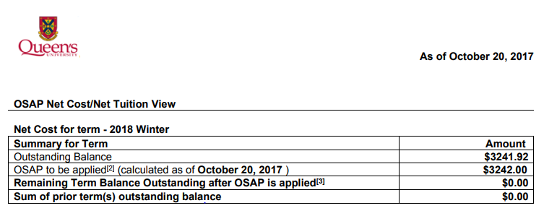
Net cost View
Notes:
There are two primary views on the Net Cost / Net Tuition View. I hope you all had a chance to take a look at this online. This is just a screen shot, and I encourage you to get familiar with accessing it.
Important to understand that the Net Cost / Net Tuition View is ‘snapshot at a point in time’ – refer to the AS OF dates.
Many interfaces between PS and OSAP sending and receiving information. Important to understand that what’s on the View today may change tomorrow if something changes in either system
OSAP is primary source for OSAP information, PS is primary source for Fees information - student should also be checking their OSAP account online for the most current and detailed information about their OSAP funding.
Lots of footnotes – attempt to explain each label on the View, and provide statements to re-iterate ‘point in time’ and in some cases depending on the ‘as of’ date some of the values they see are estimates.

Slide 23
Net Tuition View
Notes:
There are two primary views on the Net Cost / Net Tuition View. I hope you all had a chance to take a look at this online. This is just a screen shot, and I encourage you to get familiar with accessing it.
Important to understand that the Net Cost / Net Tuition View is ‘snapshot at a point in time’ – refer to the AS OF dates.
Many interfaces between PS and OSAP sending and receiving information. Important to understand that what’s on the View today may change tomorrow if something changes in either system
OSAP is primary source for OSAP information, PS is primary source for Fees information - student should also be checking their OSAP account online for the most current and detailed information about their OSAP funding.
Lots of footnotes – attempt to explain each label on the View, and provide statements to re-iterate ‘point in time’ and in some cases depending on the ‘as of’ date some of the values they see are estimates.

Slide 24
Net Tuition – Run Control Parameters
Associate Negotiable Date on MAESD Distribution file to Term in PeopleSoft
Flexibility to change Negotiable dates which may change year over year

Slide 25
Net Tuition – Exception Report

Slide 26
Net Tuition – Delivered Peoplesoft functionality
Delivered PS functionality:
Use of tables and fields in Student Records modules
Use of Run Control / Process Monitor / Exception Report
Query Manager – reconciliation queries
Customizations:
Student Centre homepage
Per Term Fee Statement and Net Tuition Views
Financial Aid components
Cost Code tables – associate career/program/plan/level to OSAP cost codes

Slide 27
Net Tuition – Challenges
Implementation schedule
Limited test data / tight timeline to meet August 1 Early Adopter deadline
One way interface
Matching issues must be corrected manually – can’t return changes to OSAP system
Matching Issues
Configuration of some programs at Queen’s – difficult to match to cost code
Distance learning, Non-degree, Dual Career programs
Level Matching – student interpretation of level differs from Academic rules established for level progression in PeopleSoft
Net Cost by Term requirement - not applicable for all student scenarios
Graduate Payment Plans – not term based
Summer 2018 Net Cost – Net Tuition Views – to be developed

Slide 28
Net Tuition - Enhancements
Develop Net Cost OSAP Aid to be Applied rules to mimic CoE OSAP remit rules
Matching rules - Enhancements to address level matching, program/plan matching
Formatting of Net Cost View – minor cosmetic changes:
Additional information to assist staff in interpreting information
Placement of information in the Net Cost View
Ability to over-ride matching exceptions for some student groups / cost codes

Slide 29
Campus Locations: Peterborough, Lindsay, Cobourg, Haliburton
Fall 2017 Enrolment: 6,250
Notes:
Brenda – We have multiple campus locations. This is our newest addition to our Brealey Campus in Peterborough Ontario.

Slide 30
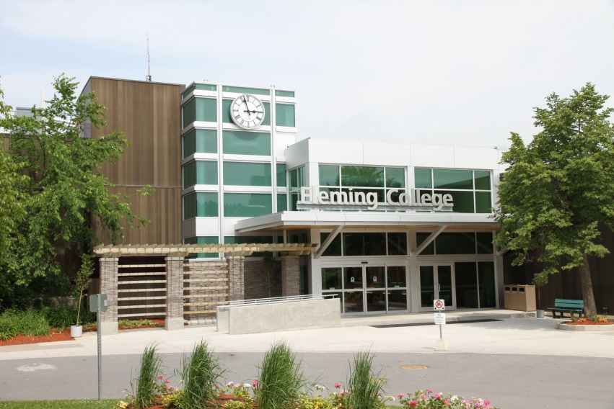
Cobourg
Peterborough, Ontario
Notes:
Some additional pictures of our Peterborough and Cobourg campuses.

Slide 31
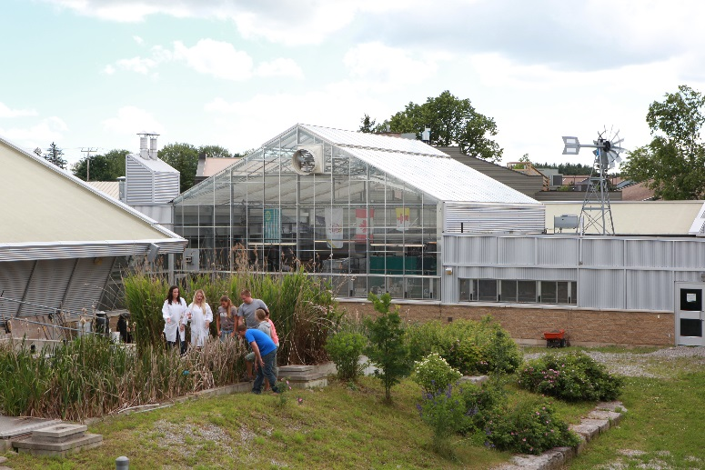
Lindsay, Ontario
Notes:
Our Lindsay campus includes our School of Environmental & Natural Resource Sciences. It is very unique and our students come from around the world to take part in some of the programs offered here.

Slide 32
Haliburton, Ontario
Notes:
This school is in Haliburton Highlands…it includes a sculpture forest and has great summer programs for those wishing to rent a cottage and take in a week or two of part-time courses.

Slide 33
SIR SANDFORD FLEMING COLLEGE & ORACLE
Evolve - Oracle/PeopleSoft Established: 2006
Tools 8.55.10 – June 2017
CS 9.2 – June 2017
FIN 9.2 – June 2016
HC 9.2 – Oct 2016
Fluid – Researching 2018

Slide 34
Solution
Used Item Types for Payments to Show OSAP Applied Amount
OSAP to Be Applied is calculated from the Loan Amount + Grant Amount – OSAP Applied
Display OSAP to be Applied as soon as the Net Cost file is available and Tuition has been applied to the Student Account
“Soft” launch – to avoid volumes of phone calls and lineups, as well as system drain

Slide 35
Student account summary - Charges
We decided to total the charges by Tuition and Ancillary Fees so that the Net Tuition Summary might be a little less confusing
This is a massive SQL

Slide 36
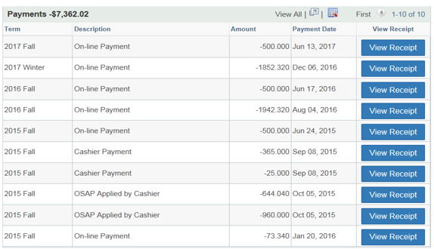
Student account summary- Payments
Before OSAP Applied
After OSAP Applied

Slide 37
Student account summary- Balance by Term
Before OSAP Applied
After OSAP Applied

Slide 38
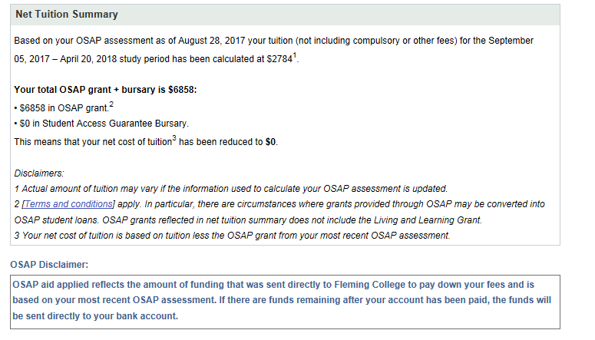
Student account summary- Net Tuition Summary
For Non-OSAP Student (Not in OSAP distribution file)

Slide 39
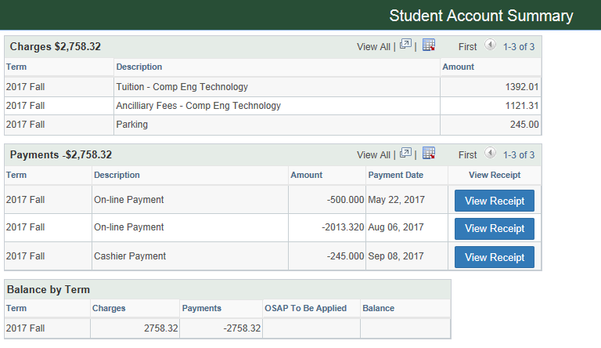
Student account summary- Table’s
Uses all delivered tables;
ITEM_SF
ITEM_TYPE_TBL
TERM_TBL
CLASS_TBL
CRSE_CATALOG
ACAD_PROG_TBL
TUIT_CALC_TBL
ACCOUNT_SF
Uses all delivered tables;
ITEM_SFITEM_TYPE_TBL
TERM_TBL
ACCOUNT_SF
Some Set up we have:
KEYWORD3 = 'PMT’
For OSAP to Be Applied we calculate it from the OSAP Distribution File, which we load into 2 custom tables FC_OSAP_NCDATA for header information and FC_OSAP_DISTRIB for distributions
and ITEM_SF as follows;
STUDENT CONSENT FOR REMITTANCE is Y –Yes (FC_OSAP_NCDATA. FC_OSAP_REMITCON)
And APPLICATION STATUS is O – Open (FC_OSAP_NCDATA. FC_APP_STATUS)
And APPLICATION ON HOLD is N - No (FC_OSAP_NCDATA.FC_APP_HOLD)
(FC_OSAP_DISTRIB.FC_LOAN_AMT + FC_OSAP_DISTRIB.FC_RED_GRANT_AMT) – OSAP Applied (Sum of Item Type 800000000072 and 800000000073 by Account Term)

Slide 40
University of waterloo
Opened in 1957 with 74 students. Today there are over 37,000 students. Known for our cooperative education, engineering and CS programs.
58% of students have an entrance average of 90+ per cent (2015)

Slide 41
University of waterloo & ORACLE
Currently upgrading to version 9.2 and Peopletools 8.55

Slide 42
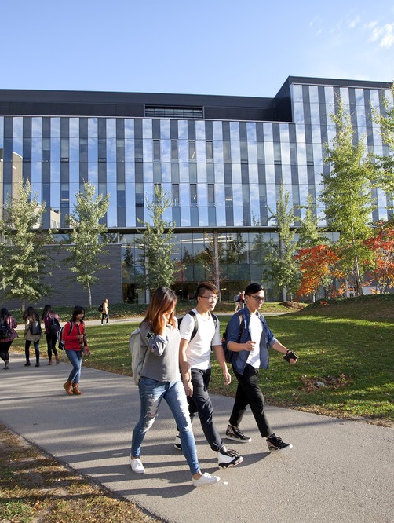
Mobile solution for Net Tuition/Net Billing
Went live in November 2014
Approx. 150 pages have been mobilized
All functional areas were included (records, admissions, Financial Aid, student financials and campus community.

Slide 43
Notes:
Currently we are manually fetching the Net Cost Distribution File, we were unable to automate given the tight timelines as authentication was via username/password vs key – decision to implement in Phase 2
As there were two layouts (Application data\Distribution data) within the same file we created two separate tables to store the different data fields
Due to our large co-op population, one student can have as many as 3 application records for each possible UW term

Slide 44
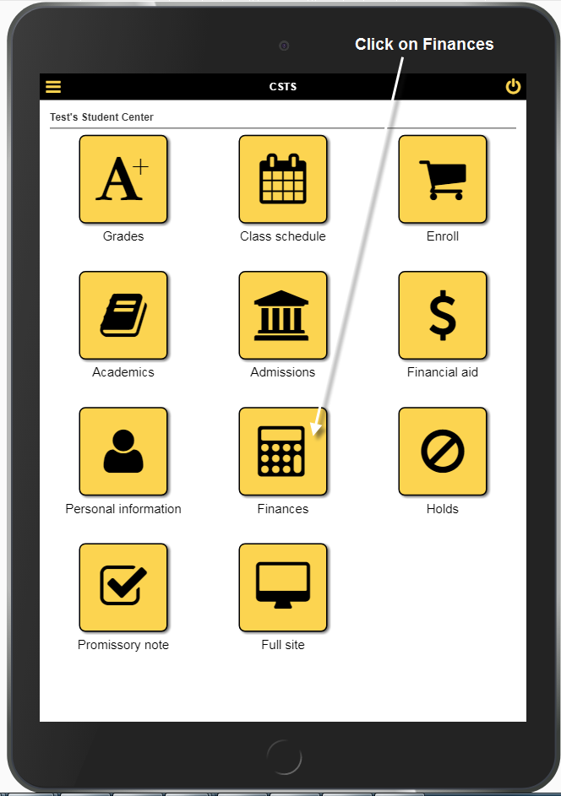
Student Center as displayed from an iPhone.
Click on “Finances” Tile

Slide 45
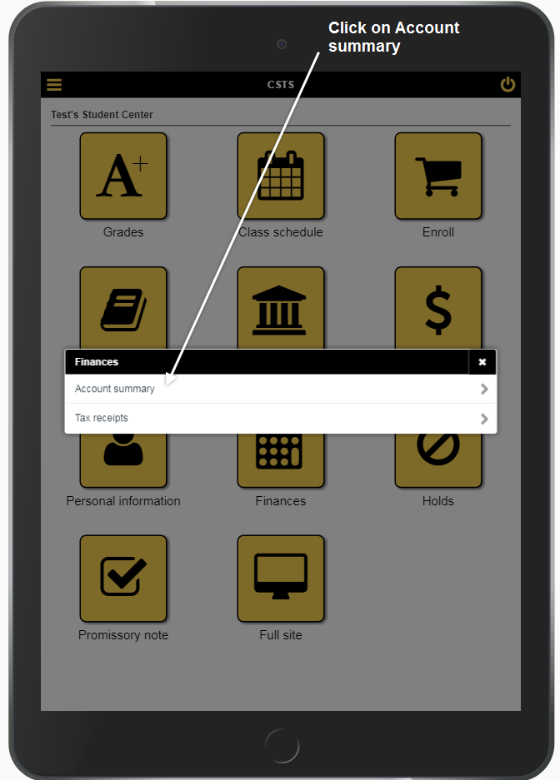

Slide 46
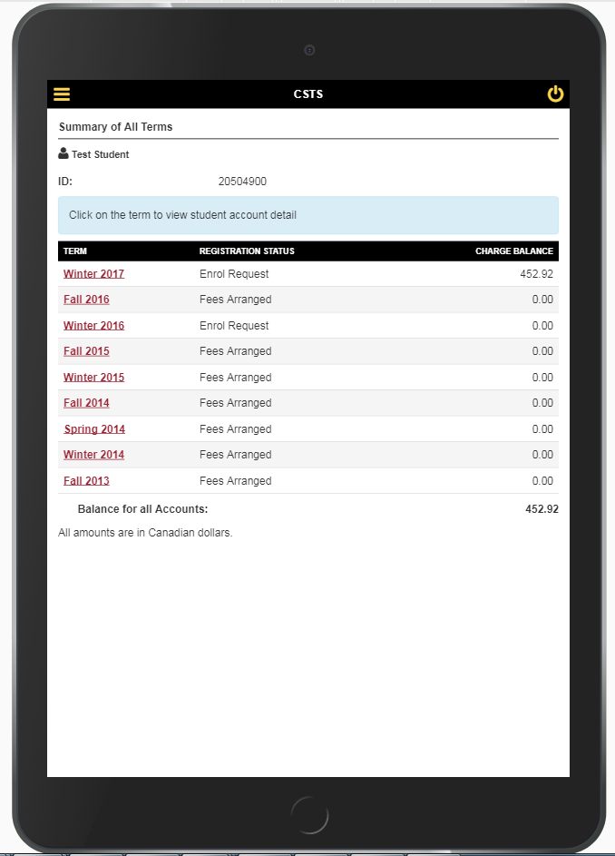
Students account summary is displayed by term
Net tuition page is displayed by academic year

Slide 47
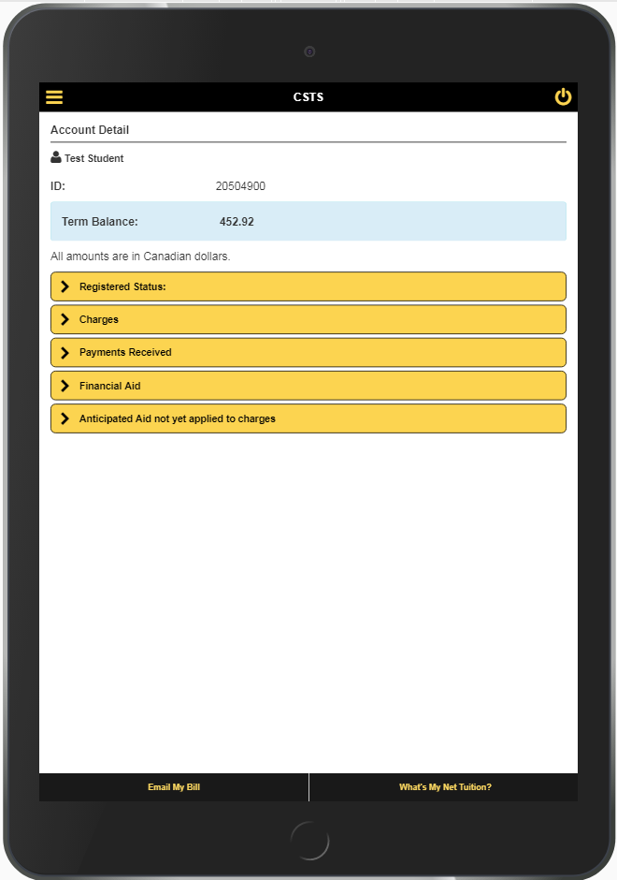
Current term balance owing is displayed in the BLUE box at the top of the screen.
Screen opens with all content collapsed.

Slide 48
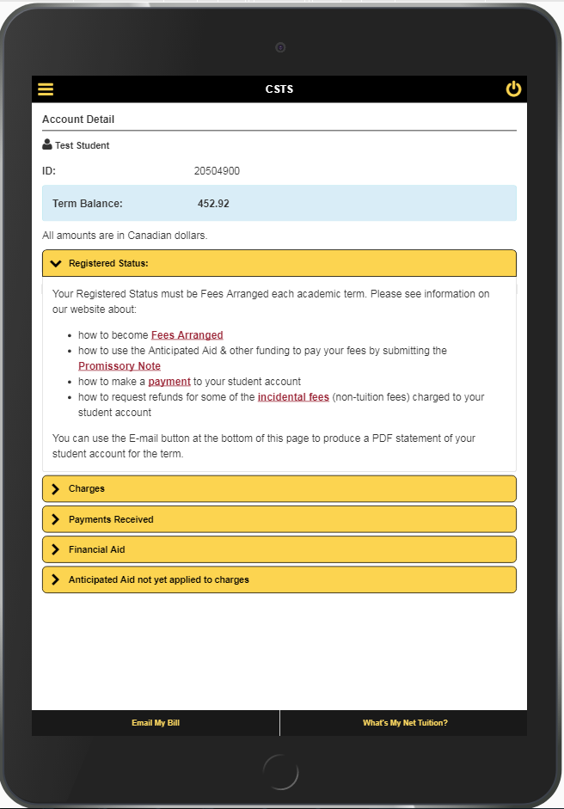
Expandable content
Registered Status: provides information on registration for the term.

Slide 49
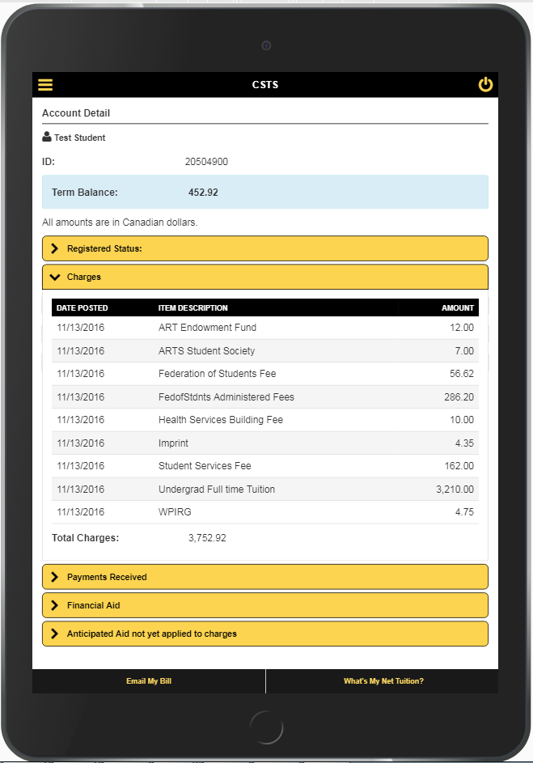
Expandable content
Charges: displays content relating to charges for the term.
Total charges are indicated at the bottom of this section.

Slide 50
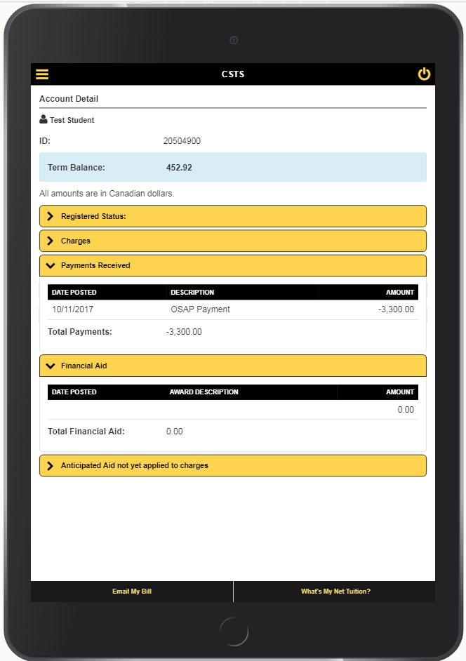
Expandable content
Payments Received: displays any payment that has been posted to the students account.
Financial Aid: displays any awards/scholarships/bursaries that have been posted the students account.
Once a payment is applied, the Term balance owing in BLUE is reduced.
Notes:
Process to direct remit OSAP is new for UW this year. Payment files are uploaded by SF to the students account using an “OSAP payment” item type

Slide 51
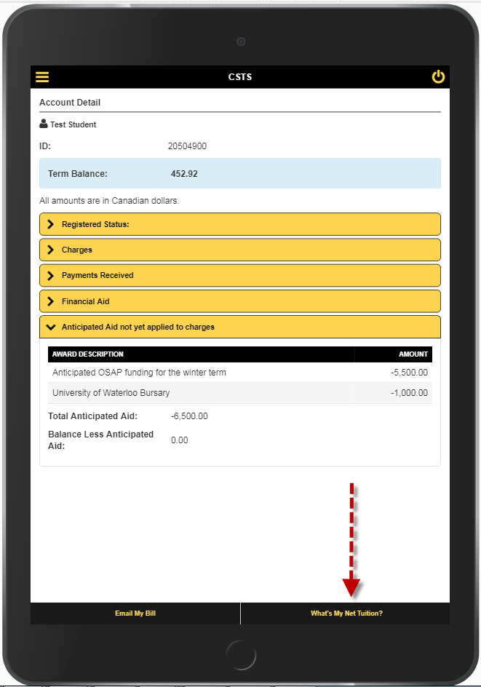
Expandable content
Anticipated Aid not yet applied to charges: “Anticipated” OSAP and award amounts that have not yet been applied to the students account.
Anticipated aid is
We use this section so a student can get registered for a term using funding they have not yet received. This section gives them the balance they owe, less any anticipated aid.
The term balance in BLUE remains as the amount owing, until payment has been received.
Students can email a PDF copy of their fee bill by clicking “Email My Bill” button.
Students can access their Net tuition page by clicking the “What’s My Net Tuition?” button.

Slide 52
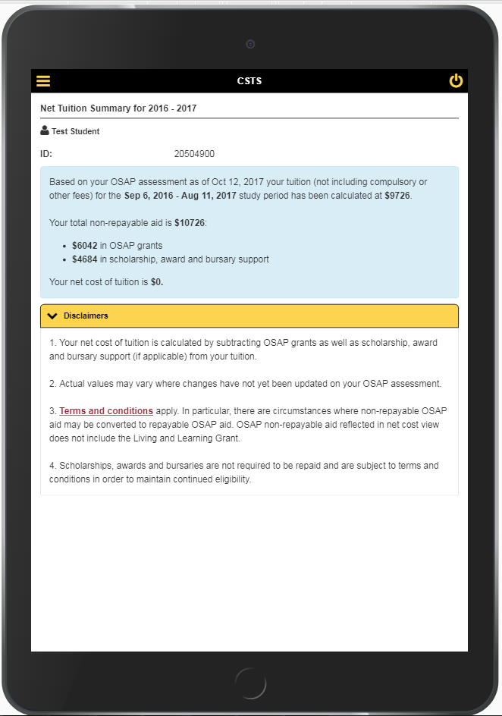
Net Tuition Summary: BLUE section is the net tuition details.
Disclaimers are collapsible content.
Net tuition is displayed by OSAP academic year (Sept – August)
new page to display the Net Tuition for the student’s academic year and leveraging message catalogue messages to display the net tuition values.
We use data from the OSAP load as part of our calculation for the UW non-repayable aid

Slide 53
Screen recording on an iPad
QUESTIONS???

Slide 54
WESTERN university LONDON, Ontario
Founded in 1878, we deliver ‘The Western Experience’, an exemplary learning experience that engages the best and brightest people challenging them to meet ever-higher standards in the classroom and beyond.

Slide 55
University of Western Ontario & ORACLE
PeopleSoft 9.0 Bundle 26
PeopleTools 8.54

Slide 56
OverviEW of Western’s Solution
OSAP data & PeopleSoft
Tuition Bill and New Link
Net Cost View / Net Tuition View
Challenges

Slide 57
OSAP DATA & PEOPLESOFT
Existing processes to import OSAP YTD data into PeopleSoft
Customized search-match process: match OSAP record to PS record, or suspend
Matched primarily on SIN, or on student number/DOB/name
Action suspended records so they can be matched prior to Net Cost View
Using these processes to match OSAP Net Cost View distribution records with OSAP data in PS
Match OSAP Account Number from Net Cost View distribution file with PS
Display if:
Career, Term match (rely on C of E process to catch differences in program/cost code)
Career: UGRD, PROF, EDUC, CONT
Must be main campus for fall term, but includes affiliated colleges in summer term
OSAP > 0
Application status not C nor H

Slide 58
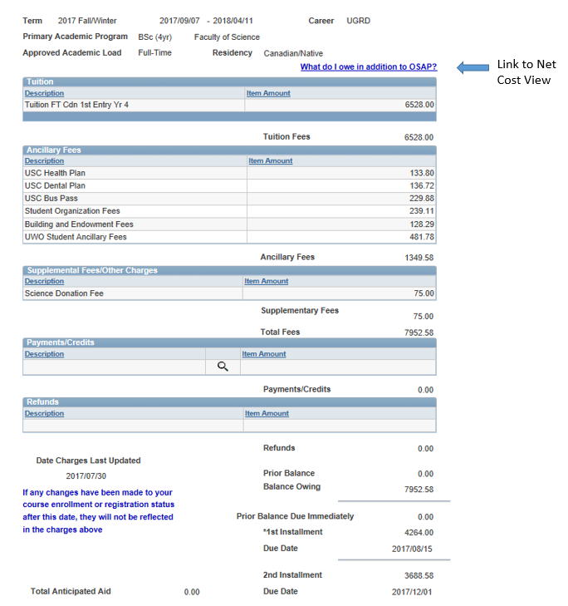
Western’s TUITION BILL
Link to Net Cost View, Net Tuition Summary
Western charges for 8 months of tuition in July
first instalment of fees represents 50% of tuition plus non-refundables

Slide 59
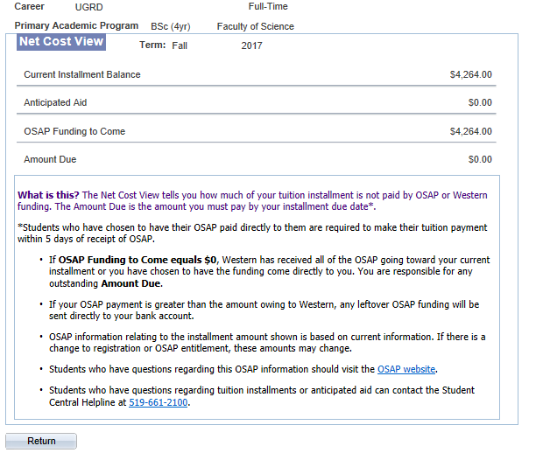
Net cost view
Net Cost View Run Controls
“Fall”: look at first instalment of fees and compare with current disbursement of OSAP (by negotiable date)
“Winter”: look at all charges and compare with total OSAP
Flip in Nov, before 2nd instalment of tuition
Notes:
OSAP students only
Students who have a completed OSAP application and assessment for the 2017-18 academic year will have access to the link on SOLUS. If a student’s OSAP application is on hold or incomplete, the link will not be present on the SOLUS homepage. If the student JUST applied for OSAP the link will not be available until Queen’s has received confirmation from OSAP that student has been assessed.
There will be some situations where we cannot match the information on the student’s OSAP application to the information in our student system.
Must be in “Full Time” academic load for terms associated with period of study
Must be match on ‘identity’ rules (e.g. Student ID and DOB)
Program and level of study student identified on OSAP application must match what is in PS
Student must be active in terms associated with study period on OSAP application

Slide 60
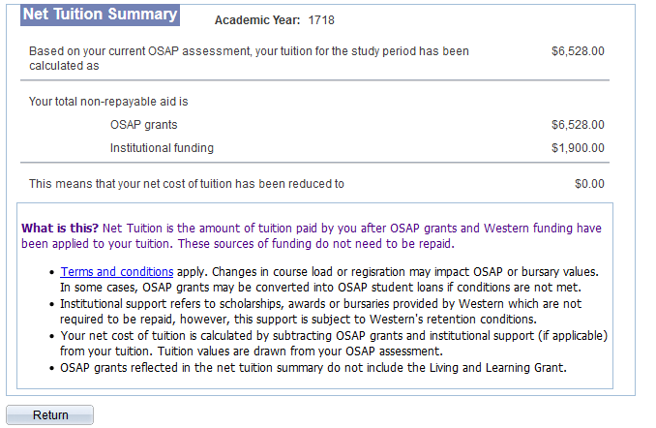
Net Tuition Summary
Notes:
There are two primary views on the Net Cost / Net Tuition View. I hope you all had a chance to take a look at this online. This is just a screen shot, and I encourage you to get familiar with accessing it.
Important to understand that the Net Cost / Net Tuition View is ‘snapshot at a point in time’ – refer to the AS OF dates.
Many interfaces between PS and OSAP sending and receiving information. Important to understand that what’s on the View today may change tomorrow if something changes in either system
OSAP is primary source for OSAP information, PS is primary source for Fees information - student should also be checking their OSAP account online for the most current and detailed information about their OSAP funding.
Lots of footnotes – attempt to explain each label on the View, and provide statements to re-iterate ‘point in time’ and in some cases depending on the ‘as of’ date some of the values they see are estimates.

Slide 61
Net Tuition – Challenges
Implementation timeline
very aggressive timeline
Determining which process should “fix” inconsistencies?
Net Cost View available before many students finalized their registration/course selection
Blending two different mindsets – tuition is billed based on intention, whereas OSAP usually reflects current state
Chose to leave program/cost code disconnects to the Confirmation of Enrolment process to correct
New/confusing terminology
potential misinterpretations by students
Summer term structure
Summer may be considered an extension of
fall/winter terms by OSAP, but workflow for summer
tuition billing and OSAP processing at Western
is very different:
 | Who bills tuition/processes OSAP?
Where is student studying? | fall/winter | summer
Main Campus | Main | Main
Affiliated Colleges | Affiliate | Main

Slide 62
Questions??

Slide 63
presenters
Shirley Marshall
Sandy McFadden
Kathy Hokum
Business Systems Analyst
McMaster University
marshsh@mcmaster.ca
Manager, Student Awards Office
Queen’s University
sandy.mcfadden@queensu.ca
Technical Business Analyst
Fleming College
kathy.hokum@flemingcollege.ca
Tina Obediah
Valerie Sarkany
Manager, Financial Aid Systems
University of Waterloo
tobediah@uwaterloo.ca
Associate Registrar, Student Financial Services
Western University
vsarkany@uwo.ca

Slide 64
THANK YOU!

