Slide 1
Dynamic Checklist item generation
SESSION 8029
28 June 2016

Slide 2
presenters
Suzette Bergman
Ronel Dijksman
Project Manager
Visions Consulting
suzette@visions.co.za
Deputy Finance Director
University of Pretoria
Ronel.Dijksman@up.ac.za

Slide 3
University of Pretoria

Slide 4
your global partner in higher education

Slide 5
ORGANIZATION & ORACLE
Oracle Preferred partner for Higher Education across EMEA
Oracle Applications Partner of the Year 2015

Slide 6
Overview
Background of current process
Issues encountered with current process
Solution to problem?
Concluding thoughts

Slide 7
Background of current process

Slide 8
Financial Aid Online application
Details required for NSFAS
Income
Sibling details
Details required for Support Bursaries
Details required from student for other bursaries and loans
Default values from CC, BIO, RELATIONSHIP tables
Marital status
Parents
Guardian
Supporting Documentation

Slide 9
Financial Aid Online application
Upload supporting documentation
Complete application
Checklist is generated
Supporting Documentation is verified
Checklist items are updated with status

Slide 10
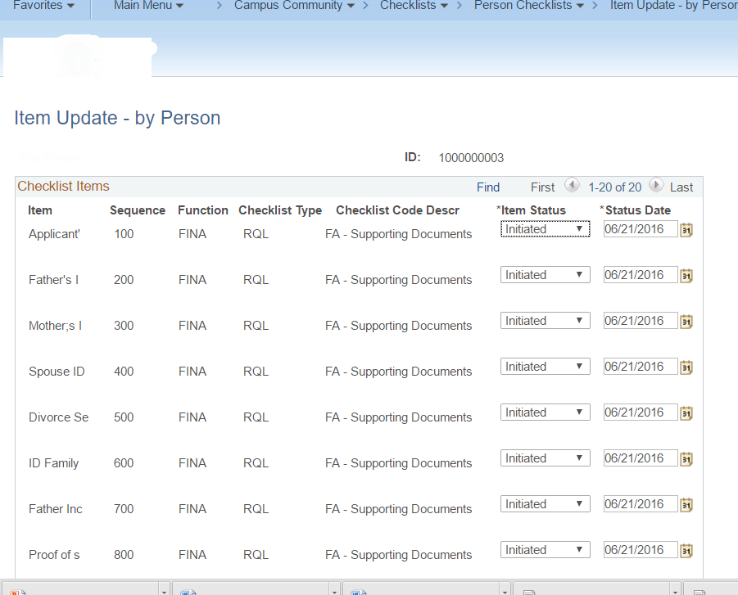
Checklist created

Slide 11
and plenty more….

Slide 12
Issues encountered with current Process

Slide 13
Issues
Checklist items appears on list that is not used
Manually changed status for “invalid” items to “Waived” or “Complete” or “Not used”
Lengthy process to work trough all the items for 15 000 applications
Checklist appears on Self-Service
Incorrect items will confuse student
Specific Checklist item are insensitive
Death Certificate
Asking for details when no Father is mentioned
Verifier deletes checklist lines to speed up process
Verifiers are monitored on Checklist line items completed

Slide 14
Solution to problem?

Slide 15
Solution
Create a checklist with dynamic Checklist items based on conditions from various sources
Only applicable Checklist items will appear on list
Allow to add manual checklist items and will not be deleted if not created by the process
View with fields from INST , Relationships and OAP
FA Applications
Dynamic Checklist Setup
Generate Checklist
Checklist

Slide 16
Process
Process run any time – for one or all students
Add or Delete Checklist Item according to criteria
Item will only be deleted if added by Process
Use Criteria to build SQL statement
- 4 conditions per Checklist item
Read all submitted student Financial Aid applications for a given Aid Year and Checklist Administration function
Multiple checklists can exist for the student
If the Item is marked to delete and the Item had been previously inserted by the program, the item will be deleted if the student passes the criteria test.
Log to display details of activity

Slide 17
View
Birthdate with calculated AGE field
GVT_COURT_ORDER - declared Mental Health condition and/or administration order
Check if declared income vary more than X%
Dependents – Preprimary, secondary and Tertiary
Details of Father, Mother, Spouse
Marital Status
Fields from different sources

Slide 18
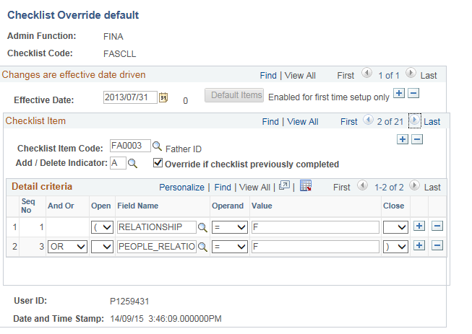
SETUP

Slide 19
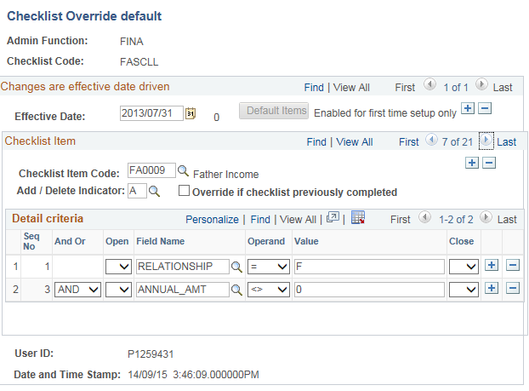

Slide 20
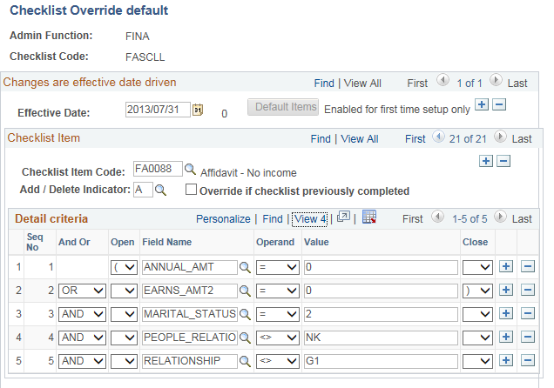

Slide 21
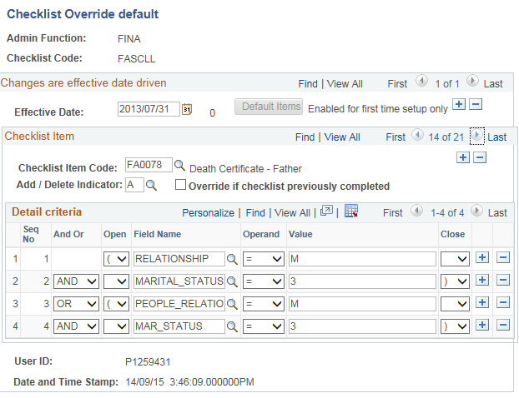

Slide 23
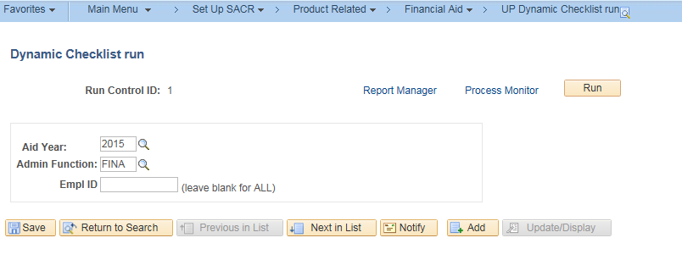
Process Run control

Slide 24
Concluding thoughts
ANY QUESTIONS?

Slide 25
Outcome
Only create Checklist items where applicable
Student only view relevant items in checklist
Updating of Checklist items quicker
Ensure correct Checklist items are created when deleted
Statistics for Reviewers more correct

Slide 26
SUMMARY
Process resulted in a more efficient way of creating checklist items to enable the verification of magnitude of supporting documentation

Slide 27
presenters
Suzette Bergman
Ronel Dijksman
Project Manager
Visions Consulting
suzette@visions.co.za
Deputy Finance Director
University of Pretoria
Ronel.Dijksman@up.ac.za
all SAHEUG Alliance presentations will be available for download from the Conference Site

Slide 28
THANK YOU!

