Slide 1
Discovery and outcomes of implementing ‘Activity Management’ for component marking
SESSION 37006
12 October 2016

Slide 2
presenters
Denise Kelly
Queens University Belfast
denise.kelly@qub.ac.uk
Over 20 years experience working across Schools and Directorates within the University
Functional Development Lead since 2014
Worked with Campus Solutions since 2008
Specialising in the Student Records and Student Financials Modules
MSc in Organisation and Management; Prince 2 and ITIL

Slide 3
Your organization
Established by Queen Victoria in 1845
The University is an international centre of research and education rooted at the heart of Northern Ireland with approximately 23,500 students.
The University is a member of the Russell Group of 24 leading UK research-intensive universities.

Slide 4
Queens & ORACLE
Campus Solutions locally branded as Qsis, implemented 2007 – 2008
Using all core modules
Campus Solutions v 9.0
PeopleSoft V8.54.07
Bundle 41

Slide 5
Component Marking – implementing activity management
1
3
The Journey So Far
Oracle Discovery
2
4
QUB Discovery
QUB Prototype

Slide 6
Implementing activity management
The Journey So Far

Slide 7
Component Marking Project
Flexible Framework
Consistency Across University
Transparency & Auditability
Enhanced Student Experience
Streamlined Assessment Process

Slide 8
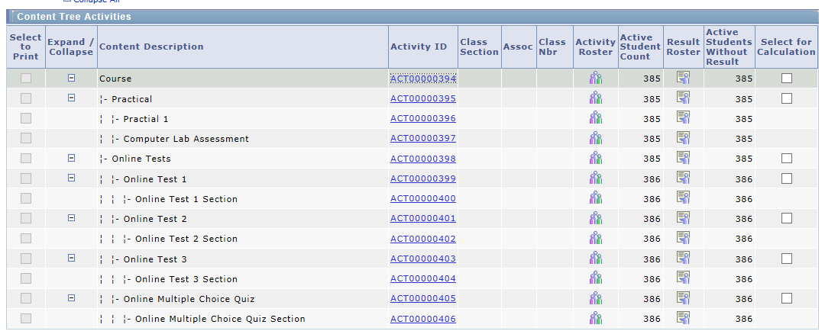
Activity management module – knight in shinning armour

Slide 9
The challenges expected on the outset of component marking implementation
Stakeholder Engagement
Getting the right people, availability, buy in.
Varied Process
No one size fits all, lack of consistency, differing resource profiles across individual Schools.
Constraints
Complex models, processes, organisational structures, technology, functionality, timeframes.

Slide 10
Challenges ‘not’ anticipated

Slide 11
Challenges with activity management functionality
Performance
Oracle Road Map
Flexible functionality?

Slide 12
Prototype
Proper Test Results

Slide 13
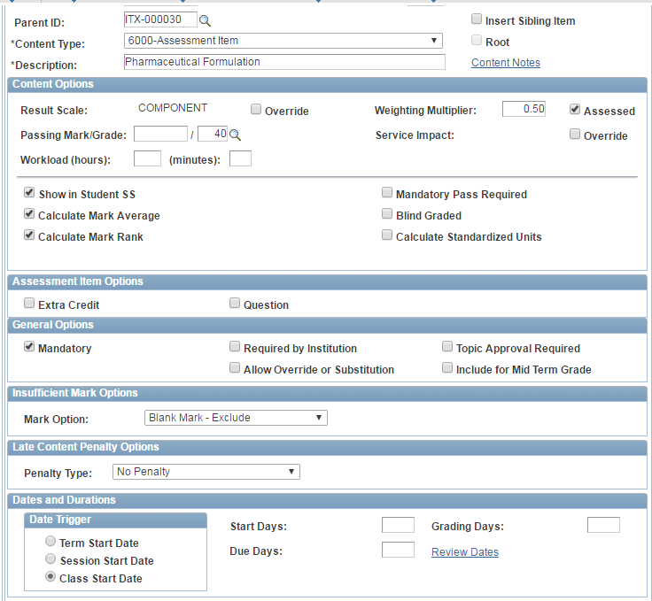
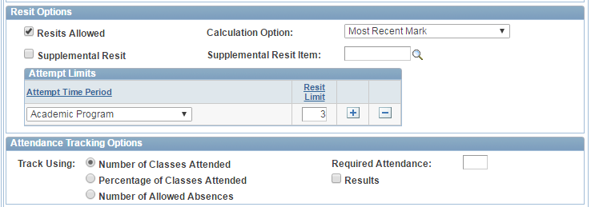
Building the prototype – first steps activity registry

Slide 14
Activity management processes
Delivered Processes
Activity Generator
IAM Student Enrol
IAM Resit Evaluation

Slide 15
Activity Roster

Slide 16
Activity roster – result roster

Slide 17
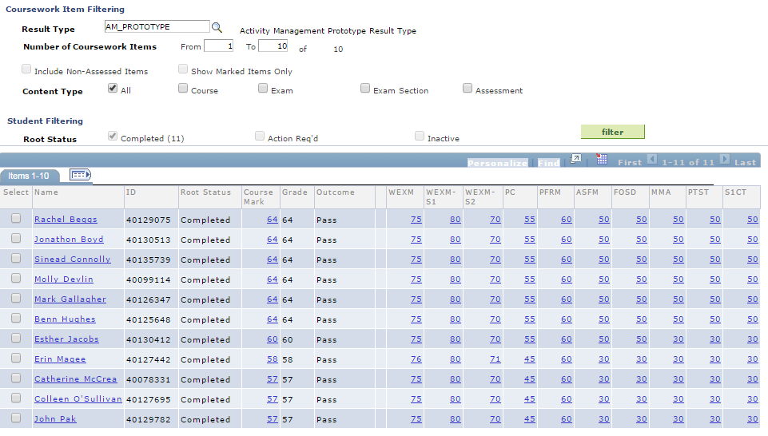
Assessment – root roster

Slide 18
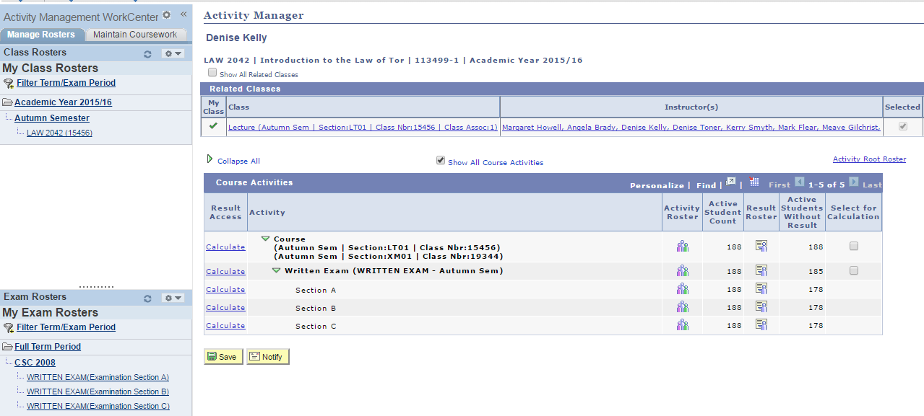
Activity management - WorkCentre

Slide 19
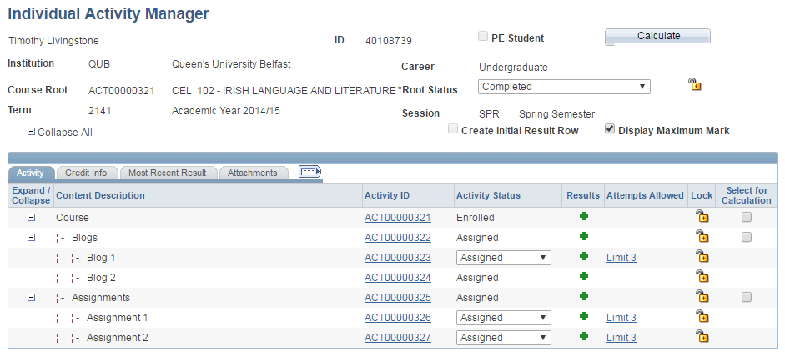
Individual activity manager

Slide 20
Lessons learned
Full Configuration Undertaken
Accommodates all three Schools
Workable Structures
Configuration requirements manageable
Copy functionality aids with configuration management
Uncovered Issues
Oracle
School
Valuable Feedback

Slide 21
QUB – Oracle Discovery

Slide 22
Oracle discovery
Support Requests

Slide 23
Oracle Discovery
Performance Issue with Calculation Process -
System inability to calculate on result rosters containing large number of students
Blind Grading Functionality -
On Oracle roadmap for future use
Creation of Result Rosters on all Components – Large process that runs at the beginning of each academic term
Inability to calculate mixed % based and non % based result scales on the same module

Slide 24
Oracle discovery
Activity Roster is unable to store results on students enrolled as Audit Only – IAM works appropriately
Mass Update functionality within Result Rosters not available
Auditability on Result History Icon differs between Activity Roster and IAM
Delayed action when opening result rosters – particularly on modules containing over 40 students

Slide 25
Qub discovery
School Requests

Slide 26
QUB discovery
Requirement for upload facility due to automation of spreadsheets directly from - Question Mark, Google Forum, Code Analytics, Evasys
Blind Grading Functionality -
School of Law blind grade all assessments
All other Schools blind grade Exam Scripts
Release of Component Marks prior to agreement of final mark (Level 3)
Timeframe
Results Classification Graduation

Slide 27
Concluding thoughts
ANY QUESTIONS?

Slide 28
SUMMARY
Performance Issues – quick customised fixes and overhead applying / maintaining
Reduce Size, Shape and Scope of Pilot
Time/Effort working with issues in 16/17 that are set to change with upcoming bundles

Slide 29
presenters
Denise Kelly
Functional Development Lead
Queen’s University Belfast
denise.kelly@qub.ac.uk
all Alliance presentations will be available for download from the Conference Site

Slide 30
THANK YOU!

