Slide 1
The added value of NFK for sending e-mails
SESSION 37022
Wed, Oct 12, 2016

Slide 2
presenters
Hendrieke Kouwenhoven
Application Manager
Leiden University
h.h.j.kouwenhoven@sea.leidenuniv.nl

Slide 3
LEIDEN UNIVERSITY
Founded in 1575.
Leiden University has approx. 25,000 students and 5,500 members of staff.

Slide 4
SANS Expert CentER for hosting, maintenance, development and technical support
User since March 2010
PS 9.0
Bundle #37
PT 8.54.13

Slide 5
Overview
1
3
NFK vs. COMMGEN
How do they compare?
CREATIVE USE OF NFK
Expand the basic functionality
2
4
NFK BATCH NOTIFICATIONS
The basics
NFK vs. COMMGEN
How to choose?

Slide 6
NFK vs. COMMGEN
ORACLE:
“NFK is not created to replace COMMGEN. It is used to complement and co-exist.”
How do they compare?

Slide 7
Key differences in framework
COMMGEN
NFK
Specific module
Static framework
E-mail/letters
Batch (real-time in theory)
Soft copy
Variable modules
Expandable framework
E-mail/sms/push/notifications/etc.
Batch & Real-time
Hard copy

Slide 8
Key differences in framework
COMMGEN
NFK
Specific module
Static framework
E-mail/letters
Batch (real-time in theory)
Soft copy
Variable modules
Expandable framework
E-mail/sms/push/notifications/etc.
Batch & Real-time
Hard copy

Slide 9
Key differences in framework
COMMGEN
NFK
Specific module
Static framework
E-mail/letters
Batch (real-time in theory)
Soft copy
Variable modules
Expandable framework
E-mail/sms/push/notifications/etc.
Batch & Real-time
Hard copy
Does NFK have an added value for sending batch e-mails?

Slide 10
NFK batch notifications
The basic setup

Slide 11
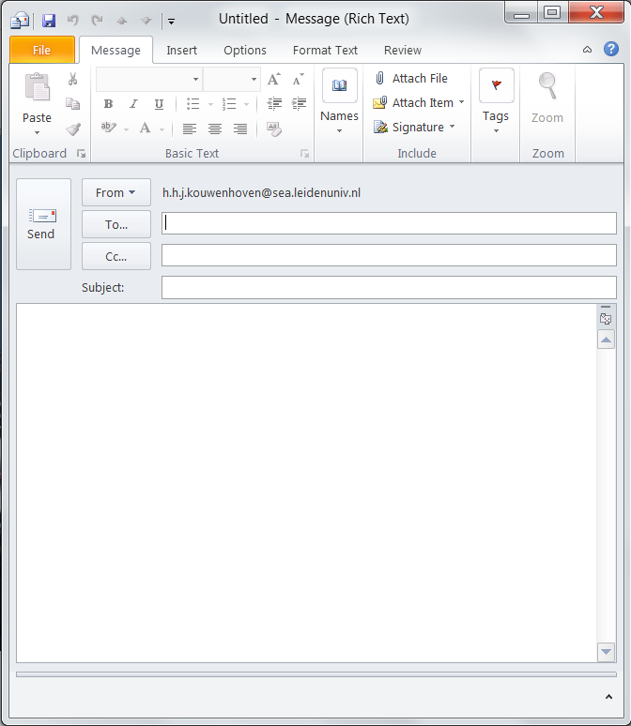
E-mail
Attachment
Text editor
Sender
Recipients:
Population
E-mail address
(B)CC options
Send
Subject
Message text

Slide 12
NFK notification setup
GENERIC TEMPLATE SETUP
Sender
Subject
No attachments
RECIPIENTS
To
CC
BCC
PopSelect
Query
CONSUMER
trigger
MESSAGE TEXT
HTML5 editor
Run-ID
Batch Notifications

Slide 13
EXAMPLE: Video message from rector
E-mail on behalf of alumni-office:
Congratulations text with video message
Every student after completing a bachelor or master program
Elements to configure:
Sender
Subject
Recipients
Message text + logo + video thumbnail

Slide 14
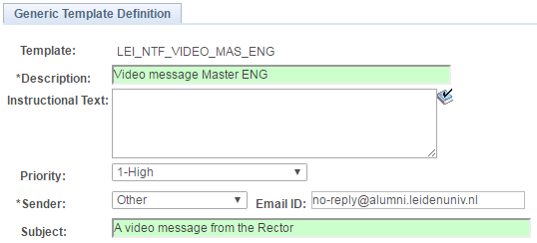
sender & subject: Generic template

Slide 15
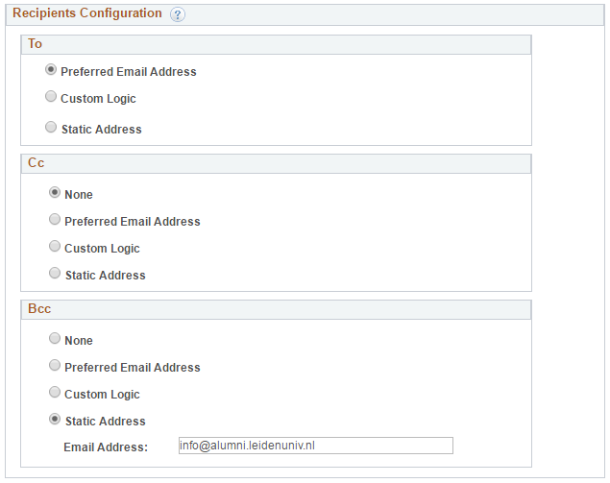
Recipients
= PopSelect Query
Multiple recipients: (B)CC options
Alumni officer wished to
observe/check first 2 runs

Slide 16
message: HTML5 (editor)
Variables!

Slide 17
NFK notification setup
GENERIC TEMPLATE SETUP
Sender
Subject
RECIPIENTS
To
CC
BCC
PopSelect
Query
CONSUMER
trigger
MESSAGE TEXT
HTML5 editor
Run-ID
Batch Notifications

Slide 18
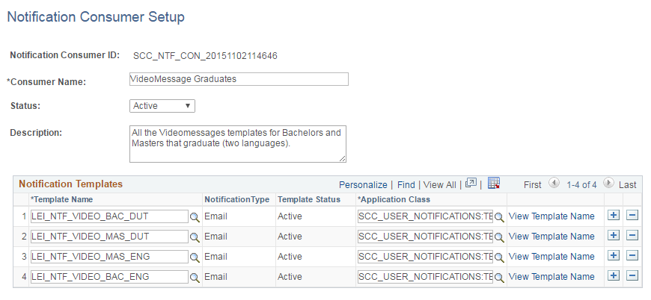
Notification consumer setup

Slide 19
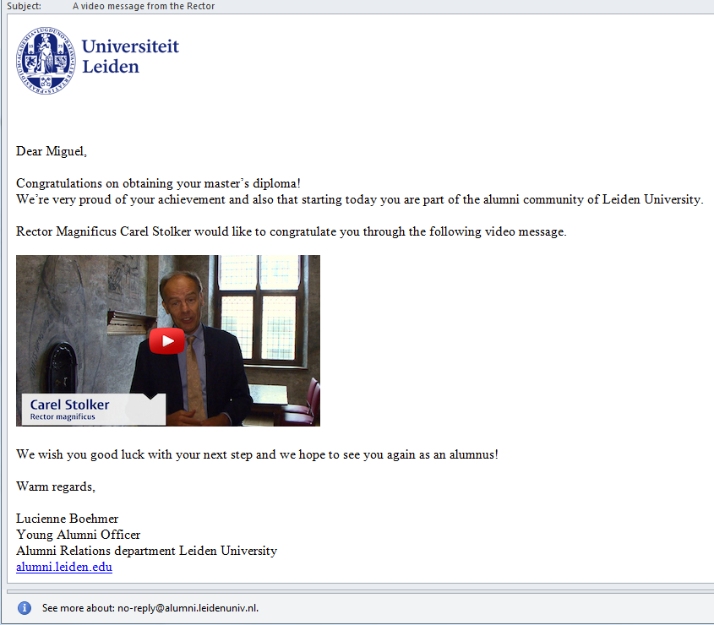
Send

Slide 20
Self service: Notification center

Slide 21
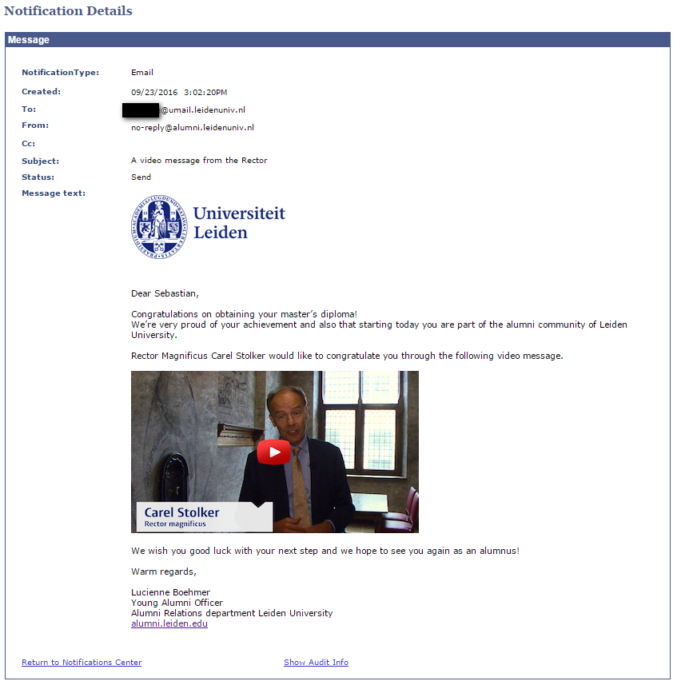
Notification details
Details includes:
Date
Time stamp
Recipient e-mail address
E-mail message
Incl. hyperlinks

Slide 22
Security
Consumer ID 1
Consumer ID 2
Notification Setup A
Notification Setup B
Notification Setup C
GENERIC TEMPLATE
GENERIC TEMPLATE
GENERIC TEMPLATE
RECIPIENTS
RECIPIENTS
RECIPIENTS
MESSAGE
MESSAGE
MESSAGE

Slide 23
Security
Consumer ID 1
Consumer ID 2
Notification Setup A
Notification Setup B
Notification Setup C
GENERIC TEMPLATE
GENERIC TEMPLATE
GENERIC TEMPLATE
RECIPIENTS
RECIPIENTS
RECIPIENTS
MESSAGE
MESSAGE
MESSAGE

Slide 24
Security
Consumer ID 1
Consumer ID 2
Notification Setup A
Notification Setup B
Notification Setup C
GENERIC TEMPLATE
GENERIC TEMPLATE
GENERIC TEMPLATE
RECIPIENTS
RECIPIENTS
RECIPIENTS
MESSAGE
MESSAGE
MESSAGE

Slide 25
Security
Consumer ID 1
Consumer ID 2
Notification Setup A
Notification Setup B
Notification Setup C
GENERIC TEMPLATE
GENERIC TEMPLATE
GENERIC TEMPLATE
No row level security
No 3C groups
RECIPIENTS
RECIPIENTS
RECIPIENTS
MESSAGE
MESSAGE
MESSAGE

Slide 26
NFK notification setup
SEND
Run-ID
Batch Notifications
CONSUMER ID
Notification
GENERIC TEMPLATE SETUP
Sender
Subject
RECIPIENTS
To
CC
BCC
PopSelect
Query
MESSAGE TEXT
HTML5 editor

Slide 27
NFK notification setup
SEND
Run-ID
Batch Notifications
CONSUMER ID
Notification
GENERIC TEMPLATE SETUP
Sender
Subject
RECIPIENTS
To
CC
BCC
PopSelect
Query
MESSAGE TEXT
HTML5 editor

Slide 28
NFK notification setup
SEND
Run-ID
Batch Notifications
CONSUMER ID
Notification
GENERIC TEMPLATE SETUP
Sender
Subject
RECIPIENTS
To
CC
BCC
PopSelect
Query
MESSAGE TEXT
HTML5 editor

Slide 29
NFK notification setup
SEND
Run-ID
Batch Notifications
CONSUMER ID
Notification
GENERIC TEMPLATE SETUP
Sender
Subject
RECIPIENTS
To
CC
BCC
PopSelect
Query
MESSAGE TEXT
HTML5 editor

Slide 30
NFK notification setup
SEND
Run-ID
Batch Notifications
CONSUMER ID
Notification
GENERIC TEMPLATE SETUP
Sender
Subject
No configuration of:
Context
Category
Letter code
RTF report definition
RECIPIENTS
To
CC
BCC
PopSelect
Query
Creative use of variables
can create similar results
MESSAGE TEXT
HTML5 editor

Slide 31
Creative use of NFK
Expanding the basic functionality

Slide 32
Creative use of NFK variables
Create your own context
Manage duplicates
Variable subject
Text building block functionality

Slide 33
variables
Create variables
Define variables
Embed variables in e-mail text
Send e-mail
PopSelect Query
Generic Template
Message text
Send e-mail

Slide 34
PopSelect query: create variables
Alumni e-mail to congratulate graduates
Every student after completing a bachelor or master program

Slide 35
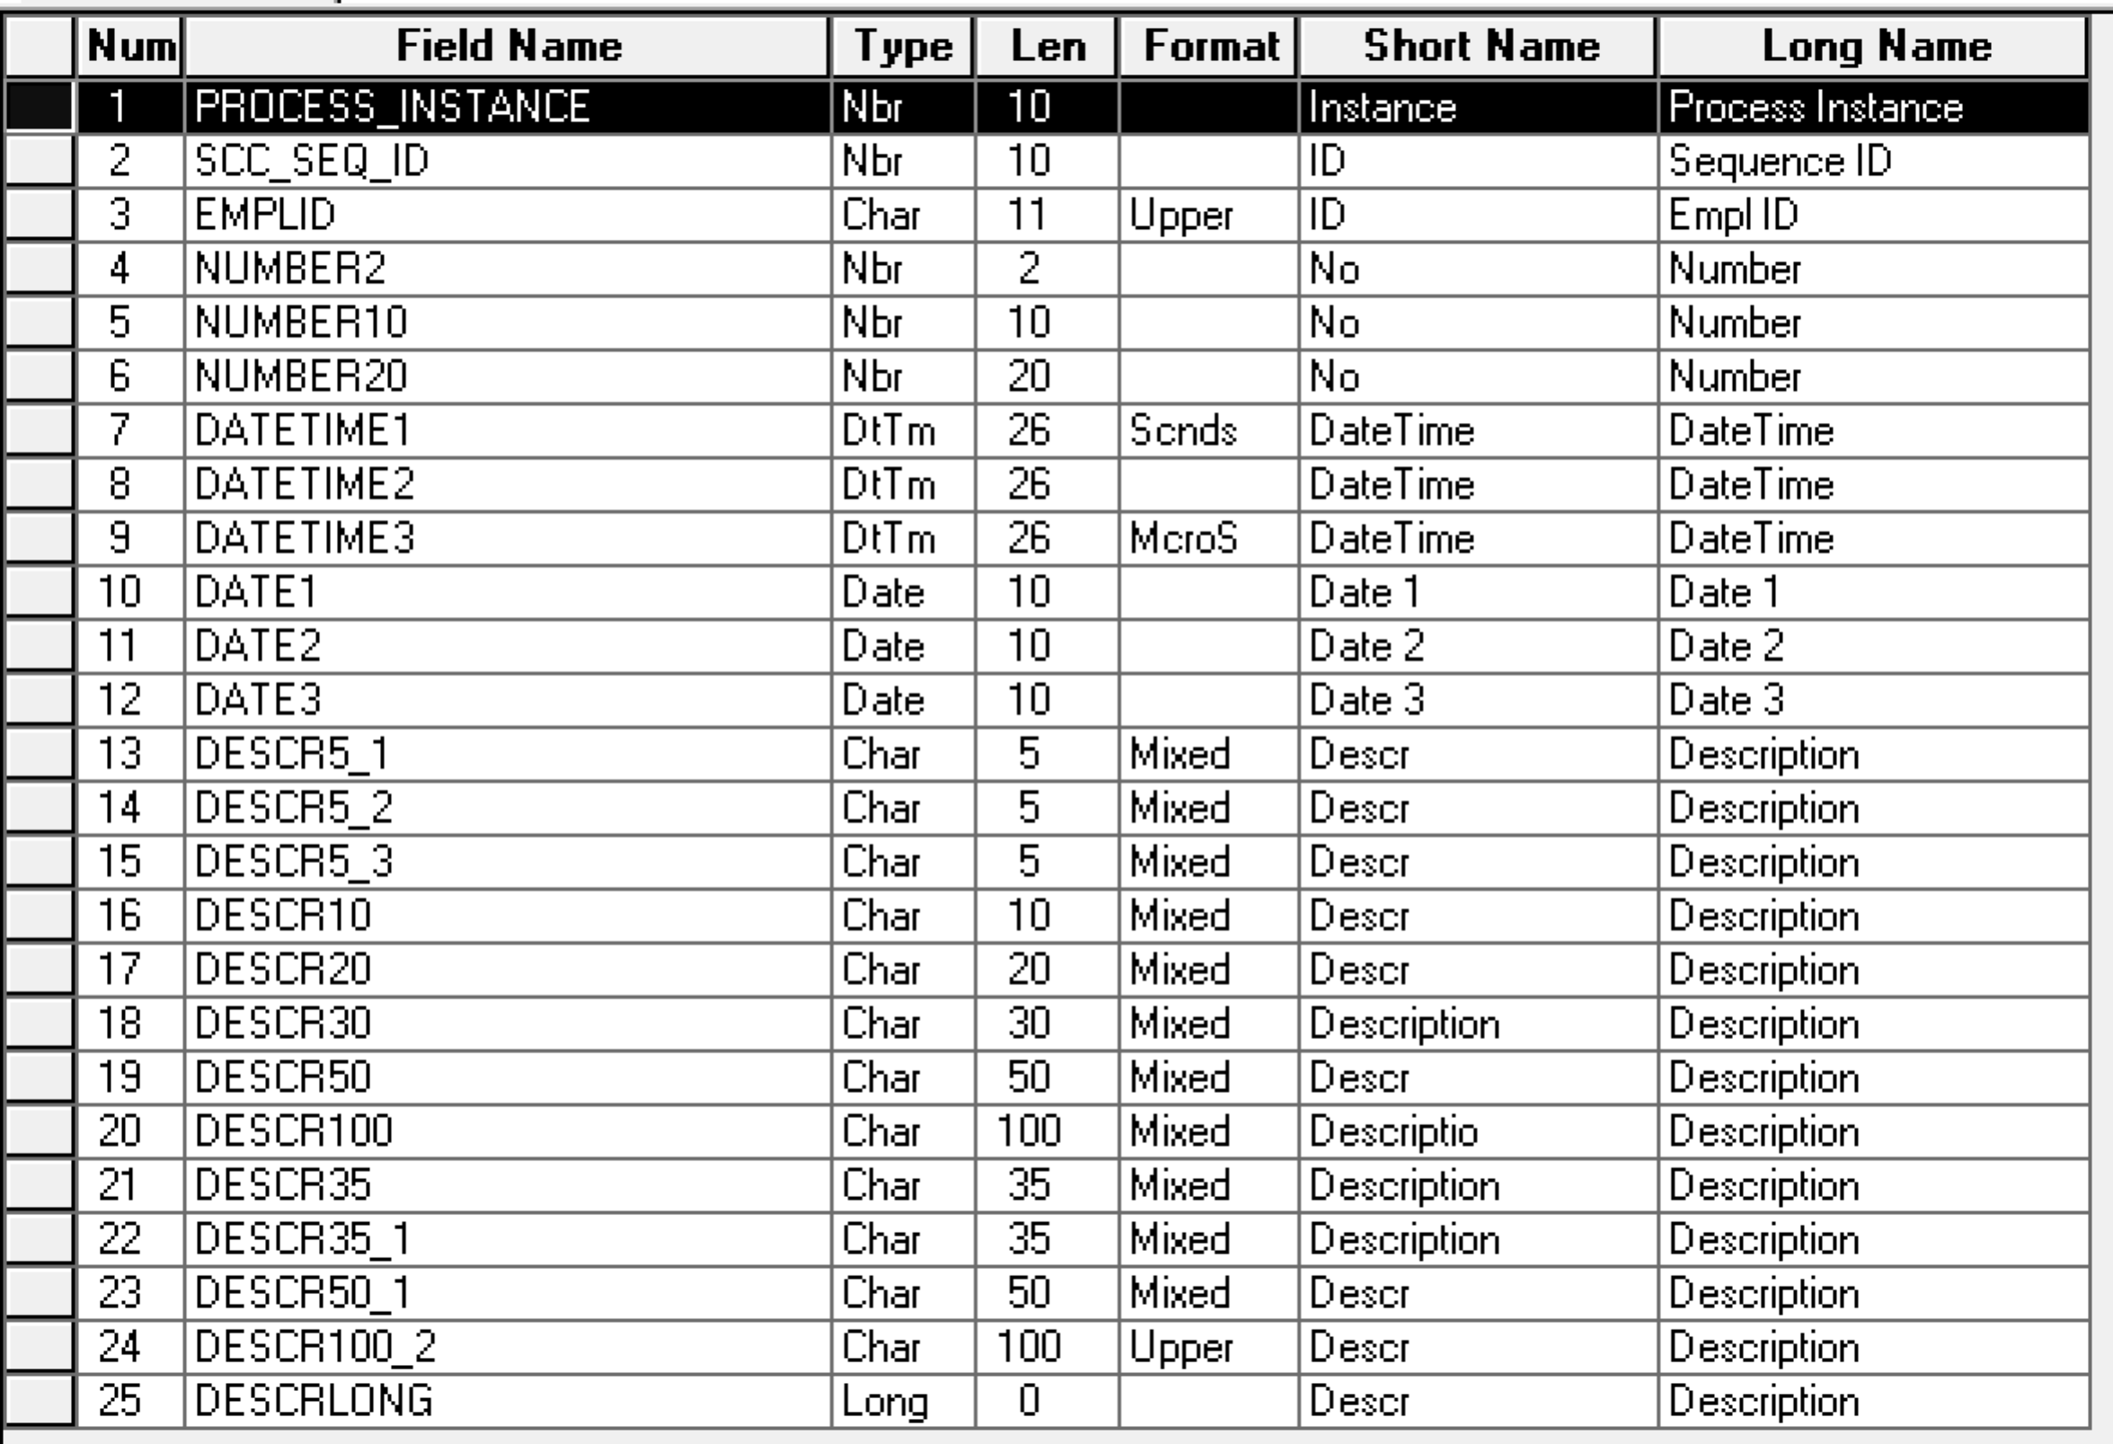
PopSelect query: create variables
Create an expression with an unique fieldname from SCC_BAT_NTF_TGT
DESCR 50

Slide 36
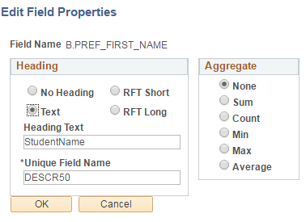
PopSelect query: create variables
B.PREF_FIRST_NAME
Expression
Unique Field Name
= DESCR50

Slide 37
Generic template: deFINE variables

Slide 38
Embed variables in text: Message text

Slide 39
Send

Slide 40
Created context
Imitation of
administrative function SPRG

Slide 41
Create your own context
Context:
Emplid
Certification status
Exam date
Manage duplicates: no previous e-mail for
Emplid
Career
Career nbr
= PopSelect: criteria
= PopSelect: does-not-exist SUBQUERY

Slide 42
Managing duplicates
= creative use of variables
SEND = variables are stored in NFK tables
→ to prevent duplicates
= check for existence of the variable in the NFK-tables
= create does-not-exist SUBQUERY

Slide 43
NFK variables
EXAMPLE: Alumni email to congratulate graduates:
%1 used in message text
%2 & %3 no occurrence in message text
= added for does-not-exist SUBQUERY

Slide 44
%1: “normal” nfk variable

Slide 45
%2 & %3: hidden variables

Slide 46
Managing duplicates: example 2
E-mail with study advice for 1st and 2nd years
Variables that determine duplicates:
Emplid
Program
Term required (in student milestone)
Advice code (grading basis in milestone)
Total of ECTS credits

Slide 47
Concatination as hidden variable
Hidden variable = %9
EMPLID||PROG||REQ_TERM||ADVICE CODE||ECTS

Slide 48
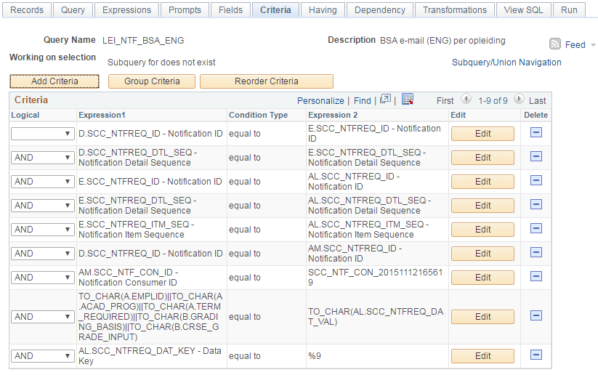
Subquery for Does-not-exist

Slide 49
Creative use of NFK variables
Create your own context
Manage duplicates
Variable subject
Text building block functionality

Slide 50
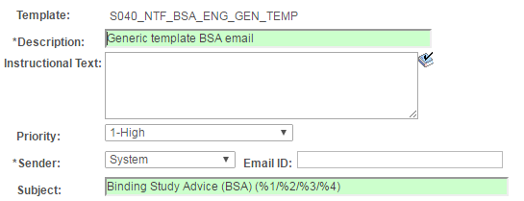
Variable subject

Slide 51
Creative use of NFK variables
Create your own context
Manage duplicates
Variable subject
Text building block functionality

Slide 52
Text building functionality
EXAMPLE: E-mail with study advice for 1st and 2nd years
= 19 possible advice codes
= 19 different e-mails (with a lot of similarities)
≠ 19 different templates → very tedious to manage over the years
→ text building functionality
→ HRMS Text Catalog

Slide 53
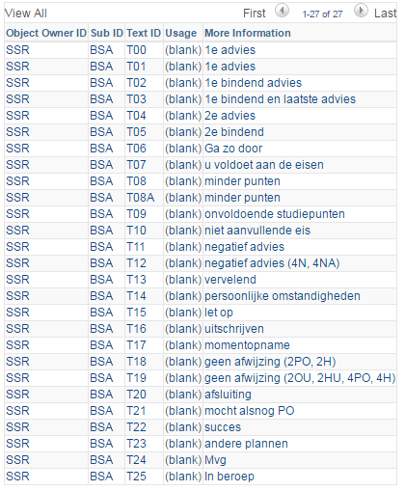
HRMS Text catalog: 25 text blocks

Slide 54
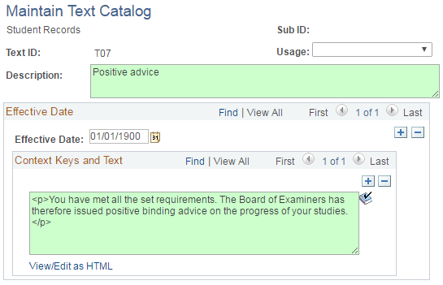
Text block 7

Slide 55
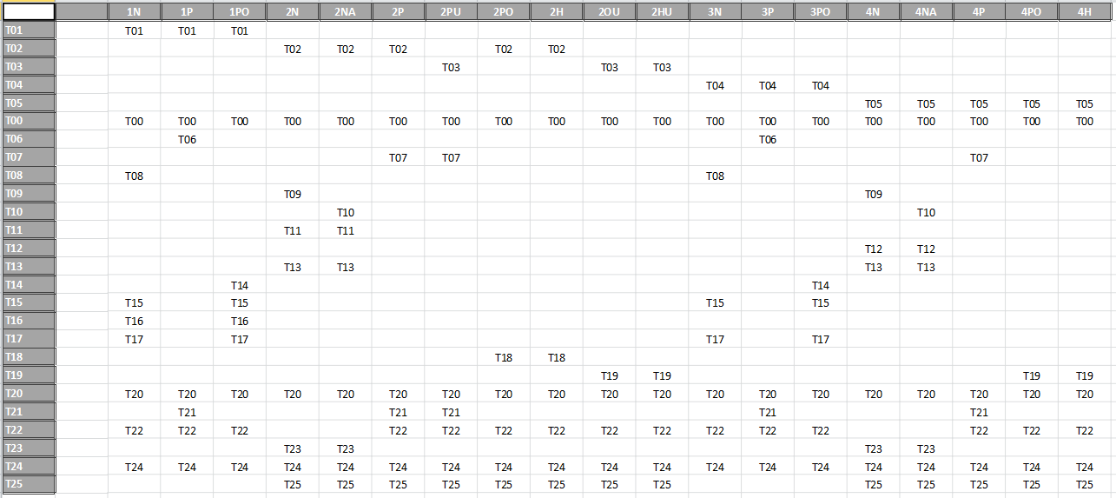
Matrix of text blocks

Slide 56
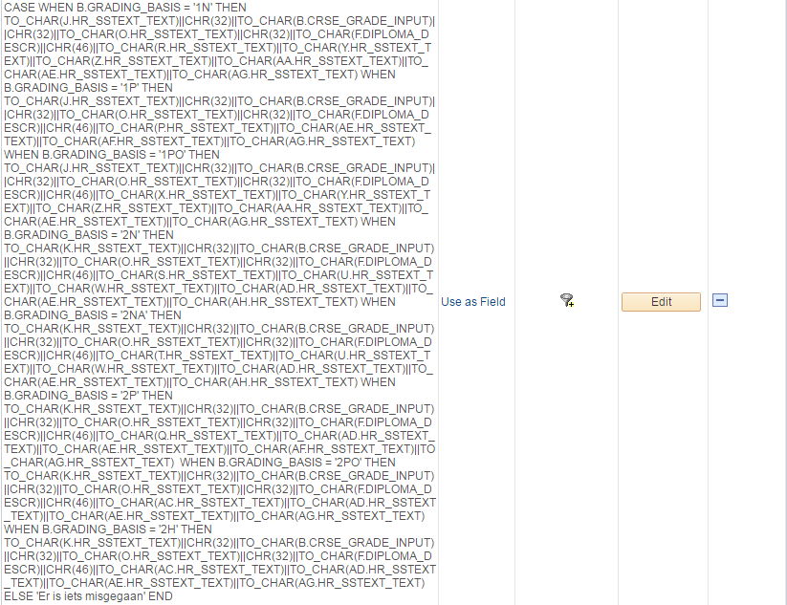
Concatination of texts blocks
= huge, unreadable, etc.
BUT: create once and enjoy forever!

Slide 57
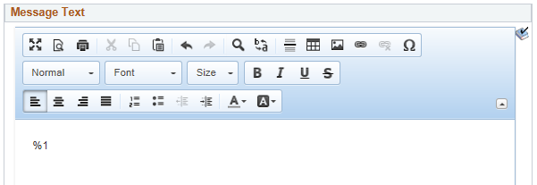
Advantages
Text changes: easy in text catalog
No query, reporting or NFK experience needed
Single & simple Notification setup
Notification setup for petition requests:

Slide 58
NFK vs. COMMGEN
How to choose?

Slide 59
Differences
COMMGEN
NFK
Attachment
Soft copy
Static subject
No (B)CC recipients
RTF report definition
Context = GEN/ADMP/SPRG
My Communications
3C groups
No attachment
Hard copy
Variable subject
Multiple recipients
HTML5 + variables
Create your own context
Notifications Center
Security per Consumer ID

Slide 60
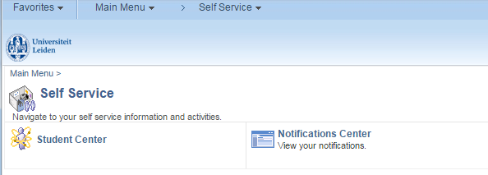
What to consider?
Existing knowledge & configurations
Student SelfService:
Student Center vs. Notification Center

Slide 61
Customization by sans
NFK messages displayed in My communications

Slide 62
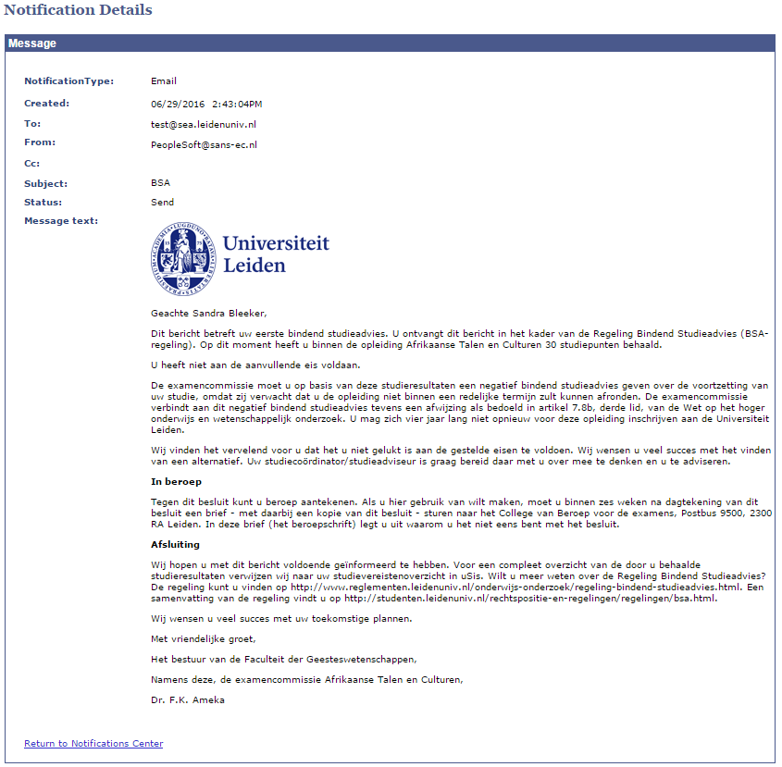

Slide 63
How to choose?
COMMGEN
NFK
Sensitive personal information
Scheduled batches
Alerts
Batches initiated by users

Slide 64
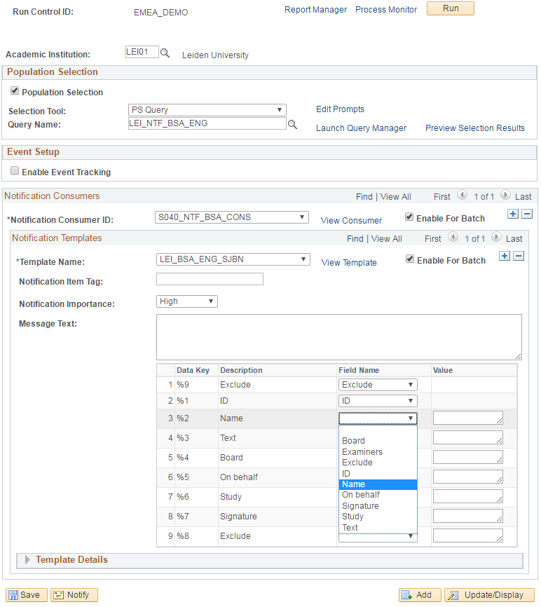
Run-ID: simple instruction
PopSelect query
Consumer ID
Notification setup
Allign variables

Slide 65
How to choose?
COMMGEN
NFK
Sensitive personal information
Scheduled batches
Alerts
Batches initiated by end-users
Hard copy & evidence of send data
Context ≠ GEN/ADMP/SPRG
HTML5 layout
Multiple recipients
Variable subject

Slide 66
presenter
Hendrieke Kouwenhoven
Application Manager
Leiden University
h.h.j.kouwenhoven@sea.leidenuniv.nl
all Alliance presentations will be available for download from the Conference Site

Slide 67
THANK YOU!

Slide 68
workcenter

Slide 69
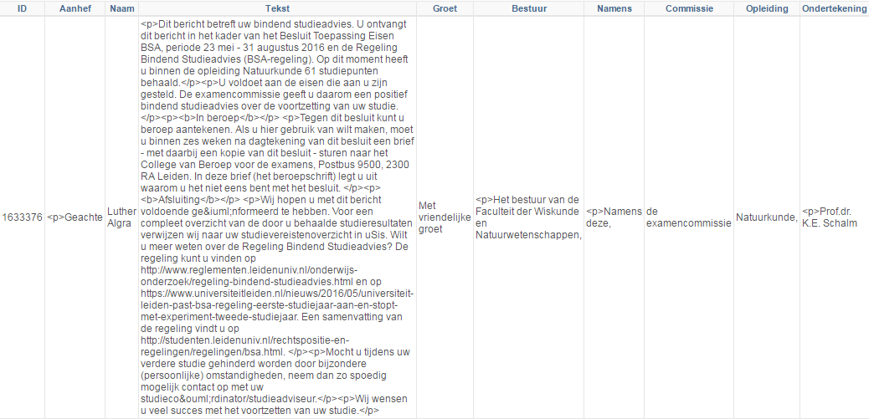
workcenter

Slide 70
workcenter

Slide 71
workcenter
Advantages:
Pre-check message text
Including signature
Checking send-status/completion of the process
Archive/alternative access to Notification Center
Mimicking of row level security

