Slide 1
Session: 3021 How to Improve Your Image

Slide 2
Presenter
Jeremy Irrthum
PeopleSoft Developer
University of Minnesota
irrth002@umn.edu
Jeremy Irrthum has been a PeopleSoft developer since 1997. He has worked on Campus Solutions, Finance, HRMS, and Interaction Hub.
His first PeopleSoft assignment was a charitable contributions report for Air Canada.
Jeremy and his family are the fourth generation living on their family farm. They raise sheep.
Notes:
Sheep video - shepherding objects start at 1 min

Slide 3
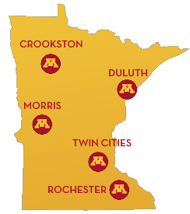
The University of Minnesota
Twin Cities - Duluth
Morris – Crookston - Rochester

Slide 4
Bulldogs Everywhere
Notes:
Bulldog convention
University of Minnesota Bulldogs

Slide 5
U of M by the numbers

Slide 6
Oracle at the U of M
History 1998 Campus Solutions 2008 Finance 2015 Interaction Hub | Current Campus Solutions 9.2 Finance 9.2 HRMS 9.2 Interaction Hub 9.1
Notes:
Exadata - servers
Exalogic – databases
PeopleTools 8.55

Slide 7
Improve Your Image
Notes:
Improve your process. Best practices.
Improve how your business sees you?
Set expectations. Open up the discussion. Ask people to interrupt.

Slide 8
Who’s Involved
Administrators/
MigrationTeam
Business Analyst/
Testers
Developers
Notes:
Explain the roles and responsibilities – from a university perspective
We all cooperate and coordinate efforts for success

Slide 9
Experience
9.2.17
9.2.21
9.2.23
HCM
9.2.4
2016
2017
2018
Financials
9.2.4
9.2.18
9.2.25
Notes:
Campus Solutions just upgraded to 9.2

Slide 10
Overview
Image Management
Architecture
Image Application
Analysis
Object Management
Deploy

Slide 11
Image Management

Slide 12
Infrastructure
Multi-tenant Database
All four instances
in one database
PSPRD
Notes:
All tightly integrated
One down – all down
Refresh refreshes all
Less databases

Slide 13
Environments
PUM
Latest Oracle Image
Latest Oracle Tools
DMO
Latest Oracle Image
University Tools
Software Development Life Cycle
DMN
Production Image
University Tools
DEV
TST
QAT
PRD
UPG
Upgrade
Notes:
What is each used for?

Slide 14
Automation
Automated Download/Provisioning
Enter Bug ID
Automated Download
Execute DPK

Slide 15
Automation
Ansible

Slide 16
Retention
Controlled Retention of Previous Images
Archive as DAT files
Change Assistant Wizard

Slide 17
More About Administrators
http://psadmin.io/
Great blogs, podcasts, tools

Slide 18
Image Application

Slide 19
How Modified are we?
Notes:
Pretty modified.
How do we reapply quickly. Less cost.

Slide 20
Where to Begin -Organize Objects
Modification Number
UM_XX000_9999
UM for U of M
XX Functional Area
000 Business Process
9999 Sub-process
All customizations in Peopletools Projects
Project Name: UM_XX000_0000
Matches Modification Number
Notes:
It all starts at the beginning. It’s all about organization and Standardization.
60% of time spent on 10% of objects that are not properly organized. How to make it faster? Make it clear.
We were skeptical at the beginning. Only able to maintain this through vigilance and commitment.
Only custom and customized objects in the Modofication projects

Slide 21
Lifecycle

Slide 22
Application Steps
Export Change Package
Compare against target database
Review Conflicts
Apply Retrofits
Migrate to next environment

Slide 23
Identify Conflicts
Compare Reports
HTML Reports
Compare Report Summary tool
Query Project Tables
Compare delivered project to modification projects
PSPROJECTITEM
Notes:
Its all about the projects
DEMO compare report.
DEMO: Compare report summary tool demonstration
DEMO: Compare report project.sql

Slide 24
Identify Conflicts
Don’t forget COBOL & SQR
Notes:
Not on the compare reports.
We do modify the delivered file reference object – flag in the compare report.

Slide 25
Evaluation
Evaluate Personalizations
PSUSEROBJTYPE
Generate List of New Pages
Apply generic security
Share with functional team to determine what roles need access
Notes:
DEMO: New Pages SQL.
PL/SQL identifies new components or new pages on existing components. Lists details needed for security (permission list) as well as the menu path.

Slide 26
Estimate
How long will it take?
Spreadsheet of object types and historical time to retrofit
Reconcile compare results and historical data to produce estimate
Notes:
DEMO: Estimation Spreadsheet

Slide 27
Object Control
STAT
Lock Delivered objects
Identify current conflicts
Identify future conflicts
Lock retrofits
Notes:
Enables us to process image and have in flight work
Object locking in DEV only
Read only access in all other instances
STAT creates the object lock for dev but also a lock that prevents migration / overwrite
STAT has version history

Slide 28
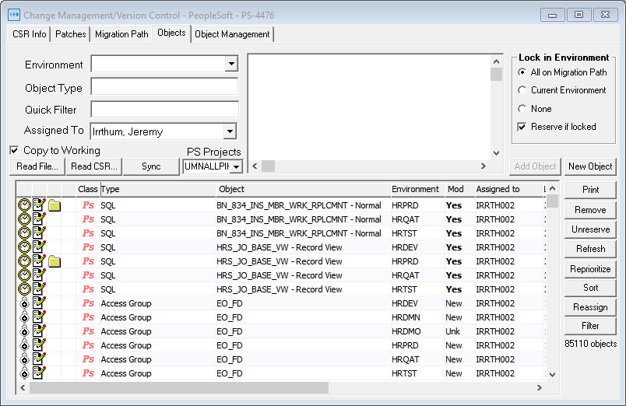
Object Control

Slide 29
Retrofit Assignment
Assign to several developers
Grouped by Modification
Notes:
DEMO Show assignment / task spreadsheet
Why group by modification instead of object types?

Slide 30
Applying Retrofits
Compare Tools
Compare Reports
STAT
PeopleTools Queries
Notes:
We take all delivered changes.
We do not spend time evaluating which to take (and we apply our changes) and which to ignore (and we apply Oracle’s changes).
Time better spent just adding our stuff back. That way we know we have ALL the delivered changes.
Triangulate changes. DMN to DMO – Oracle changes. DMN to PRD – our changes.

Slide 31
Applying Retrofits
Compare Report XML Files
Open XML files in Excel
Formulas
Filters
Conditional Formatting
Notes:
DEMO Open xml as spreadsheet. Show examples.
Portal Registry on the compare report
Portal registry xml spreadsheet
Page xml spreadsheet

Slide 32
Applying Retrofits
Page compare SQL
Use query with database link to compare delivered page to custom page
Notes:
PNLFLDID very important. Keeping customizations and adding the delivered changes destroys the delivered PNLFLDID numbers.
DEMO page compare sql

Slide 33
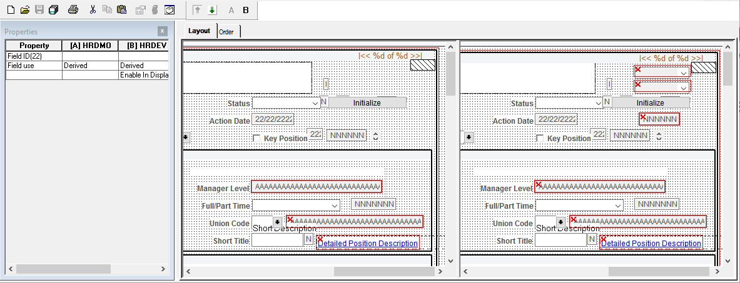
Applying Retrofits
Diff/Merge Page
Application Designer Tools > Diff/Merge Page
Notes:
Identify differences and quickly (and accurately) apply retrofits.
Don’t miss an option buried deep in the page field properties tab.

Slide 34
Deployment
Change Package
Change Assistant
Let change assistant drive the process
Run on VM
STAT
Migrate retrofits
PeopleTools and Batch objects
Notes:
Multiple test moves.
Testing in each environment
Follow their steps.
Always changing
Hubris when we start to believe we understand it.

Slide 35
Post Migration Verification
STAT Compare
Technical Verification
Always evolving list of items to verify based on experience
Functional Verification
Functional Testing
Notes:
Change Assistant has lots of steps. We have encountered some peculiarities. Images have thousands of objects.
Technical verification by application development team. Run ae, sqr, cobol, IB test connections to CS, FS, and WSDL
Testing two things.
Testing the code – the applications but also testing the installation process.
Complete regression test of everything. Even if not on the Cumulative Feature Overview or release notes.

Slide 36
Production Application
Practice what you implement
Implement what you practice
Notes:
DEMO Deployment spreadsheet.
Test well no need for luck.

Slide 37
Looking Forward
Customization Repository
More Organization
Better and faster estimates
PeopleSoft Test Framework
Faster and repeatable
Campus Solutions 4 images/year
Standardization
DevOps
Notes:
We better get good at this!
Customization Repository – clean up our projects. Identify modified objects not in project. Identify delivered objects in projects.

Slide 38
Jeremy Irrthum
PeopleSoft Developer
University of Minnesota
irrth002@umn.edu

