Slide 1
Academic Workspace University of Derby’s Fluid Answer to Personal Tutoring
SESSION 5306
Tues 17th November 11:00am

Slide 2
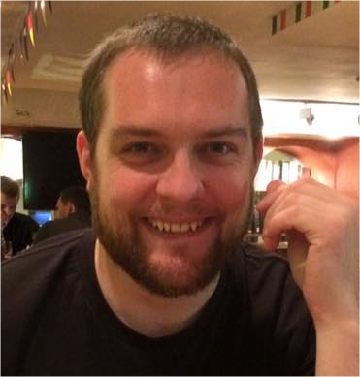
presenter
Simon Turner
Senior PeopleSoft Developer
University of Derby
e : s.turner@derby.ac.uk
t : +44 (0)1332 592100

Slide 3
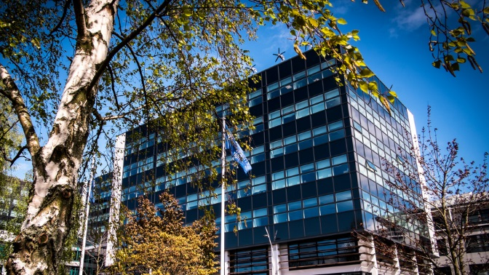
UK based Higher Education Institution
22,000+ students (undergraduate, postgraduate, online and partnerships)
1,700 international student from over 120 countries
PeopleSoft Campus 9.0
PeopleSoft Financials 9.2
PeopleSoft CRM 9.2
&

Slide 4
General Objectives
Greater knowledge of designing and building custom Fluid pages
Understanding how pre-built Fluid Homepages can be rolled out to a specific target audience.
Practical application of Fluid technology for Campus Solutions and how it can be used effectively with Single Sign on.

Slide 5
Steps Taken
REQUIREMENTS Drivers for the project
A TOE IN THE WATER Early Ideas / Investigations / Look and Feel
DEVELOPMENT Building the ideas into PeopleSoft
REFLECTION Lessons learned, pitfalls and problems

Slide 6
Requirements
1) To quickly access a student's record whether attached to the academic or not
2) The ability to add a note to the student's record (and to be controlled by appropriate security to respect data protection)
3) To be able to send an email to a student or groups of students
4) To manage student appointments
5) To attach files to the student record

Slide 7
Early Ideas
Looking at Interaction Hub - Possibly CRM for recording Notes / Interactions
Making PT8.53 responsive (if you dare)
jQuery / CSS design - Pushing limits of what we can do
Learning about Themes in PT8.54
Early Exploration in Fluid (PeopleSoft Delivered)
Modals – Design rewrite

Slide 8
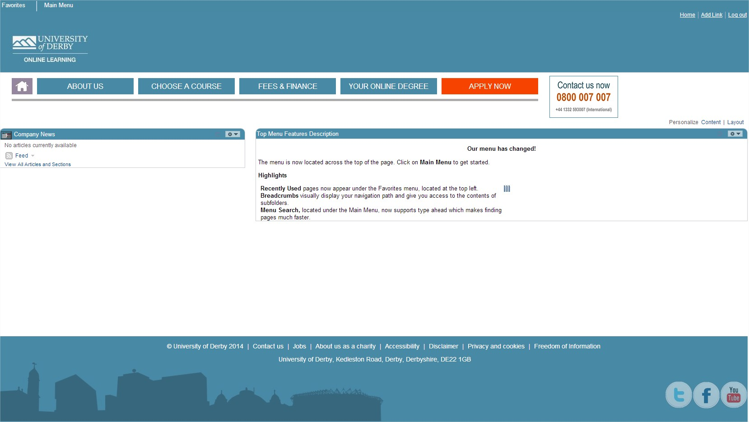
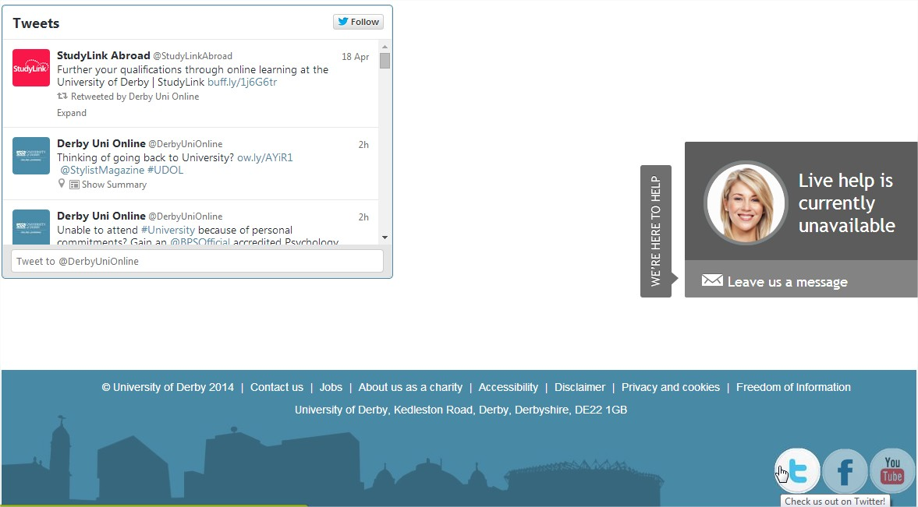

Slide 9
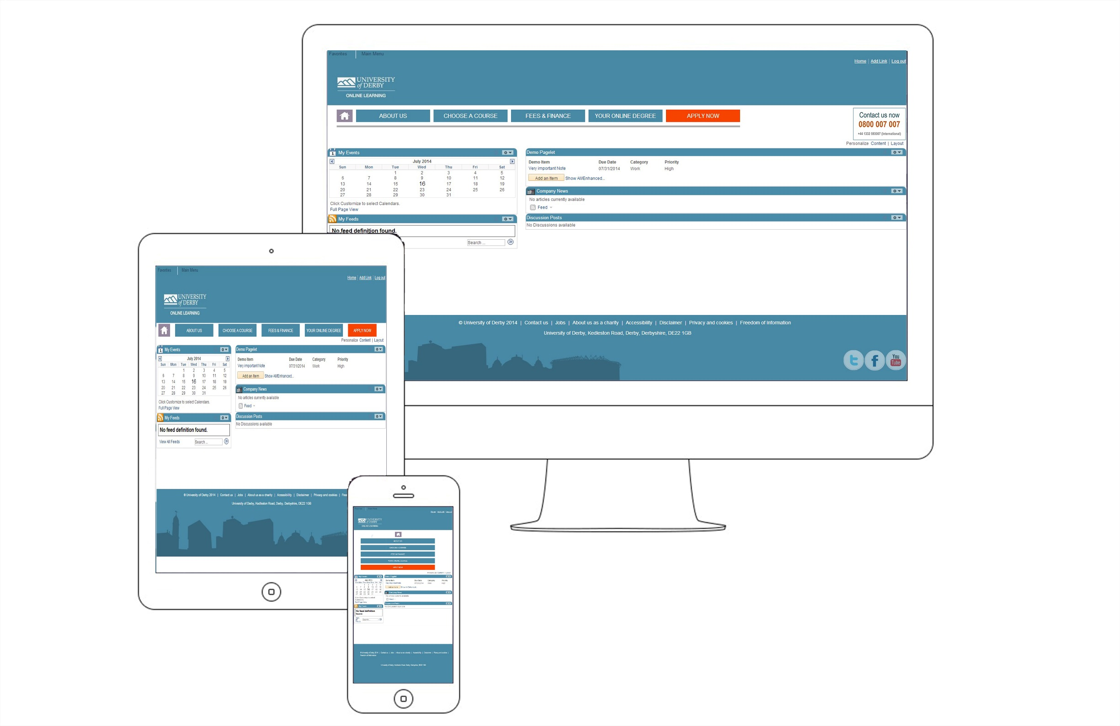

Slide 12
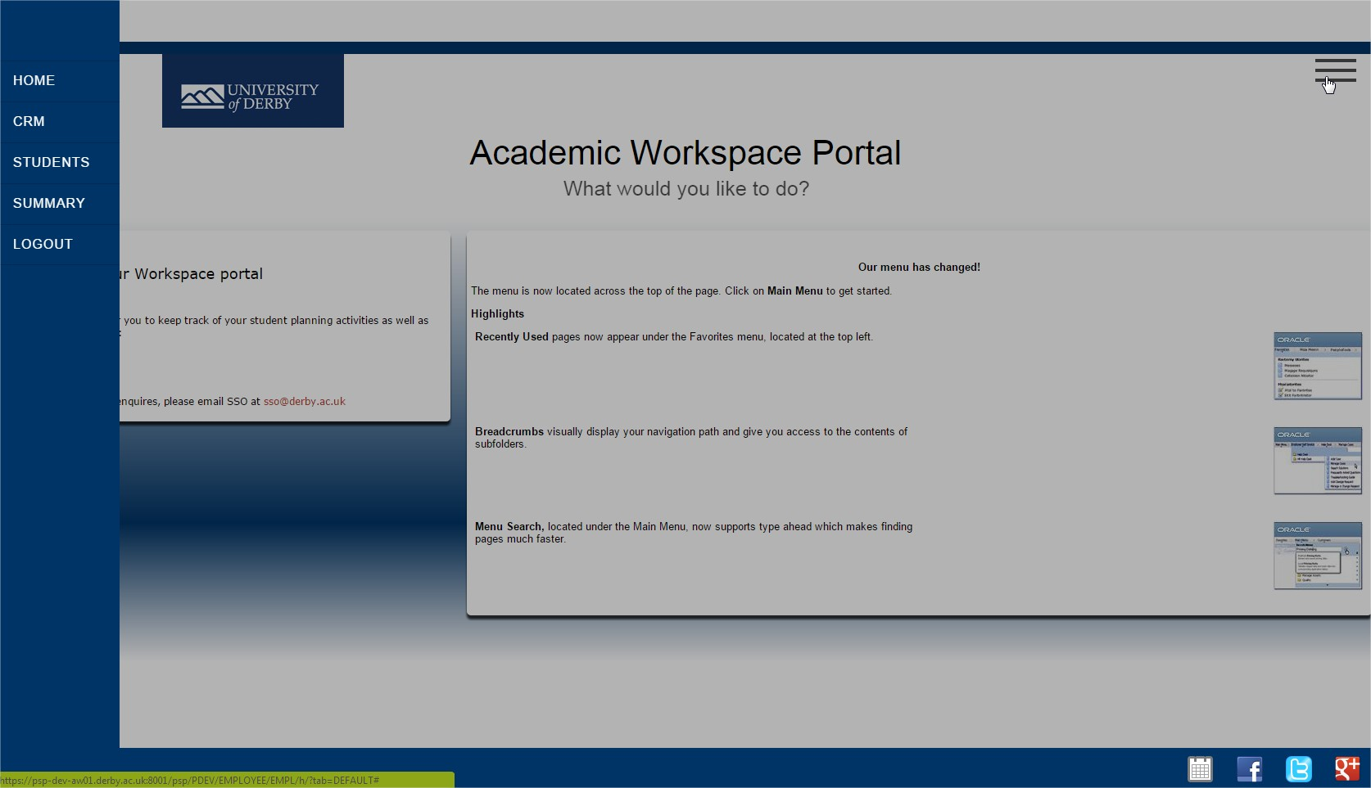

Slide 14
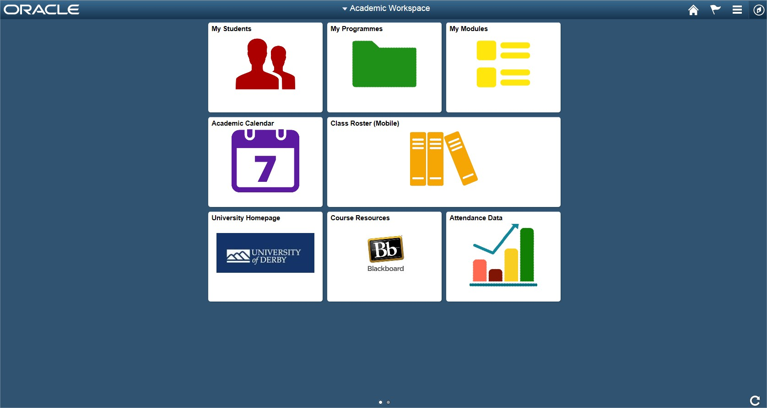
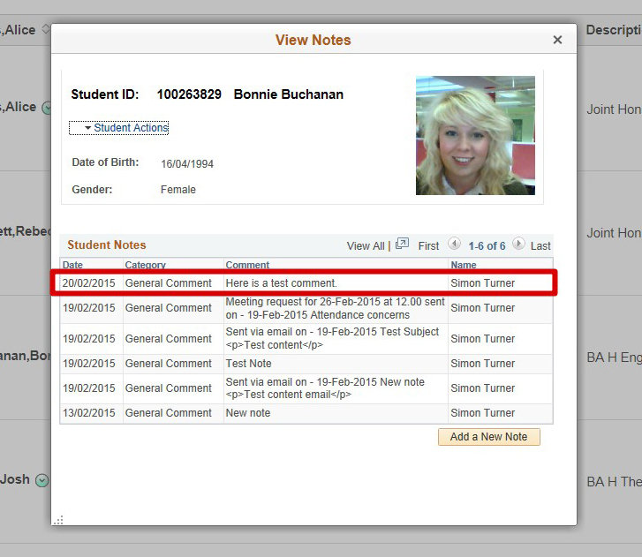
Original Design for Fluid Homepage and also original use of Modals on Tutees page.
PeopleTools 8.54.02

Slide 15
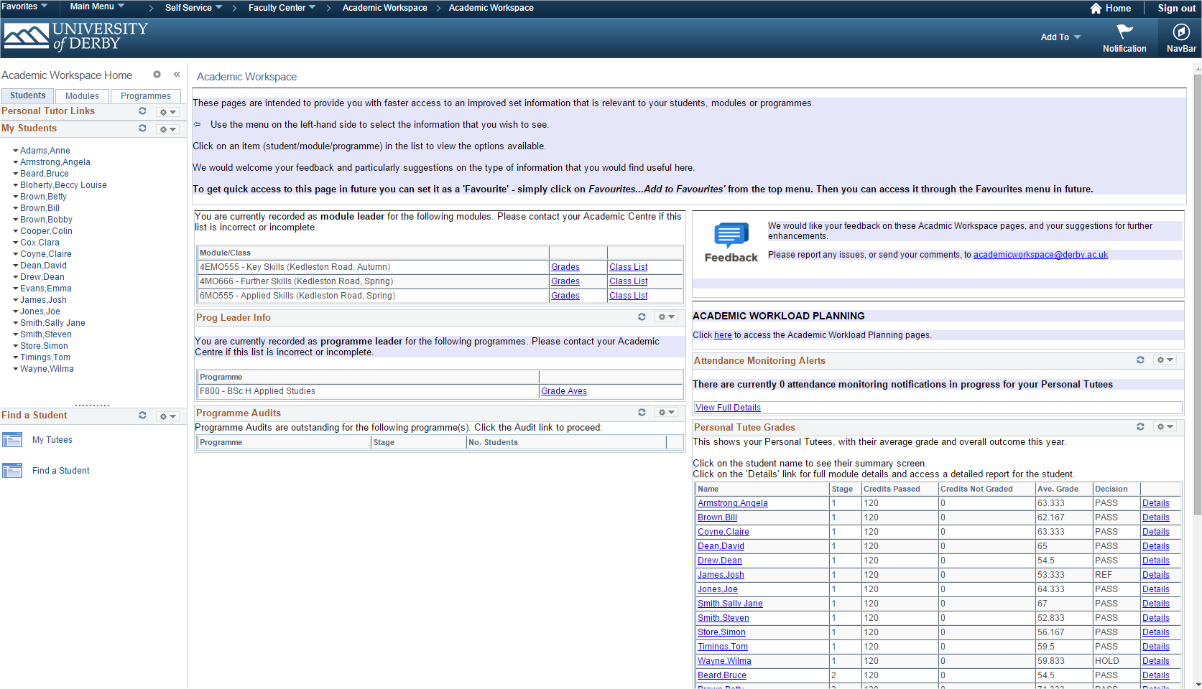
Development

Slide 16
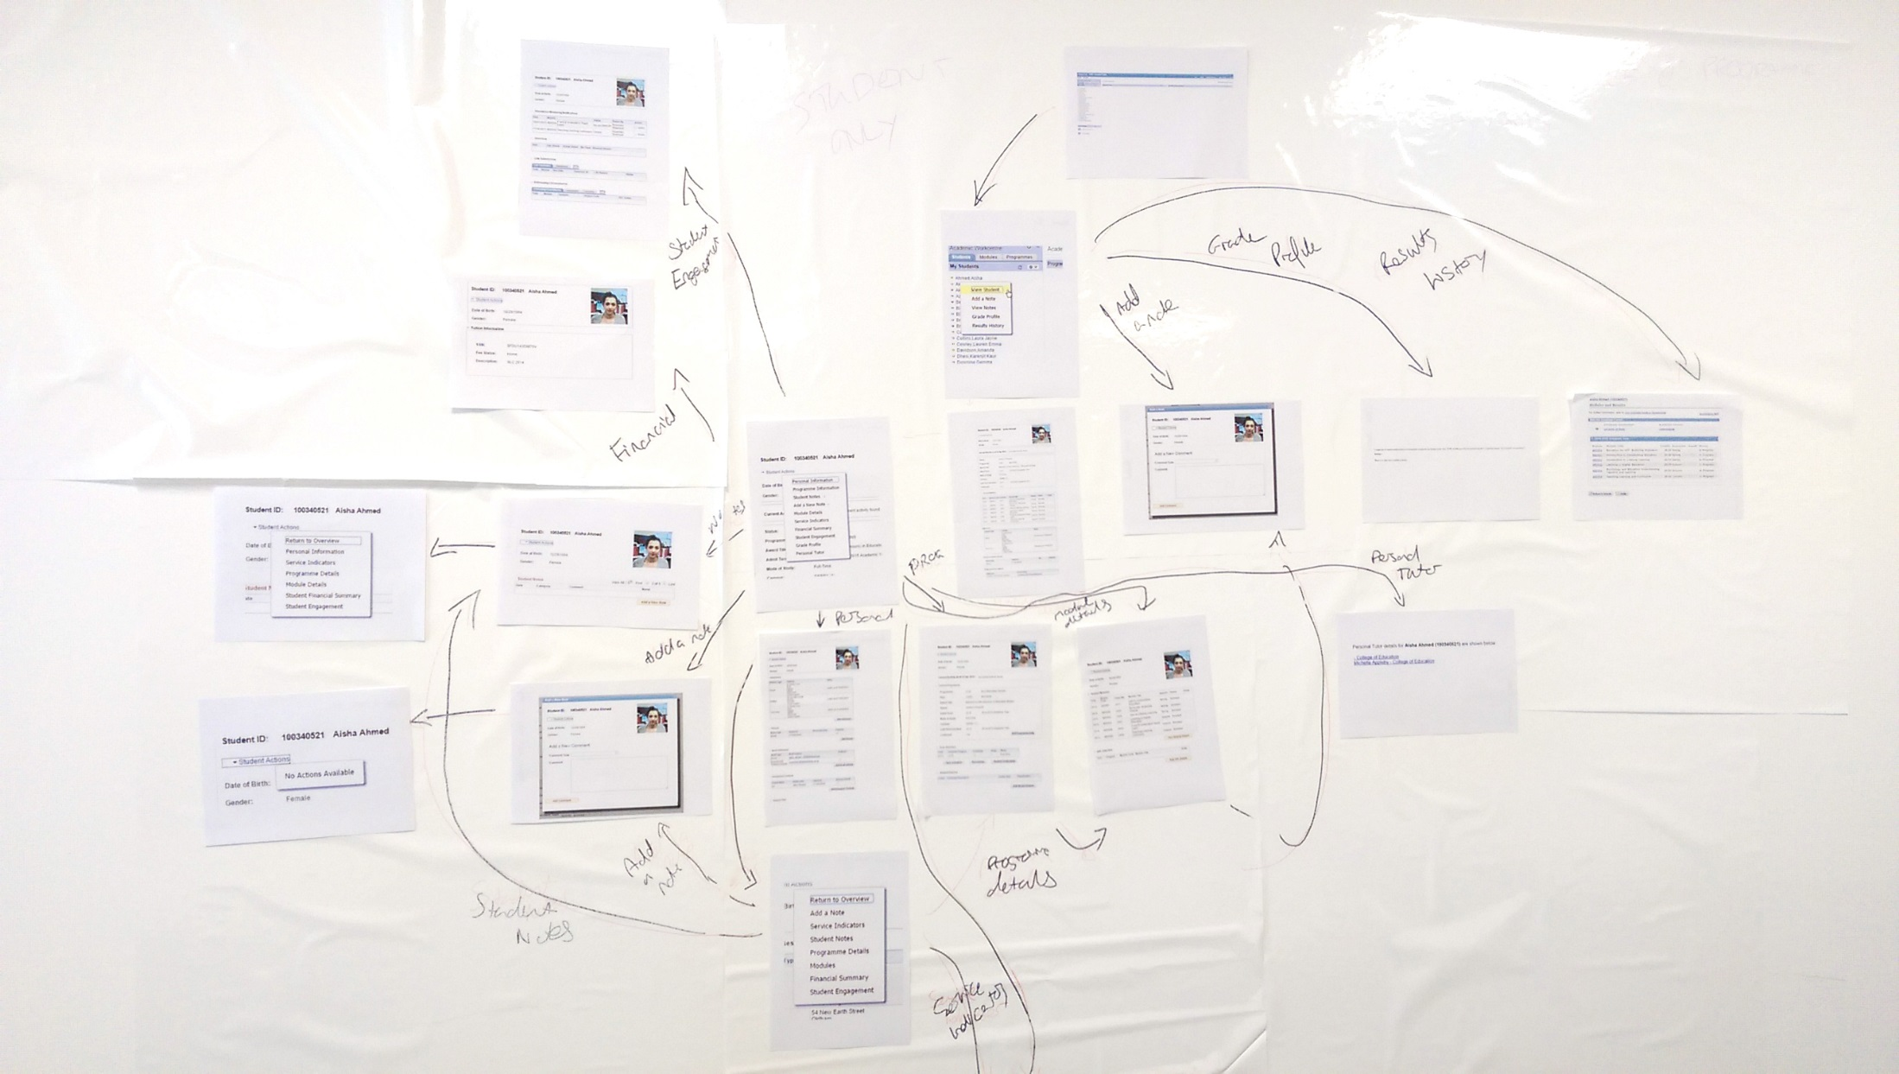

Slide 17
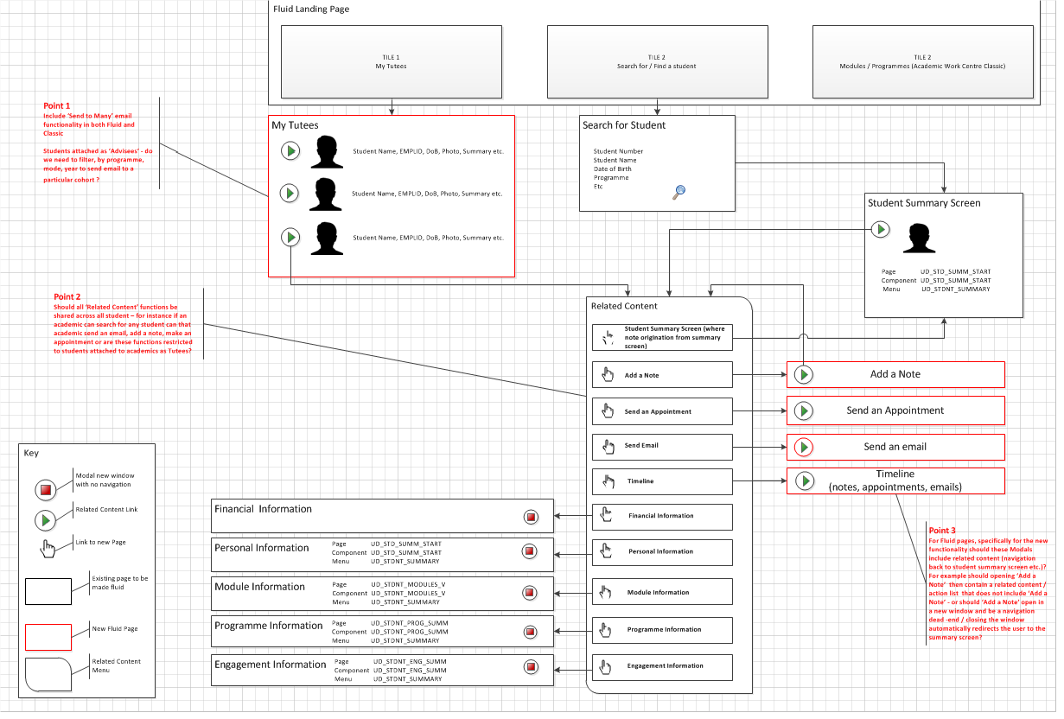

Slide 18
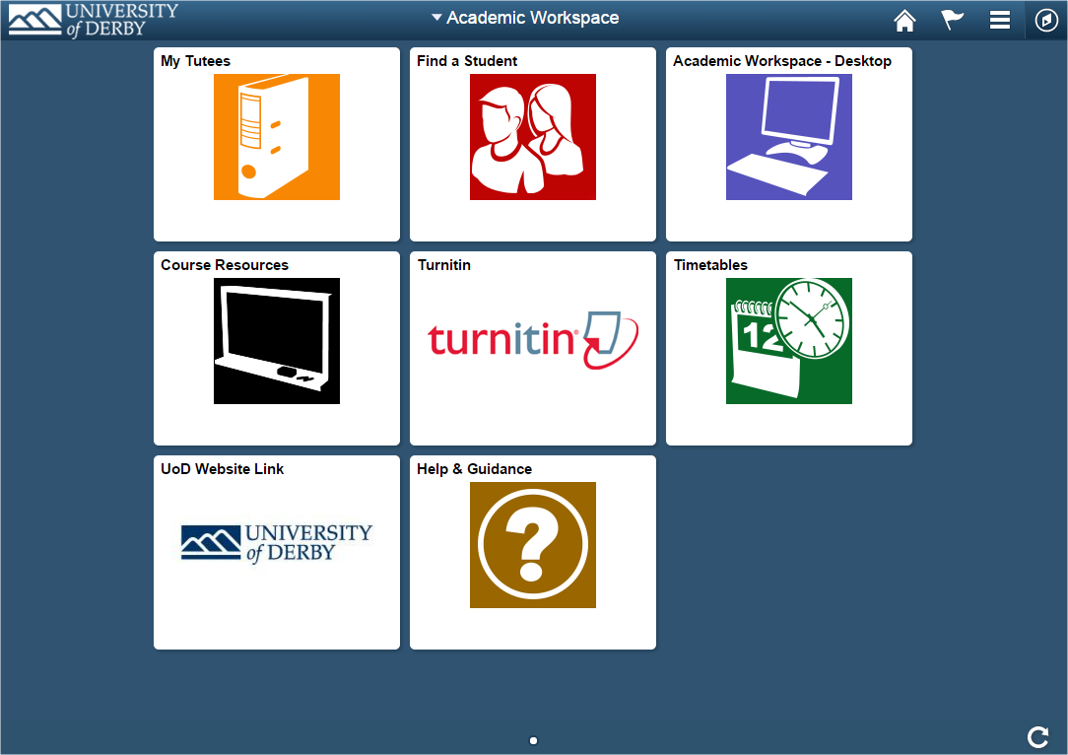

Slide 19
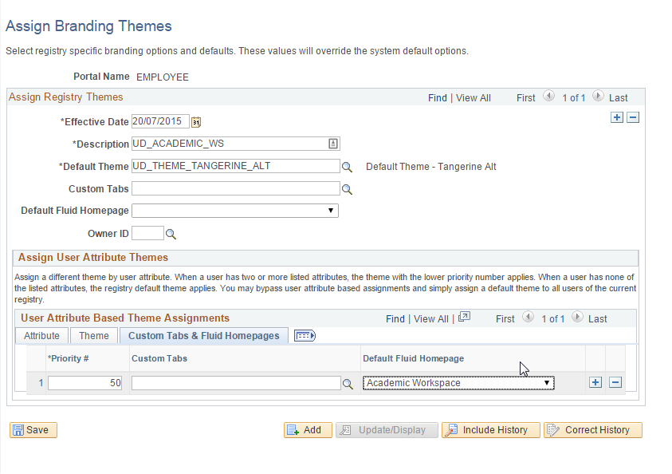
Branding Theme drives the visibility for academic staff only.
All AWS pages assigned to our UD_INSTRUCTOR Role / Permission List.

Slide 20
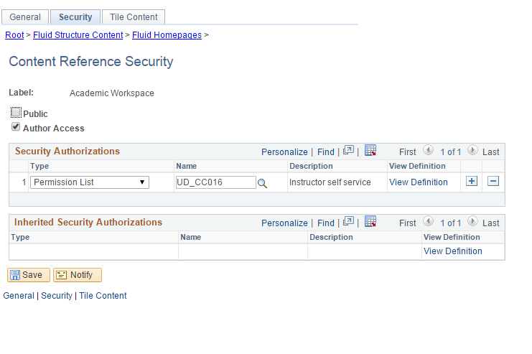
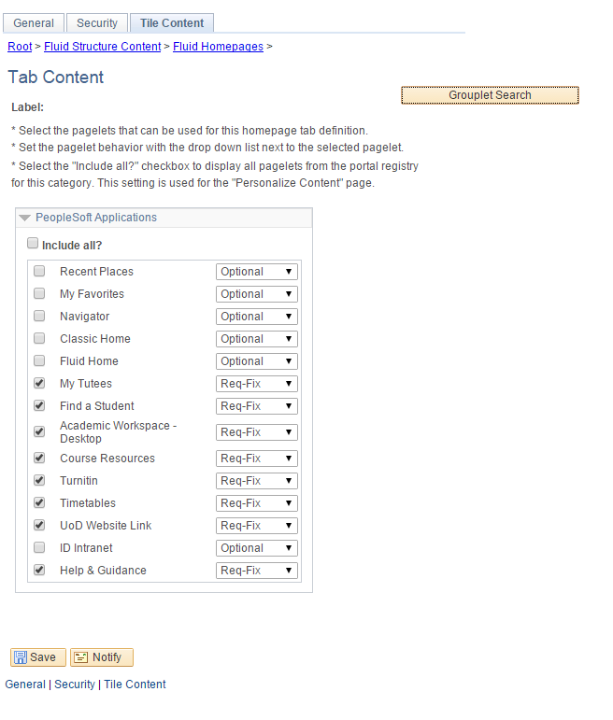
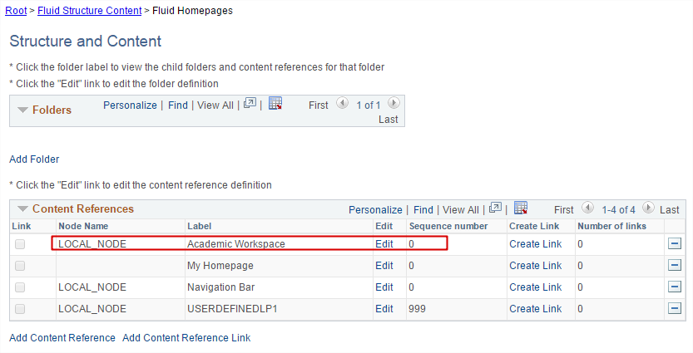
Setting the Tile content for the Academic Workspace homepage

Slide 21
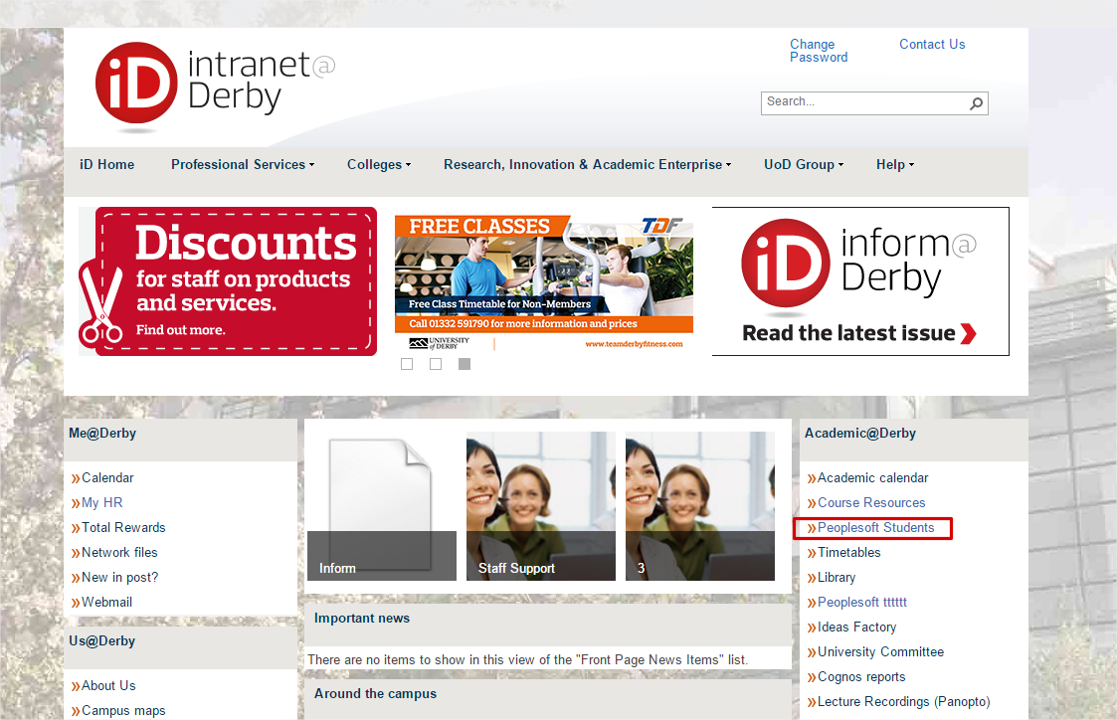
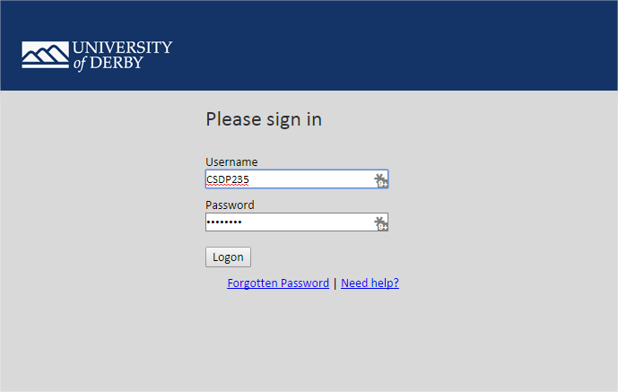
New URL: https://academics.derby.ac.uk
Link label changed to PeopleSoft Campus
Sits behind F5
Single Point of Login
Lands in PS
Signs straight into BlackBoard & Timetabling system

Slide 22
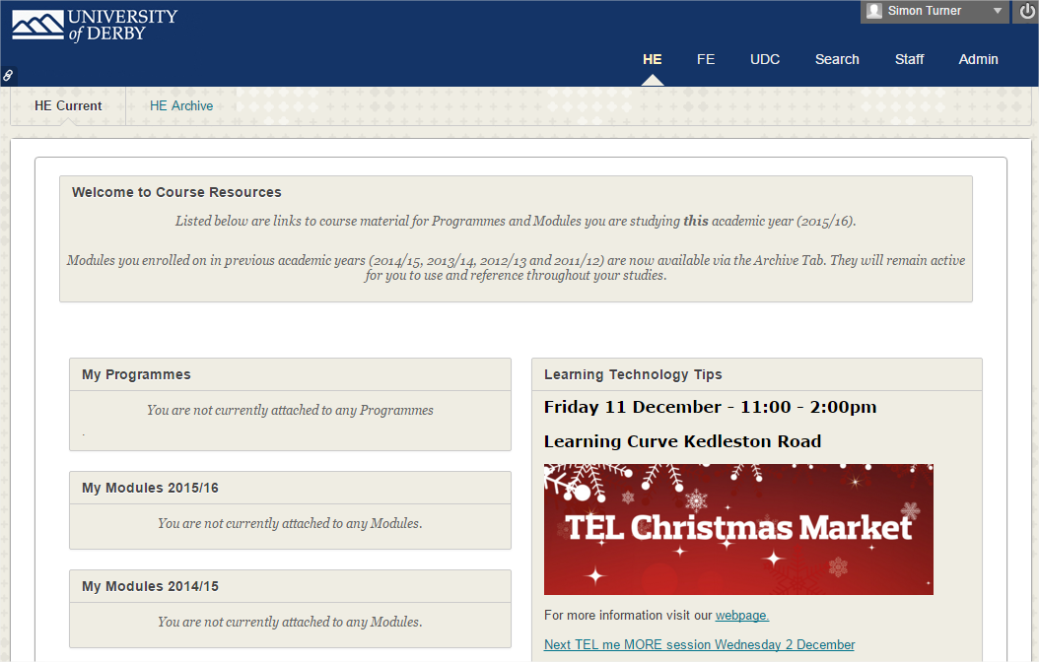
Link to ‘single sign’ into BlackBoard

Slide 23
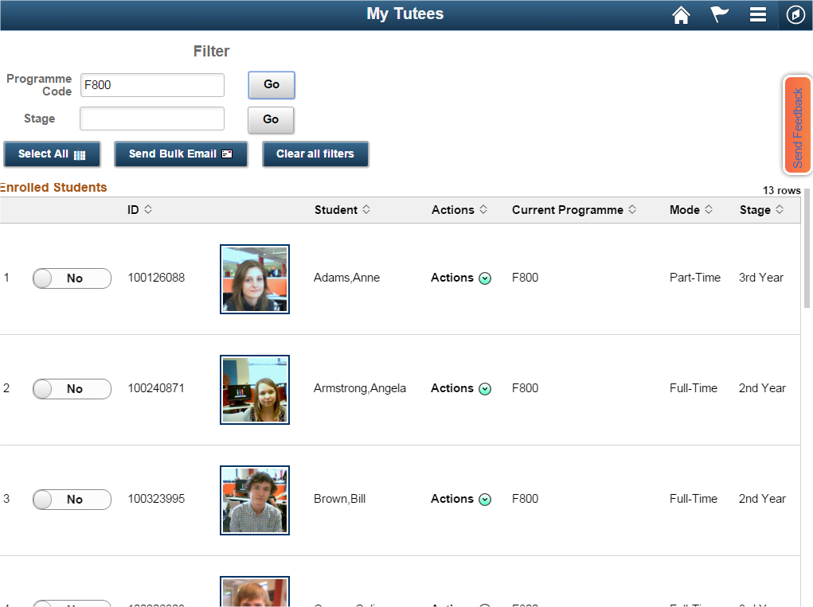

Slide 24
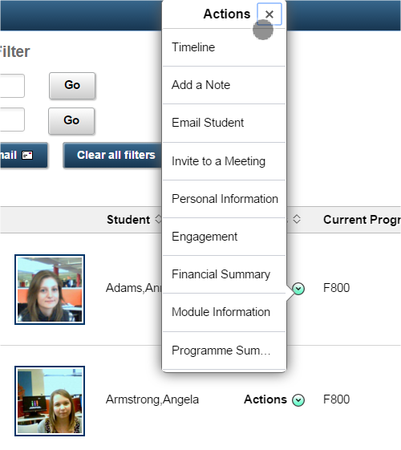
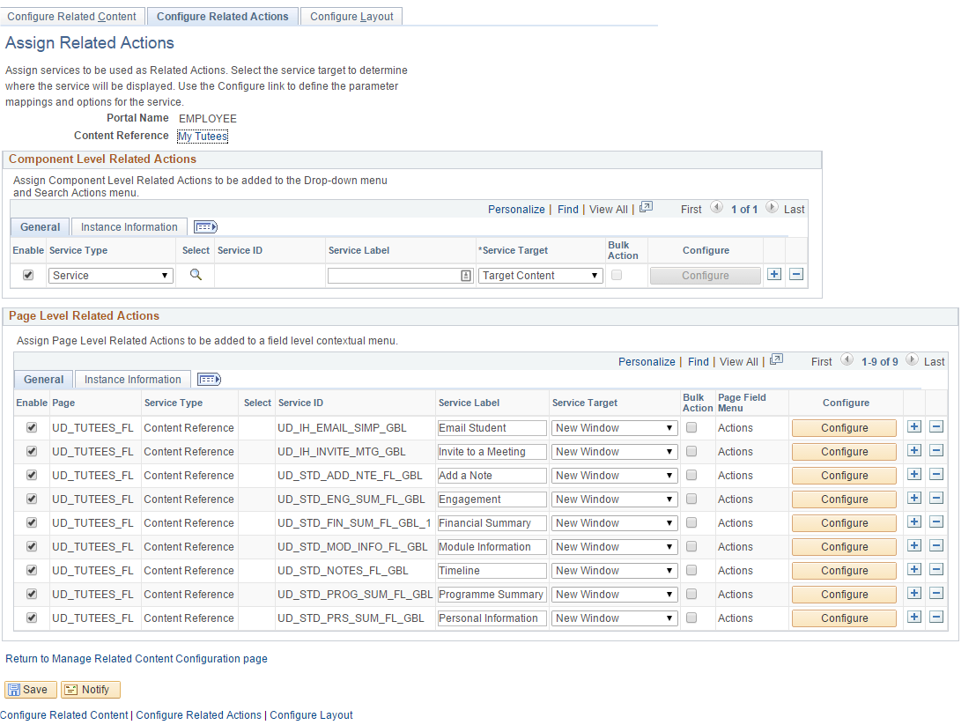
Related Actions Setup
PeopleTools > Portal > Related Content Service >Manage Related Content

Slide 25
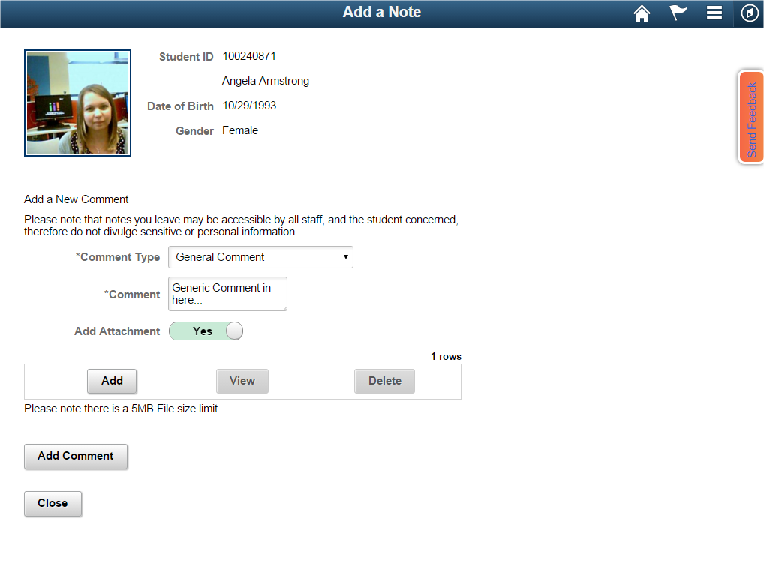

Slide 26
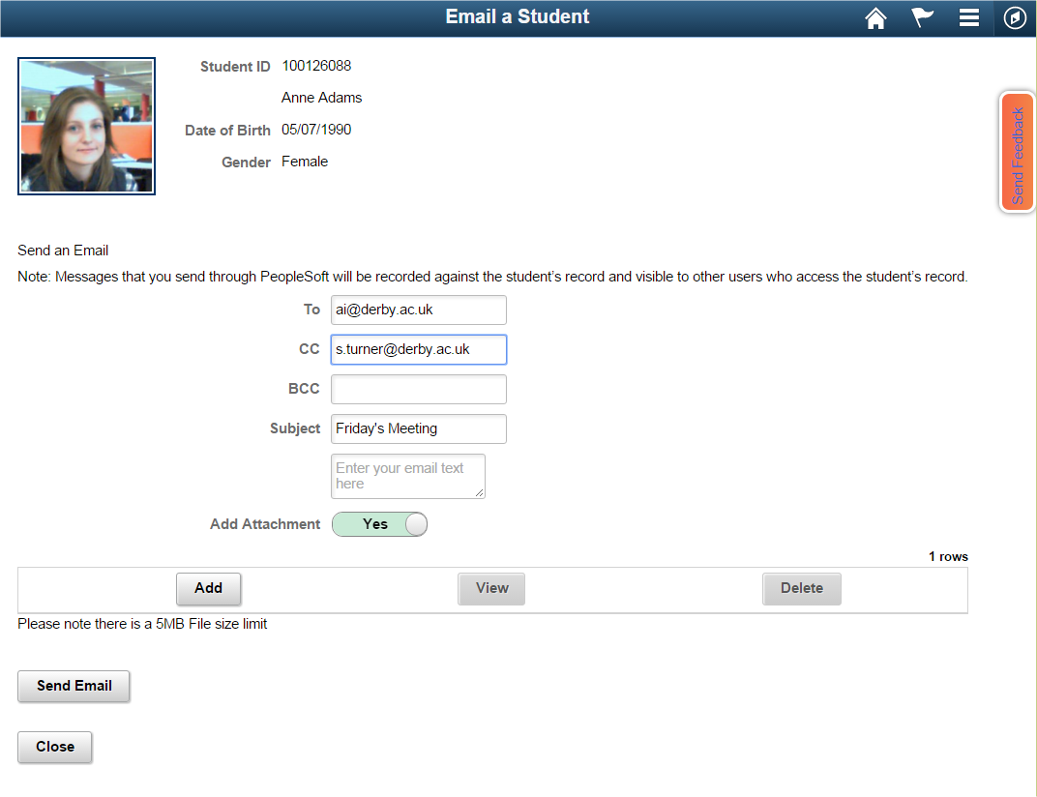

Slide 27
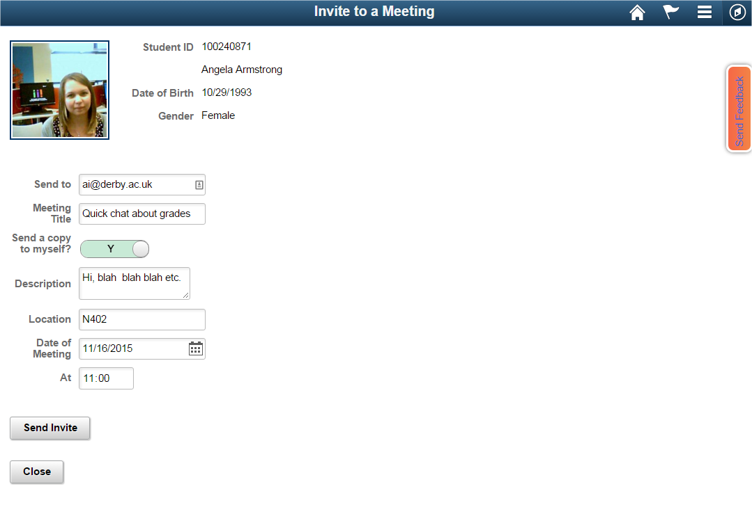
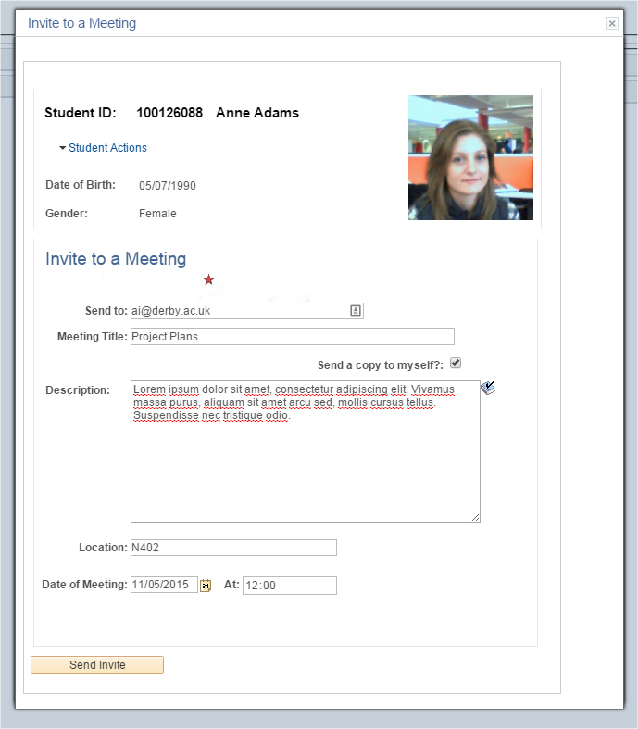
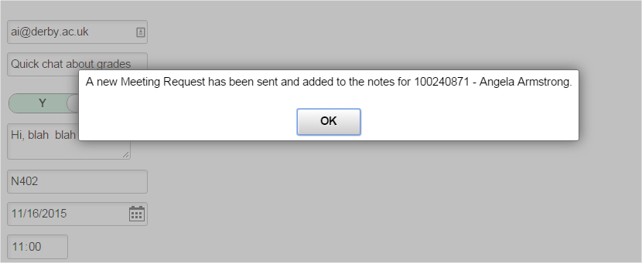

Slide 28
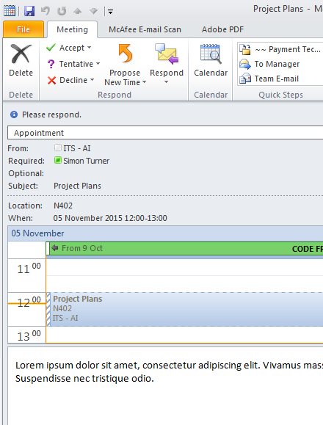

Slide 29
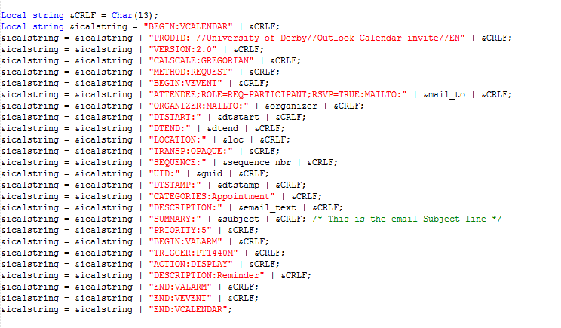
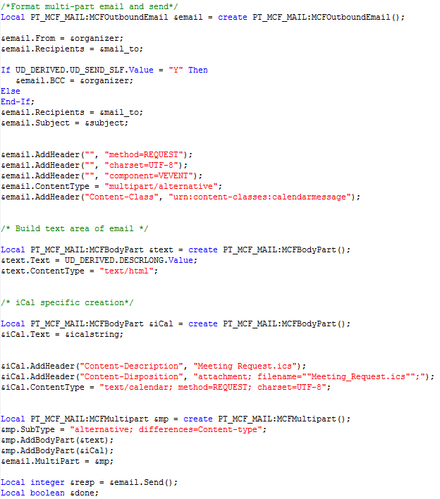
Building the Calendar File as a string object.
Create Multipart Email
Evaluate, Error checking and send as email
Process through Component Interface to add into ‘Timeline’ notes.

Slide 30
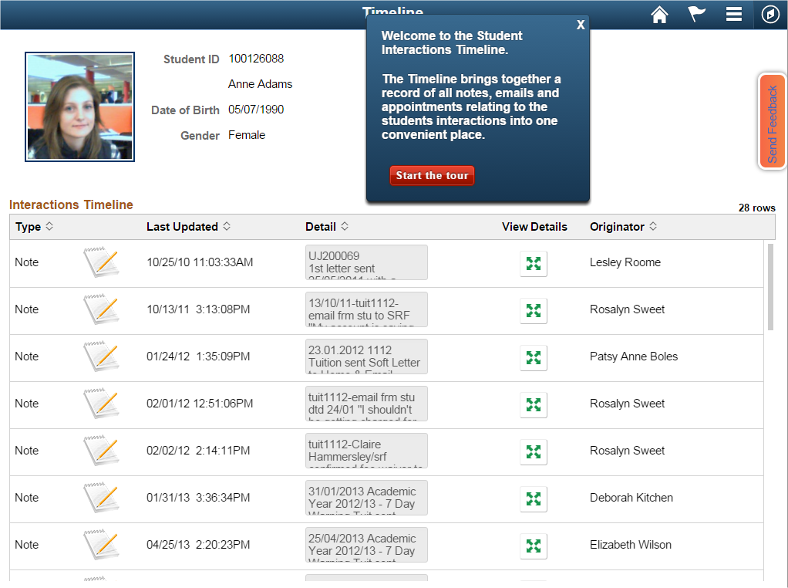
TOPIC TITLE
Remember to limit your bullet points and text, they should highlight the important details of your presentation, but they are meant to support the speaker(s).
Highlight of a topic
Second highlight of this topic
Third highlight of the topic
Maybe a fourth
Or even a fifth highlight

Slide 31
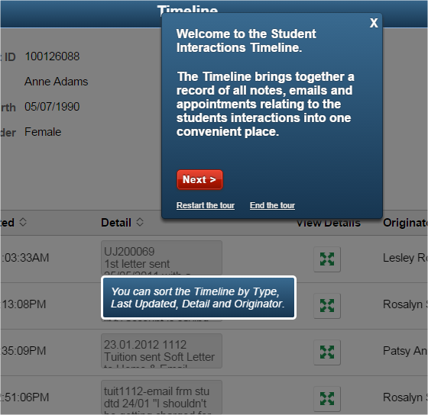
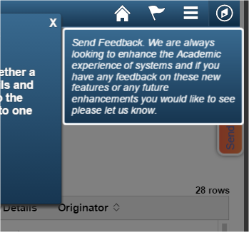
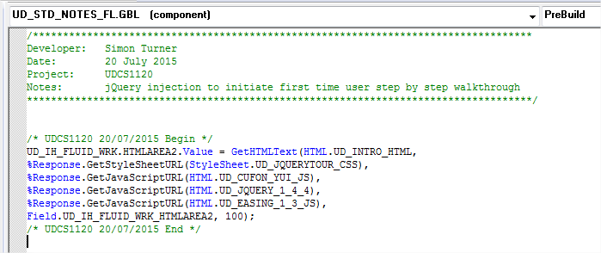
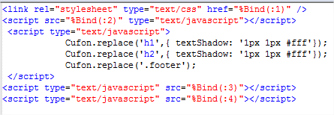

Slide 32
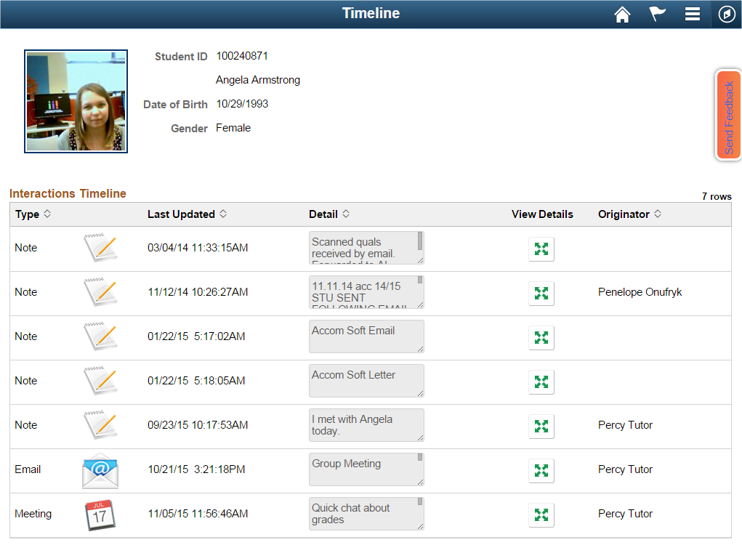

Slide 33
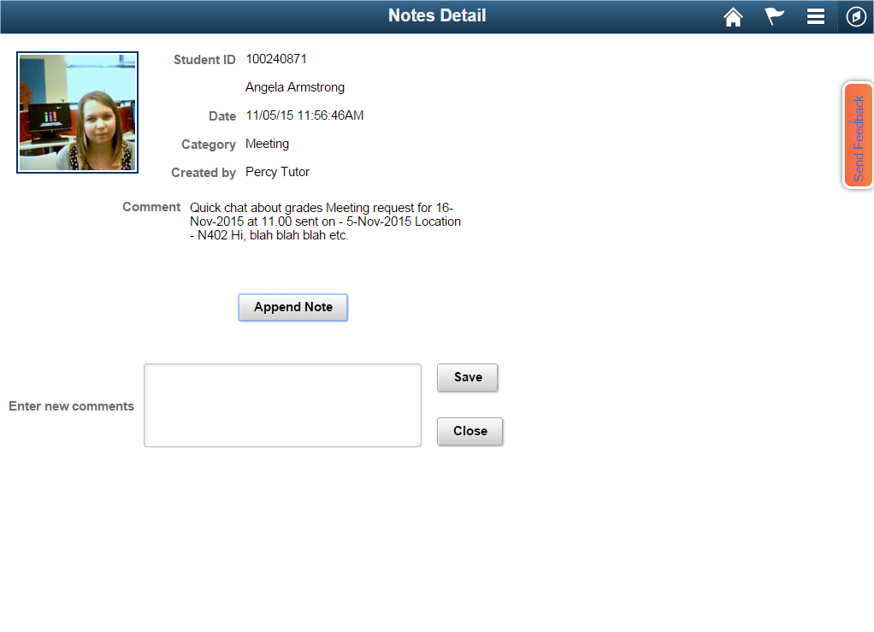
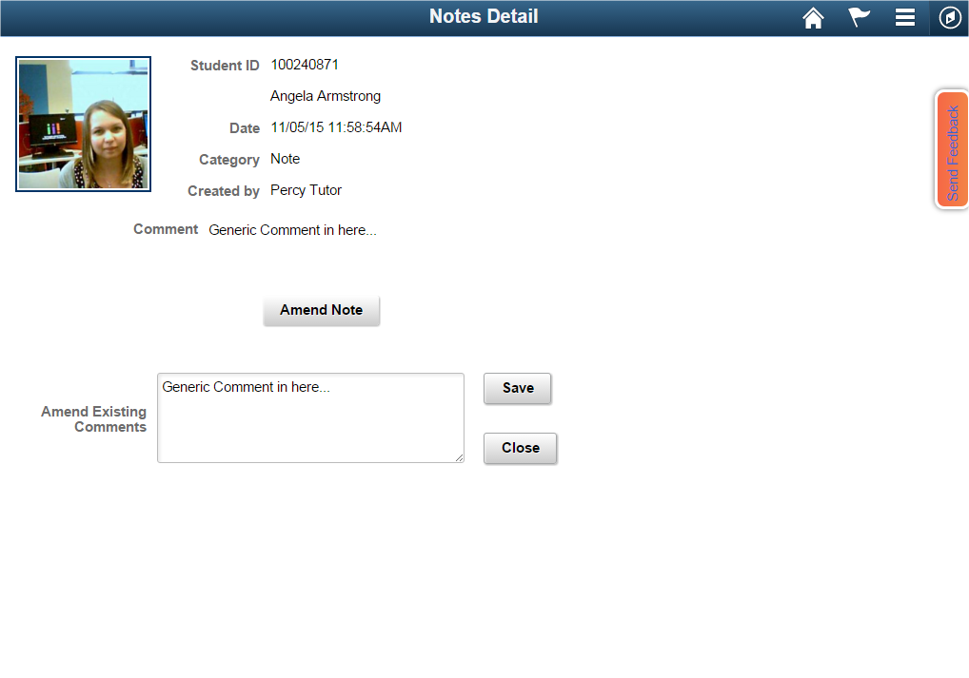

Slide 34
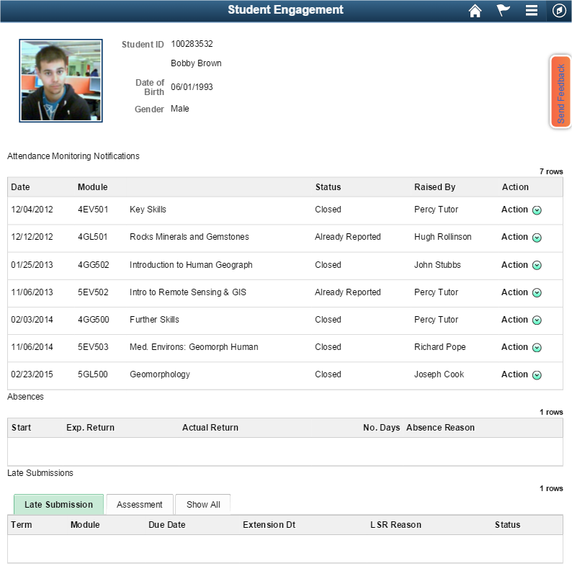

Slide 35
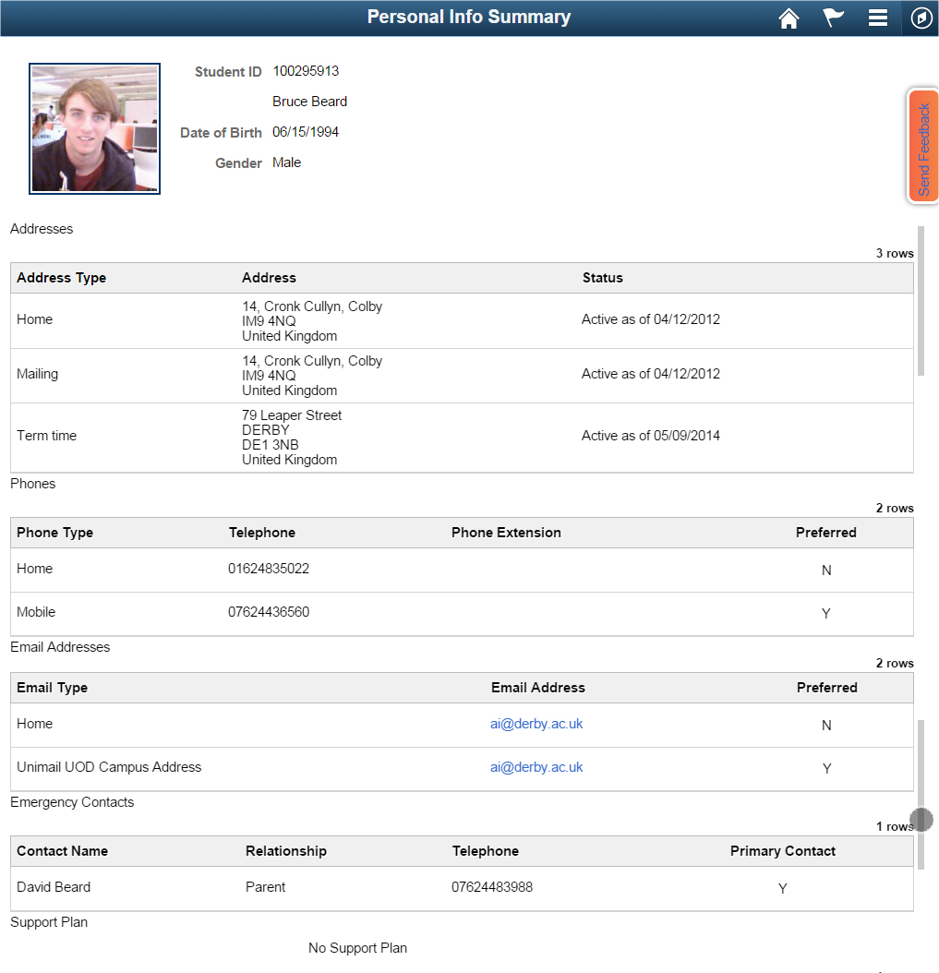

Slide 36
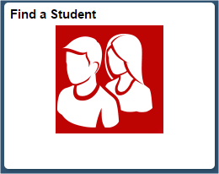
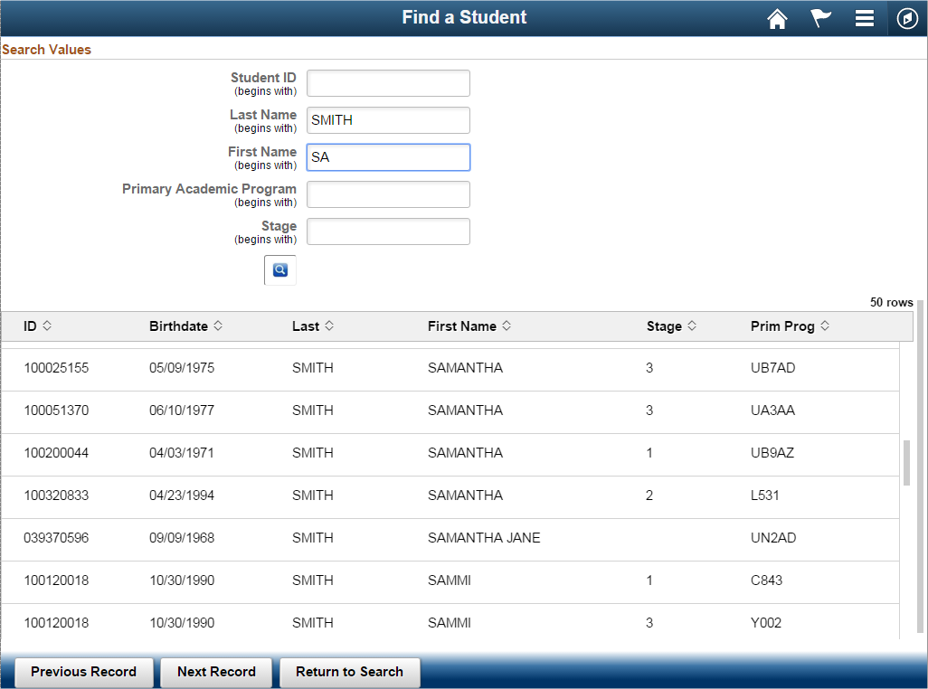

Slide 37
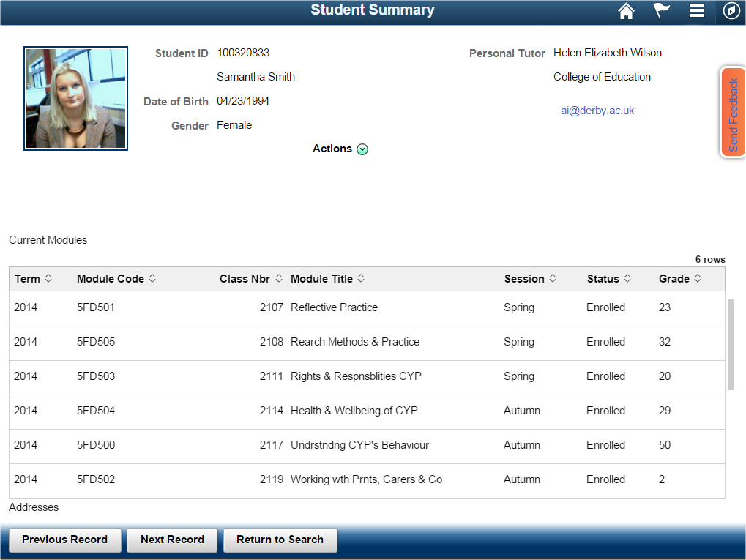

Slide 38
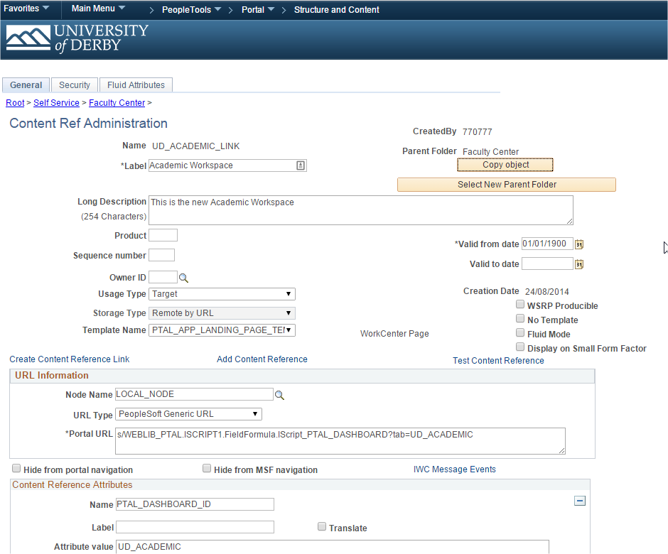
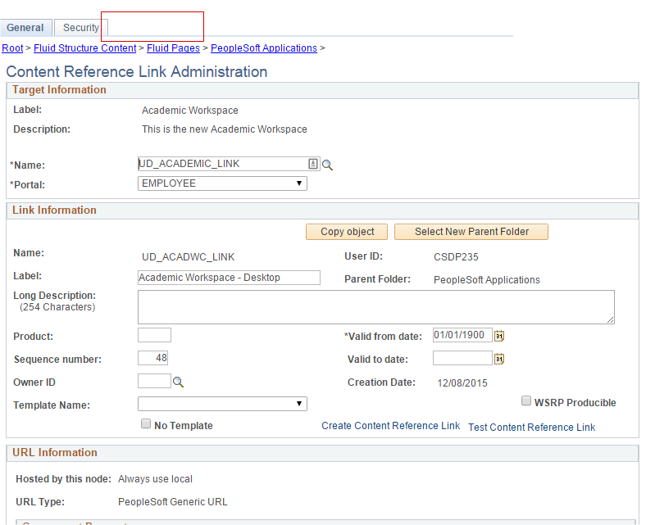
Tile ‘Fluid Attributes’ can only be set on the original content reference page when using Content reference links.

Slide 39
REFLECTION
Modals removed in PT 8.54.10
F5 issues with multiple tokens
Positioning elements takes longer in Fluid
No delivered Accordion Navigation
Multiple bugs in early releases

Slide 40
Thanks for Listening!
Simon Turner
Senior PeopleSoft Developer
University of Derby
e : s.turner@derby.ac.uk
t : +44 (0)1332 592100
AWS in action – Our user tutorial : https://youtu.be/u_0_r-pUGCo
ALL ALLIANCE PRESENTATIONS WILL BE AVAILABLE FOR DOWNLOAD FROM THE CONFERENCE SITE

Slide 41
THANK YOU!

