Slide 1
UoA eForm Journey
SESSION 6003
Thursday 8th November 2018

Slide 2
presenters
Jane Smart-Foster
Interim Associate Director – HR Shared Services
University of Adelaide
jane.smart-foster@adelaide.edu.eu

Slide 3
The University of adelaide
Established: 1874
Campuses: 4
Faculties: 5
Divisions: 3
Students: 22,000
Staff: 3,500 (excl casuals)

Slide 4
ORGANIZATION & ORACLE
HCM, Campus & Finance
PeopleSoft HCM 9.2
PeopleTools 8.55, PUM #27
GP, Time & Labour, Profile Mgmt, Partial Position Mgmt, Contract Admin, Training Admin

Slide 5
Overview
UoA eForm Journey to date and beyond
Our Last Hurrah – Voluntary Flexible Work Arrangements eForm
Deep Dive – Account Code Amendment eForm
Key Learnings

Slide 6
Uoa eForm Journey
From GT to PeopleSoft

Slide 7
Uoa eForm Journey
October 2014 First GT form - CRAFT
September 2015 Account Code Amendment
February 2016 Temporary Finance / HR delegations
May 2016 Titleholder Renewals
August 2016 New Titleholders
March 2017 AppoINT
June 2018 First PeopleSoft Form CAPS
January 2018 VFWA
Notes:
CRAFT – Fixed Term Contract Renewals
Account Code Amendments – deep dive shortly
Temp Delegation – the transfer of HR and Finance delegations
Titleholder renewals and new applications
AppoINT – appointment of internal applications i.e. direct appointments
VFWA – deep dive shortly
CAPS
With PeopleTools upgrade to 8.55 in 2017 and after reviewing Gideon Taylor v3, the functionality being offered in GT was also available directly in PeopleSoft, the effort to upgrade GT and all existing forms to the new version was a major driving factor in selecting PeopleSoft as our eForm application moving forward

Slide 8
Our Last Hurrah
VFWA eForm – the last GT eForm at UoA

Slide 9
VFWA Scope
Full workflow automation of:
Temporary Reduction in Employment Fraction
Compressed Weeks
Purchased Leave
Change in Work Pattern
Integration into:
Job Data
Work Schedule
View an existing VFWA request
End an existing VFWA request early
Notes:
Reduced employment fraction of temporary changes only, primarily used for care of child / family member also available to increase it back up if you are already on a VFWA
Permanent fraction variations are either done through contract variation or a short term variation advice form
Integration / form smarts exist around existing VFWA’s ensuring new arrangements in some cases don’t overlap with other VFWA’s or extend beyond certain action/reason combinations on job data for e.g. Higher Duties, Secondments, Terminations
Whilst pay is being finalised eForms are paused and once the new pay period is open the forms are then integrated
Exceptions to integration rules are emailed to Payroll for manual processing
As at 31st October 2018 543 VFWA processed through the online system

Slide 10
VFWA benefits
No manual data entry (except purchased leave)
No paper forms or manual approvals
Reduction in effort and rework
Improved user experience
Notes:
Our manual process for entering VFWA’s was one of the most complex process within the operational teams. So even though the numbers are relatively low the time saving has been significant.

Slide 11
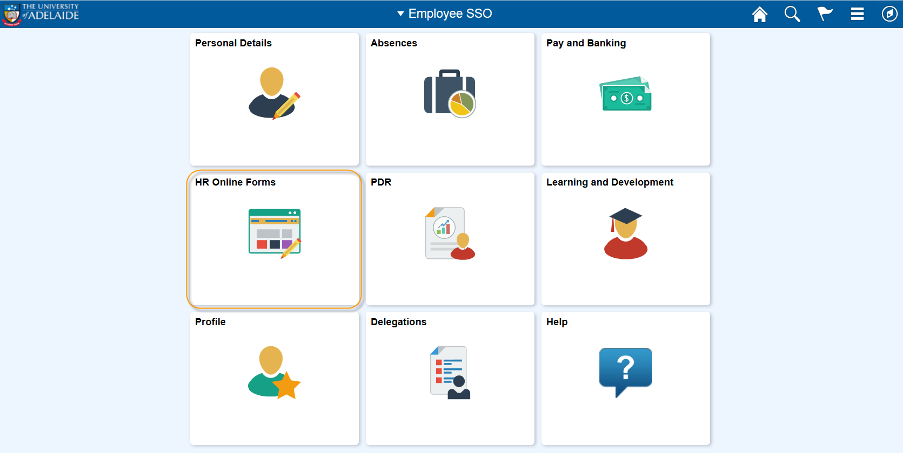
Demonstration

Slide 12
Demonstration
Notes:
At this stage the only 2 online forms available through our SSO portal is VFWA and Payment and deductions (leveraging the POIT Self Service Payment Tool)

Slide 13
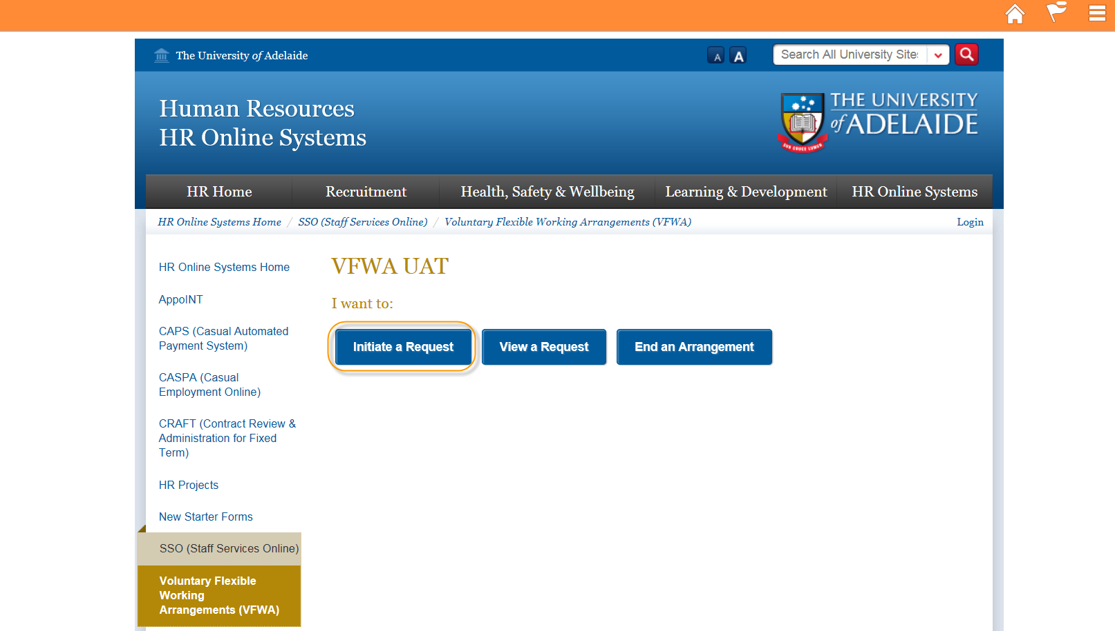
Demonstration
Notes:
Hoping the links to a web page embedded in SSO will be removed soon

Slide 14
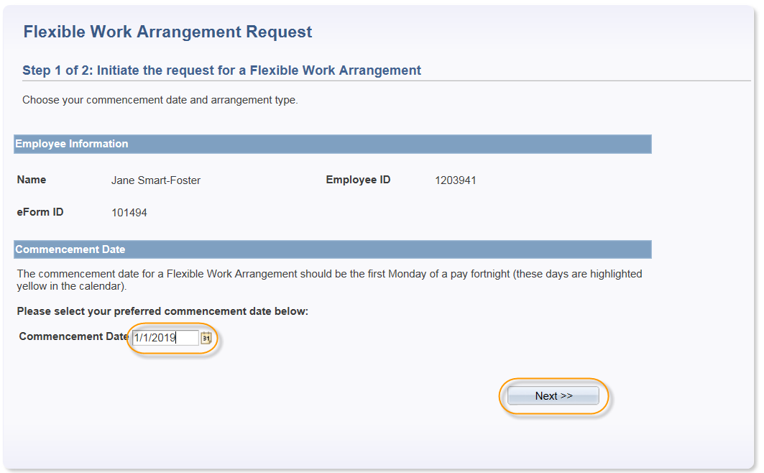
Demonstration

Slide 15
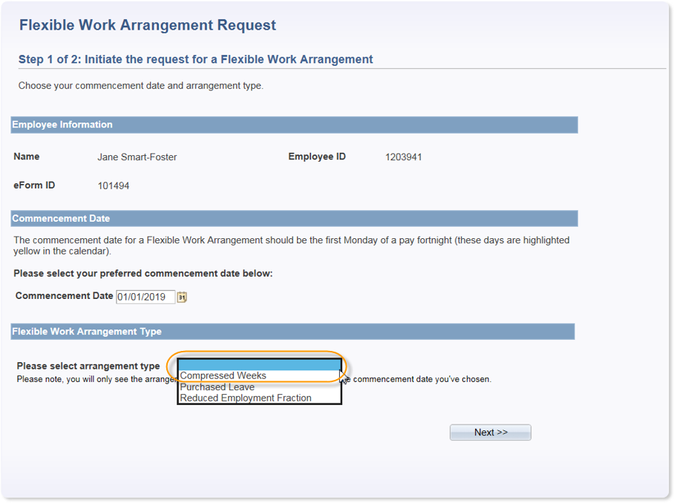
Demonstration
Notes:
Drop down values are smart enough to recognise your profile, for e.g. if you are part time compressed weeks will not be an option

Slide 16
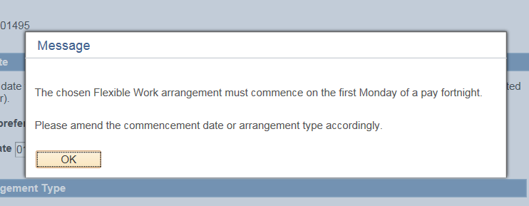
Demonstration
Notes:
Business decision made early onto ensure a VFWA must commence at the beginning of a pay fornight.

Slide 17
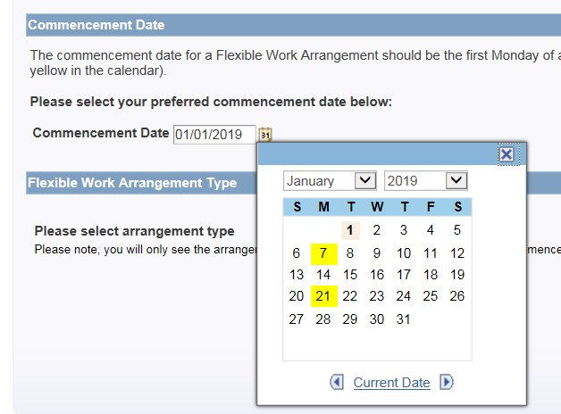
Demonstration
Notes:
Surprisingly many ‘non payroll’ users struggle with the start of a fortnight so colour coded for ease

Slide 18
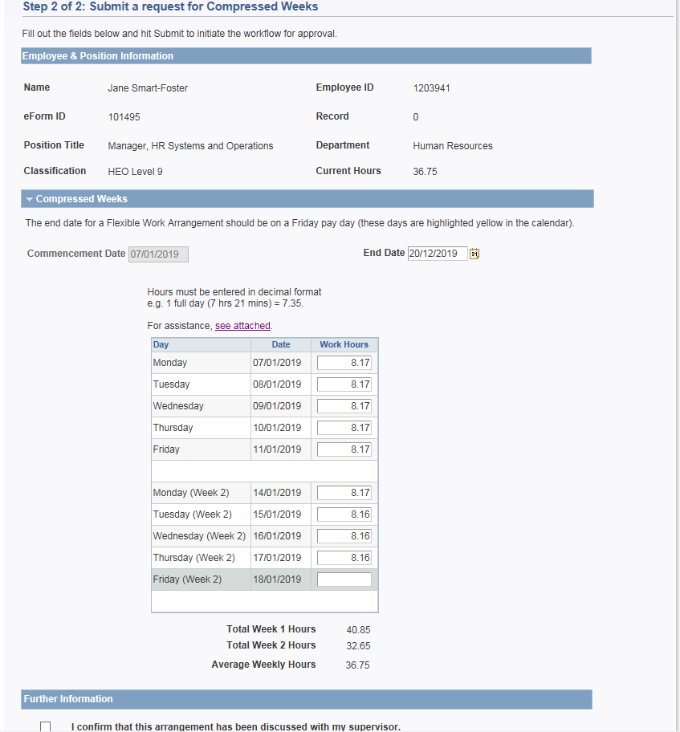
Demonstration

Slide 19
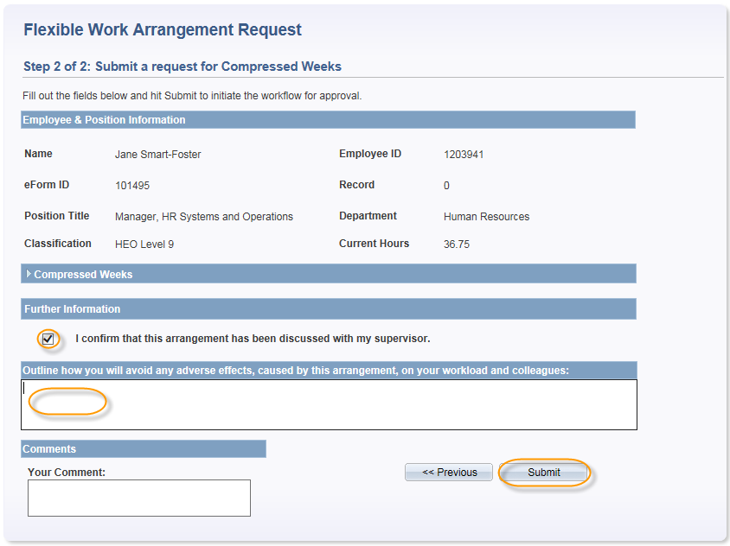
Demonstration

Slide 20
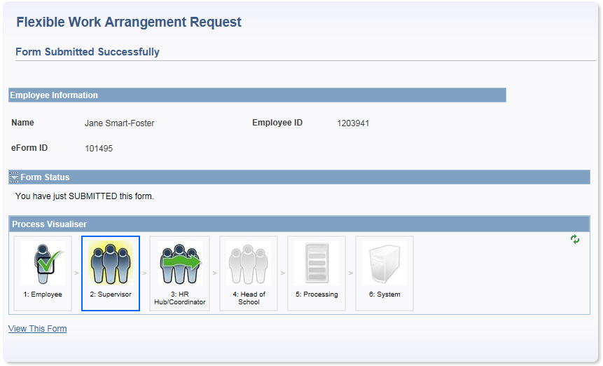
Demonstration
Notes:
Standard GT eform visualser. For those Faculties with HR Hubs, workflow to the HR Coordinator is included

Slide 21
Demonstration
Notes:
A supervisor email is received, linking out to PeopleSoft delivered worklist

Slide 22
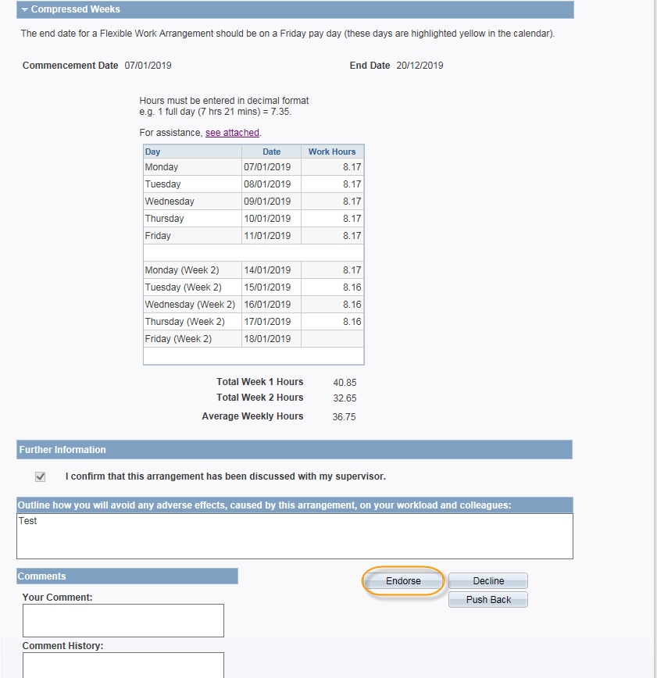
Demonstration
Notes:
Options to Endorse, Decline or Pushback

Slide 23
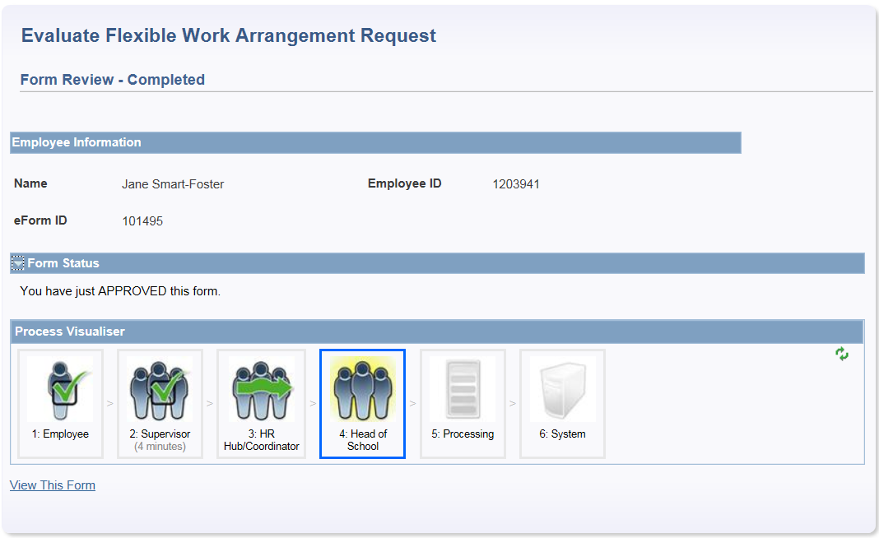
Demonstration
Notes:
A HoS email is received, linking out to PeopleSoft delivered worklist

Slide 24
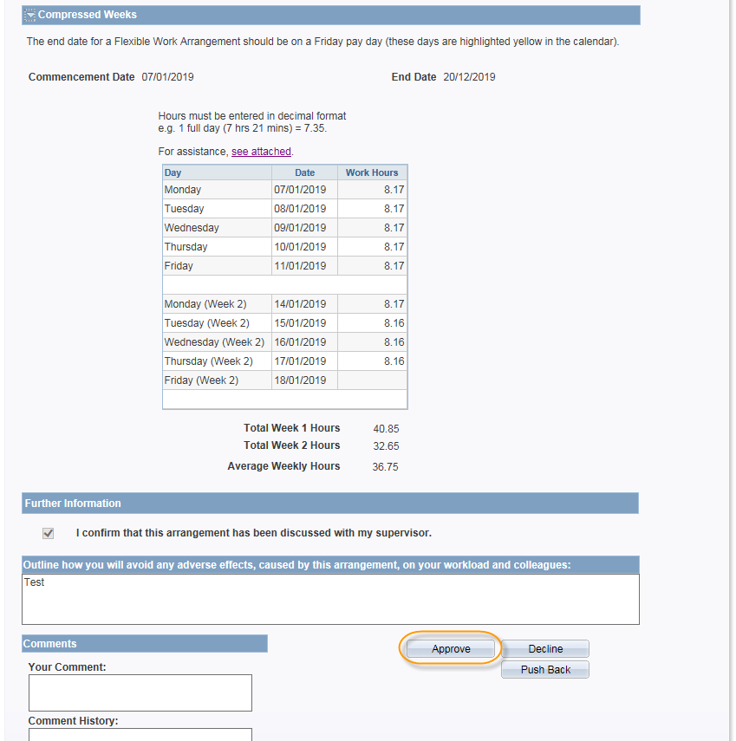
Demonstration
Notes:
Options to Approve, Decline or Pushback

Slide 25
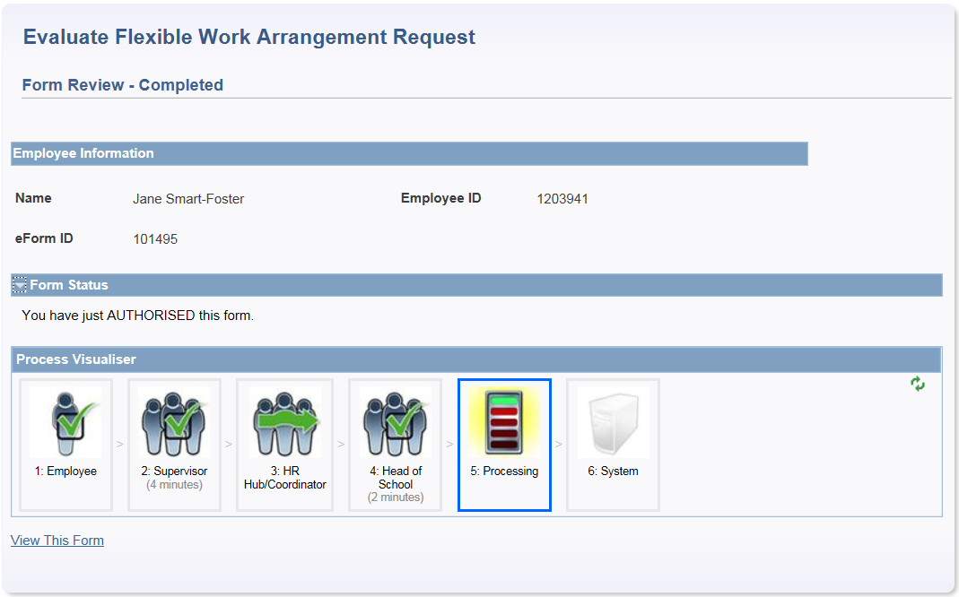
Demonstration
Notes:
Integration into Job Data andWork Schedule

Slide 26
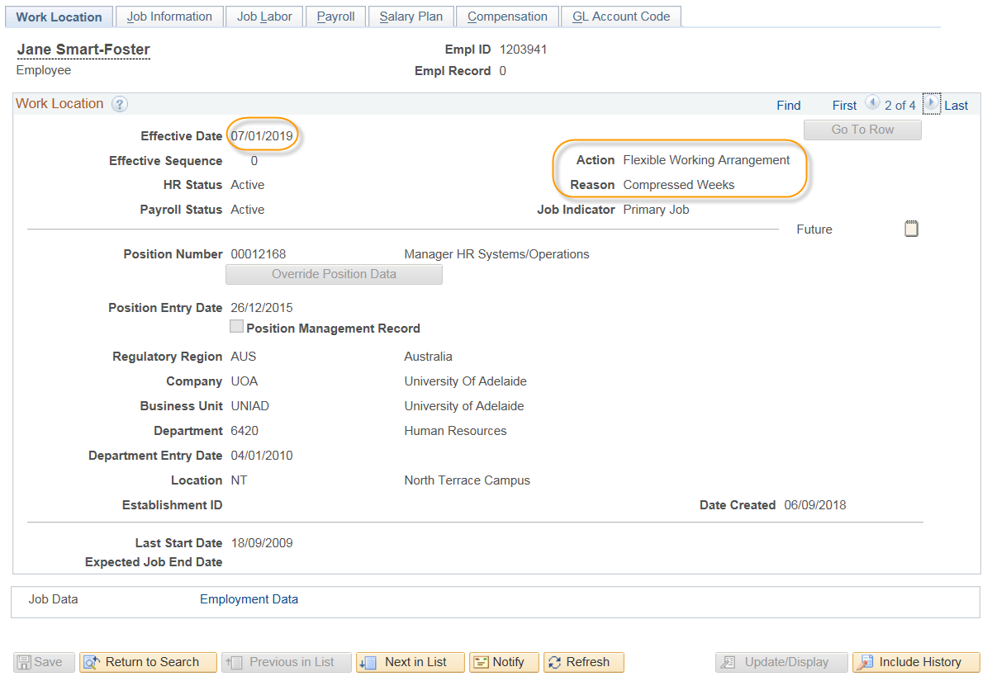
Demonstration

Slide 27
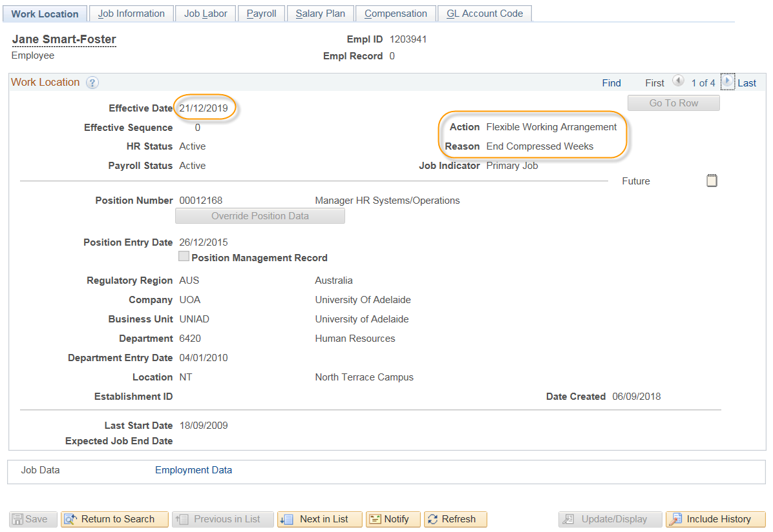
Demonstration

Slide 28
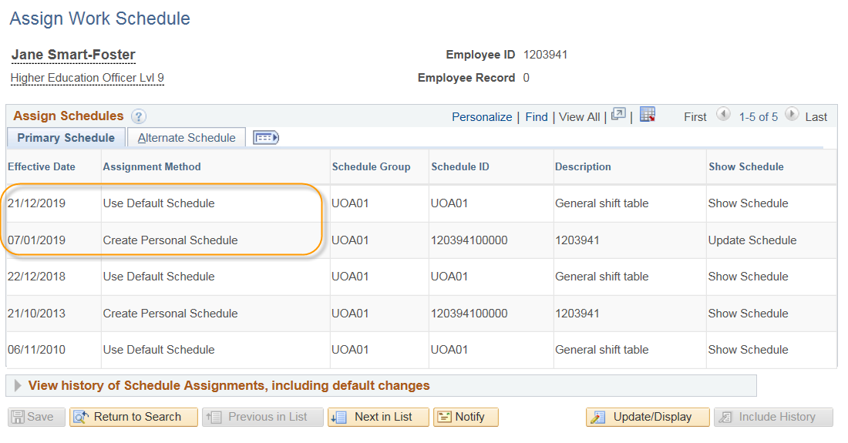
Demonstration

Slide 29
Questions?

Slide 30
Deep Dive
Account Code Amendment

Slide 31
Account Code Amendments
Initiated by any employee for employees within their HR department (driven by Job Data)
HR Management User List identifies positions (e.g. Faculty HR) who can request amendments for a defined area, such as faculty wide
Up to 5 way cost centre split can be requested
Fund, GL Department and Project Code are the only fields that can be modified
Effective date smarts around current open pay period start date, to stop any retrospective changes
Email notifications once integrated
CAPS (Casual System) links account code changes to the same eForm
Notes:
As at 31st October 2018 2572 account code amendments processed through the system

Slide 32
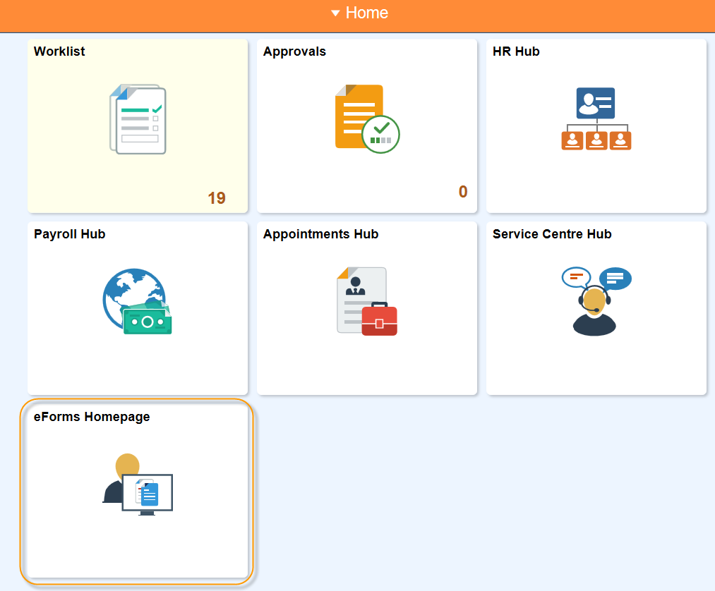
Demonstration

Slide 33
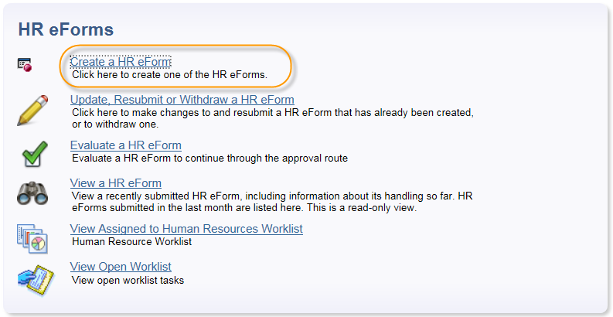
Demonstration

Slide 34
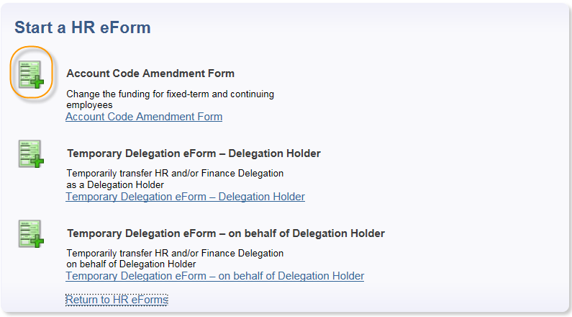
Demonstration
Notes:
The amount of forms displayed is driven by security

Slide 35
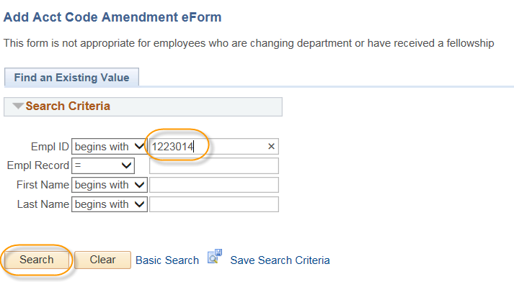
Demonstration

Slide 36
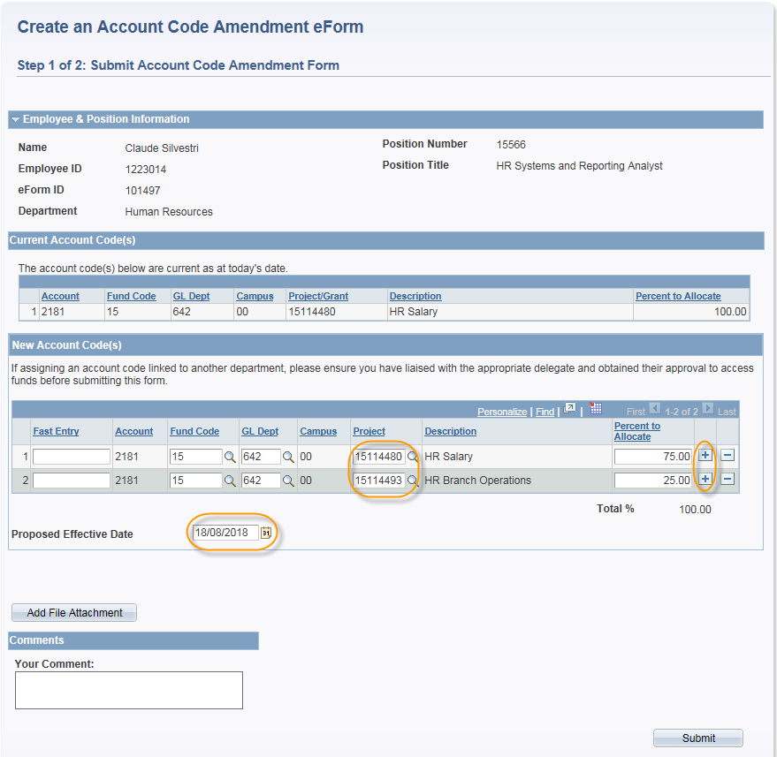
Demonstration

Slide 37
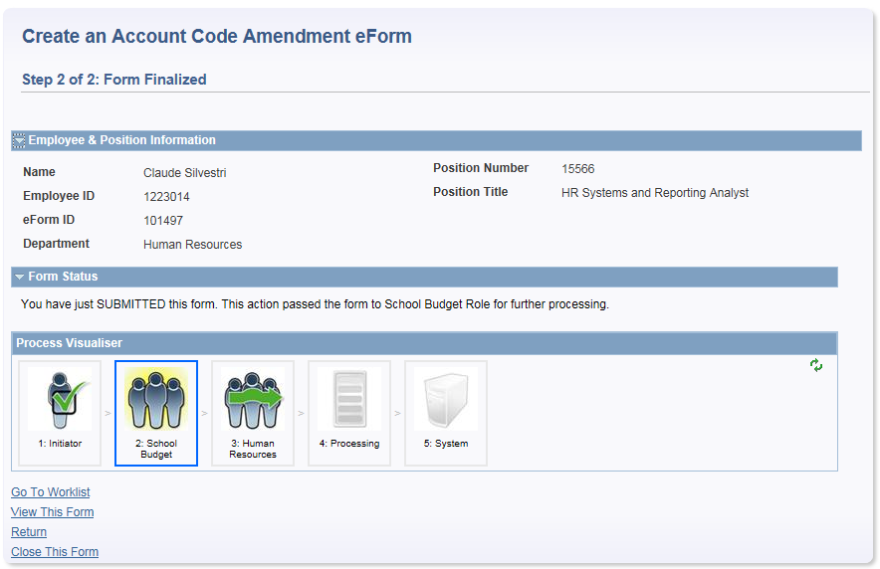
Demonstration
Notes:
School Budget workflow recipients maintained by positions within a User List

Slide 38
Demonstration
Notes:
School Budget administrator receives an email with a link to PeopleSoft delivered worklist

Slide 39
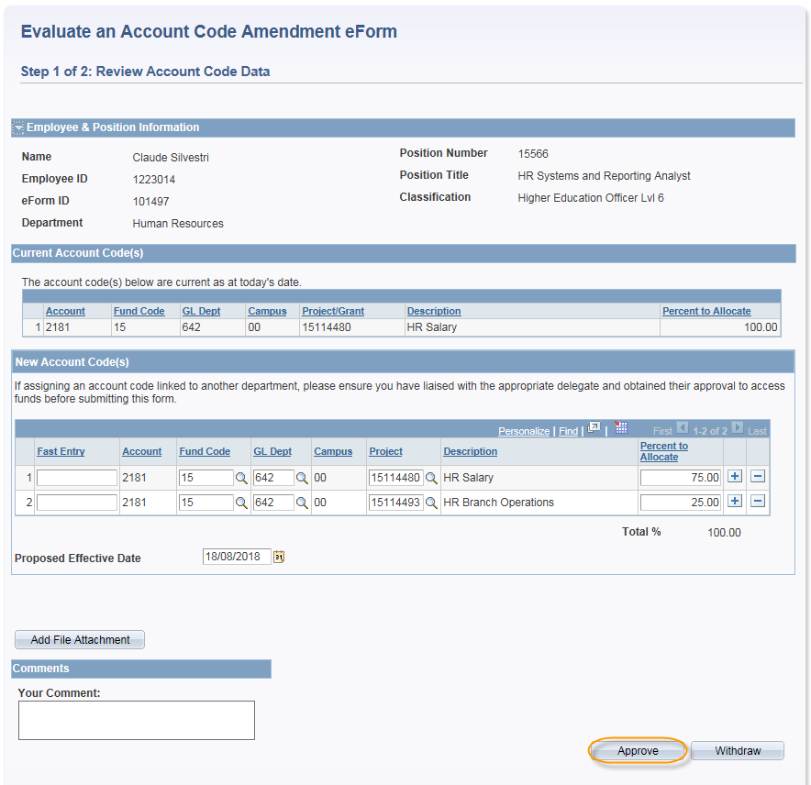
Demonstration
Notes:
Option to approve or withdraw

Slide 40
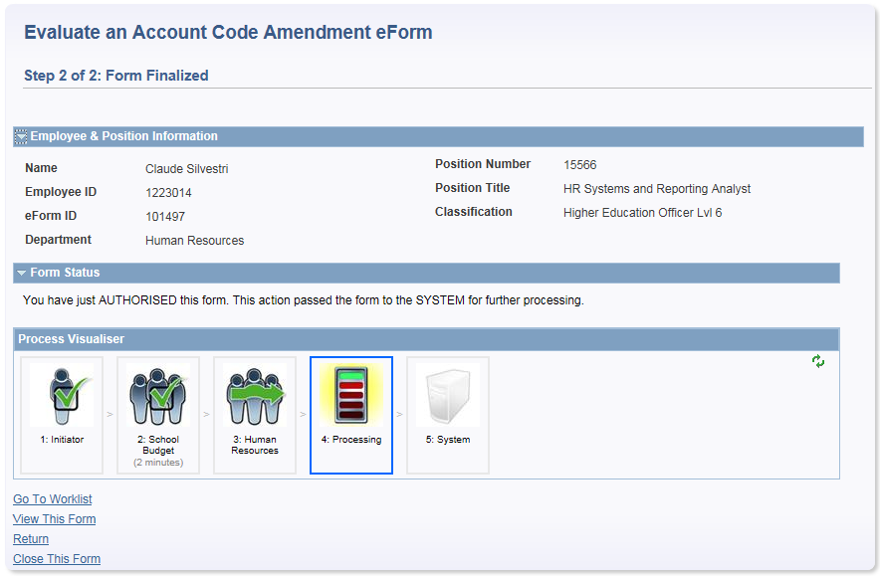
Demonstration
Notes:
Once approved integration into Job Data occurs unless the payroll pause is on (occurs whilst payroll is being finalised). Effective date logic always checks to see if the requested effective date is post the current open pay period start date

Slide 41
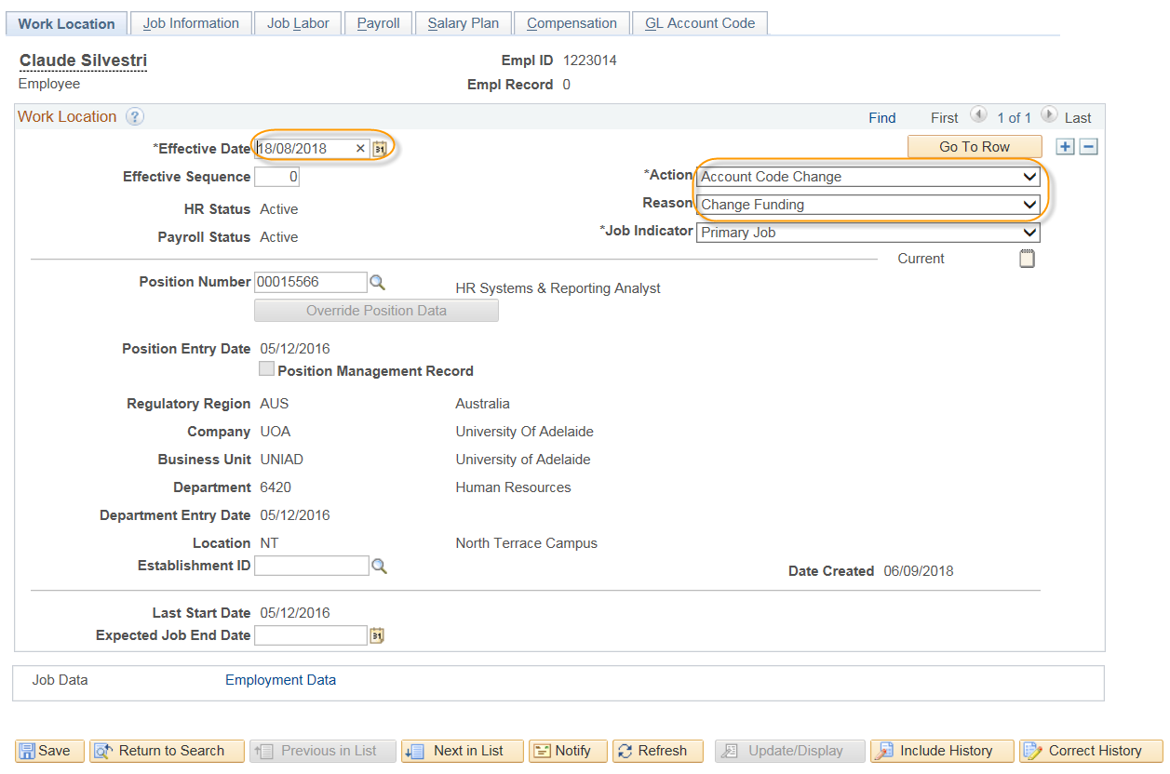
Demonstration

Slide 42
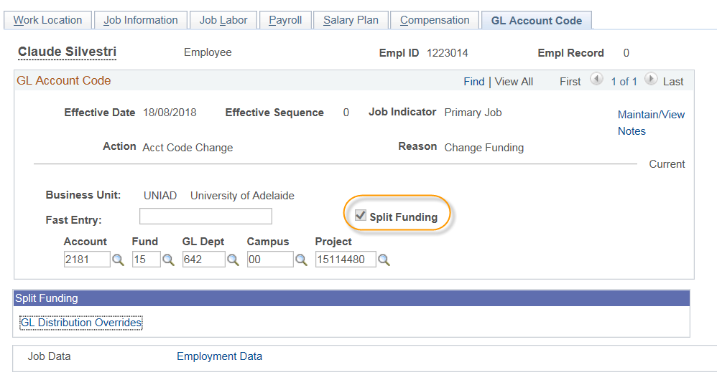
Demonstration

Slide 43
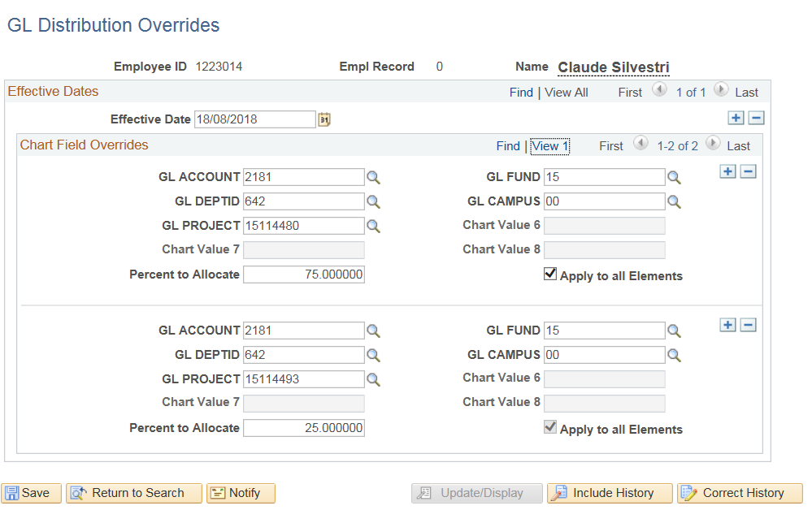
Demonstration

Slide 44
Questions?

Slide 45
Key Learnings
SHORT DESCRIPTION

Slide 46
Key Learnings
KISS (Keep it Simple Stupid!)
Bronze v’s Silver v’s Gold v’s Platinum
Support Staff re-levelling
Underestimation of project impacts on HR operational staff
Cost Benefit Analysis
Product / Business Owner level of involvement
Notes:
Trying to over complicate eForms impacting time, cost, usability
Analogy from Emma resinated with me last year – adjustment of customer expectation to perhaps be content with silver or gold
Relevelling of support staff required as additional functionality is added to the core HCM products and as new modules are turned on – from both a functional and technical perspective.
Cost Benefit Analysis – a comprehensive assessment of the true benefits for the additional costs

Slide 47
Questions?

Slide 48
presenters
Jane Smart-Foster
Interim Associate Director, HR Shared Services
University of Adelaide
jane.smart-foster@adelaide.edu.eu
all Alliance presentations will be available for download from the Conference Site

Slide 49
THANK YOU!

