Slide 1
Using Forms to Enhance Business Processes in the Office of the Registrar
SESSION 5056
November 6, 2017
Notes:
Ted

Slide 2
presenters
Ted Stebbins
Brenda McCue
Technical Systems Analyst Office of the Registrar
Sir Sandford Fleming College
ted.stebbins@flemingcollege.ca
Systems Analyst Information and Technology Services
Sir Sandford Fleming College
brenda.mccue@flemingcollege.ca
Heading into a fourth year of employment with the Office of the Registrar at Fleming College. Primary responsibilities of support for SR, Admissions, SF, and FA* modules. Previously employed at the University of Michigan and Accenture with PeopleSoft experience since 1997.
Work in ITS at Fleming College for 27 years. Was the Technical Team Lead for Fleming’s implementation of PeopleSoft in 2006. Responsible for security and liaison between departmental functional Business Analysts and IT Programmer Analyst staff for all areas of PeopleSoft (Student, HR and Financials).

Slide 3
Campus Locations: Peterborough, Lindsay, Cobourg, Haliburton
Fall 2017 Enrolment: 6,250

Slide 4
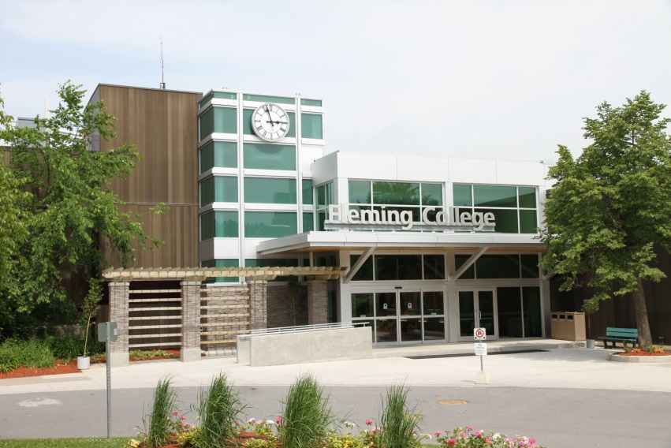
Cobourg
Peterborough, Ontario

Slide 5
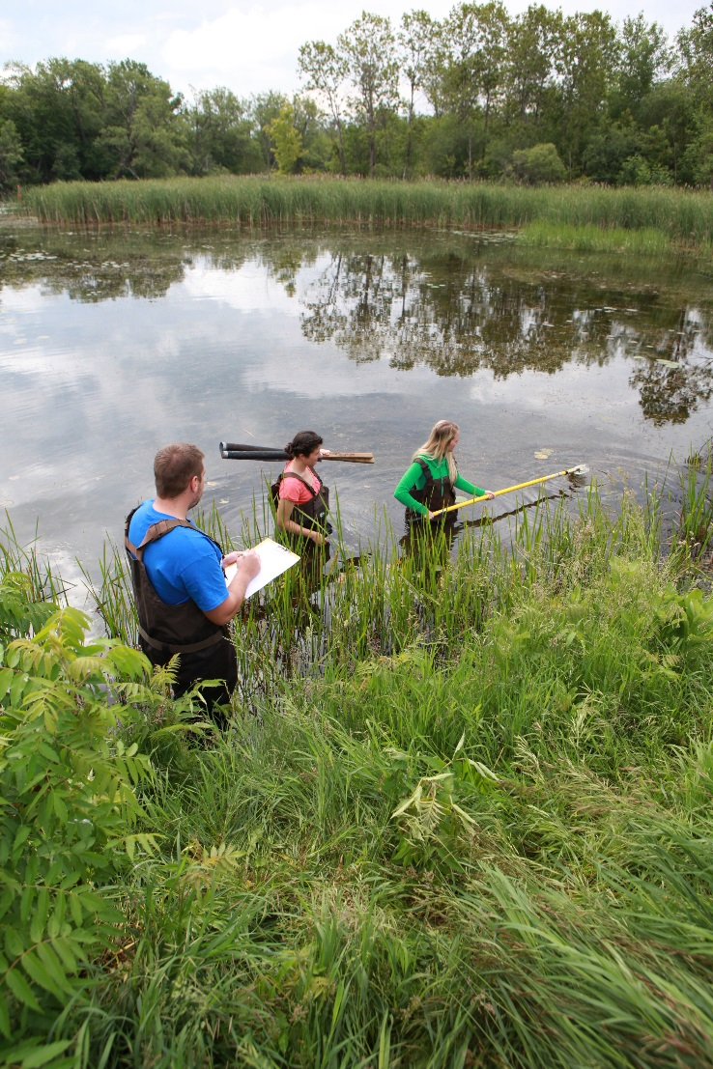
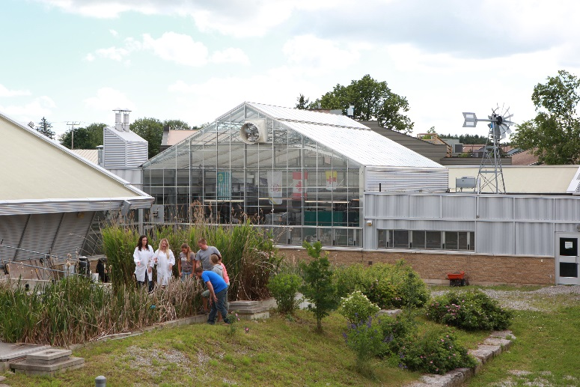
Lindsay, Ontario

Slide 6
Haliburton, Ontario

Slide 7
SIR SANDFORD FLEMING COLLEGE & ORACLE
Evolve - Oracle/PeopleSoft Established: 2006
Tools 8.55.10 – June 2017
CS 9.2 – June 2017
FIN 9.2 – June 2016
HC 9.2 – Oct 2016
Fluid – Researching 2018

Slide 8
Presentation Overview
Withdrawal Forms: A Brief History of Paper and People
Configuring the Approval Framework to Work with Forms Notification Template, SQL Object Identifiers, Form Approver User Lists
Designing the new Withdrawal Form Using the new CS Forms Design
Securing and Deploying Forms and Approvals Security Roles and Permission Lists, Migration/Configuration
Demo
Lessons Learned
Concluding Thoughts/Next Steps
Attendee Questions

Slide 9
Withdrawal Forms
A Brief History of Paper and People

Slide 10
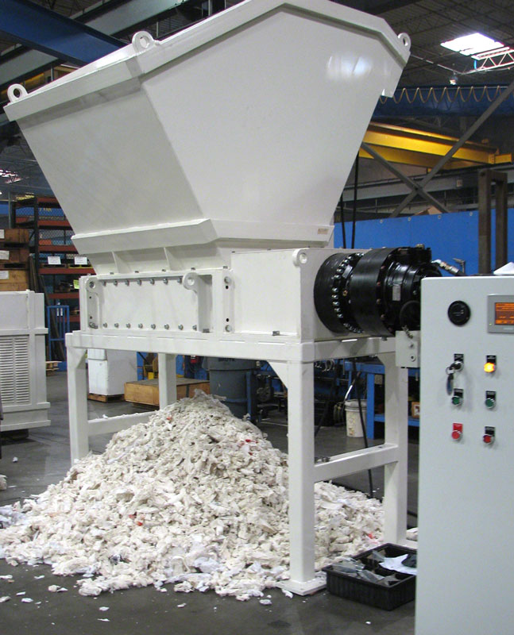
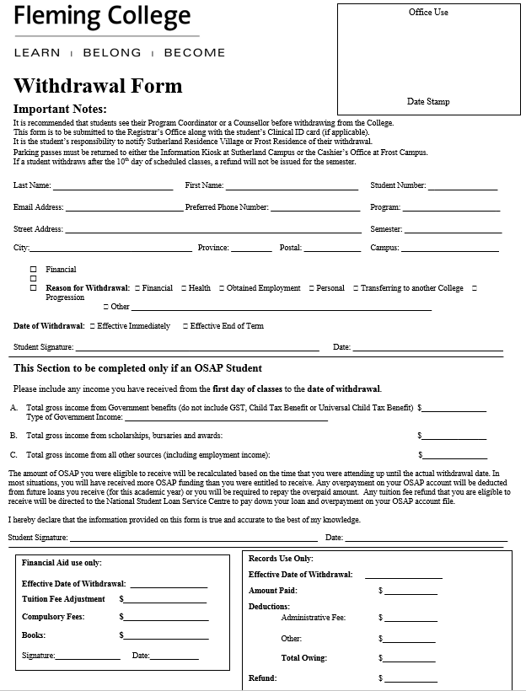
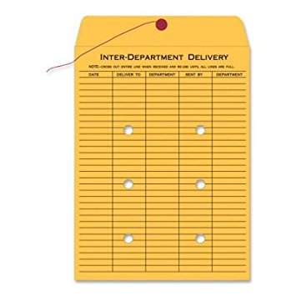
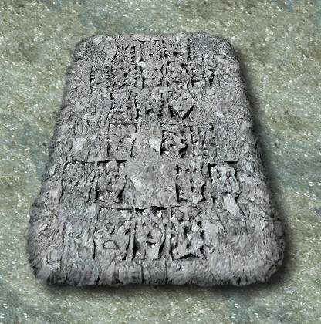
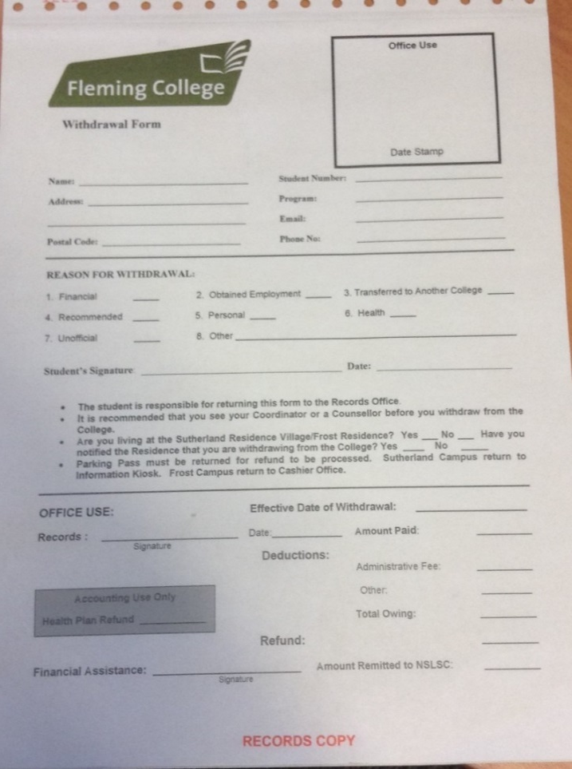
Withdrawal Forms – Paper-BASED model

Slide 11
Configuring the Approval Framework
Approval Framework, Notifications, Transactions, User Lists

Slide 12
Configuring the Approval Framework
Events and Notifications Overview
Verify Transaction Registry
Configure Transactions
Create Form Approver User List

Slide 13
Configuring the Approval Framework (Events & NOTIFICATIONS Overview)
Route for Approval
Approve, Denial, or Request Information

Slide 14
URL Maintenance
PeopleTools > Utilities > Administration > URLs

Slide 15
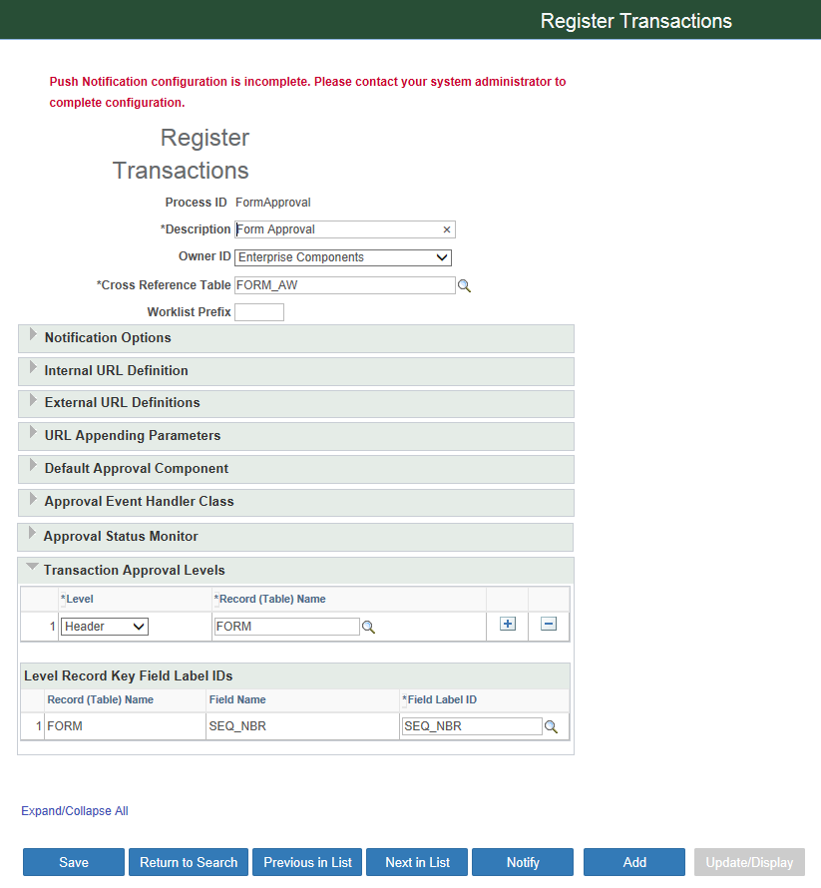
Configuring the Approval Framework (Verify Transaction Key Fields) Navigation: Enterprise Components > Approvals > Approvals> Transaction Registry

Slide 16
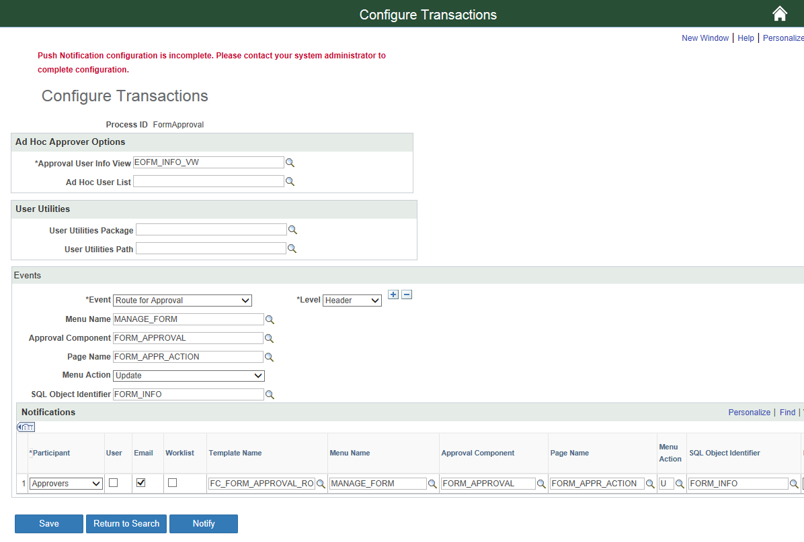
Configuring Form Approvers (Transaction configuration) Navigation: Enterprise Components > Approvals > Approvals > Transaction Configuration
Note: SMTP must be setup at the server level for emails to work at your institution
FC_FORM_APPROVAL_ROUTING (FC prefix represents custom template object for Fleming College)

Slide 17
Configuring the Approval Framework (Generic Template configuration) Navigation: People Tools > Workflow > Notifications > Generic Templates

Slide 18
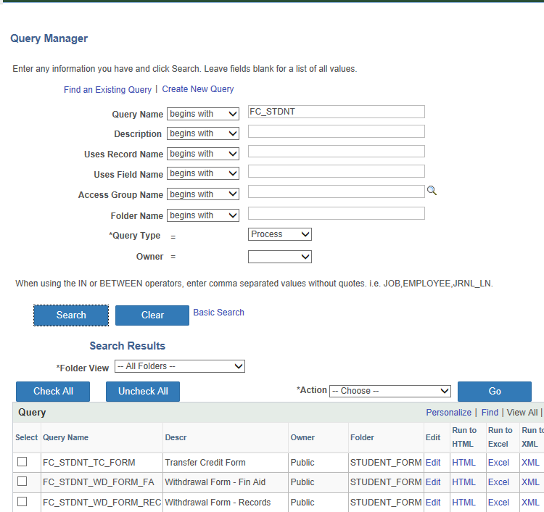
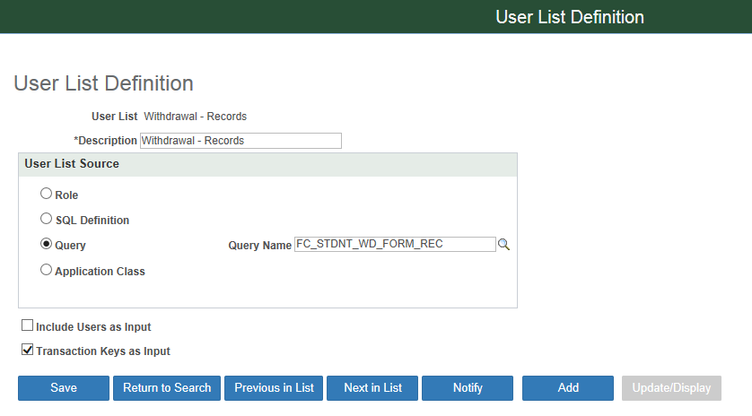
Configuring the Approval Framework (User list) Navigation: Enterprise Components > Approvals > user list

Slide 19
Designing the new Withdrawal Form
Using the new CS Forms Design

Slide 20
design the form (overview)
Layout
Form Fields
Establishing Prompt Records
Layout Section Space
Attachments
Publishing Forms and Establishing Approval Process
Registration of Record and Component

Slide 21
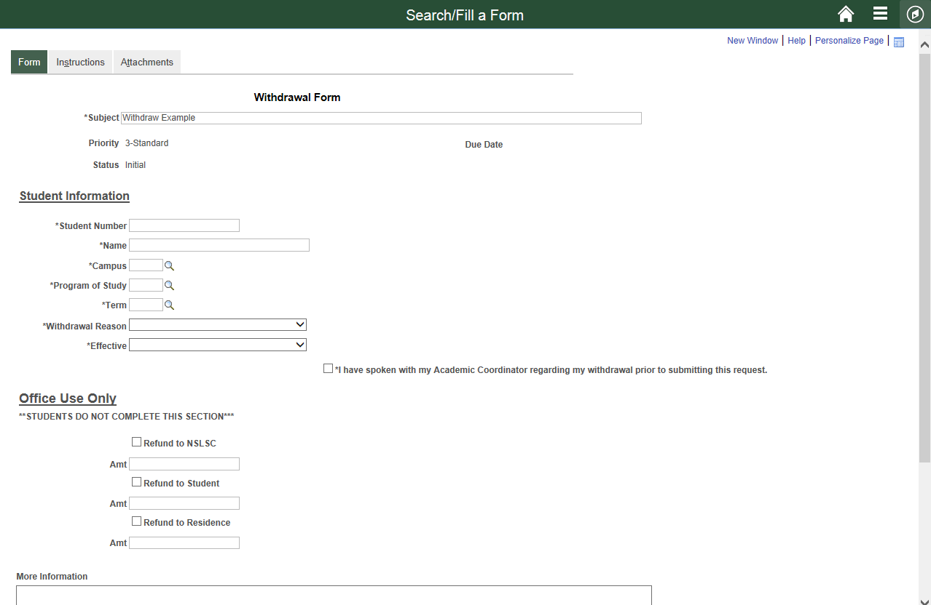
design the form (Layout Objective)

Slide 22
design the form (General Content)

Slide 23
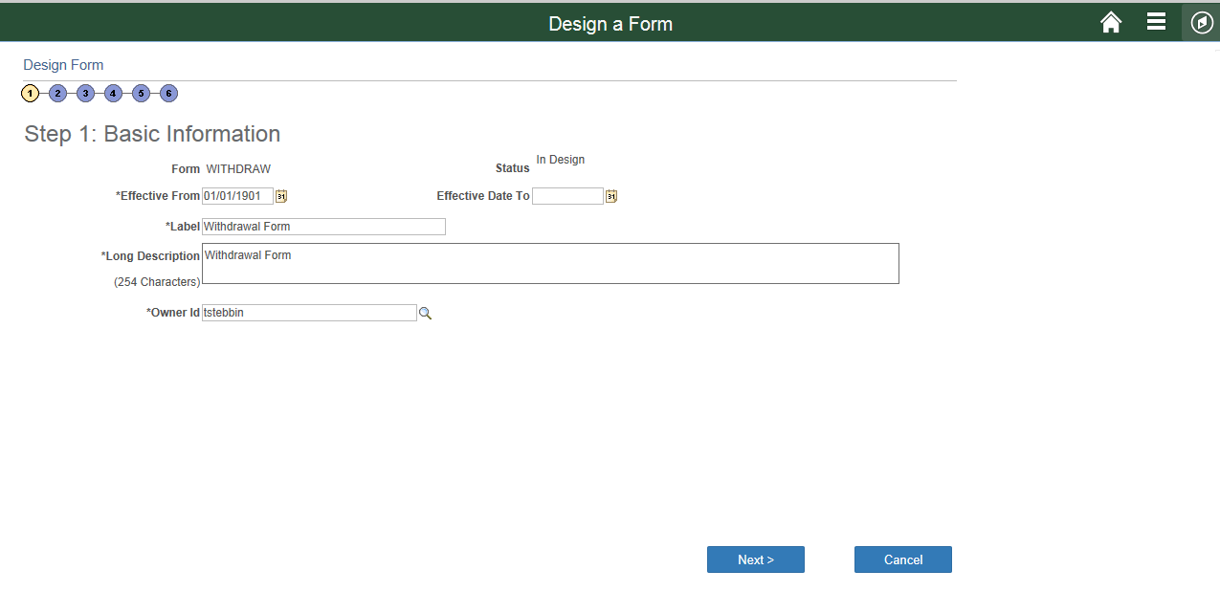
design the form (Basic information – label definition) Navigation: Enterprise Components > Forms > Design A Form

Slide 24
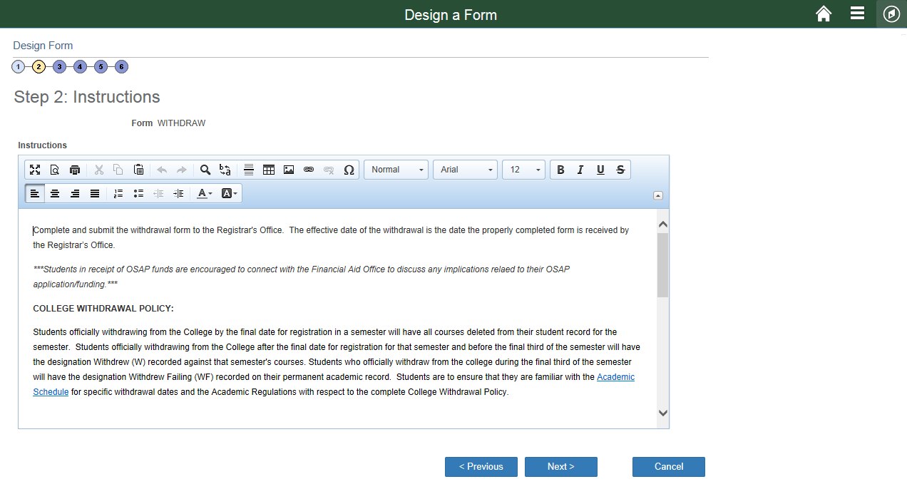
design the form (form Instructions) Navigation: Enterprise Components > Forms > Design A Form

Slide 25
design the form (layout Basics) Navigation: Enterprise Components > Forms > Design A Form
Default fields on all forms:
Subject (required field)
Priority
Due Date
Status
LEFT
RIGHT
TWO COLUMN LAYOUT

Slide 26
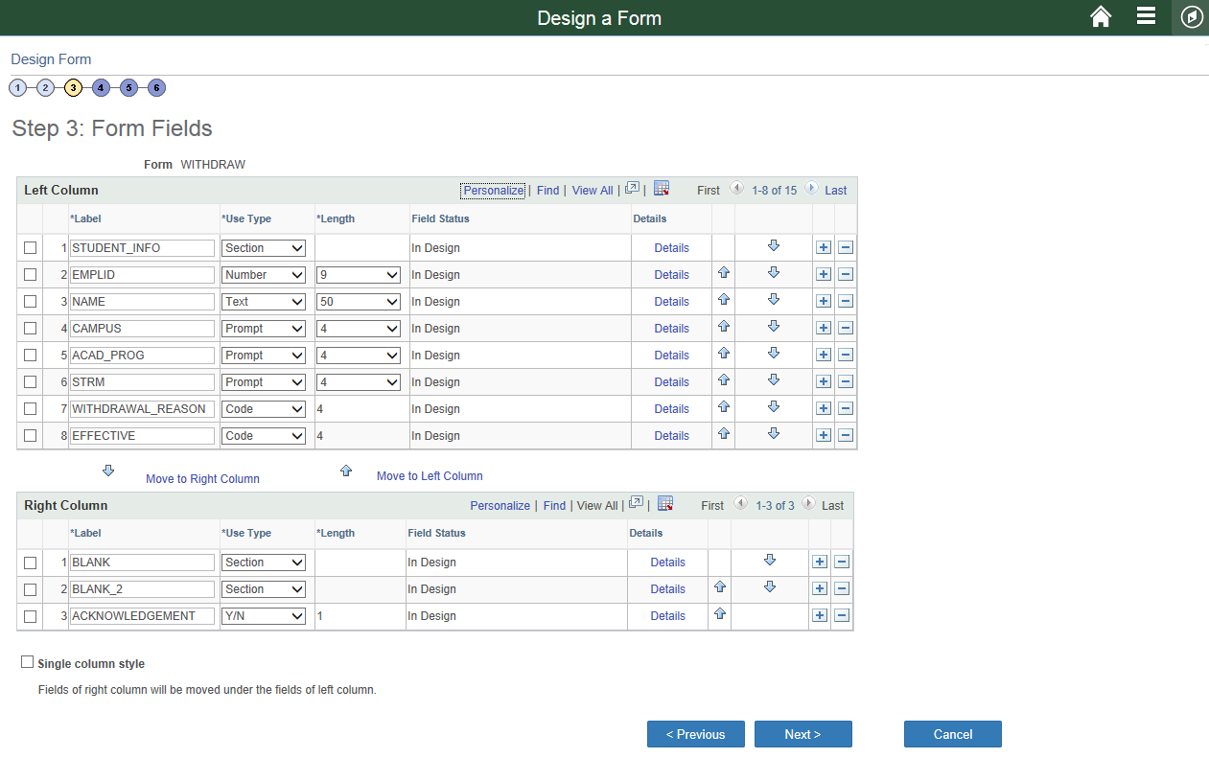
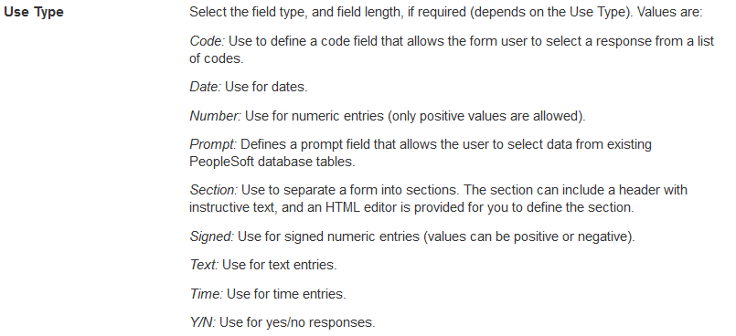
design the form (Creating FORM FIELDS) Navigation: Enterprise Components > Forms > Design A Form

Slide 27
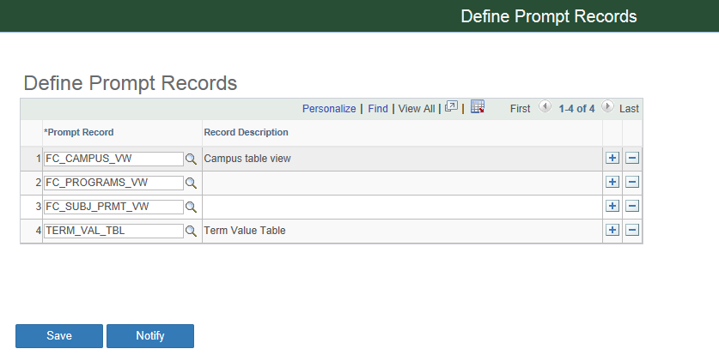
design the form (Establish Prompt Record) Navigation: Enterprise Components > Forms > Define prompt records

Slide 28
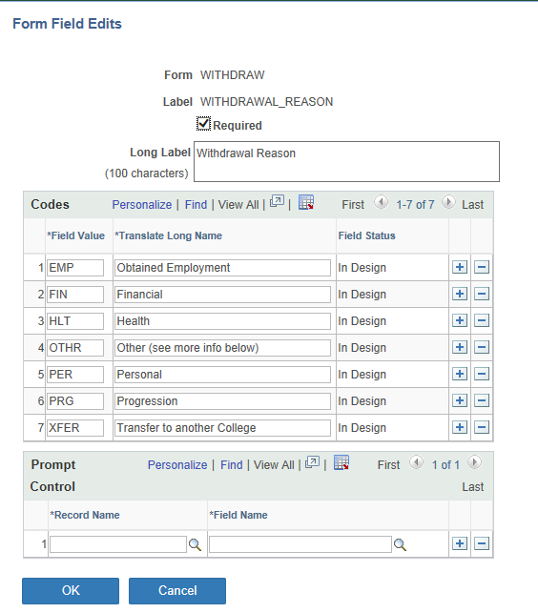
design the form (Creating form fields) Navigation: Enterprise Components > Forms > Design A Form

Slide 29
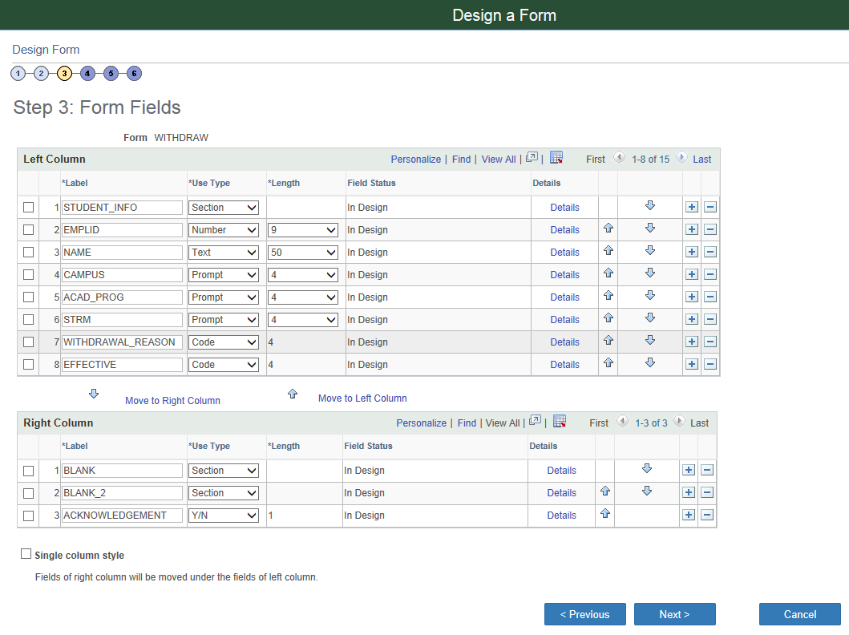
design the form (creating section space) Navigation: Enterprise Components > Forms > Design A Form

Slide 30
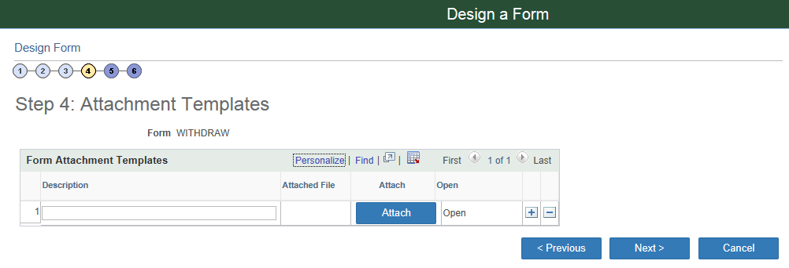
design the form (Attachment templates) Navigation: Enterprise Components > Forms > Design A Form

Slide 31
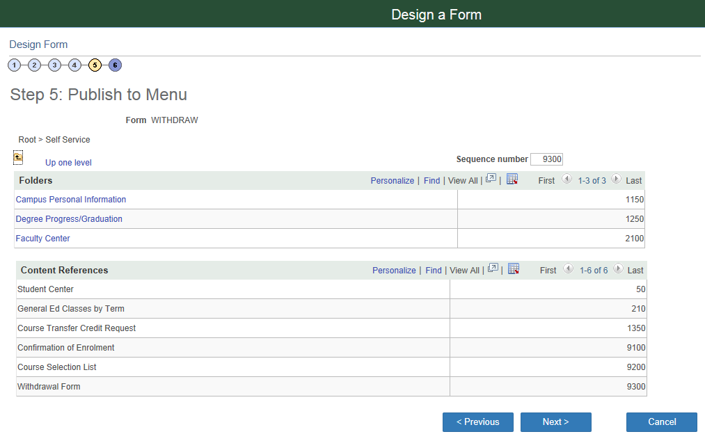
design the form (publish to menu designation) Navigation: Enterprise Components > Forms > Design A Form

Slide 32
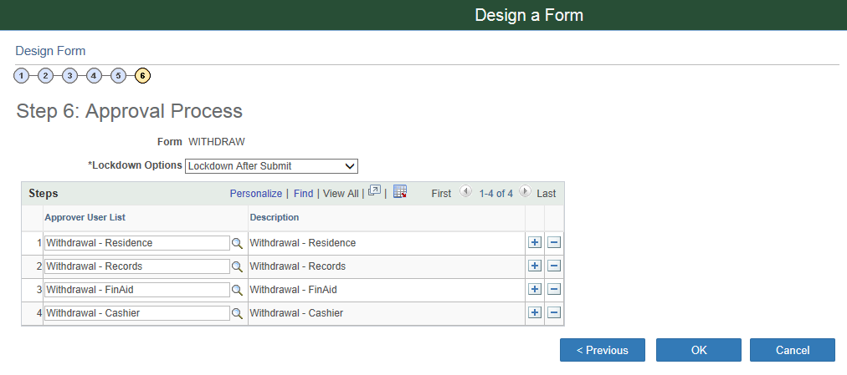
design the form (Approval process) Navigation: Enterprise Components > Forms > Design A Form
Lockdown Options
Do Not Lockdown
Lockdown After Approval
Lockdown After Submit

Slide 33
design the form (PUBLISH the form) Navigation: Enterprise Components > Forms > Design A Form

Slide 34
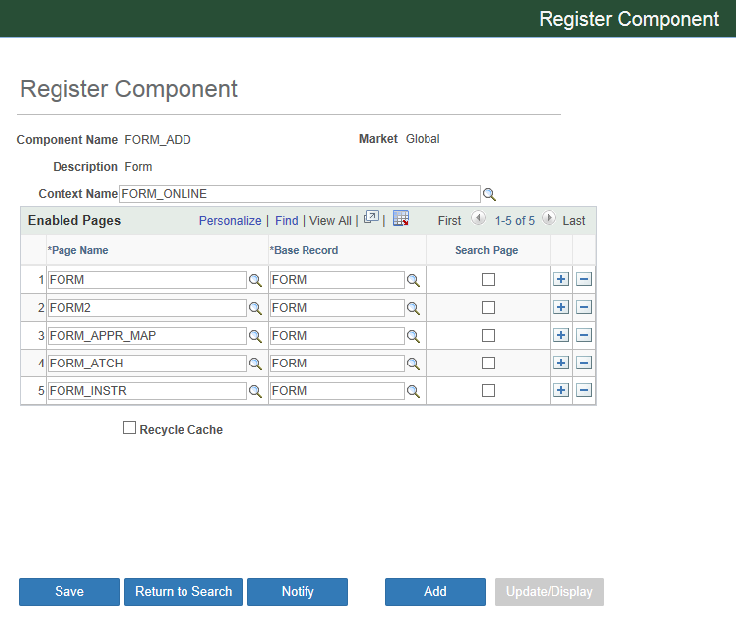
design the form (Register Component) Navigation: Enterprise Components > supplemental data > register component
FORM_ADD
Enables all pages associated with the FORM_ADD component to be accessible

Slide 35
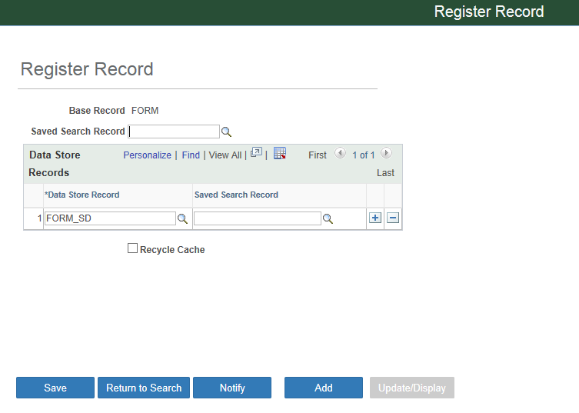
design the form (Register record) Navigation: Enterprise Components > supplemental data > register record
Data Store Record (FORM_SD - Form Supplemental Data)
Registers record for data to be written to from the Form

Slide 36
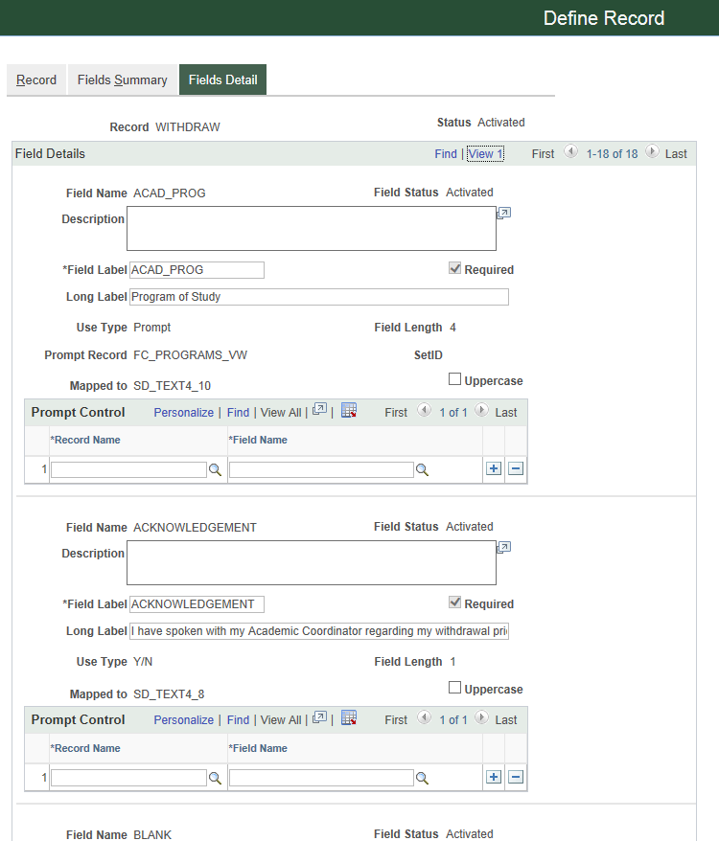
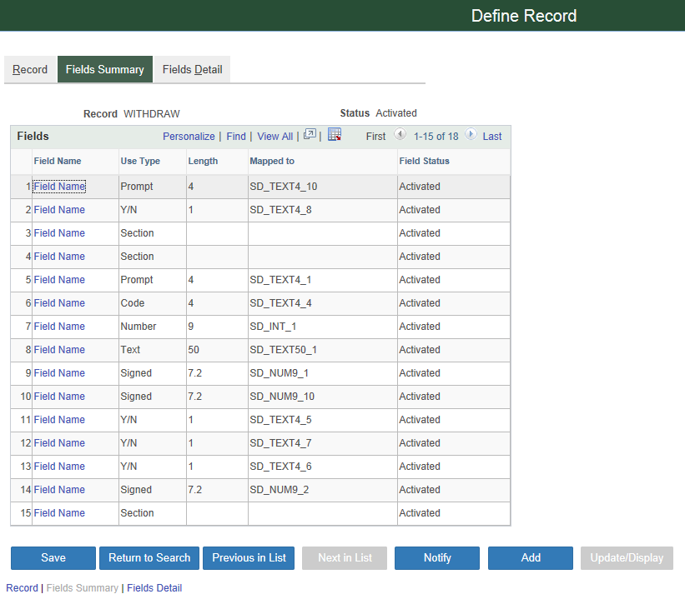
design the form (define record) Navigation: Enterprise Components > supplemental data > DEFINE record
Fields on FORM_SD

Slide 37
Securing and Deploying Forms and Approvals
Security

Slide 38
Security
Roles – we cloned from FORM_USER, FORM_ADMIN and FORM_DESIGNER
Access to form – nightly SQL to grant access to current students
Structure and Content - setup
Query Trees – added tables to FC_ trees for query access

Slide 39
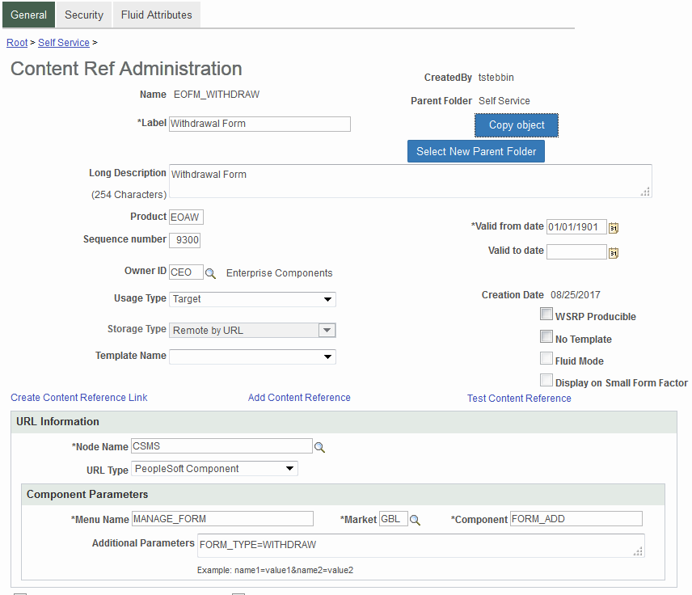
Structure and Content design the Review and secure the structure and content item created as part of the design stage of the form. (publish to menu designation as show above)

Slide 40
Roles Delivered
FORM_USER: Users with this access have the ability to complete and submit forms.
FORM_DESIGNER: Same access as FORM_USER but also has access to the Form Design Wizard. Form designers has update/display access to their forms only.
FORM_ADMIN: Same access as FORM_DESIGNER but can access ALL forms regardless of ownership.

Slide 41
Nightly jobs
At Fleming we remove and auto assign many roles to users via nightly SQL jobs that run automatically. We use this to assign certain students to certain forms (again this secures the menu option but in each option they can see ALL forms) Snippet below..
procedure PSROLEUSER_FORM_TRANS_CRED as begin
delete from role_users_tbl z;
insert into role_users_tbl z (SELECT distinct (H.OPRID) FROM csprd.PS_ACAD_PROG@csprd A, … / Refresh hcprd. /
delete from csprd.psroleuser@csprd x where x.rolename = 'FC_FORM_TRANS_CRED'; insert into csprd.PSROLEUSER@csprd(ROLEUSER, ROLENAME, DYNAMIC_SW) select oprid, 'FC_FORM_TRANS_CRED', 'N' from role_users_tbl z;

Slide 42
Query Trees
The following are the records we added to our custom trees:
FORM
FORM_TYPE
FORM_APPR_VW
FORM_LINE
FORM_SD
FORM_AW
FORM_DTL
FORM_DATA
FORM_TBL

Slide 43
Forms demo

Slide 44
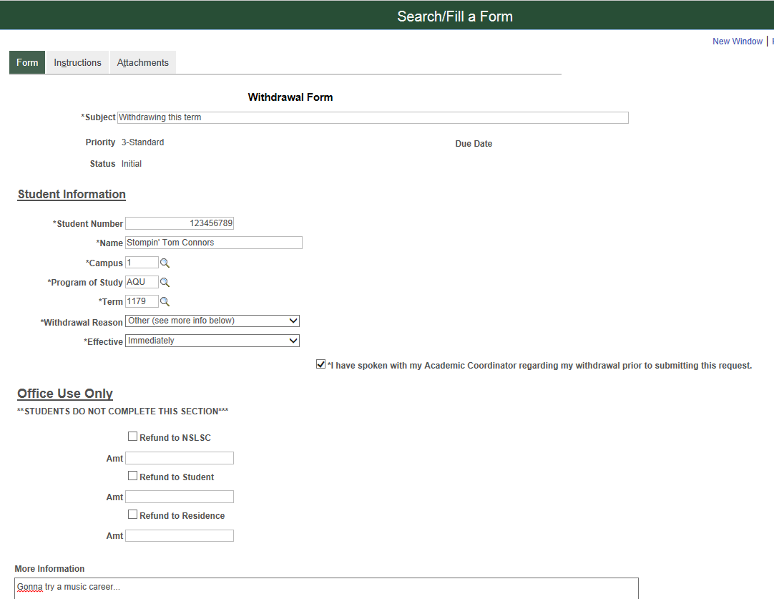
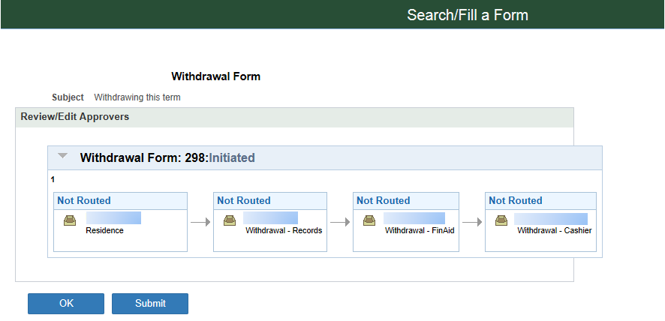
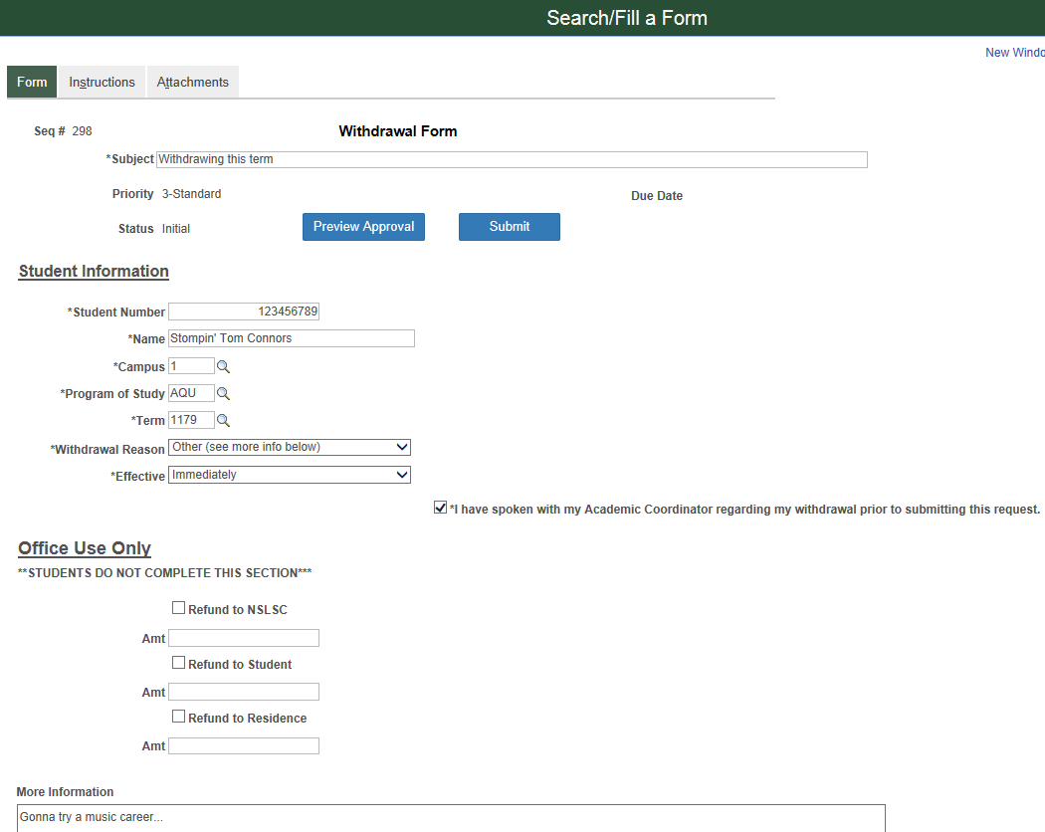
Filling out a form as a user

Slide 45
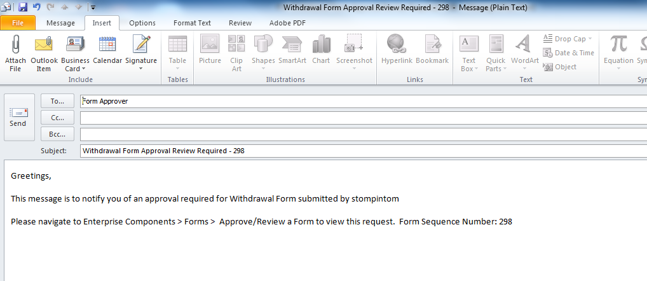
Approver Notification email example

Slide 46
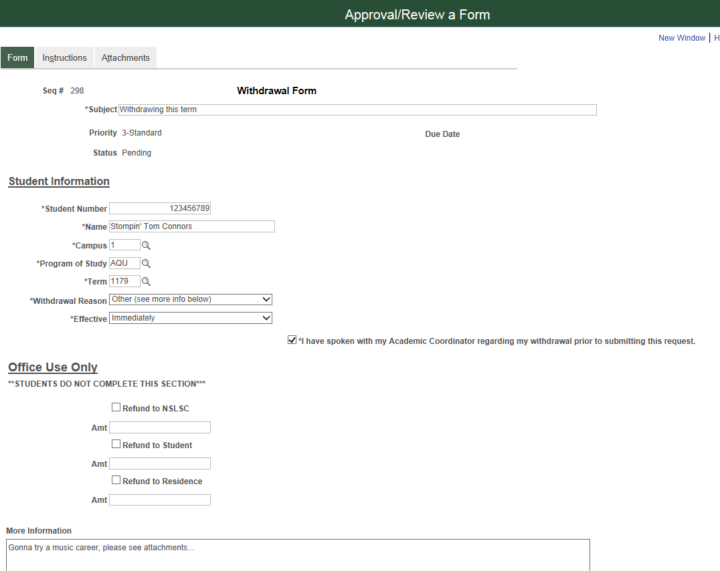
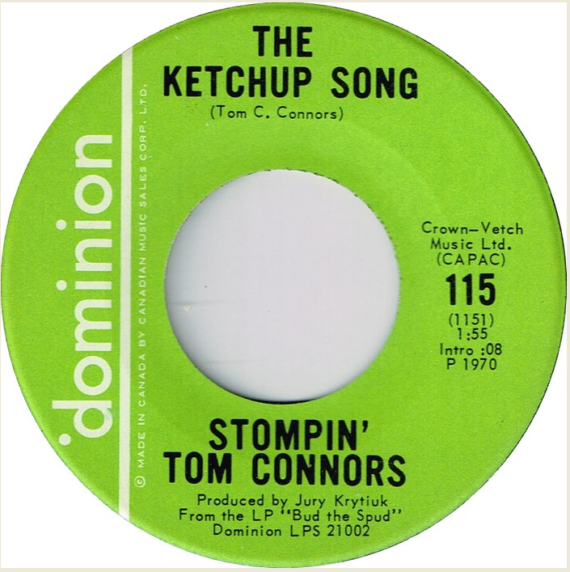
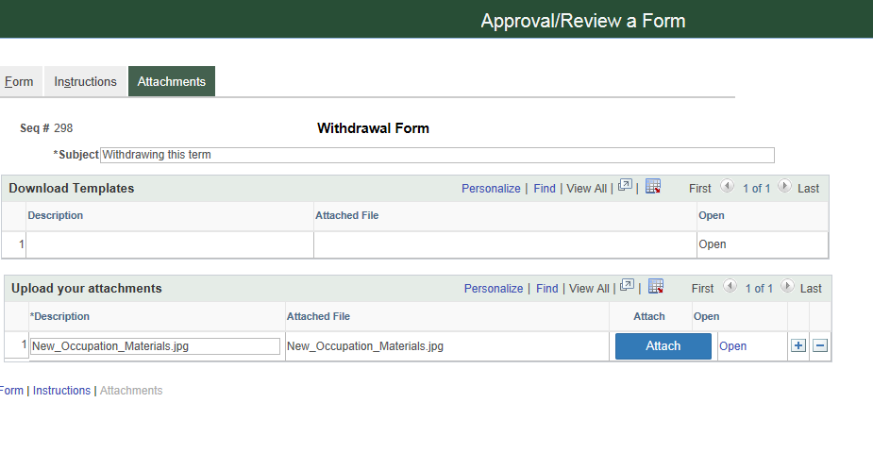
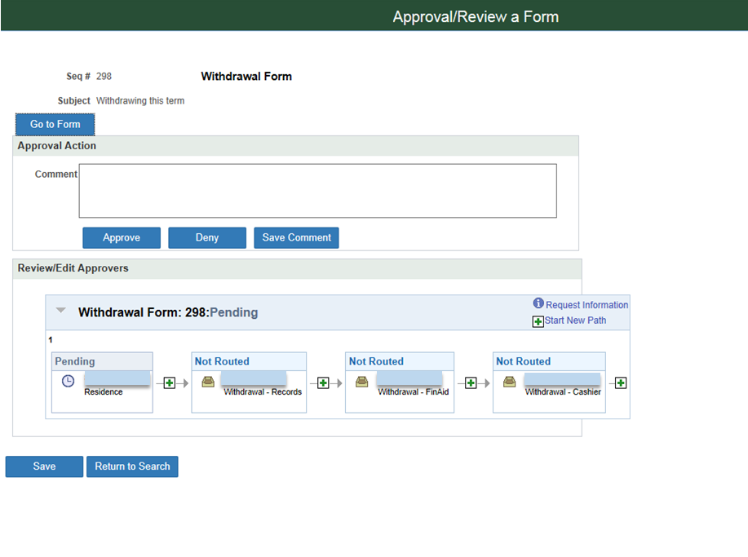
Form Approver view Enterprise Components > Forms > Approve/Review a Form

Slide 47
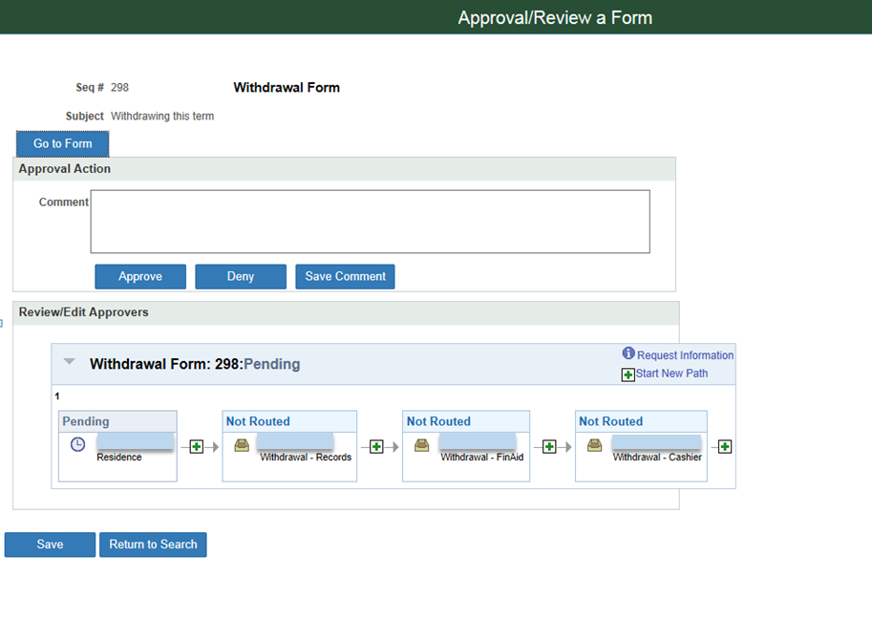
Form Approver view Enterprise Components > Forms > Approve/Review a Form

Slide 48
FORM Approval Notification email example

Slide 49
Lessons Learned
Generic Template vs Component Template, Bugs, URL Maintenance

Slide 50
BUG “The Component FORM_ADD has not been registered to enable supplemental data” error and fix…
Doc ID 1554871.1 – Check to see if the row is missing in your environment.
SELECT BASE_RECNAME , RECNAME , RECNAME_SAVED_SRCH FROM PS_FS_SD_STORE
Access the "FORM" registration by Unhide the SUPPLEMENTAL DATA subfolder located in Enterprise Component Folder from portal navigation.
Then Register the "FORM“ record and Register the "FORM" Component.
OR
Insert row in Record PS_FS_SD_STORE
Below Values
Base_Recname: Form Recname: FORM_SD
Navigation: Enterprise Components > Supplemental Data > Register Component

Slide 51
You can control by permission list who has access to the structure and content created BUT they can still search and fill out all forms. Oracle SR 3-15972033541
Although we run nightly jobs to assign certain permission lists to the menu items (structure and content) for each new form the student can see ALL forms if they do a search. This is okay when you have a few forms all for students but once you have many and student and staff forms in there it could get confusing. Users could fill out forms they shouldn’t.

Slide 52
Unable to use "Save Comments" button on Approval/Review a Form page – SR 3-15965640011
Users are unable to use the "Save Comments" button on the Approval/Review a Form page in CS9.2. Page FORM_APPR_ACTION Component FORM_APPROVAL Menu MANAGE_FORM If the user enters a comment and presses the approve or deny button the comment does save, however if the "Save Comment" is pressed nothing happens.

Slide 53
We need to investigate modifying SQL Objects in Application Designer to put more unique variables into our communication.
Doc ID 1207703.1 - With Approval Framework, AWE, the Generic Template variables are populated using the SQL Object Identifier SQL Definition configured on the Transaction Configuration page, for specific Event that notification is sent for. All of the fields needed for Generic Template variables, must be included in the SQL Definition's SELECT statement, which will pull those values into the Component Buffer, so the Template Variables can resolve to the respective values. For AWE this is how the variable values are passed to the Generic Templates. Please implement the following instruction steps 1. Navigate to Enterprise Components, Approvals, Approvals, Transaction Configuration, open configuration for specific Transaction. 2. Locate the specific Event that the Generic template is configured for, such as Route for Approval. 3. Note the name of the SQL Object Identifier. 4. Run Application Designer, open SQL Definition by that name. 5. Insure that all the Variable fields used in Generic Template are present as Selected fields in the SELECT statement. 6. Retest the behavior in that environment. 7. Migrate the solution as appropriate to other environments.

Slide 54
Concluding thoughts/Next Steps
Transfer Credit Form
Questions?

Slide 55
SUMMARY
Withdrawal Form Available to Fleming College Students: December 2017*

Slide 56
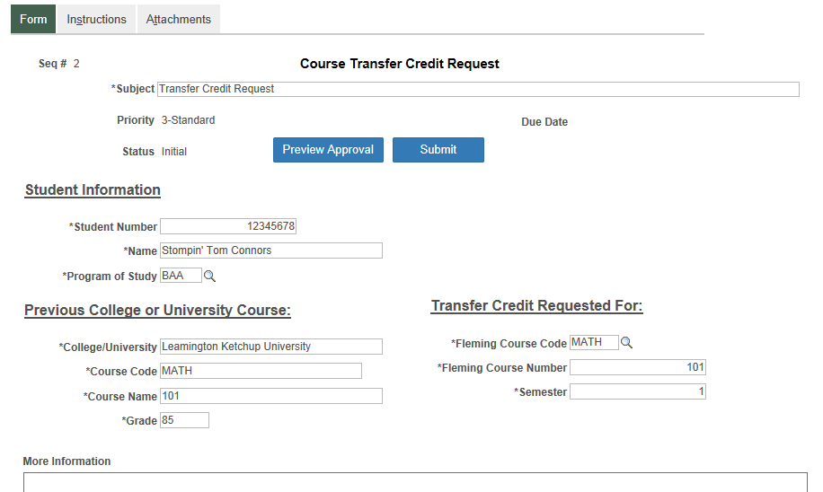
Course Transfer Request Form
Introduced in August 2017
327 of 545 (60%) course to course transfer credit requests submitted by students in the Fall 2017 term were via the new Form
All students will be required to submit course transfer requests for the Winter 2018 term using the new Form

Slide 57
Forms and approval
Looking ahead….
Fluid User Interface Research
Form to Component Interface Mapping
Internal Program Transfer Forms
Academic Probation Form
Staff-Based Forms (assuming resolution of Form security)
Refund processing
SQL Object Expansion for Form Approval Emails

Slide 58
presenters
Ted Stebbins
Brenda McCue
Technical Systems Analyst Office of the Registrar
Sir Sandford Fleming College
ted.stebbins@flemingcollege.ca
Systems Analyst Information and Technology Services
Sir Sandford Fleming College
brenda.mccue@flemingcollege.ca
all Alliance presentations will be available for download from the Conference Site

