Slide 1
PeopleSoft Single Sign On moving from CAS to ADFS/SAML at the University of Calgary
SESSION 6040
November 14, 2018

Slide 2
presenters
Simon Dyck
Simon Chiu
Architect, HR, ELM, Portal
University of Calgary
dycks@ucalgary.ca
Senior Systems Analyst
University of Calgary
simon.chiu@ucalgary.ca
This Simon has been at the University of Calgary since 2005, as the lead developer for HCM, ELM, Security and Portal. He started working with PeopleSoft applications in 1997, which isn’t as long ago as it sounds.
A new team member with the University of Calgary as of April 2018. PeopleSoft experience with the Interaction Hub, IB, Branding & PeopleSoft Security.

Slide 3
The University of Calgary
26,200 Undergrad Students
6,100 Grad Students
5,300 Staff
Recognized as one of Canada's Best Diversity Employers
333 Sunny Days - Most in Canada!
Notes:
The University of Calgary is a global intellectual hub located in Canada’s most enterprising city. In our
spirited
, high
-
quality learning environment, students thrive in
programs made rich by research, hands
-
on experiences and
entrepreneurial thinking. Our strategy drives us to be recognized as one of Canada’s top five research universities,
engaging the communities we both serve and lead. This strategy is called
Eyes High
, inspired by the university's Gaelic
motto, which translates
as
'I will lift up my eyes.' For more information, visit
ucalgary.ca/eyeshigh

Slide 4
U of C & ORACLE
FSCM 9.2 PI 26
HCM 9.2 PI 26
ELM 9.2 PI 17
CS 9.2 PI 8??
IH 9.1 PI 3 + IntraSee
All on Tools 8.55
Oracle 12c database
AIX 7.1
8.56 Due in Nov ‘19
w/ New Linux Infrastructure
We’re becoming old timers – original go-lives began in 2004. We’re now live with Student Admin, Finance, HCM, ELM and Integration Hub.

Slide 5
U of C and Single Sign on
Background - Where we began
Evolving Identity Landscape - Why we need to change
Adding SAML/ADFS to the mix - How we changed it
Testing and Go-Live - How we tested it
Demo! – We hope this works
Notes:
The University of Calgary has to date managed authentication and single sign on via an integration with a local implementation of Central Authentication Service. As that implementation nears its end of life, and, this presentation will review the work done to add SAML/ADFS integration to the mix, including accommodations for multifactor authentication.
Since the University of Calgary’s original PeopleSoft implementation, the bulk of user authentication has been handled via a local version of Central Authentication Service (CAS). The CAS sign on page has allowed users, from a single location, to authenticate by their IT account, their “eID” ( a light weight applicant account), or using their RSA SecurID token. A brief review of this implementation will kick off the presentation. The University of Calgary continues to add web based services for Staff and Students, such as Office 365. At the same time, the CAS service nears its end of life, pushing the need to implement a parallel option for SAML/ADFS based authentication. This presentation will review • The original design for the CAS authentication • How two-factor/multi-factor has been used for PeopleSoft systems at the University of Calgary • How the above two points influence the design for adding SAML/ADFS authentication • The high-level design and configuration for SAML integration • Custom configuration and development added to the PeopleSoft systems • Considerations for single sign out • Testing plans and other validations • Go-live considerations, and hopefully by then, a live demo

Slide 6
Background
Original Landscape

Slide 7
Our Original identity landscape
At go-live, CAS Logins are the only official PIA login
CAS federates LDAP, Active Directory, and RSA SecurID
Custom attributes– Employee ID and Strength
LDAP – “EID”s
Not everyone has IT accounts
LDAP EIDs allow an id & password to be assigned to a student/employee ID without creating other system accounts
RSA SecurID Tokens control back-office services
RSA signons have a different Strength than a normal login

Slide 8
CAS: Central Authentication Service
Open-source Single Sign On protocol - JASIG
3 parties in the sign-on
Client web-browser
Web application
CAS Server
Key features:
Application re-directs Client to Server
Server validates identity, and issues a ticket to the Client.
Client presents ticket to Application, validates via secure back-channel

Slide 9
Step up/down REQUIREMENTS
“Default” roles, e.g. Employee Self Service, are always available
Other roles require a 2-factor token at sign-on
Based on the Strength reported from CAS, the sign-on code adds or removes roles as necessary
Requires a custom table to store all the ‘potential’ roles, and whether or not they require 2-factor

Slide 10
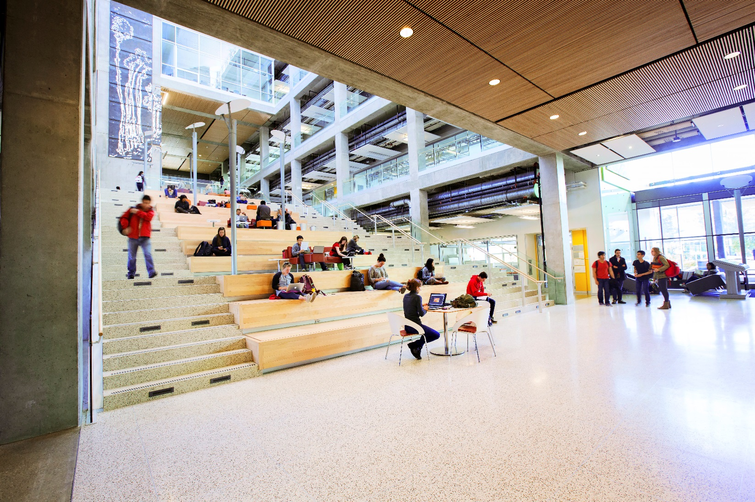
Evolving Identity Landscape
Why it needs to change
Notes:
How the above two points influence the design for adding SAML/ADFS authentication

Slide 11
What’s changing?
CAS installation is aging
“Everyone” has Office 365
And Active Directory Accounts!
Institution moving away from CAS towards new standards
SAML Standards are mature(ing)
ADFS - Vendor Supported IdP with built in MFA
Cost benefit over RSA?

Slide 12
Benefits over CAS
Stock solution backed by Microsoft premiere support
Authentication against our modern UC domain
Possibly others down the road
Azure MFA, token-based authentication with campus-wide license
Resilient application and proxy farm
Future plans to extend to cloud compute resources
3+ years of production use for Office 365
Drawback – until we’re “done”, we have two single-sign-on platforms

Slide 13
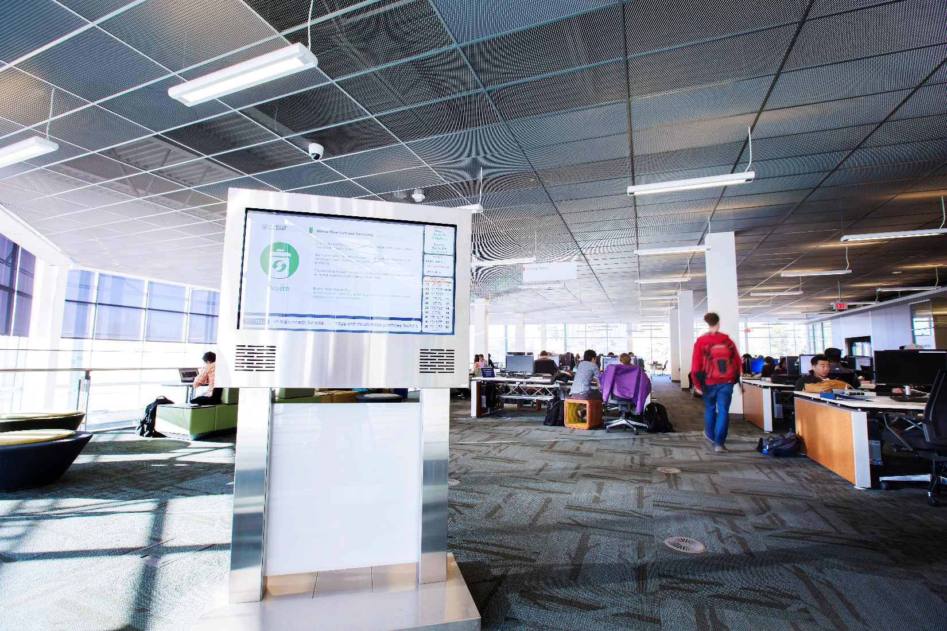
Adding SAML/ADFS

Slide 14
ADFS / SAML signon – high Level
Still 3 parties
Client Browser requests access to a Service Provider
PeopleSoft is a service provider, which (if necessary) re-directs to the Identity Provider
ADFS is our identity provider
The IdP gives the browser a XML assertion, a SAMLResponse
No backchannel – stay tuned
2-Factor
For SAML purposes, we need to define a second end point, basically a second service
2-factor protection is “per Service”
UC Domain
Azure MFA
ADFS
User agent (browser)
Service Providers
D2L
Service Now
PeopleSoft
Office 365

Slide 15
SAML Assertion features
Basic features
Issuer and Signature – verifies the integrity of the document
No backchannel –check the signature against known, trusted certificate
Subject – “name” of the user the IdP authenticated
Conditions – e.g. time restraints
UofC Additional decisions
Yes - Encrypted SAMLAssertion – avoid, slow down attackers from manipulating the XML
Maybe – XSD Validation – avoid XML manipulation attacks
No – graceful certificate rollover

Slide 16
PS Customization
Add a java call from signon on PeopleCode
Validate XML response
Verify the signature with the ADFS public key
Confirm it’s for our service
Check the constraints
Extract the user / employee ID
If the SAMLResponse is valid, the user is signed on, from here it’s just like current state

Slide 17
SAML, MFA and step up/down
ADFS defines each Service Provider
Binary - SP requires MFA or not.
How to satisfy our step up requirements?
Two Service Providers for PS
Long term plans for this still a work in progress
Two actual PS sites?
Re-login?

Slide 18
Custom configuration and development

Slide 19
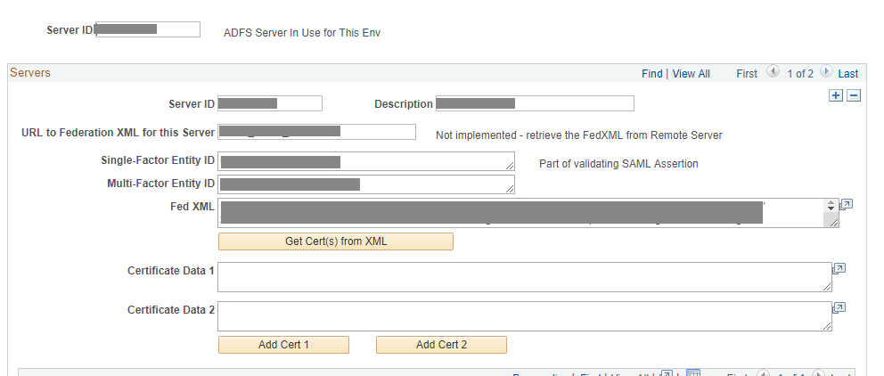
high-level design and configuration for SAML
Configuration Pages designed
Public Key
Service Name
Encryption
Logging
JavaScript – signin.js
Redirect and URL stuff
Custom PeopleCode
Handle different modes
2 ADFS runs – SFA, MFA

Slide 20
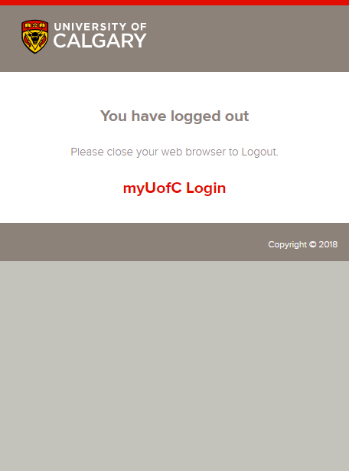
Single Log out?
Being authenticated via an external Identity Provider introduces some unique problems:
PeopleSoft / ADFS Timeouts Differ
You will be authenticated via ADFS until you close your browser

Slide 21
Single Log Out
Logout Request either:
Initiated by PeopleSoft
Received from another Service
2. Logout Request
SP2
1. Logout Request
SP1
IDP
3. Logout Response
4. Logout Request
SP3
6. Logout Response
5. Logout Response

Slide 22
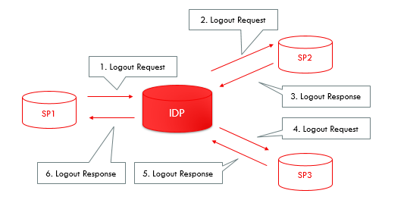
Single Log Out
Business Problems: what is the expectation if SLO request from another source.
PeopleSoft will need flexibility to handle SLO requests

Slide 23
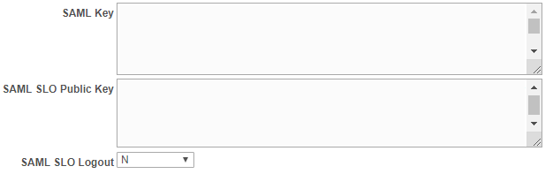
Single Log Out
Under the hood:
We used an iScript that will invoke a java class to sign an XML SLO Request and pass it to ADFS
The same iScript will listen for and pass on SLO requests.

Slide 24
Testing and Go live
Discoveries on the way

Slide 25
Testing and go live
Scope of Change
PUM Images
Security Validation
Performance Testing

Slide 26
Scope of Change
SAML introduced a large amount of change into many systems, keeping the changed managed is important to the success of this project.
Notes:
It was important that at each phase, we tried to ensure the least amount of human intervention was needed, and end to end steps were thoroughly documented and followed.

Slide 27
Scope of Change
We have chosen to keep CAS as our default authentication service, but allow SAML also to work. We have chosen to put this into our production system to allow users to try it out and report back any issues.
-Gives us time to iron out any unanticipated issues.
-We can make the full switch at a later date with a higher degree of confidence.

Slide 28
DEV on a PUM Images
While developing this product, it was useful to try to install it on a few different PUM Images: (with both tools 8.55. and 8.56).
-Gives us a degree of confidence that this solution will last beyond our AIX Implementation towards Redhat
-Nice when developing that no one else was interrupted.
-Helped promote a healthy overall understanding of some of the security inner workings.

Slide 29
Security Testing
The basic premise of SAML is that client will submit a signed XML document into your Service Provider. We want to ensure there was no way for this to be manipulated.
ADFS
BURP SAML Raider
User agent (browser)
Service Providers
D2L
Service Now
PeopleSoft
Office 365
Canada Alliance 12-14 November 2018

Slide 30
SAML Raider
We used SAML Raider, a plugin in for the BURP Suite, a web vulnerability scanner.
-Operates on the man in the middle attack vector.
-Contains a number of preconfigured SAML manipulations (XSW Signature wrapping).
Canada Alliance 12-14 November 2018

Slide 31
Performance Testing
We used Load Runner to gauge Resource Usage and Average Transaction Response time, emulating our more heavier periods (the add/drop cycle on the Student side).
It was important that this be done to ensure our java classes unencrypting and validating XML Signatures at a high volume would not overburden the system.
Canada Alliance 12-14 November 2018

Slide 32
Demo!?
Let’s hope this works!

Slide 33
Concluding thoughts
ANY QUESTIONS?

Slide 34
presenters
Simon Dyck
Simon Chiu
Architect, HR, ELM, Portal
University of Calgary
dycks@ucalgary.ca
Senior Systems Analyst
University of Calgary
simon.chiu@ucalgary.ca
This Simon has been at the University of Calgary since 2005, as the lead developer for HCM, ELM, Security and Portal. He started working with PeopleSoft applications in 1997, which isn’t as long ago as it sounds.
A new team member with the University of Calgary as of April 2018. PeopleSoft experience with the Interaction Hub, IB, Branding & PeopleSoft Security.

Slide 35
THANK YOU!

