Slide 1
Oracle SQL Tuning with HKU Case Study in PeopleSoft Global Payroll Version 9.0
30th Apr, 2019

Slide 2
Agenda
Introduction of HKU
HKU Human Capital Management System
Case Study:
System performance issue in payroll calculation
SQL tuning techniques and examples sharing

Slide 3
Introduction of HKU
The University of Hong Kong (HKU)
Founded in 1911
The oldest public-funded and non-profit making research university in Hong Kong
29,000+ undergraduate and postgraduate students
5,000+ full-time staff and 6,000+ temporary/honorary staff
offers 41 undergraduate programmes across 10 faculties, covering more than 70 major areas of study.
36th in the World¹
1 THE World University Rankings 2019
2 QS World University Rankings 2019

Slide 4
HKU Human Capital Management System
Implemented by using:
PeopleSoft HCM v9.0
PeopleTools v8.49
Oracle Database 11g Enterprise Edition
Deployed Modules
Workforce Administration
Base Benefits
Global Payroll & Absence
Enterprise Learning
Finance Clearance & Staff Commitment (Tailored)
Launched in 2011

Slide 5
Case Study: System performance issue in payroll calculation
Processing volume:
Payroll on monthly basis
Calculate for ~15,000 payees in a monthly cycle
Process 60,000-80,000 segments in a monthly cycle
Problem encountered:
There is an increasing trend in processing time, and it took up to 19 hours before tuning
A single SQL statement that originally completed less than 2 hours unexpectedly took over 15 hours without completion occasionally, i.e. processing time is unstable

Slide 6
Potential issues
In the worst case, fail to complete the payroll calculation may cause delay in payment and violate the Employment Ordinance
The poor performance of payroll processing causes extra workload to HR payroll users and IT support significantly

Slide 7
Findings & Solution
Like many enterprise applications, the payroll process accessed large volume of data by using SQL statements
Some SQL statements unexpectedly and abnormally, took very long time to process
Applying SQL tuning to the problematic SQL statements can effectively speed up and stabilize the time taken for these statements

Slide 8
Benefits
Benefits of applying SQL tuning to payroll calculation process:
Reduce the pressure of payroll preparation
Reduce IT support effort
Skills in SQL tuning can apply to other enterprise applications and functions as well

Slide 9
Risks of SQL Tuning
Worsen the system performance
Modified SQL can be rollback easily and individually without affecting one another
The result of tuned process may be different from the original process
Decided only tuned the SQL by adding hints and indexes without changing any others SQL context
All the hints used in the tuning are the very common constitution elements of SQL outline data utilized by the database optimizer,

Slide 10
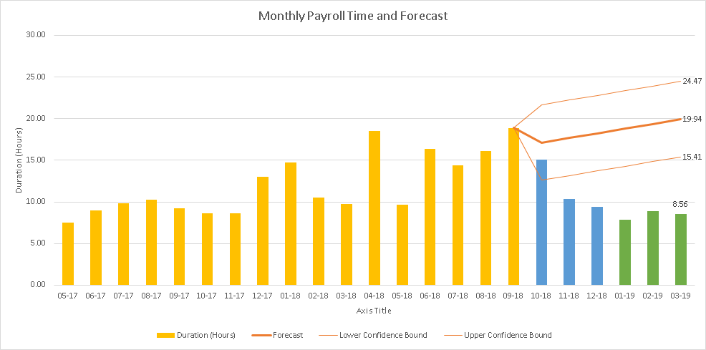
Monthly Payroll Process Time
Reduced 57% time from Nominal value
Reduced 44% time from Lower Confidence Bound
Notes:
This is the monthly payroll process time and Forecast chart
It listed out all monthly payroll timing measured by hours , from May of 2017 to March of 2019 from left to right
Orange bar represent pre-Tune payroll process time
Based on them we use excel forecast function to estimate the payroll processing time trend if no tuning had not been done
The upper and lower weak orange line represent the slowest and fastest time of forecasted payroll process time respectively
For example ,at the Mar 2019, which is the last bar , it shown the expected process time is 19.94 and 95% chance the process time will be in the range of 15.41 hours and 24.47
The Blue bars is the time of payroll tuning in progress
While the green bar is applied all payroll tuning.
By comparing the forecast value of unturned payroll process time with the tuned payroll process time, we calculate the performance improvement improvement
It reduced57% time from nominal value and 44% time from lower estimation bound

Slide 11
Techniques in SQL tuning and example sharing

Slide 12
Topics for sharing
Tuning Cycle
Tuning Concept by Examples
- Pin Point Analysis
- Overall Analysis
Review tuned SQL performance

Slide 13
SQL Execution plan
SQL requires database operations to retrieve data from underlying base tables
Database optimizer will formulate and follow SQL execution plan to perform database operations
Different SQL plans provide exactly the same results with different speed
The optimum execution plan is the key of optimum SQL performance

Slide 14
Plan generation
Bind variable , database object statistics, cardinality estimation and cursor reuse can affect the plan generation
We use the SQL hints to affect the plan generation if the SQL preformed poor with the inappropriate plan.

Slide 15
SQL Tuning Cycle
Identification
Replication
Optimization
Review
Top SQL ,
Top SQL statistics
Top SQL Plan
Retrieve & record the Pre & Post tune timing, plan and statistics
Actual Stepwise SQL statistic
Hints
Index
Notes:
Let’s go through our SQL tuning cycle
SQL Tuning basically can be divided into 4 parts
Identification
We identify the top sql , the slowest SQL of a process , and get those SQLS’ statistics and the plan used
Replication
With these information , we can replicate the slowness in the testing env.
Then get the actual stepwise statistics so that we can locate the exact slowest steps in the top SQL.
Optimization –
Optimize the SQL plan by adding hints and indexes
Review []
Can also do elapsed time projection if required ,as we showed it in the previous slides

Slide 16
Top SQL
SQL Statement
Elapsed Time
Start Time
SQL 6
1000s
SQL 3
100s
Process
… …
SQL 10
1s
End Time
Notes:
Top SQL is the several slowest SQL in the process
We have process start time and end time , and some process id info ,
We can enquire for the system to return the SQL run to us , sorting the elapsed timed in descending order , we can the top SQL
I will go through it littler deeper in the coming slides

Slide 17
Identification – Top SQL
Run SQL statement
Parser
ASH / AWR Views
Optimizer
All
SQL String
SQL ID
PLAN ID
Statistics
Execution
Process’s
SQL String
SQL ID
PLAN ID
Statistics
Start , End Time
Enquire Top SQL
ASH : Active Session History
AWR : Automatic Workload Repository

Slide 18
Identification – Top SQL Plan
Wrapped as “SQL TABLE”
Enquire Plan
SQL ID
DISPLAY_XPLAN
Plans
SQL outline data
Bind variables
Notes:
We use the SQL_ID to enquire the plan by selecting the DISPLAN_XLAN package functions which was wrapped as an table .
Just copy the output and paste the plan to excel , we will get the well formatted execution plan with all
Historical plan , SQL outline and variables.

Slide 19
Replication
SQL outline data
Verify DB Parameters
Alter session
Variable
Prepare the tables content
Gather statistics
SQL String
Build the SQL string & Run
Plan
Verification

Slide 20
Replication
SQL outline data
Variable
/*+BEGIN_OUTLINE_DATA
IGNORE_OPTIM_EMBEDDED_HINTS (…)*/
SELECT
EMPLID FROM PS_JOB WHERE HR_STATUS = :1
SQL String
‘A’
AND EMPLID BETWEEN ‘00001000 ’AND ‘00002000’
Plan
Notes:
We SQL string , subsite the bind variables , embed the SQL outline data
The top sql may be so slow to be completed. We may add, say the employee range , to greatly the record need to be processed

Slide 21
Optimization
From previous replication, get the execution plan with stepwise statistics
Ready to locate the slowest step

Slide 22
Optimization
Pin-point analysis
Focus on the slowest step, consider any joining order or transformation to reduce the works required. Also consider using “All-in” index
Overall analysis
Overview and examine the whole data flow.
Evaluate the key objects and their process order and methods so that less temporary data and operation time are required

Slide 23
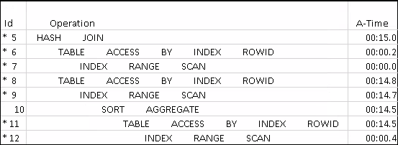
Simple execution plan
Two Things
'3 columns, named ID , Operation , A-Time
Each row is a step
Notes:
But for the both approach, some basic understand of SQL execution plan is essential.
Let’s quickly go through an example

Slide 24
Plan - Slowest Children
(ID 5)
Read first line
Read it’s child
Find the slowest children
(ID 6 & ID 8 )
(ID 8)

Slide 25
Plan – Operation Time
Read first line (ID 8)
Read it’s child (ID 9)
Find the slowest children(ID 9)
Operation time = A-Time – Child’s A-Time
For ID8 , Operation Time = A-Time - Child’s A-Time

Slide 26
Plan – Operation Time
Read first line (ID 8)
Read it’s child (ID 9)
Find the slowest children(ID 9)
Operation time = A-Time – Child’s time

Slide 27
Plan – Operation Time
Read first line (ID 9)
Read child ( ID 10)
Find the slowest children (ID 10)
Operation time = A-Time – Child’s time

Slide 28
Plan – Operation Time
Read first line
Read child
Find the slowest children
Operation time = A-Time – Child’s time

Slide 29
Plan – Operation Time
Read first line
Read child
Find the slowest children
Operation time = A-Time – Child’s time

Slide 30
Simple Case Completed
Actual Case now…

Slide 31
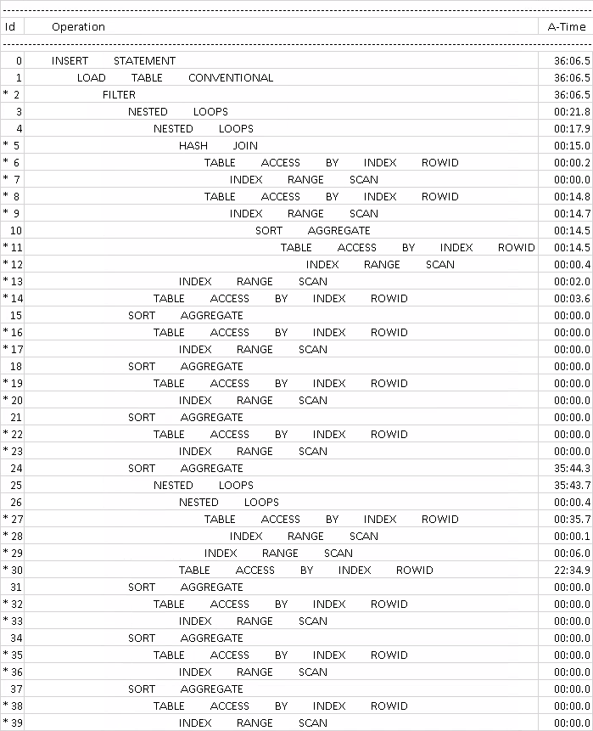

Slide 32
Real Case – Pin Point Analysis
Read first line
Read child
Find the slowest children
Operation time = A-Time – Child’s time

Slide 33
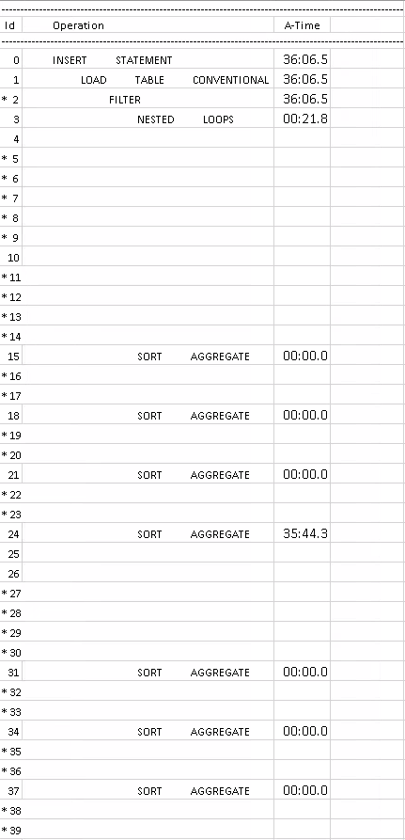

Slide 34
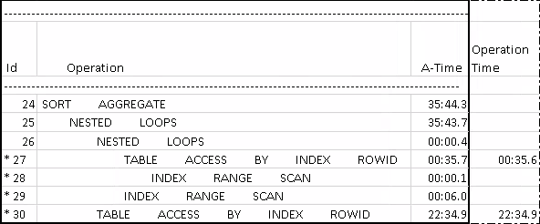
Real Case – Pin Point Analysis
Read first line
Read it’s child
Find the most time consuming node
4 At that section, calculate the Operation time
Notes:
Se we focus on the line 24 and its child, grand child …etc
We read sort aggregate , nested loops and then find the slowest part is step 30 which consumed 22:mins34 secs

Slide 35
Real Case – Pin Point Analysis
Read first line
Read it’s child
Find the most time consuming node
4 At that section, calculate the Operation time
Create an “All-in” index for all column of PS_GP_PYE_PRC_STAT and PS_GP_PYE_SEG_STAT being used
Notes:
So now we check the operation , which is TABLE ACCESS

Slide 36
All-in Index
Staff ID (Key) | Birthday
S0300 | 29/04/1980
S0900 | 30/10/2000
Staff ID (Key) | Birthday | Row ID
S0300 | 29/04/1980 | A0
S0900 | 30/10/2000 | A1
Staff ID (Key) | Birthday(Index) | Row ID
S0300 | 29/04/1980 | A0
S0900 | 30/10/2000 | A1
Staff ID (Key) | Birthday
S0300 | 29/04/1980
S0900 | 30/10/2000
Person Table
Normal Index – Indexed Staff only
Person Table
Staff ID | RowID
S0300 | A0
S0900 | A1
Row ID | Birthday
A0 | 29/04/1980
A1 | 30/10/2000
Staff ID (S0300)
Return Birthday
All-in Index – Include all required columns
Staff ID | Birthday | RowID
S0300 | 29/04/1980 | A0
S0900 | 30/10/2000 | A1
No Person Table Access!
Notes:
Considering the table access is required if the index not contain all columns required.
If we include all columns required, the table access can be skipped

Slide 37
Real Case – Overall Analysis
Before adding index - TABLE ACCESS exists and slow
After adding index – Eliminated TABLE ACCESS
Notes:
After add index PS_Z_GP_PYE_PRC_STAT and PS_Z_GP_PYE_SEG_STAT, all TABLE ACEESS in the section were eliminated , only index scan remained is required

Slide 38
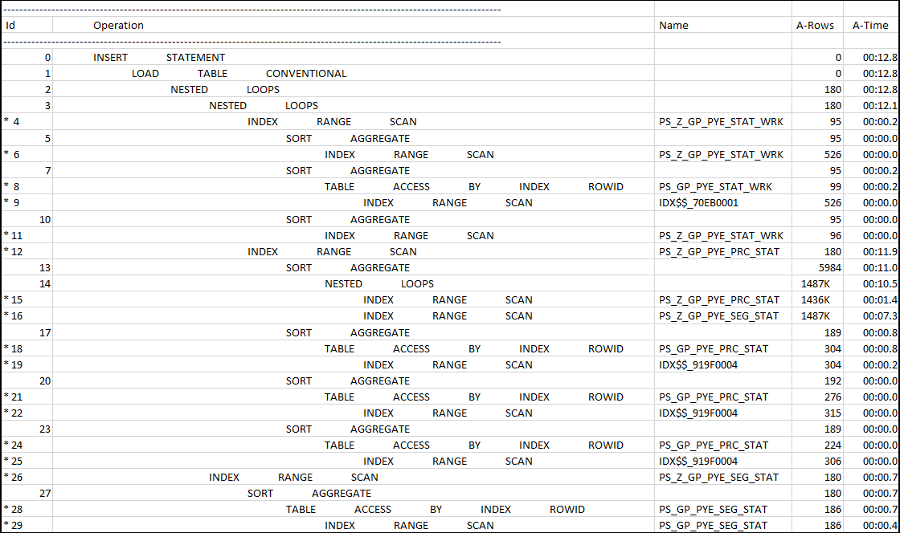
After tune Full Execution Plan – Small Range employee
Add all column of PS_GP_PYE_PRC_STAT and PS_GP_PYE_SEG_STAT used in the subquery
Notes:
We back to the full execution plan
Let see the id 2, which represents the total rows returned and inserted to result table
Only 180 rows here
We introduced previously , if the top-sql run too slow (35 before tune) , we may use the small employee range to make sure it can be completed , so that the A-Rows can be shown
Now as it come faster , let’s see the A-Rows and A-Time after remove the employee range limiter

Slide 39
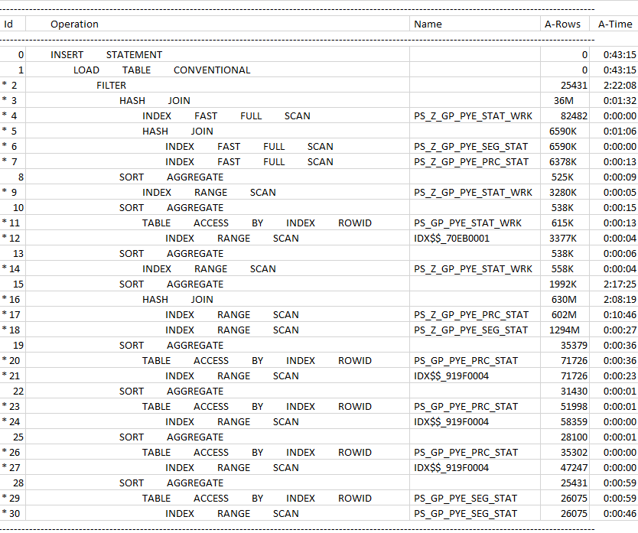
After tuned Full Execution Plan – Full Range employee
Notes:
It is twenty five thousands rows
The slowest part still the HASH JOIN , it take 2 hours
You see the index still work very well , only less 20 seconds
Most time spend on the HASH JOIN operation itself , no more the table access after added index.
So to further improve it , we shall seek to reduce the join operation , of PRC_STAT and SEG_STAT which is what the hash join based on

Slide 40
Real Case – Overall Analysis
Operation Time
< A-Row Hash Join
< A-Row of Hash Join childs
< large “Starts” - No. of executions)
SQL is basically sequential
To reduce the executions
required of this (slow) step
Reduce the A-rows just before this (slow) Operation
Move this (slow) operation to process later, and let effective filtering operation process first (the whole section of ID 15)
→
→
Notes:
This is the slow step , find a effective operation to process earlier

Slide 41
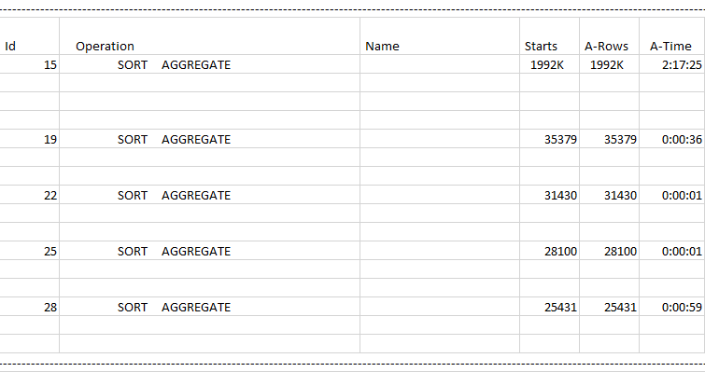
Real Case – Overall Analysis
Objective
Let effective filtering operation process first
No. of execution drop after each operations (SORT AGGREGATE)
because
Each of them filtered out unnecessary data
Remained data reduce after each of them
They are the effective filtering operation
Notes:
Effective Filter
Do Earlier
Add /*+PUSH_SUBQ*/ to them

Slide 42
Real Case – Overall Analysis
Add PUSH_SUBQ hints in the subquery filter
to move them to process early
The same hints apply to other subquery like RSLT_REV_NUM , EMPL_RCD…etc

Slide 43
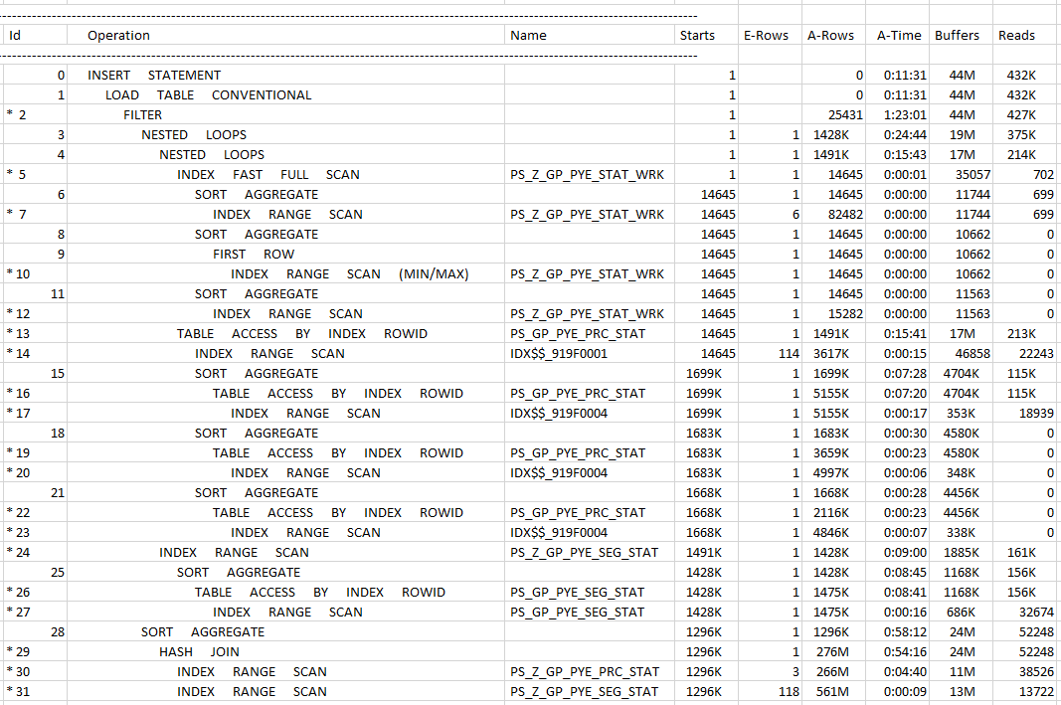
Add all column of PS_GP_PYE_PRC_STAT and PS_GP_PYE_SEG_STAT used in the subquery
Notes:
So we successfully move the complex HASH JOIN to the bottom,
And the subquery do earlier than the hash join
The time of the complex Sort Aggregate consumed 58mins

Slide 44
Real Case – Overall Analysis
Pre-Tune
Post-Tune
Starts(Execution) reduced 30%
A-Rows Sort Aggregate reduced 30%
A-Rows Hash Join reduced 60%
A-Time of Hash Join reduced 50%

Slide 45
Review
Compare the Pre-tune and Post-tune result
Individual SQL
All SQL in the process
Notes:
Let see how to compare the SQL first

Slide 46
Review
Simplified Statistics from AWR exported to Excel
Objective: Sort the Pre-tune and Post-tune SQL together for easy comparison
Issue: No columns provided in ASH and AWR can achieve it.
Notes:
at the replication , we get pre-tune SQL statistics and we copy to the excel
After the optimization , we get the post-tune SQL statistics and we also copy them to the excel
There are lots rows and I just show 4 here
We want to do the on-par comparison for the Pre-Tune and Post-Tume version of same SQL
We can’t do that by sorting any column inclluding SQL fulltext because the SQL hints had affected the order

Slide 47
Review - Difficulties
Simplified Statistics from AWR exported to Excel
Notes:
Now we add the Statement ID , we can easily identify the 1st and 3rd is the same SQL statement
There is a table storing this stmt_id so we can do it easily

Slide 48
Review – Difficulties (2)
So Statement ID was added, unrelated statement sort outed
Another Issue: Which entry is pre-tune , which are post-tune ?
Notes:
now we add the Statement ID , we can easily sort out the same sql from all the SQL captured

Slide 49
Review - Timing
We further join the process instance table so we have the follow info
Run control id
Oprid
Elapsed time
…etc (may agree the pattern with user)
We can further figure out the “Timing” column by this way
Notes:
There is another table storing the process instance table and

Slide 50
Review - Rows per seconds
Rows per seconds prove the post tune is actually more efficient
Post tune take longer the pre tune
Notes:
The post tune is the top row
The pre tune is the bottom row
Most time we compare the elapsed time only for the same kind of payroll
But if the post tune looks slower , we may need to check the rows per second and the disk read buffer ratio which not shown here
You can see the upper post tune row per second is lower which mean more efficient.

Slide 51
Review - Plan Unstable
After the Overall Analysis analysis, we may fix it by hints / baseline
The same SQL (SQL_ID) keep on changing plan, even return similar rows
Performance varies significantly

Slide 52
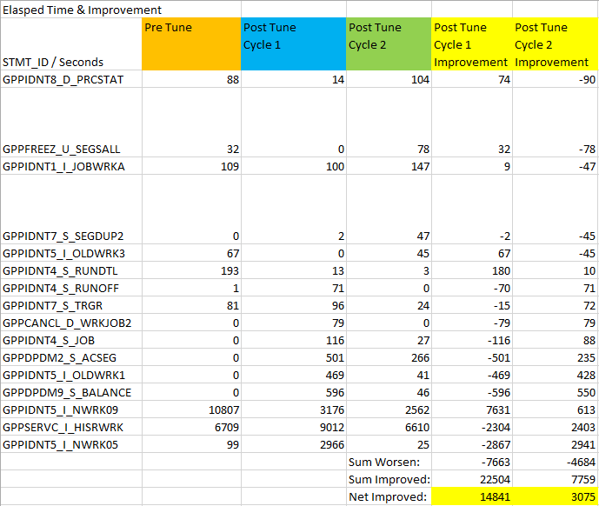
Review – Process SQL
Post
Notes:
The previous example is just one SQL comparison
This summary shows the all SQL at once , for different timing
Here we listed all SQL throughout different timing and calculate the improvement during each time tuning ,
So we can better evaluate the effectiveness of the tuning
We can keep on the append the excel , update the pivot table , for continuous monitoring

Slide 53
Q & A

