Slide 1
Implementing "approval required" in, or outside of, Program Enrolment
 | Implementing "approval required" in, or outside of, Program Enrolment, a pilot project at UvA
ROTTERDAM 1
November 17, 2015, (15:50 AM - 16:20 PM)

Slide 2
presenter
Wolter Kaper
SIS helpdesk / functional administrator
Science department
University of Amsterdam
w.h.kaper@uva.nl
SaNS decision level: 4 cooperating institutions
UvA decision level: 1 institution, various departments
Science department: just 1 department !

Slide 3
Science department University of Amsterdam
Department: ± 6000 students
University: ± 30 000 students

Slide 4
OUR UNIVERSITY & ORACLE, Peoplesoft CS
Production:
-Student Records
-Aacademic Advisement
-…
“Proof of Concept”:
- PEAM, Program enrolment & Activity Management

Slide 5
“approval required” - Overview
CURRENT SITUATION - Academic Advisement + SaNS “petitions” module
LIMITATIONS OF CURRENT SITUATION - Fit with exam committee policies - Usability - Some good points of the SaNS “petition” module
POSSIBILITIES OF PROGRAM ENROLMENT (short) - APT has draft status until approved - Part of UvA PE “Proof of concept”
“STUDYPLAN” LAYER ON TOP OF SIS - Departmental pilot - To validate requirements - One programme: bio-medical sciences (±150 students graduating) - Pilot period: Dec. 2015 – Aug. 2016

Slide 6
CURRENT SITUATION
- Academic Advisement - SaNS “Petitions” module

Slide 7
CURRENT SITUATION
Academic Advisement Personalize degree requirements: - “Authorize Student Exceptions” - “Course Substitutions”
SaNS “Petitions” module - Students can request changes in their study plan (=Advisement Rept.) - Requests routed to exam committee for approval - On approval, changes are effected in study plan automatically

Slide 8
LIMITATIONS OF CURRENT SITUATION
- Fit with exam committee policies
- Usability - Some good points of the SaNS “petition” module

Slide 9
LIMITATIONS 1: Fit with exam committee policies
Policy: Check of study plan as a whole !
Policy: Some types of customisations may be requested BEFORE programme-as-a-whole is checked: - Exemptions - External Education (at another institution)
Policy: Some types of customisations may only be requested AS PART OF the final checkup of the study plan ! - Free choice courses approval - Adapt detailed EC requirements (e.g. 59 EC instead of 60 EC required courses, and to make up for that: 61 EC free choice courses instead of 60 EC)
Policy: Various requests need attachment documents - Exemptions - External Education

Slide 10
LIMITATIONS 2: USABILITY SaNS “Petition” module
Good: point-and-click in study plan
Good: select from valid UvA courses
Good: after approval, study plan changes automatically
Problem: various petition types > instructing students when to use which type (long manual) > student mistakes > administrative work
Problem: external education. Approval only fully effected after grade is in. But students want to know before they go…! > setup a process partly outside of SIS, e.g. emails.
Problem: Attachments not possible > Students need to send request in 2 ways: in SIS + outside > Exam committee must match the two parts

Slide 11
LIMITATIONS: UvA summary
UvA departments that tried (Letting students use the petitions module like intended) - Economics - Law - Communication Sciences
Reportedly successful: - Communication sciences, a big programme
No longer trying: - Economics - Law
Never tried: - Science - Medicine - Humanities – have developed a solution outside of SIS (works well, but no SIS integration yet)

Slide 12
POSSIBILITIES OF PROGRAM ENROLMENT (short)
- Academic Progress Tracker as “draft” - Part of UvA PE “Proof of concept”

Slide 13
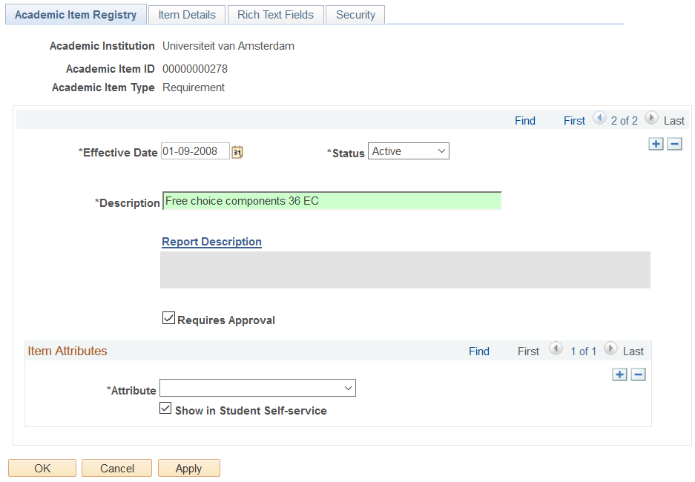
It does not do anything !

Slide 14
POSSIBILITIES OF PROGRAM ENROLMENT
Free choice courses + Constrained choice courses: >> Academic Progress Tracker = DRAFT until approved challenge: how to make the draft status visible / effective
Other programme customisations - exemptions - replacement of required courses - changing required number of EC’s for sub-requirements >> Service requests ?

Slide 15
Service requests + Rules + CAF ?
Use for: Exemptions – replacements – changing required EC’s
Good: attachments are possible
Good: a request that concerns the whole study plan (“please check the whole of it”) is now possible.
Challenge: How to realize “point and click” in study programme ? - the SaNS module has it, that was one of its’ GOOD points !
Challenge: After approval, effect the change automatically - the SaNS module has it…!
Possibilities are further researched at UvA PEAM “proof of concept” project, in which the Science department participates.

Slide 16
“STUDYPLAN” LAYER ON TOP OF SIS
- Departmental pilot - Bio-medical sciences (±150 students graduating) - Period: Dec. 2015–Aug. 2016

Slide 17
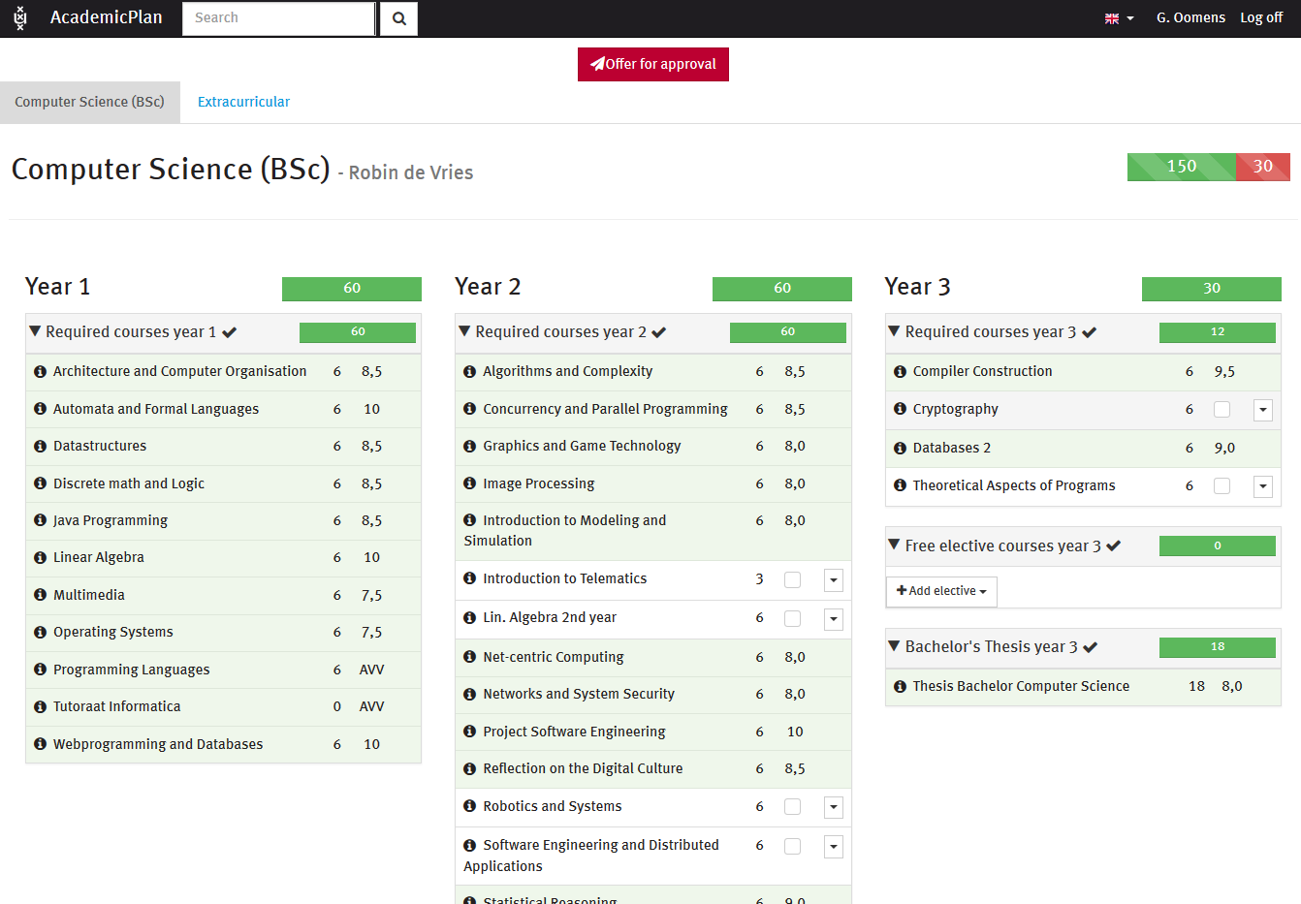

Slide 18
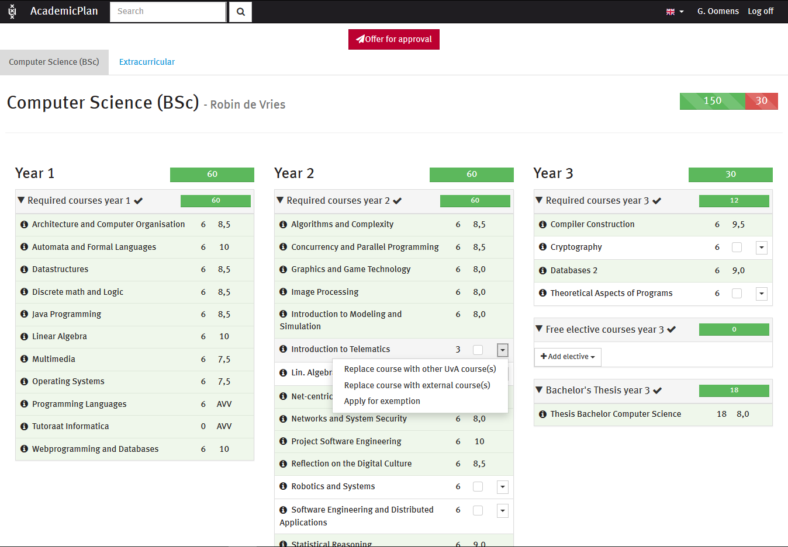

Slide 19
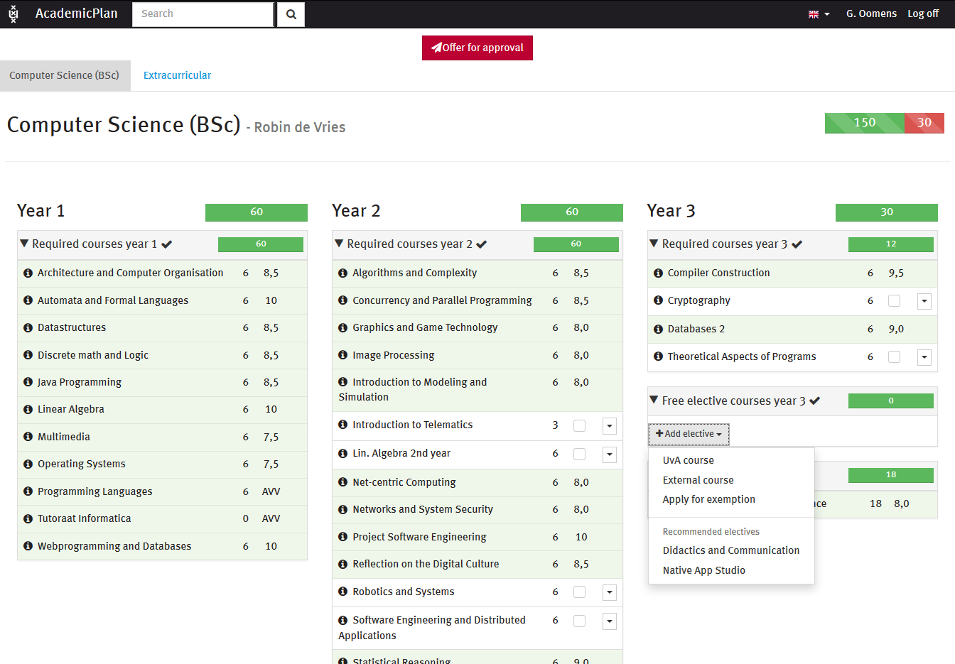

Slide 20
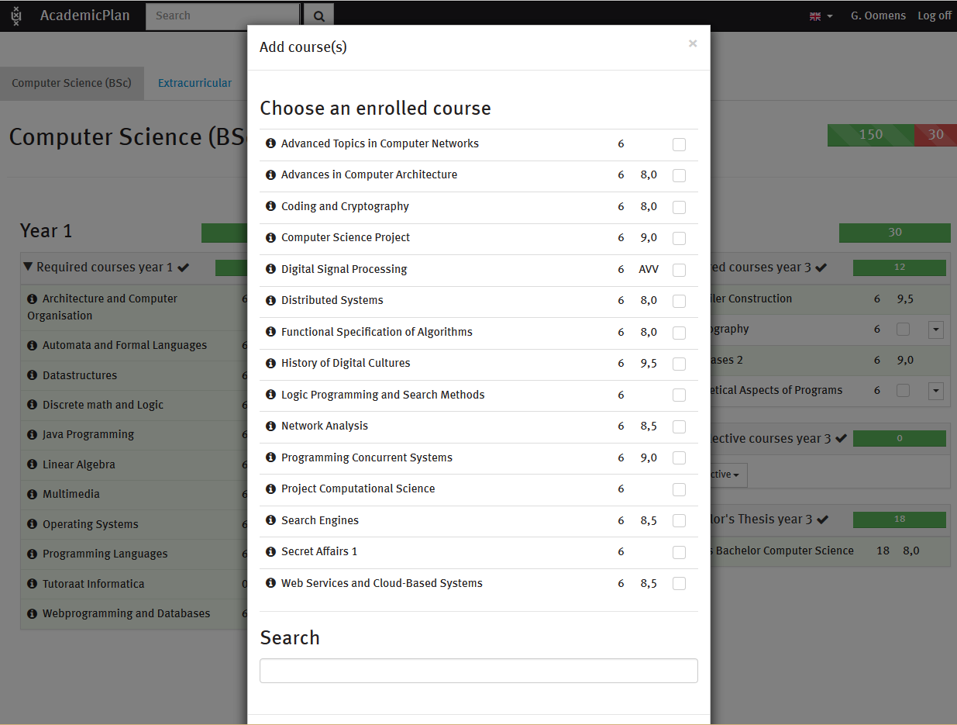

Slide 21
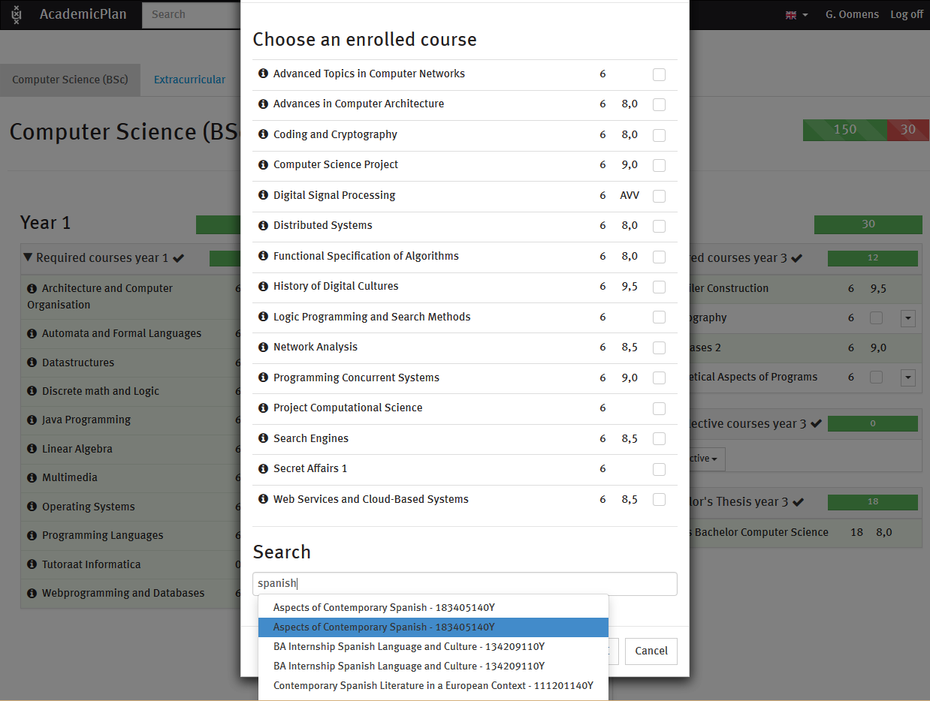

Slide 22
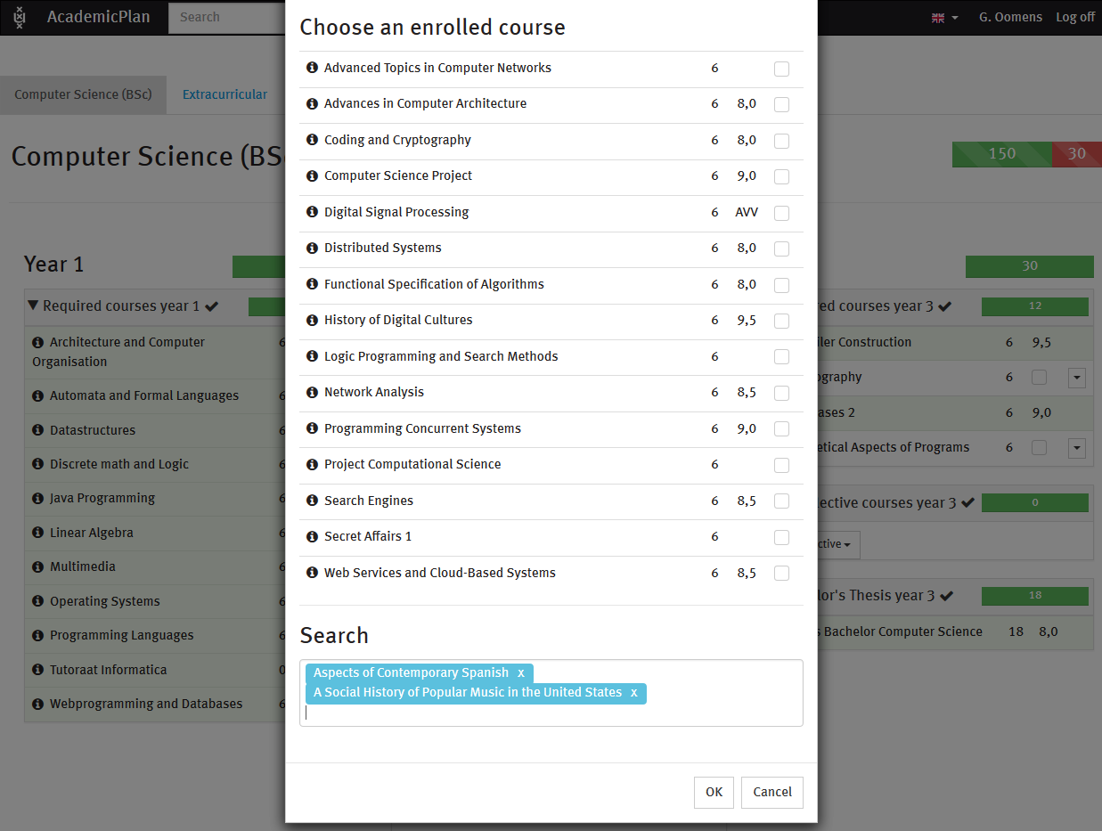

Slide 23
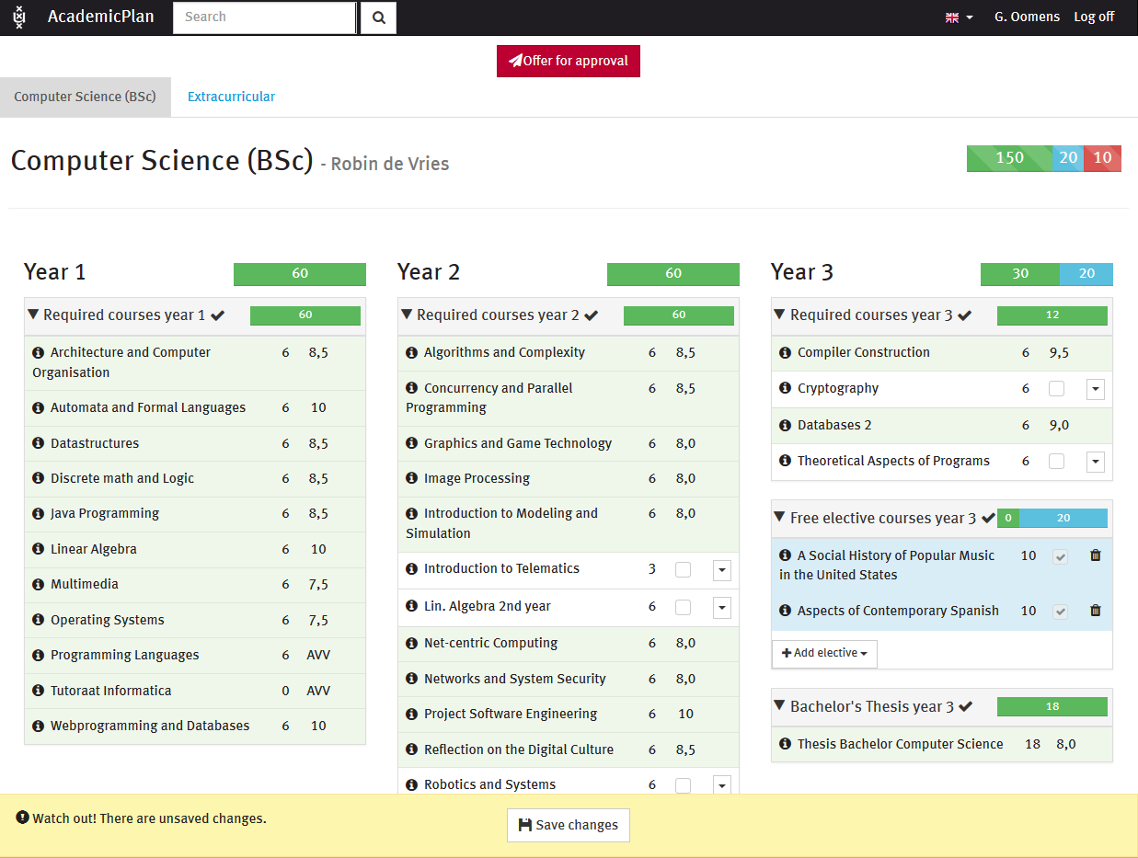

Slide 24
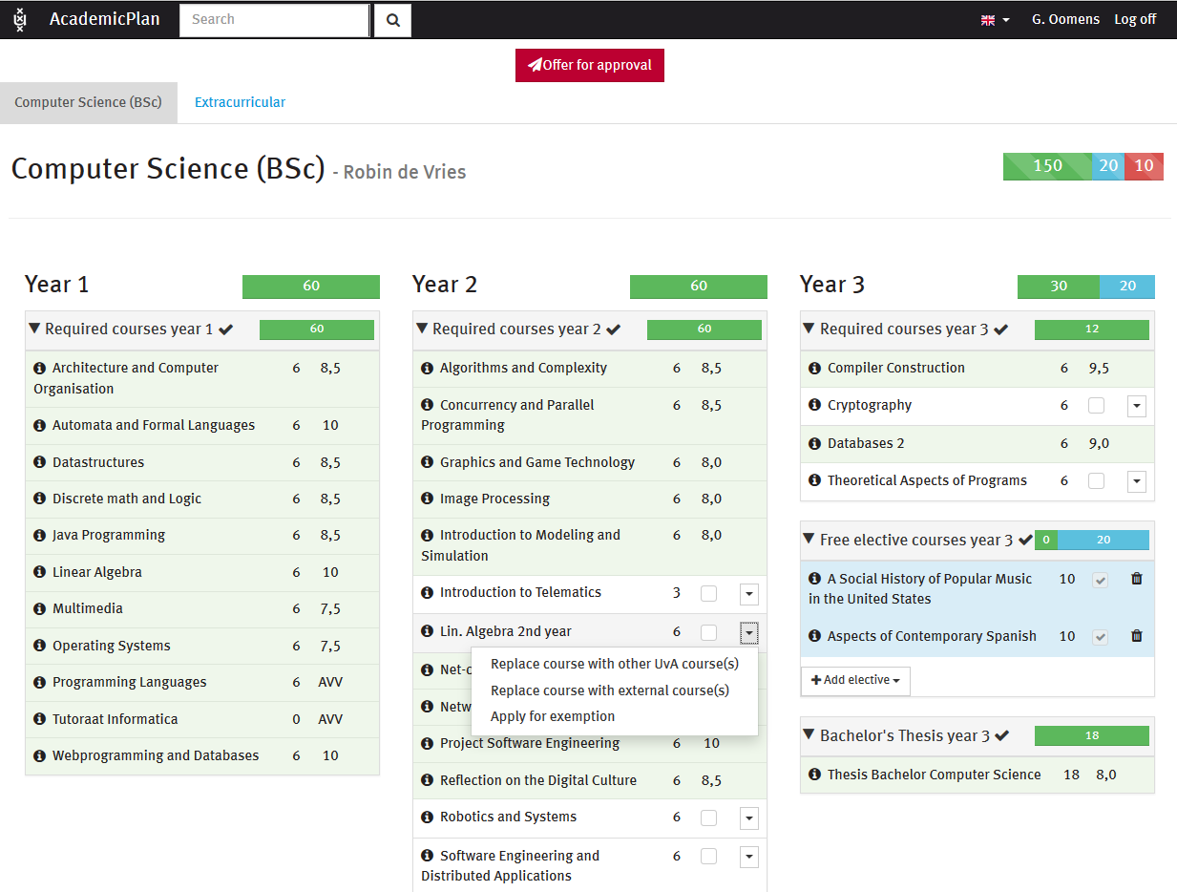

Slide 25
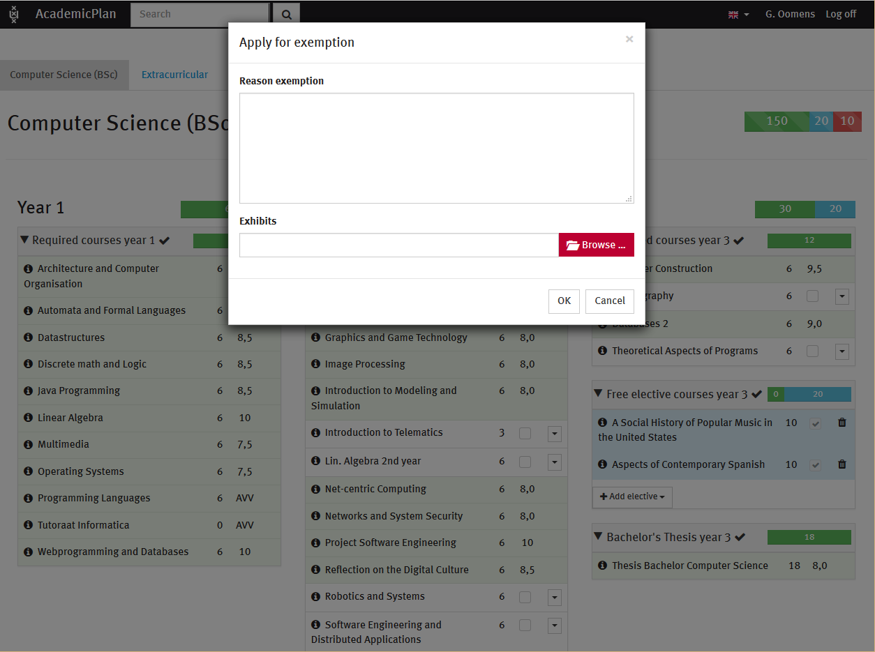

Slide 26
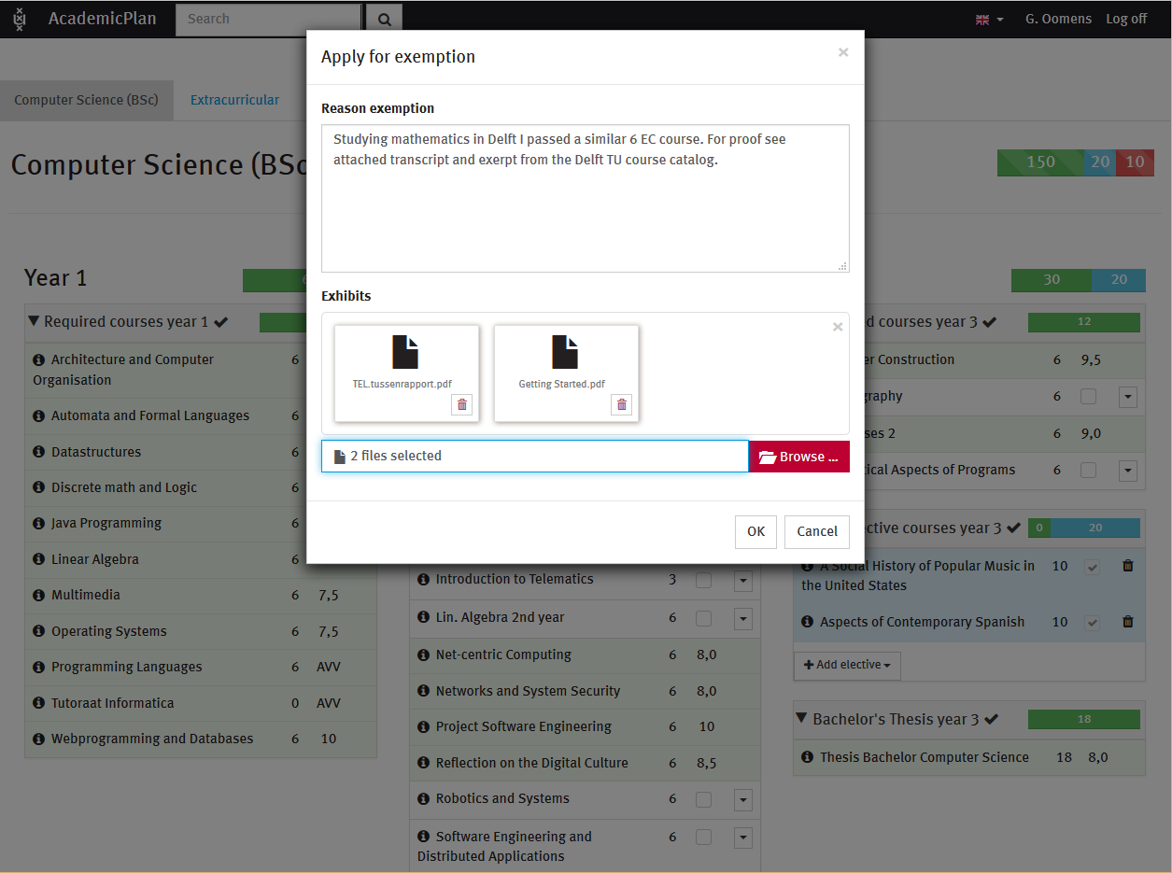

Slide 27
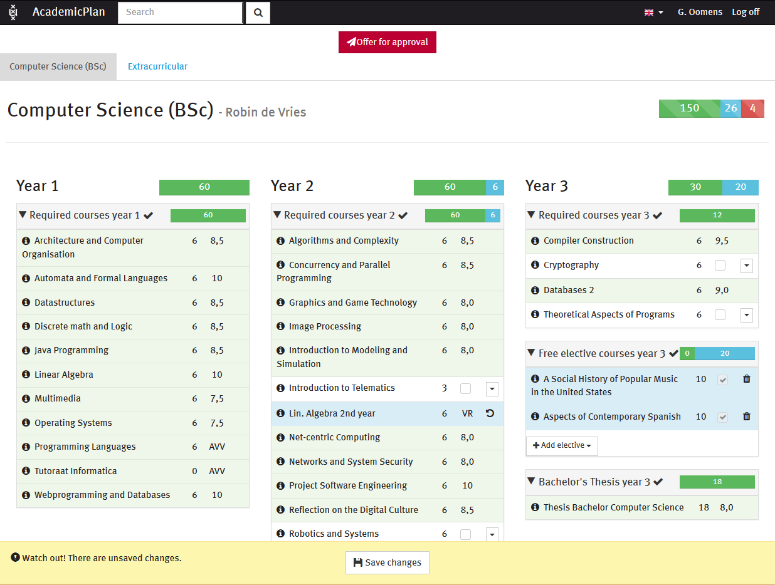

Slide 28
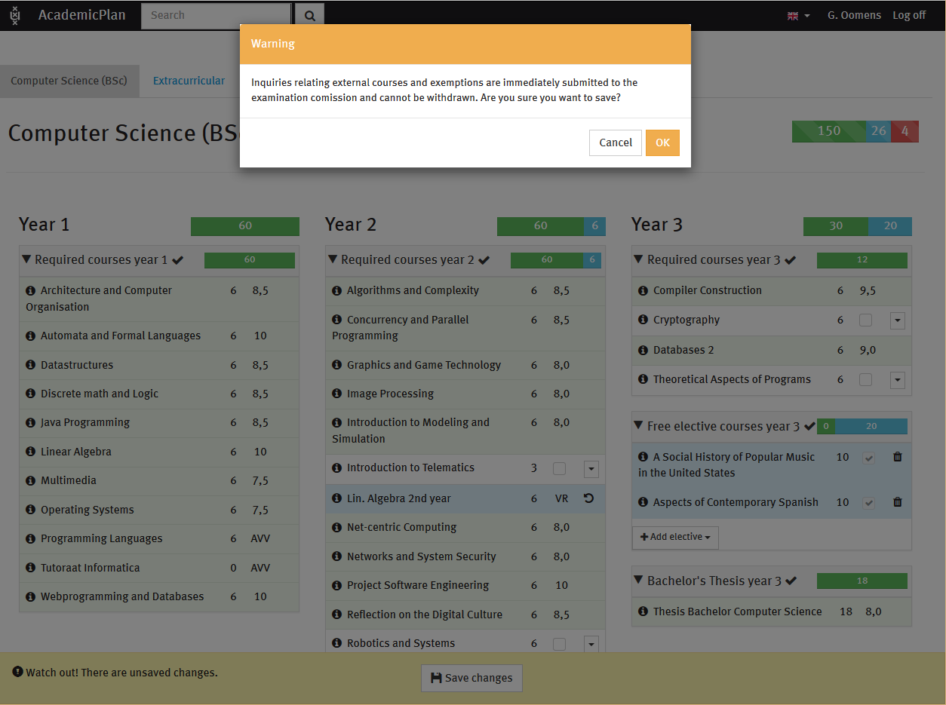

Slide 30
Exam committee

Slide 31
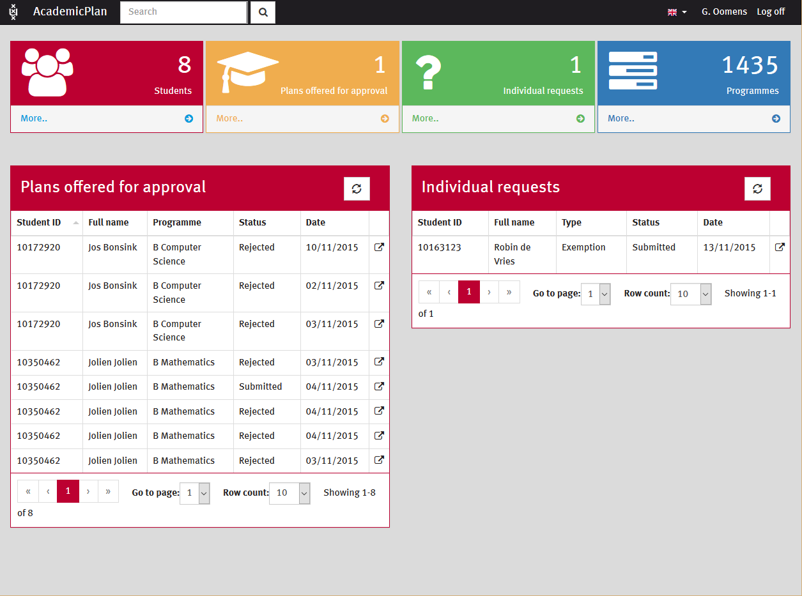

Slide 32
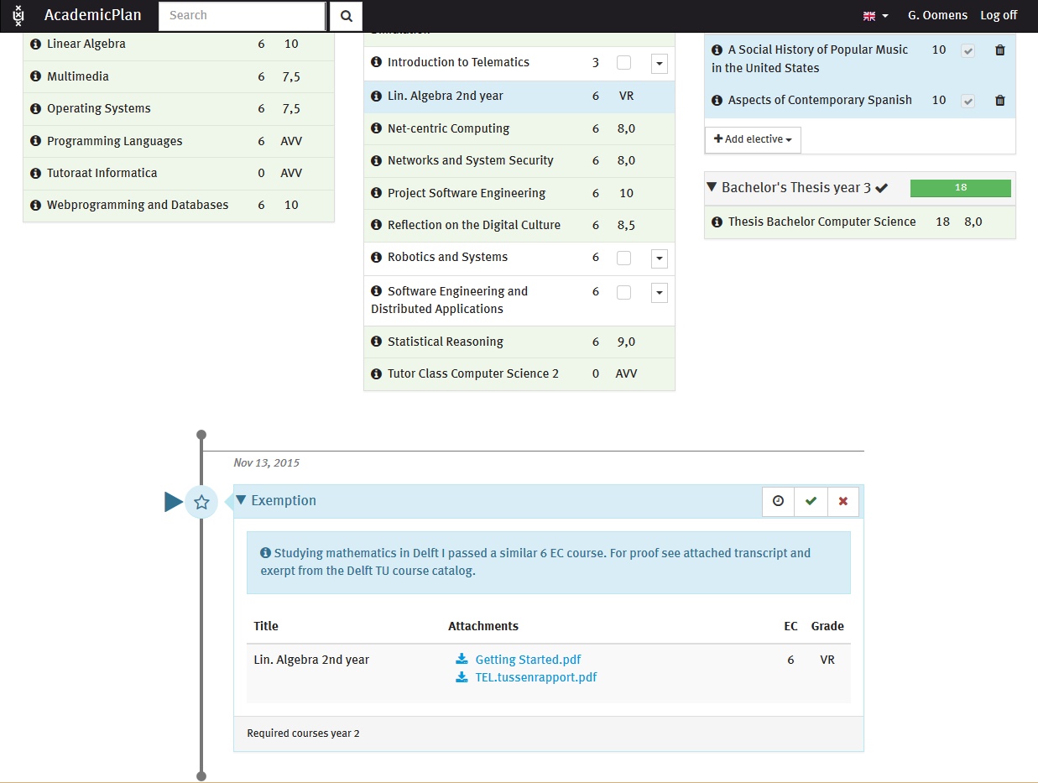

Slide 33
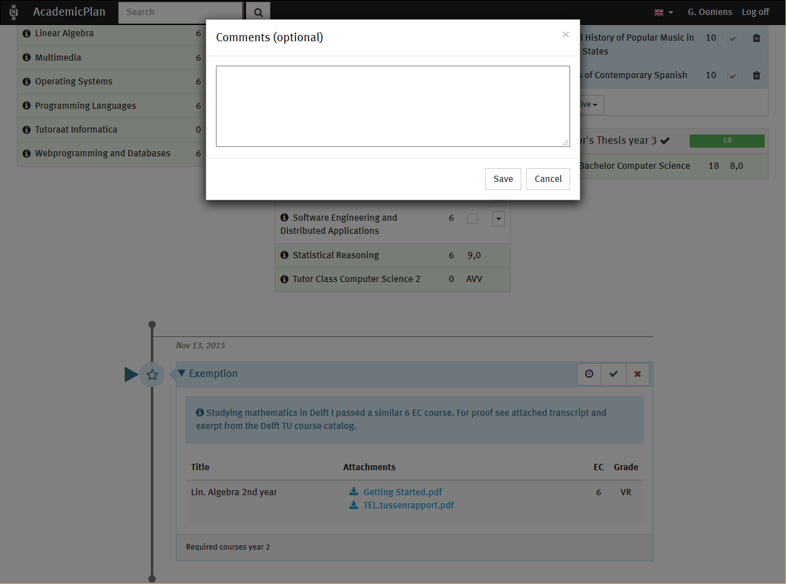

Slide 34
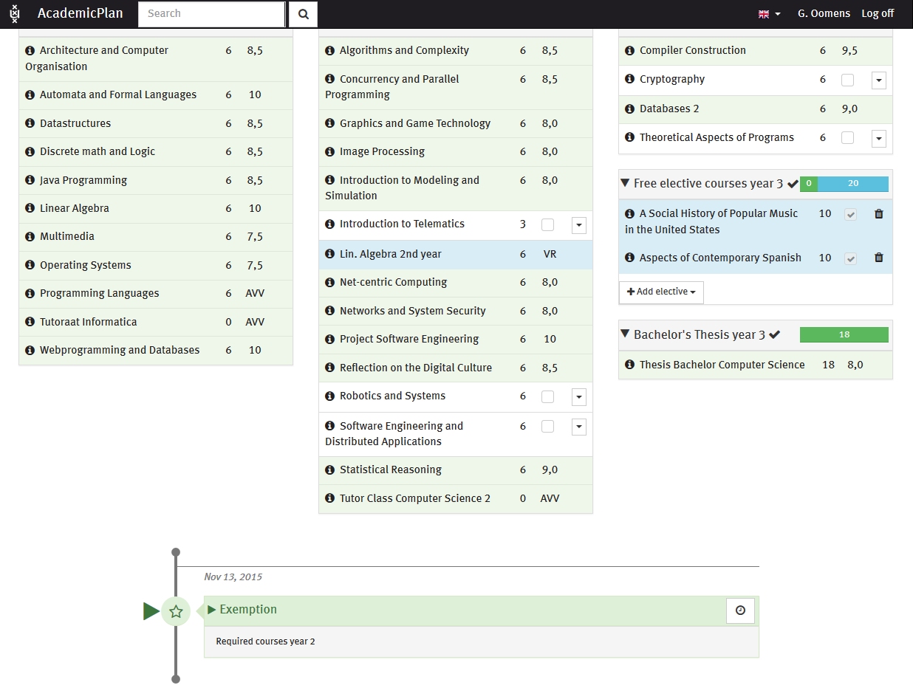

Slide 35
student

Slide 36
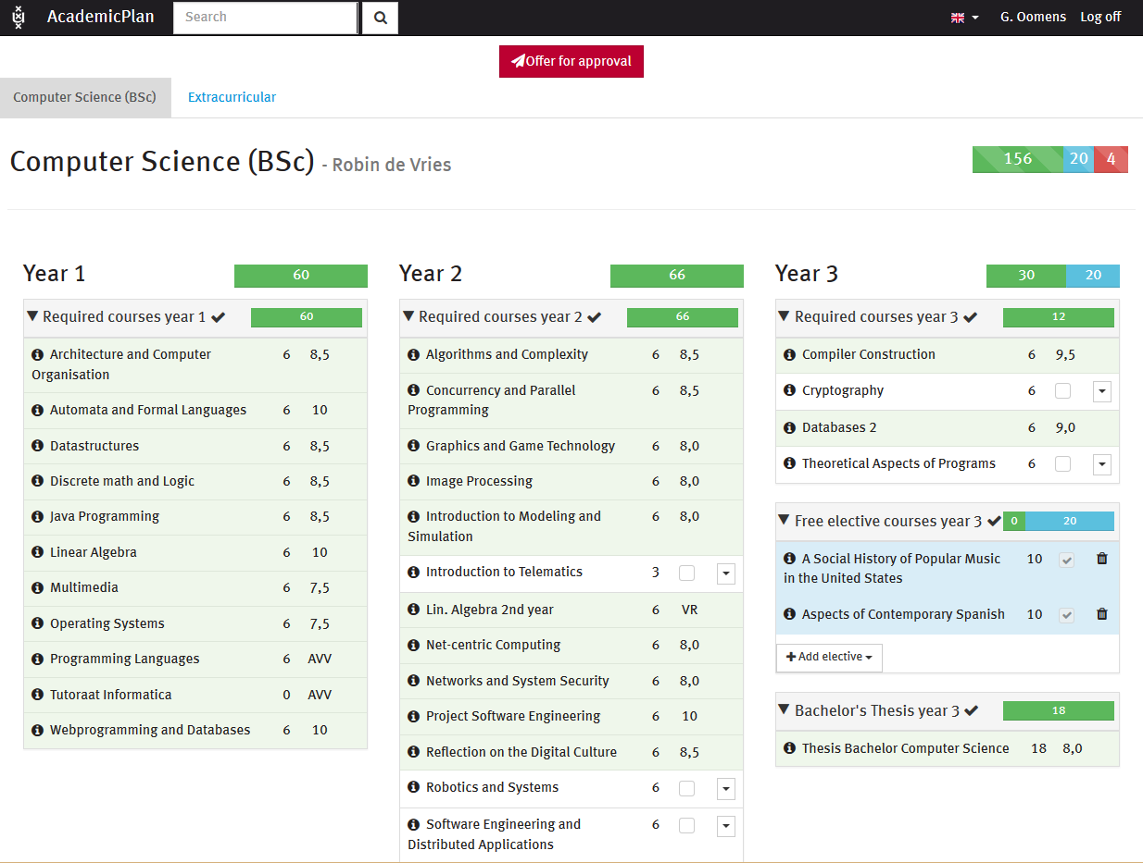

Slide 37
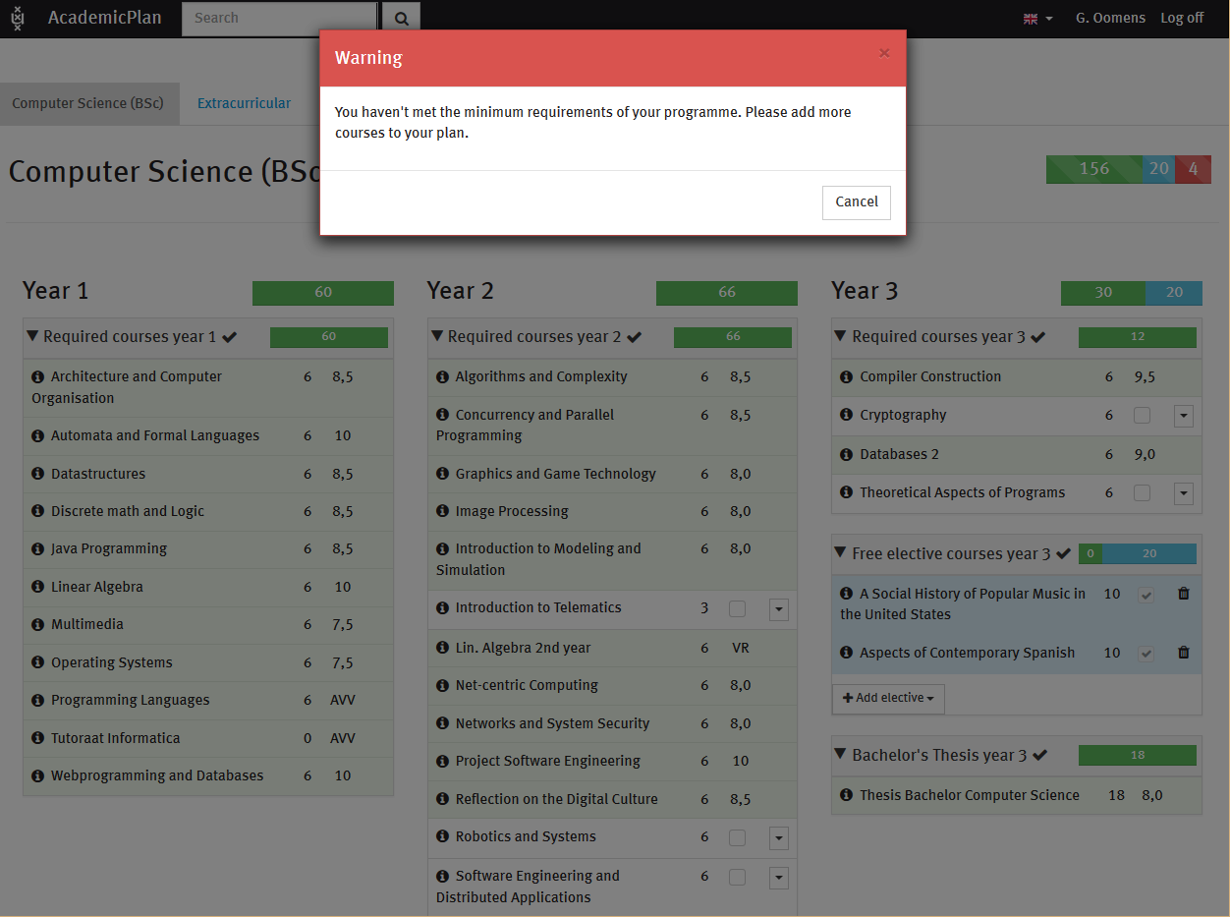

Slide 38
OTHER STUDENT

Slide 39
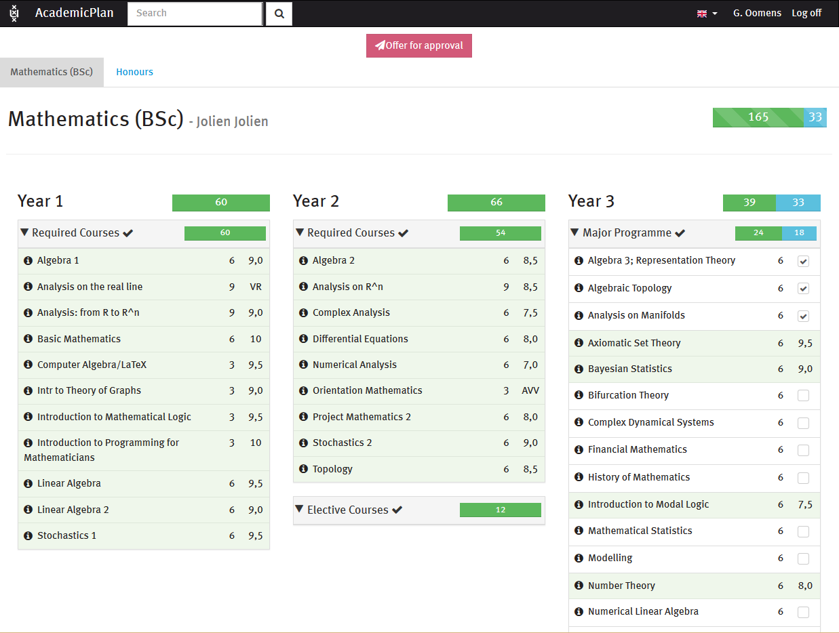

Slide 40
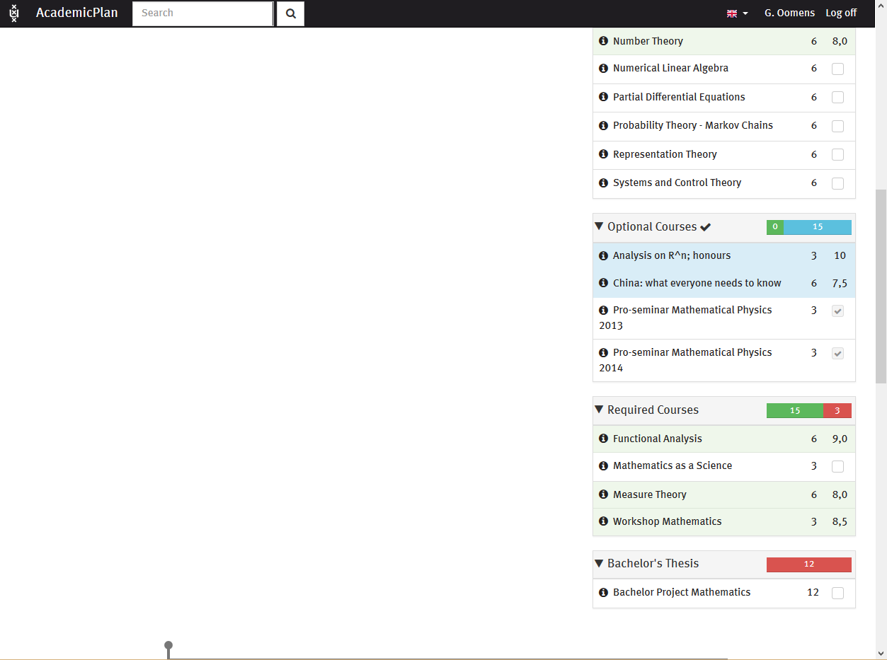

Slide 41
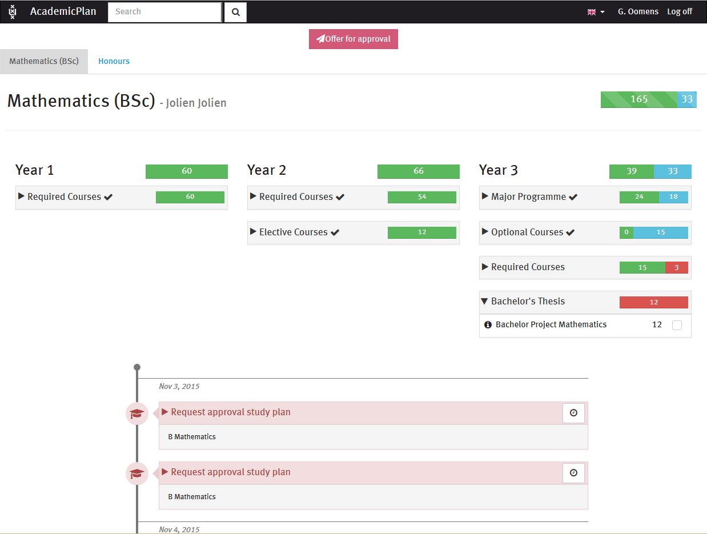

Slide 42
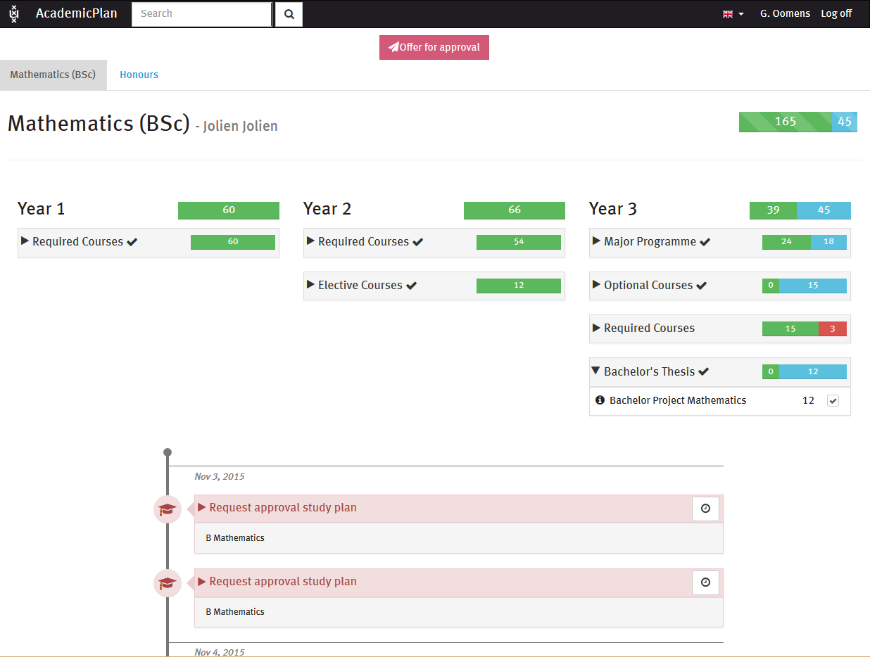

Slide 43
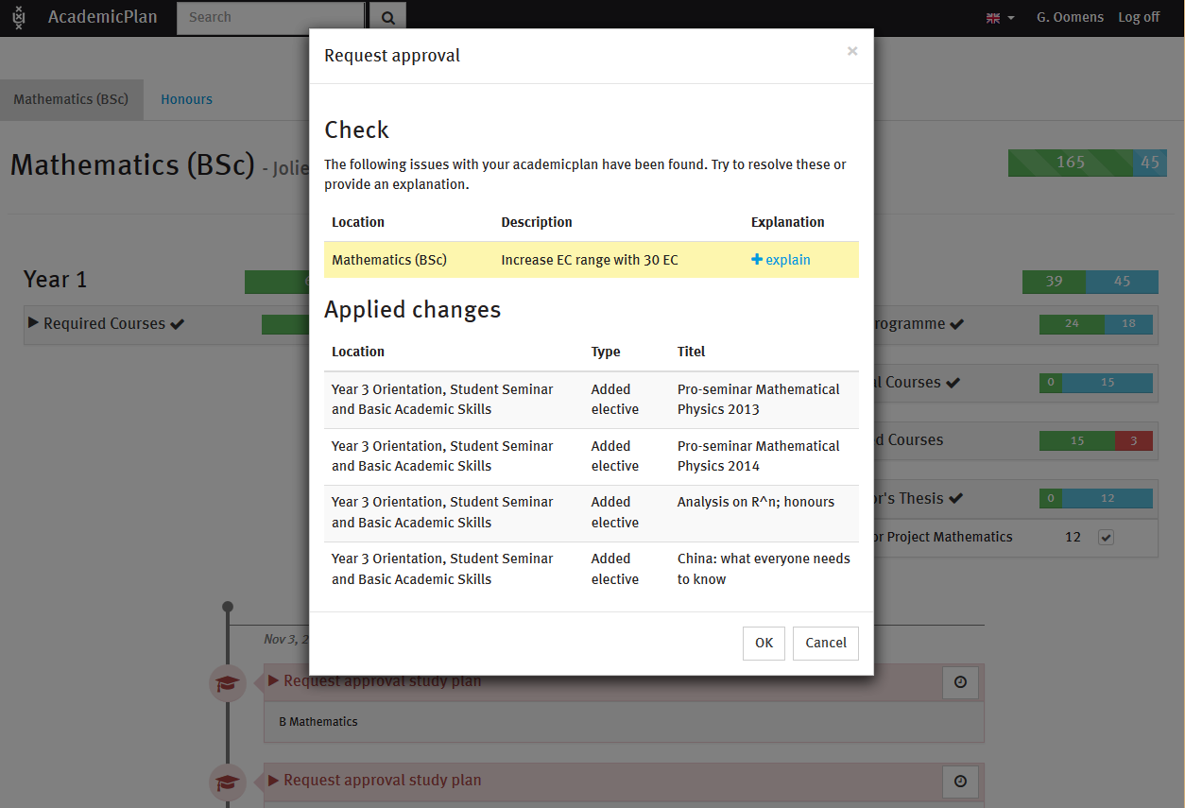

Slide 44
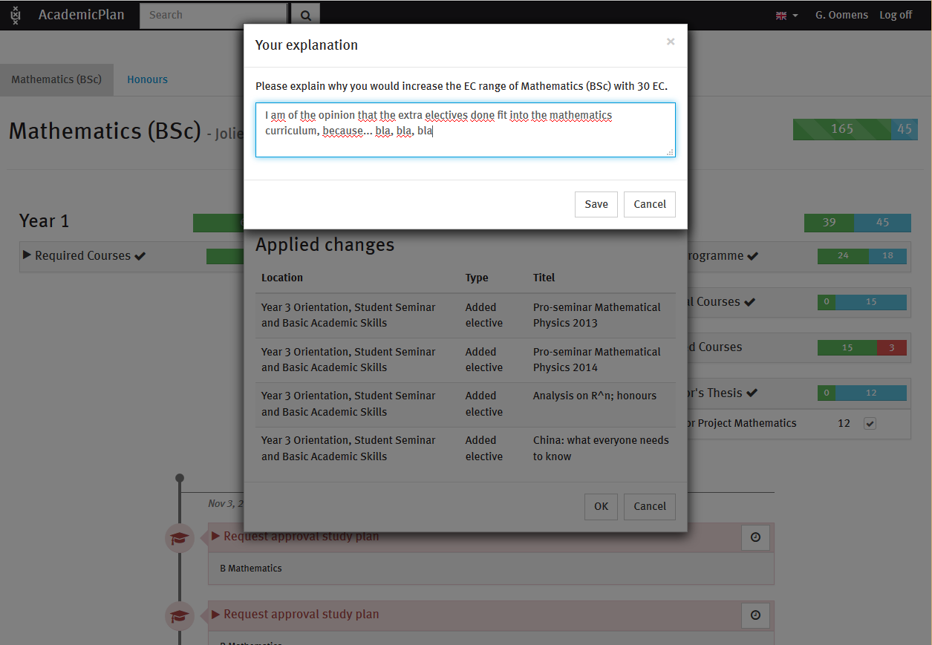

Slide 45
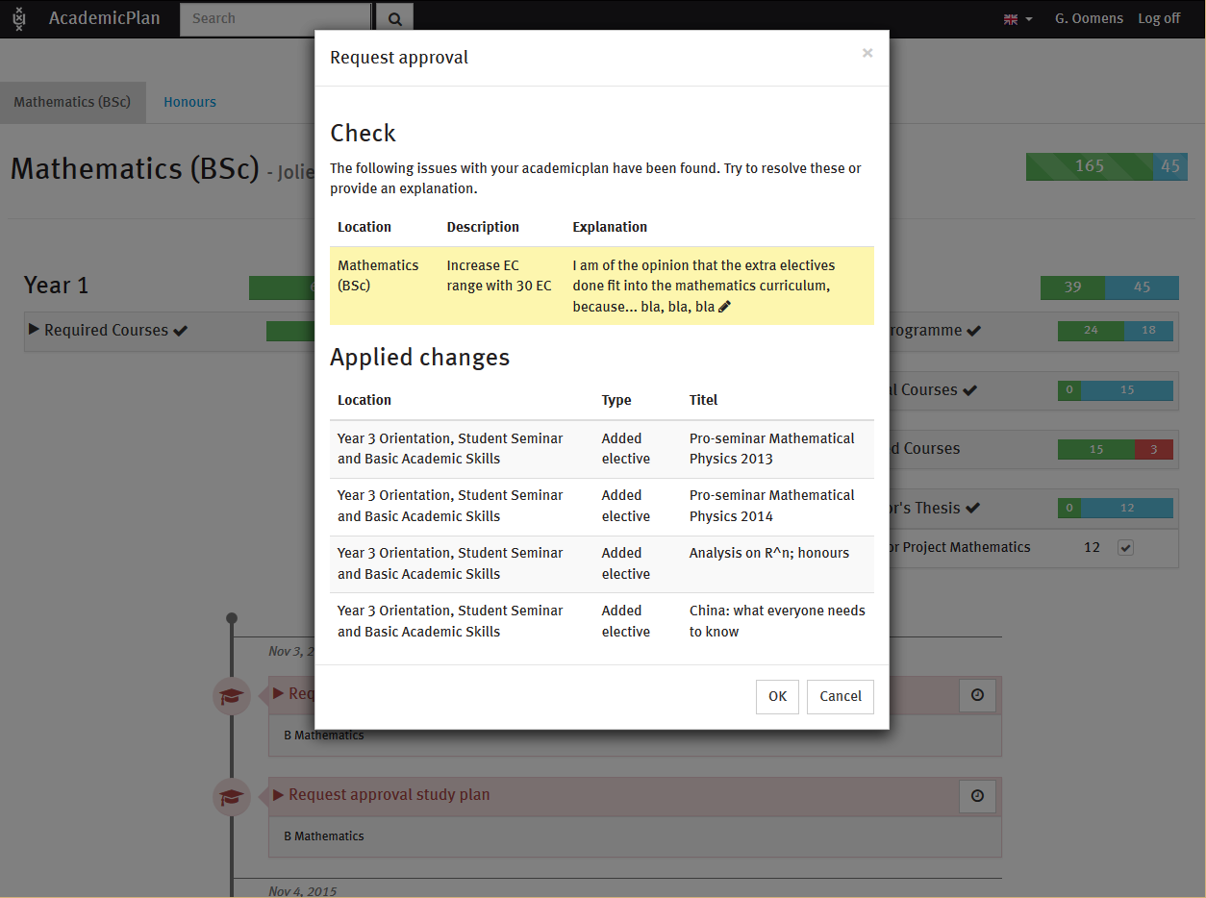

Slide 46
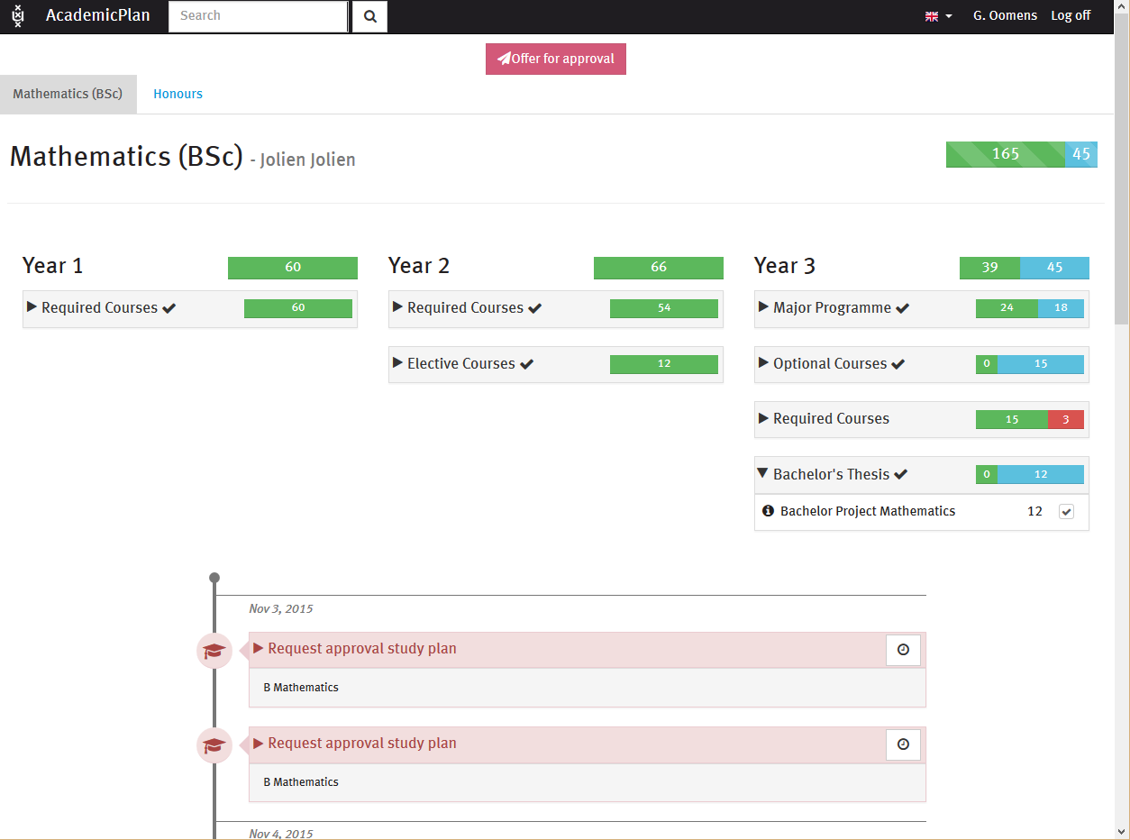

Slide 47
Exam committee

Slide 48
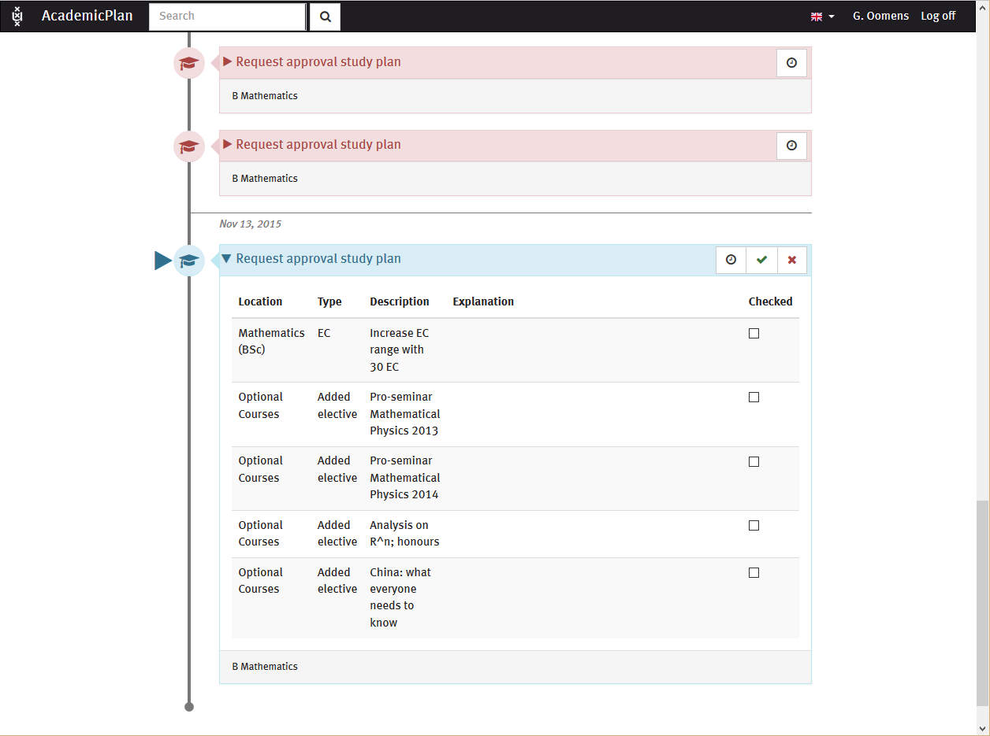

Slide 49
SUMMARY

Slide 50
Summary
Current situation: - Academic Advisement + SaNS “petitions” module
Limitations experienced: - no attachments to petitions - petition types not self explanatory - no workflow for checking studyplan as a whole - exam committee allows some petition-types only as part of final checkup
Two try-outs in parallel: - PEAM try-out (SaNS project) As a part of it: Try out servicerequests + rules + CAF - Home-built “Studyplan” layer on top of SIS

Slide 51
presenters
Wolter Kaper
SIS helpdesk
Science department
University of Amsterdam
w.h.kaper@uva.nl
all Alliance presentations will be available for download from the Conference Site

Slide 52
THANK YOU!

