Slide 1
SELF SERVICE PROFORMA at UCT
Session # 11017
5 July 2019

Slide 2
presenters
Michelle Cook
Yolokazi Quwe
Systems Analyst
University of Cape Town
Manager: Student Fees
University of Cape Town

Slide 3
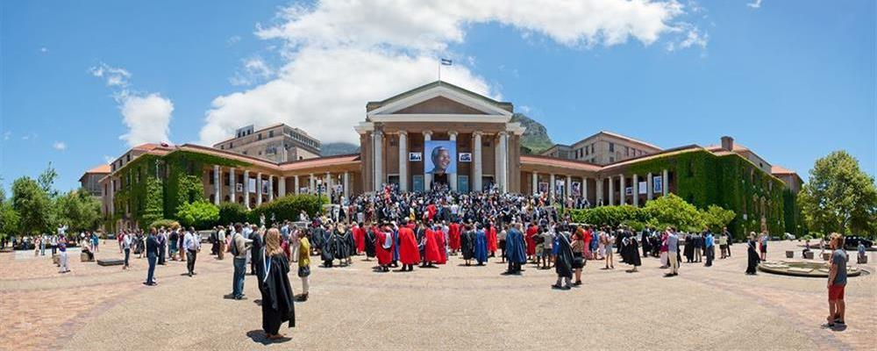
UCT
South Africa’s oldest University - Founded 1829
Ranked 1st in Africa
6 Faculties
> 100 000 Alumni
> 80 Specialist Research Units

Slide 4
Proforma invoices at UCT
Fees Office Proforma
Generated by the Fees Office for students, based on their requirements
Self Service Proforma
Online facility to empower students to generate their own quote
Relieve pressure on the Fees Office
Shopping basket style

Slide 5
requirements
Public Access page
Campus ID required
Current year or one year ahead
SA student or SADC student
‘Typicals’ or selection of courses
Housing options or ballpark amount
Meal options
Other miscellaneous costs
Output as a PDF

Slide 6
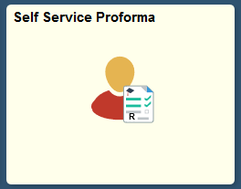
DEMO – online pages
Self Service Proforma

Slide 7
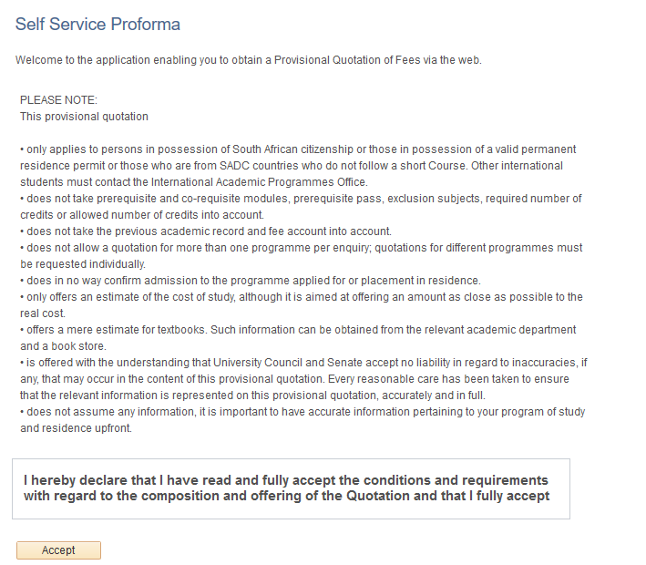

Slide 10
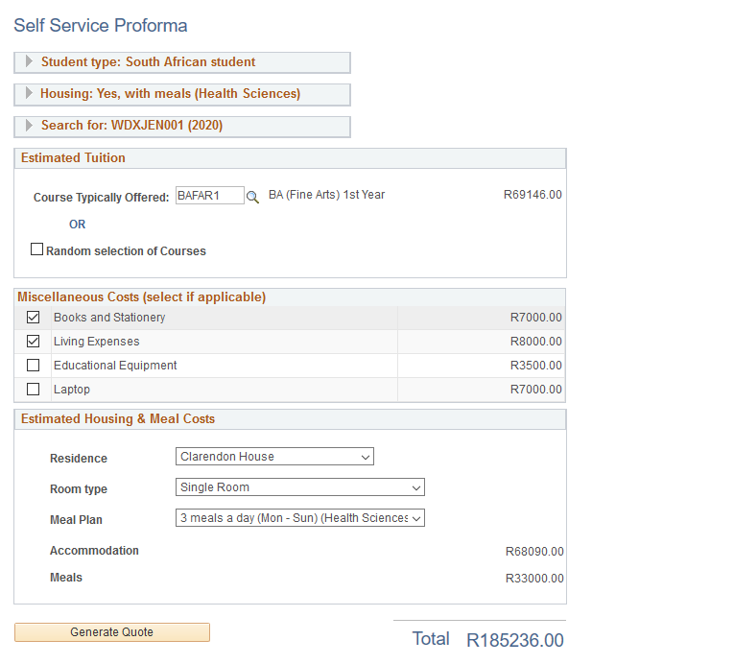

Slide 11
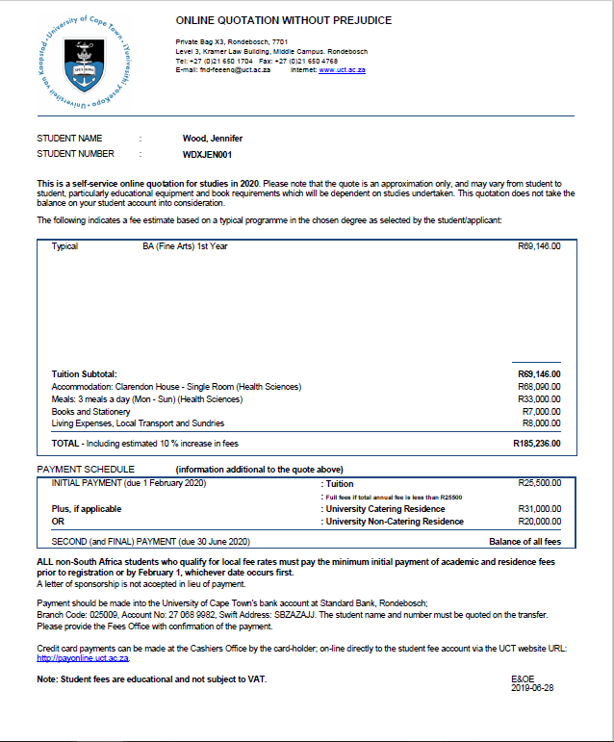

Slide 12
DEMO – housing setup
Self Service Proforma
Setup

Slide 13
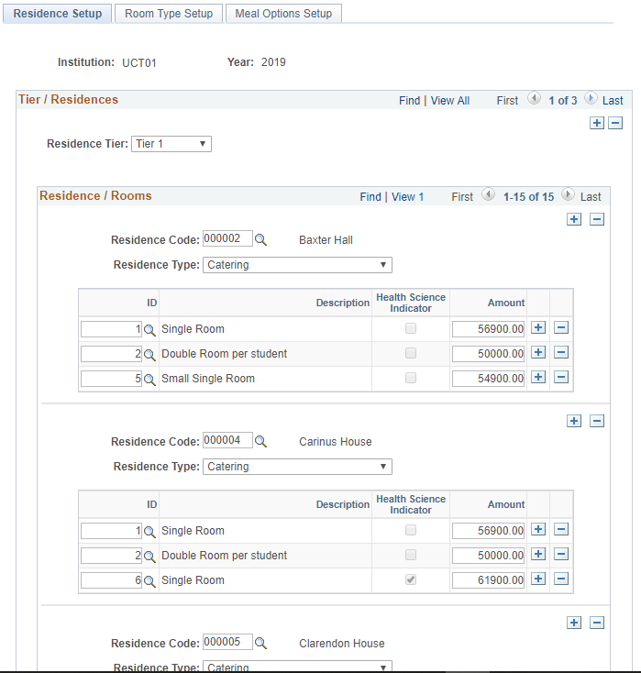

Slide 14
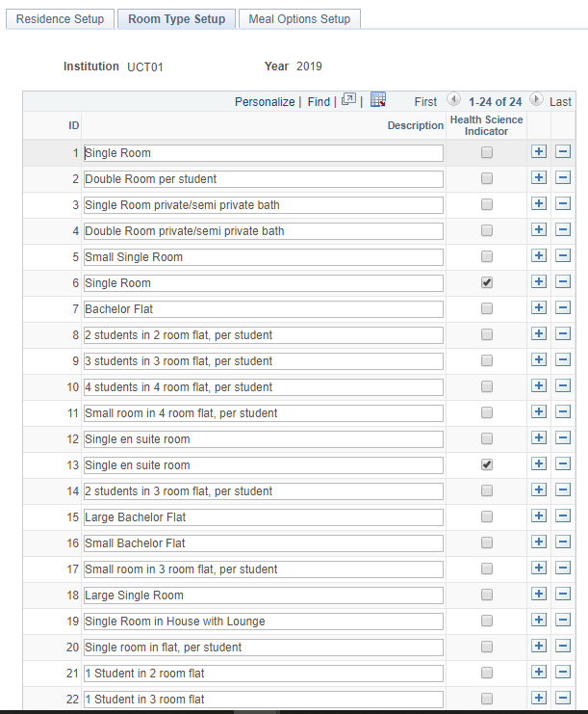

Slide 15
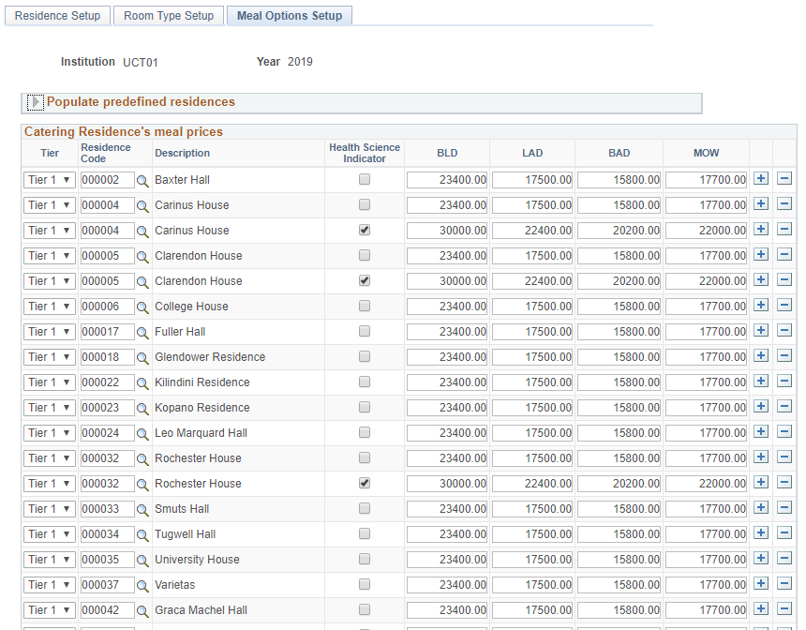

Slide 16
DEMO – proforma general setup
Self Service Proforma
Setup

Slide 17
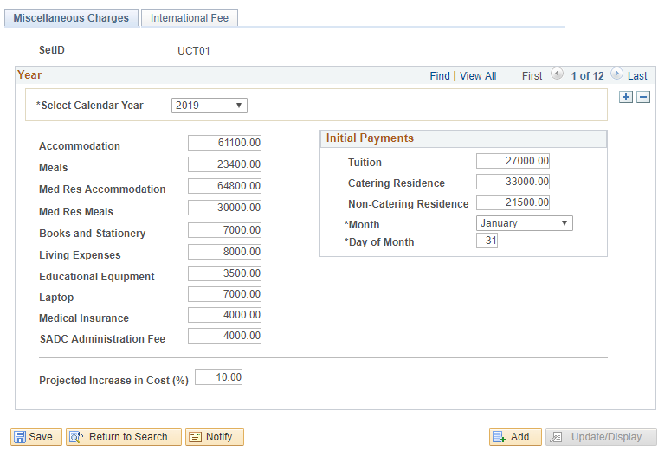

Slide 18
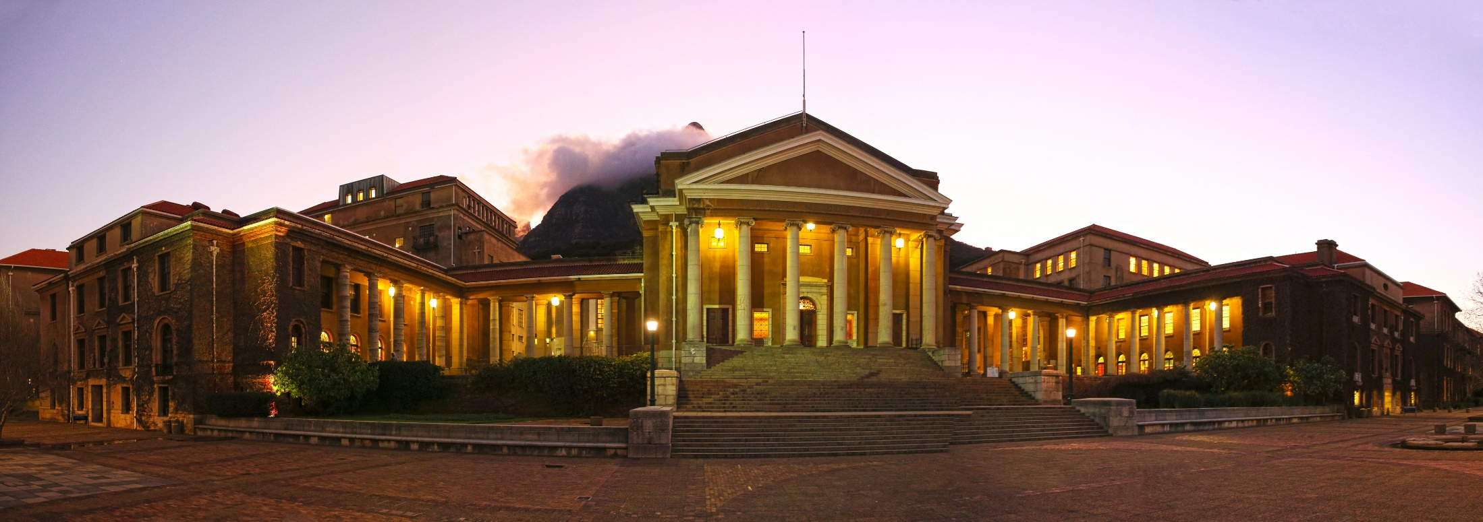
QUESTIONS?

Slide 19
presenters
Michelle Cook
Yolokazi Quwe
Systems Analyst
University of Cape Town
Michelle.cook@uct.ac.za
Manager: Student Fees
University of Cape Town
Yolokazi.quwe@uct.ac.za
all Alliance presentations will be available for download from the Conference Site

Slide 20
THANK YOU

