Slide 1
Student birds of a feather
SESSION 5067
10/11/2017

Slide 2
Overview
Birds of a Feather gives you the opportunity to meet your SIG members and find out what they have been doing, discuss priorities and raise issues.

Slide 3
ANZ Student SIG
Who are the SIG and what do they do?

Slide 4
What does the SIG do?
ANZ Student Special Interest Group
Monthly conference calls with Oracle
Collating regulatory requirements (Aust & NZ)
Working with Oracle on regional issues
Informing and communicating with ANZ Student community
Organise and facilitate ANZ Student Track at Alliance Down Under
We represent you!

Slide 5
SIG Members
Matt Barton (UniSA)
Clinton Lamont (Griffith) - Student Admissions AG
Jason McIntyre (USC)
René Oosthuysen (UNITEC)
Jonathan Peters (ANU)
Shayne Simpson (USC) - Student Records AG
Leah Vaz (USQ)
Suzanna Wong (UQ) - Financial Aid AG
Liz Kitto (UoA)

Slide 6
New SIG members
Marcia King
Fed Uni
Linda Cecere
Adelaide

Slide 7
SIG Members leaving us in ‘17
Rim El Kadi
ANU
Alison Krishnadas
RMIT
Renee Picton
UON

Slide 8
Open Discussion

Slide 9
TOPIC
Is anyone who has upgrade to version 9.2 using the new forms builder functionality?
If so what has been your experience? What types of forms have you implemented and how successful have they been?
Michelle Nunn
Federation University
mc.nunn@federation.edu.au

Slide 10
TOPIC
What systems do you use for scholarship (both government and university) application and assessment processing?
Kristin Humphreys
University of Southern Queensland
kristin.humphreys@usq.edu.au

Slide 11
TOPIC
Higher Degree Research reporting. What are institutions doing for reporting, especially those with the Research bolt-on? Are any institutions performing data conversion from the bolt-on to use the Oracle delivered functionality for Thesis Submission and Completion Dates?
Suzanna Wong
University of Queensland
s.wong7@uq.edu.au

Slide 12
Commonwealth Assistance Forms (CAFs)
in EOL
Opting in to optional loans
Verified citizenship requirement
Self-service eCAF reactivation

Slide 13
Background
DET introduced the eCAF portal in Jan 2017.
From May 2017, RMIT posts all students eligible for a CAF to the portal. These students receive an invitation email and login credentials
Complaints from students about eCAF spam. Exacerbated by deleting/reposting for past census dates
Agreed solution with DET is to only post student CAFs where student has indicated interest in the CAF.
Changed rules for deleting/reposting eCAFs:
only when Census Date has passed
students initiate eCAF reactivation

Slide 14
Changes from 6 Oct 2017 (4/4)
My Student Record
The View Commonwealth assistance form link has changed to Manage Commonwealth assistance and optional loans.
Students can opt-in to an optional loan if citizenship is verified.
Students can reactivate an expired or lapsed CAF if they have a valid future census date
Submitted and Approved CAF statuses display

Slide 15
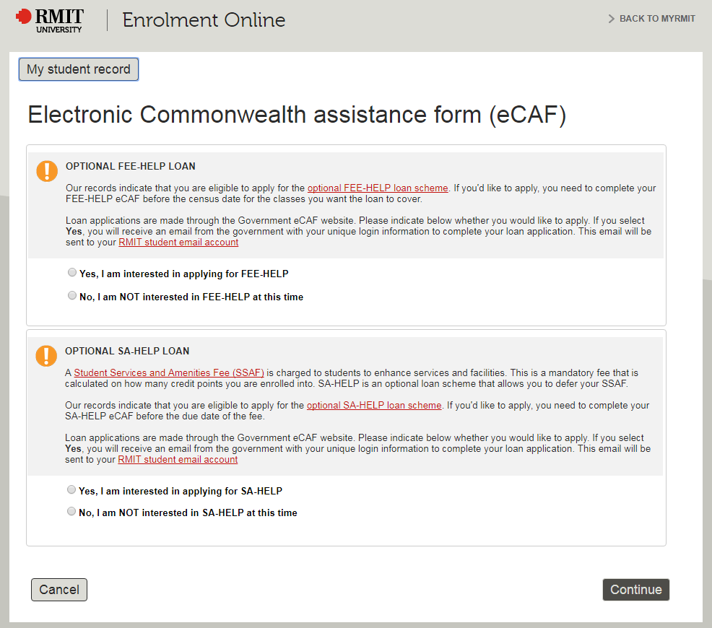
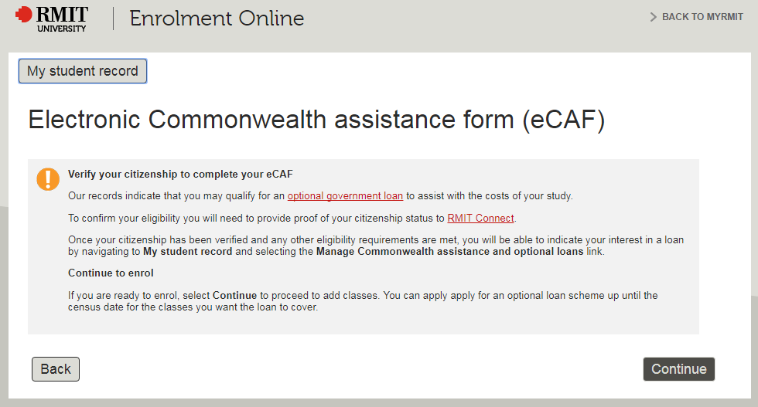
FEE-HELP and SA-HELP
...unverified citizenship

Slide 16
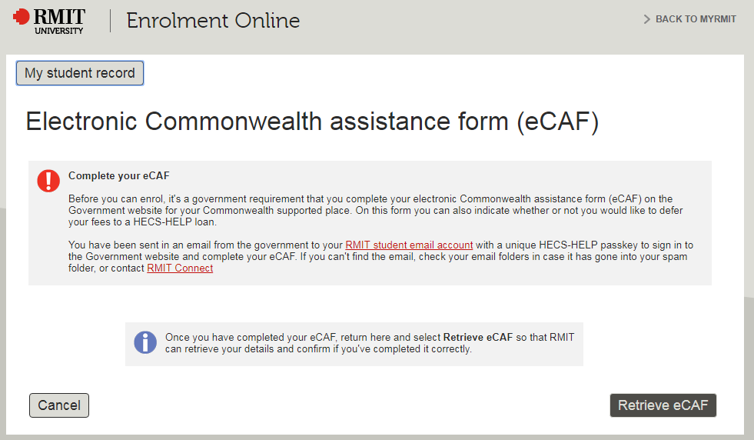
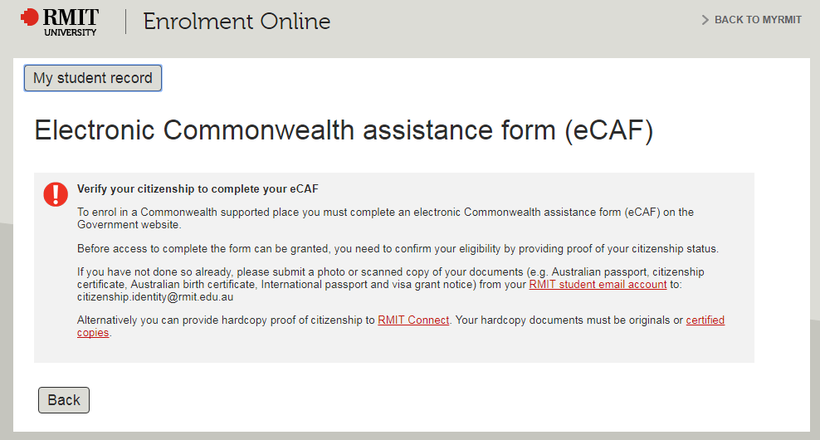
HECS-HELP (1/2)
...unverified citizenship
Notes:
ID: 3508970

Slide 17
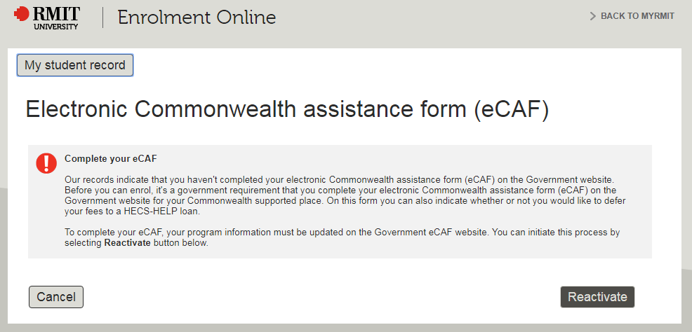
HECS-HELP (2/2)
...Expired / Lapsed (past census date)
Notes:
ID: 3508970

Slide 18
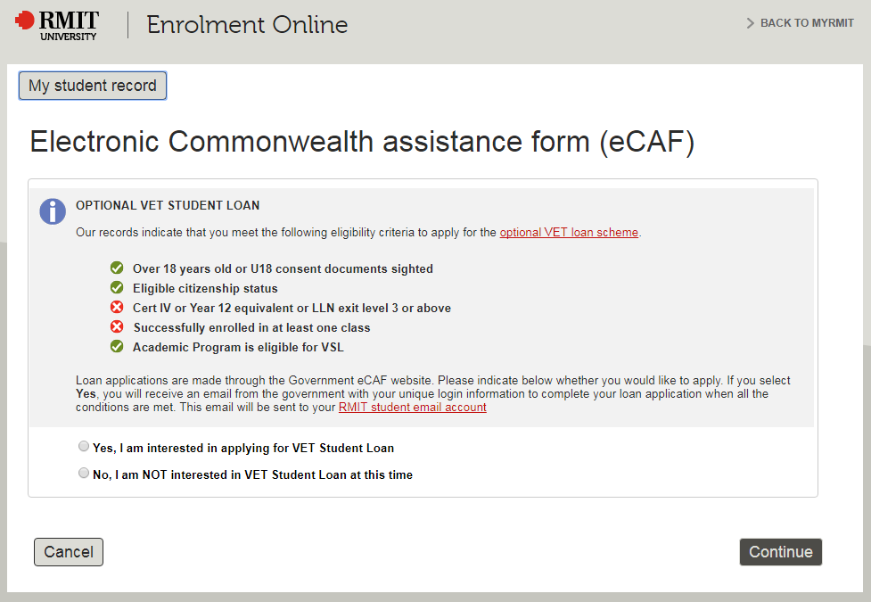
VET Student Loan (VSL) (1/2)
...unverified citizenship
Notes:
Eg ID 4043397

Slide 19
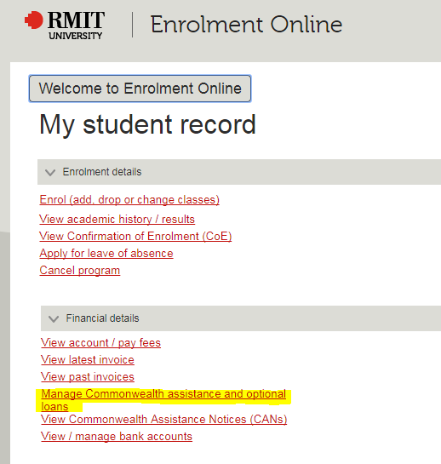
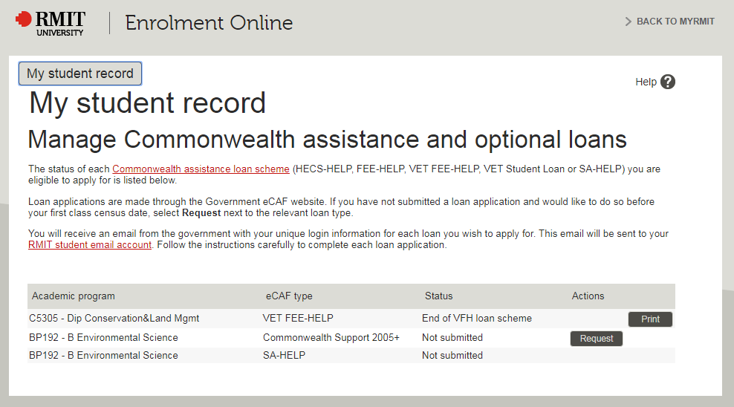
Manage CAFS & optional loans
Notes:
ID: 3508970

Slide 20
Issues
The initial implementation sought to use the APIs provided by the Government to automate integration as much as possible. The following pains were felt:
Initial upload to the portal was by spreadsheet as webservices were not ready. This resulted in missing staging records which we later came to rely on (eg missing gCAFIDs that were later required for other services like VSL progression compliance)
The Government ‘lapses’ CAFs when the census date uploaded to the portal has passed. This means the student can no longer submit their CAF. To reactivate the CAF for the student requires a DELETE webservice to delete the lapsed CAF and a REPOST of their CAF data. Each delete/post spawns two emails to the student. If the Census date is volatile (eg flexible enrolment terms), this can result in a lot of webservices being called for the same student to delete/reactivate. Students are spammed with email which generates complaints to DET and the provider.

Slide 21
When the institution’s password expires the services fail. There is no warning that the password used by the integration layer is about to expire.
The government can change their APIs with little notice. It may not be obvious that when they introduce a new ‘optional’ element it may actually break the webservices.

Slide 22
Get involved
Log GSC cases through My Oracle Support
Raise Enhancement requests via Enhancement Tracker on HEUG online - keep them up to date and vote
Votes are used by the AG’s and Oracle to prioritise the delivery of fixes or enhancements
Use the HEUG listservs to ask questions and provide answers
Participate in surveys and volunteer for working parties/focus groups.
Communicate with the ANZ Student community at:
anz.stulist.heug.org@list.heug.org

Slide 23
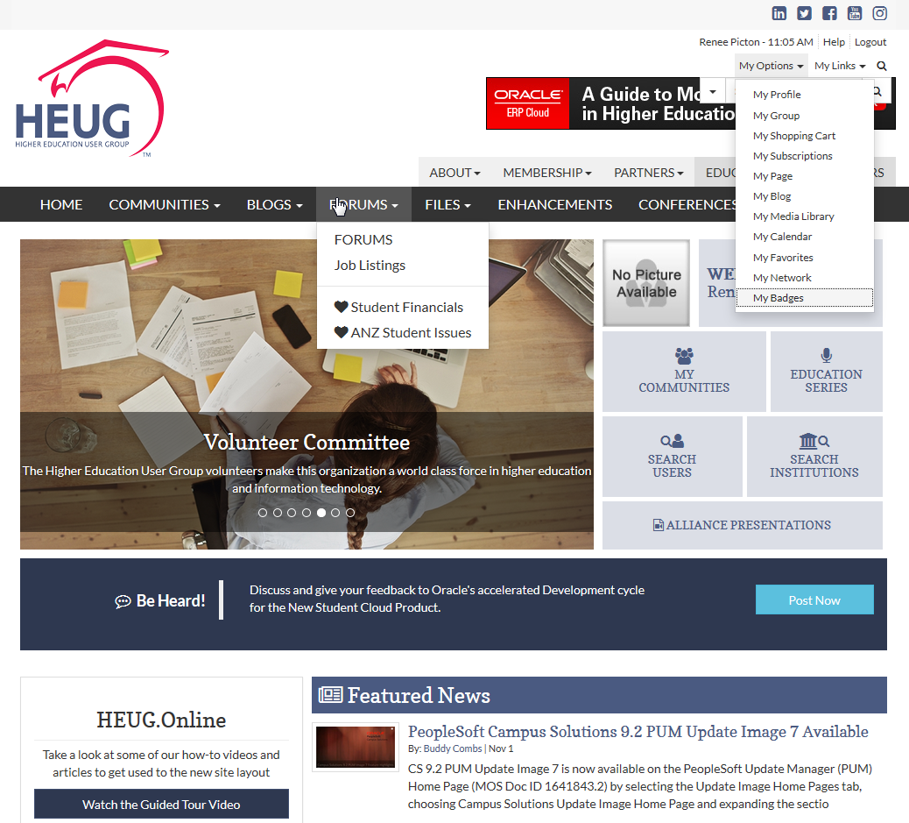

Slide 24
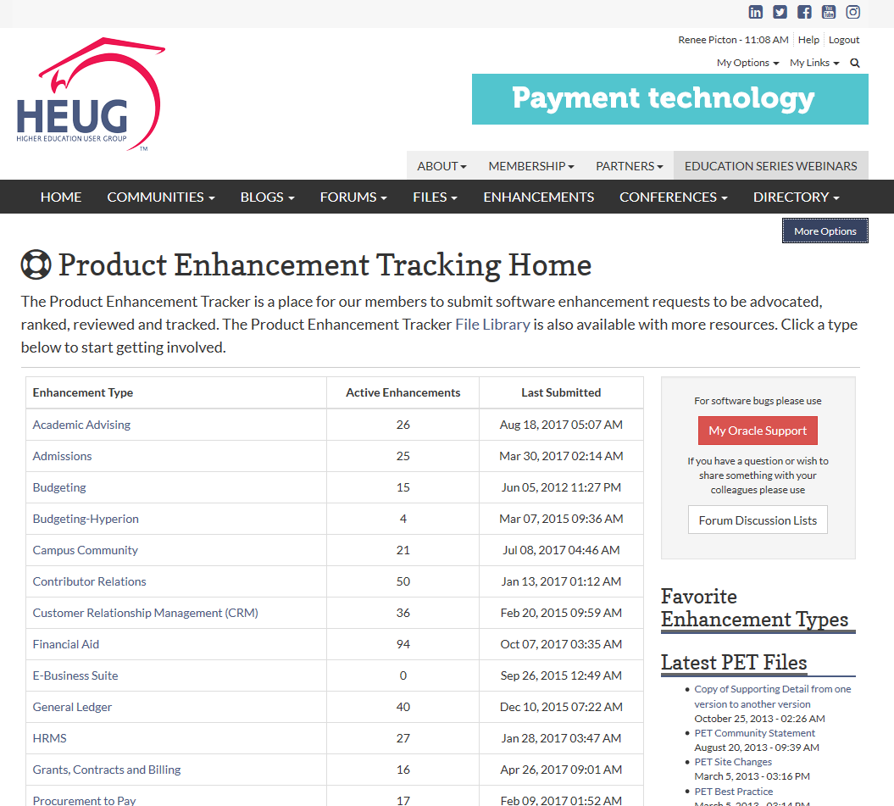

Slide 25
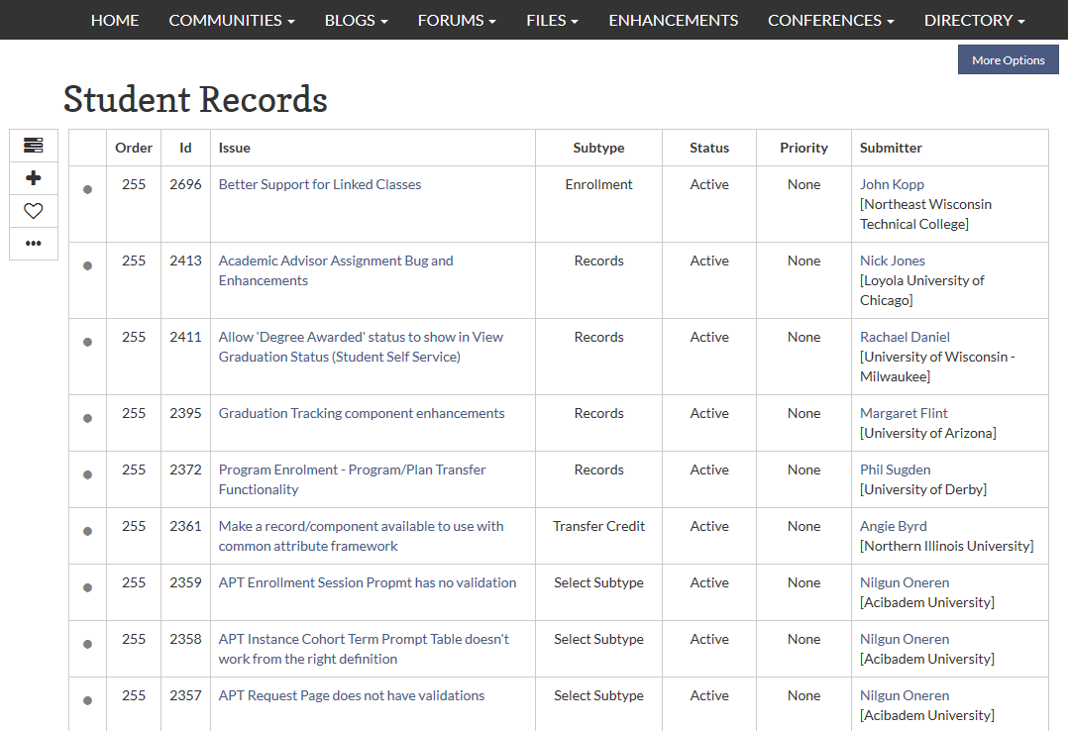

Slide 26
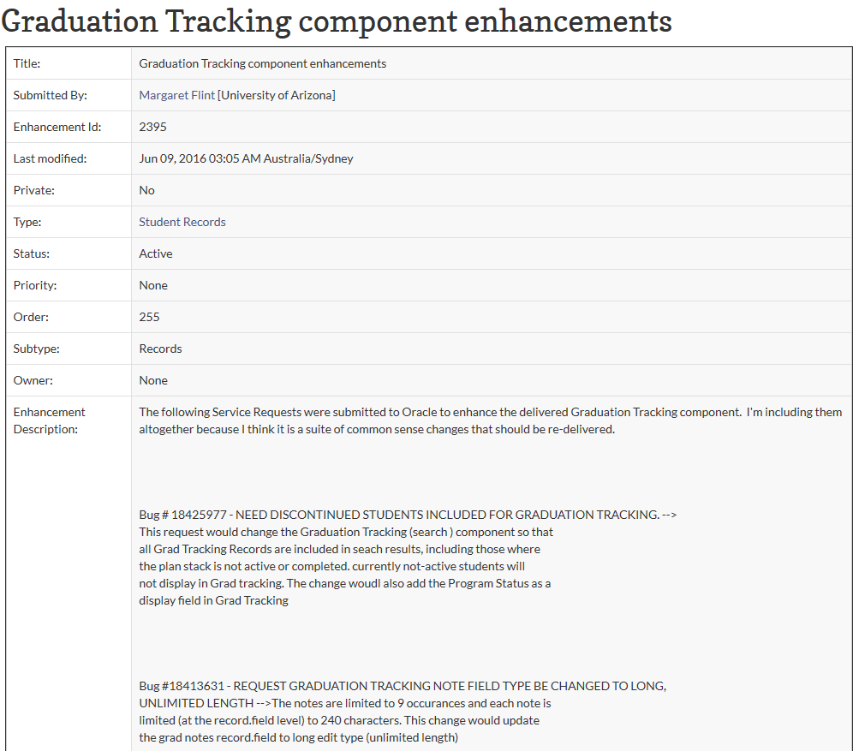

Slide 28
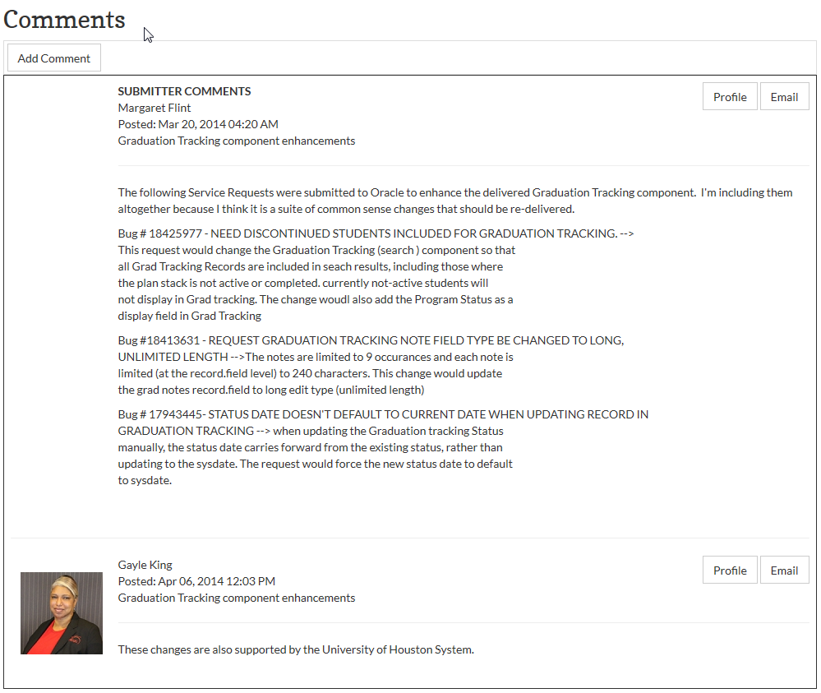

Slide 29
Contact Us
Contact any of your ANZ Student SIG representatives
Matt Barton
Clinton Lamont
Jason McIntyre
Shayne Simpson
Jonathan Peters
Liz Kitto
René Oosthuysen
Suzanna Wong
Leah Vaz
Marcia King
Linda Cecere
all Alliance presentations will be available for download from the Conference Site

Slide 30
Concluding thoughts
ANY QUESTIONS?

Slide 31
THANK YOU!

