Slide 2
Admission Application is now Online
Presenter Information
Ashar Rahman
IT Project Manager
Abu Dhabi University
ashar.rahman@adu.ac.ae
Co- Presenter Information
Vani Kovilakathu
ERP Functional Analyst
Abu Dhabi University
vani.kovilakathu@adu.ac.ae
SESSION 1004
Nov 16, 2016

Slide 3
Admission Application is now Online
Agenda
Overview
Business Process
Benefits
Lessons Learned
Next Steps
Questions

Slide 4
Admission Application is now Online
Overview
Under Graduate, Post Graduate, Short Courses.
Live with Campus Solutions since 2010
Admissions, Student Records, Student Financials, Academic Advisement
Online Admission live since Fall 2015.

Slide 5
Admission Application is now Online
Business Process
Application Submission
Initial Screening
Application Review by College
Admission Offer

Slide 6
Admission application is now Online
What was changed?
Notes:
Paper based application forms.
Students can apply only from university or through the University Campaigns .
Admission People used to have lot of manual work entering application details in the system.
Application fee payment was a tiring process, students has to visit cashier’s to pay the application fee.
All the letters related to admission has to be manually prepared

Slide 7
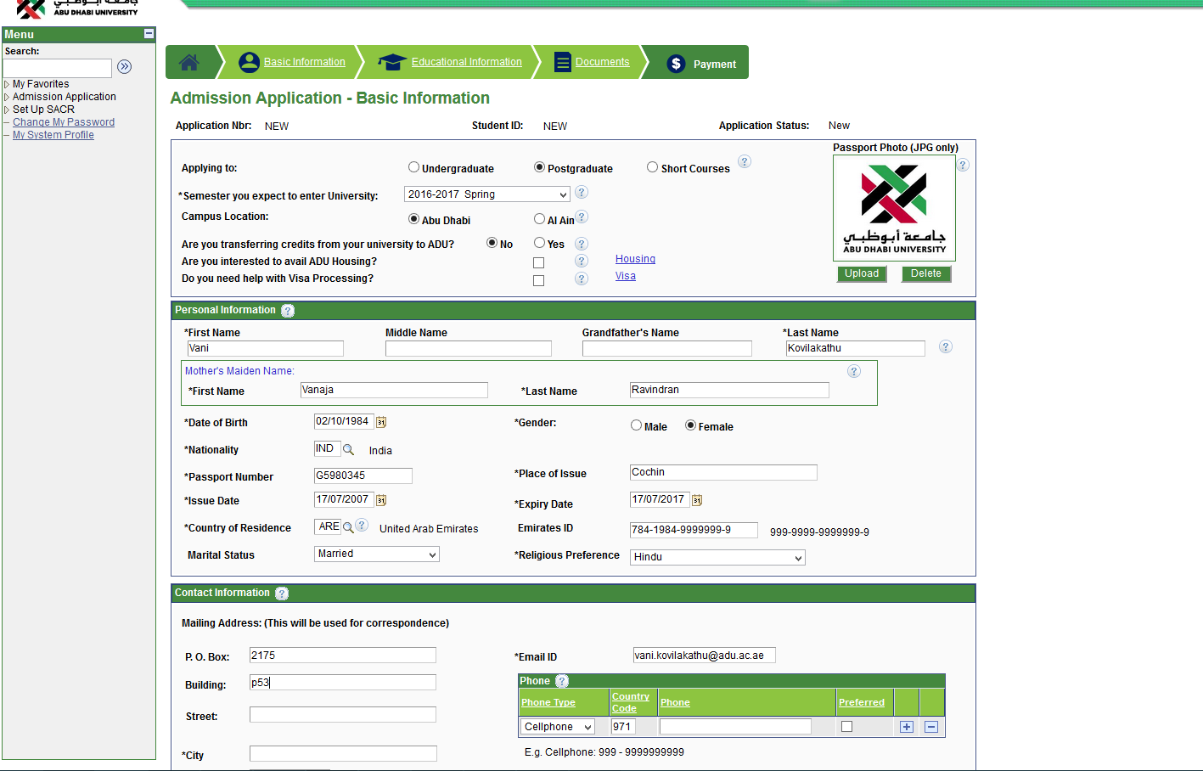
Admission application is now Online
What was changed?
Notes:
Students can submit the application from any where in the world.
Application review is happening online, students are getting updated on each progress on their application .
Applications sent to Colleges for further approval has been shifted to Online
All the letters Related to admission has been automated.
Information about an applicant can be easily tract from Online application.

Slide 8
Admission Application is now Online
What was changed?
Online Admission Application Portal
Single application across careers.
Online Application Review
Communication with Applicant.
Online Offer Letters.
Admission WorkCenter

Slide 9
Admission Application is now Online
How does it work?
Applicants Registration
4 Step Application Form
Online Application Fee Payment
Application Screening
Application Review by Colleges
Communication with Applicant
Offer Letters
Admission WorkCenter
Integration with Student Admissions
Integration with CRM
Notes:
Student can go to ADU web site and apply online
First step students needs to register in the website with required details

Slide 10
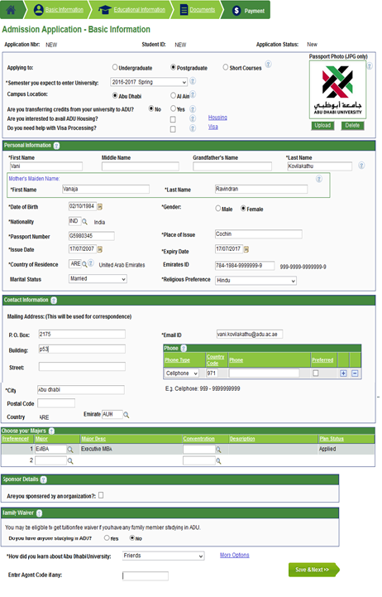
Admission Application is now Online
Notes:
Student needs to fill the Personal details in the Basic information Tab.
Specify the Career the student is trying to get admission
Specify the Term ,Campus, choose the Major .
If the student is getting transferred from other universities ,needs to specify the details

Slide 11
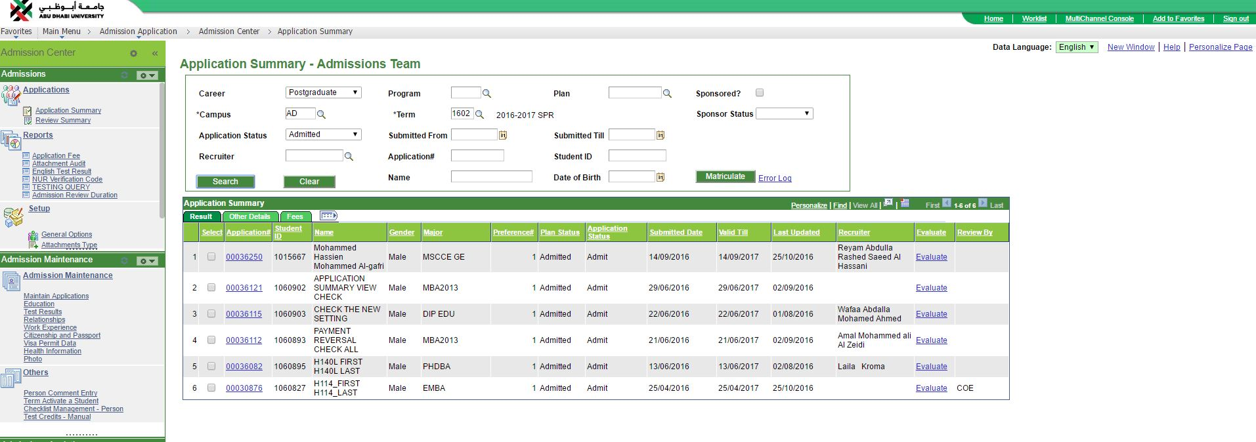
Admission Application is now Online
How does it work?
Notes:
Application submitted by student will get evaluated by Admission staff.
Admission Staff will evaluate the Attachments submitted by Students
Basic information
Also the Education details entered by the student.

Slide 12
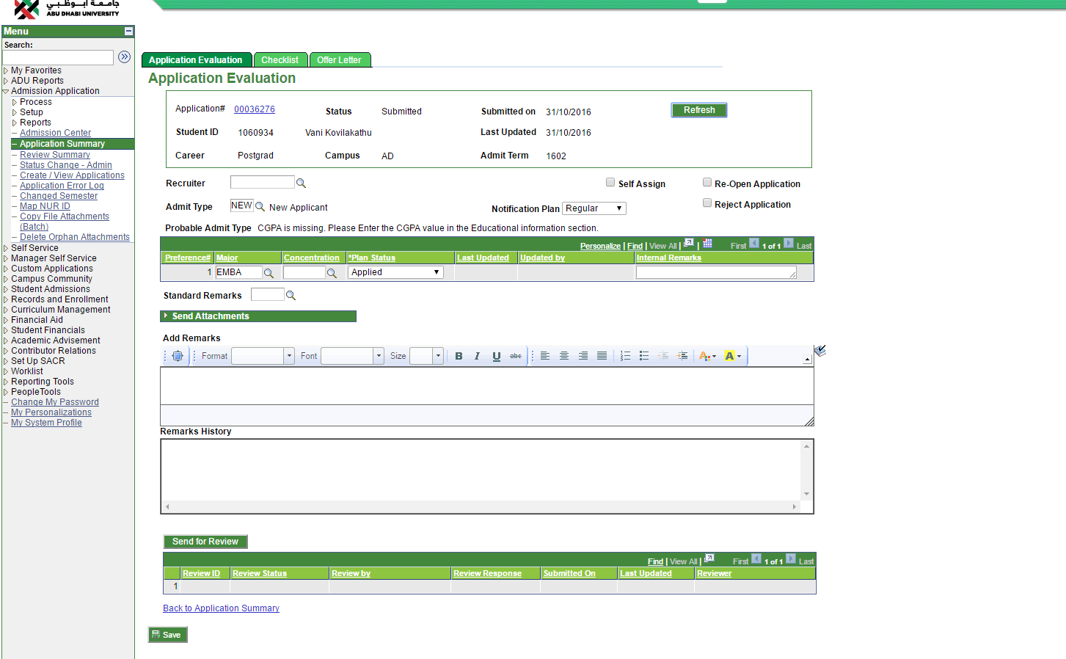
Admission Application is now Online
How does it work?
Notes:
Once the Admission sent the application for Review, College deans and the Program directors will get notified via email.
College Deans will review the applications and the documents attached , based on the evaluation College dean will admit or reject the students. Students will get notified about the decision taken.
Review status also will get updated as Completed once Dean approve the application.

Slide 13
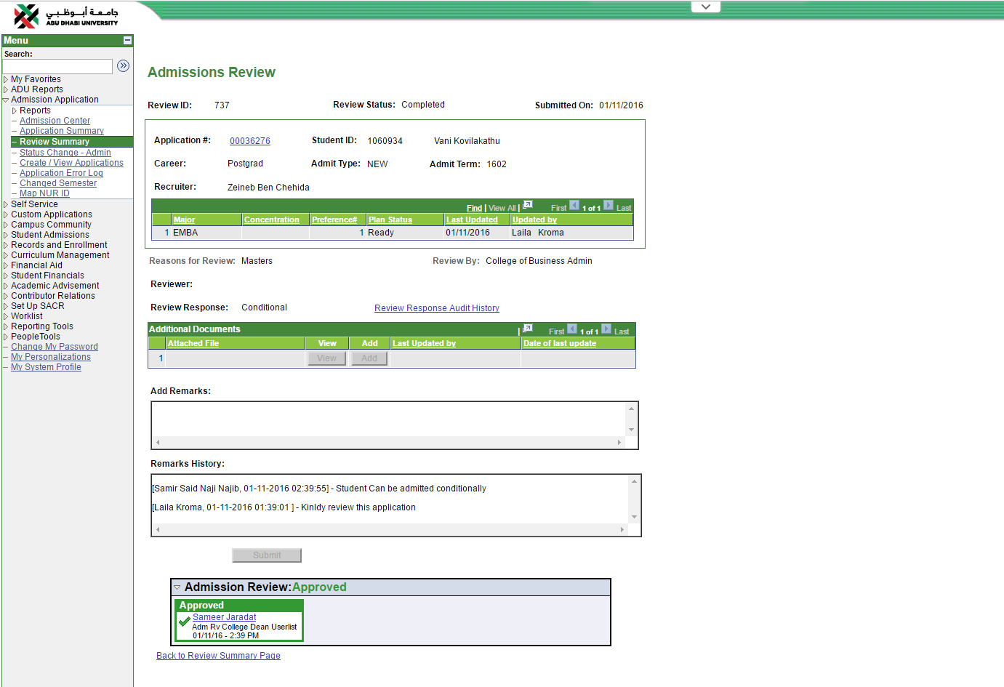
Admission Application is now Online
How does it work?
Notes:
Once the Admission sent the application for Review, College deans and the Program directors will get notified via email.
College Deans will review the applications and the documents attached , based on the evaluation College dean will admit or reject the students. Students will get notified about the decision taken.
Review status also will get updated as Completed once Dean approve the application.
Once the application Review is completed by College, Admission Team will send the offer letter to students, based on the type of admission offer letter template will automatically change.
Then Admission team will matriculate the student, Applicant will be an active student in the system, student can proceed to take courses in ADU.

Slide 14
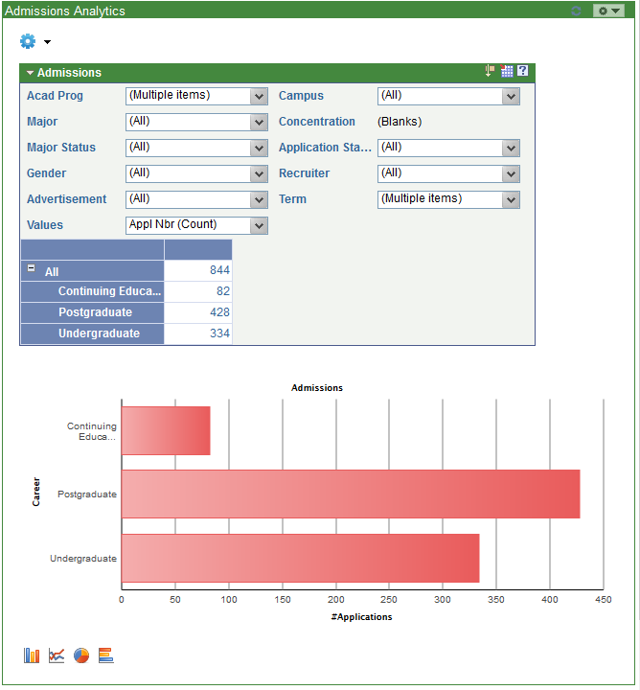
Admission Application is now Online
How does it work?
Notes:
Once the Admission sent the application for Review, College deans and the Program directors will get notified via email.
College Deans will review the applications and the documents attached , based on the evaluation College dean will admit or reject the students. Students will get notified about the decision taken.
Review status also will get updated as Completed once Dean approve the application.
Once the application Review is completed by College, Admission Team will send the offer letter to students, based on the type of admission offer letter template will automatically change.
Then Admission team will matriculate the student, Applicant will be an active student in the system, student can proceed to take courses in ADU.

Slide 15
Admission Application is now Online
What we like
Paperless Admission
No misplaced/lost applications
Reduced turnaround time
Application Fee is not lost
Better Reporting/Analytics
Integration with CRM

Slide 16
Admission Application is now Online
Lessons Learned
Involve business users in all stages of the project
Conduct several iterations of UI design review
Conduct conference room pilots

Slide 17
Admission Application is now Online
Next Steps
UI Redesign

Slide 19
Thank you

