Slide 1
Page & Field Configurator – Hands on
SESSION 4538
October 10th, 2018
09:00 AM – 09:50 AM Antwerp

Slide 2
presenters
Lukas Degens
Wouter de Bruin
Consultant
CY2
lukas@cy2.nl
Partner
CY2
wouter@cy2.nl
Lukas is a functional consultant who enjoys working internationally and has experience working in Ghana, the Netherlands, Spain, Belgium and Turkey. Lukas’ hunger for knowledge, his enthusiasm and adaptability is quite impressive as he seeks to continuously extend his experiences with Oracle PeopleSoft Campus Solutions.
In 2001 Wouter started his career working with version 7.5 as a functional specialist. Nowadays Wouter combines business consultancy with account management and pre-sales.

Slide 3
Cy2
CY2 is a global reference partner of educational institutions for training and guidance. We aim for state of the art solutions related to student information services.

Slide 4
TOPICS
1
3
5
INTRODUCTION
DEMO
TIME TO GET INTERACTIVE!
2
4
6
HOW CAN IT HELP YOU?
LET’S GET HANDS-ON!
LET’S DISCUSS!

Slide 5
INTRODUCTION
What is the Page & Field Configurator?

Slide 6
WHAT IS the Page & Field Configurator? – the main features
Hide fields and/or pages;
Modify the label for fields;
Disable entry for fields;
Make a field required;
Assign a default value to a field;
Make a page display-only;
This all can be done using roles, userid’s or you can apply changes to everyone with or without exceptions.
Notes:
Page & Field Configurator helps you customize the lay-out of fields and pages without the need for knowledge of PeopleCode or Application Designer. It’s main features are: Hide fields and/or pages;
Modify the label for fields;
Disable entry for fields;
Make a field required;
Assign a default value to a field;
Make a page display-only;
This all can be done using roles, userid’s or you can apply changes to everyone with or without exceptions.

Slide 7
WHAT IS the Page & Field Configurator? – REQUIREMENTS
Delivered functionality!;
PUM 8;
PeopleTools version 8.55.15 and 8.56.02 and up;
Navigation:
Enterprise Components > Page and Field Configuration > Page and Field Configurator;
Component name
Beware of pages with a lot of PeopleCode
Notes:
It is Delivered functionality!; It requires you to have
CS PUM 8;
PeopleTools version 8.55.15 and 8.56.02 and up;
How can you find it? Navigation: Enterprise Components > Page and Field Configuration > Page and Field Configurator;
You need the Component name of the page to configure. Does everyone know what a component is and how to find it’s name?

Slide 8
Sources
Some interesting links to information on Page and Field configurator:
https://www.youtube.com/watch?v=sbRfdZAERGg
https://docs.oracle.com/cd/F10139_01/ps91pbr11/eng/ps/eccp/concept_UnderstandingPageAndFieldConfigurator.html?pli=ul_d29e119_eccp

Slide 9
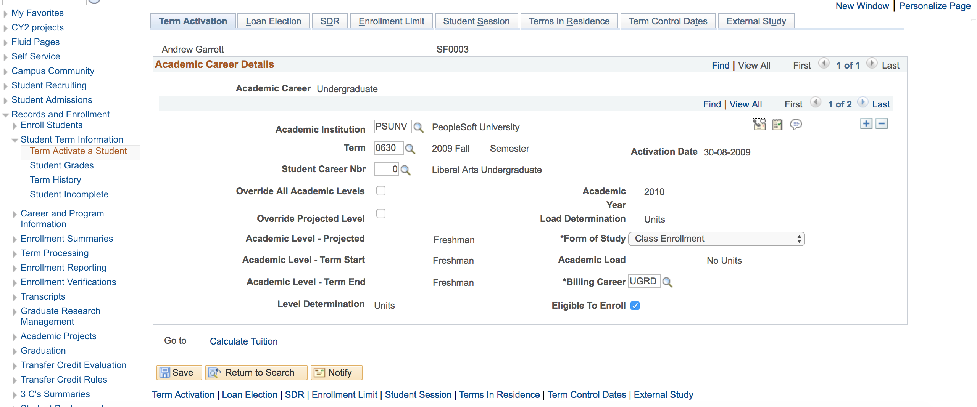
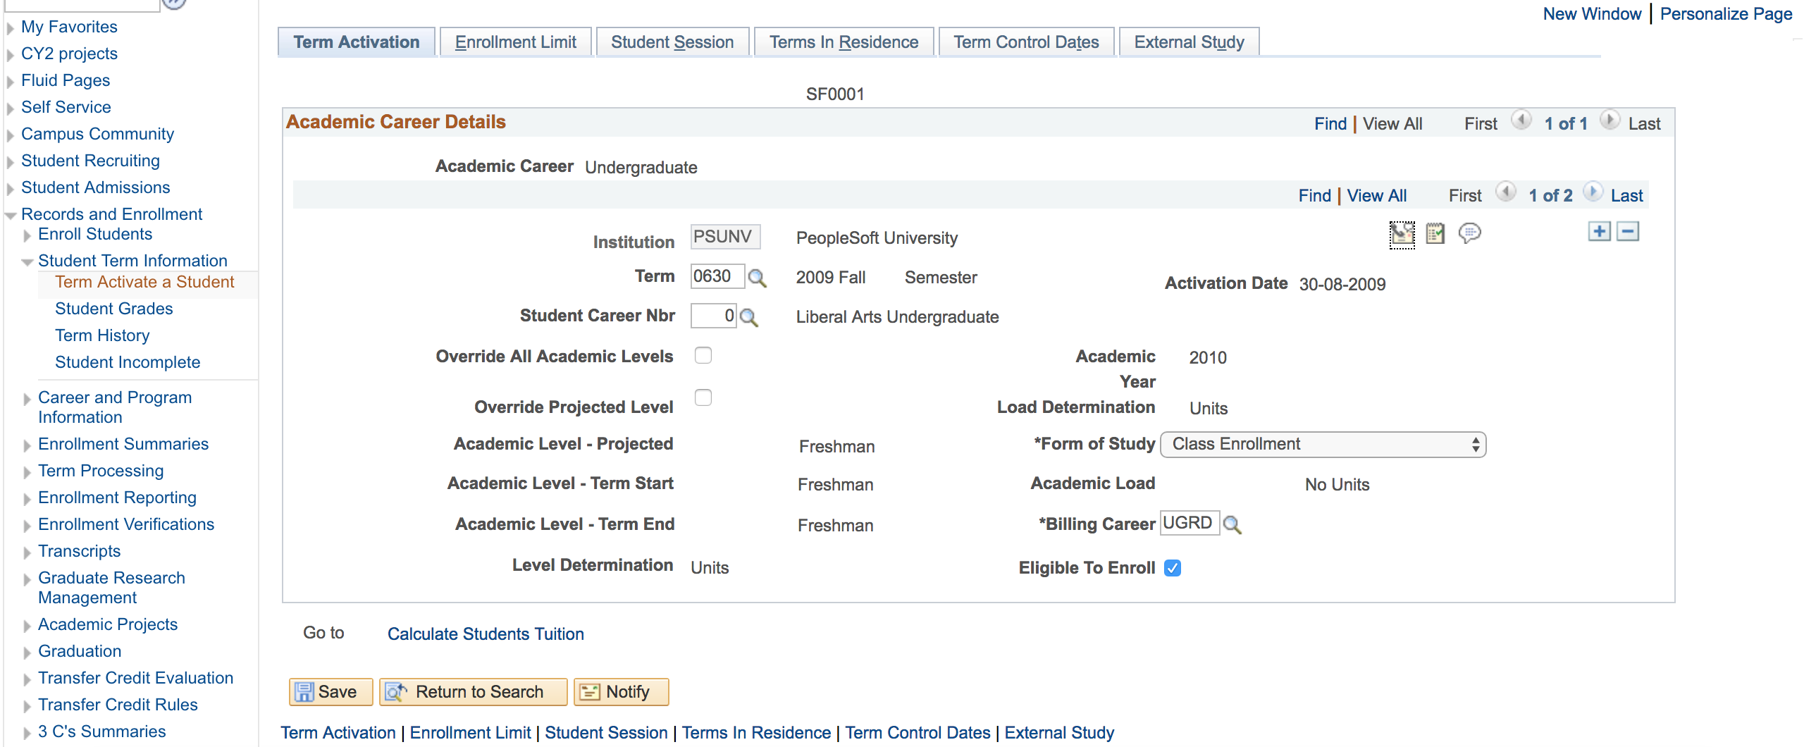
WHAT IS the Page & Field Configurator? – SPOT THE DIFFERENCES
Notes:
Can you spot the diferences?

Slide 10
HOW CAN IT HELP YOU?
Let’s go over some examples of when this can be of use

Slide 11
How Can it Help you? – Some Examples
Some real world examples
GDPR – Removing display name
Prevent mistakes – Field read-only and user group specific defaults & default values
User Experience – Hide irrelevant fields, add a default value
Fields – Change labels to replace translation
Notes:
You should consider using the page and field configurator if you are thinking about:
Implementing GDPR measures – for example to help you remove a displayed name
Want to help Prevent mistakes – you can Make irrelevant fields read-only and fill fields with a default value
Improve the User Experience – you can Hide irrelevant tabs (although this can also be done through the use of security) or add a default value to a field to make things easier
Changing Fields – you can Change labels to replace wrongful translation or to use them for a different purpose

Slide 12
demo
Let’s play!

Slide 13
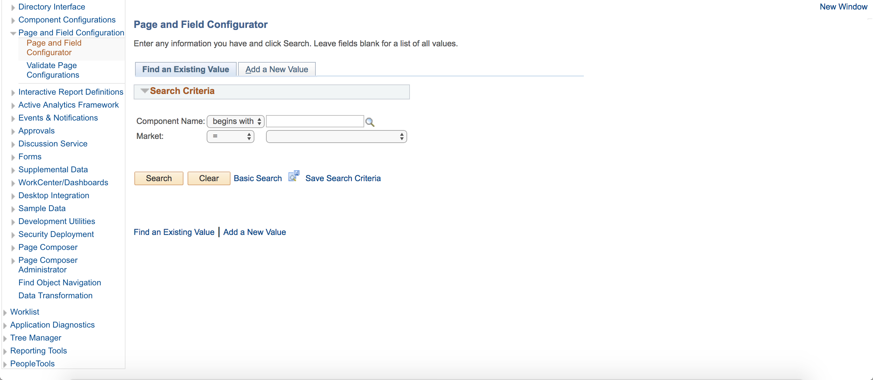
DEMO

Slide 14
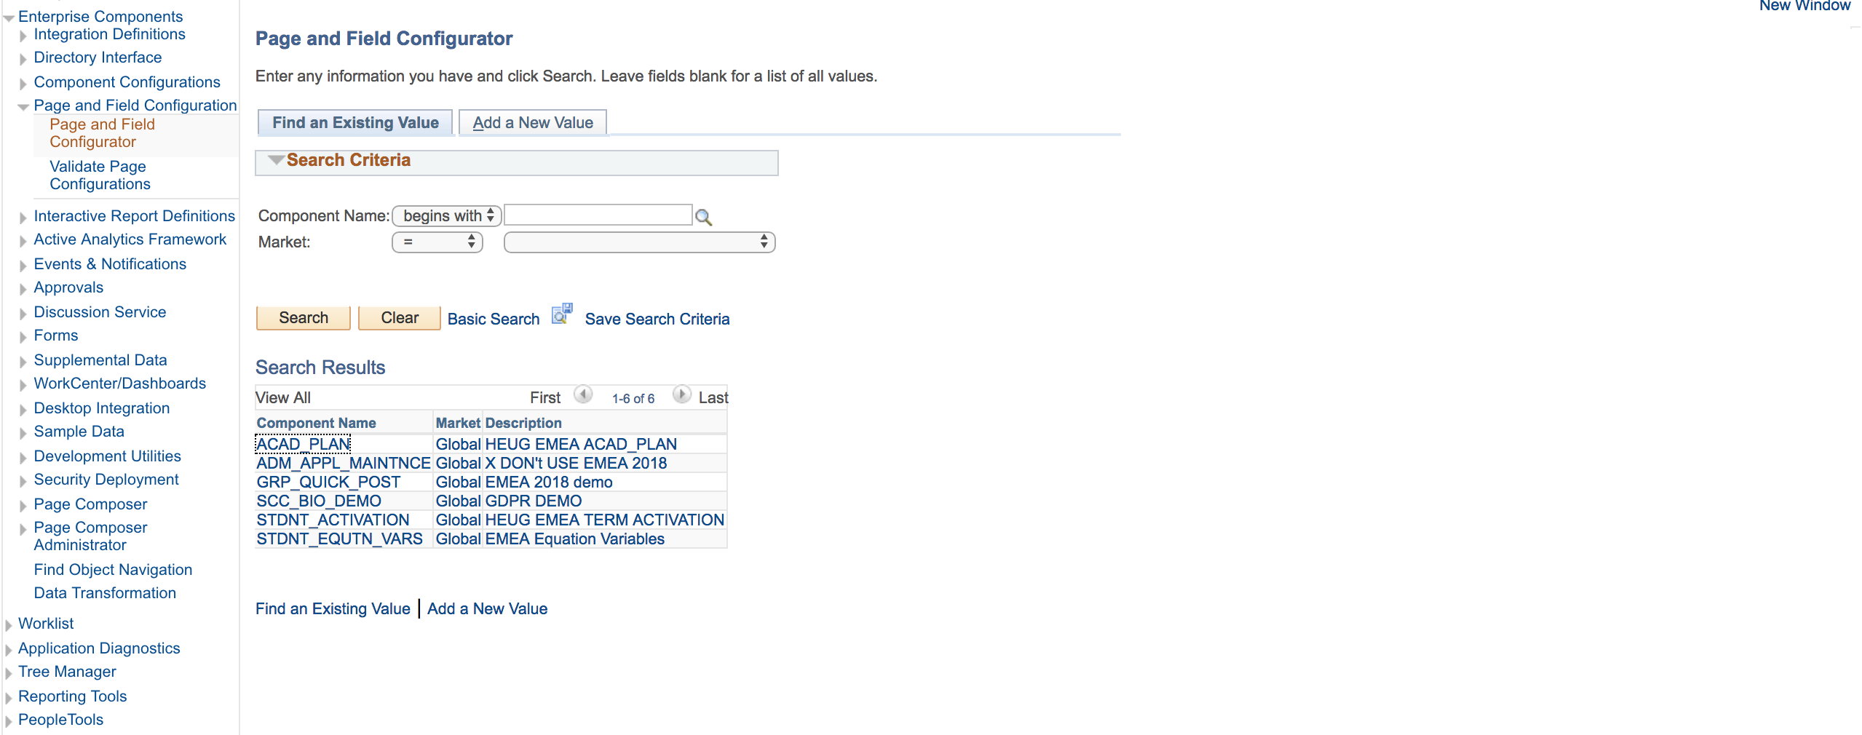
DEMO

Slide 15
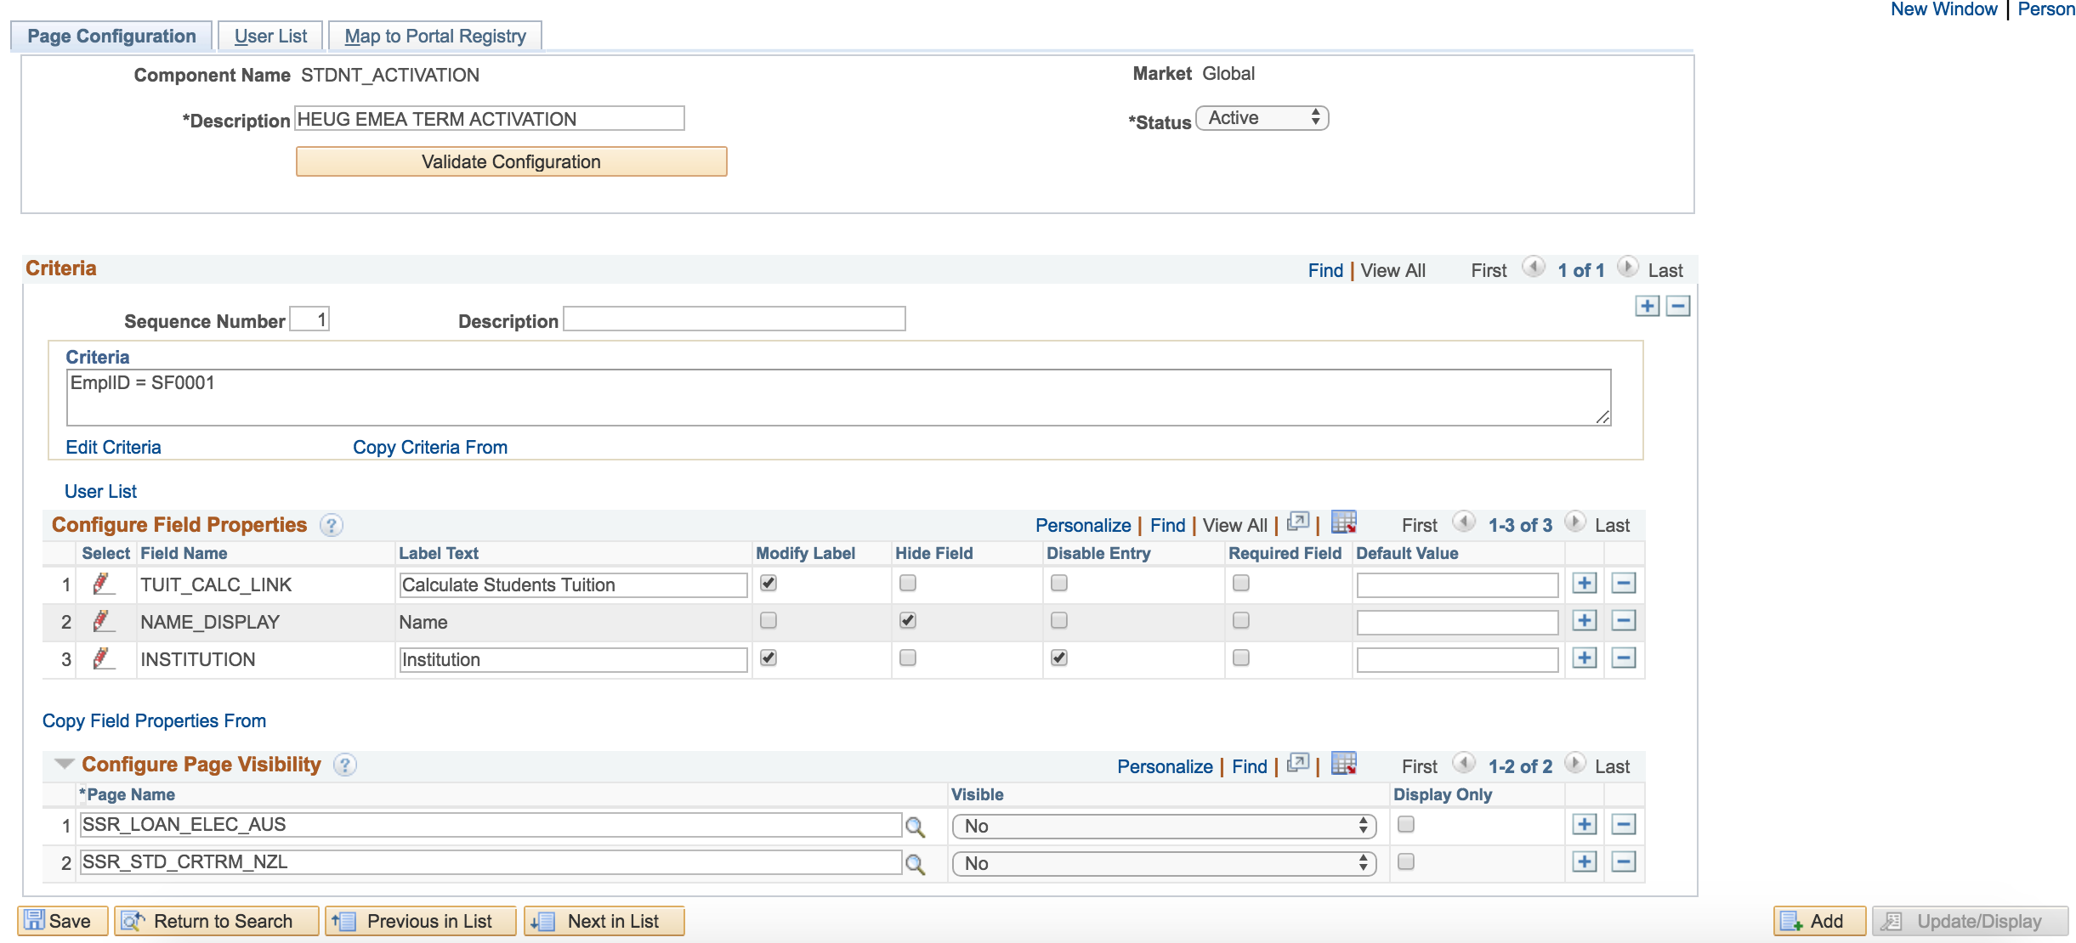
DEMO

Slide 16
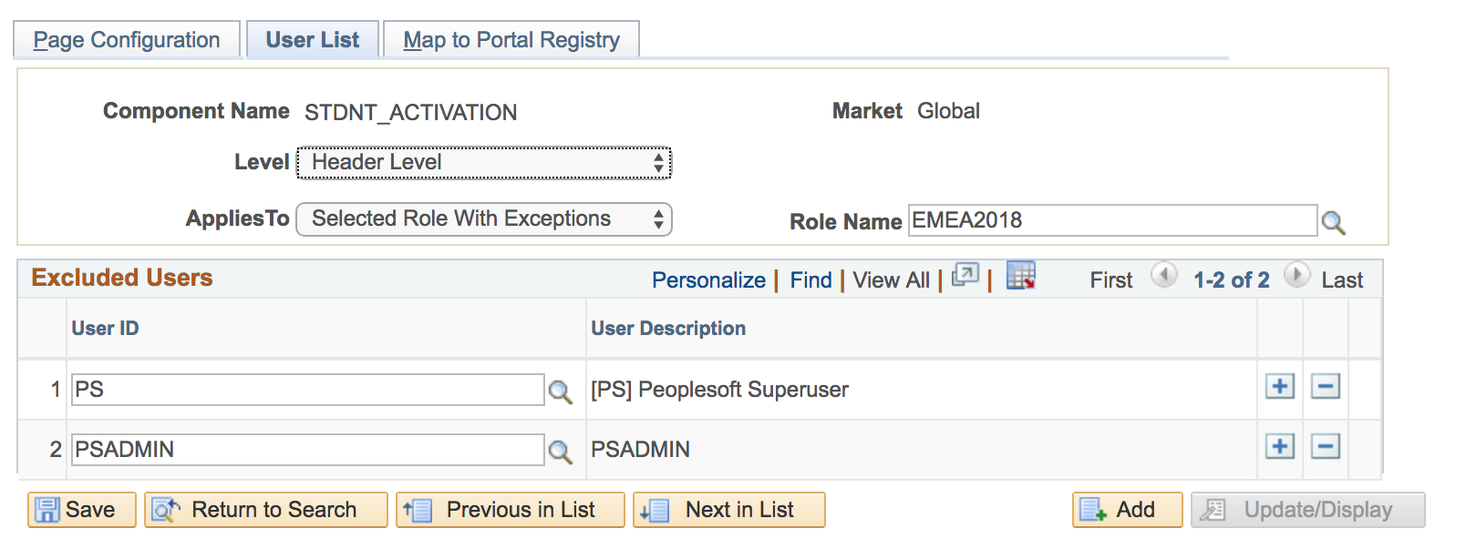
DEMO

Slide 17
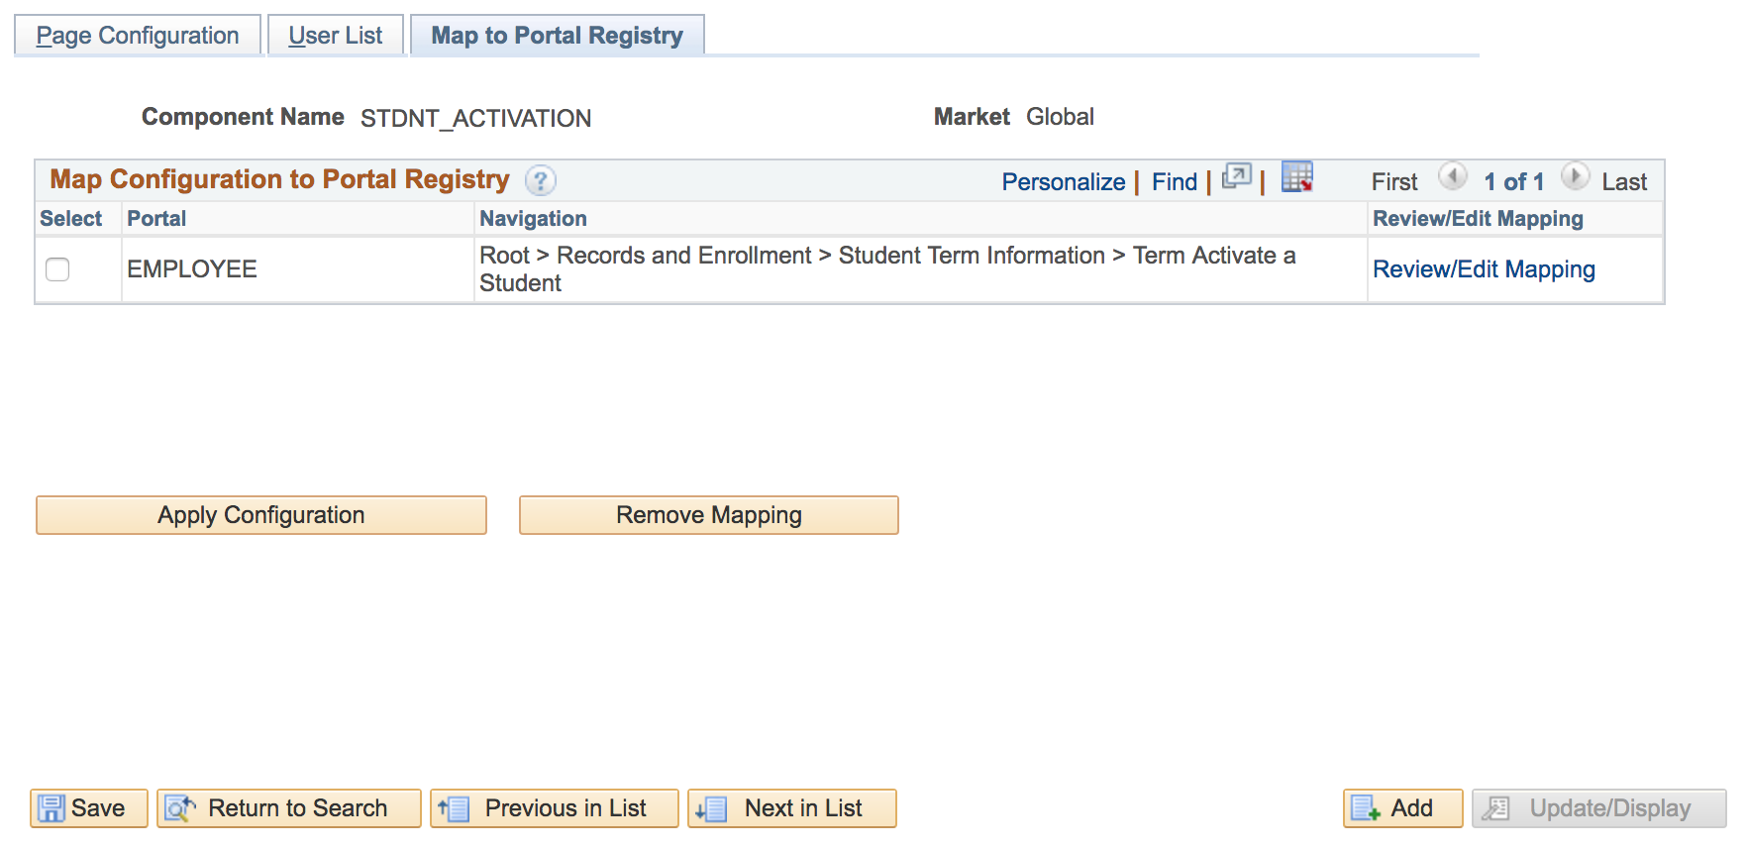
DEMO

Slide 18
DEMO

Slide 19
DEMO

Slide 20
LET’S GET HANDS-ON!
How can we use this on another page?
Notes:
Now, let’s get hands-on! We are going to use the RELATIONSHIP Component to:
Hide the Relationship Details tab;
Hide the suffix field;
Change the label of the SEX field to Gender
Disable entry on the related ID field
Make the PreFix field mandatory
And add the default value “Fill in details here” to the Comments field.

Slide 21
DEMO

Slide 22
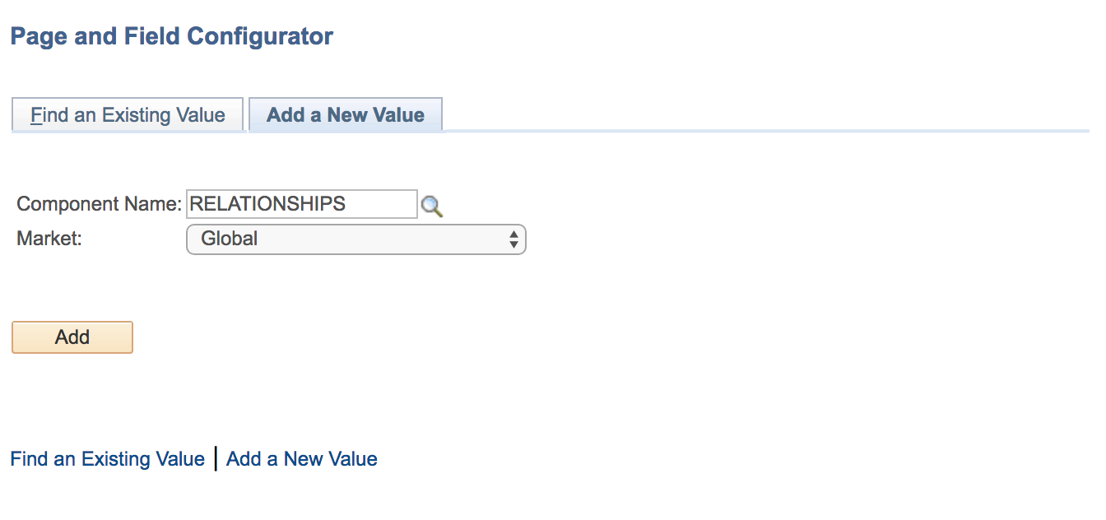
DEMO

Slide 23
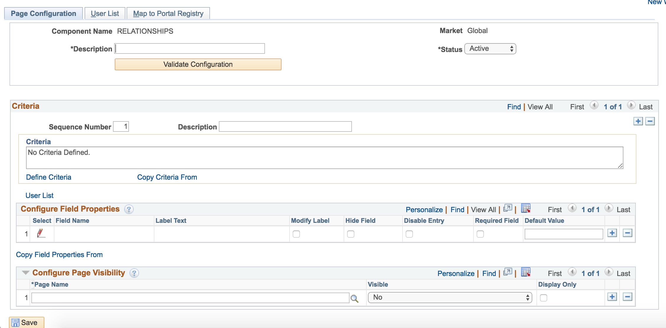
DEMO

Slide 24
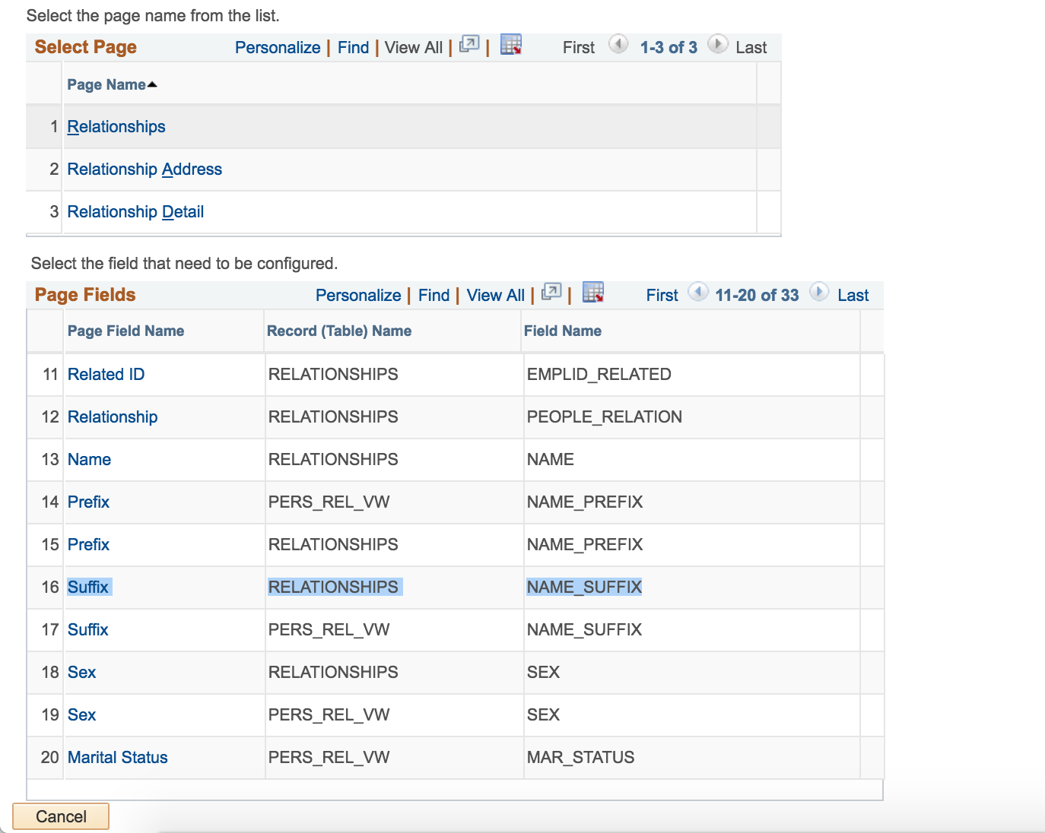
DEMO

Slide 25
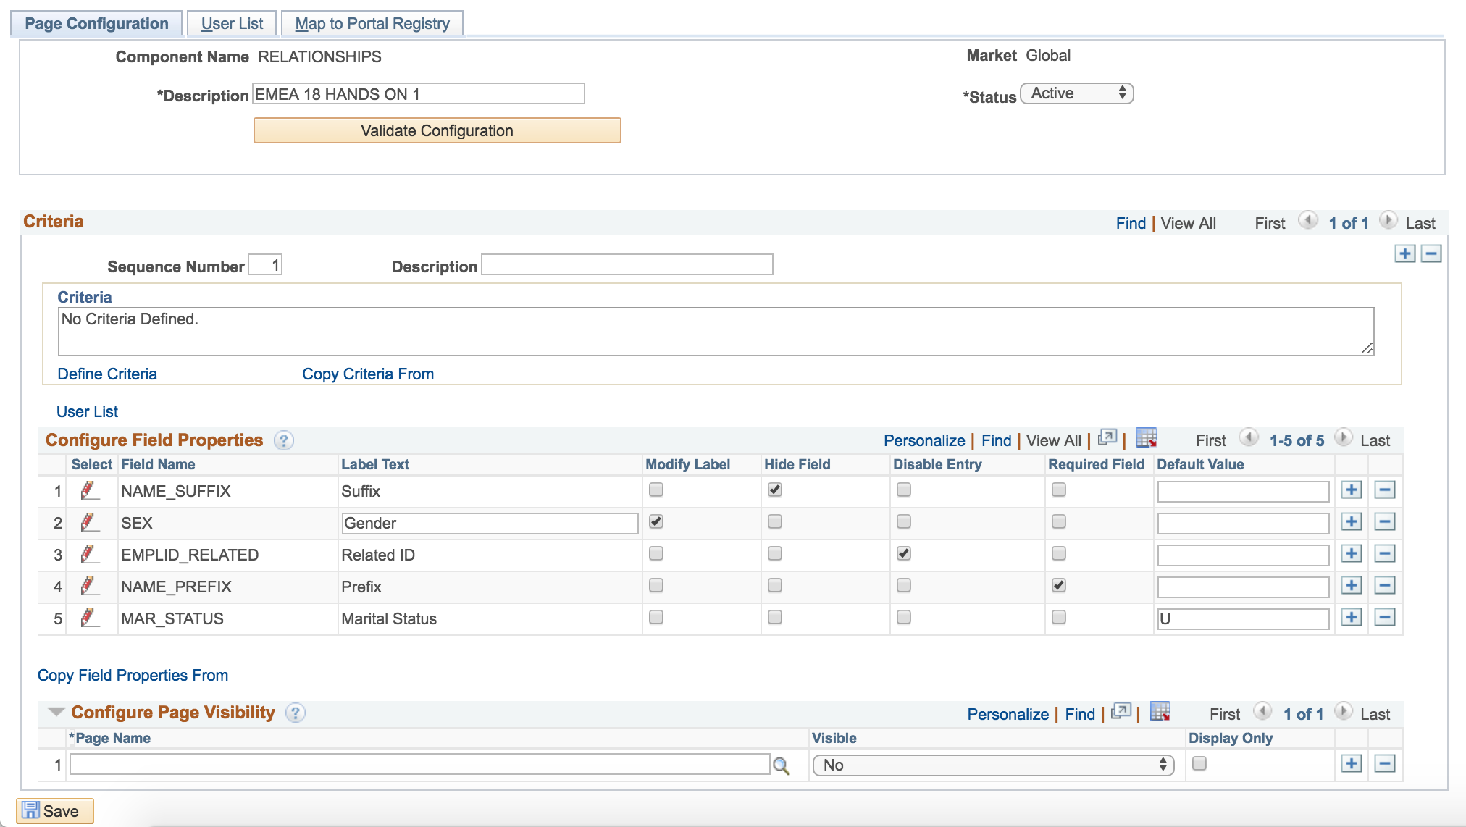
DEMO

Slide 26
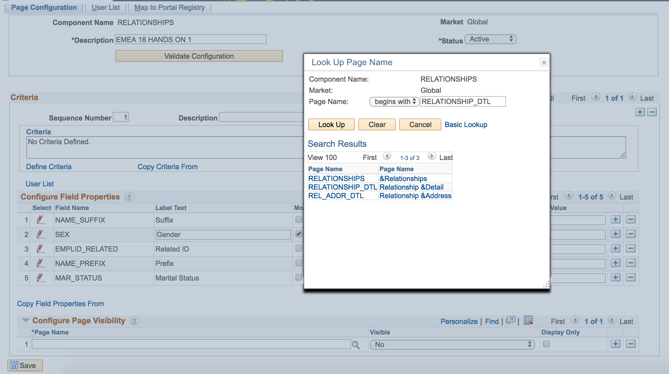
DEMO

Slide 27
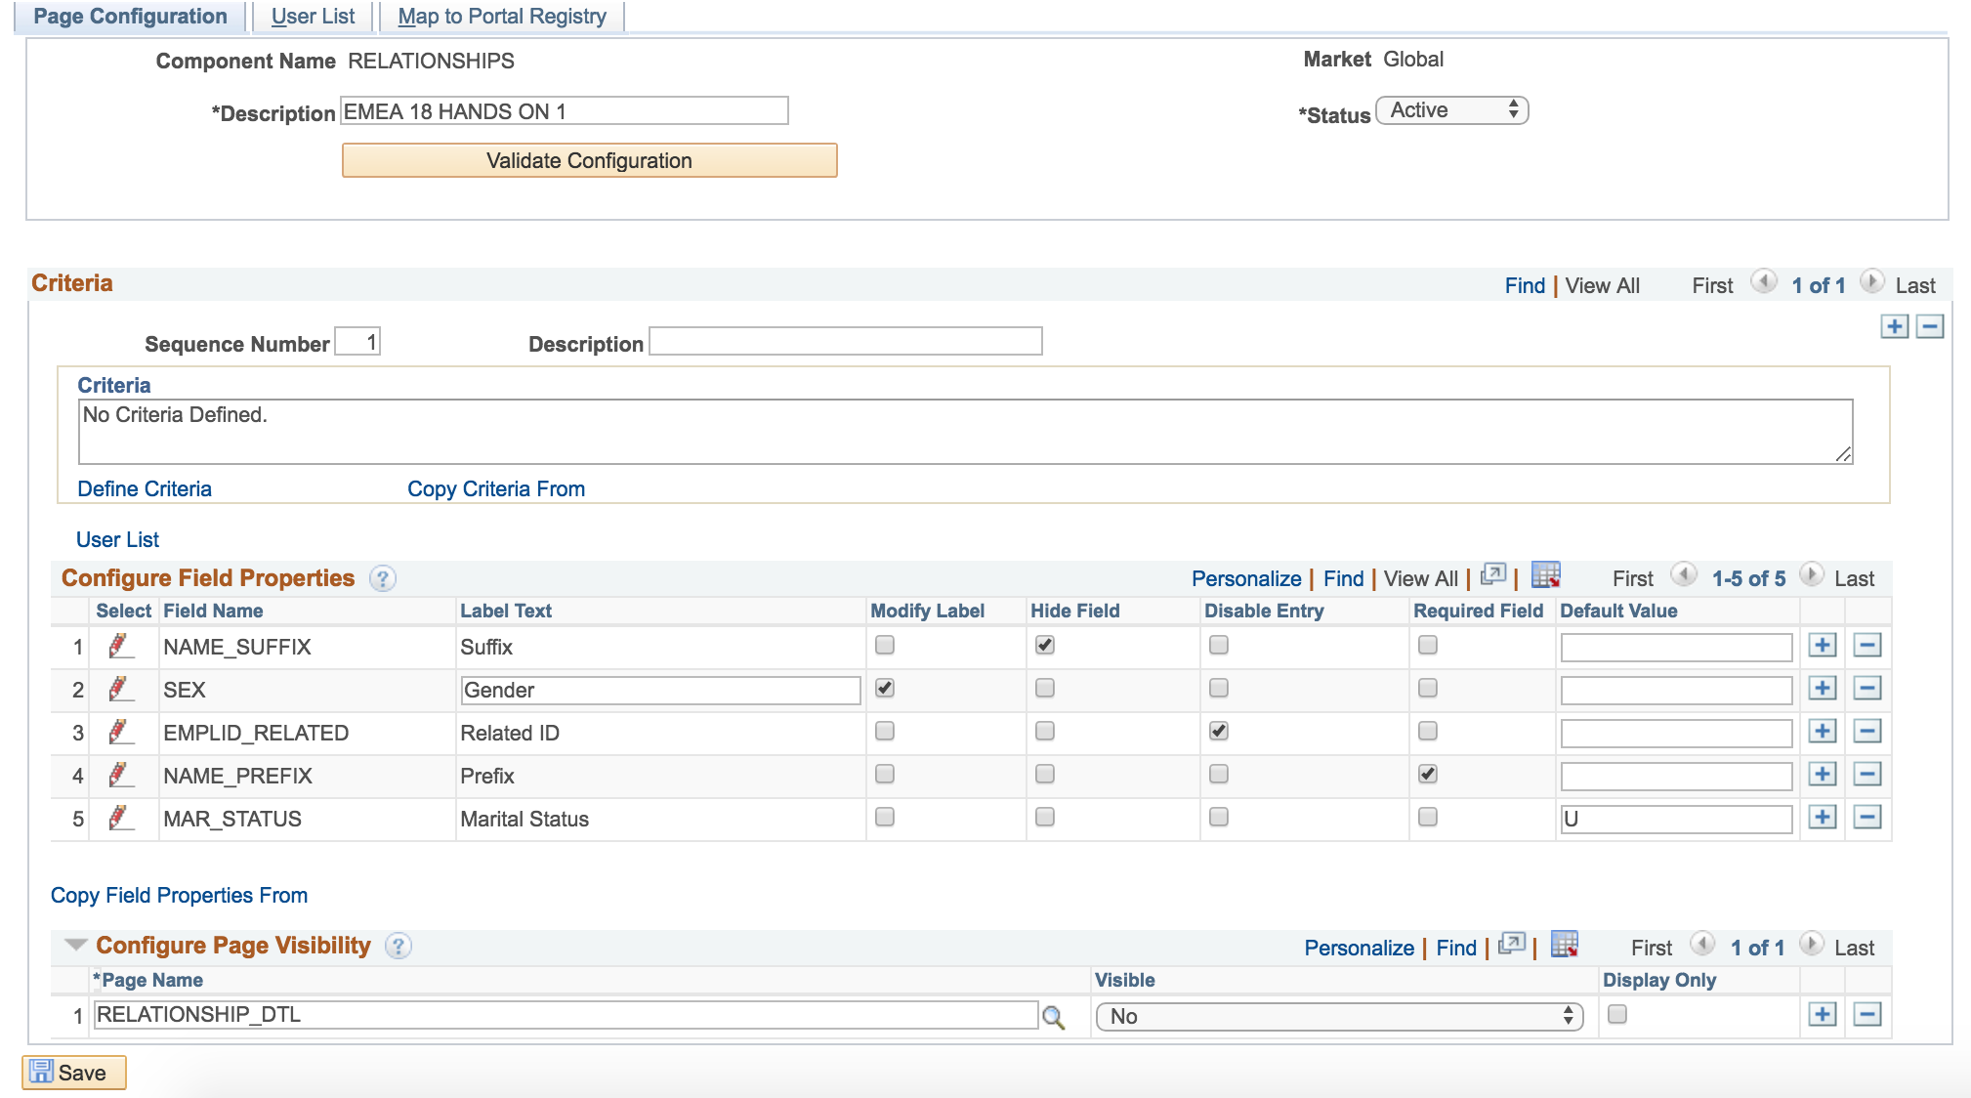
DEMO

Slide 28
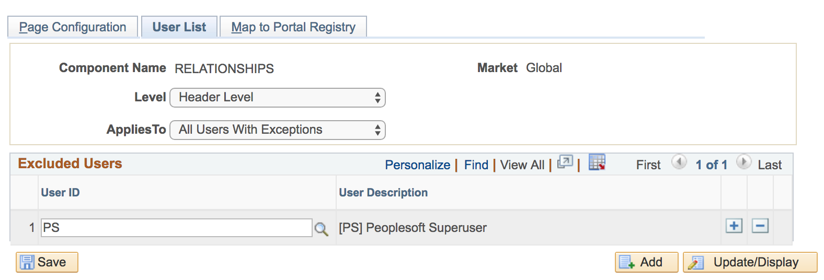
DEMO

Slide 29
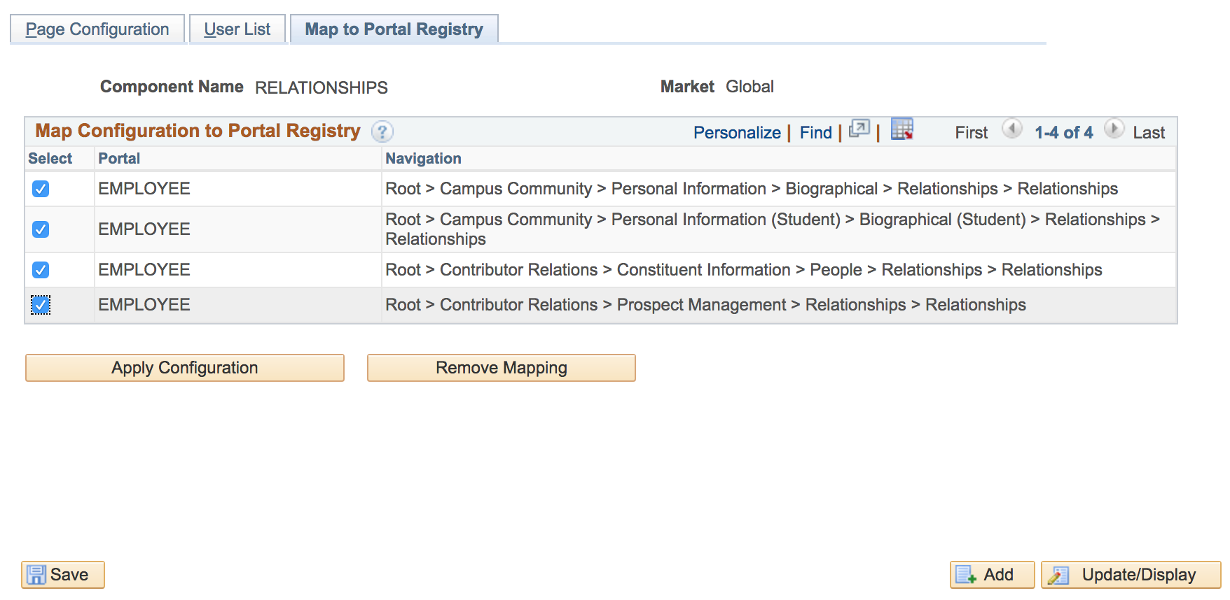
DEMO

Slide 30
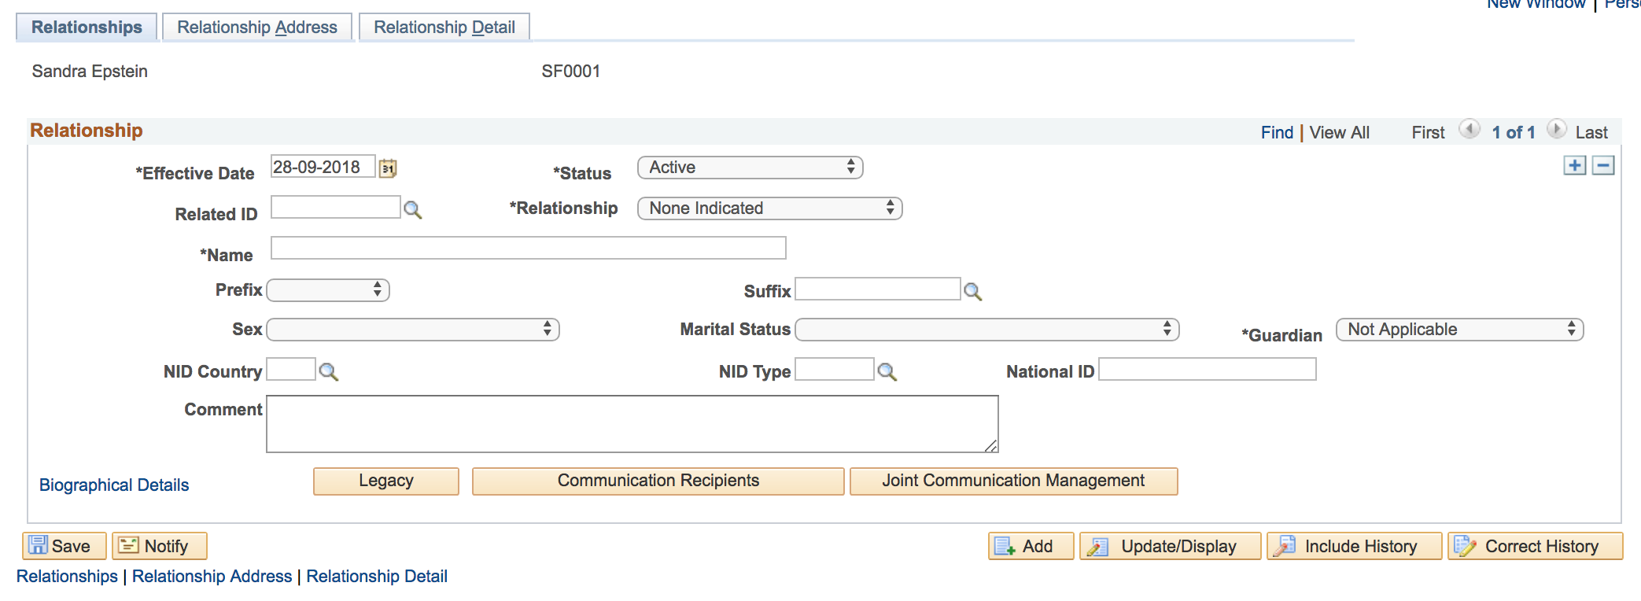
DEMO

Slide 31
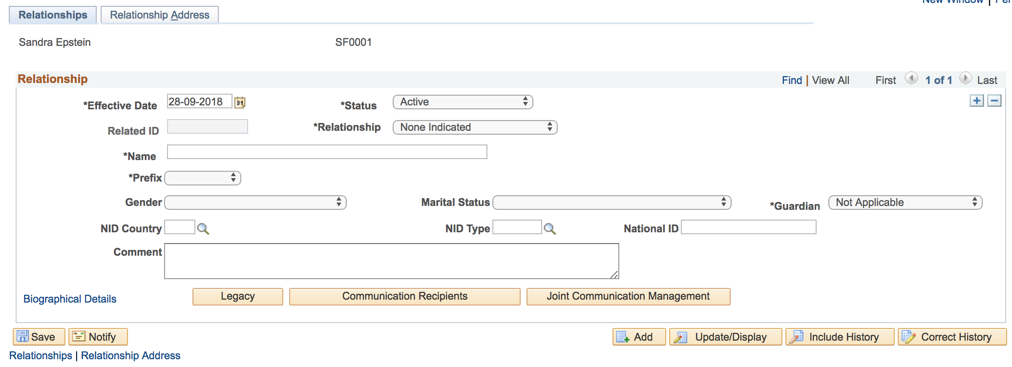
DEMO

Slide 32
TIME TO GET INTERACTIve!
Let’s do one together!
Notes:
Let’s do one toghether! Does anyone have a suggestion?
Let’s look at the page first
Take component name ctrl j
Go to page and field config
Edit (suggestions anyone?)
Let’s look at the results!!

Slide 33
LET’S DISCUSS!
How do you see this functionality be of use? Would you use it?
Notes:
You have seen quite a bit now, it is now time to share your thoughts! How (and) do you see this functionality be of use?
Do you think you would use it in the (near) future?

Slide 34
Concluding thoughts
SUMMARY
Notes:
Let’s go over a quick summary of what we have seen today

Slide 35
SUMMARY
Concluding, page and field configurator is…
EASY– Easy to use without the need for application designer and or knowledge of PeopleCode!;
VERSATILE – It can be useful in multiple scenario’s;
AVAILABLE – When your system meets the requirements it can be used out of the box;

Slide 36
Q&a
Do you have all the information to get started?
Notes:
Can you get started?
Do you have any questions?

Slide 37
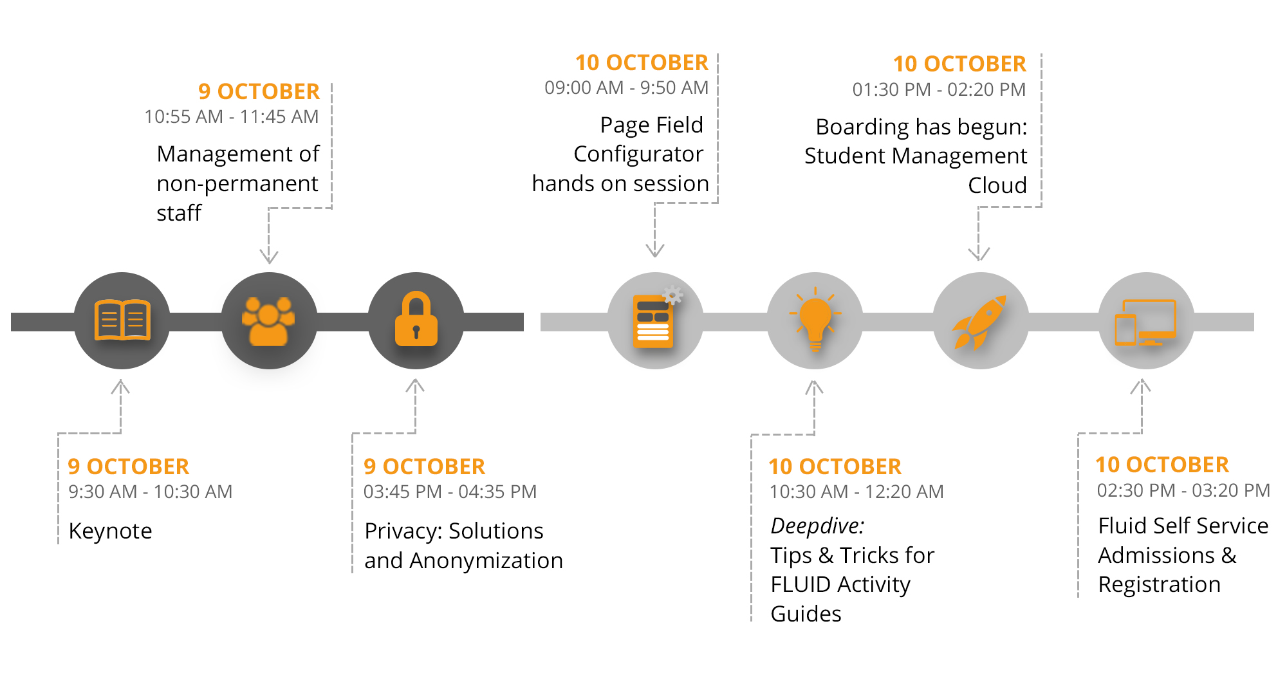
Session overview

Slide 38
presenters
Lukas Degens
Wouter de Bruin
Consultant
CY2
lukas@cy2.nl
Partner
CY2
wouter@cy2.nl
all Alliance presentations will be available for download from the Conference Site

Slide 39
THANK YOU!

