Slide 1
Data Privacy Framework in PeopleSoft
A complete solution for GDPR requirements?
Roel Griffioen, managing consultant

Slide 2
1.
2. Data Privacy Framework
3. Page and Field Configurator
4. Data masking
5. Roadmap and Conclusions
6. Questions and Answers

Slide 3
Epicenter
Dutch Oracle Consulting Firm, specialized in PeopleSoft and Oracle Cloud
→ Fit4Cloud

Slide 4
Anything I say about ‘upcoming’ stuff is protected by ‘safe harbour’
= Everything is based on rumours

Slide 5
Data Privacy Framework

Slide 7
Data Privacy Framework
Is about:
Personal identifiable info
&
Sensitive information
Some examples …
Can be used to uniquely identify whom it’s about
Data you wouldn’t want to give away in a bar unless …

Slide 8
EMPLID
PII
Not Sensitive

Slide 9
NAME
PII
Not sensitive

Slide 10
PHONE
PII
Sensitive

Slide 11
BIRTHDATE
Not PII
Sensitive

Slide 12
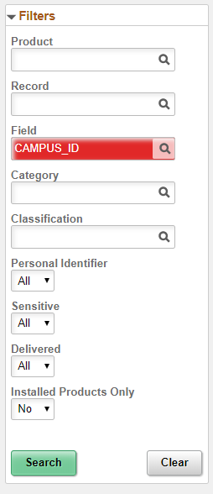
CAMPUS_ID
Not PII
Not Sensitive
According to Oracle
-
Can be changed

Slide 13
Delivered inventory
Record Fields
Filtering possible
Change PII/Sensitive*
Notes:
* bug: when just changing checkboxes and saving, the changes will not be committed to the database. SR created, see bug-ID https://support.oracle.com/epmos/faces/BugDisplay?id=30420476&parent=SrDetailText&sourceId=3-21292930251 . Workaround: also select a different classification on one of the rows, and then select the original back, after that save and all changes will be saved, including the checkboxes.

Slide 14
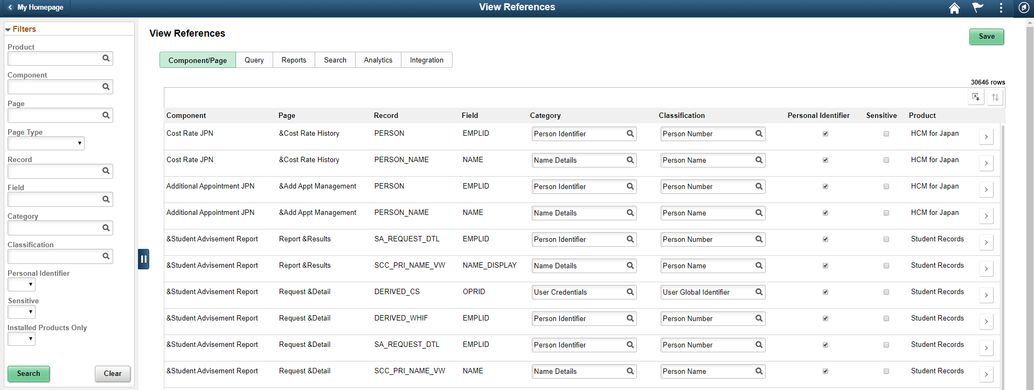
View references:
Where are those fields?
Notes:
30646 delivered (takes some time)

Slide 15
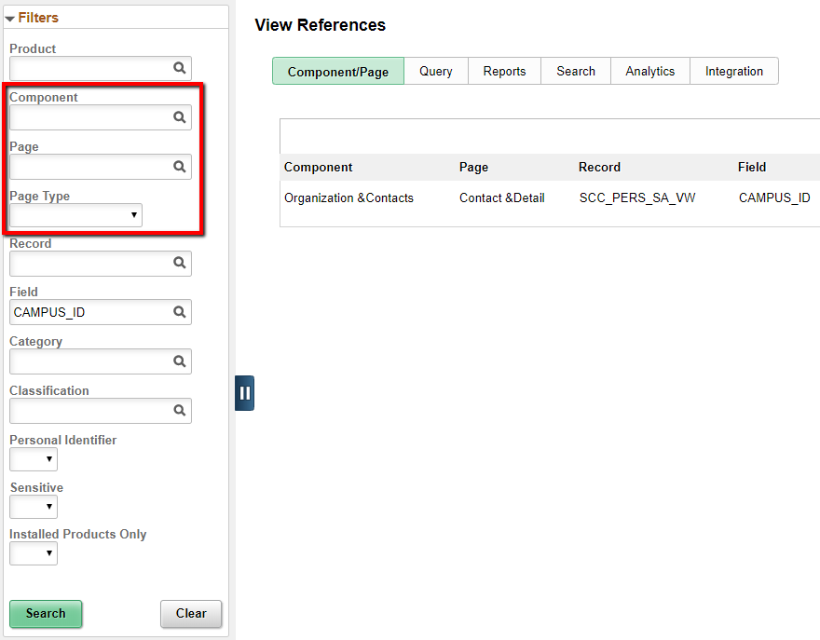
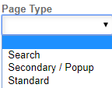
Extra filters
Override possible
Of attributes PII/Ss
Only for Comp/Page
Other types read-only
Default from recfield

Slide 16
6 reference types with exposure:
Component/page
Query (normal/connected/composite)
Reports (BIP/SQR)
Search (definitions/categories)
Analytics (pivot grids)
Integration (IB related objects)
Notes:
If you have custom SQR’s and SQC’s, then you need to run the file-pre-processor first (see Pbooks)

Slide 17
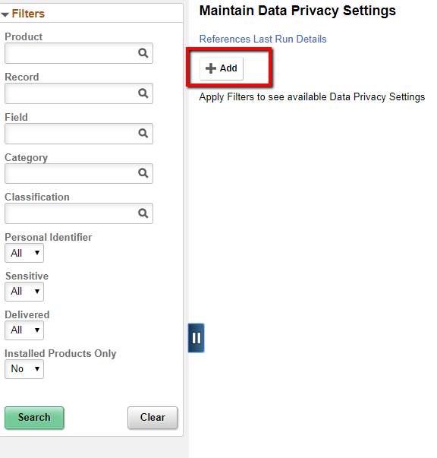
Can we include our own fields?
Yes, we can.
Even custom fields.
Notes:
Let’s add it! there is a PLUS sign.

Slide 18
Adding Campus_id
Adding another record
Notes:
Adding SCC_PERS_SA_VW.CAMPUS_ID and PERSON_SA.CAMPUS_ID as new personal identifiable record fields, but not sensitive.

Slide 19
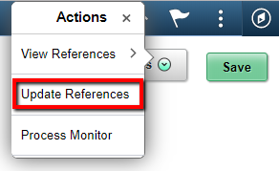
Running the process
Directly from DPF page
Notes:
Don’t forget to run the process! Actually several processes will start. initially everything is empty except for Component/Page references.

Slide 20
Viewing the newly created references
Only one page
Notes:
Not much … only 1 page.

Slide 21
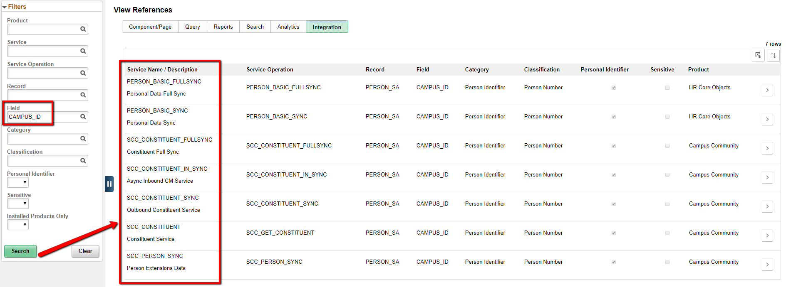
… but a number of webservices …
Notes:
This is a nice catch! Several service operations will spread the CAMPUS_ID like wildfire.

Slide 22
… and a query!

Slide 23
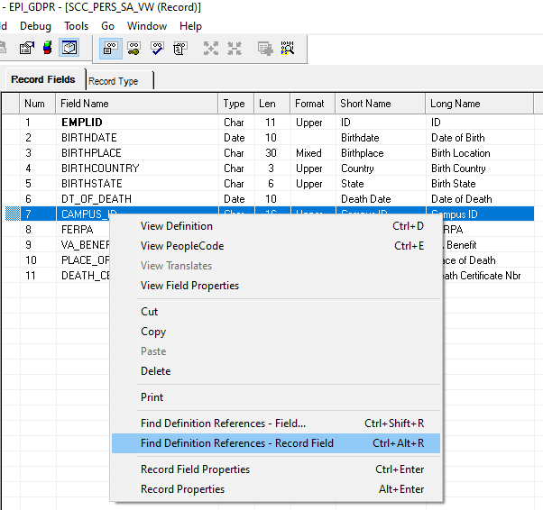
Isn’t ‘find definition references’ in App designer the same?

Slide 24
No!
Because
It only finds comp/pages and query’s
It can do only one record field at a time
With DPF, a complete set of PII/sensitive record fields can be searched in one run!

Slide 25
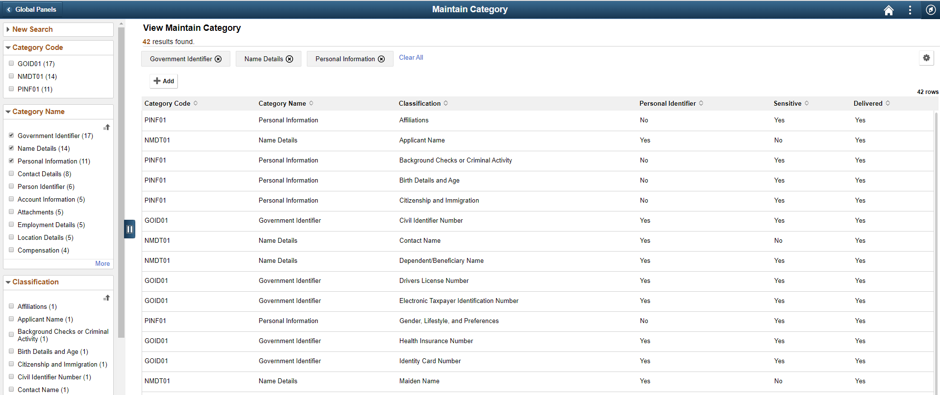
Categories can be added

Slide 26
Add existing classifications to new categories:

Slide 27
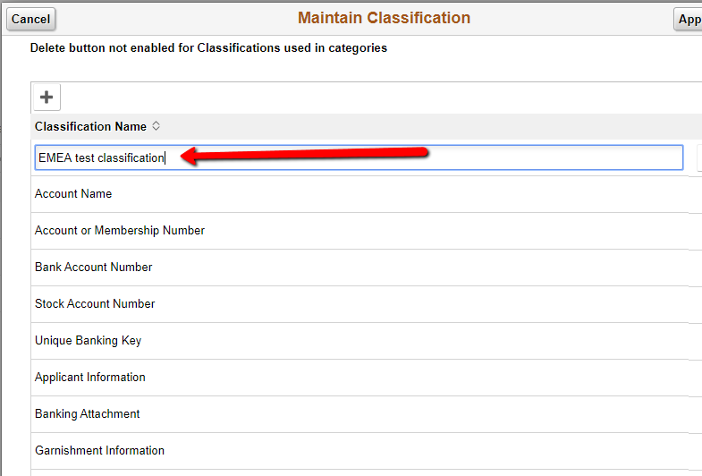
You can also add new classifications:

Slide 28
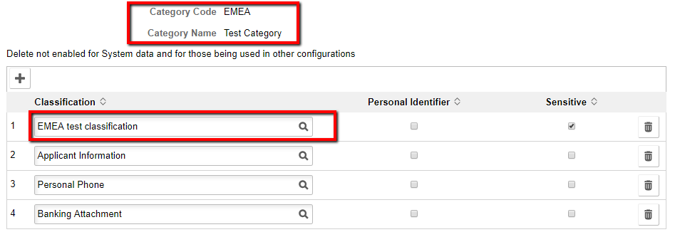
And add new classifications to your new categories

Slide 29
Categorize and classify your own (vanilla/custom) fields
PII/sensitive classification setup works like default

Slide 30
Now what can we actually do with it?
Can we mask or hide that data?
Can we do that based on user role/PL?

Slide 31
Can we use this?
No, we can’t

Slide 32
HCM
(not in CS yet)

Slide 33
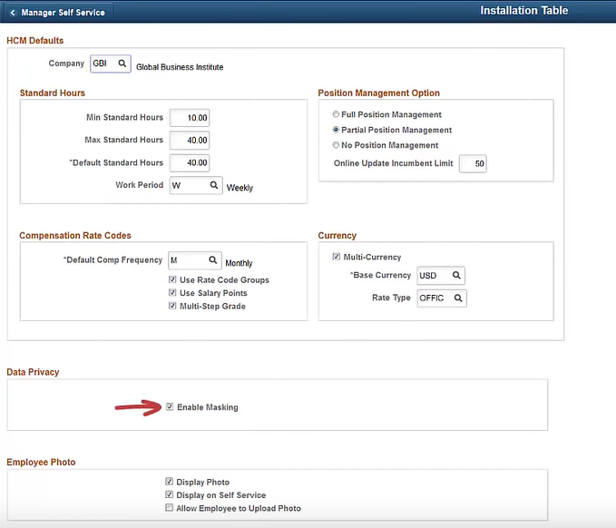
HCM
Installation
table

Slide 34
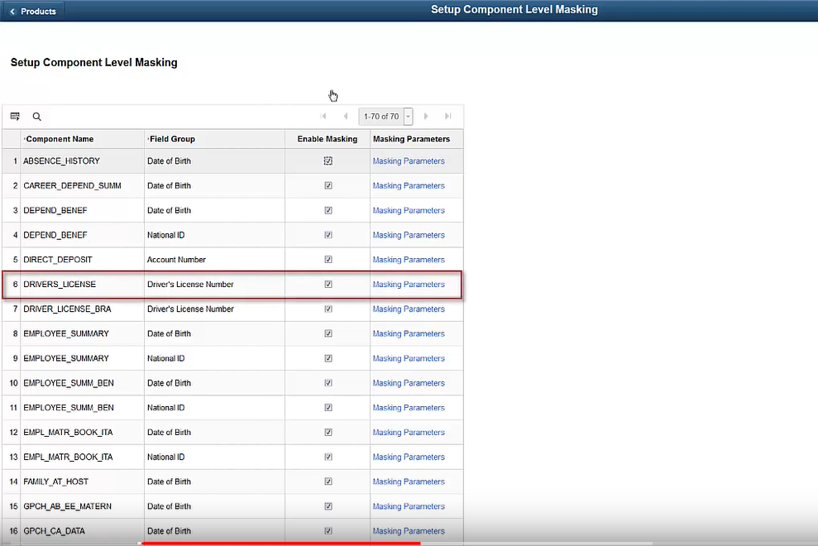
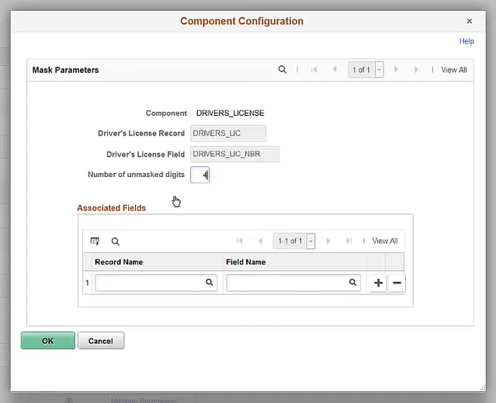
Notes:
Only for HCM, not for CS (yet)

Slide 35
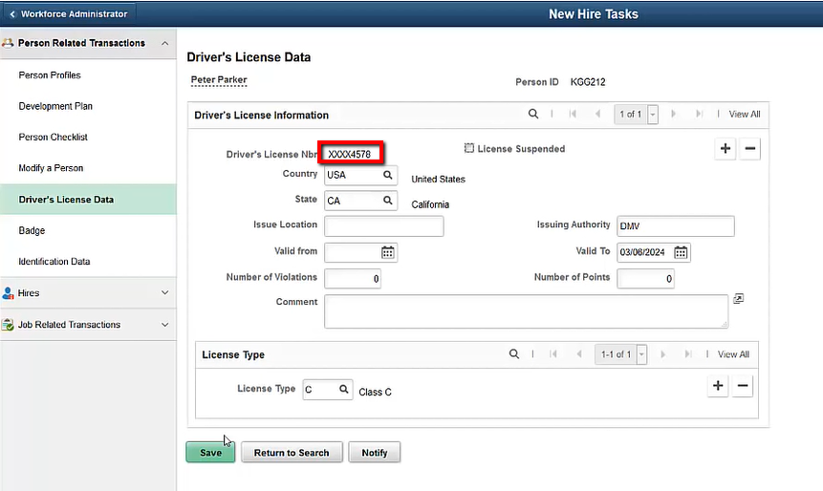
Driver’s license in HCM

Slide 36
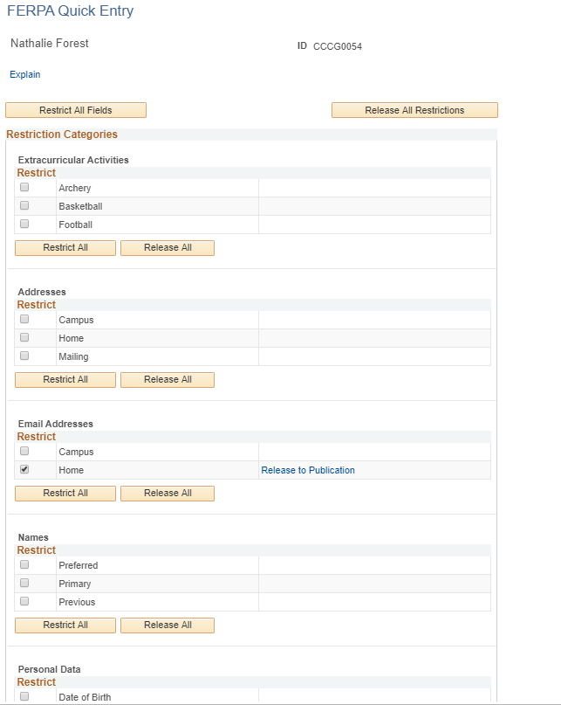
But now CS …
FERPA?
Very old
Fields and values hardcoded

Slide 37
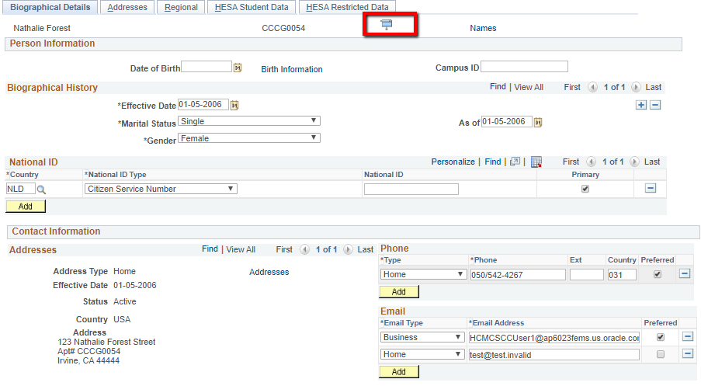
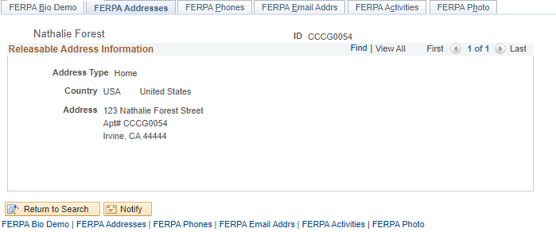
1 component with hidden fields
Rest has just the ‘roller shutter’.

Slide 38
DDA? Has masking! But …
Only 2 fields supported
But don’t add fields as customization!
No difference between pages
Too old … not flexible enough

Slide 39
CS
(alternative)
Page & Field configurator

Slide 40
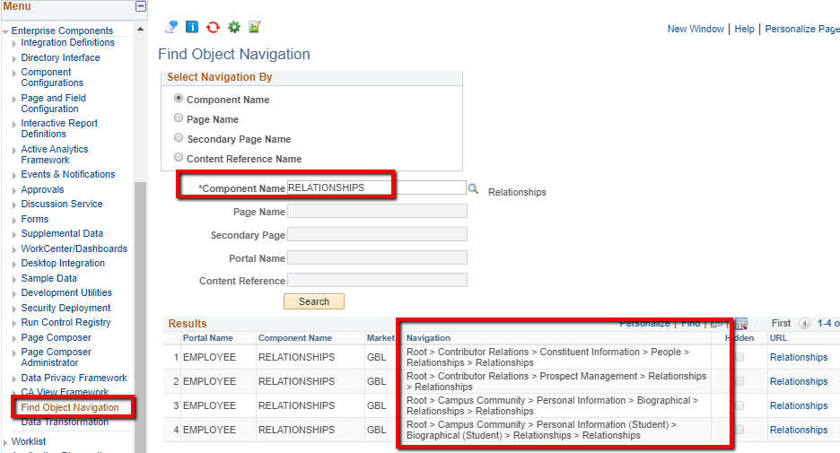
Find portal navigation(s)
sensitivity might differ between navigations!
(nice tool ☺)
Notes:
Where do we find our component in the portal navigation?

Slide 41
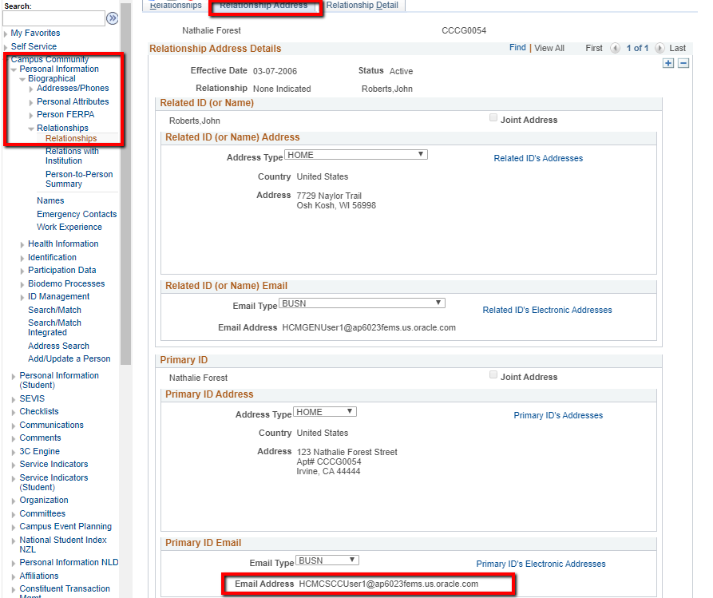
Let’s say this is a sensitive or PII Email address
Notes:
This email address is something we want to protect.

Slide 42
Add a new P&F configuration
Notes:
Create configuraton for your component

Slide 43
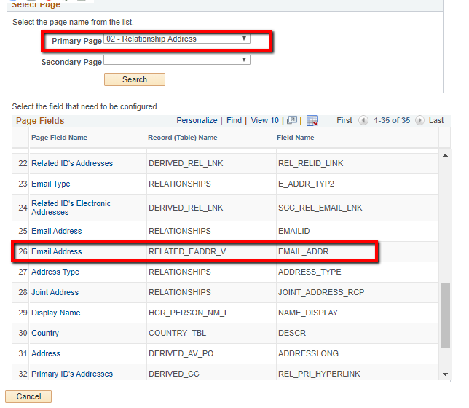
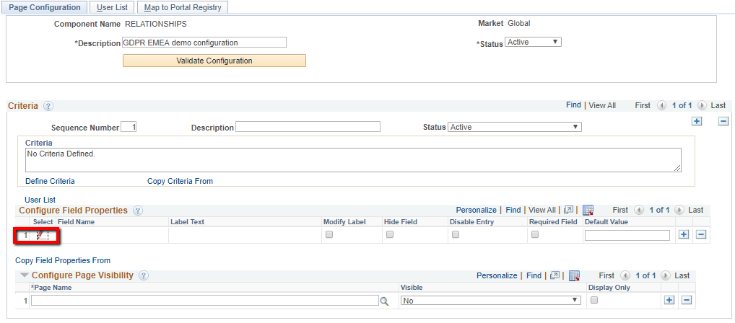
Select page field
Notes:
Find your field, first select applicable Primary (and Secondary) field

Slide 44
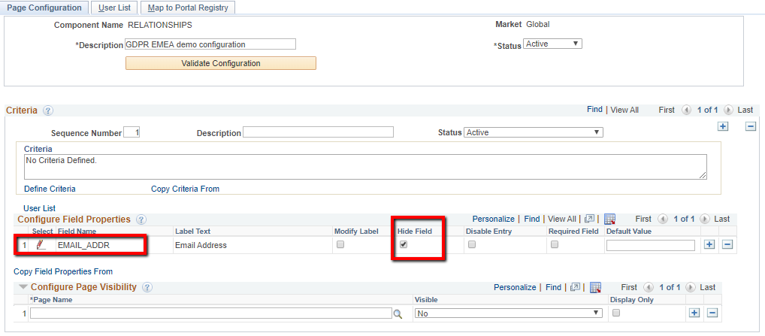
Hide the field
(Masking not yet available)
Notes:
Hide the field

Slide 45
To which of the navigations do we apply the configuration?
Notes:
Find the desired portal navigation

Slide 46
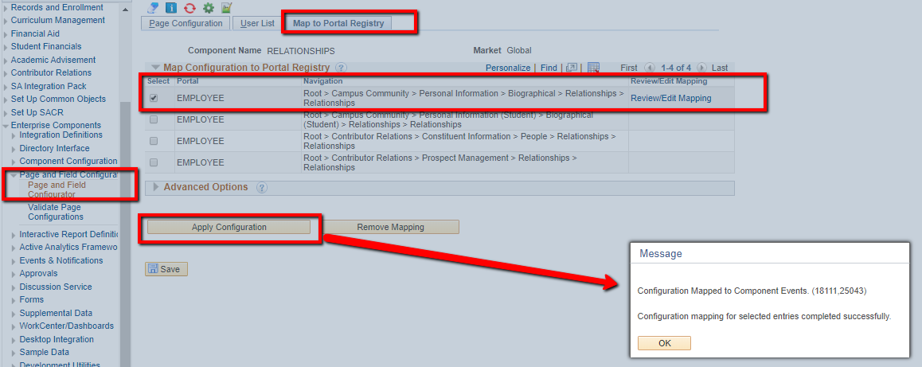
Apply configuration once!
All changes are dynamic
Notes:
Don’t forget to apply configuration (one time only, not needed after subsequent changes)

Slide 47
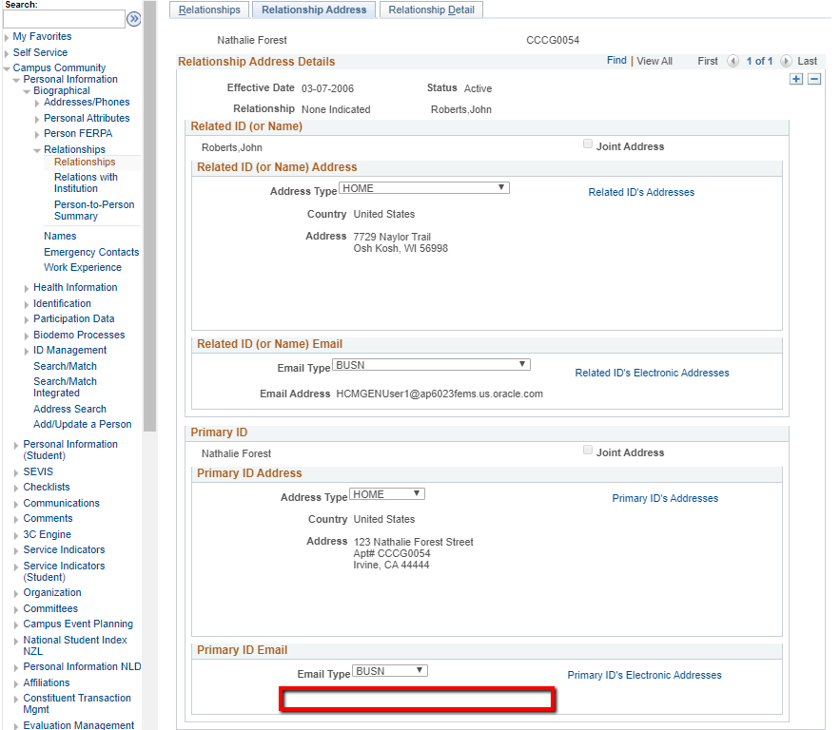
Email address has gone!
However …
Someone should see all!
Notes:
It’s gone

Slide 48
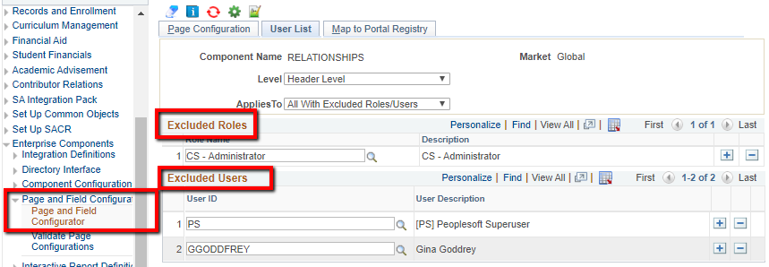
Exclude your ‘God’ users / roles
Notes:
Exclude your GOD users and roles

Slide 49
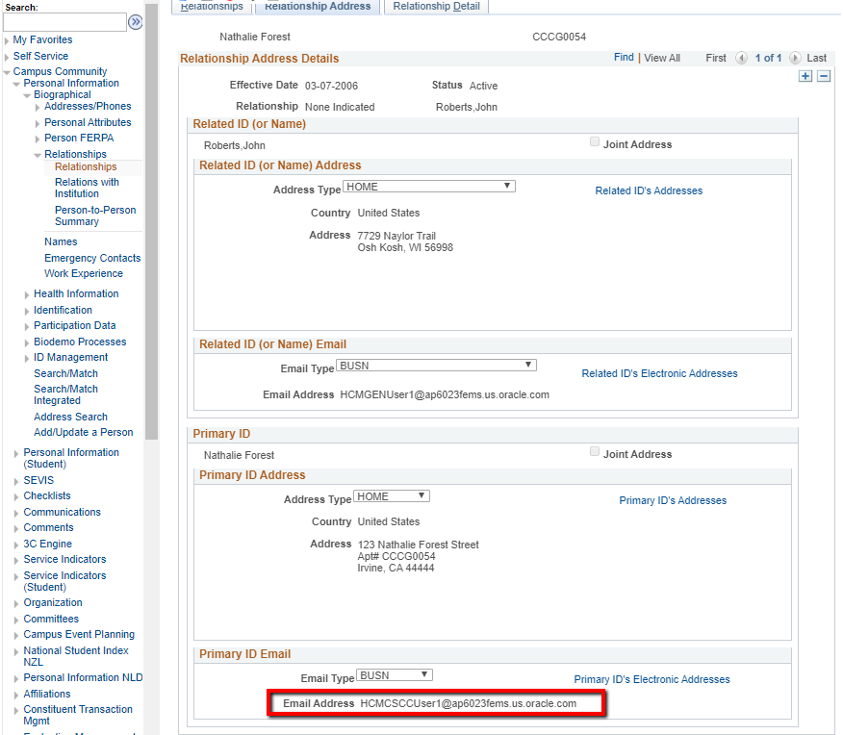
Back at the page … ‘God’ user sees all!
Notes:
For GOD user and roles, it’s back.

Slide 50
Can we do (partial) masking with P&F config?
No …. (?)
Not yet!
possibly/probably coming in Pt 8.58
With backport to PT 8.57
In the mean time
Just hide on the page …
How to handle query’s?

Slide 51
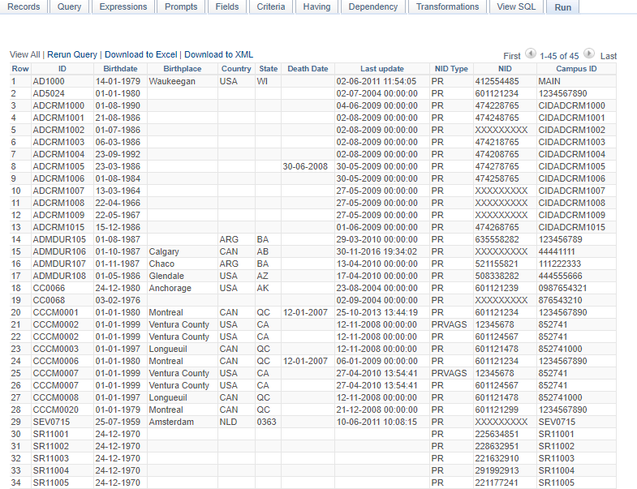
Campus-ID
exposed

Slide 52
How to do your own masking in query’s:
Create generic SQL object in App designer
Use syntax dependant on platform
Use in any query with any field to be masked
Include prompt with %P(1) instead of :1

Slide 53
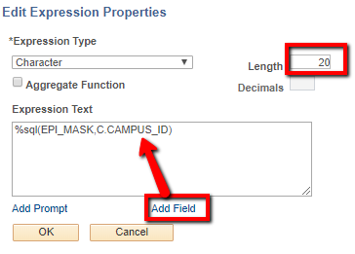
How to include masking in your query’s:
Add expression as a field (long enough!)
Include any field you want to mask
Remove after check!
Exposed
Masked
The Result:

Slide 54
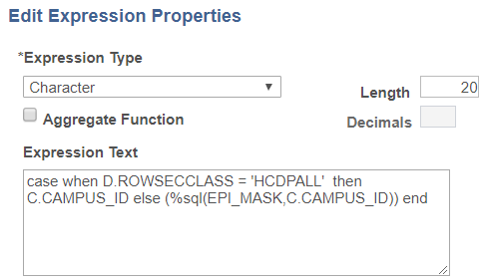
How to handle ‘GOD’ in your query’s:
Add PSOPRDEFN with dynamic SQL
Adjust expression to support this:
HCDPALL = GOD PL
Sees unmasked
All others see masked

Slide 55
‘Human’ user sees this:
‘GOD’ view
Don’t forget to remove this!

Slide 56
Roadmap:
Tools enhancements for P&F config
Masking?
Enterprise components enhancements
Automatic masking?
Query output masking included?

Slide 57
Conclusion:
Is CS ready for GDPR? Yes
It has quite a bit delivered
With (almost) no customization much can be added
Is GDPR functionality in CS finished?
No, there is more to come
Life will get easier then, but don’t wait for Oracle
Start with quick wins and heavily used components / query’s
Fines are much lower if you’re ‘on the road’!

Slide 58
WWW.EPICENTER.EU
roel.griffioen@epicenter.eu

