Slide 1
Implementing Research Tracking on a tight budget
SESSION 6025
Wed, Nov 07, 2018

Slide 2
presenters
Murray Gould
Lyndal Viney
Functional Analyst
University of the Sunshine Coast
mgould@usc.edu.au
Manager, HDR Systems
University of the Sunshine Coast
lviney@usc.edu.au
Notes:
Introduce ourselves, backgrounds relevant to the project:
Lyndal Viney, current Manager, HDR Systems (secondment), previous Team Leader, HDR at USC
Murray Gould, Functional Analyst

Slide 3
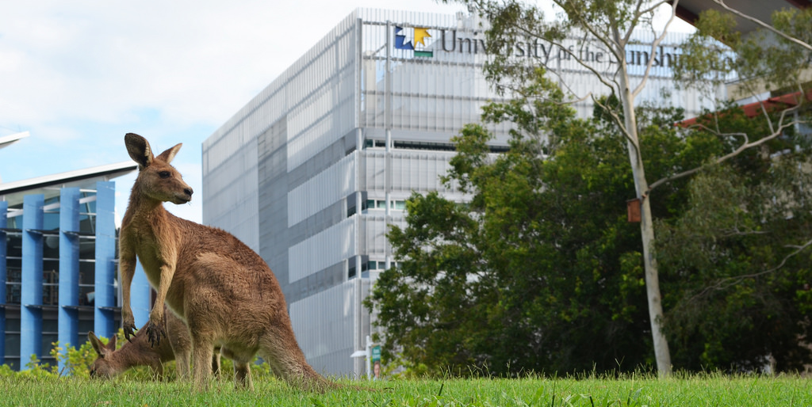
University of the sunshine Coast
16,594 students (460 research approx.)
new campus opening 2020 USC Moreton Bay
(Petrie, North Brisbane)

Slide 4
USC & ORACLE
PeopleSoft 9.2
PeopleTools 8.56.07
PUM 8

Slide 5
Aim: HDR in PeopleSoft
An internal audit of HDR administration recommended that the University “automate HDR administrative processes through support of a single, accessible IT platform”.
As USC already uses PeopleSoft for all student enrolments, considering transition to PeopleSoft was an obvious choice.
Our goal is to have an online record of each student’s Research lifecycle.
Notes:
At USC, Graduate Research Studies Management (GRSM) is part of the Office of Research, separate from Student Services and Engagement.
Research student administration is a mini student admin within OR, and is subsequently a silo.
The result of the “silo” effect is that research student administration systems were not included when other improvements have been made to PeopleSoft for coursework student enrolments over the past 10 years or so.
Research students at USC have no access to their research candidature information, and rely on emails from the GRSM to remind them about their upcoming milestones and due dates.
And who reads email, right?
The internal audit was a deliberate strategy by the Director, OR to make the neglect of research student administration system visible to the University. It worked!
The “HDR PeopleSoft” project was born.

Slide 6
Getting Started
Proof of concept
Review other Universities implementation of research tracking
Build the basic components using the technologies as delivered for research tracking
Demonstration to Management and Graduate Research Studies Management (GRSM) Team Leader
Budget and savings elsewhere
Budget $325,000 with savings over 3 years of $123,000
Minimal development work

Slide 7
AGILE approach
Limited resources so delivery is staggered
Use Jira software
Track issues in the project
Use epics to mange issues
Sprints and monthly meetings
Configuration and development impacting the system added to the Student Administration project

Slide 8
Implementation
Delivered functionality
Research tracking
Thesis management
Candidate Management
Service Requests
Technologies used
Affiliations (delivered research specific approach)
Evaluation management (delivered research specific approach)
Configuration to enable new students to automatically be in research tracking (delivered)

Slide 9
Minimum Viable Product
Requirement | Solution
Supervisors | Affiliation code
Research consumption | Candidate Management > Consumption & Submission
Scholarship | Candidate Management > Other Assignments + CAF
Thesis details | Thesis Management
Thesis examinations | Evaluation management
Milestones | Student Milestones and Grades
Change request and milestone submission and review | Service requests
Hide fields not currently used | Page and field configurator
Notes:
The HDR PeopleSoft project commenced in approximately March 2018. At conception, the goals of the project were to respond to audit findings, and timeframes were set accordingly.
However, USC’s existing research candidature management software licence expires at the end of 2018, so a new time pressure was introduced.
Replacement for existing software – Get out of existing software “free”
Required us to consider the bare minimum functionality required for GRSM to transition from existing software to PeopleSoft.
This shifted focus from capitalising on improvements PeopleSoft offered to “getting out of the old system free”.
Project will continue into 2019 for implementation of evaluation management, online workflows, dashboards: we just have to hope that our rushed implementation doesn’t limit our options for future improvements.

Slide 10
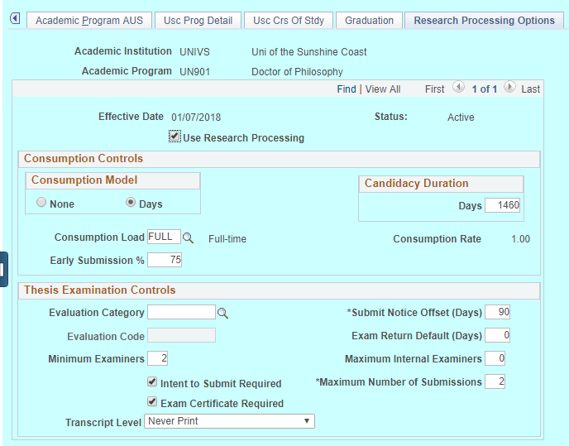
Automated candidature
Configuration to enable new students in research programs to automatically be in research tracking

Slide 11
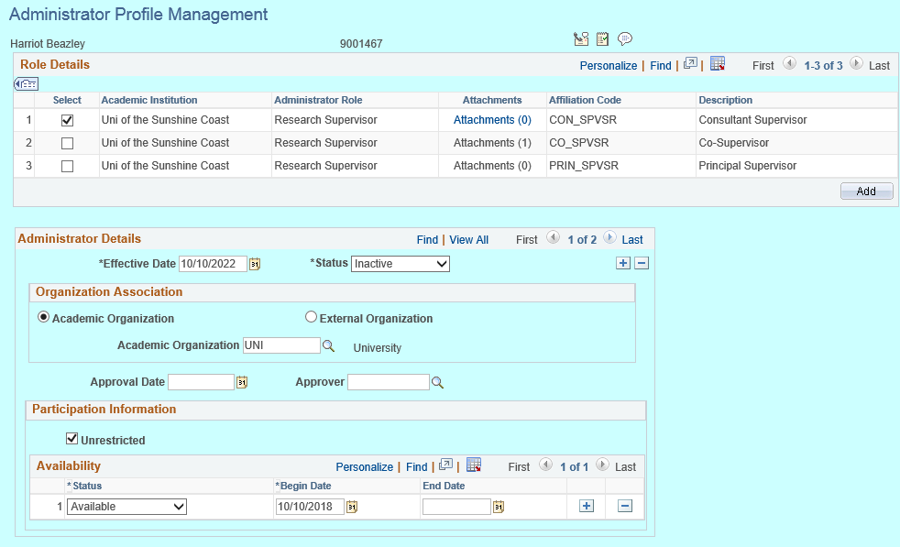
Supervisors (Affiliations)

Slide 12
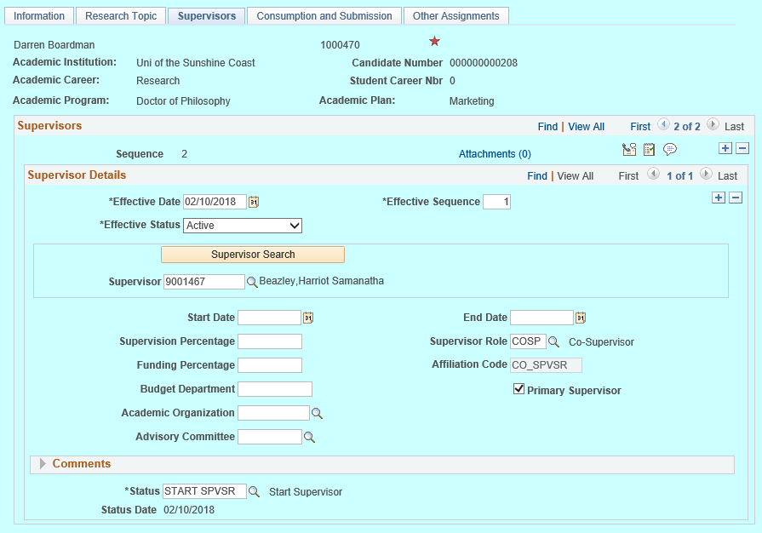
Student’s Supervisors

Slide 13
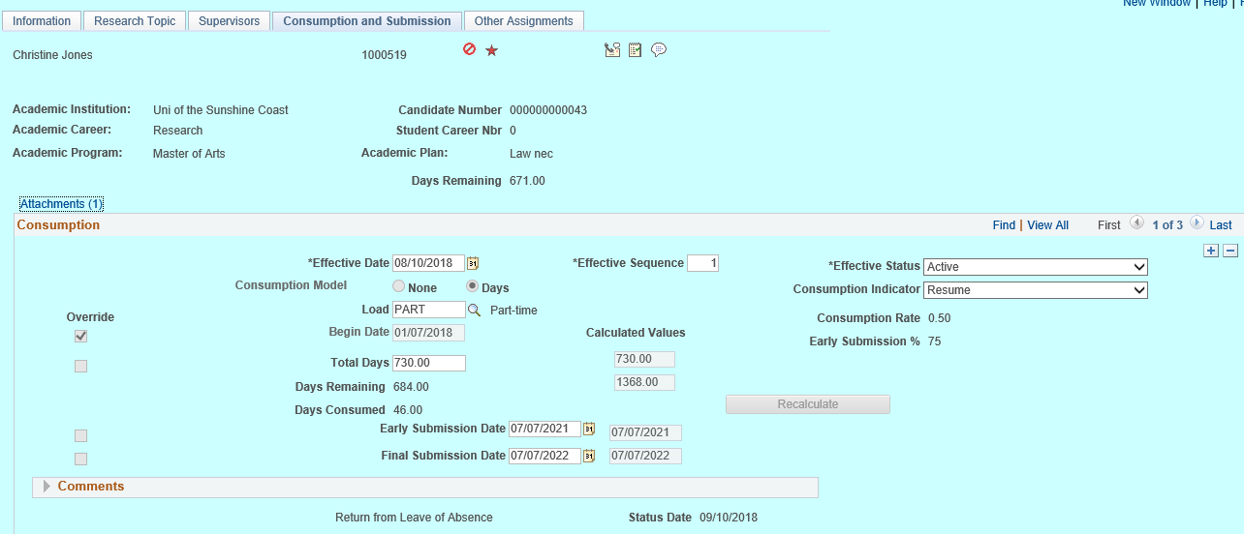
Consumption

Slide 14
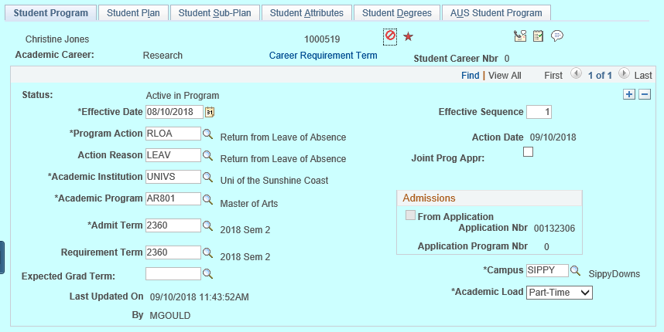
Program/Plan row

Slide 15
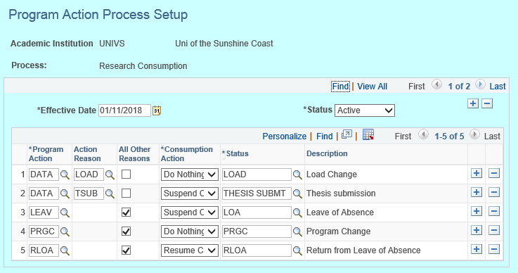
Program/Plan and Consumption link

Slide 16
Scholarship

Slide 17
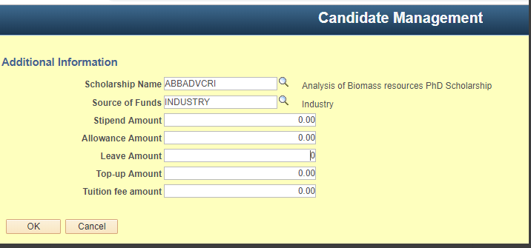
Scholarship CAF

Slide 18
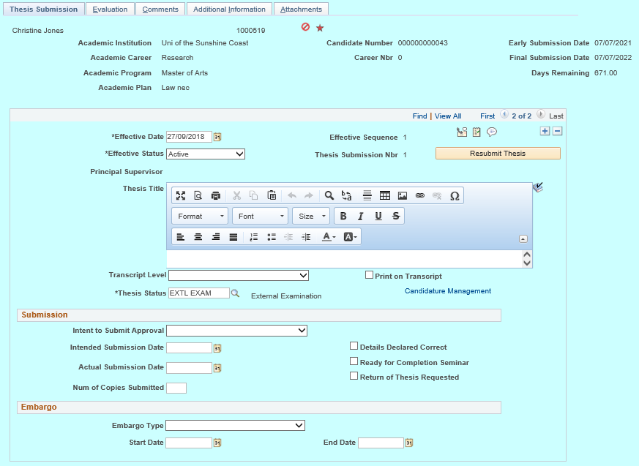
Thesis Management

Slide 19
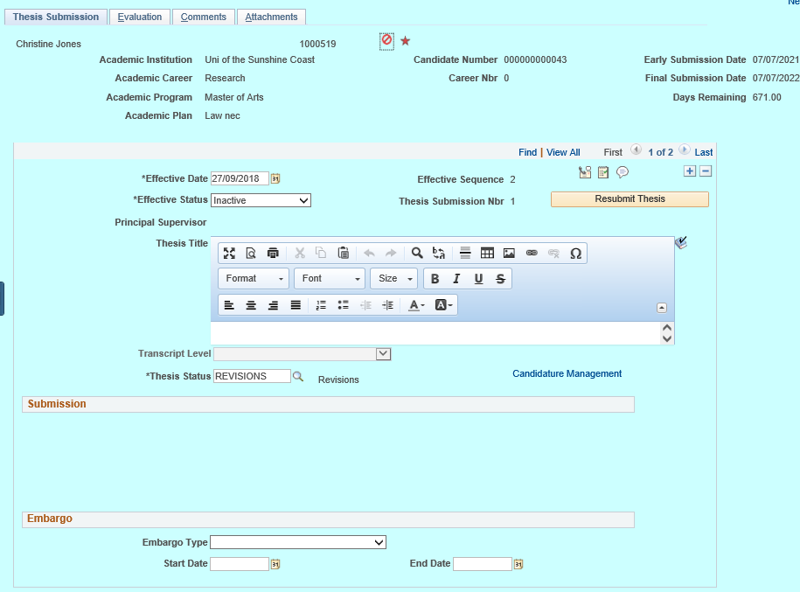
Thesis Management (after field configuration)

Slide 20
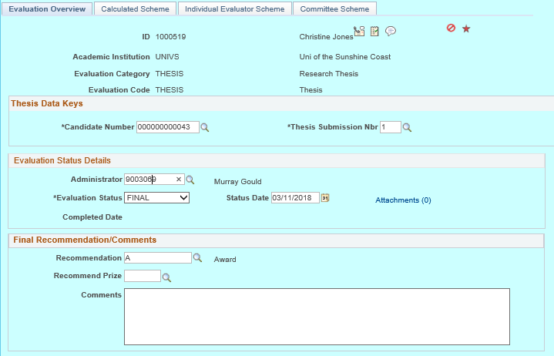
Examination (Evaluation management)
Delivered research specific approach

Slide 21
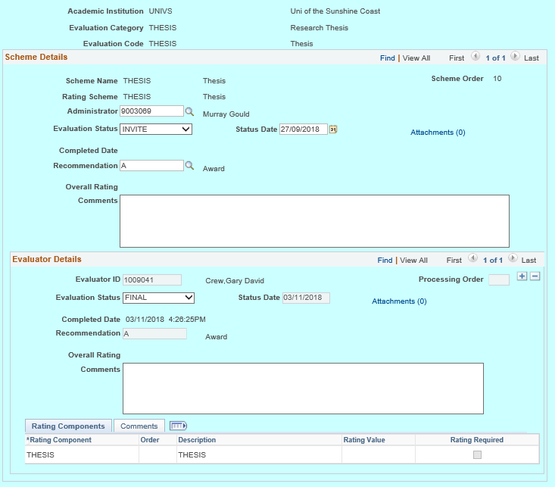
Evaluation (examiner) results

Slide 22
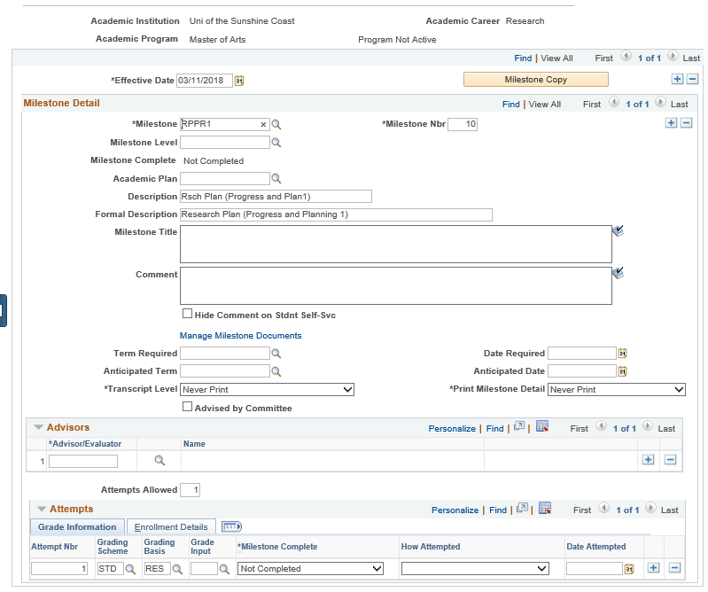
Student Milestones

Slide 23
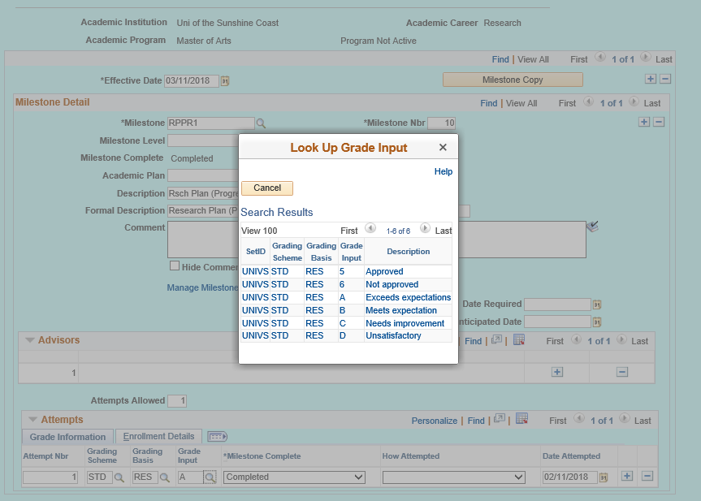
Student Milestones and Grades (after field configuration)

Slide 24
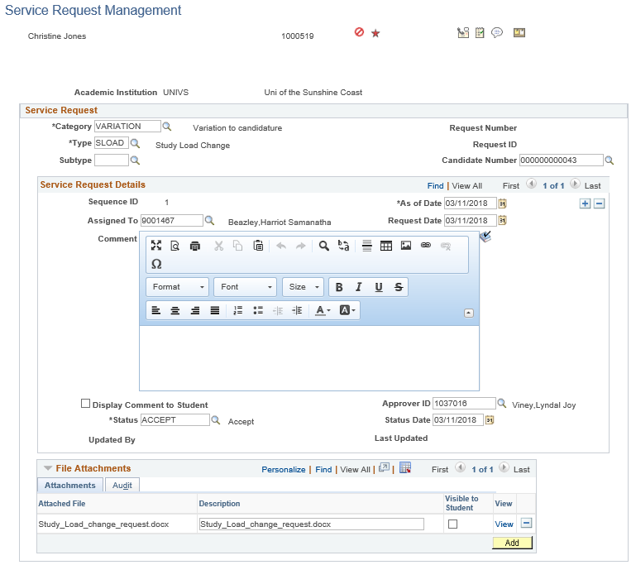
Service requests

Slide 25
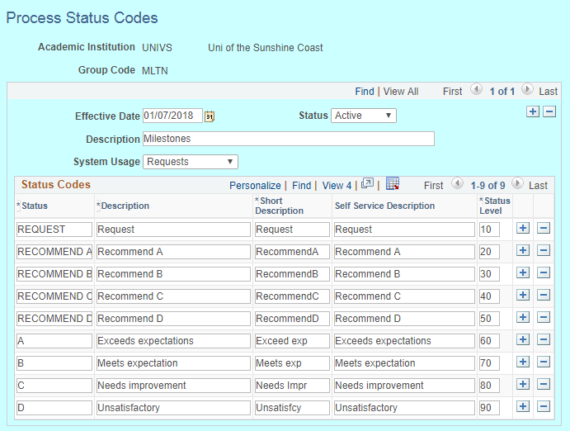
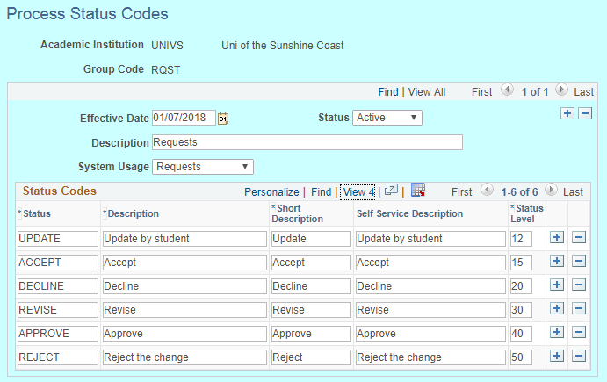
Service Requests configuration

Slide 26
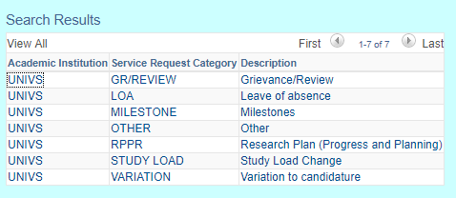
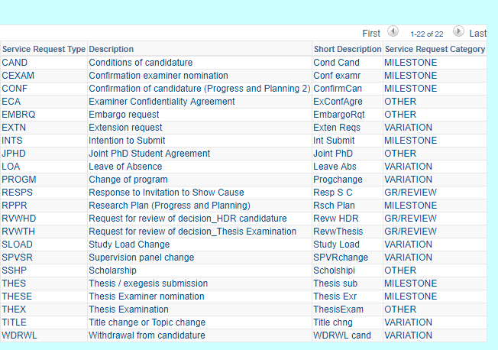
Service Request categories and types

Slide 27
Queries to track progress and initiate action

Slide 28
Minimum development
CAF page to record scholarship details
Candidature tracking consumption data (student dashboard displays # of days left based on effective date, not the current date)
Load and begin dates (getting these to match within and across relevant pages within Admissions and Student records modules)
Restrict deletion of attachments
Duplicate candidate numbers are created by changing program part-way through the completion of an online application
Automate suspension of consumption on thesis submission

Slide 29
Existing functionality
Online applications
Financial Aid
Scholarships
Fluid pages
Evaluation management
Notes:
Already used in Undergrad career

Slide 30
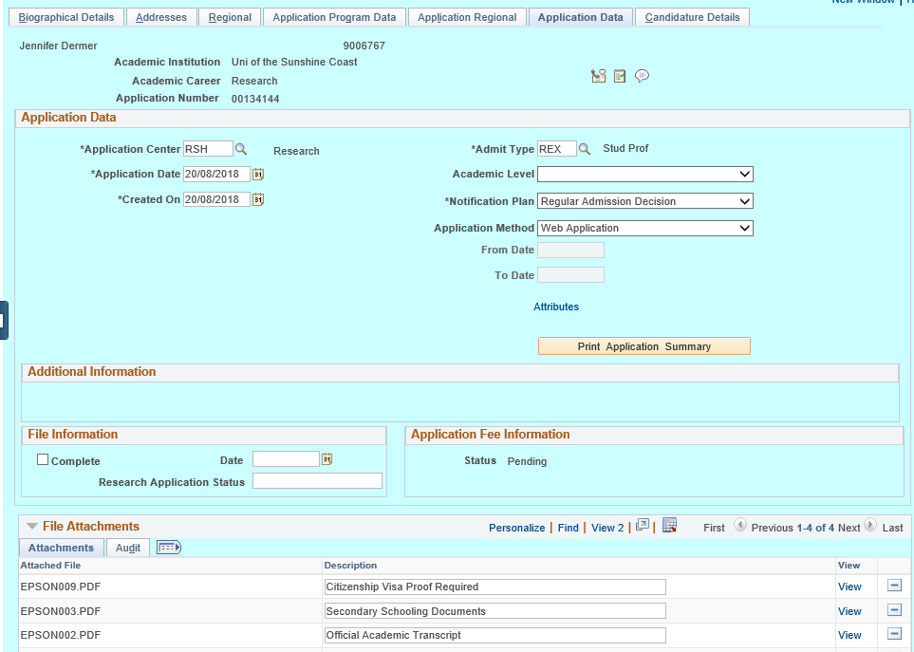
Online application and admissions
Notes:
Undergraduate online applications using Admission Applications Web Services (AAWS) used with some development for research specific functionality (principally supervisors), application data page with page and field configuration applied

Slide 31
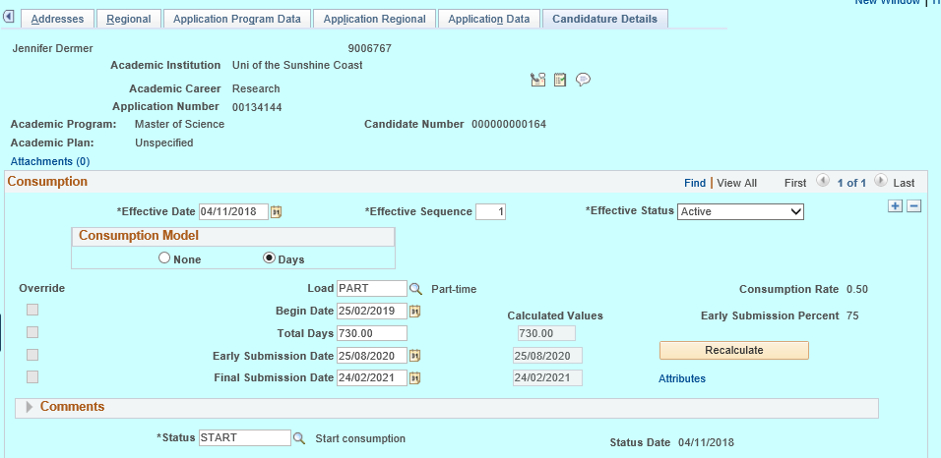
Admissions Candidature Details

Slide 32
Additional functionality
Service requests (existing processes transferred to PeopleSoft)
Scholarships
Evaluation management
Notes:
GRSM at USC uses service requests to track workflow of review of change requests, milestone submissions throughout the review process (which is often lengthy)
We needed to link scholarship information to the student record so that scholarship rules could be considered when GRSM applies changes to candidature

Slide 33
Data migration
Backfill of existing (GRSM) team with casuals
UAT, training, then data migration by existing staff
Staged approach to manually migrate ~500 student records and ~70 admission applications in progress
Supervisors
Examiners
Scholarships
Students under examination
Confirmed students
Probationary students
Current applications
Once a student record was migrated it was “turned off” in the old system, and GRSM use PeopleSoft for migrated records immediately
Notes:
Given the relatively small number of current student records (~500), USC decided to take a manual approach to data migration, rather than building scripts.
Risks include human error, so our Data Conversion Plan includes data integrity checks both prior to migration, and after migration to ensure accuracy.
Staged approach helped managed enormity of change for the GRSM team, allowing sufficient time for training and re-design of business processes where necessary.
Foundation data required to exist before student records can be set up
Supervisors
Examiners
Scholarships
Student records
Current examinations
Confirmed students
Probationary students
Admissions (remaining in old system)

Slide 34
Additional functional and development Work
Student and staff WorkCenters
Research student fluid home page and pages

Slide 35
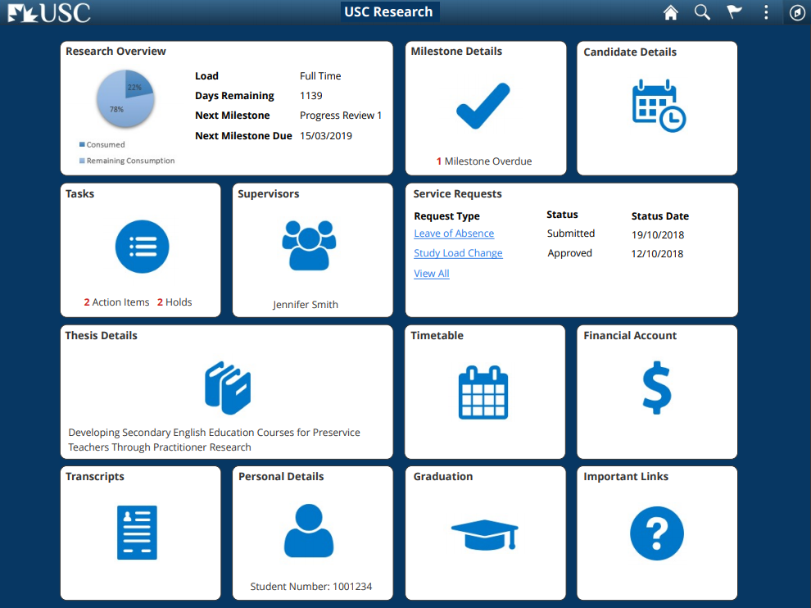
Research Student Home Page

Slide 36
Current issues
Student/supervisor communication prior to WorkCentres go live
Data migration delay
Change management
Meeting the MVP deadline
Finishing minor development work into production
Finishing functional tasks (queries, CAF work, configuration tweaking, user procedures)
Notes:
Current research candidature management software allows emails to be sent directly to students/supervisors to remind of upcoming tasks, to send information (e.g. notify of outcomes)
USC has decided not to implement delivered dashboards as we will be rolling out fluid dashboards within 3 months of MVP delivery. This would have meant two lots of change for research students in a short-time.
Subsequent issue is there will be no mechanism in PeopleSoft MVP to communicate with students. This will be done manually by GRSM team via USC’s CRM until student dashboards are available. This will require additional staff resources in GRSM to manage during the transition.
As we learned that our planned consumption conversion approach wasn’t viable, we needed to revise this approach which distracted from finalisation of configuration of final components required for MVP. Subsequent delays to completion of UAT, User Procedures, Training and commencement of data migration by approximately 1 week (so far)
The value of careful Change Management is difficult to sell to Management when budgets and timeframes are tight.
Most training has been done in-house and on the fly, and end-users have been provided with User Procedures to interpret and build into their business processes as data migration commences
UAT, training and data migration all occurring almost simultaneously
Risk of findinding significant issues after go-live is moderate …

Slide 37
Lessons learned…
Needed the subject matter expert leading the project to make decisions and move forward quickly
Data migration approach
Notes:
The GRSM team experienced significant staff turnover as the project launched. This meant there was limited capacity for them to provide business requirements when they were needed, which significantly slowed progress
These issues within the GRSM team were in progress before the HDR PeopleSoft project “launched”
The Project should have been delayed until SME could provide input
Migrating existing research student’s consumption data to PeopleSoft Candidature Management
We originally intended to overwrite the start date, days remaining, days consumed, however we later realised that the early and final submission dates would not automatically calculate going forward
We realised we needed to record entire consumption history (all instances of leave and study load changes) for each candidate going back to their start date
This is problematic because of the numerous steps required to transfer a record, which increases opportunities for error
Previous software counts leave from start to end dates, PeopleSoft uses return from leave date
Each change MUST be added in consecutive order from the start date (or dates won’t calculate correctly)
We estimate this to have approximately doubled our data migration task

Slide 38
Concluding thoughts
ANY QUESTIONS?

Slide 39
presenters
Murray Gould
Lyndal Viney
Functional Analyst
University of the Sunshine Coast
mgould@usc.edu.au
Manager, HDR Systems
University of the Sunshine Coast
lviney@usc.edu.au
all Alliance presentations will be available for download from the Conference Site

Slide 40
THANK YOU!

