Slide 1
LEVERAGING FLUID AND BOOTSTRAP TO IMPROVE THE ONLINE APPLCIATION EXPERIENCE
SESSION - 8018
DATE OF PRESENTATION
28 June 2016

Slide 2
presenters
Mr. Andrew Jusjong
Mr. Edmon Garzouzie
PeopleSoft Technical Expert
University of the Free State
jusjongae@ufs.ac.za
Assistant Director – Business Analyst
University of the Free State
garzouzieet@ufs.ac.za

Slide 3
University of the Free State
Founded 1904
33 000 Students
121 Departments
7 Faculties
51 Satellite campuses, in 69 locations
4 337 Staff

Slide 4
Oracle
Oracle 12C
Campus Solutions 9.0.39
PeopleTools 8.54.12

Slide 5
Overview
Description of the previous system
Challenges faced with the previous system
Reasons for moving to Fluid
Moving to Fluid and incorporating Bootstrap
Challenges faced with the move to Fluid
Comparison of Statistics

Slide 6
Description of the previous system
Technology and Process

Slide 7
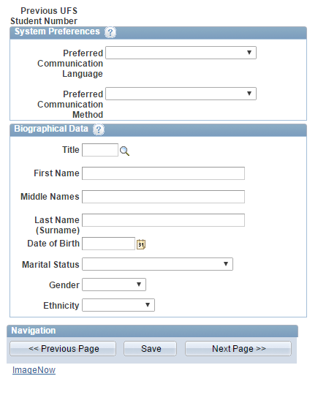
Description of the previous system
Implemented using PeopleSoft Internet Architecture (PIA).
Online Application system launched in 2013.
Used a staging area that was processed by application transaction management process.
Demo

Slide 8
Challenges faced with the previous system
Business and Prospective Students

Slide 9
Challenges faced with the previous system
Old system find a nice old screen
Prospective students unfamiliar with interface and navigation.
No corporate branding.
Not mobile friendly.
Usability / User-friendliness of the system.
Unaesthetic User Interface.

Slide 10
Reasons for moving to Fluid
Business and Prospective Students

Slide 11
online vs hardcopy
Hardcopy capture dominated applications.
Suggests online application usability is flawed
Suggests applying online was not a smooth and simple process.
Students opted for hardcopy applications instead of online applications.
80% - 90% of Prospective Students have mobile devices:
Online Application system not mobile friendly.
Applicants therefore opt for hardcopy applications.

Slide 12
Reasons for moving to fluid (cont.)
Required a mobile friendly interface.
Require branding.
Smooth transition between pages.
Improve the online application experience.

Slide 13
Moving to Fluid and incorporating Bootstrap
Bootstrap’s 12 Column Grid System
Converted old component to Fluid Component
jQuery, Bootstrap JavaScript, Bootstrap CSS, custom CSS for UFS Branding
Incorporate Google Analytics for better reporting on audience

Slide 14
Moving to Fluid and incorporating Bootstrap (cont.)
Bootstrap Grid System maps well to PeopleSoft GroupBoxes – style class just needs to be overridden.
Containers
Rows
Columns
Use of HTML5 properties on input controls (text fields)
Replacement of PS controls that have proven to confuse learners
Demo

Slide 15
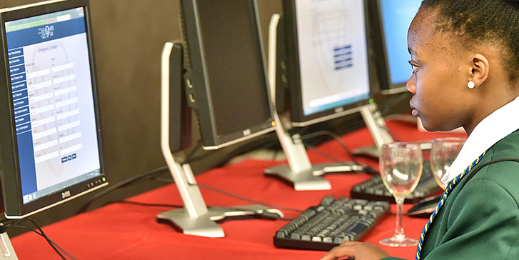
Challenges faced with the move to Fluid
Technical

Slide 16
Challenges faced with the move to Fluid
Use of Subpages
PeopleCode Page Activate Event
Order of <div> HTML tags (GroupBoxes)
Large set of devices, of which not all support HTML5.
Computer literacy of prospects
Improve the online application experience.

Slide 17
Comparison of Statistics
2015 vs 2016
Monthly comparison
Hardcopy
Online

Slide 18
Online and hardcopy – Month on Month 2015 VS 2016
Notes:
Hardcopy applications have decreased month on month with a change:
Hardcopy 195% June 2014 to 2015
May 56%
Online 14% 2014 to 2015
2015 to 2016 April 313% change

Slide 19
Statistics
Device Category vs Total User Sessions

Slide 20
Questions?

Slide 21
presenters
Mr. Andrew Jusjong
Mr. Edmon Garzouzie
PeopleSoft Technical Expert
University of the Free State
jusjongae@ufs.ac.za
Assistant Director – Business Analyst
University of the Free State
garzouzieet@ufs.ac.za
all SAHEUG Alliance presentations will be available for download from the Conference Site

Slide 22
THANK YOU!

