Slide 1
PeopleSoft On Phire
SESSION 6041
8th November 2018

Slide 2
presenter
Owen Van Itallie
Senior Application Technical Analyst
The University of Queensland
o.vanitallie@uq.edu.au
PeopleSoft Developer and Phire Starter!

Slide 3
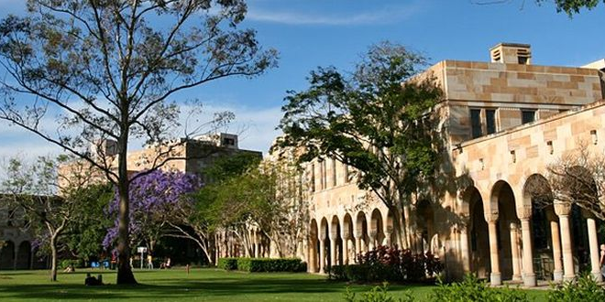
The University of Queensland & ORACLE
PeopleTools 8.56
Phire 13.1
PeopleSoft Campus 9.2
PeopleSoft Financials 9.2

Slide 4
Overview
Walking through Phire!
PHIRE STARTER: Planning & Implementation
CONFIGURATION: Domains, Workflows, Security
DEVELOPMENT: Version Control, Comparisons, Migrations, Rollback
VISIBILITY: Reporting & Auditing
BENEFITS: Productivity & Process Improvement
LESSONS: What we’ve learned so far
DEMO

Slide 5
Phire STARTER
Planning and Implementation

Slide 6
What is PHIRE?
Phire is software that helps manage and control changes that are required for PeopleSoft and other large enterprise applications.
Runs on PeopleSoft Technical Architecture.
Provides Workflow Driven Change Request Tracking.
Handles PeopleTools Object Versioning and Migrations.
Provides Reporting and Real-time Inquiry.
Has Incident Management Capabilities. (not used at UQ)
Notes:
Phire is software that helps manage and control changes that are required for PeopleSoft and other large enterprise applications.
Runs on PeopleSoft Technical Architecture.
Provides Workflow Driven Change Request Tracking.
Handles PeopleTools Object Versioning and Migrations.
Provides Reporting and Real-time Inquiry.
Has Incident Management Capabilities. (not used at UQ)
Prior to implementing Phire, UQ was using a combination of Quest Stat, Application Designer, and manual actions to facilitate change management and migration of customisations.
Key advantages of Phire for UQ are:
It’s a web application that runs on PeopleSoft infrastructure.
It’s server based without the need of a thick client or agent installation.
It automates build and script execution with migrations.
It has lower maintenance and support costs.

Slide 7
Planning
Phire is built with PeopleTools, so existing PeopleSoft Application infrastructure can easily be leveraged.
Define Technical Architecture
Plan Workflows
Notes:
Planning for Phire’s implementation was relatively straightforward as the software can leverage off existing PeopleSoft infrastructure.
Apart from organising resources, planning basically consisted of defining the technical architecture and workflows.

Slide 8
Define Technical Architecture
Phire provides a pre-installation checklist to assist with architecture planning and installation.
Centralised/Decentralised
Bare Metal/Virtual
Database
Application Server
Web Server
Process Scheduler
PeopleTools
PeopleSoft Applications
Network/Firewalls
Component | OS | Product | Version
Database Server | Linux 4.1.12 | Oracle | 12g
Application Server | Windows 2012 R2 SunOS 5.11 | Tuxedo | 12.1.3 12.2.2
Web Server | Linux 2.6.18 Linux 3.10.0 | WebLogic | 12.1.3 12.2.1
Process Scheduler | Windows 2012 R2 SunOS 5.11 | Tuxedo | 12.1.3 12.2.2
PeopleTools |  | PeopleTools | 8.56.048.56.08
PeopleSoft App |  | Campus Solutions | 9.2
PeopleSoft App |  | Finance | 9.2
Notes:
Phire provides a pre-installation checklist to assist with architecture planning and installation.
Phire can be installed on physical or virtualised hardware and your choice will most likely depend on your existing infrastructure landscape.
Phire utilises the same kind of infrastructure that supports PeopleSoft Applications.
The quickest way to create the infrastructure for Phire is to clone a PeopleSoft environment stack.
Phire recommends that you use a ‘SYS’ PeopleTools only database as the basis of a centralised installation, but you can also use a demo or application copy.
UQ has installed Phire in a centralised configuration which integrates with the components shown in the table.
When UQ first went live with Phire, it was configured to support PeopleTools 8.55 for Finance and 8.56 for Campus Solutions, we have since upgraded Finance to PeopleTools 8.56.
Phire supports different versions of PeopleTools for different applications. Phire itself can also be installed on a different version of PeopleTools.
A decentralised Phire installation is where Phire is installed within the same database as another PeopleSoft Application instead of it’s own dedicated database and middleware.

Slide 9
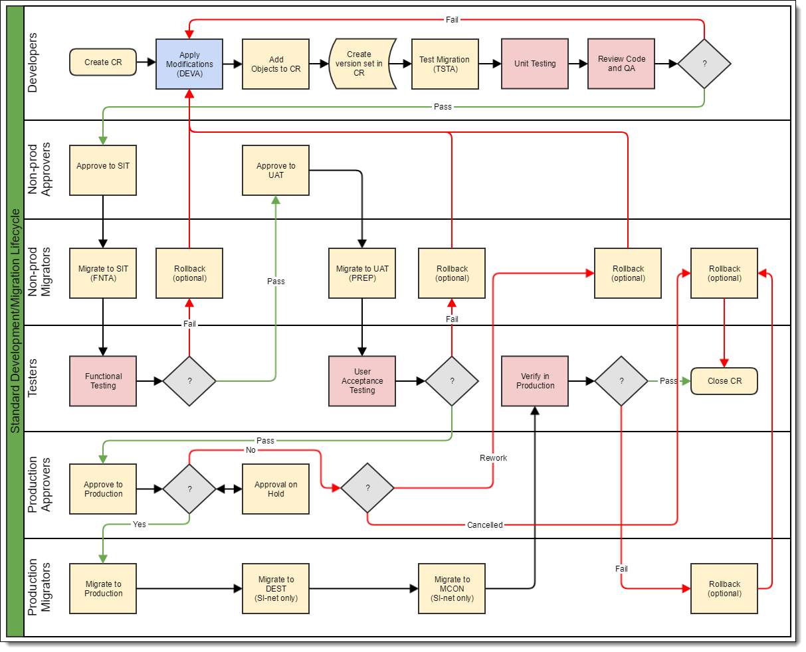
Plan Workflows
A Phire Domain will generally map to a single PeopleSoft Application. Within each domain, multiple workflows can be configured to support the development lifecycle and common work patterns.
Workflows (or Task Lists) are structured around team processes and migration paths.
Notes:
Phire workflows are configured with Phire’s Domain Setup Wizard and appear as a task list. In the planning stage, I utilised a visual tool to assist with the workflow design and later transferred the conceptual flow into Phire’s configuration.
UQ has configured the following workflows
Standard Migration: used to manage and migrate PeopleSoft customisations of online and batch objects.
Script Only: used to execute SQL and DMS scripts (generally data fixes).
Configuration Migration: used for Data Migration Workbench (we’re still exploring this capability)
nVision Migration: a streamlined workflow for Finance that allows the business to maintain nVision reports.

Slide 10
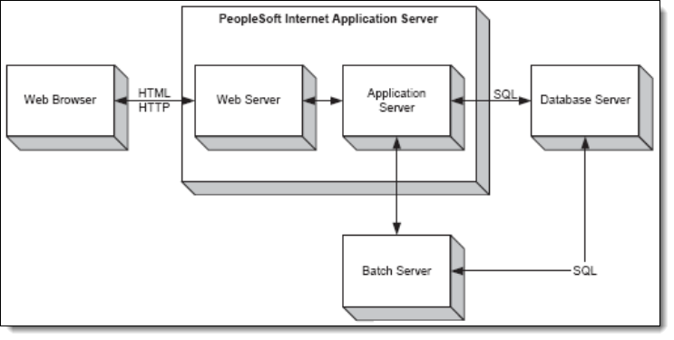
Implementation
Phire is built with PeopleTools, so existing PeopleSoft Application infrastructure can be leveraged for rapid implementation.
Installation
Configuration
Testing Workflows and Migrations
Notes:
Phire can be implemented in a few weeks.
Installation requires setup of a PeopleSoft environment and then applying Phire to that environment.
UQ had the Phire vendor on-site for 1 week to guide the initial setup and configuration.
UQ has been live with Phire 13.1 since mid-April 2018.
The planning and implementation time was around 4 weeks in total.
5 to 10 days of planning which included architectural decisions and organising resources/infrastructure
5 to 10 days of implementing which included installation and initial configuration with the vendor, followed by testing of the workflows and migration paths.

Slide 11
Phire Configuration
Domains,
Workflows,
Security

Slide 12
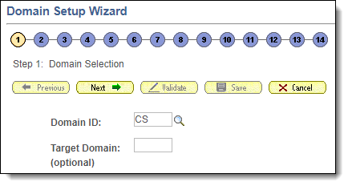
Configuring Phire
Domain Setup Wizard
Domain Security
Row Level Security
Notes:
The Domain Setup Wizard is used to configure Phire to do change management for a particular application
UQ has created a domain for each Application that Phire manages.
All aspects relating to workflows, database source/targets, servers, file locations, file types, default build actions for an application are configured within a domain.
Domain Security is
Role based, using PeopleSoft permission lists and
PeopleSoft Roles are extended by Phire to control Phire specific actions
Row Level Security is
Used to override domain security and
Restrict roles from doing certain actions in certain environments, while still allowing them in others.

Slide 13
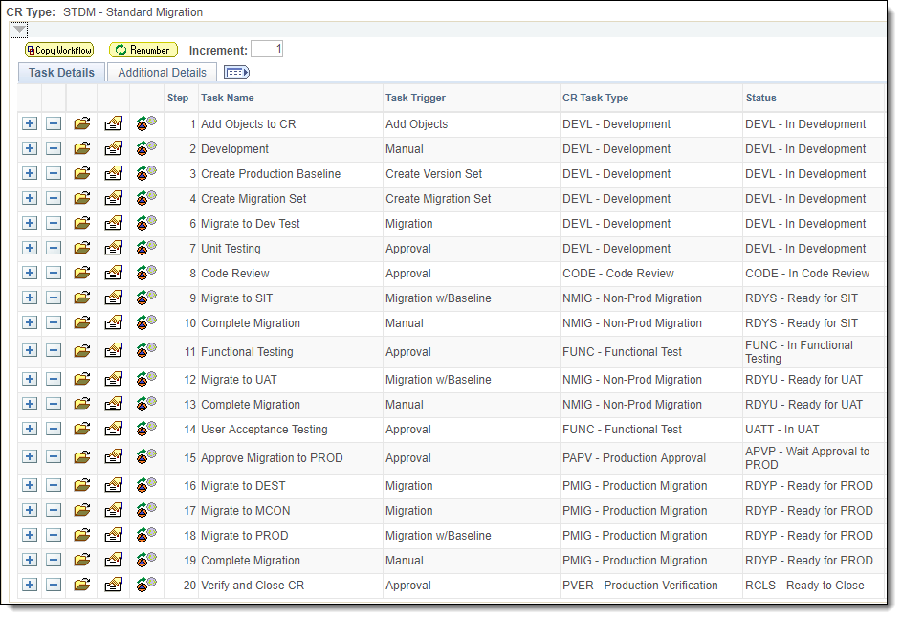
WorkflowS
Notes:
Phire Workflows are configured with the Domain Setup Wizard as a series of steps.
The workflow, coupled with Domain and Row Level security is the core control mechanism within Phire.
All required (and optional) steps are defined to match the required business process for execution of tasks, segregation of duties, and approvals.
I recommend keeping workflows as simple as possible to streamline interaction within Phire.
Eliminate or minimise steps which cause task “bouncing” between assignees where possible to avoid workflow “bottlenecks”.
For example, UQ is using Agile Scrum methodology and a cross-functional team so there is no need for formal approval steps for SIT and UAT
We initially had these Approval steps configured, but found that they were unnecessarily cumbersome in our work-model, other organisations with segregated Functional and Development teams may find benefit in including such steps.

Slide 14
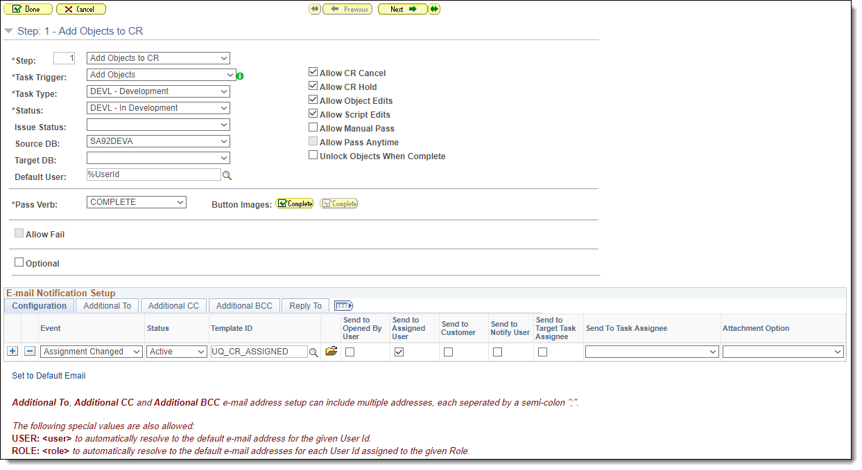
Workflow STEPS
Notes:
Workflow steps can:
Be tied to source and target databases, and
Define allowable actions, pass/fail flow, notification triggers, and status changes.

Slide 15
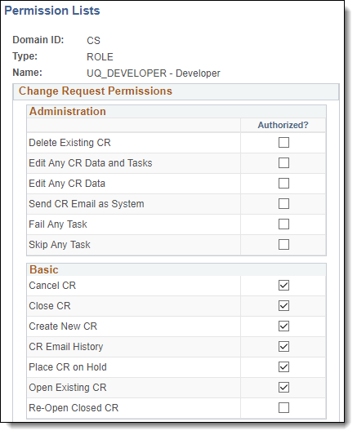
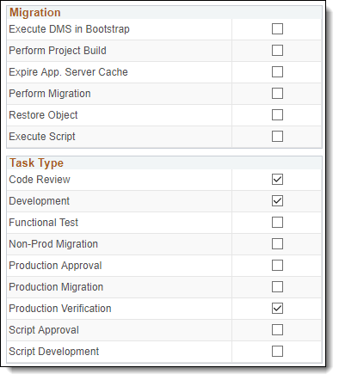
Domain Security
Notes:
Domain security defines what actions a Role can do on a Change Request.
- The Administration, Basic, and Migration actions are standard for all Change Requests, while the
- Task Types will vary according to the domain’s workflow configuration.

Slide 16
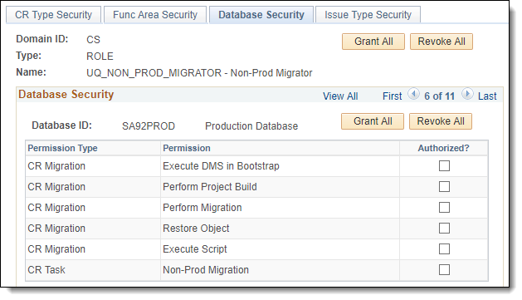
Row Level Security
Notes:
Row Level Security can be used to override permissions for workflows and limit permissions to certain databases.
- UQ uses row level security to restrict “Non-Prod Migrators” from migrating to production, but allows them to migrate to the other non-prod environments.

Slide 17
DEVELOPMENT
Version Control,
Comparisons,
Migrations,
Rollback

Slide 18
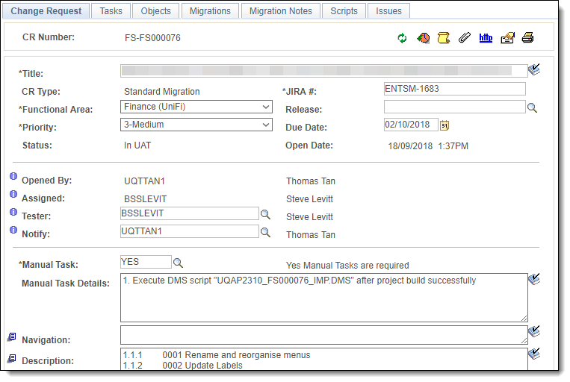
CHANGE REQUEST (CR)
Notes:
A Change Request is created for any customisation or scripted data change.
UQ has used Phire’s flex fields to customise (via configuration) the Change Request page to add the Manual Task and Manual Task Details fields
Phire delivers a Migration Notes page that can also be used for documenting manual steps etc. however we found this page was overly complex and superfluous to our requirements.
Phire’s Doman Setup Wizard can be used to rename fields, add flex fields, and make fields required.
For example, UQ uses Jira to track user stories, tasks, and bugs so we renamed the Tracking # field to JIRA #
The selected CR Type controls which workflow, flex fields, and labels are available for the CR.

Slide 19
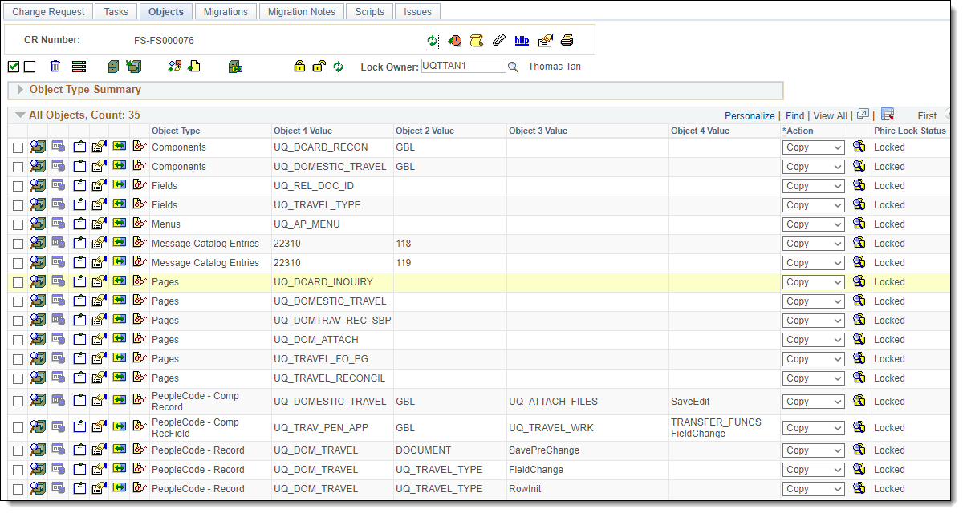
Adding OBJECTS
Notes:
Objects from Application Designer or Files (like SQR, COBOL) can be added to the CR
Phire manages the object locks to prevent clashes in object modifications, locking can also be integrated with Application Designer object locking.
When all objects have been added to your CR, a version set can be created which will be used to migrate the CR to other environments.
Phire can also be configured to restrict certain object types for different workflows.
- For example UQ’s nVision workflow does not allow App Designer objects to the included in the CR.

Slide 20
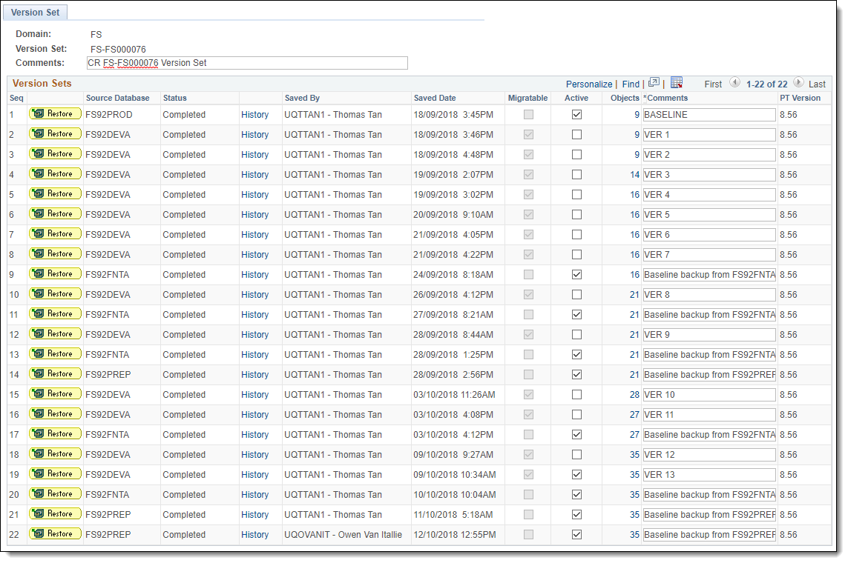
VERSON CONTROL
Notes:
Version Control in Phire is achieved with version sets
A version set is a snapshot of a set of objects as a point in time.
A version set can be migratable or just created for backup/restore purposes.
When migrating to an environment you can choose to create a backup version set of the target environment prior to migrating the objects, this version set can then be used to rollback the customisation if required.
Version sets can also be restored into an environment at any time.
Individual objects can also be restored from a version set into an environment.
Phire always migrates from a version set (not the live source environment).

Slide 21
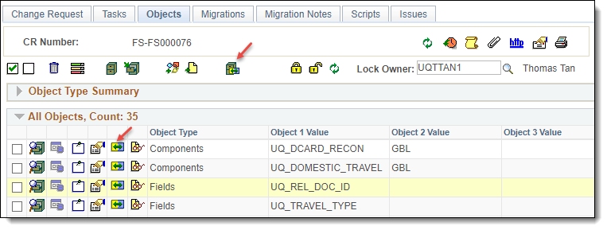
Comparisons
Notes:
Phire can produce comparison reports for a CR as a whole, or an individual object contained within a CR.
Comparisons for individual objects can be done between two different live environments.
Comparisons at the CR level can be done from a version set to a live environment, or from a live environment to another live environment.
Phire 13.2 is also said to be introducing comparisons between two version sets.
Phire does all comparisons without the need of opening Application Designer on the client computer.

Slide 22
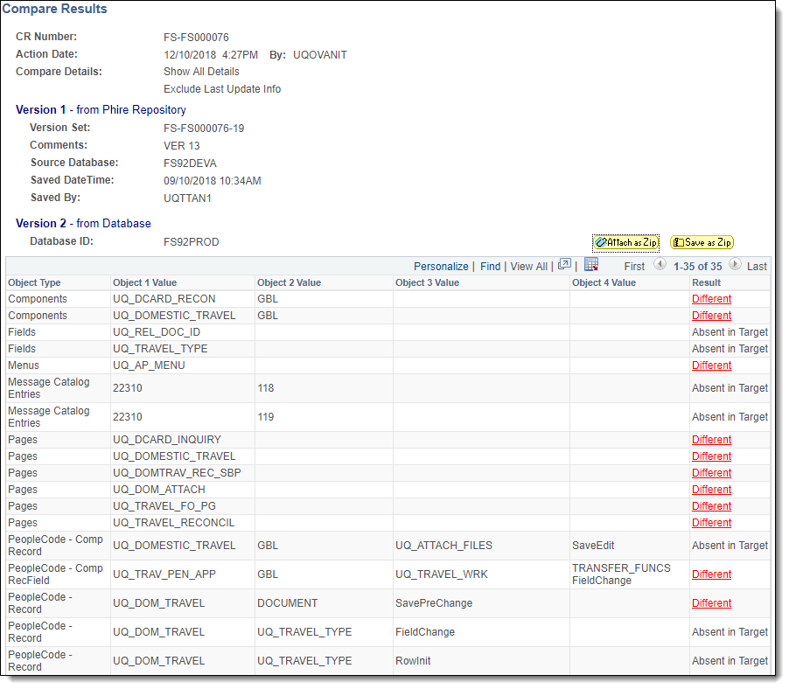
Compare Report Summary
Notes:
At the CR level, the comparison report shows a list of all objects in the CR and whether the object is Same, Different, or Absent.
You can drill in on differences to see exactly what has changed.
Comparison reports make code reviews more straightforward. A code review can also be done solely within Phire if you wish as all differences and object properties can be viewed from within Phire.

Slide 23
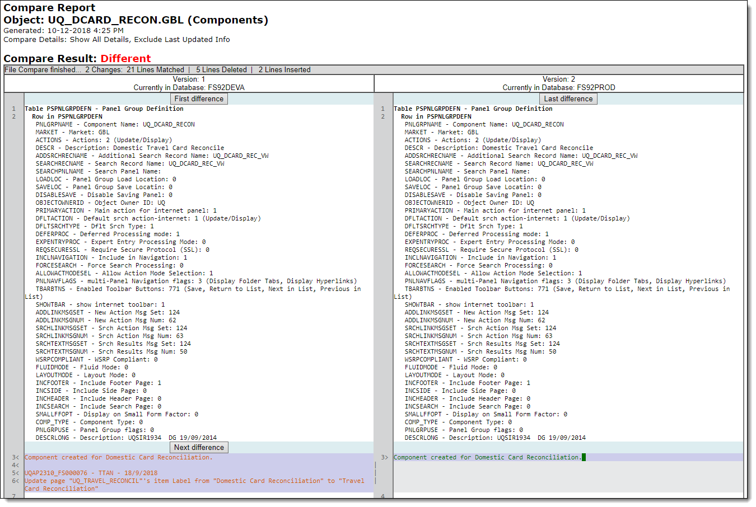
COMPARE REPORT DETAIL
Notes:
Drilling into the object differences report highlights the specific differences for the object between the two sources.
- You can easily step through each difference with the buttons provided.

Slide 24
Migrations
Notes:
Phire supports the concept of Standard and Ad hoc migrations.
Standard Migrations are linked to and controlled by the CR’s workflow steps. Standard migrations can only be performed on a migration step and only to the allowed target for that step.
This allows a standard migration path to be enforced. E.g. DEV > TEST > UAT > PROD.
Ad hoc Migrations can be performed to any environment that has been configured as an ad hoc target in domain configuration.
This allows customisations to be migrated to environments that are not on the standard migration path. E.g. a daily refresh support environment for testing with the latest production data.

Slide 25
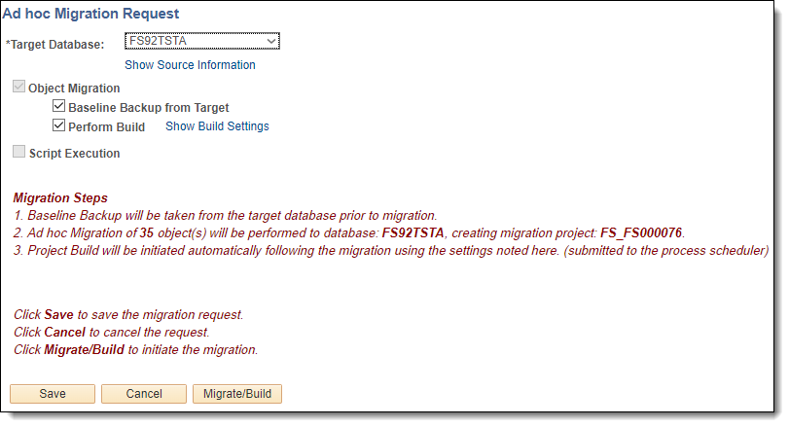
Migrations
Notes:
Phire performs project build automatically after all objects are copied into the target.
Scripts can be attached to the CR and set to execute automatically with the migration
Migrating with Phire is generally a simple one-click operation.

Slide 26
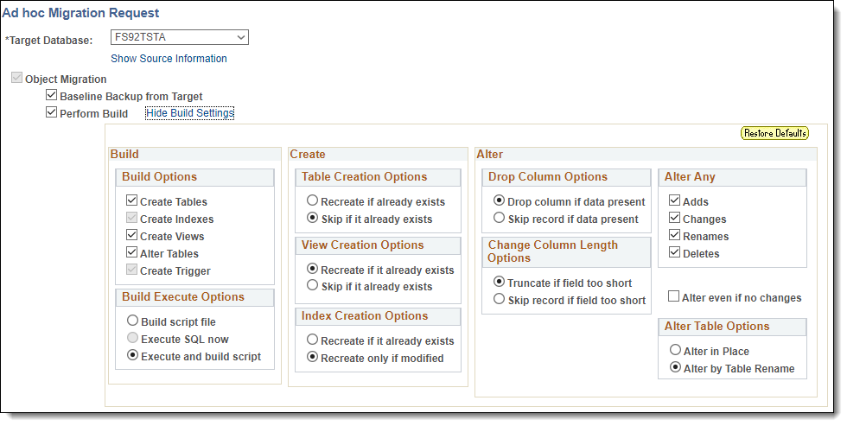
Automated BUILD
Notes:
Build defaults are set at the Domain level, but can be overridden if necessary when performing a migration.
Application Designer is not necessary to perform the build as Phire performs the build on the server.

Slide 27
Rollback
Notes:
Rollback of the CR’s objects is a simple one-click operation.
As Phire can create a backup version set in the target prior to migration, all that is necessary is to restore/rebuild from the backup version set – this is fully automated by Phire.
Note: If your migration uses scripts to change data in the target you will need to write custom rollback scripts to restore the data if necessary.
Rollback scripts can also be set to run automatically when a rollback is performed.

Slide 28
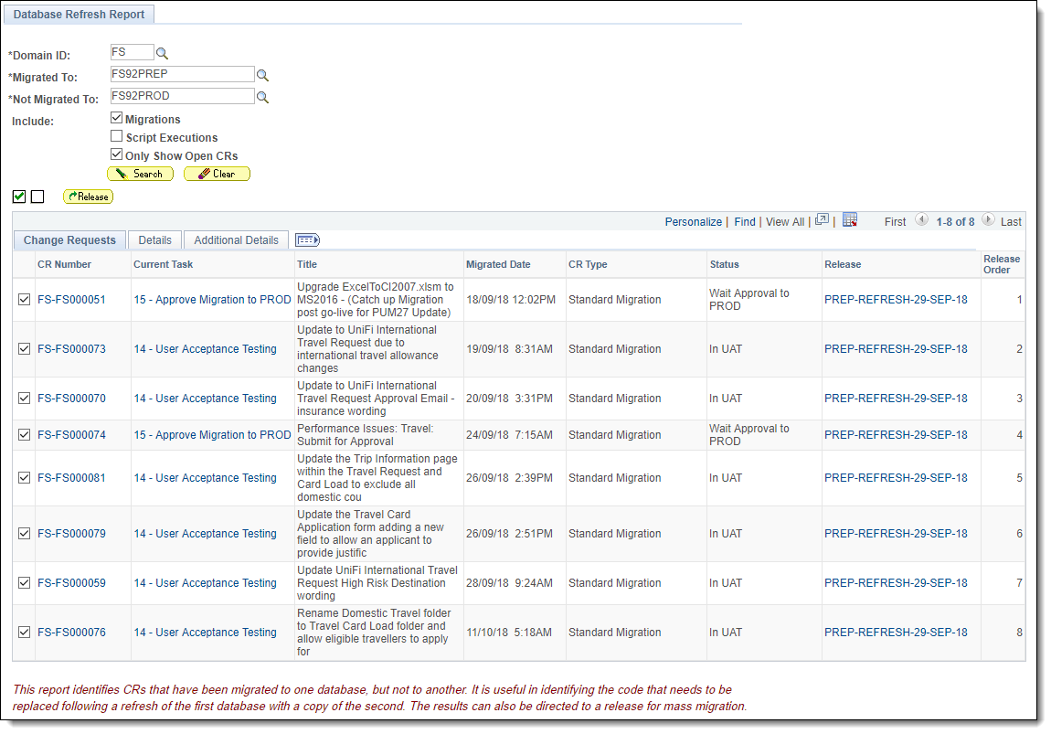
Database Refresh Report
Notes:
Phire can assist with the restoration of customisations to an environment after it has been refreshed
For example, when you refresh your UAT environment to get the latest production data, but lose some unreleased customisations that your were testing. Phire can restore the customisations easily and reliably.
To do this
Run the Database Refresh report to quickly identify any CRs that are missing after a refresh
Package the CRs up into a release definition in Phire and
Use the release to mass-migrate the CRs back into the environment.

Slide 29
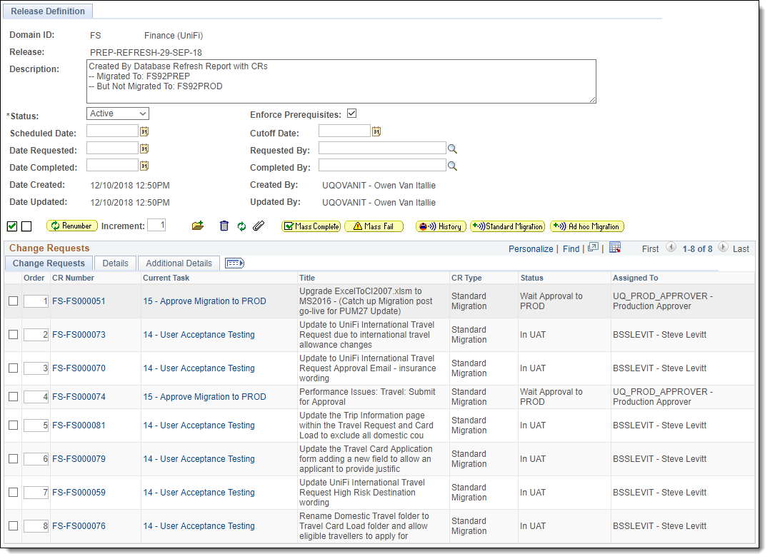
Release Definition
Notes:
Releases can be used to perform mass-operations on multiple CRs.
For example, Mass Complete, Mass Fail, Mass Migrate
You can order the CRs into whatever sequence is required and then mass-migrate with one click.
Be sure to take note of any manual migration steps prior to mass migrating and ensure you do any pre or post manual steps prior to, or after the migration as required.

Slide 30
VISIBILITY
Reporting,
Auditing

Slide 31
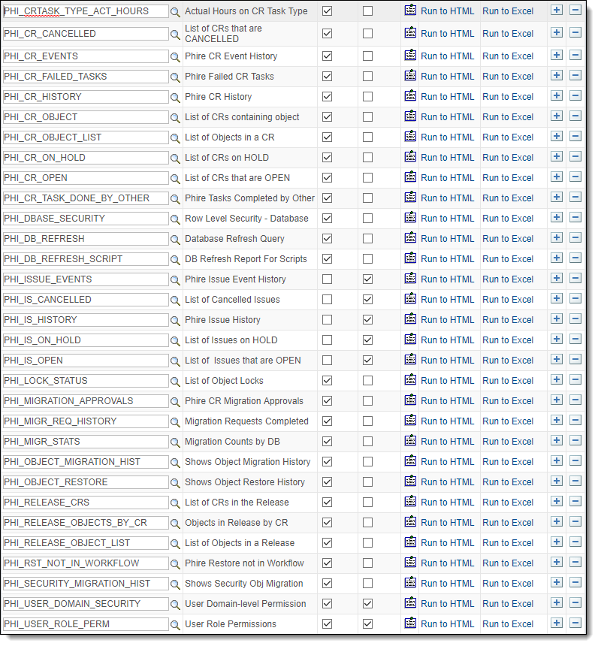
REPORTS
Delivered Reports
CR Report Builder
CR Management Report
PS Queries
Create your own with any PeopleSoft reporting technology
Notes:
Phire provides many delivered PeopleSoft Queries for reporting and a simple Report Builder tool.
UQ has used PeopleSoft Query to create reports for various purposes such as
CRs for Production Approval Review – Used weekly to review and identify the CRs to be migrated to production for the week
CRs ready for Code Review
CRs ready for Verification in Production
CRs that are released to Production – Good for yearly audits
Using PeopleSoft Query’s Drilling URL function it’s also possible to drill into the CRs and link to the related Jira ticket

Slide 32
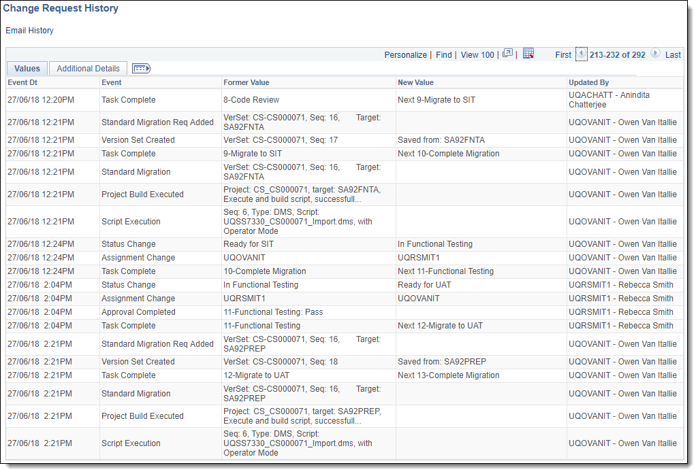
AUDITS
Notes:
Phire logs all actions that are performed on a CR from Creation to Closure or Cancellation.
This is useful for annual auditing or checking if/when a particular action occurred
When a task is failed, Phire will ask for a reason to be logged.
Comments can also be entered against any workflow step.

Slide 33
BENEFITS
Productivity,
Process Improvement

Slide 34
Benefits
Phire has improved team productivity by automating actions that were previously done manually.
Phire has increased quality assurance and aided process improvements.
Phire provides secure, robust and reliable methods for managing change.
Significantly lower maintenance and support costs
Automated build and script execution
Version Control and ability to rollback
Workflows and Approvals ensure consistent and controlled process
Notes:
Prior to implementing Phire UQ was using many manual processes revolving around email approvals and logging helpdesk requests to various support teams to action tasks.
Phire has streamlined these processes and provided a cohesive and consistent method for managing PeopleSoft customisations and scripted data changes.
Phire has significantly reduced the ongoing cost of change control both in terms of licensing and support and productivity gains.
Phire’s version control and ability to rollback reduces the risks involved in development and release of customisations.
Phire’s workflows and approvals ensure a robust and consistent process for change management.

Slide 35
LESSONS LEARNED
What we have
learned

Slide 36
LESSONS LEARNED
Increase Application Server Timeouts when migrating CRs with a very large number of objects or long builds.
Automated Post-Build script execution can only be used when Pire is running on a Windows App Server. (fixed in 13.2?)
Keep workflows simple to prevent bottlenecks in your process.
Add rollback on error directives to SQL scripts if the script shouldn’t commit unless every statement in the script executes successfully.
Phire’s Database Refresh report and Release mass migration saves time and ensures work in progress is not lost after a refresh!
Notes:
Some lessons we have learned are
The Application Server may timeout (default 5 mins) when migrating several hundred objects with baseline backup and/or long running builds. To avoid issues we recommend increasing the App Server timeout for Phire to suit your usage patterns.
Phire allows for automatic execution of scripts after completion of build, however in Phire 13.1 this can only be done if Phire is running on a Windows Application Server. Phire 13.2 is said to be allowing this to be done on *nix platforms as well.
It’s a good idea to add SQL error rollback directives to SQL scripts in Phire if the script should only commit when all statements have executed successfully. Failing to do so may result in a partially committed script with potentially unpredictable results.
Prior to Phire, restoration of work in progress customisations to a refreshed environment was laborious. Phire’s Database Refresh Report coupled with Mass Migration from a release significantly reduces the effort involved and ensures reliable restoration.

Slide 37
DEMO
A quick run through Phire

Slide 38
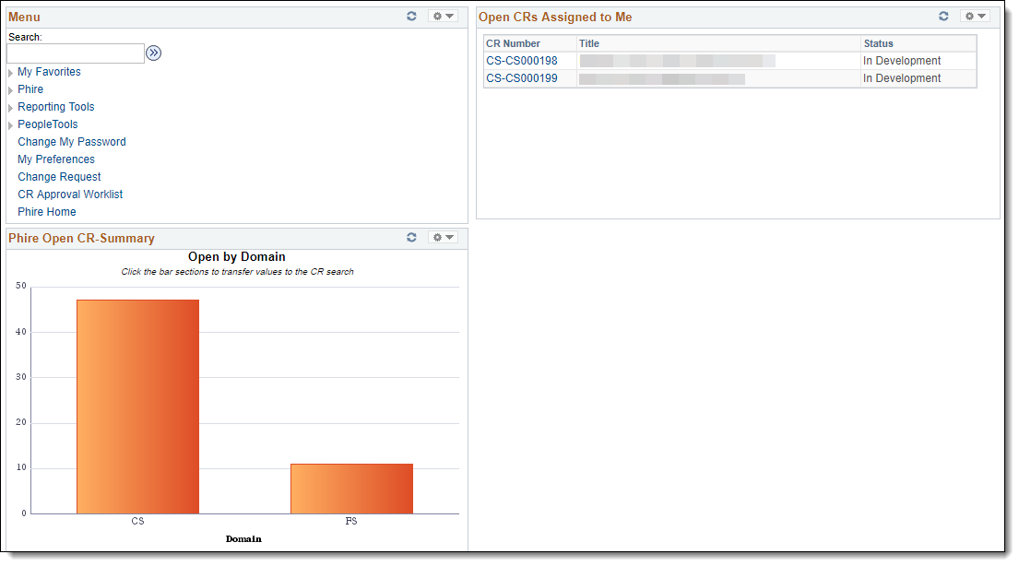
DEMO
Notes:
A short demonstration of Phire if there is time and interest in the audience.

Slide 39
QUESTIONS
Q&A
Notes:
Any questions?

Slide 40
presenters
Owen Van Itallie
Senior Application Technical Analyst
The University of Queensland
o.vanitallie@uq.edu.au
all Alliance presentations will be available for download from the Conference Site

Slide 41
THANK YOU!

