Slide 1
Building a Responsive & Modern UI with PT8.49
SESSION 6009
09 November 2015

Slide 2
Presenter
Mark Burton
Senior Manager
Enterprise Information Systems – Student Information Systems
Singapore Management University
mburton@smu.edu.sg
Almost 20 years of experience with PeopleSoft Technologies
Over 6 years experience in Campus Solutions
Earliest version Tools 3.24 / Financials 2.2

Slide 3
Singapore Management University

Slide 4
Singapore Management University (SMU)
A premier university in Asia, the Singapore Management University (SMU) is internationally recognised for its world-class research and distinguished teaching.
Established in 2000, SMU’s mission is to generate leading-edge research with global impact and produce broad-based, creative and entrepreneurial leaders for the knowledge-based economy.
Home to around 9,000 undergraduate, postgraduate, executive and professional, full- and part-time students.
SMU has six schools: School of Accountancy, Lee Kong Chian School of Business, School of Economics, School of Information Systems, School of Law, and School of Social Sciences.

Slide 5
SMU & ORACLE

Slide 6
SMU & Oracle
PeopleSoft Campus Solutions | Version
Current Version | 8.9
Campus Solutions Modules | Academic Advisement, Student Financials, Admissions & Recruiting, Student Records, Campus Community, Campus Self Service
PeopleSoft Enterprise Portal | Version
Current Version | 8.9
PeopleTools | Version
Current Version | 8.49
Oracle Database | Version
Current Version | 11g RAC
SUN Solaris | Version
Current Version | 10

Slide 7
Agenda
Overview
Case Study
Background
Objectives and Challenges
Implementation and Techniques Applied
Demo
Learning Points and Tips
Q & A

Slide 8
SECTION 1
Overview

Slide 9
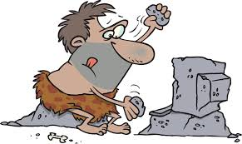
Background
The delivered PeopleSoft user Interface (UI) in PeopleTools 8.49 is menu-driven and does not offer a great user experience.
Colour scheme and layout are old-fashioned and does not match the portal's UI theme and branding.
Not web-responsive to mobile devices.
Inconsistent among various browsers and version.
Forms are cumbersome and difficult to use.
Entry errors are unclear and presented one at a time.
Notes:
Aimed at crafting sites to provide an optimal viewing and interaction experience—easy reading and navigation with a minimum of resizing, panning, and scrolling—across a wide range of devices (from desktop computer monitors to mobile phones)

Slide 10
Limitations
PeopleTools 8.49 has limitations.
No dynamic branding at the code level.
Cannot place custom navigation at the top of the screen.
Cannot highlight a grid row on mouse over.
Does not support cascading style sheets (CSS).

Slide 12
Workaround
But we can overcome the limitations using
JavaScript & Jquery
PeopleSoft stylesheet
PeopleSoft HTML objects
PeopleSoft HTML fields

Slide 13
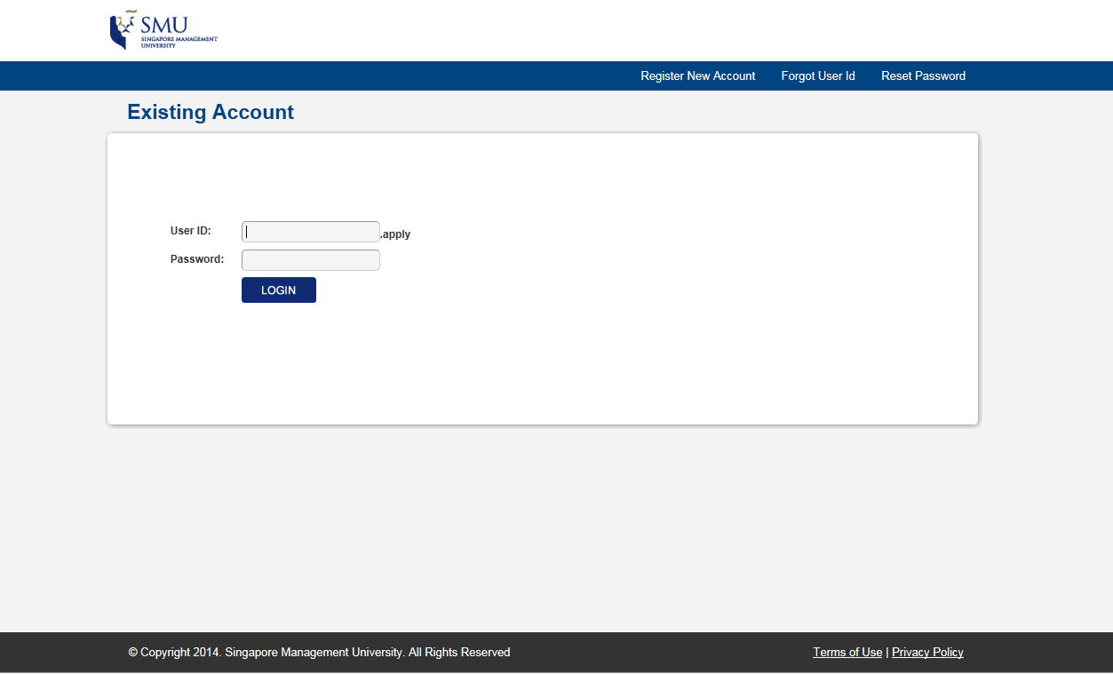

Slide 14
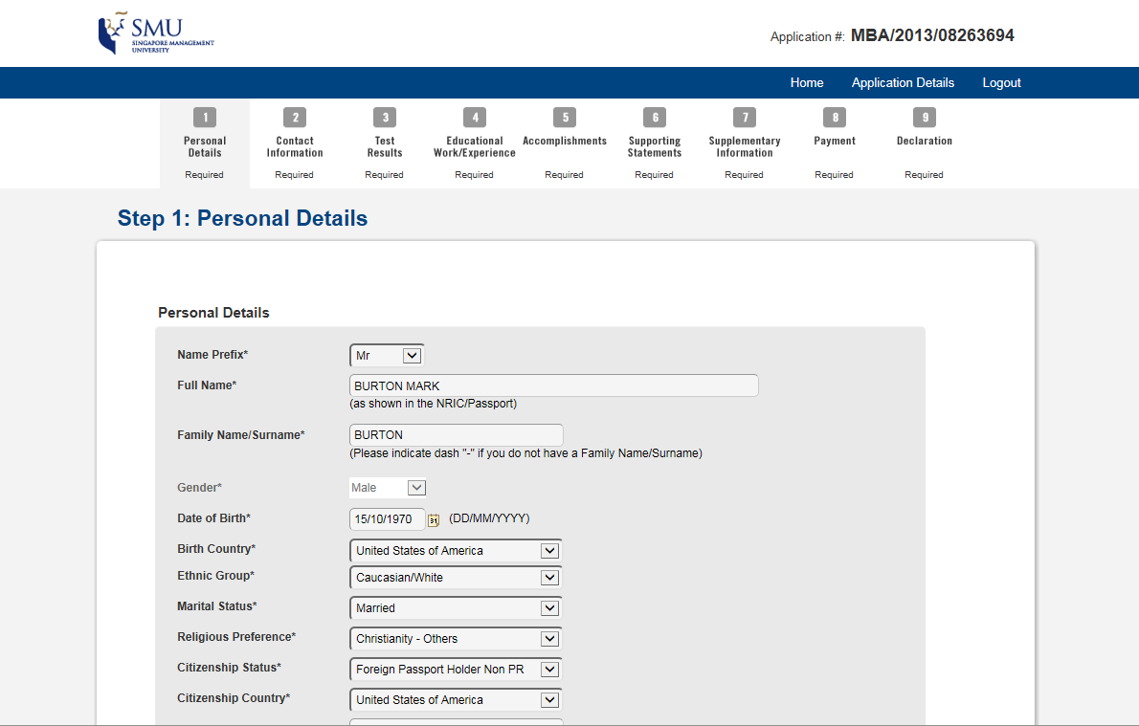

Slide 15
SECTION 2
Case Study – Postgraduate Application Form

Slide 16
Project Background
In 2013 SMU’s Office of Postgraduate Professionals Programme (PGPP) requested to revamp their online application forms.
Cumbersome and difficult to use.
Validations were unclear and presented one at a time.
Not-responsive to tablet devices.
Outdated UI
Inconsistent among browsers and versions
Branding could not accommodate partner schools

Slide 17
Project Objectives
Pleasant experience
Improve efficiency and effectiveness
Update application look and feel
Responsive for use in tablets
Improve consistency among browsers and versions

Slide 18
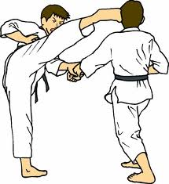
Techniques Used
Use JavaScript and JQuery to overcome many of the limitations found in the PT 8.49.
Use CSS to enhance your existing PeopleSoft Style Sheets and the overall look of your application.
Use a Group Box to encapsulate continent, group related content and aid in page configuration.
Leverage HTML areas to as a means of executing scripts from your web page.
Create HTML stored procedures to simplify your efforts.

Slide 19
PS Style Sheets
Don’t forget padding and margins
Apply designed color schemes
Change your button design

Slide 20
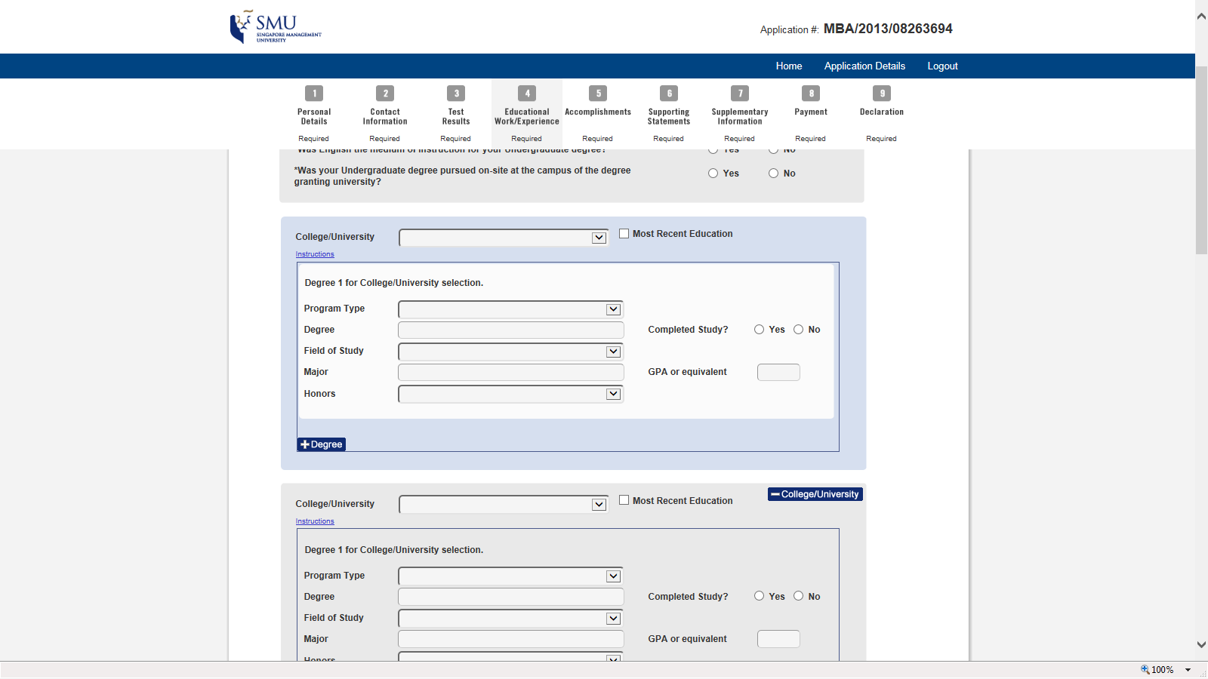
Group Box and Frame Classes
Use classes to group items and limits for your content

Slide 21
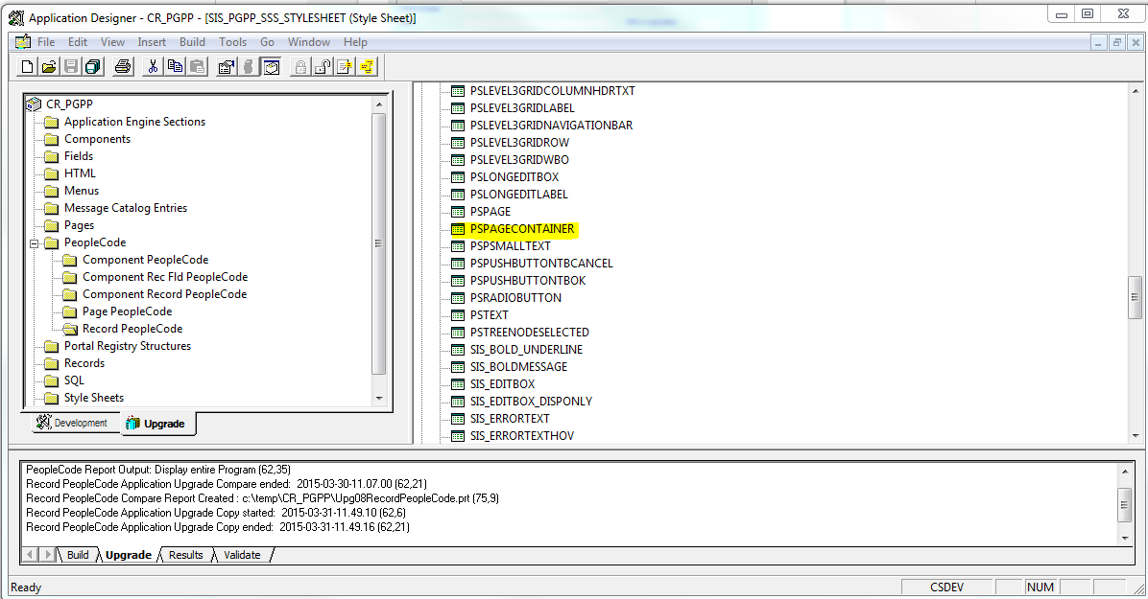
Page Container
Create a custom PeopleSoft Style Sheet with modified PSPAGE and PSCONTAINER to center page.

Slide 22
Add CSS to your design
Use JavaScript to place CSS in the page <header>.
function importStylesheet(sheetUrl) {
var ss = document.createElement("link");
ss.rel = "stylesheet";
ss.href = sheetUrl;
ss.type = "text/css";
document.getElementsByTagName("head")[0].appendChild(ss);
}

Slide 23
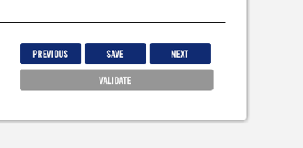
CSS to enhance PS Class
Add Cascading Style to your PeopleSoft Class
Rounding the corners
Add Border Effects

Slide 24
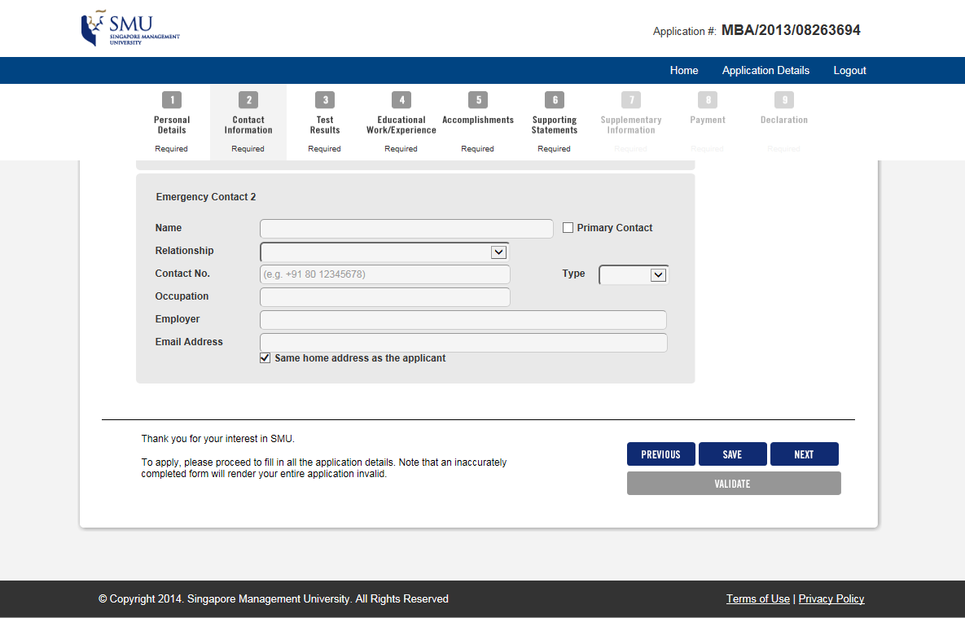
CSS for Header and Footer

Slide 25
CSS for Compatibility
For a Responsive UI that is multi-browser compatible, use different CSS files depending on the device that is browsing. We used three different CSS files:
Mobile CSS
Standard Browser CSS
Internet Explorer Compatibility CSS

Slide 26
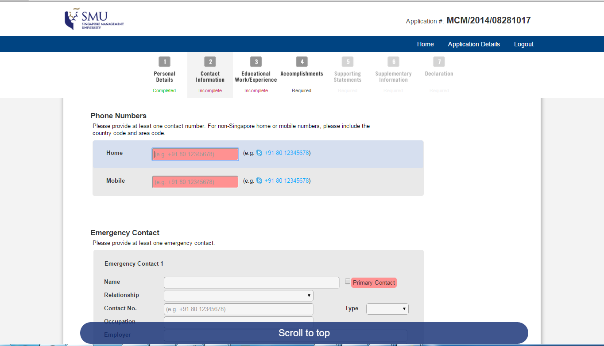
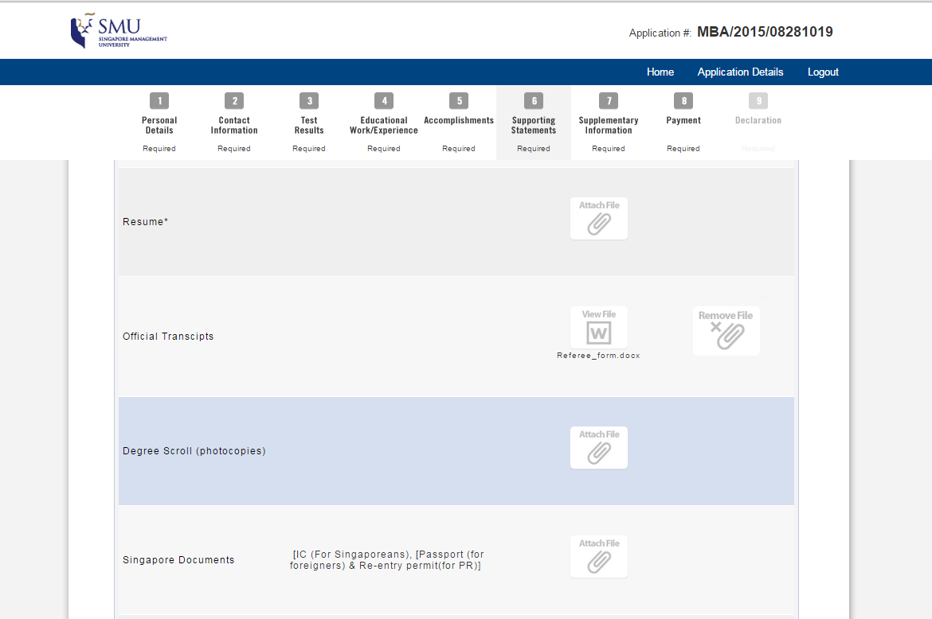
Use JavaScript
Use JavaScript to add multi-layer mouse over highlights to your page.

Slide 27
Stored HTML
When possible modularize HTML and use bind variables
<div class="%BIND(:1)">
<a name='%Bind(:2)' id='%Bind(:2)' %Bind(:3) >
<img src="%Image(%BIND(:4))" %BIND(:5) alt="click here" width="94" height="74" id="%BIND(:6)" /></a>
<span class="steps_status %BIND(:7)">%BIND(:8)</span>
</div>

Slide 28
Call PeopleCode
Use custom PeopleCode call procedure in your code.
javascript:submitAction_win%BIND(:1)(document.win%BIND(:1),'%BIND(:2)');
%BIND(:1) - Session Number
https://peoplesoft/psp/ps/.....
https://peoplesoft/psp/ps_1/.....
https://peoplesoft/psp/ps_2/.....
%BIND(:2) - Field Reference

Slide 29
IE Severe Scrolling Issue
For long pages, IE causes severe scrolling when page refreshes. Update the X/Y functions to accommodate IE.
function getScrollY()
{
var sis_posy = (window.pageYOffset !== undefined) ? window.pageYOffset : (document.body || document.documentElement || document.body.parentNode).scrollTop;
return sis_posy;
}
function getScrollX()
{
var sis_posx = (window.pageXOffset !== undefined) ? window.pageXOffset : ( document.body || document.documentElement || document.body.parentNode).scrollLeft;
return sis_posx;
}

Slide 30
IE Compatibility Mode
There are quarks found with Internet Explorer Compatibility mode. To resolve these you may try the following:
Use PIE.js to enhance formatting.
Add a one pixel invisible image in the CSS in order to stabilize rendering.
Increase the font slightly for the dropdown lists in order to improve look.

Slide 31
IE Version < 11
Internet Explorer version 10 and below work best in compatibility mode. You can force compatibility mode by placing this code in FieldFormula PeopleCode
If %Request.BrowserType = "IE" Then
Local string &BrowserVersion;
&BrowserVersion = LTrim(RTrim(%Request.BrowserVersion, " "), " ");
If Len(&BrowserVersion) = 3 Then
&BrowserVersion = "0" | &BrowserVersion;
End-If;
If &BrowserVersion <= "10.0" Then
%Response.SetHeader("X-UA-Compatible", "IE=5");
End-if;
End-if;

Slide 32
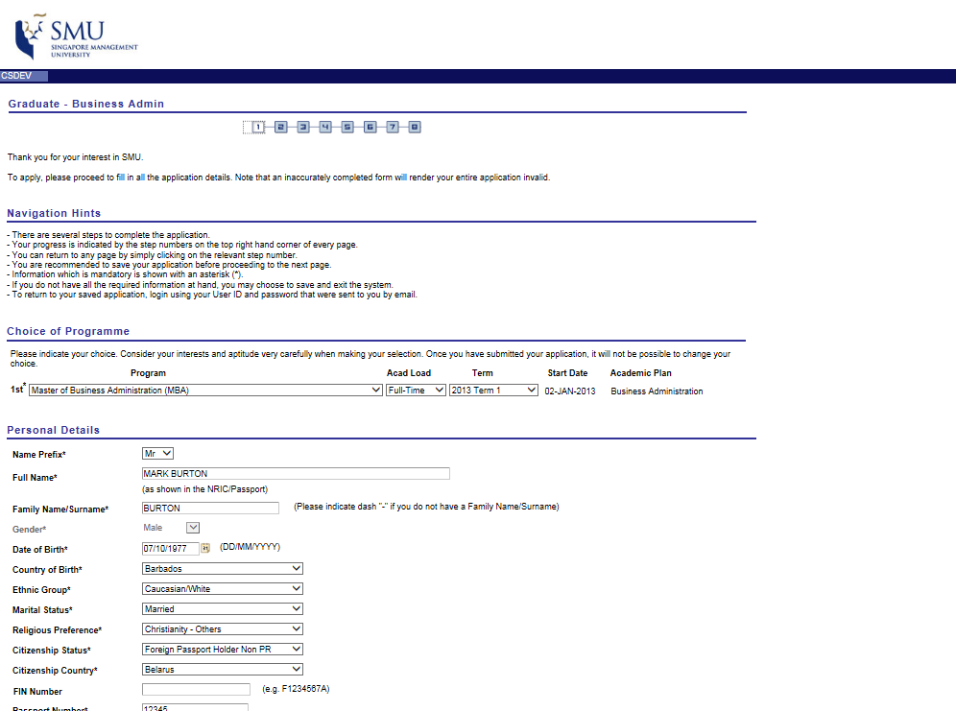
Before: Outdated Style

Slide 33
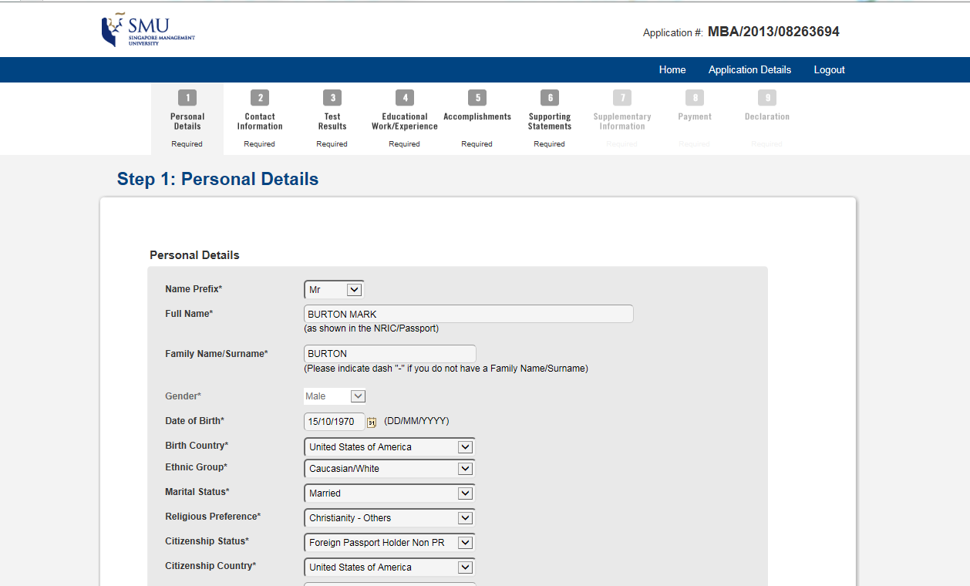
After: Updated Style

Slide 34
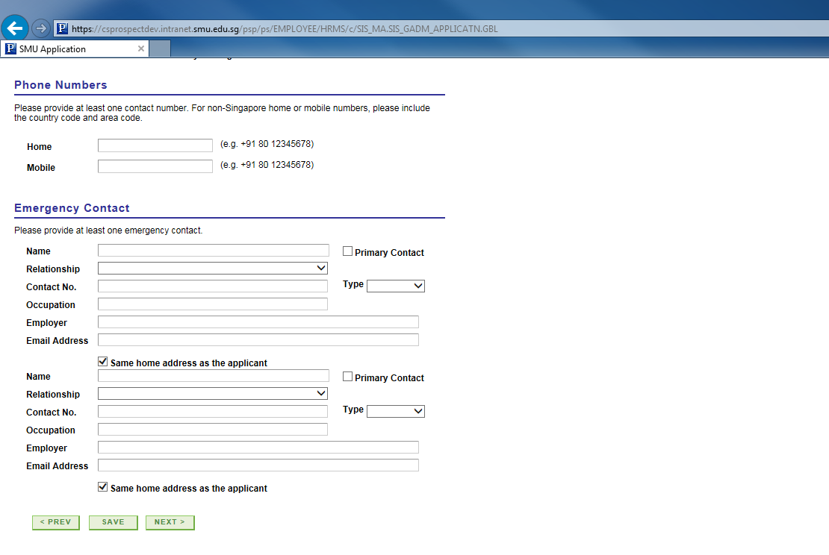
Before: Poor Navigation

Slide 35
After: Improved Navigation

Slide 36
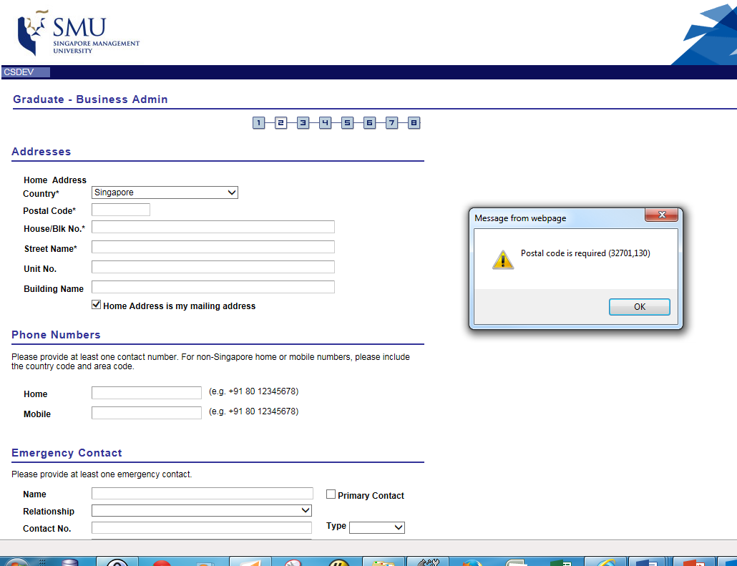
Before: Inefficient Validation

Slide 37
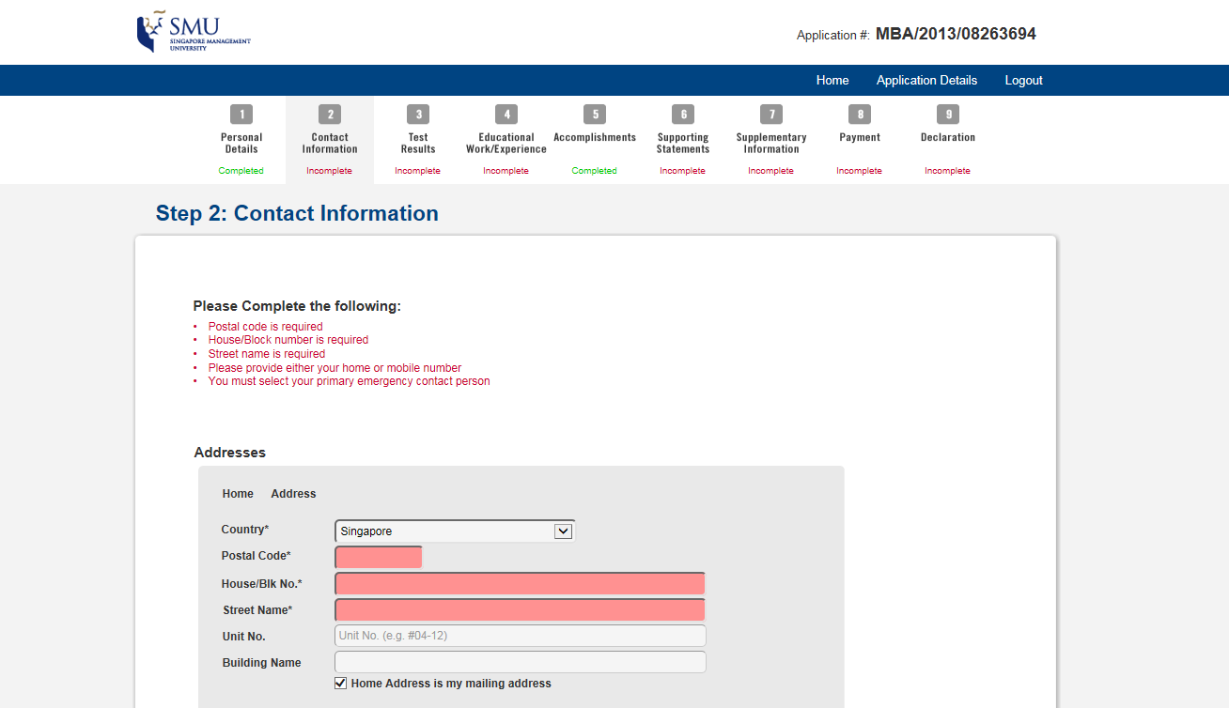
After: Validation Lists and Status

Slide 38
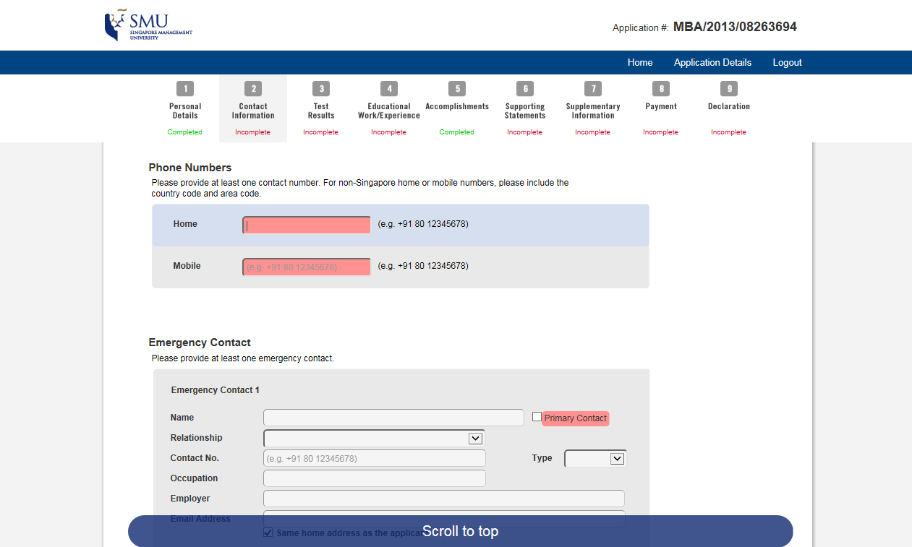
After: Validation Field Redirect

Slide 39
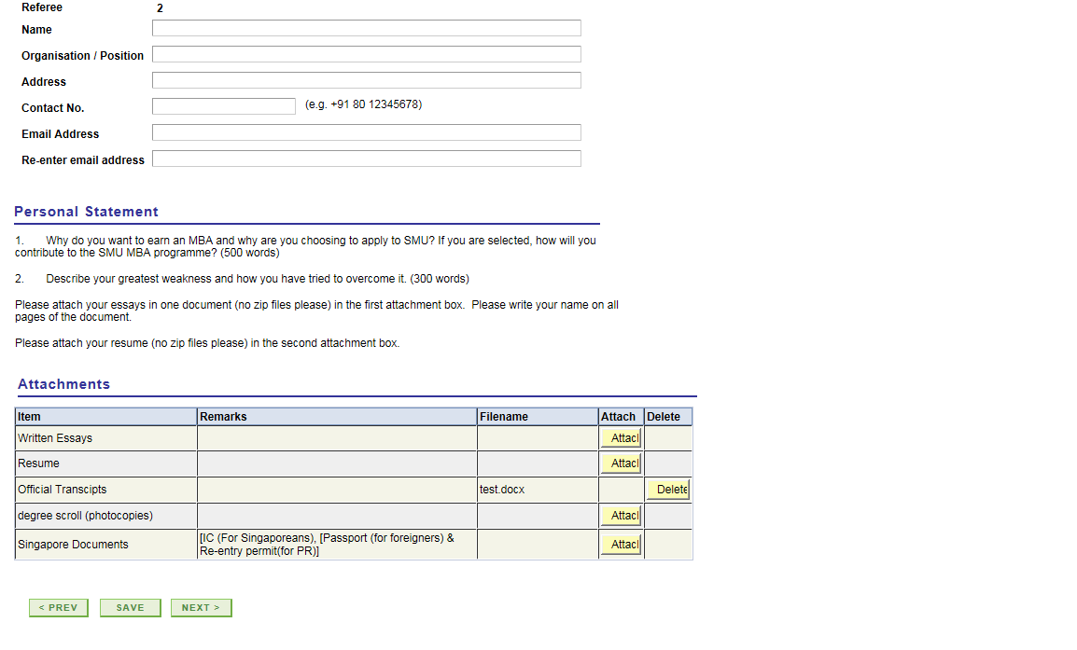
Before: Plain Buttons and Grids

Slide 40
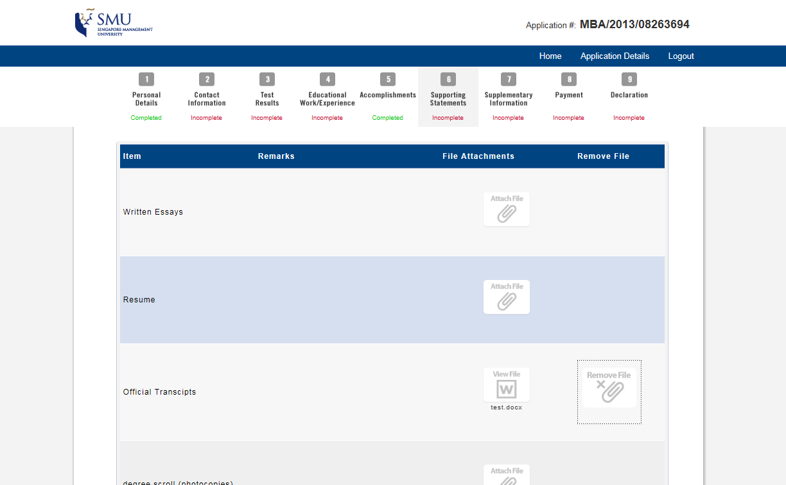
After: Icons and Row Highlights

Slide 41
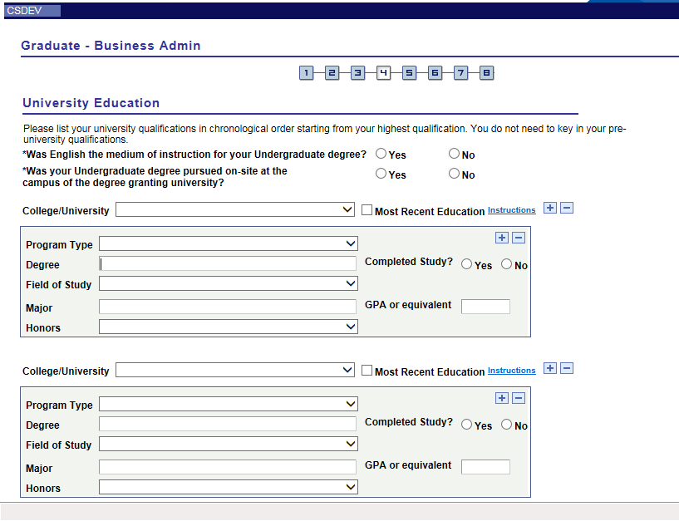
Before: No Mouse-Over Highlights

Slide 42
After: Highlight by Groupings

Slide 43
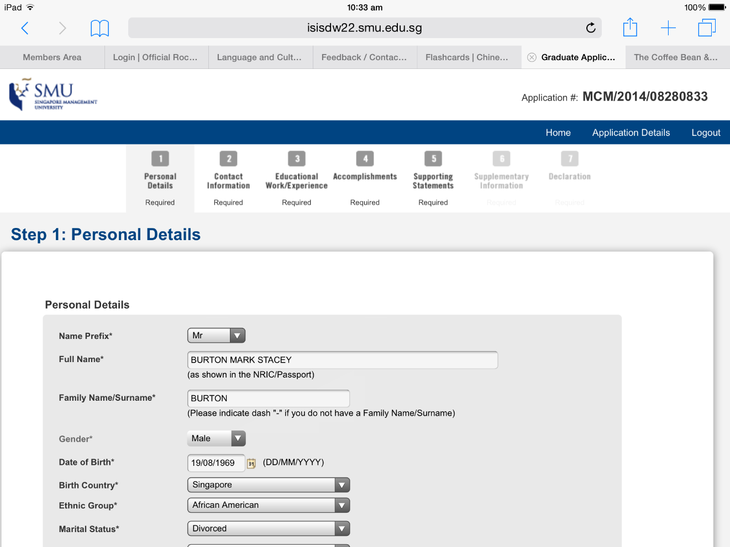
After: Responsive to Tablet

Slide 44
Outcomes from the Change
The form is intuitive and easy for applicants
Enables custom branding for partner school programs
Applicants are not frustrated with presentation of validation messaging
Admissions staff are satisfied with the overall look and feel

Slide 45
Demo

Slide 46
SECTION 3
Learning Points & Tips

Slide 47
Learning Points and Tips
It is best to use the prototype approach by starting small and elaborate functionality incrementally.
Include your Web Design team early as they can help designing and refining your CSS and Java scripts
Perform comprehensive browser testing that includes different operating systems as well as browser versions
Upgrade your Tools to the latest version (currently 8.54) so that you can take advantage of PeopleSoft Fluid UI

Slide 48
Resources
http://docs.oracle.com/cd/E13292_01/pt849pbr0/eng/psbooks/index.htm
http://www.w3schools.com/
http://stackoverflow.com
http://www.java2s.com/
http://jjmpsj.blogspot.sg/
http://css3pie.com/documentation/pie-js/
https://dev.modern.ie/tools/vms/windows/

Slide 50
Presenter
Mark Burton
Senior Manager
Enterprise Information Systems – Student Information Systems
Singapore Management University
mburton@smu.edu.sg
all Alliance presentations will be available for download from the Conference Site

Slide 51
THANK YOU!

