Slide 1
The Lowdown on 1098-Ts
The Skinny on University of Nebraska/Nebraska State College System Processing
Mid-HEUG 2017

Slide 2
Your Presenter
Suzan Manthey
Student Financials Functional Coordinator
Nebraska Student Information System (NeSIS)
University of Nebraska/Nebraska State College System
20+ Years Supporting Student Information Systems
9 Years in PeopleSoft
6 Years in SF

Slide 3
“Oh I just love 1098-T time!”
Said no one, ever.

Slide 4
Agenda/Contents
About NeSIS
Reporting Method Changes
Annual Process Planning
Student Communications
Prep for the Tax Year
1098-T Generation
Post-Generation Validation
Electronic Access and Form Printing
Questions

Slide 5
Nebraska Student Information System NeSIS
2 Multi-institution Instances
State Colleges
University System

Slide 6
NeSIS & Oracle
Campus Solutions 9.2 (May 2017)
PUM Image #6 (October 7, 2017)
PeopleTools 8.55 (October 7, 2017)
In-House Developed Student Dashboard
Students do not use delivered Student Center SF pages

Slide 7
NeSIS & 1098-T Reporting
Utilize Campus Solutions delivered processes
Generate 1098-T process (vanilla)
1098-T Audit Report (modified)
1098-T Form Print (vanilla)
update print flag/date
Create transmittal files
In-House printing (custom)
Student Dashboard Access to 1098-Ts (Custom)

Slide 8
NeSIS & 1098-T Reporting
Modified the Edit 1098-T and View 1098-T pages to show Electronic Consent status

Slide 9
NeSIS & 1098-T Reporting
2016 Tax Year
 | NU | NSCS
1098-Ts Generated | 68,301 | 12,836
1098-Ts Printed | 30,111 | 9,967
1098-Ts Electronic Consent | 33,473 | 2,773
Multi-institution setup however we report to the IRS as one entity on each instance
University of Nebraska Board of Regents
Nebraska State College System

Slide 10
Disclaimer
I am not a tax accountant
Many tax rules and regulations are clear as mud
This is our (NU and NSCS) interpretation

Slide 11
Reporting Method Changes
From Amounts Billed to Payments Received

Slide 12
Regulation Changes/Activity
December 2015
Trade Preferences Extension Act (TPEA)
Provides exemption if institutions comply with IRS standards for obtaining TIN
Protecting Americans from Tax Hikes Act (PATH)
Reporting of only amounts paid on 1098-T beginning with 2016 Tax Year

Slide 13
Regulation Changes/Activity
January 2016
NACUBO urges IRS for a 1 year delay
May 2016
IRS announces delay allowing amounts billed reporting for 2016 1098-T Forms
November 2016
IRS announces an additional 1 year delay
Summer 2017
July - NACUBO requests another delay
August – IRS informs association that Box 1 reporting will be required for TY 2018

Slide 14
Regulation Changes/Activity
Our Response
Started meeting monthly in February of 2016
Began testing payment method functionality
Several iterations and comparisons
Changes in business practices during transition period – actively
Delaying Spring tuition calc until after 12/31
Not applying “internal credits” until after 12/31
FA disbursement after 12/31
Decision: Payments Received Reporting for 2017

Slide 15
Annual Planning

Slide 16
Annual Planning
September/October
Review any tax law changes
Discuss changes to the 1098-T Form
delivered in Q3 CS Bundle/PUM Image
Run tests in non-Production environments
Review task list and establish timeline

Slide 17
Timeline and Task List
 | Task | Who | When
 | ComGen to no SSN/ITIN students | Campus | October
 | Set up 1098-T TIN Table | FC | October
 | ComGen to no consent students | Campus | November
 | Review Item Type Setup | Campus | By 1/4/18
 | Sign-off to Generate 1098-Ts | Campus | By noon on 1/5/18
 | Generate 2017 1098-Ts | FC | 1/5/18 – afternoon
 | Run 1098-T Audit Report | FC | 1/5/18 – afternoon
 | Run Validation Queries | Campus | 1/8/18 – 1/10/18
 | Override data to correct issues | Campus | 1/8/18 – 1/10/18

Slide 18
Timeline and Task List - continued
 | Task | Who | When
 | Activate Self-service access | FC | 1/10/18
 | ComGen to consent students | Campus | 1/11/18
 | Run Audit Report | FC | 1/11/18
 | Create print file | FC | 1/12/18
 | 1098-T Printing | CSN | 1/12 – 1/16/18
 | Distribute non-USA forms to campus | FC | 1/16/18
 | 1098-T forms mailed | UNL | By 1/31/18
 | Run Update 1098-T TIN Request | Campus | By 4/15/18
 | Create IRS Transmittal File | FC | 4/18/18
 | Transmit File to IRS | FC | 4/19/18

Slide 19
Student Communications

Slide 20
Student Communications
Collecting Taxpayer Identification Numbers
Communication Generation
Utilize Letter Codes for Update TIN Request Process
October
Based on current year transactions (ITEM_SF)
Eligible 1098-T charge item type (ITEM_TYPE_TBL)
US Citizens (CITIZENSHIP)
SSN = XXXXXXXXX (SCC_PERS_NI_QVW)
Late January
Based on 1098-T record (SF_1098_DTL)
1098-T SSN not between '000000000' AND '999999999'
1098-T Validation Status = Overridden

Slide 21
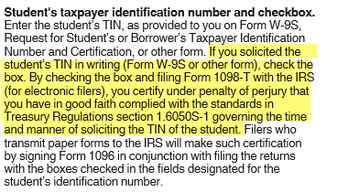
Student Communications
Collecting Taxpayer Identification Numbers
Update TIN Request Process – our interpretation
https://www.irs.gov/pub/irs-pdf/i1098et.pdf

Slide 22
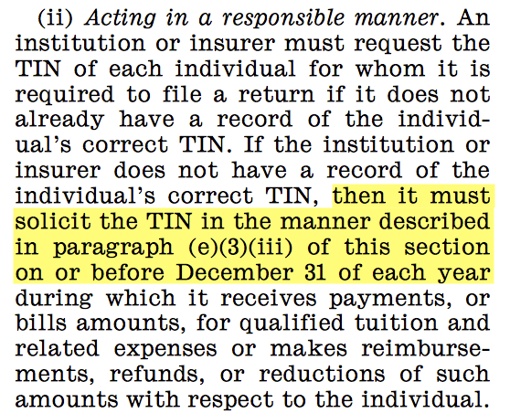
Student Communications
Source: Treasury Regulations section 1.6050S-1

Slide 23
Student Communications
Electronic Delivery Consent
November
Students without electronic consent (SSF_AGREE_VW)
Based on current year transactions (ITEM_SF)
Eligible 1098-T charge item type (ITEM_TYPE_TBL)
US Citizens (CITIZENSHIP)
January
Notice to students who have given consent that tax forms are available
IRS Regulation: Must inform the recipient, electronically or by mail, of the posting and how to access and print the statement

Slide 24
Tax Year Preparation
Item Type Review and Set Up

Slide 25
Tax Year Preparation
Item Type Review
Query ITEM_TYPE_TBL
Charge Item Types
ITEM_TYPE_CD = C
Display the SF_1098_FLG field for all active item types
Waiver Item Types
ITEM_TYPE_CD = W
Display the SSF_1098_WVR_OFFST
Do Not Offset Reported Tuition Flag
Value = ‘Y’ – included in Box 1 (payment method) or not included in Box 2 (billed method)

Slide 26
Tax Year Preparation
Item Type Set Up – Payment Method Reporting
True Waiver
Item Type | Code = Waiver Do Not Offset Reported Tuition = unchecked
1098-T Item Type Group | Excluded
Box 1 Reporting | No
Box 5 Reporting | No

Slide 27
Tax Year Preparation
Item Type Set Up – Payment Method Reporting
Waiver as Scholarship
Item Type | Code = Waiver Do Not Offset Reported Tuition = Checked
1098-T Item Type Group | Included
Box 1 Reporting | Amount applied to eligible charges
Box 5 Reporting | Total Amount

Slide 28
Tax Year Preparation
Item Type Set Up – Payment Method Reporting
True Payment
Item Type | Code = Payment
1098-T Item Type Group | Excluded
Box 1 Reporting | Amount applied to eligible charges
Box 5 Reporting | No

Slide 29
Tax Year Preparation
Item Type Set Up – Payment Method Reporting
Payment as Waiver
To be correctly reported on the 1098-T, these item types should be set up as waiver item types.
Waivers should not show in Box 1 or Box 5

Slide 30
Tax Year Preparation
Item Type Set Up – Payment Method Reporting
Third Party Contract – Payments
Item Type | Code = Payment
1098-T Item Type Group | Included
Box 1 Reporting | Amount applied to eligible charges
Box 5 Reporting | Total amount
See NACUBO’s Recommendations for Completing Form 1098-T for exceptions

Slide 31
Tax Year Preparation
Item Type Set Up – Payment Method Reporting
Third Party Contract – 529 Payments
Item Type | Code = Payment
1098-T Item Type Group | Excluded
Box 1 Reporting | Amount applied to eligible charges
Box 5 Reporting | No

Slide 32
Tax Year Preparation
Item Type Set Up – Payment Method Reporting
Financial Aid – Loans
Item Type | Code = Financial Aid
1098-T Item Type Group | Excluded
Box 1 Reporting | Amount applied to eligible charges
Box 5 Reporting | No

Slide 33
Tax Year Preparation
Item Type Set Up – Payment Method Reporting
Financial Aid – Scholarships/Grants
Item Type | Code = Financial Aid
1098-T Item Type Group | Included
Box 1 Reporting | Amount applied to eligible charges
Box 5 Reporting | Total Amount

Slide 34
Tax Year Preparation
Item Type Set Up – Payment Method Reporting
Financial Aid – Scholarships/Grants
Item Type | Code = Financial Aid
1098-T Item Type Group | Included
Box 1 Reporting | Amount applied to eligible charges
Box 5 Reporting | Total Amount

Slide 35
1098-T Generation

Slide 36
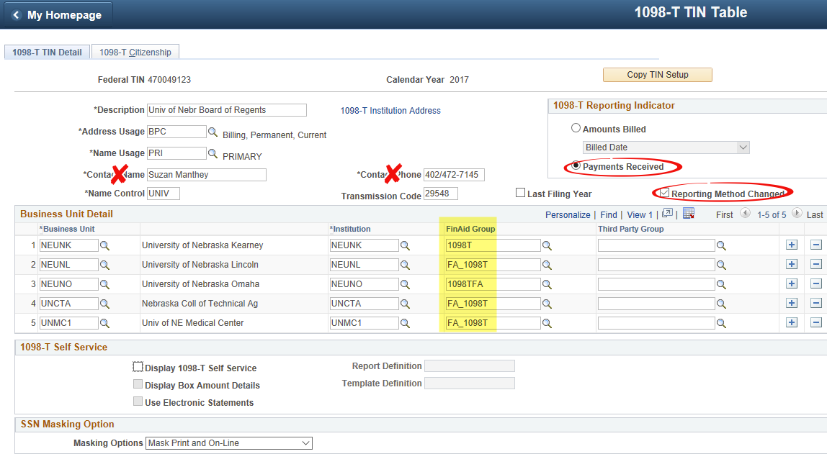
1098-T Generation
1098-T TIN Table Set Up
Navigation: Set Up SACR > Product Related > Student Financials > Taxes > 1098-T TIN Table

Slide 37
1098-T Generation
1098-T TIN Table Set Up
Navigation: Set Up SACR > Product Related > Student Financials > Taxes > 1098-T TIN Table

Slide 38
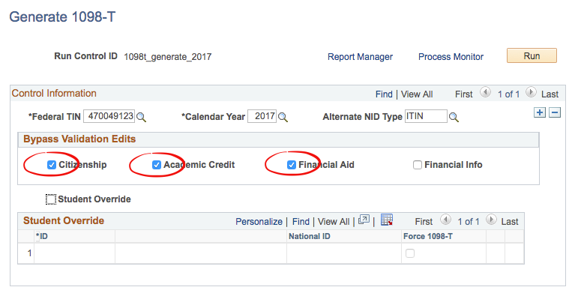
1098-T Generation
Generate 1098-T Run Control
Navigation: Student Financials > Taxes > Generate 1098-T

Slide 39
1098-T Generation
Academic Credit Bypass – Checked
Source: IRS Bulletin: 2006-36: Information Reporting for QTRE
https://www.irs.gov/irb/2006-36_IRB/ar10.html

Slide 40
Post Generation Validation

Slide 41
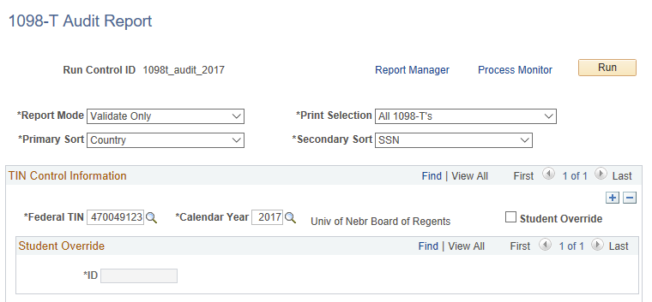
1098-T Validation
1098-T Audit Report
Navigation: Student Financials > Taxes > Tax Reports > 1098-T Audit

Slide 42
1098-T Validation
1098-T Audit Report
Report Mode = Validate Only
Invalid SSN (XXX-XX-XXXX) replaced with “blank”
Validation Status is set to Overridden
If invalid name, address or amount – validation status is set to Failed Validation
Our Modifications
If USA Citizenship Status = Other, do not update SSN to “blank” and set Status = Failed
Our reasoning
produce a 1098-T record for all students with eligible charges including non-USA citizens
Report only those who provide a SSN/ITIN

Slide 43
1098-T Validation
Validation Queries
Failed Validation
Report shows USA Citizen Status, name, address, box amounts
Deceased Students
Check address to make sure it is deliverable
Decease Students with Electronic Consent
Revoke consent to insure a form is printed
Duplicate IDs
Do not report duplicates – ‘XXXDup’
May need to override box totals
Invalid Amounts
Box amount totals < zero
Future Flag Issue
Future flag set but no future term transactions

Slide 44
Electronic Access and Form Printing

Slide 45
Form Printing and Access
Student Access to 1098-T Forms
Set Up SACR > Production Related > Student Financials > Taxes > 1098-T TIN Table
Use Electronic Statements - checked
Students with electronic consent can access TY form once record is validated/overridden
Delivered 1098-T Print process will not produce a output for electronic consent students

Slide 46
Form Printing and Access
Student Access to 1098-T Forms
Set Up SACR > Production Related > Student Financials > Taxes > 1098-T TIN Table
Customize our 1098-T Form to include
Institution contact information
Grid of box totals by institution

Slide 47
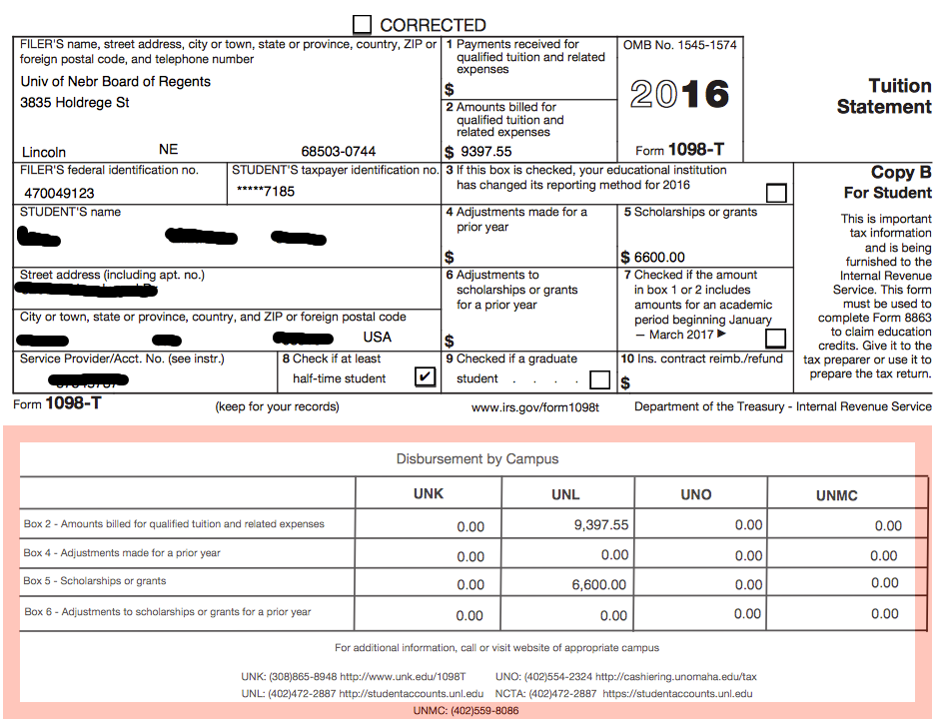
Form Printing and Access
1098-T Form Customizations

Slide 48
Form Printing and Access
Form Printing
Printed in-house
Step 1 – run the delivered Print 1098T Forms process
Sets the print flag on the 1098-T record for students who have not granted electronic consent
Step 2 – run our custom application engine process
Creates a flat file containing records with print flag=Y
Step 3 – flat file output is merged with the 1098-T form overlay
Printed on V-fold paper
Folded and sealed

Slide 49
Questions?

Slide 50
Contact
Suzan Manthey
Student Financials Functional Coordinator
Nebraska Student Information System (NeSIS)
University of Nebraska
E-mail: smanthey@nebraska.edu

Slide 51
This presentation are available for download from the Conference site at https://www.heug.org/page/us-alliance-conference-files Note: Sessions from previous HEUG conferences are also available.

