Slide 1
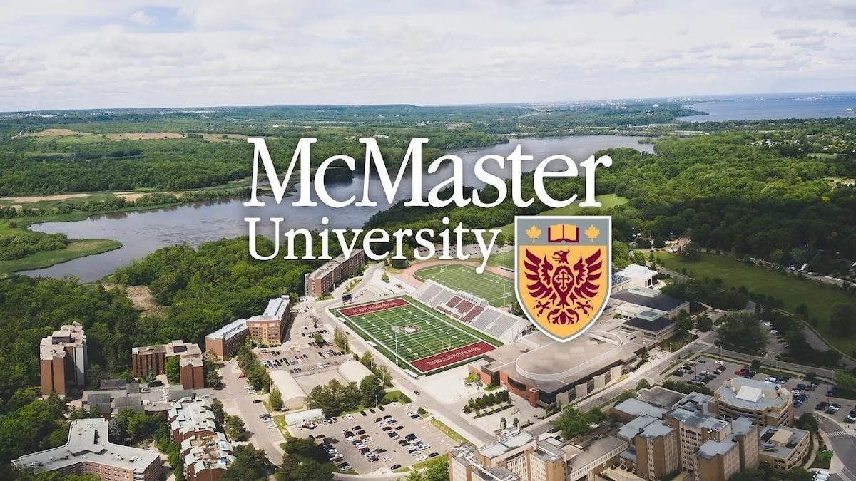
The evolution of Academic Standing process at McMaster University
SESSION 7049
November 5, 2019
01:30 PM - 02:30 PM

Slide 2
presenter
Dennis Tian
Business Systems Analyst
Registrar Office, McMaster University
tianh@mcmaster.ca
10+ years at McMaster, IT and Registrar Office
4+ years of PeopleSoft CS experience

Slide 3
MCMASTER UNIVERSITY
• Founded in 1887
• Located in Hamilton, Ontario
• A medical-doctoral, research-intensive university
• ~28K full-time students
• 955 full-time faculty members
• ~11K staff members
A research-intensive public institution.

Slide 4
McMaster University & ORACLE
PeopleSoft 9. 2, PUM 7, PeopleTools 8.55.22

Slide 5
Agenda
Background: How Academic Standing is processed in home-grown Student Information System in the past. Pro and Cons that we had
How Academic Standing is evolved when McMaster moved to PeopleSoft 9.0 in March 2015, then upgraded to PeopleSoft 9.2 in October 2018
A brief introduction of how McMaster's Registrar Office manages End-of-Term processes which Academic Standing process is part of it.
A summary of how McMaster balance the business requirement and Peoplesoft customization in the case of Academic Standing process evolvement.

Slide 6
Background
How Academic Standing is processed in home-grown Student Information System in the past. Pro and Cons that we had
What happened in legacy system

Slide 7
Legacy system Pros & cons
Cons:
Lack of flexibility and configurability to adapt changes
Cumbersome job execution and configuration updates
Multiple steps and places to update and prep for production run
Pros:
customized features tailored to business process. e.g. course calcs group, special rules designed for specific programs.
combined result of session and academic advisement in one process
use flag to ease academic review. e.g. clear to graduate flag

Slide 8
Result of session decision rules

Slide 9
Result of Session code
ROS | Description
1 | CLEAR TO GRADUATE.
3 | WORK COMPLETE.
8 | MISSED WORK.
9 | WITHDREW.
13 | REQUIRED TO WITHDRAW FROM UNIVERSITY.
16 | G.P.A. BELOW 5.
19 | DECEASED.
20 | MAY NOT CONTINUE IN PROGRAM.
30 | MAY PROCEED IN PROGRAM.
31 | INELIGIBLE TO CONTINUE.
40 | WORK INCOMPLETE.
50 | MAY CONTINUE IN PROGRAM.
51 | MAY CONTINUE ON PROGRAM PROBATION.
53 | MAY CONTINUE.
54 | MAY CONTINUE TOWARDS HON B. COMMERCE DEGREE.
55 | MAY CONTINUE TOWARDS B. COMMERCE DEGREE.
56 | ELIGIBLE FOR CONSIDERATION FOR COMMERCE II.
57 | MAY CONTINUE TOWARDS HON B. COMMERCE/ARTS DEGREE.
64 | MAY NOT CONTINUE IN FACULTY, MAY SEEK TRANSFER TO ANOTHER FACULTY.
65 | NOT ELIGIBLE TO GRADUATE.
79 | MAY CONTINUE TOWARDS B. COMMERCE DEGREE OR TOWARDS HON B. COMMERCE DEGREE.
80 | INELIGIBLE TO CONTINUE TOWARDS HON B. COMMERCE DEGREE, MAY CONTINUE TOWARDS B. COMMERCE DEGREE.
85 | INELIGIBLE TO CONTINUE TOWARDS HON B. COMMERCE/ARTS DEGREE, MAY CONTINUE TOWARDS B. COMMERCE DEGREE.
90 | MAY ONLY RE-REGISTER IN YOUR LEVEL I PROGRAM ON ACADEMIC PROBATION.
100 | MAY NOT CONTINUE AT UNIVERSITY.
101 | NOT ELIGIBLE TO GRADUATE, MAY CONTINUE ON PROGRAM PROBATION.
102 | NOT ELIGIBLE TO GRADUATE, MAY NOT CONTINUE AT UNIVERSITY.
103 | WITH PERMISSION MAY CONTINUE ON PROGRAM PROBATION.
104 | MAY CONTINUE ON ACADEMIC PROBATION.
105 | NOT ELIGIBLE TO GRADUATE, MAY CONTINUE ON ACADEMIC PROBATION.
106 | MAY NOT CONTINUE IN PROGRAM, MAY REQUEST TRANSFER TO A 3-LEVEL PROGRAM ON ACADEMIC PROBATION.
107 | NOT ELIGIBLE TO GRADUATE, MAY REQUEST TRANSFER TO A 3-LEVEL PROGRAM ON ACADEMIC PROBATION.
108 | NOT ELIGIBLE TO GRADUATE, MAY APPLY TO GRADUATE FROM A 3-LEVEL PROGRAM AT FALL CONVOCATION.
109 | NOT ELIGIBLE TO GRADUATE, MAY CONTINUE ON PROGRAM PROBATION.
110 | NOT ELIGIBLE FOR COMMERCE II, MAY CONTINUE AS IRREGULAR ON ACADEMIC PROBATION.
111 | NOT ELIGIBLE FOR COMMERCE II, MAY CONTINUE AS IRREGULAR OR SEEK TRANSFER TO ANOTHER FACULTY.
112 | MAY CONTINUE TO B. COMMERCE ON PROGRAM PROBATION.
113 | NOT ELIGIBLE TO GRADUATE, WITH PERMISSION MAY CONTINUE.
114 | NOT ELIGIBLE TO GRADUATE, MAY NOT CONTINUE IN FACULTY, MAY SEEK TRANSFER TO ANOTHER FACULTY ON ACADEMIC PROBATION.
115 | NOT ELIGIBLE TO GRADUATE, MAY NOT CONTINUE IN FACULTY.
116 | MAY CONTINUE IN FACULTY ON ACADEMIC PROBATION AS IRREGULAR.
117 | NOT ELIGIBLE TO GRADUATE, MAY CONTINUE TO B. COMMERCE ON PROGRAM PROBATION.
50 | MAY CONTINUE IN PROGRAM.
51 | MAY CONTINUE ON PROGRAM PROBATION.
53 | MAY CONTINUE.
54 | MAY CONTINUE TOWARDS HON B. COMMERCE DEGREE.
55 | MAY CONTINUE TOWARDS B. COMMERCE DEGREE.

Slide 10
Course Calcs group
4) Graded Social Work Course Group Code - 04
Included in this group are all graded Social Work courses which must have a grade of at least C+ (grade point 006) in order to be considered to have met the minimum grade requirements in result of session calculations. These courses will be considered to have met this criteria if the grade was below C+ and the course was subsequently taken and received C+ or better. (See result of session documentation for details of resulting result of sessions).
These are the courses that are in the crs.calc.groups tables for this Course Group Code:
04 620 2A06 2009-03-04-16.00.39.000000 TIANH 200903 999912
04 620 2BB3 2009-03-04-16.00.39.000000 TIANH 200903 999912
04 620 2B03 2009-03-04-16.00.39.000000 TIANH 200903 999912

Slide 11
PeopleSoft
How Academic Standing is processed in PeopleSoft.
What is happening in new PeopleSoft system

Slide 12
Peoplesoft Pros & cons
Pros:
Different environments for development version control and testing
Reduced Standing code to 18
Flexible to run Academic Standing for selected student(s)
Simple job run to process Academic Standing.
Academic Standing Course Calc Groups are eliminated
Cons:
Customization maintenance cost
Changes
Academic Standing and Advisement are separate processes
In-Course vs. Potential Graduate Student Academic Standing processes
Potential Graduate Student Degree Checkout Status
Validation queries to catch odd scenarios

Slide 13
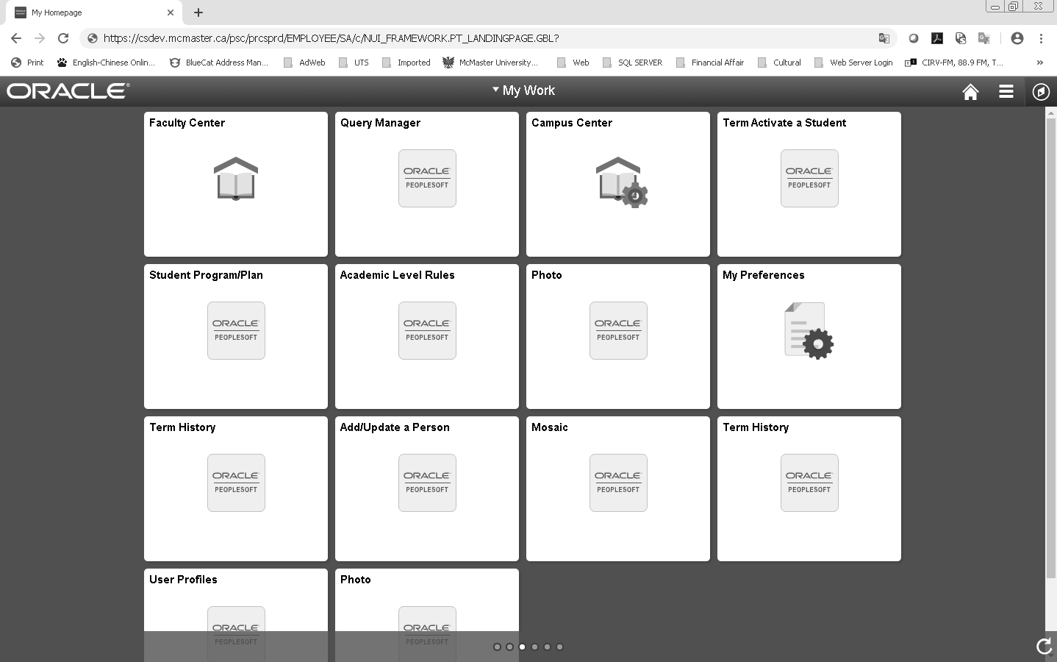
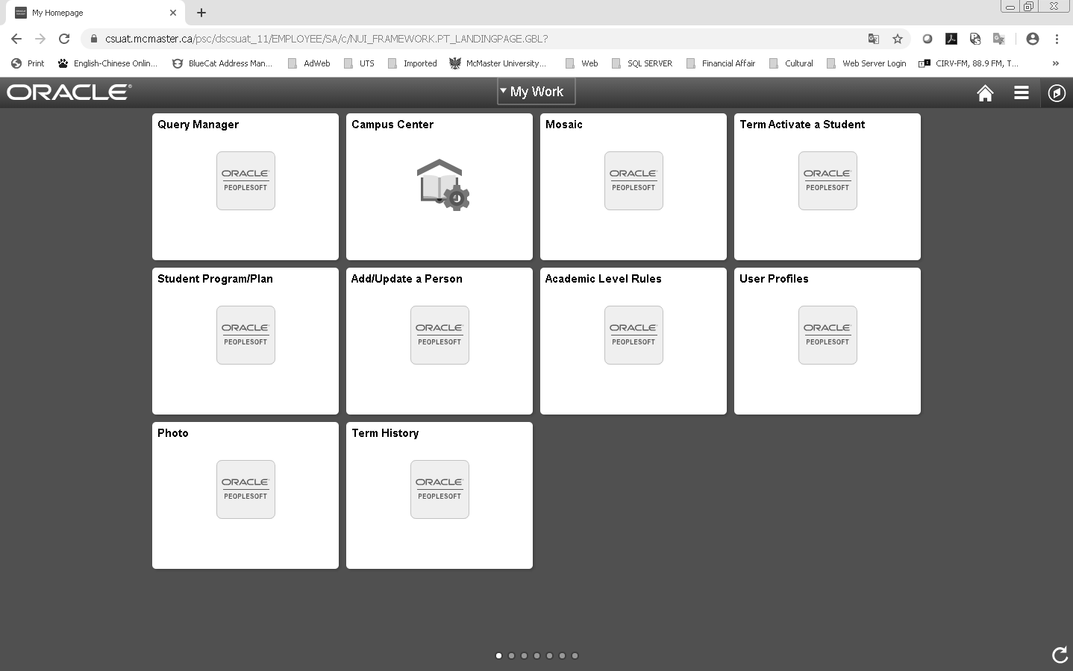
Different system environments
Great for development version control and testing

Slide 14
Significantly reduced standing code
 | ID | Standing Code | Description
INCOURSE STANDING | 010 | NULL | Nil (not reviewed)
 | 020 | REV | Under Review
 | 030 | BLNK | Pending Grades
 | 040 | WDRW | Must withdraw from University
 | 050 | CONU | May not continue at University
 | 060 | CNPA | May Not Continue in Program - AP
 | 070 | PROA | May Continue in Program - AP
 | 080 | CONF | May not continue in Faculty
 | 090 | PROB | May Continue in Program - PP
 | 100 | CONP | May not continue in program
 | 110 | GOOD | May continue
 | 120 | CNFA | May Not Continue in Faculty - AP
GRADUATION STANDING | 130 | BLNK | Pending Grades
 | 140 | GRAD | Clear to Graduate
 | 150 | GCNP | Not Eligible to Grad Prog Prob
 | 160 | GNCL | Not Eligible to Graduate
 | 170 | GCNA | Not Eligible to Grad Acad Prob
 | 180 | GCNU | Not Elig Grad Not Cont Univer

Slide 15
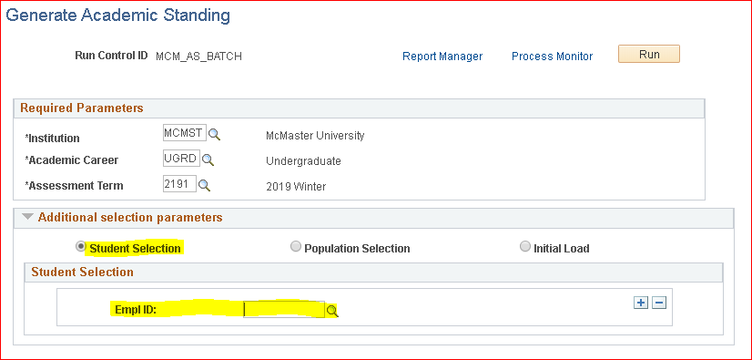
Flexible to run academic Standing

Slide 16
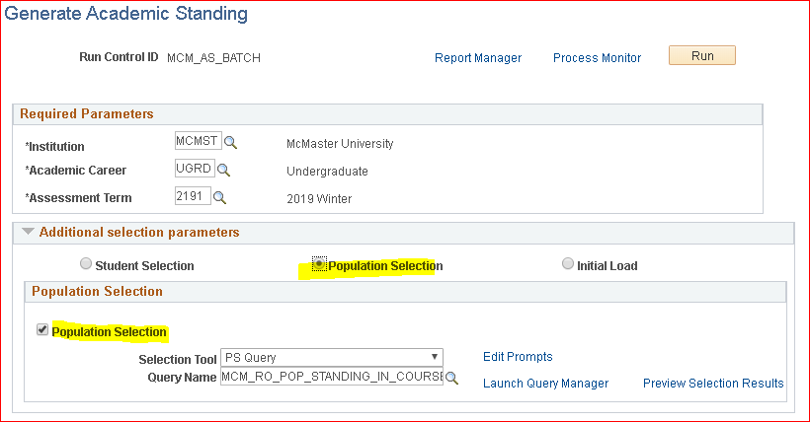
Flexible to run academic Standing

Slide 17
Customization cost
This Photo by Unknown Author is licensed under CC BY-NC

Slide 18
Academic Standing and Advisement are separate processes
Academic Standing
Academic Advisement
Result of Session

Slide 19
Potential Graduate vs. In-Course Student Academic Standing
End of Term Processes Prep
Pot Grad Standing
In-Course Standing

Slide 20
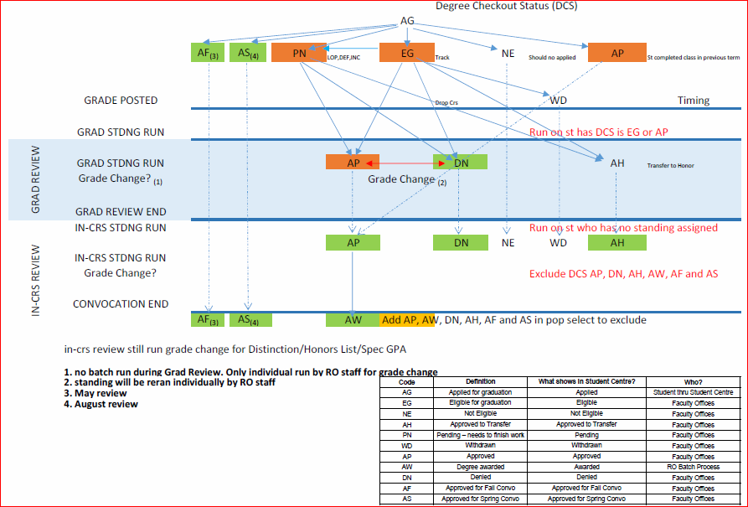
Degree checkout status

Slide 21
Validation queries to catch odd scenarios
Run Standing Validation Queries:
More than 18 attempted units but does not have standing assigned
Less than 18 attempted units but has standing assigned
… …
Run Repeat Checking Validation Queries:
Students repeating courses, with a pre 2149 attempt (to add RRC codes)
2nd degree students repeating a course (to add RRC codes)
Students who are repeating a course where the first attempt was a transfer credit pre-2189 (to add RRC codes)
Students who are repeating a course where the first attempt had an IP (LOP) pre 2189 (to change to N.C. or T and add RRC Codes)
Students who are repeating a course where the first attempt had an IP (LOP) (to change to N.C. or T)
Students who are repeating a course with an EXNY code on the previous attempt (to change it to EXNN before repeat checking runs).
Grade changes prior 2189 (to adjust RRC codes)
Missing and in-progress grades for previous attempts
W’s with repeat codes
Courses with PERM code
… …

Slide 22
System processes
Managing Systems processes
Challenge of managing systems processes

Slide 23
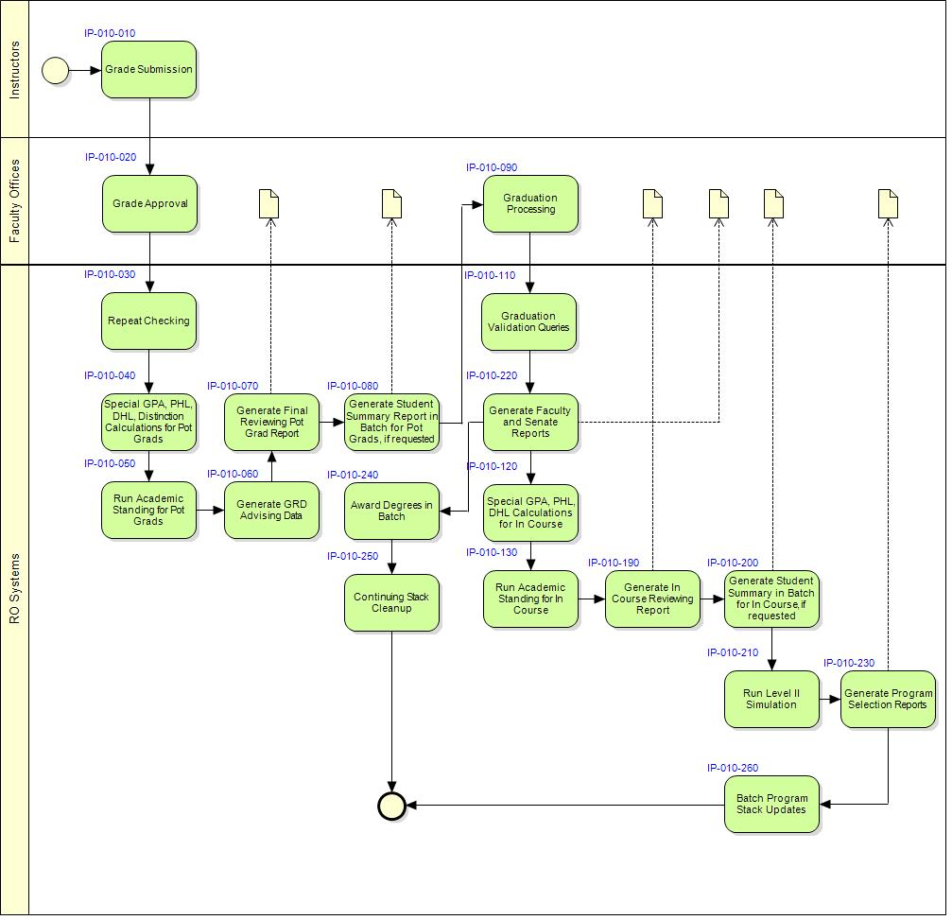
Overview End of term processes

Slide 24
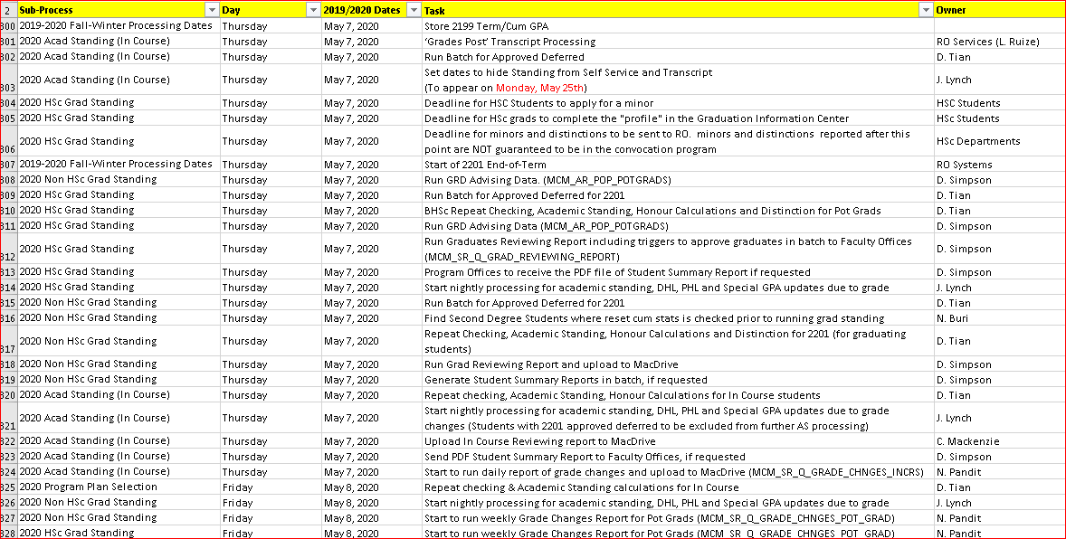
Process management tool: Excel

Slide 25
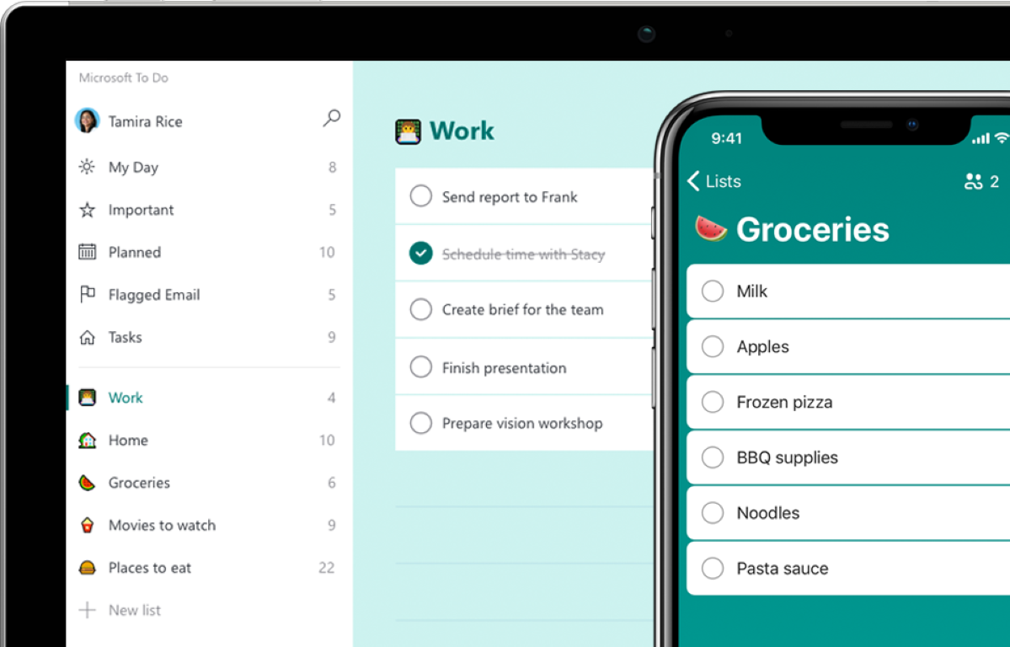
Ms todo
A promising process/task management tool to explore

Slide 26
Concluding thoughts and future work
Summary:
Balance customization and business requirements
Keep and update design documents and operation documents
On going improvements to keep team excited
Change management
Be aware of impacts from new initiatives. E.g. introducing new repeat rule, new grade, new class type
Thorough functional testing for PeopleSoft upgrade/selective adoption
Future work:
PeopleSoft Program Enrollment function to enhance Academic Progression and Advisement
Microsoft 365 suite to help manage work/process flow. E.g. ToDo
ANY QUESTIONS?

Slide 27
presenter
Dennis Tian
Business Systems Analyst
Registrar Office, McMaster University
tianh@mcmaster.ca
all Alliance presentations will be available for download from the Conference Site

Slide 28
Other McMaster presentations
Tue, Nov 05, 2019 (03:00 PM - 04:00 PM)
TRBI 7046: Developing an Application to Support Collective Bargaining using Oracle Business Intelligence
Finance 7018: Travel & Expense Fluid - McMaster's Experience With Implementation & Adoption
Wed, Nov 06, 2019 (10:30 AM - 11:30 AM)
TRBI 7047: PeopleSoft Lifecycle Management at McMaster - Maximizing Productivity through Collaboration
HRMS 7039: Process Efficiency- The Smart Choice
SF 7017: The Essentials of Non-Essential Fees
Finance 7001: Working with Peoplesoft Forms and Approval Builder: Fluid vs. Classic
Wed, Nov 06, 2019 (01:00 PM - 02:00 PM)
SF 7015: Automagically UHIP
TRBI 7037: ExaCC (Oracle Database Exadata Cloud at Customer ) Overview
Finance 7034: Hyperion Planning - A year in a life of a McMaster Planner
Student Records 7000: McMaster's Journey with the Blockchain Technology

Slide 29
Thank you!

