Slide 1
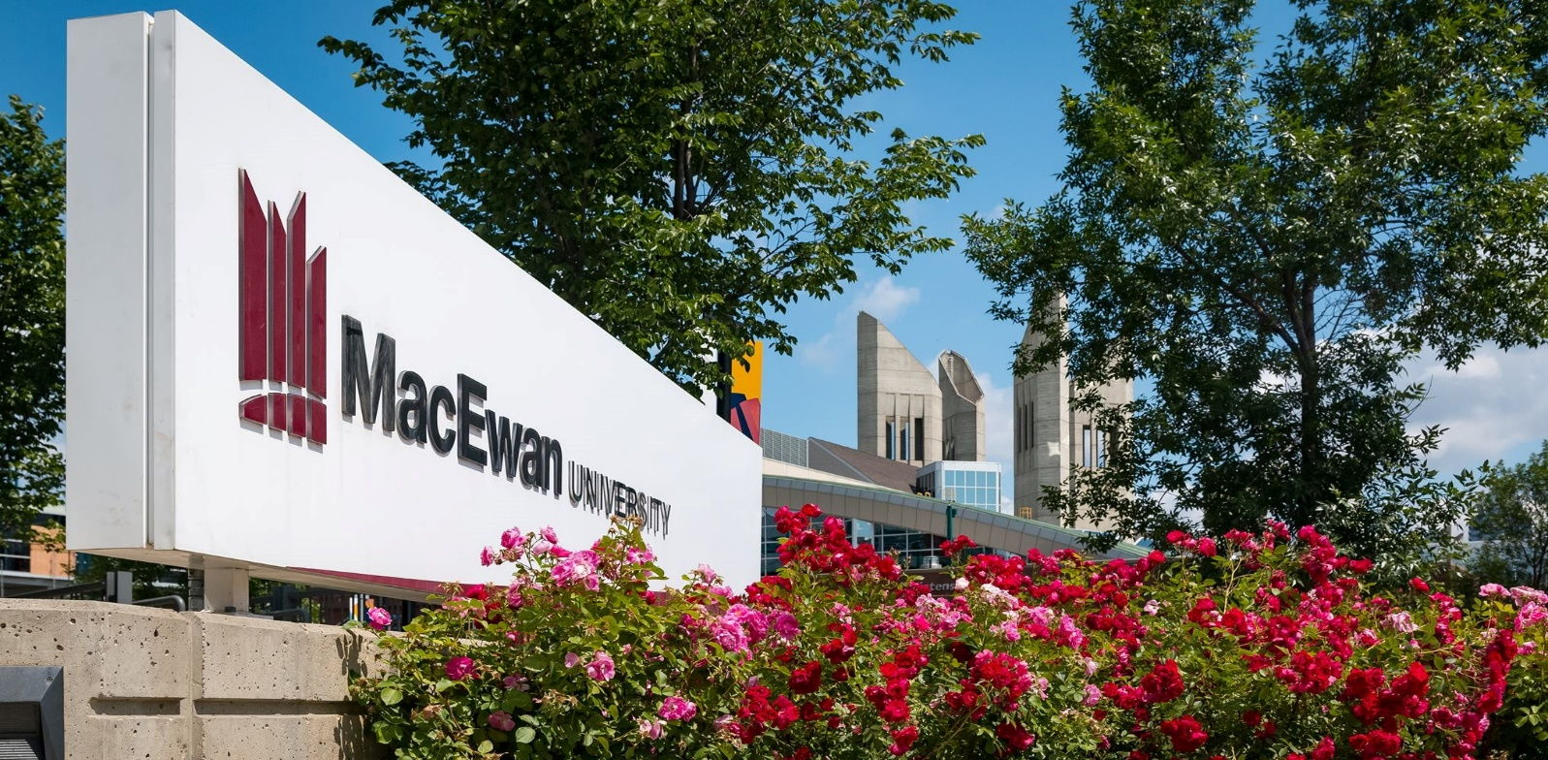
Campus Solutions 9.2 Upgrade panel: Upgrade and post-upgrade
SESSION 6047
November 13, 2018
1:30 PM

Slide 2
agenda
Important Dates and Events
Survey results from March 2018
Introductory statements
Panel Discussion and Questions
References

Slide 3
presenters
Jean-François Bourgault
Brad Finley
Manager – SIS Planning & Support Office
Concordia University
jf.bourgault@concordia.ca
Director of Enterprise Systems
Illinois Central College
bfinley@icc.edu
Functional lead during the SIS renewal project of 2013-2015 when we migrated from a homegrown system to CS 9.0
17 years of PeopleSoft experience. Started with v.7.6, then 8.1,8.9,9.0, 9.0/HR Split, to 9.2.
HEUG Board member for 4 years, currently VP of Membership & Communication.

Slide 4
presenters
Tamara Foster
Adam Wlad
Developer Lead
Northwestern University
tjif@northwestern.edu
Technical Lead
University of Waterloo
awlad@uwaterloo.ca
Developer on the Campus Solutions team since 2004 and a member of the TAG/TRAG for the last five years.
Project Manager for the CS 9.2 upgrade and upcoming 8.56/Fluid Navigation implementation. Background as a PeopleSoft Admin.

Slide 5
presenters
Jane Baratta
Functional Analyst
Western University, Canada
jbaratta@uwo.ca
Team member during the original PeopleSoft implementation in 1998. Worked on 8.9 and 9.0 upgrades. Currently involved in upgrade to 9.2 and PeopleTools 8.56.

Slide 6
Upgrades and Updates
Campus Solutions Update Image Schedule for 2018 (Doc ID 1641843.2)
PeopleTools 8.57 Release – September 2018
October 2018 CPU includes Elastic 6.1.2 with Kibana backported to PeopleTools 8.55.26 and PeopleTools 8.56.09
A re-certified upgrade image once a year.
December 2019: Campus Solutions 9.0 enters sustaining support (Doc ID 2238951.1)

Slide 7
Campus Solutions 9.2 Upgrade Survey Results

Slide 8
Comparison 2017 to 2018
 | 2017 | 2018
CS 9.2 w/PT 8.56 |  | 3%
CS 9.2 w/PT 8.55 | 8 % | 36%
CS 9.2 w/PT 8.54 | 2% | 0%
In process CS 9.2 w/PT 8.56 |  | 15%
In process CS 9.2 w/PT 8.55 or PT 8.54 | 35% | 17%
Plan upgrade in next year | 39% | 23%
Don’t know plans or don’t know plans | 16% | 6%

Slide 9
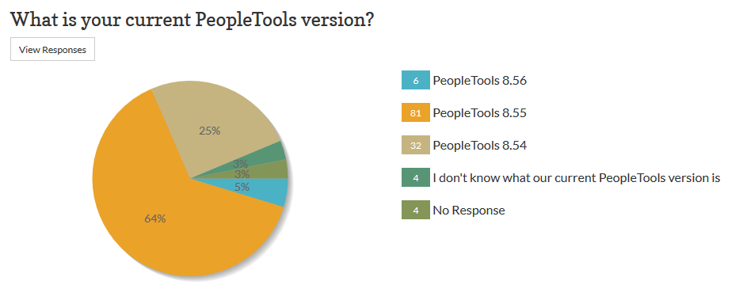
Your current peopletools version ?

Slide 10
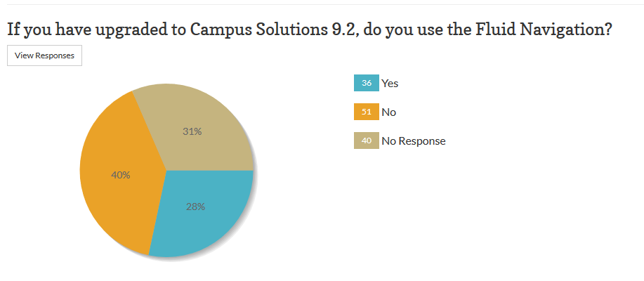
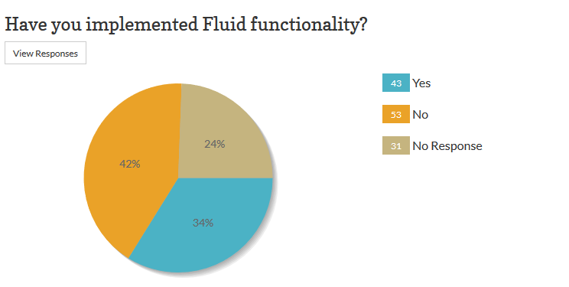
Are you using fluid Navigation ?

Slide 11
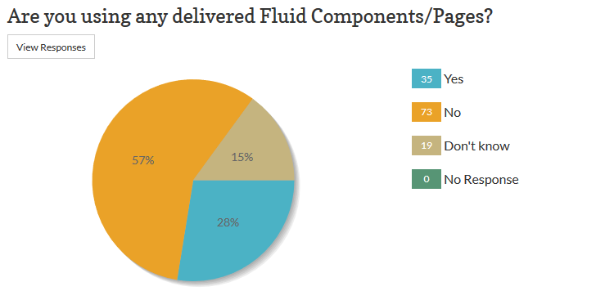
Are you using delivered Fluid Pages?
If yes, what type of Fluid Functionality have you implemented?
Tiles | 22
Admin staff only page | 1
Mixed | 1
WorkCenter | 1
HCM Self service | 1
Activity Guide | 11
Will use fluid | 1
many | 1
Master Detail | 2
Not yet | 1
Navigation Collections | 2
Some delivered pages | 1
MasterDetail | 2
Self service portals | 1
Home Pages | 3
Student Self Service | 2
Elasticsearch | 1
Pivot Grids | 1

Slide 12
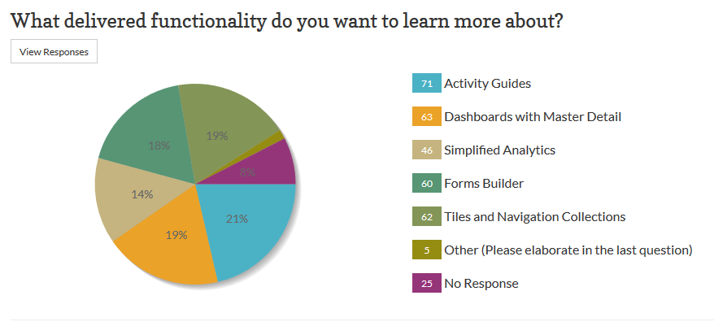
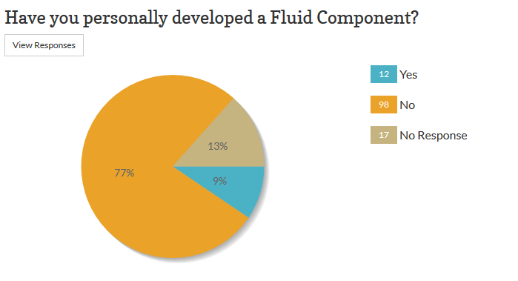
What do you want to hear about?

Slide 13
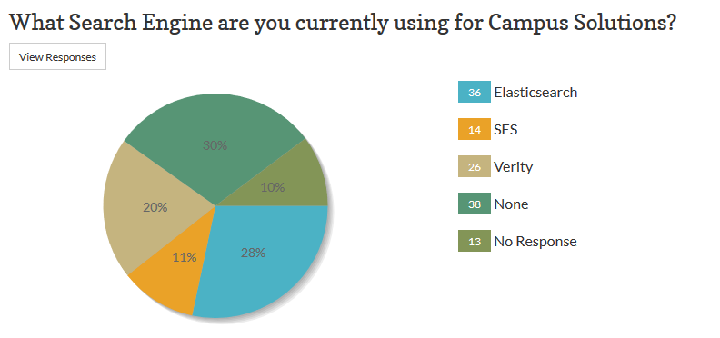
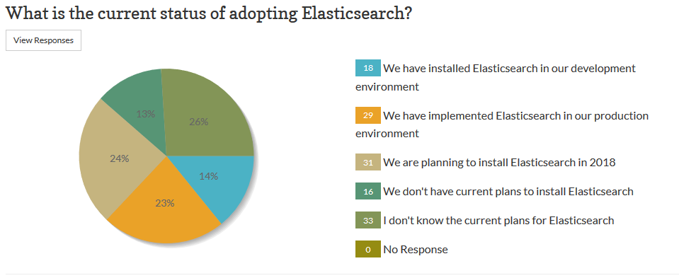
Elastic search usage

Slide 14
Concordia University
Located In Montréal, Qc
46 000 enrolled

Slide 15
9.2 Project Highlights
Initial planned project duration: 7 months , Actual duration 13 months due to technical issues
Upgraded from CS 9.0 bundle 39 to CS 9.2.005
Tools upgrade from 8.54.10 to 8.55.15
No consulting services used
Severely under budgeted vs tenders received
Team: 5 primary ress., 18 overall on part time basis, 90+ UAT testers
Issues
Security deletion and extensive rework – CHEUG/HEUG to the rescue!
Lack of internal technical expertise on PUM
DMS scripts issues
Drilling URL queries
Query performance in general

Slide 16
9.2 Since Go-live
Planned PUM upgrade, selective adoption of 160 bugs (360 overall) for late Nov 2018
Evaluating 3rd party layers for mobile responsiveness – RFI published
Evaluating Tools upgrade for 2019
University wide initiative for an AWE based student request system
Requirements gathering phase in progress
Pilot project to release Advising notes with latest 9.2 security features

Slide 17
Illinois Central College
Go-Live Campus Solutions 9.2, Finance 9.2, PeopleTools 8.56.07 - March 11, 2019
PUM Image 11, PeopleTools 8.56.07, Elasticsearch

Slide 18
9.2 Project Highlights
Initial planned project duration: 12 months – on target, so far
Upgraded from CS 9.0 bundle 39 to CS 9.2.011 FS 9.1 bundle to FS 9.2.029
Tools upgrade from 8.53.11 to 8.56.07 (also upgraded HCM tools from 8.54.09 to 8.56.07)
Consulting Services Used
Sierra-Cedar Remote upgrade lab for technical upgrade.
IB assistance as needed
FS assistance as needed
Primary team: 15 primary, plus departmental testing for testing
Issues
Large number of customizations in CS
BI publisher check is FS
3rd party add ons
Others . . .

Slide 19
Adoption of New Features and Functionality
Go-Live
No Fluid – slowly begin to add these in
Basic delivered Elastic Search
2FA on HCM with new tools

Slide 20
Northwestern.edu
Go-Live Campus Solutions 9.2, October 17, 2017
PUM Image 6, PeopleTools 8.55.10, Elasticsearch

Slide 21
Upgrade and Post-Upgrade events
October 17, 2017
Live on Campus Solutions 9.2/PT 8.55.18
January 13, 2018
PUM Image 7: Selective adoption of fixes for Fluid Class Search and Enrollment
October CPU with PeopleTools 8.55.20 patch
March 10, 2018
PUM Image 8: Get current (3712 objects)
January CPU with PeopleTools 8.55.21 patch
June 30, 2018
April CPU with PeopleTools 8.55.24
September 8, 2018
PUM Image 10: Get current

Slide 22
Adoption of New Features and Functionality
Go-Live
Fluid Navigation
Created New Homepages for Instructors and Advisors, Guest Users
Global search for Administrative users
Fluid Grades, IPEDS, Unofficial Transcript, Course List.
Course and Teach Evaluation search converted to Fluid UI
Fluid Class Search – One career February 2018, Eight more careers - May 2018

Slide 23
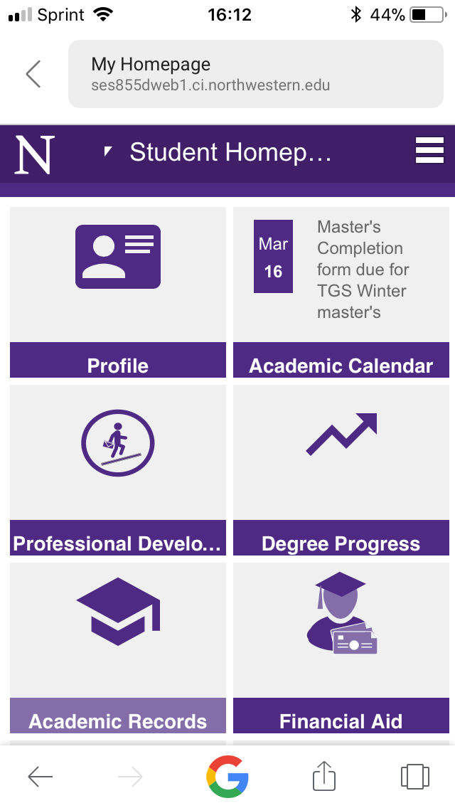
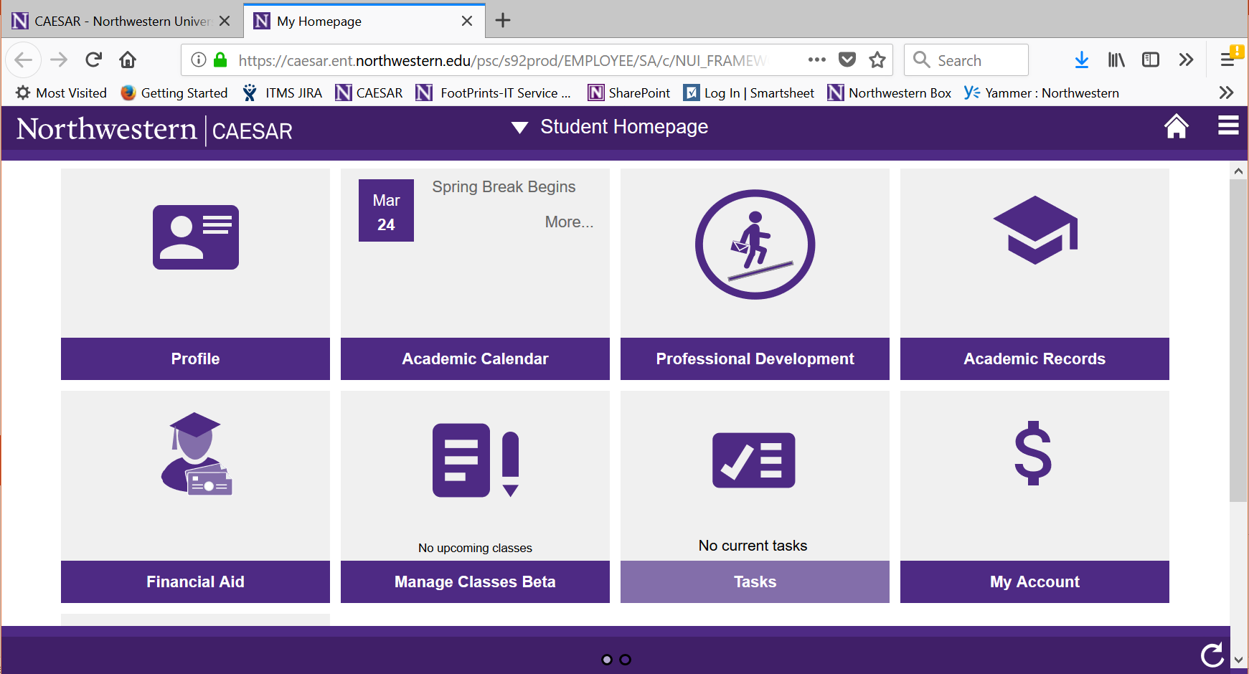
Student home page

Slide 24
University of Waterloo
Go-Live Campus Solutions 9.2, Feb, 2018
PUM Image 5, PeopleTools 8.55.19

Slide 25
9.2 Project highlights
Used Oracle Consulting Canada to reapply customizations
Very positive experience – accurate, quick, and complete
Surprised by functional configuration going missing
Low number of Fluid pages in PUM5, so no Fluid
5 months of planning, 7 months of testing
Adoption of January PeopleTools CPU broke functionality – had to abandon this patch

Slide 26
9.2 Since Go-live
Since Feb, we have applied a PeopleTools CPU
Apply at least 2 per year
Selective adoption of a fix from PUM9
Starting another upgrade – 8.56/PUM 10. Minimal impact on customizations
Deploying Fluid Navigation without Fluid pages –
Homepages
Tiles
Navigation Collections
Search

Slide 27
Western University
9.2 Go Live end of November 2018
PUM image 9, People Tools 8.56.11

Slide 28
9.2 Project Highlights
Started August 2018
Upgrading from CS 9.0 bundle 26 to CS 9.2.009
Tools upgrade from 8.54.21 to 8.56.11
No consulting services used
FunctionalTeam: 1 lead plus 6 primary resources, 9 others on a part time basis
Issues
Deprecation of T4A
Missing items after initial pass (e.g. mass change templates, countries in the country table)
Ensuring that all users only see the Classic view
New style sheet

Slide 29
Institution Topic | Northwestern University | Western University | Illinois Central College | Concordia University | Waterloo University
Tools versions | From 8.54.13 To 8.55.18 | From 8.54.21 To 8.56.11 | From 8.53.11 To 8.56.07 | From 8.54.10 To 8.55.13 | From 8.53.28 To 8.55.19
CS version | From 9.0 To 9.2.006 | From 9.0 b26 to 9.2.009 | From 9.0 b51 to 9.2.011 | From 9.0 b39 to 9.2.005 | From 9.0 b33 to 9.2.005
Project duration | August 2016-October 2017 15 months | 5 months (ongoing) | 12 months planned (in progress) | 13 months (7 planned) | 13 months
Team size | Project Manager Steering Committee Functional and Technical consultants, 3 Systems Analysts, 7 developers, 1 DBA, 2 SysAdminis + 1 consultant | 15 Func. (1 lead), 1 tech. lead, 1 DBA, 5 devs | 7 Func. Lead, 2 devs, 2 tech. lead, 2DBA, 1admin | 1Func. lead, 1 tech. lead, 2 devs, 1 DBA, 1 admin. 8 BAs 90+ UAT testers | 27 Func. (7 leads), 2 tech. lead, 1 dev, 1 DBA, 1 admin, 1 security admin, 1 testing coordinator
Consulting used | Upgrade Lab | No | Upgrade Lab | No | Yes
Deployed Fluid | Yes | No | No | No | No
Elastic or SES | Implemented Elasticsearch | No SES or Elastic used | Implemented Elastic search | No SES or Elastic used | No SES or Elastic used

Slide 30
Content to consider and questions
What was your role on the upgrade?
What was your starting version and what did you upgrade to?
How long did it take?
How big was the team? Functional/technical split
Challenges – expected and unexpected?
Was there any development during the upgrade or was it frozen?
Production issues?
Did you use any consultants?
Were you using search technology previously (SES) and did you deploy Elastic?
Update methodology since the upgrade? Application of PUMs, selective adoption or both
Did you deploy Fluid navigation and/or any Fluid pages?
Post Upgrade
Lessons Learned

Slide 31
References and Resources – update
PEOPLESOFTINFO.COM
PeopleSoft Campus Solutions Upgrade Home Page (Doc ID 2078564.2)
PeopleSoft Upgrade Source Images Home Page (Doc ID 1552580.1)
PeopleSoft Campus Solutions 9.2 Installation (through Update Image 8) (Doc ID 2079232.1)
Campus Solutions 9.2 Upgrade Image 9.2.001 Available January 2017 (Doc ID 2215904.1)
PeopleSoft Update Manager (PUM) Home Page (Doc ID 1641843.2)
PeopleSoft Planned Features and Enhancements (1966243.2)
Oracle's PeopleSoft PeopleTools 8.55 New Features Overview (Doc ID 2079572.1)
E-DPK PT8.55: Frequently Asked Questions about Deployment Packages (DPKs) (Doc ID 2127715.2)
PeopleTools 8.55.11 or Higher Elasticsearch Home Page (Doc ID 2205540.2)

Slide 32
THANK YOU!

