Slide 1
Online Invoice request form– A journey to Accounts Receivable automation
SESSION 6013
7 November 2018

Slide 2
presenter
Angela Liu
Business Systems Analyst
Enterprise Support Systems
Information Technology Services
The University of Queensland
y.liu15@uq.edu.au

Slide 3
The University of Queensland
Founded in December 1909
Founding member of the Group of Eight (Go8) universities and a member of the global Universitas 21
3 main campuses (St Lucia, Gatton & Herston)
About 52,331 students
Nearly 6,613 full-time staff
Total revenue (2017): $1,828 million
Total expense (2017): $1,777 million
Assets (2017): $3,113 million

Slide 4
Peoplesoft financials
UniFi
Version 9.2
PeopleTools 8.56.08
Oracle 12.2.0.1.0
Image 27 (went live in September 2018)
Modules
• General Ledger
• eProcurement
• Purchasing
• Accounts Payable
• Billing
• Accounts Receivable
• Project Costing
• Contract & Grants
• Cash Management
• Asset Management
• UQ Travel

Slide 5
Overview
1
3
APARA PROJECT CONTEXT
Background and drivers
SOLUTION
Invoice Request Form layout
2
4
PROCESS MAPPING
What did we do
LESSONS & NEXT
What did we learn and what we will do next

Slide 6
Accounts Payable and accounts Receivable Automation PROJECT context
Background and drivers

Slide 7
APARA PROJECT
Stands for Accounts Payable and Accounts Receivable Automation
Initiated by Chief Operating Office to
Streamline and standardise AP/AR processes
Implement a system solution to provide automation to accounts payable and receivable processes through Optical Character Recognition (OCR) capabilities, robotics and intelligent workflow
Project to be completed by March 2019
Business Benefits:
Standardised AP/AR processes
Reduced processing time for invoices
Improved management of debtors
Enhanced functionality for process owners and end users

Slide 8
AR FUNCTIONS Review

Slide 9
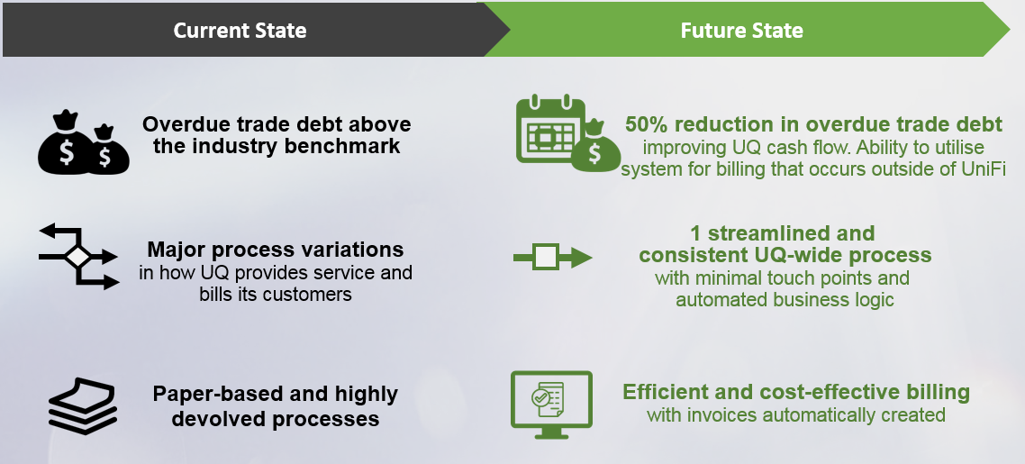
AR Case for change

Slide 10
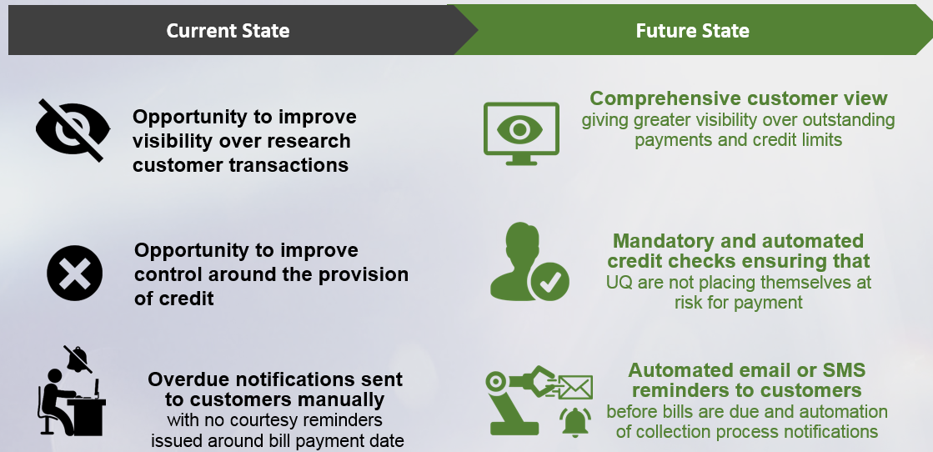
AR case for change

Slide 11
Why use the Online Invoice Request Form?
Improve UQ cash flow
Simplify and standardise processes
Convert manual procedures to paperless processes
Manage credit risk before work is provided to customers
Reduce the administrative burden
Enable the automatic billing

Slide 12
process mapping
What did we do

Slide 13
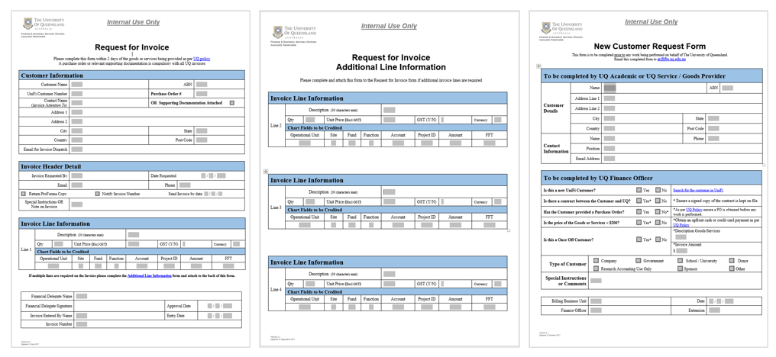
Current manual Forms
Automatic generation of invoice will replace the following as-is steps

Slide 14
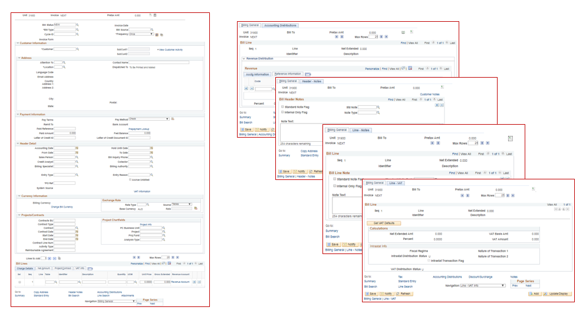
Current UniFi Billing
Automatic generation of invoice will replace the following as-is steps in UniFi Billing

Slide 15
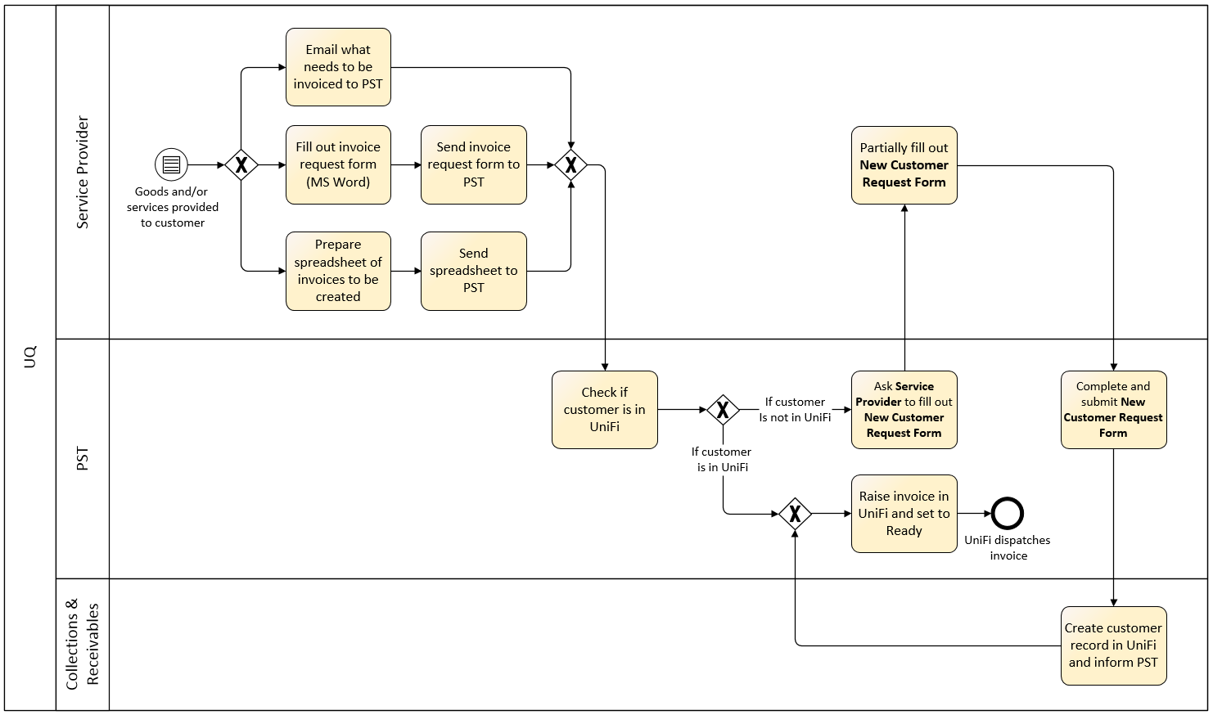
Business process (Current State)

Slide 16
Business process (Future State)

Slide 17
Solution
Invoice Request Form layout

Slide 18
Online Invoice request form DESIGN
Implemented a workbench custom built online form
Simplifying the manual forms and UniFi billing pages
Digitise the Request for Invoice form, Request for Invoice Additional Line Information form and New Customer Request Form
Approved Online Invoice Request Form data to be stored in the staging table
Online Invoice Request Form data extracted to create new bills automatically

Slide 19
RTI Workbench
Navigation: Main Menu > Billing > RTI Workbench
The user can also do one of the following actions by selecting it from the Action drop-down and clicking the Go button.
View / Edit – Displays a saved RTI form.
Copy – Copies data from a saved RTI form into a new one.
Cancel – Cancels a saved RTI form

Slide 20
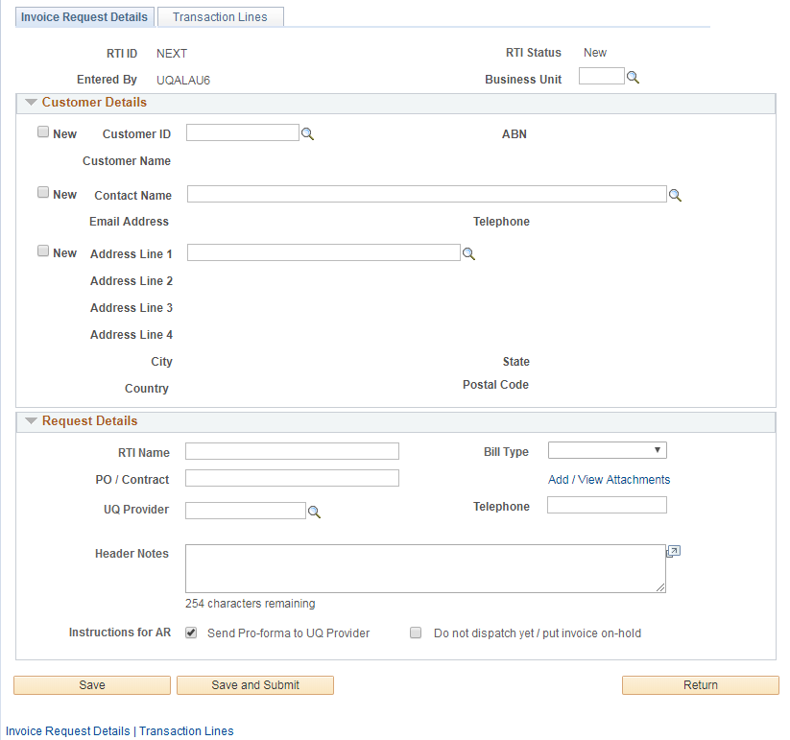
Invoice request details tab

Slide 21
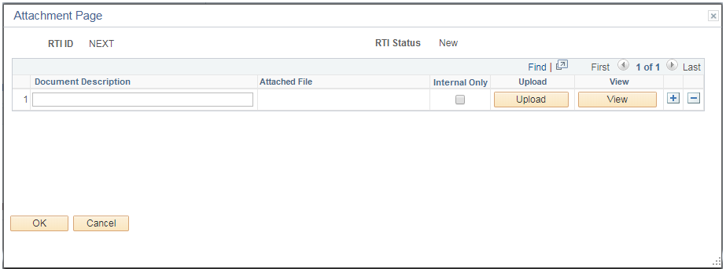
Manage Attachments
Users are able to attach supporting documentation relevant to the invoice request. They also can specify if the attached file should be internal-only (i.e. not dispatched to the customer).

Slide 22
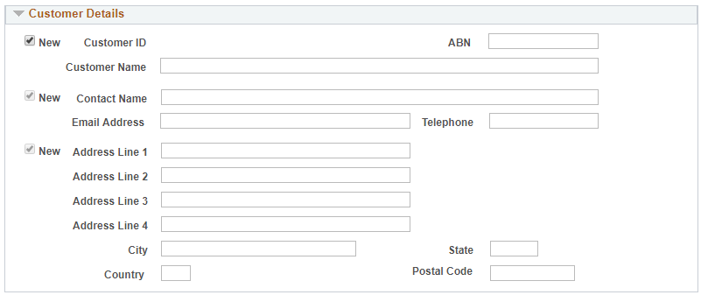
New Customer
If a customer is not found through the look-up, users are not required to fill out a New Customer Request Form. Instead, they’ll tick the New checkbox on the left of the Customer ID field to display text boxes on all customer-related fields.
Once the form is submitted, an email will be automatically sent to AR team for creating the new customer in the financial system.

Slide 23
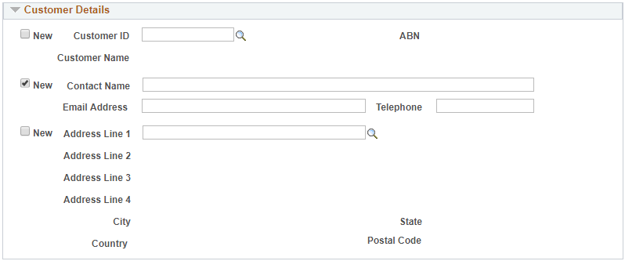
Existing customer but new contact
If a contact is not found through the look-up, users are not required to fill out a New Customer Contact Request Form. Instead, they’ll tick the New checkbox. Once the form is submitted, an email will be automatically sent to the AR team for creating the new customer contact in UniFi.

Slide 24
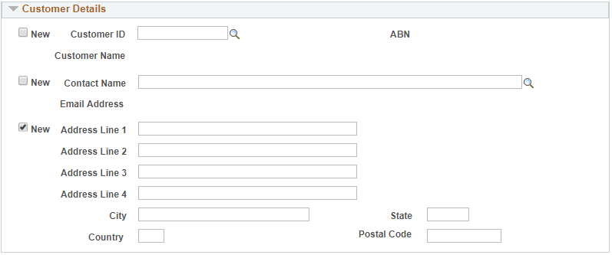
Existing customer but new address
If an address is not found through the look-up, users are not required to fill out a New Customer Address Request Form. Instead, they’ll tick the New checkbox. Once the form is submitted, an email will be automatically sent to the AR team for creating the new customer address in UniFi.

Slide 25
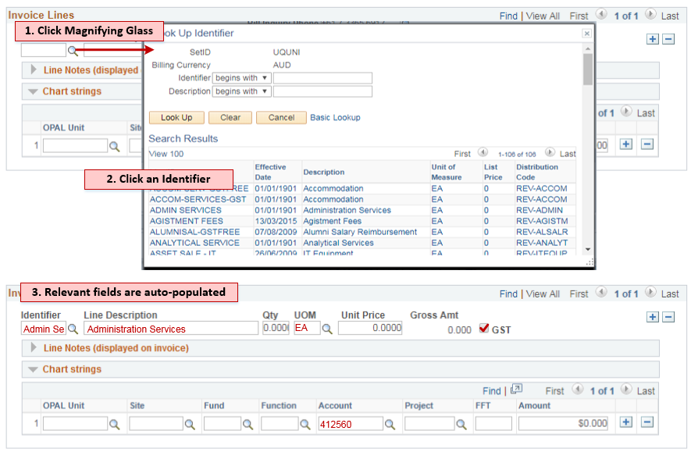
Transaction details
Users are able to add multiple transaction lines either by selecting an identifier or by directly inputting information. They should also be able to specify one or multiple chart strings so that the revenue goes to the correct department and account.

Slide 26
Adding Line Notes

Slide 27
Adding More Than one transaction line

Slide 28
Splitting Chart Strings

Slide 29
LESSONS & next
What did we learn and what we will do next

Slide 30
LESSONS & next
User friendly form
Too much information vs Not enough data for auto billing
One-UQ approach vs Decentralised processes
Design change –
Stage 1 pilot trial for one division and assess the business impacts
Stage 2 roll out to all sections

Slide 31
SUMMARY
Digitized Form
Automatic Billing
Reduced Credit Risk
Simplified and Standardized Billing Processes

Slide 32
Concluding thoughts
ANY QUESTIONS

Slide 33
presenter
Angela Liu
Business Systems Analyst
Enterprise Support Systems
Information Technology Services
The University of Queensland
y.liu15@uq.edu.au
all Alliance presentations will be available for download from the Conference Site

Slide 34
THANK YOU!

