Slide 1
External Award Load - Taking Full Advantage of this Excellent Tool
MidHEUG 2017 Workshop Presentation
Thursday, 12 October, 2017
St. Charles, Illinois

Slide 2
Your Presenter
Jessica Holler
In my LAST year on the FA-Product Advisory Group
This month marks 30 years in Higher Education for me
3 years in Student Accounts
9 years in a Financial Aid Office
18 years as a Financial Aid Business Analyst
SCARY!
Avid knitter – I promise this is pertinent

Slide 3
DePaul University
We are the largest Roman Catholic University in the United States.
We serve about 24,000 students.
We have Undergraduate, Graduate, and Law programs.

Slide 4
DePaul University
Initial PeopleSoft implementation was Version 7.6 for the 2000-01 Processing Cycle
Currently running on 9.0, Tools 8.54, Bundle 46
Testing the Critical Fix for 2018-19
Implementing 9.2 Summer of 2018

Slide 5
Standing on the Shoulders of Giants
This presentation would not have been possible without these earlier ones…
2008 Alliance – “A Closer Look at External Awards and Repackaging”
Barbara Fong – Oracle
2008 Alliance – “External Awards – Student Financials Feed”
Ken Lyman – Oracle
2009 Alliance – “External Awards- Alive and Kicking”
Elaine Nowak – University of Michigan
Barbara Fong – Oracle
2011 HEUG-UM “External Award Load Amazing Uses”
Luann Kiesow – Fox Valley Technical College
John Whitt – UW- Madison
2011 HEUG-UM – “Scholarship Processing with External Awards and File Parser”
Scott Cho – ‘nuff said!

Slide 6
Moving Forward on the Shoulders of Giants
Here are some more recent presentations that will help you move forward…
2014 Alliance – “Just the Basics: Cancel the Aid”
Julie Churchill – UW-Parkside
2016 Alliance – “Ride the Great Wheel of External Award Load”
Thara Baker-Alley – University of Missouri-Columbia
There are even more, just go out to HEUG Online, access the ”Files” area and search on External Award – you will find a vast resources there, take advantage of them!
Notes:
See Julie’s “EA_EXCLUDE.docx” for an equation to add to the run control for the Load External Awards process to change packaging status to Completed when there is no overaward created by the EA Processes.

Slide 7
Agenda – Starting Small and Expanding
External Award Overall Design and Functionality
Manual Entry
External File Load
Student Financials Feed
Reporting Scholarships via the Student Center
Resolving Error and Suspend Status Awards
Follow-Up Processes/Queries
Myriad Uses for External Awarding
PET Items Pertaining to External Award Functionality

Slide 8
External Award - Overall Design & Functionality
Data are initially loaded to staging tables and then processed to Student’s awards
Data can be entered to the staging tables in several ways:
Manual
External File
A feed from Student Financials
From the Student Center

Slide 9
External Award - Overall Design & Functionality
External Awarding “jams” awards/changes in to a Student’s Award
Scholarships are jammed at the TOP of the award (low award sequence)
Loans are jammed at the BOTTOM of the award (high award sequence)
Packaging Status set to “Repackage” based on the assumption that jamming an award on to a Student’s award can cause problems like overawards…from time to time
Packaging Status of Repackage prevents a Student from accepting loans

Slide 10
External Award - Overall Design & Functionality
Some basics – External Award “Report Codes”
Report Codes determine how the external awards are jammed in to a Student’s Award.
A – Append – Add to an existing item type
If the item type to be posted does not already exist on the Student’s award, the External Award transaction will treat it as if it the Report Code value is “New”
N – New – Used only to add new item types to a Student’s Award
If the item type to be posted already exists on the Student’s Award, the External Award transaction will error.
R – Replace – Used to overlay an existing item type
If the item type to be posted does not already exist on the Student’s award, the External Award transaction will treat it as if the Report Code value is “New”

Slide 11
External Award - Overall Design & Functionality
What External Awards Cannot Do…
Sequence a Loan anywhere other than at the BOTTOM of an award
Sequence a Grant/Scholarship/Assistantship/Bursary anywhere other than at the TOP of an award

Slide 12
External Award - Overall Design & Functionality
What External Awards Can Do…
Load Full-Year Awards
Load Custom Split Awards
Load Single-Term Awards
Add New Awards
Replace Existing Awards
Append Existing Awards
Load more than one item type at a time
Load awards to more than one career at a time
Cause over-awards
And if you’re not cautious… wreak havoc

Slide 13
Manual Entry – FA > Awards > External Awards
Add External Awards by Type
Add External Awards to Student
Manage External Award Data
Manage Awards by Status
Manage Student External Awards
See “External Award Component Security” document uploaded to this presentation.

Slide 14
Manual Entry – External Awards by Type
External Award setup not required to use this component
Used to enter awards from one item type to multiple Students’ awards
Unless specified, Disbursement Plan/Split Code from FA Item Type 5 page will be used.
Use the +… button to add this more than one row for entry.

Slide 15
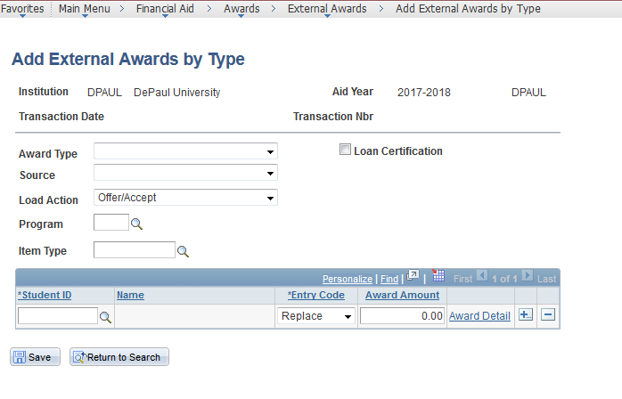
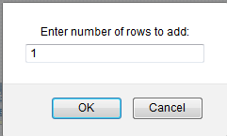
Manual Entry – External Awards by Type
Notes:
I’ve outline the information that needs to be entered in order to use this page.

Slide 16
Manual Entry – Add External Awards to Student
External Award setup not required to use this component
Used to enter award from many item types to one Student’s award
Unless specified, Disbursement Plan/Split Code from FA Item Type 5 page will be used.
Use the + button to add additional item types for this Student.

Slide 17
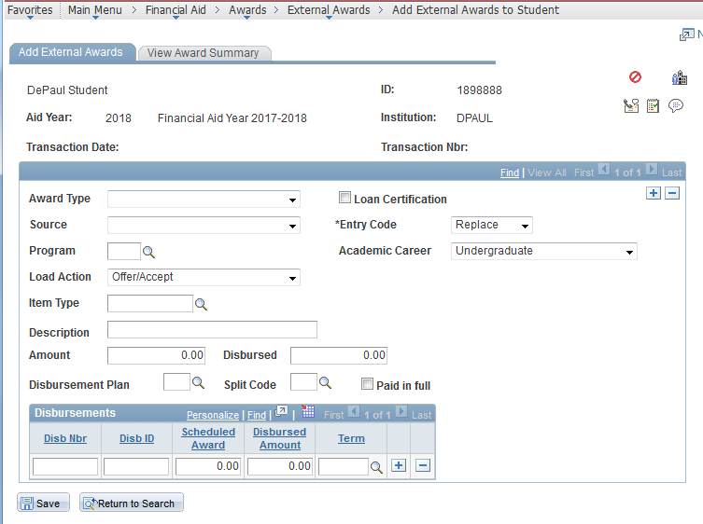
Manual Entry – Add External Awards to Student

Slide 18
Manual Entry – Manage External Award Data
Used to view/edit data already saved to the External Award Staging tables
On the Search page, select Data Source of “Manual Entry” to review/edit information entered using the previous two components (and perhaps Transaction Date or Transaction Nbr)

Slide 19
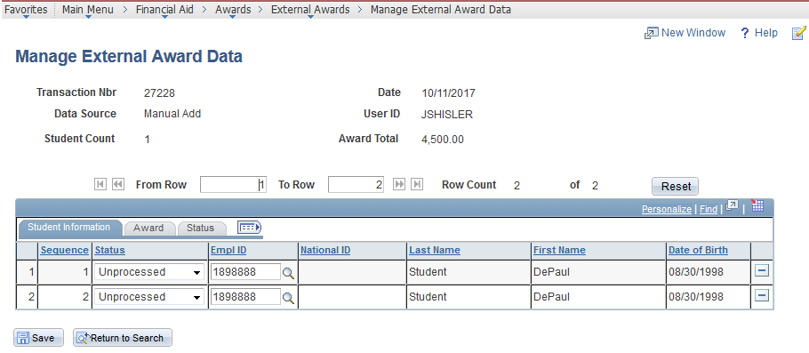
Manual Entry – Manage External Award Data

Slide 20
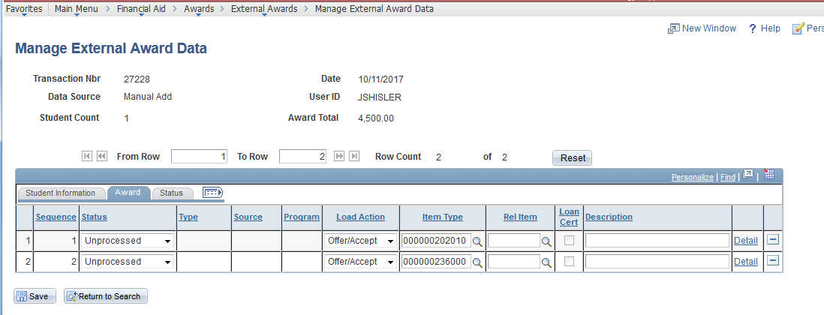
Manual Entry – Manage External Award Data

Slide 21
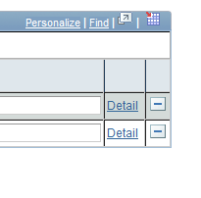
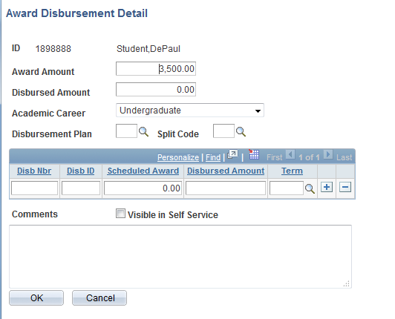
Manual Entry – Manage External Award Data

Slide 22
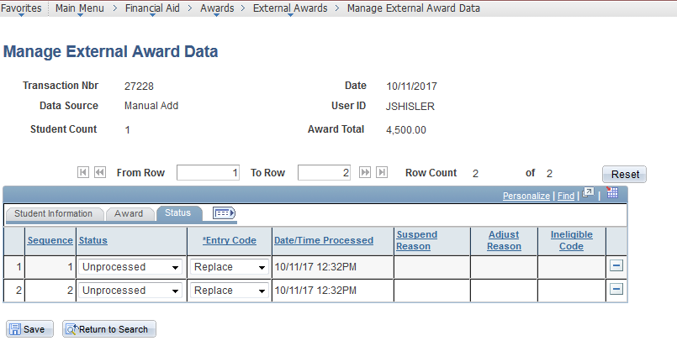
Manual Entry – Manage External Award Data

Slide 23
Manual Entry – Manage Awards by Status
Used to view/edit data already saved to the External Award Staging tables by a particular status
On the Search page, select Data Source of “Manual Entry” and then a particular status (Unprocessed, Error*, etc.) to review/edit information
* We’ll discuss resolving errors later on…

Slide 24
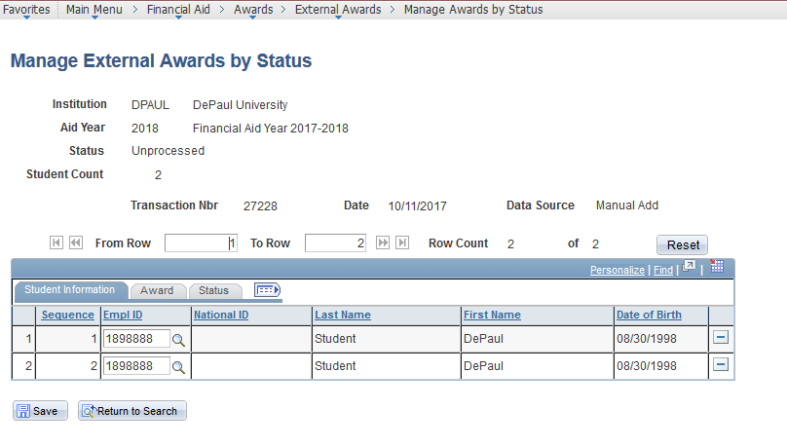
Manual Entry – Manage Awards by Status

Slide 25
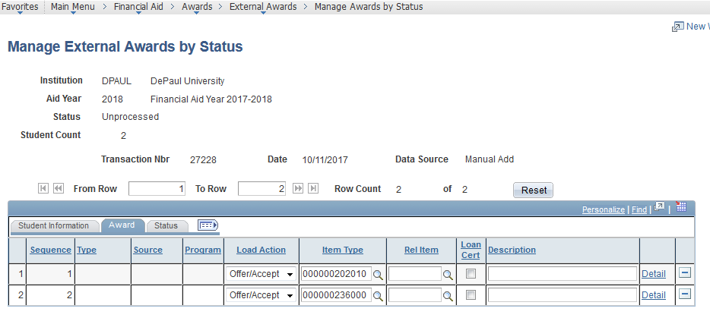
Manual Entry – Manage Awards by Status

Slide 26
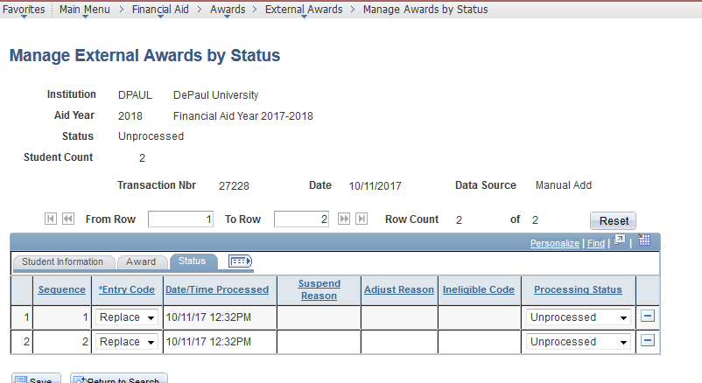
Manual Entry – Manage Awards by Status

Slide 27
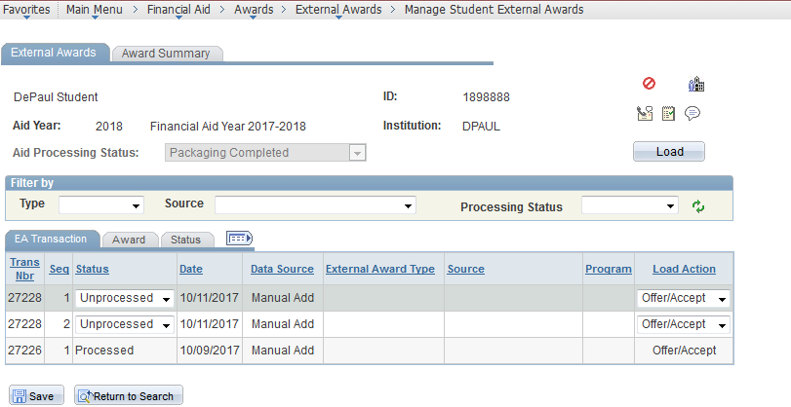
Manual Entry – Manage Student External Awards

Slide 28
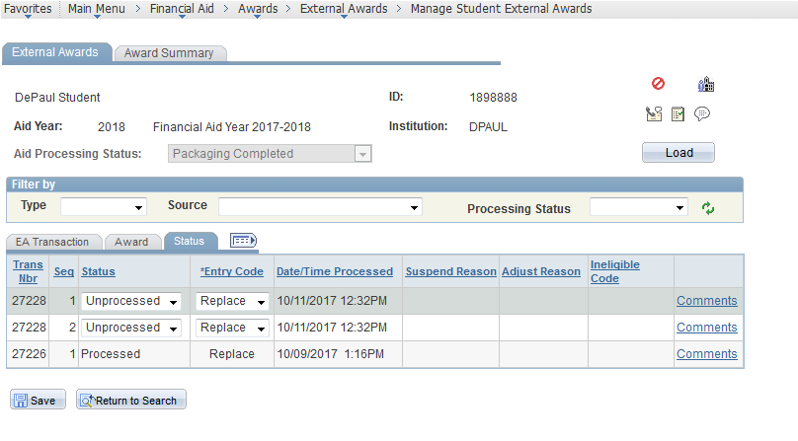
Manual Entry – Manage Student External Awards

Slide 29
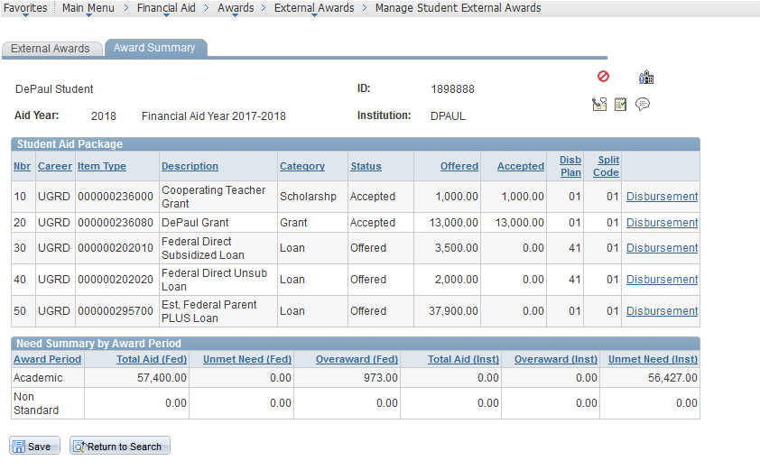
Manual Entry – Manage Student External Awards

Slide 30
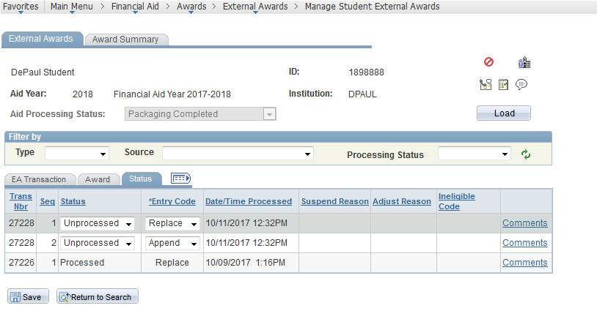
Manual Entry – Manage Student External Awards

Slide 31
Manual Entry – Load External Awards
Proceed with an appropriate amount of caution…this is one of the pages where you can wreak havoc
Used to programmatically load data already saved to the External Award Staging tables for a particular
Status – generally “Unprocessed”
Data Source – in this case “Manual Entry”
Transaction Date
Transaction Nbr
Populate the run control page with just enough information to load only the awards you intend (“overpopulating” this page can mean that nothing gets processed)

Slide 32
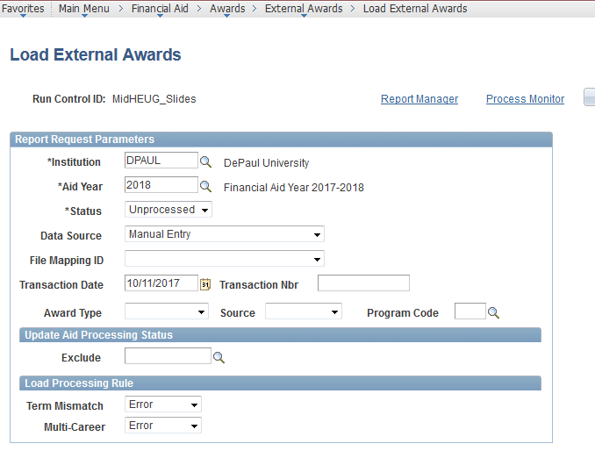
Manual Entry – Load External Awards

Slide 33
Manual Entry – Load External Awards

Slide 34
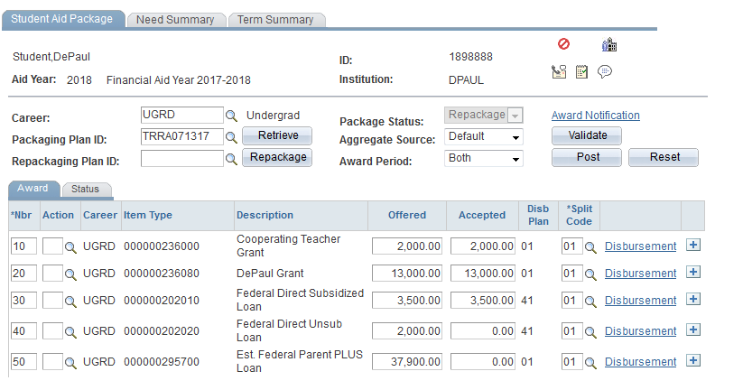
Manual Entry – Load External Awards

Slide 35
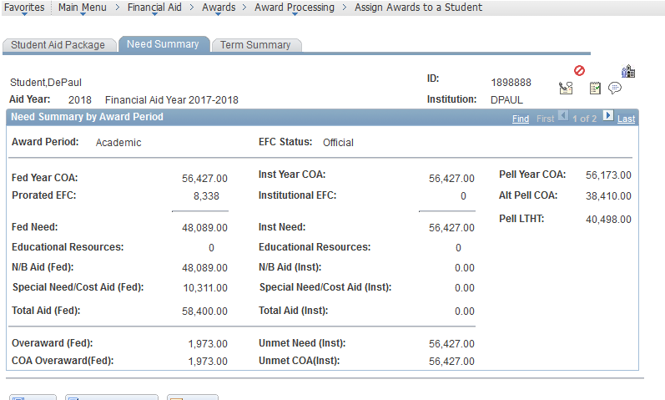
Manual Entry – Load External Awards

Slide 36
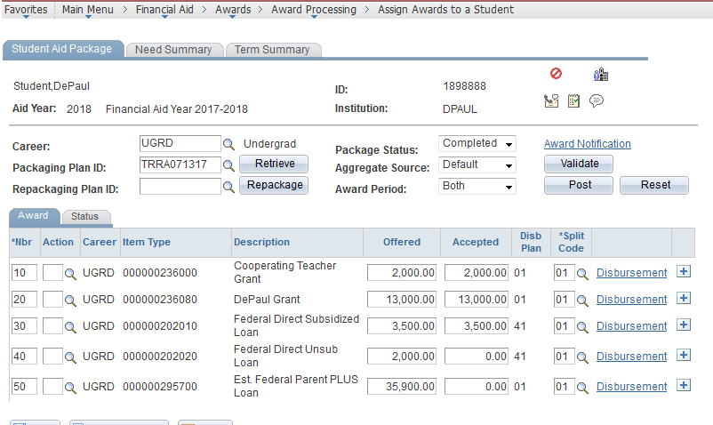
Manual Entry – Load External Awards

Slide 37
External File Load
External Award setup not required to use this aspect of EA
Set Up of File Mapping is required to use this aspect of EA
Used to process large numbers of awards for many Students
No limit to the number of item types in one file **
No limit to the number of Student EmplIDs in one file **
Create a file
Load it to the EA Staging Tables
Process the awards to the Students’ records
** There is an open bug at Oracle discovered when processing very large files.
Bug:
Workaround: Limit number of rows in a file to 1,000

Slide 38
External File Load – Set Up SACR > System Administration > Utilities > File Parser
Set Up SACR > System Administration > Utilities > File Parser
Context Definition
File Mapping Definition
Copy File Mapping Definition

Slide 39
External File Load – Context Definition
You really only need the delivered “External Award Load” context definition
Make changes on the context definition to make fields “Visible for Mapping”
Feel free to “start simple” – you can always come back here to make additional fields visible for mapping
If an item in the “Mapping Action” column has been set to “Inherit from Parent” or “Default Value” do not change it unless you have an excellent reason

Slide 40
External File Load – File Mapping Definition
Set up field-to-field mapping to load data from a spreadsheet or flat file to the External Award Staging tables
This just like the Manual Entry pages, but to enter data on a larger, faster scale

Slide 41
External File Load – File Mapping Definition
File Definition page
Map Name: 30 Characters is the limit
Map Name will default to ALL CAPS
Context Definition: External Award Load
File Type: “Flat” or “Delimited” – we’ll start with a Delimited file
We’ll start with a more straightforward example – mapping in a full year award.

Slide 42
External File – File Mapping Definition
File Layout page – For a straightforward Full Year Award
Select SFA_EASTAGE_DTL from the Staging Table dropdown (caution – the fields are presented in alphabetical order)
Click “Load Fields”
All of the fields you set to “Visible for Mapping” in the External Award Load context definition appear – delete the ones you do not need
If you want to, change the values in the Sort Order column to start with 10 and then increment by 10 – you can also change the order to match your spreadsheet
Field Position is used to map Comma Delimited files enter the number corresponding to the column
Starting Position and Field Length are used to map flat files
Save your work – this is required so that these fields are available on the Mapping tab

Slide 43
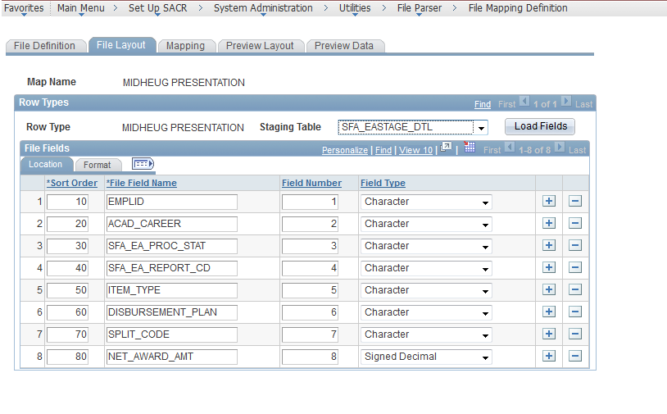
External File – File Mapping Definition

Slide 44
External File Load – File Mapping Definition
Mapping page – general information
Always include the SFA_EASTAGE_HDR even though we did not load any fields from this record. It’s the Parent Record for the others.
Next is SFA_EASTAGE_DTL – this is the award level and always needs to be included because it contains fields like Career, Item Type, and disbursement plan
Third is SFA_EASTAGE_DSB – this is the disbursement ID level
Finally is SFA_EASTAGE_CNT – this could be used for mapping in data from an external entity like a Government Agency that has a trailer record containing record count, etc.

Slide 45
External File Load – File Mapping Definition
Mapping page – For a Full Year Award
Select SFA_EASTAGE_HDR
Insert a row and select SFA_EASTAGE_DTL (again, the fields are presented in alphabetical order)
If you click Auto Map all of the fields from your File Layout tab will appear with the names – you can change the field names here if you choose to

Slide 46
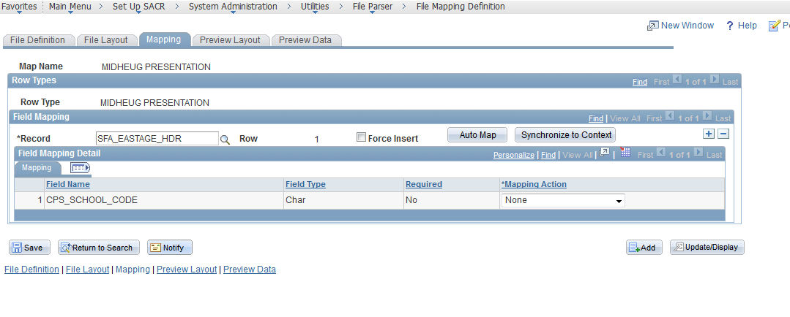
External File Load – File Mapping Definition

Slide 47
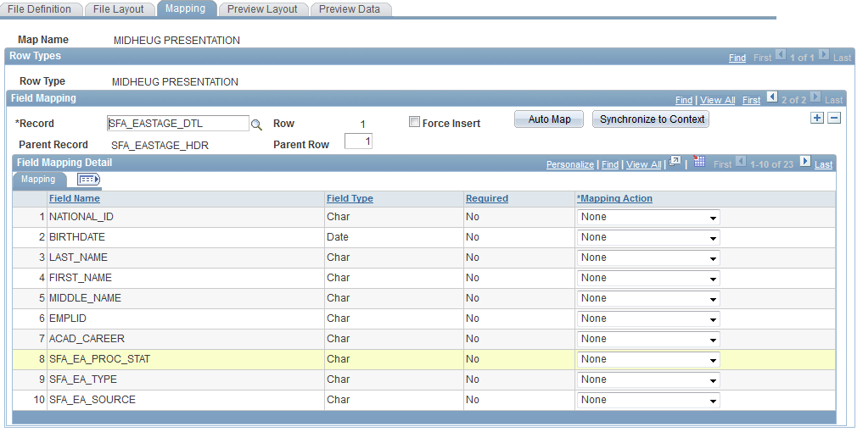
External File Load – File Mapping Definition

Slide 48
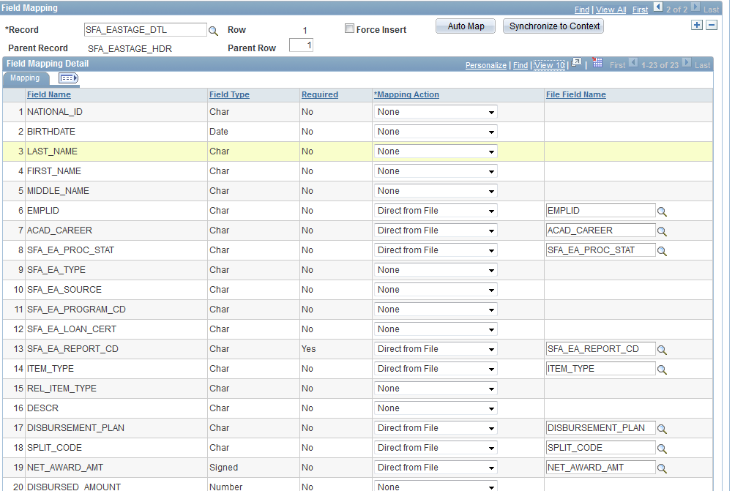
External File Load – File Mapping Definition

Slide 49
External File Load – File Mapping Definition
Preview Layout page
Click the Refresh Layout Tree button
Any fields that appear on the File Layout page should have (0,0) after the name
Any fields that do not appear on the File Layout page should have (None) after the name

Slide 50
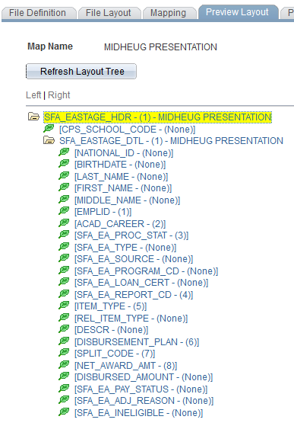
External File Load – File Mapping Definition

Slide 51
External File Load – Preview Data
We ALWAYS check the Preview Data page before loading ANY file
This is like knitting a “gauge swatch” to confirm that your knitted garment will end up the size you intend – the knitting adage translated into financial aid-speak is: To save time, take the time to preview your data
Click the “Add Attachment” button and find the file on our hard drive or shared drive.
Click the Preview Data button
Most error messages are straightforward
The SFA_EASTAGE_HDR record in the preview is really boring, so go to the next row
On the SFA_EASTAGE_DTL record click the “View Add” link at the Field Values level
How does it look?
If good – move on!
If not so good – edit the column order on your spreadsheet or the order of fields on the File Layout tab of your mapping definition

Slide 52
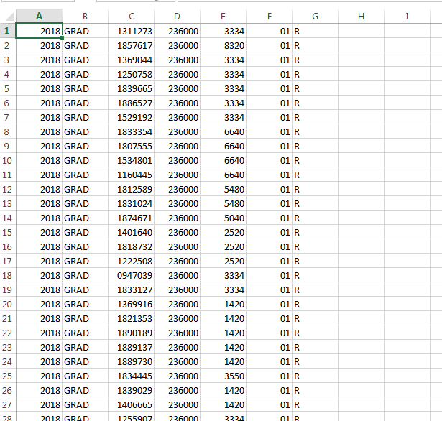
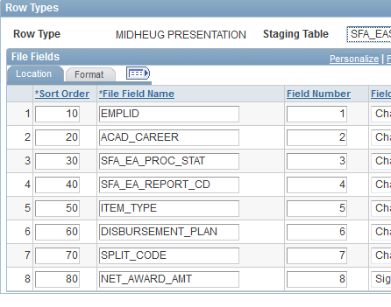
External File Load – Preview Data

Slide 53
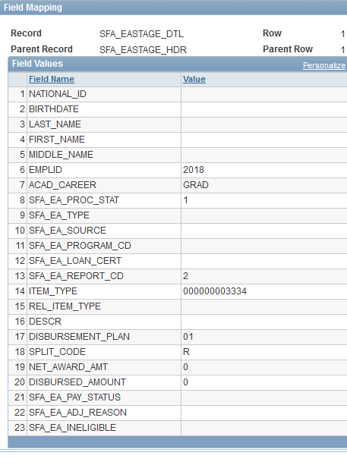

Slide 54
Let’s do two things:
Remove SFA_EA_PROC_STAT and SPLIT_CODE from the file layout and have those be default values
Update the field numbers to match the file

Slide 55
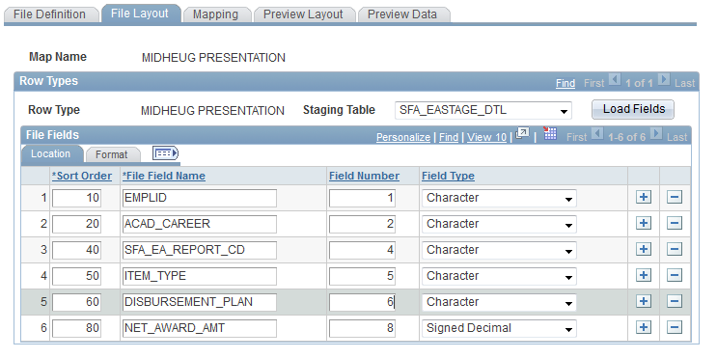
Remove SFA_EA_PROC_Stat and SPLIT_CODE from the file layout and have that be a default value
File Layout page – delete the rows
File Mapping page – change the Mapping Action and add the Default values

Slide 56
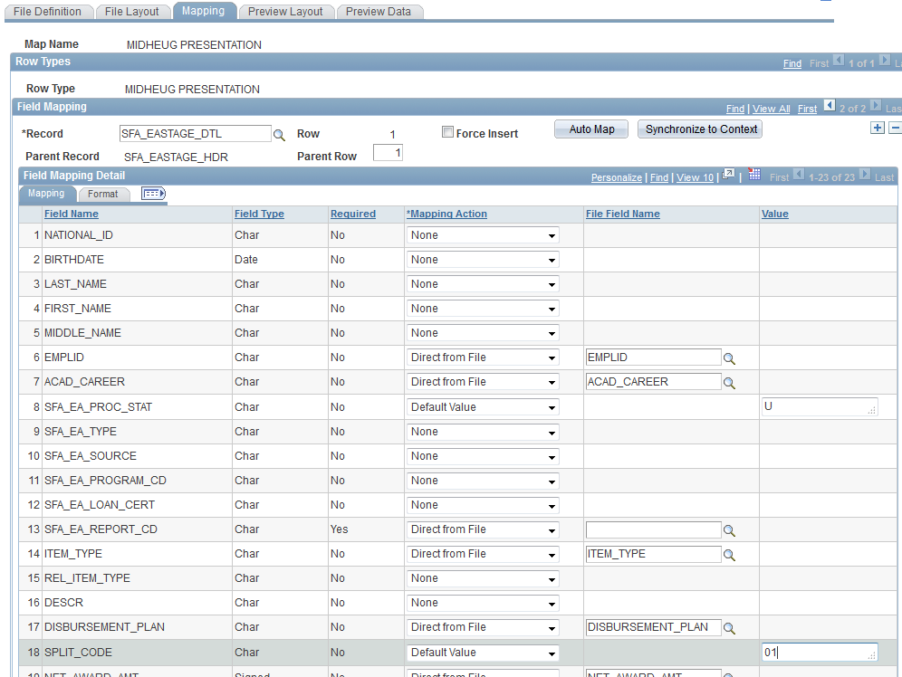
Remove SFA_EA_PROC_Stat from the file layout and have that be a default value
File Layout page – delete the rows
Mapping page – change the Mapping Action and add the Default values

Slide 57
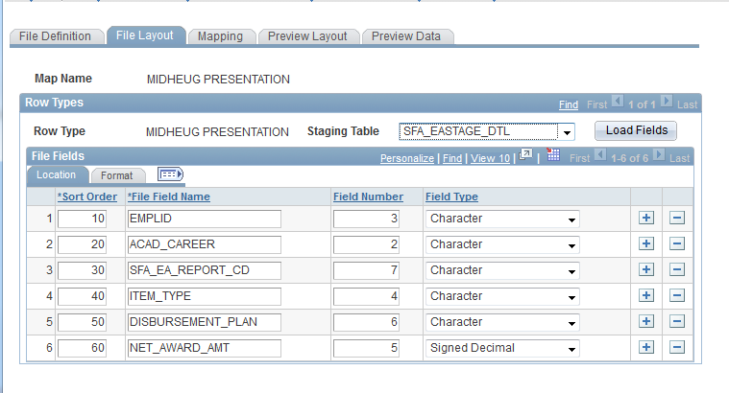
Update the field numbers to match the file

Slide 58
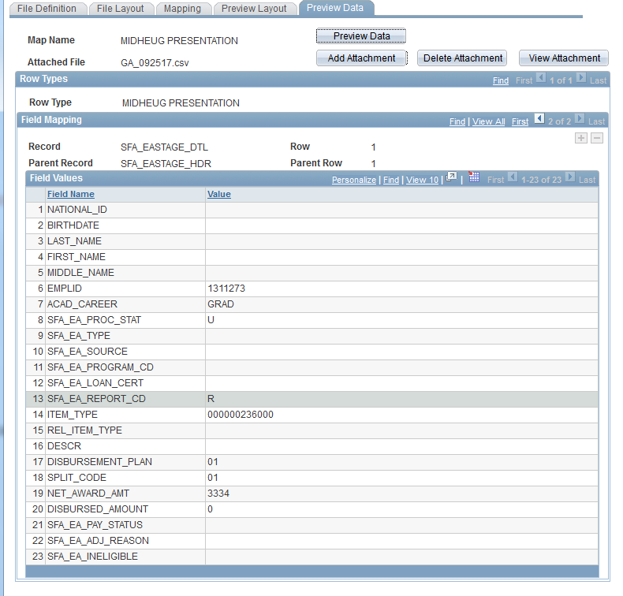

Slide 59
External File Load – FA > Awards > External Awards
Process External File
View File Staging Results
Process External File
External Award Load Summary
External Award Load Detail
Manage Awards by Status

Slide 60
External File Load – Process External Award File
Proceed with an appropriate amount of caution…this is one of the pages where you can wreak havoc
Used to programmatically load data to the External Award Staging tables
Select your Aid Year even if you have that in your file
Aid You will default in here from your User Defaults – be aware!
Select the appropriate value for “Load Action”
Select the appropriate File Mapping ID
Enter the full File Path and Name

Slide 61
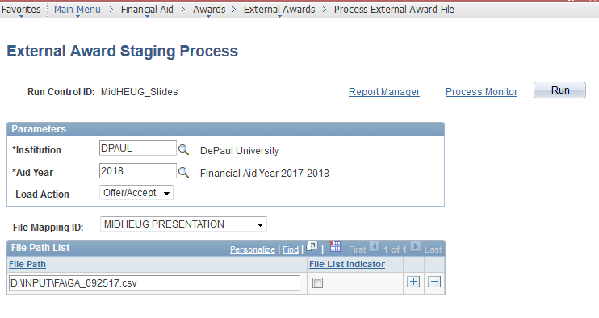
External File Load – Process External Award File

Slide 62
External File Load – View Data File Staging Results
Used to view/edit data loaded to the EA Staging Tables from external files
If you used the Preview Data on the File Mapping component most things will be fine, but still check -
File Mapping ID – if you selected an incorrect Mapping ID (or forgot to change it) you can avoid processing this data any further
Award Total – if the file has only one item type now would be a good time to check whether there is enough available n the Fiscal Item Type Setup to process the data
Load Action – if you are loading a loan file and see “Offer/Accept” when you intended to load them as “Offered” you can avoid processing this data any further
Disbursement – does the data behind this link look correct?
To save time, take the time…

Slide 63
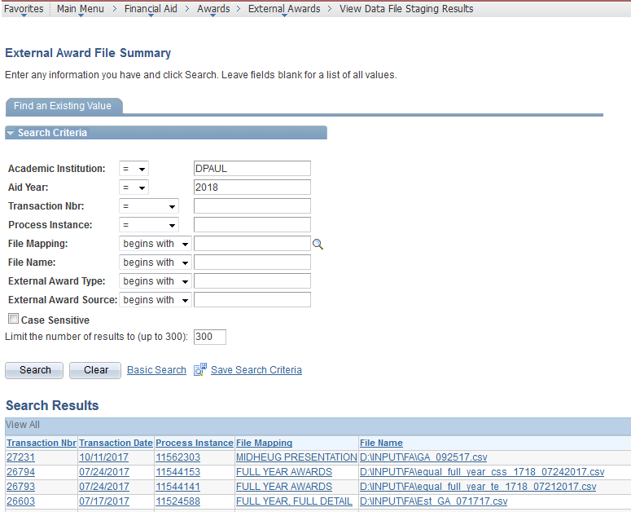

Slide 64
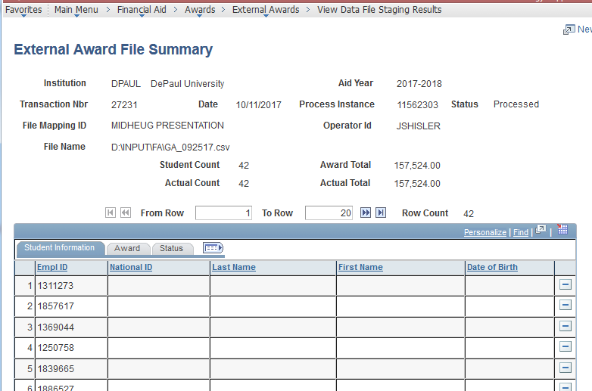
External File Load – View Data File Staging Results

Slide 65
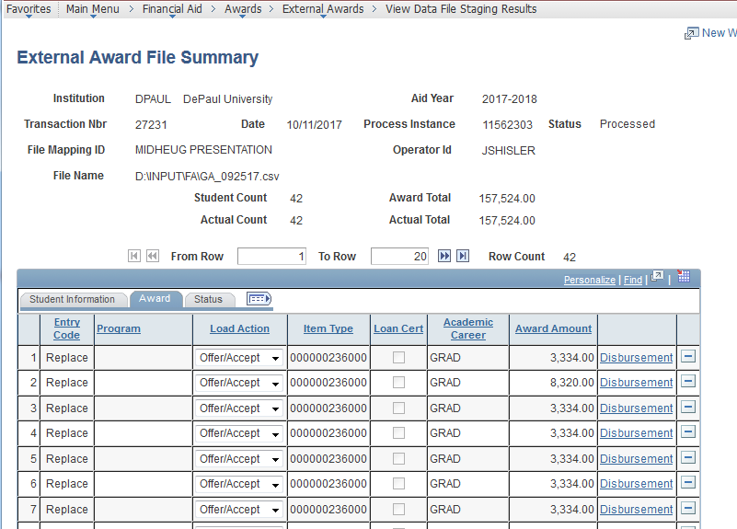
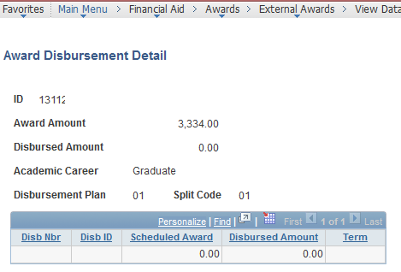
External File Load – View Data File Staging Results

Slide 66
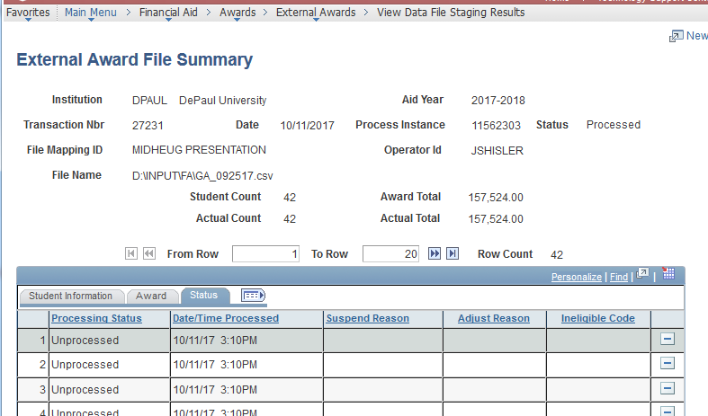
External File Load – View Data File Staging Results

Slide 67
External File Load – Load External Awards
Proceed with an appropriate amount of caution…this is one of the pages where you can wreak havoc
Used to programmatically load data already saved to the External Award Staging tables for a particular
Status – generally “Unprocessed”
Data Source – in this case “External File”
File Mapping ID – in this case “MIDHEUG PRESENTATION”
Transaction Date…optional
Transaction Nbr…optional
Populate the run control page with just enough information to load only the awards you intend (“overpopulating” this page can mean that nothing gets processed)

Slide 68
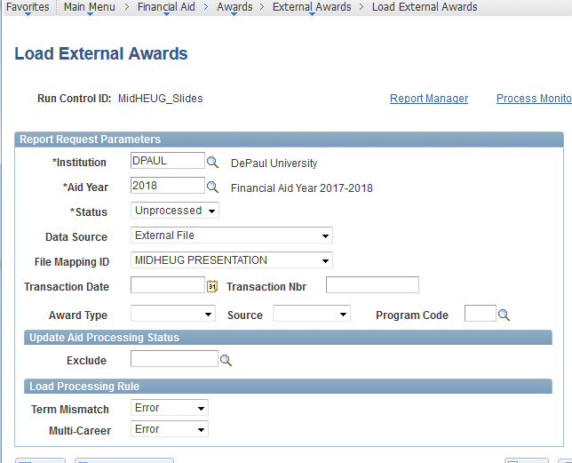
External File Load – Load External Awards

Slide 69
External File Load – External Award Load Summary
Used for a quick glance to see whether any records in the External File errored
Make certain the Selected number totals those in the Processed, Skipped, and In Error statuses *
If Selected and Processed totals are the same – move on!
If Selected and the sum of the other three are the same – there’s some exception processing to deal with
If Selected and the sum of the other three are not the same – there’s a little more processing to deal with
* Resolving errors will be discussed later on…

Slide 70
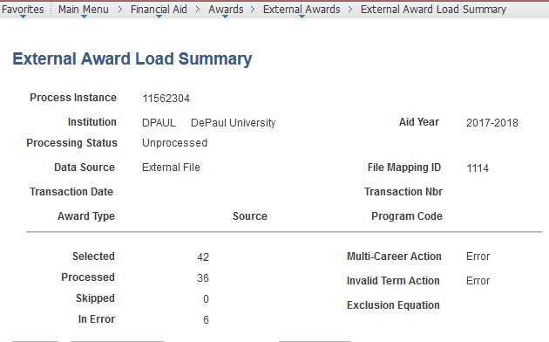
External File Load – External Award Load Summary

Slide 71
External File Load – External Award Load Detail
Used to view (only) the full details for each transaction in an External File that has been loaded to the staging tables and processed.

Slide 72
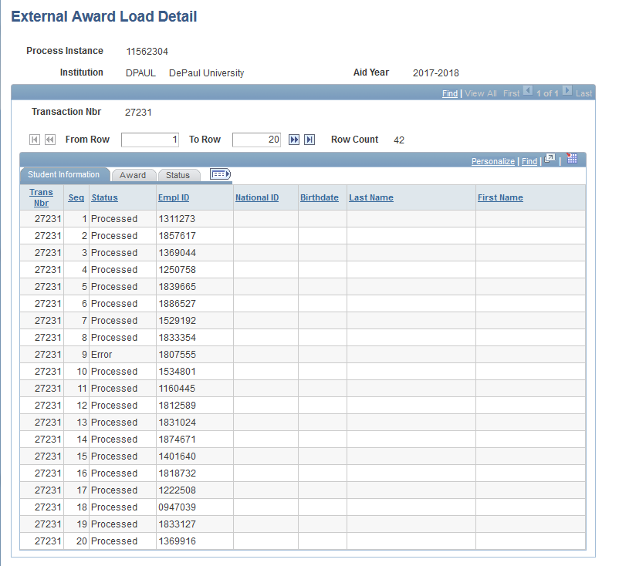
External File Load – External Award Load Detail

Slide 73
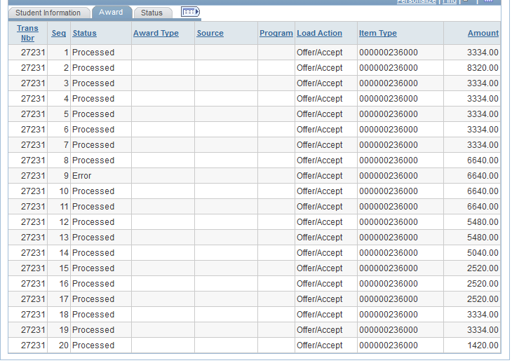
External File Load – External Award Load Detail

Slide 74
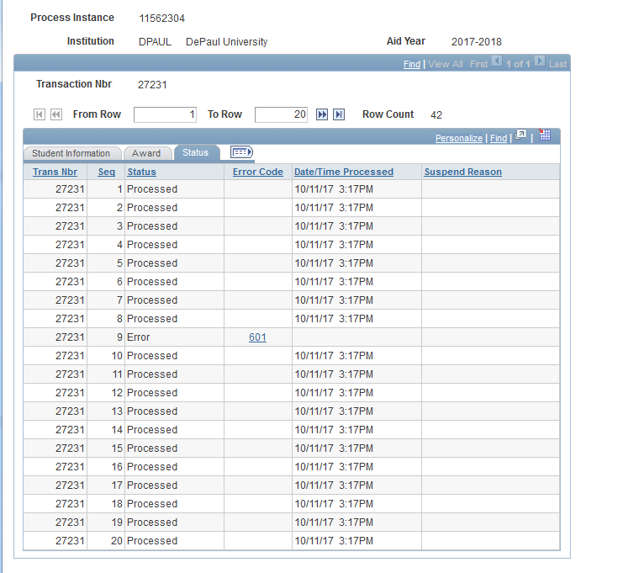
External File Load – External Award Load Detail

Slide 75
Student Financials Feed (SF Feed)
External Award setup IS REQUIRED to use this aspect of EA
Used to draw tuition discounts, 3rd Party Payments, employee/dependent tuition waivers into Students’ awards
Many SF Item types can be mapped to one FA item type
External Award setup is added to the “many SF” item types
FA Item Type should have Disbursement Method = No
Pull the credits into the EA Staging tables using a PopSelect Query and Delivered Process
Process the awards to the Students’ records
Optional Step: Project the award for the remainder of the year

Slide 76
SF Feed – Set Up SACR > PR > SF > Item Types > Item Types
Item Types
Add External Award setup to existing Waiver item types (NO FA Item Type Setup)
Create new Financial Aid Item Types to be “receiver” Item Types (Full FA Item Type Setup required)

Slide 77
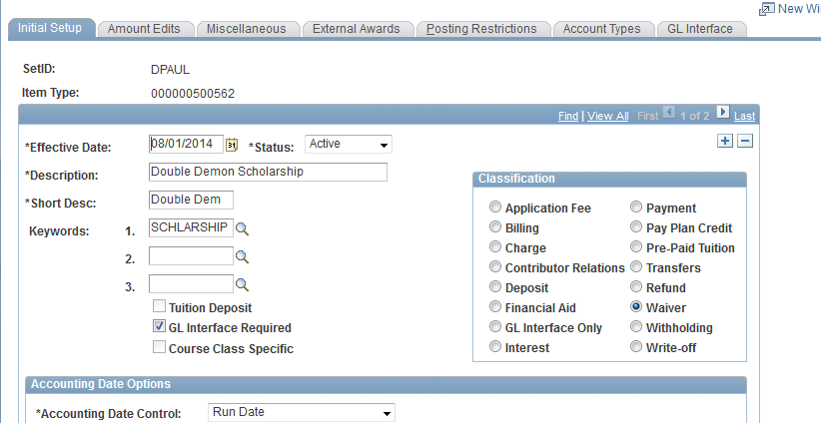
SF Feed – Set Up SACR > PR > SF > Item Types > Item Types

Slide 78
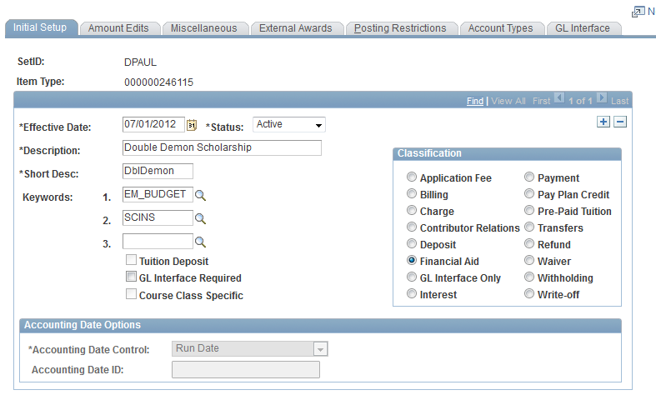
SF Feed – Set Up SACR > PR > SF > Item Types > Item Types

Slide 79
SF Feed – Set Up SACR > PR > FA > Awards
Disbursement Plan Table
Disbursement ID Table
Disbursement Split Codes
Disbursement Split Cd Formula
Financial Aid Item Types
Fiscal Item Types

Slide 80
SF Feed – Disbursement Plan Table
Set up a disbursement plan that will span both Academic and Non-Standard terms
Student Financials Waiver item types are keyed by Term (among other things) so the SAME item type can be used for Fall, Winter, Spring, AND SUMMER.
Financial Aid Item types are not keyed by Term or even Award Period, so we cannot use the same item type for the Regular Academic Year that we do for Summer
One SF Waiver item type cannot map to more than one External Award item type

Slide 81
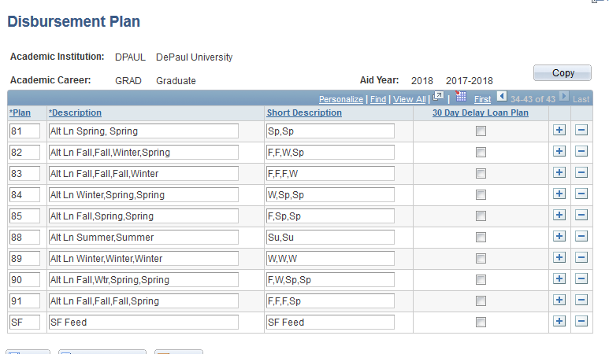
SF Feed – Disbursement Plan Table

Slide 82
SF Feed – Disbursement ID Table
Insert a row for each term for each possible term within an aid year.

Slide 83
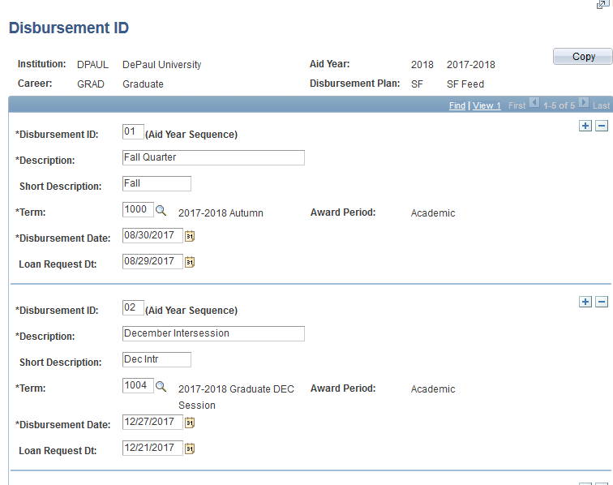
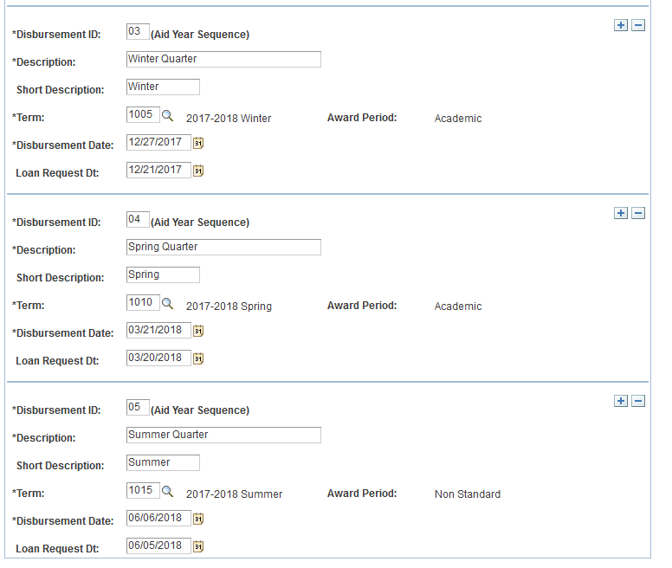
SF Feed – Disbursement ID Table

Slide 84
SF Feed –Disbursement Split Codes
Just set up one as if all awards will be an even split
When the awards are loaded they will automatically go to a custom split

Slide 85
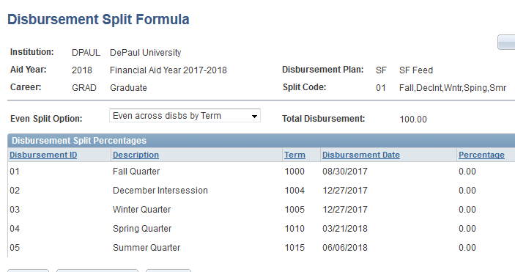
SF Feed – Disbursement Split Cd Formula
Again – Just one, plain Split Code Formula

Slide 86
SF Feed – Financial Aid Item Type
This is the item type that will receive the awards drawn in from Student Financials
Type = Waiver
Disburse Method = No
Default Disbursement Plans = your new SF disbursement plans

Slide 87
SF Feed – Financial Aid Item Type
This is the item type that will receive the awards drawn in from Student Financials
Type = Waiver
Disburse Method = No
Default Disbursement Plans = your new SF disbursement plans

Slide 88
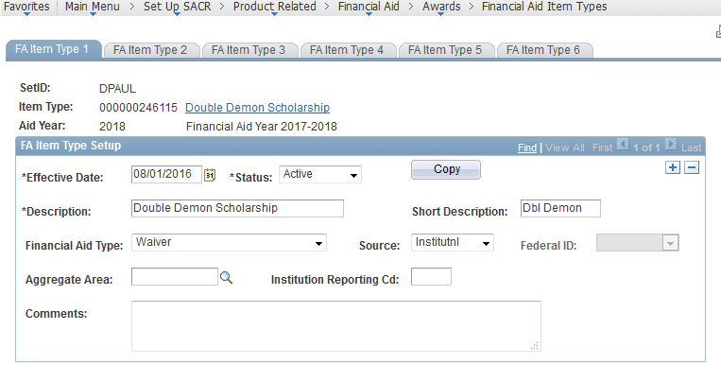
SF Feed – Financial Aid Item Type

Slide 89
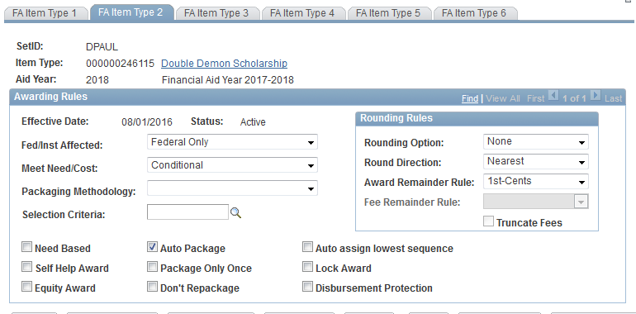
SF Feed – Financial Aid Item Type

Slide 90
SF Feed – Financial Aid Item Type

Slide 91
SF Feed – Financial Aid Item Type

Slide 92
SF Feed – Fiscal Item Types
You need to fund the item type
You do not need to enter an amount in the Disbursements field
No, you don’t need to worry about overspending – remember, these are drawn in to Financial Aid from Student Financials so if a budget is overspent FA did not overspend it!

Slide 93
SF Feed – Fiscal Item Types

Slide 94
SF Feed – Set Up SACR > PR > FA > EA
Define External Award Types
Define External Award Sources
Item Type Cross Reference

Slide 95
SF Feed – Define External Award Types
External Award-specific Setup component 1 of 3 for SF Feed
Naming each one of the SF Feed categories

Slide 96
SF Feed – Define External Award Sources
External Award-specific Setup component 2 of 3 for SF Feed
Insert a row for each of the rows in the Define External Award Types

Slide 97
SF Feed – Item Type Cross Reference
External Award-specific Setup component 3 of 3 for SF Feed
Insert a row for each of the FA item types set up to “receive” SF Feed amounts

Slide 98
SF Feed – Set Up SACR > PR > SF > Item Types > Item Types
Item Types
Return here now that all of the setup is complete to Populate the External Award for each Waiver item type

Slide 99
SF Feed – Process SF External Award
Using a Query to select students, draw amounts in to the EA Staging tables from the Waiver item types you just marked

Slide 100
SF Feed – A PopSelect Query Example
On the Query tab - remember to include the Bind record – SSF_EA_BIND
On the Fields tab - remember to include all of the key fields from the bind record

Slide 101
SF Feed – A PopSelect Query Example
On the Query tab - remember to include the Bind record – SSF_EA_BIND
On the Fields tab - remember to include all of the key fields from the bind record

Slide 102
SF Feed – A PopSelect Query Example

Slide 103
SF Feed – A PopSelect Query Example

Slide 104
SF Feed – A PopSelect Query Example
Query SQL
SELECT DISTINCT C.EMPLID, C.INSTITUTION, C.AID_YEAR, D.SFA_EA_TYPE, D.SFA_EA_SOURCE, D.SFA_EA_PROGRAM_CD
FROM PS_PAYMENT_TBL A, PS_STDNT_AID_ATRBT B, PS_SSF_EA_BIND C, PS_ITEM_TYPE_TBL D
WHERE ( B.EMPLID = A.EMPLID
AND C.EMPLID = A.EMPLID
AND A.BUSINESS_UNIT = 'DPAUL'
AND B.TABLE_ID = '1'
AND B.AID_APP_STATUS <> 'C'
AND B.AID_YEAR = :1
AND A.STRM IN (:2,:3,:4,:5)
AND B.AID_YEAR = C.AID_YEAR
AND D.ITEM_TYPE = A.ITEM_TYPE
AND D.EFFDT =
(SELECT MAX(D_ED.EFFDT) FROM PS_ITEM_TYPE_TBL D_ED
WHERE D.SETID = D_ED.SETID
AND D.ITEM_TYPE = D_ED.ITEM_TYPE)
AND D.SFA_EA_TYPE = :8
AND D.SFA_EA_SOURCE = :6
AND D.SFA_EA_PROGRAM_CD = :7)

Slide 105
SF Feed – Reviewing the Results
Use the Manage Awards by Status component and search for Processing Status = Unprocessed and Transaction Source = Student Financials
Remember – this is not an external file – that’s why you cannot review these using the View Data File Staging Results component

Slide 106
SF Feed – Load External Awards
Proceed with an appropriate amount of caution…this is one of the pages where you can wreak havoc
Used to programmatically load data already saved to the External Award Staging tables for a particular
Status – generally “Unprocessed”
Data Source – in this case “Student Financials”
Perhaps Transaction Date
Perhaps Award Type, Source, and/or Program code
Populate the run control page with just enough information to load only the awards you intend (“overpopulating” this page can mean that nothing gets processed)

Slide 107
SF Feed – Load External Awards

Slide 108
SF Feed – Projecting for the Full Aid Year
SF Feed awards are ALWAYS loaded using the Report Code of “Replace”
If an award includes a full year amount, when the SF Feed runs that will be replaced with just the amounts that appear on the Student’s tuition and fees account
To reduce over-awards we project that amount for the rest of the academic year using the most recent amount from the SF Feed
Create a query from the EA staging tables of the SF Feed data to create an External File to APPEND to the existing award
Load and Process that file to the EA staging tables
CAUTION! Set up separate run controls to “force” SF Feed to run first – when left to its own devices, PeopleSoft will process Data Sources alphabetically

Slide 109
SF Feed – Projecting for the Full Aid Year

Slide 110
SF Feed – Projecting for the Full Aid Year

Slide 111
SF Feed – Projecting for the Full Aid Year

Slide 112
SF Feed – Projecting for the Full Aid Year

Slide 113
Resolving Error and Suspend Status Awards
The most frequent Errors we see are:
601 - Student is not active for Aid Year specified. No row found in PS_STUDENT_AID
604 – No valid FA Term data found. No rows found in PS_STDNT_FA_TERM
608 – Invalid Disbursement Plan and Split Code. The specified disbursement plan and split code would result in invalid disbursement rows for the student
610 – Invalid tem specified. The term specified on a disbursement entry is not a valid term for the student
622 – Charge Priority not found for Item Type
637 – New award with 0.00 amount cannot be posted

Slide 114
Resolving Error and Suspend Status Awards
601 - Student is not active for Aid Year specified. No row found in PS_STUDENT_AID
Short Term – Aid Year activate the student(s)
Long Term – consider running the Process Aid Years App Engine using a PopSelect Query/Equation/File prior to processing

Slide 115
Resolving Error and Suspend Status Awards
604 – No valid FA Term data found. No rows found in PS_STDNT_FA_TERM
Short Term – Build FA Terms for the student(s)
Long Term – consider running the FA Term Build processes prior to processing

Slide 116
Resolving Error and Suspend Status Awards
608 – Invalid Disbursement Plan and Split Code. The specified disbursement plan and split code would result in invalid disbursement rows for the student
Short Term – review and edit the data in the staging tables and Process the data again
Long Term – no simple solution here – could be a training issue for folks providing data, sometimes is a function of forgetting to Preview the data, and then sometimes Students’ information changes unexpectedly…

Slide 117
Resolving Error and Suspend Status Awards
610 – Invalid tem specified. The term specified on a disbursement entry is not a valid term for the student
Short Term – review and edit the data in the staging tables and attempt to Process the data again
Long Term – no simple solution here – could be a training issue for folks providing data, sometimes is a function of forgetting to Preview the data, and then sometimes Students’ information changes unexpectedly…

Slide 118
Resolving Error and Suspend Status Awards
622 – Charge Priority not found for Item Type
Short Term – Review and update the SF Item Type, attempt to process the data again
Long Term – make it a business practice always to have a Charge Priority on every financial aid item type – even those set up with a Disburse Method = No

Slide 119
Resolving Error and Suspend Status Awards
637 – New award with 0.00 amount cannot be posted
Short Term – either leave it be or delete the rows from the staging tables
Long Term – generally encountered when canceling awards via External File Load, so remember to use the Report Code of R-replace when awarding a 0.00 amount

Slide 120
Resolving Error and Suspend Status Awards
The most frequent Suspend reason is:
I forgot to make certain the item type has available funds

Slide 121
Follow-Up Processes/Queries
Reset Packaging Status (STDNT_AID_ATRBT.PROCESSING_STATUS) – we use a PopUpdate process driven by a query. Please know there are other ways of doing this.
EA Sets Packaging Status to 4=Repackage only when Packaging Status is currently 9=Completed. This prevents students from accepting awards through self service.
EA does NOT change when Packaging Status is:
0=No App Rcd
1=Applied
2=Ready for Counselor Review
3=Ready for Packaging

Slide 122
Follow-Up Processes/Queries
Notes:
Query SQL
SELECT DISTINCT A.AID_YEAR, A.ACAD_CAREER, A.EMPLID, A.PROCESSING_STATUS, B.AWARD_PERIOD, B.FED_OVRAWD_AMT, B.FED_OVRAWD_COA, G.AWARD_PERIOD, G.FED_OVRAWD_AMT, G.FED_OVRAWD_COA, A.INSTITUTION, E.ITEM_TYPE FROM PS_STDNT_AID_ATRBT A, PS_STDNT_AWD_PER B, PS_SCCPU_STDNT_BND C, PS_SCC_PS_FINA_BND D, PS_SFA_EASTAGE_DTL E, PS_SFA_EASTAGE_HDR F, PS_STDNT_AWD_PER G WHERE ( A.INSTITUTION = 'DPAUL' AND A.AID_YEAR = :1 AND A.EMPLID = C.EMPLID AND (( A.EMPLID = B.EMPLID AND A.INSTITUTION = B.INSTITUTION AND A.AID_YEAR = B.AID_YEAR AND B.FED_OVRAWD_AMT = 0.00 AND B.FED_OVRAWD_COA = 0.00 AND B.AWARD_PERIOD = 'A') AND ( A.EMPLID = G.EMPLID AND A.INSTITUTION = G.INSTITUTION AND A.AID_YEAR = G.AID_YEAR AND G.AWARD_PERIOD = 'N' AND G.FED_OVRAWD_AMT = 0.00 AND G.FED_OVRAWD_COA = 0.00 AND A.PROCESSING_STATUS = '4')) AND A.EMPLID = D.EMPLID AND A.INSTITUTION = D.INSTITUTION AND A.AID_YEAR = D.AID_YEAR AND A.EMPLID = E.EMPLID AND A.INSTITUTION = E.INSTITUTION AND A.AID_YEAR = E.AID_YEAR AND E.SFA_EA_TRANS_NBR = F.SFA_EA_TRANS_NBR AND F.TRANSACTION_DATE > (SYSDATE)-2) ORDER BY 2, 3

Slide 123
Follow-Up Processes/Queries
Remove EA Flag – we have recently come to the conclusion that it is better for us to remove the EA Flag from any/all item types in Students’ awards.
If an award is made prior to packaging and that item type is included in a packaging plan:
When EA Flag is set to Y Mass Packaging will increase the existing award by the amount in the packaging plan
When the EA Flag is blank for set to N, mass packaging will re-package the item type to be consistent with the packaging plan setup
If an award has been canceled using EA and is subsequently re-awarded manually:
When the EA Flag is set to Y, that acts similar to the PJ flag and allows the User to award ANY amount.
When the FA Flag is blank or set to N, the packaging engine does its job and saves the User from egregious error.

Slide 124
Follow-Up Processes/Queries
Notes:
Query SQL
SELECT A.EMPLID, A.INSTITUTION, A.AID_YEAR, A.ITEM_TYPE, A.ACAD_CAREER, B.LOCK_AWARD_FLAG, B.SFA_EA_INDICATOR, C.DISBURSE_METHOD FROM PS_SCCPU_STAWD_BND A, PS_STDNT_AWARDS B, PS_ITEM_TYPE_FA C WHERE ( A.EMPLID = B.EMPLID AND A.INSTITUTION = B.INSTITUTION AND A.AID_YEAR = B.AID_YEAR AND A.ITEM_TYPE = B.ITEM_TYPE AND A.ACAD_CAREER = B.ACAD_CAREER AND A.INSTITUTION = 'DPAUL' AND A.AID_YEAR = :1 AND B.SFA_EA_INDICATOR = 'Y' AND B.AID_YEAR = C.AID_YEAR AND B.ITEM_TYPE = C.ITEM_TYPE AND C.SETID = B.SETID AND C.EFFDT = (SELECT MAX(C_ED.EFFDT) FROM PS_ITEM_TYPE_FA C_ED WHERE C.SETID = C_ED.SETID AND C.ITEM_TYPE = C_ED.ITEM_TYPE AND C.AID_YEAR = C_ED.AID_YEAR))

Slide 125
Myriad Uses for External Awarding
An alternative title for this section could be:
“All the Tangents We Didn’t Take Earlier”
Item Type Swaps
October 1 Loan Fees
Generic Grant award for Endowed Scholarship

Slide 126
Myriad Uses for External Awarding
An alternative title for this section could be:
“All the Tangents We Didn’t Take Earlier”
Target Cancellation:
Canceling specific term(s) after SAP Processing

Slide 127
Myriad Uses for External Awarding
An alternative title for this section could be:
“All the Tangents We Didn’t Take Earlier”
State or other Governmental Grants
Awarding Grants from a Flag File
Mass reduction of existing awards…but only for one term
Reinstating those reductions when funds suddenly become available again

Slide 128
Myriad Uses for External Awarding
An alternative title for this section could be:
“All the Tangents We Didn’t Take Earlier”
Testing
Creating large numbers of refunds for SF

Slide 129
Contact Information
Jessica Holler
System Integration Analyst
Enrollment Management & Marketing
DePaul University
jshisler@depaul.edu

Slide 130
This presentation and all MIDHEUG presentations are available for download from the Conference site at www. heug.org Note: Sessions from EACH AND EVERY HEUG Conference and Webinar are also available Go Wild!

