Slide 1
Third Party Payments Just the Basics
SESSION 7506
07 November 2022

Slide 2
Presenter
Buddy Combs
Assistant Vice President Financial Support Services
KCTCS
Buddy.combs@kctcs.edu
HEUG and PeopleSoft Advocate.

Slide 3
Poll Question
Show of hands
Do you use the delivered PeopleSoft Third Party Contracts?

Slide 4
Cashiering - Setup

Slide 5
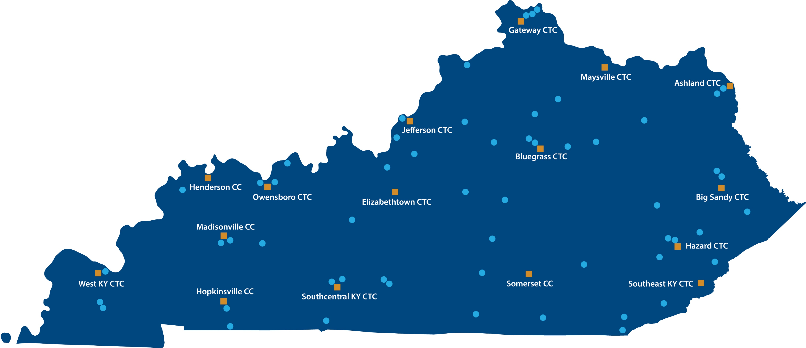

Slide 6
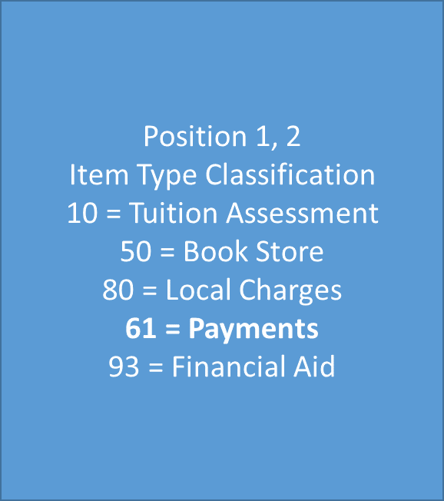
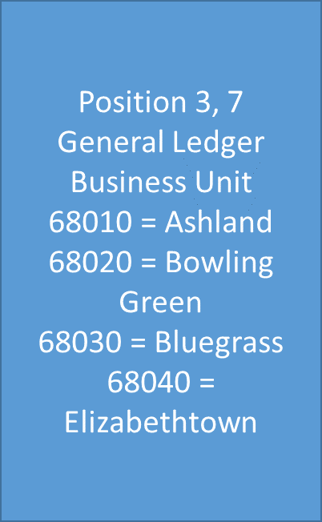
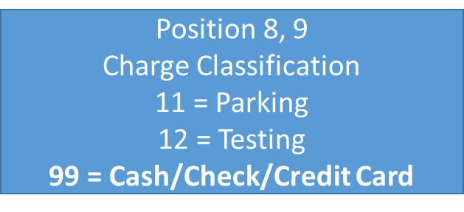
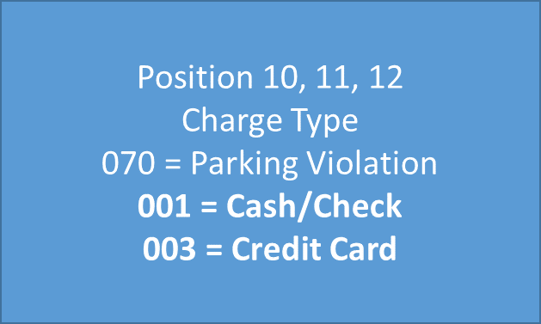
Item Type Creation
Item Type Definition
12 Digits
Example: Elizabethtown Cash/Check
616804099001

Slide 7
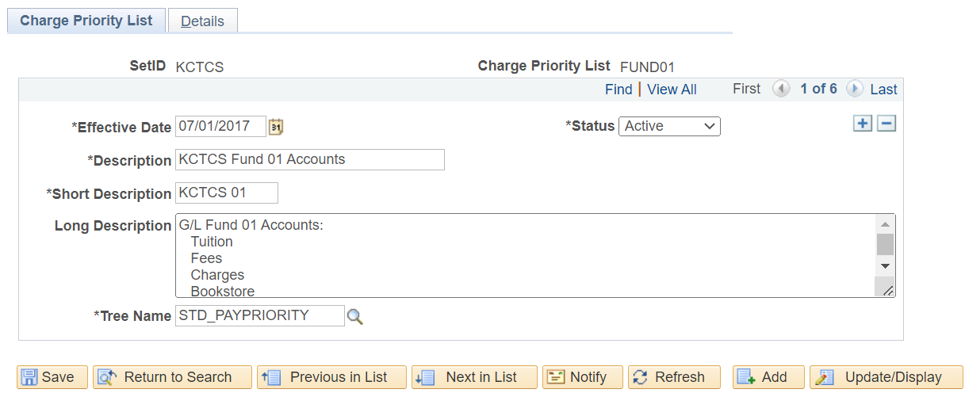
Charge Priority List

Slide 8
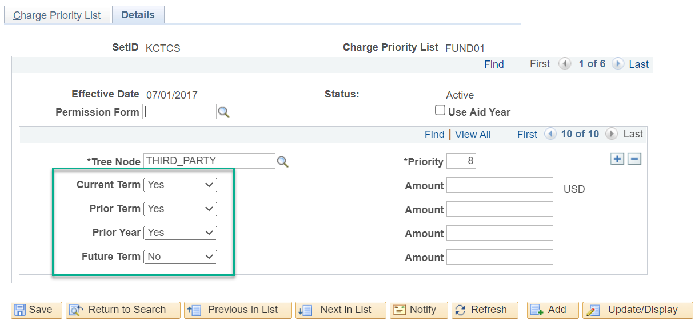
Charge Priority List - Details

Slide 9
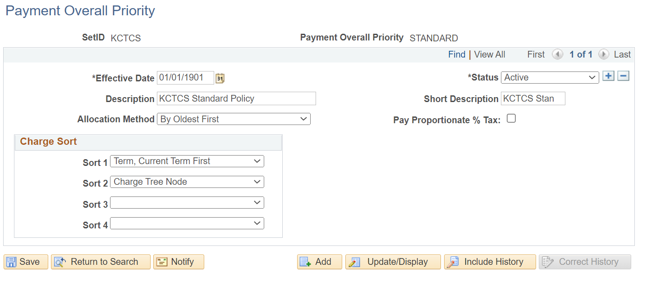
Payment Overall Priority

Slide 10
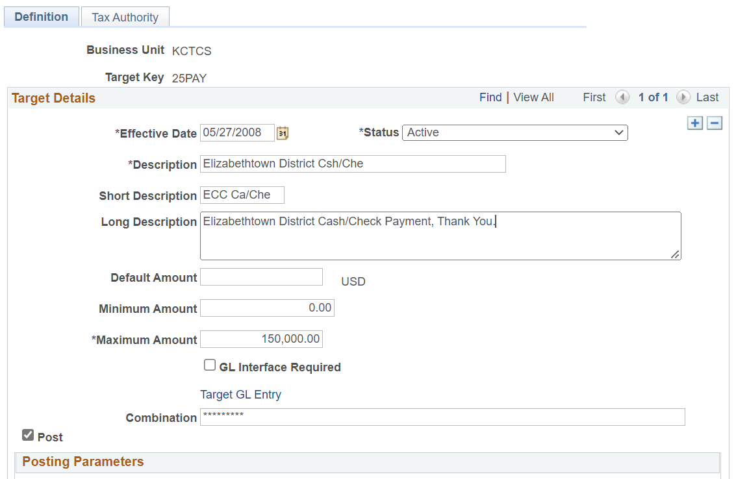
Target Key

Slide 11
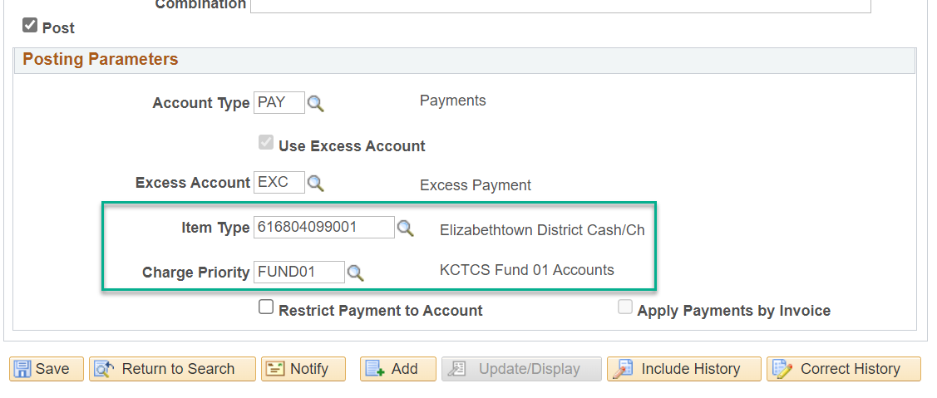
Target Key continued
Notes:
We are not using Apply Payment by Invoice however we have been doing some testing for Third Party Payments.

Slide 12
Poll Question
Show of hands
Do you use the delivered PeopleSoft Cashiering?

Slide 13
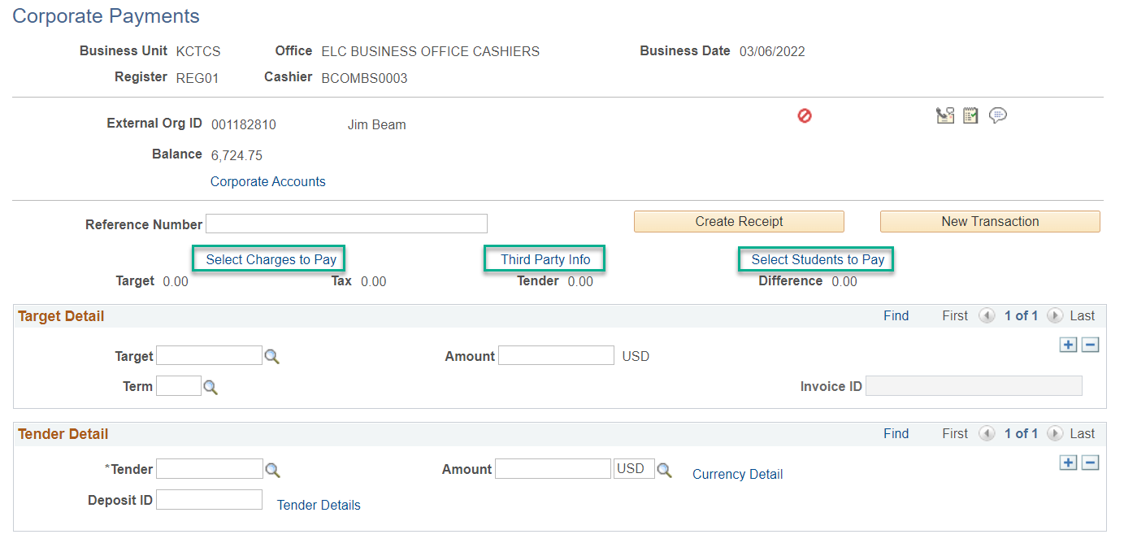
Notes:
Four options when posting a payment via Cashiering, 1) Target, Amount, Term, Tender, 2) Target, Amount, Term, Tender, Select Charges to Pay, 3) Target, Amount, Term, Tender, Select Students to Pay 4) Target, Amount, Term, Tender, Third Party Info

Slide 15
Cashiering - No Selection Payment Option
Notes:
Received $100 payment

Slide 16
Notes:
Did not select a payment option

Slide 17
No Payment Selection
Notes:
Process used the Charge Priority for the payment item type.

Slide 18
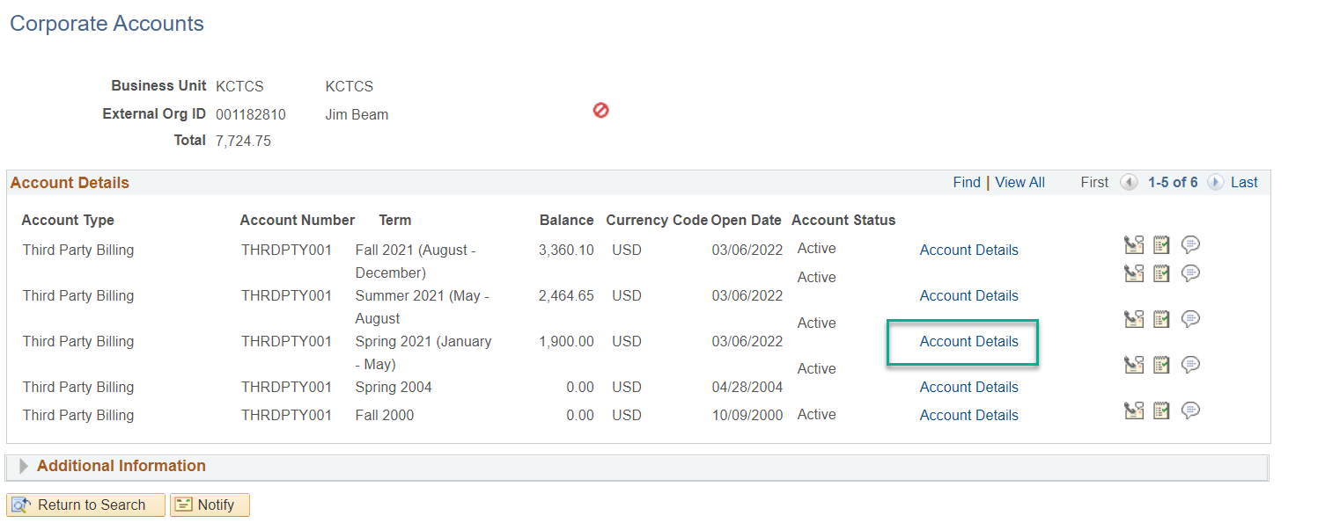
View Corporate Account

Slide 19
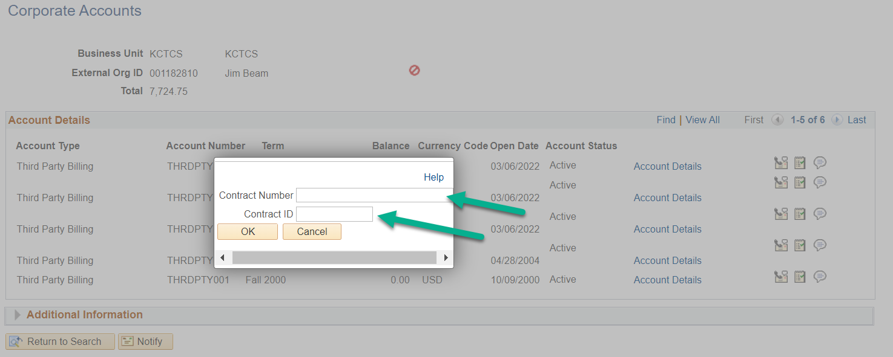
View Corporate Account – Account Details
Notes:
Two options here one click on OK and all lines for this term will pull back, or you can enter a Contract Number and Contract ID (student EMPLID)

Slide 20
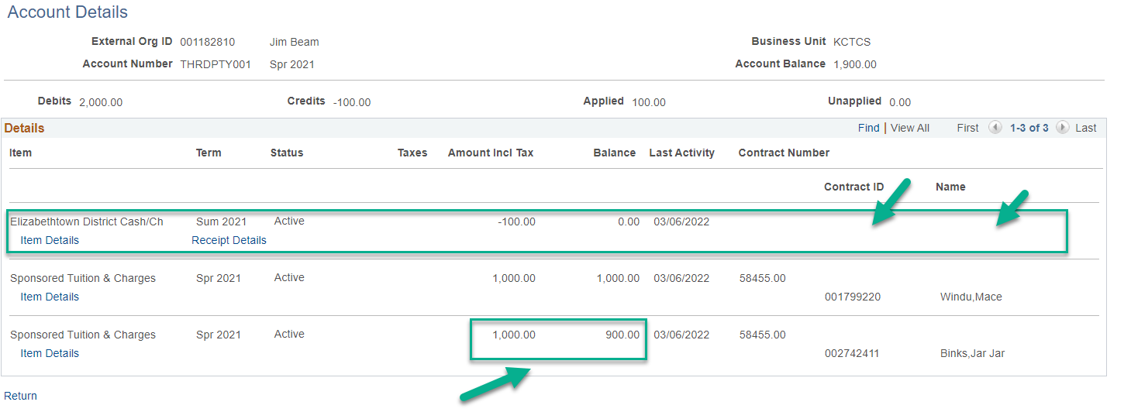
View Corporate Account – Account Details
Notes:
This payment is not attached to a Contract ID or Name. This payment uses the Payment Priority of the payment item type.

Slide 21
Cashiering - Select Charges to Pay

Slide 23
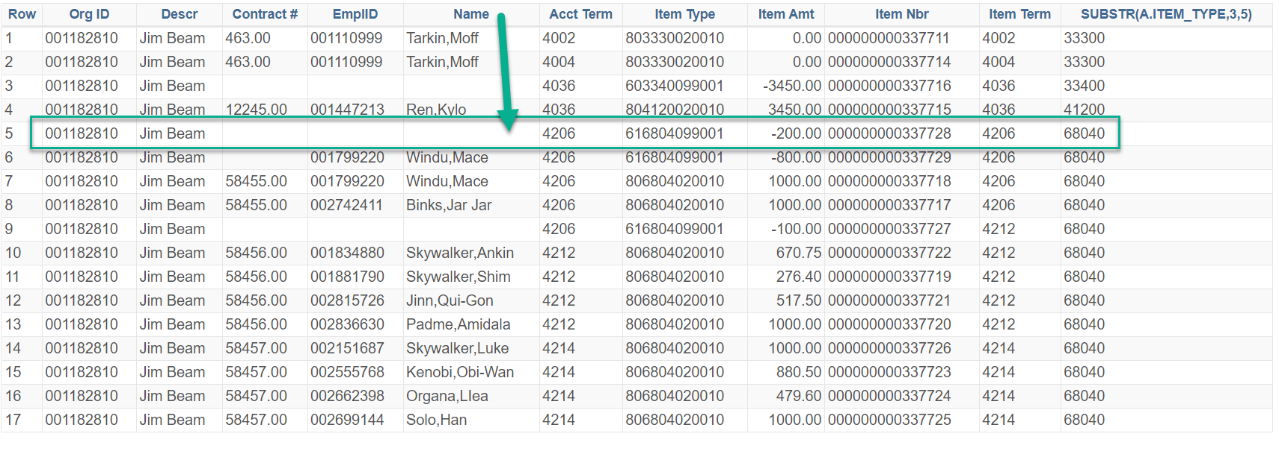
Cashiering - Select Charges to Pay
Notes:
The payment paid off the charge for Mace Windu, however again no Contract ID or Name is associated with the payment.

Slide 24
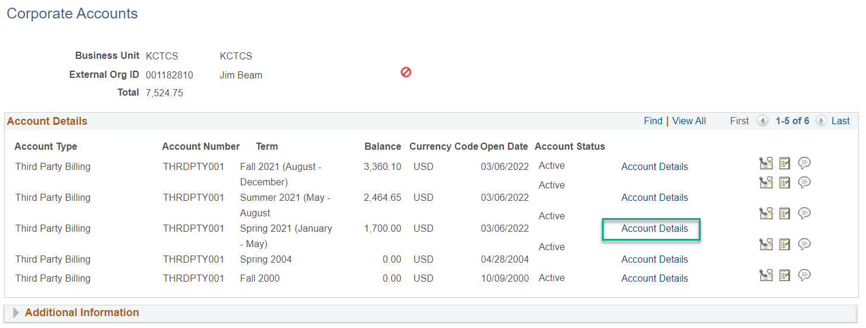
Corporate Account – Select Charges to Pay
Notes:
Used the Select Charges to Pay link

Slide 25
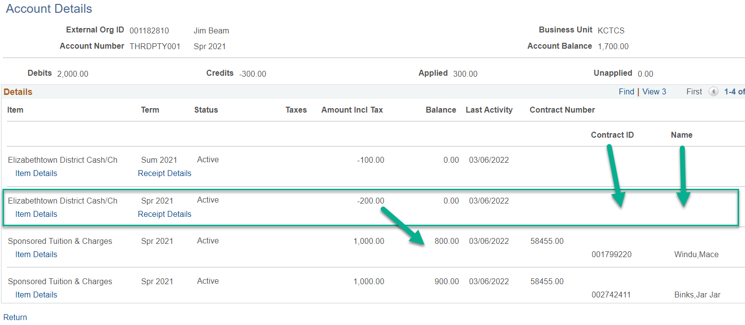
Account Details – Select Charges to Pay
Notes:
The payment paid off the charge for Mace Windu, however again no Contract ID or Name is associated with the payment.

Slide 26
Cashiering - Select Students to Pay

Slide 27
Notes:
Select Students to Pay

Slide 28
Cashiering – Select Students to Pay

Slide 29
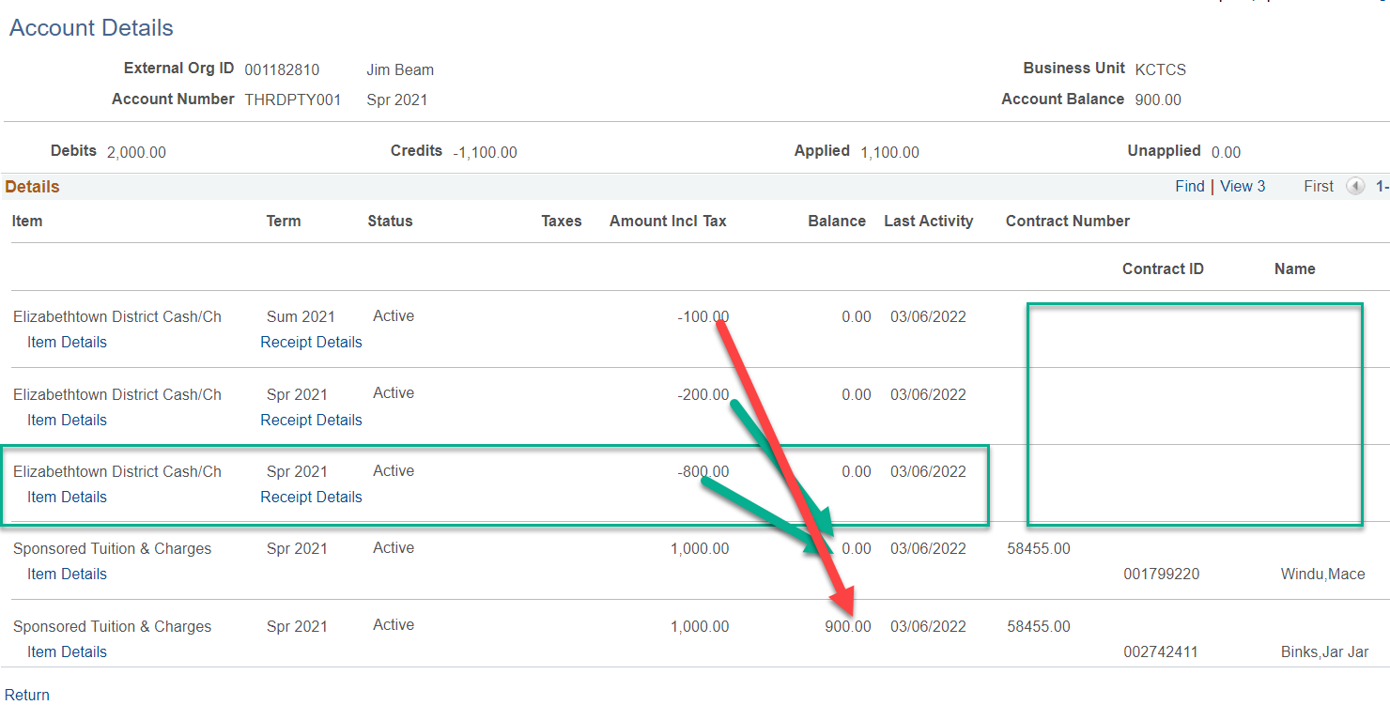
Account Details – Select Students to Pay
Notes:
Skipped right too the Account Details. The two green lines are payments with Select Charges to Pay and Select Students to Pay All three of these process do not keep with the student as you can see from the Contract ID and the Name they are all blank.

Slide 30
Cashiering – Third Party Info

Slide 32
Cashiering – Third Party Info
Notes:
The payment line populates the Contract # and the EmplID, this payment will stick to this student.

Slide 33
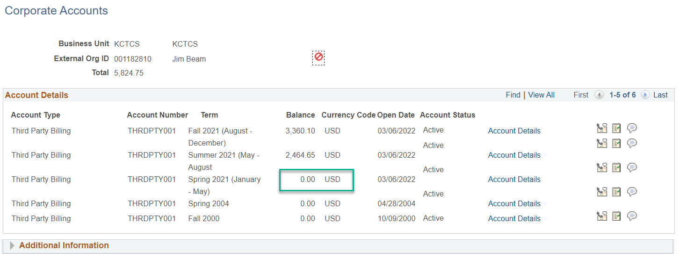
Corporate Accounts – Third Party Info
Notes:
The balance is now zero

Slide 34
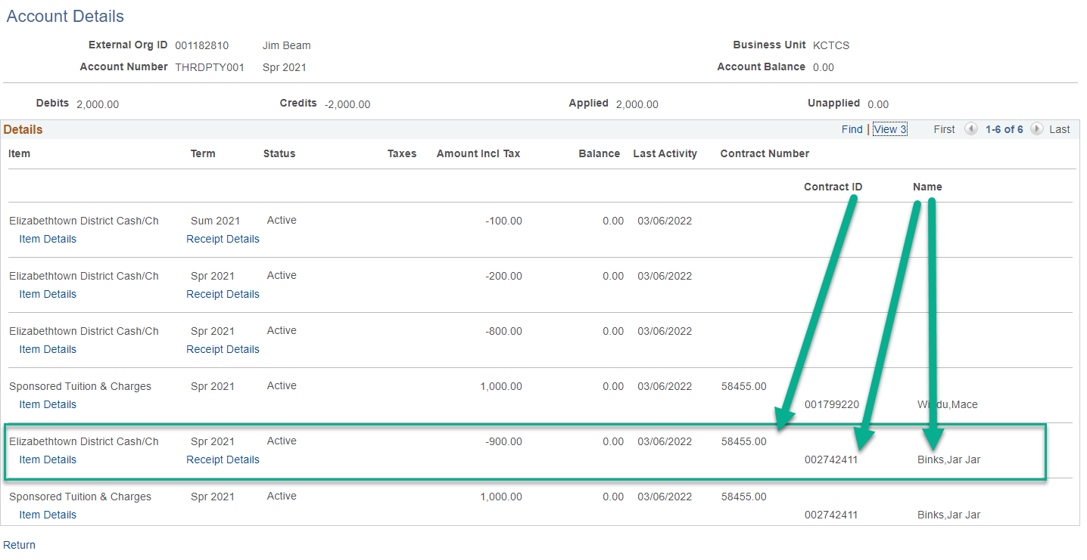
Account Details – Third Party Info
Notes:
With Third Party Info link the payment populates the Contract ID Student ID and Name. This payment will stick.

Slide 35
Cashiering Pros
Easy to setup
Four options to post payments
No Selection Criteria
Select Charges to Pay (able to select multiple charges
Third Party Infor (able to select Contract Nbr and Contract ID
Select Students to Pay (able to select multiple students)

Slide 36
Cashiering CONs
No Selection Criteria
Payments are subject to Payment & Charge Priority, can move within term, prior term and contracts
Select Charges to Pay
Difficult to pick the correct students, subject to Payment & Charge Priority and shifting contracts and terms
Third Party Info
Limited to one Contract Nbr and Contract ID
Select Students to Pay
Easy to pick the correct students, subject to Payment & Charge Priority and shifting contracts and terms

Slide 37
Cashiering Impact Examples
No Selection Criteria
Select Charges to Pay
Select Students to Pay

Slide 38
Changes to contracts since payments applied
Contract 58455.00 Term 4206 Student ID 001799220 Cancelled ($200 and $800 payment in excess pay)
Contract 58458.00 Term 4204 created for Student ID 001799220 and 002742411 for a total of $2,000
Excess payment of $1,000 from Contract 58455.00 Term 4206 excess pay dropped down and paid off charges for Contract 58458.00 Term 4204

Slide 39
Poll Question
Show of hands
When a Sponsor does not pay for a student, what is your process?
Cancel student from contract based on your Financial Agreement?
Nothing, becomes a bad debt and a Corporate Write-off is completed?

Slide 40
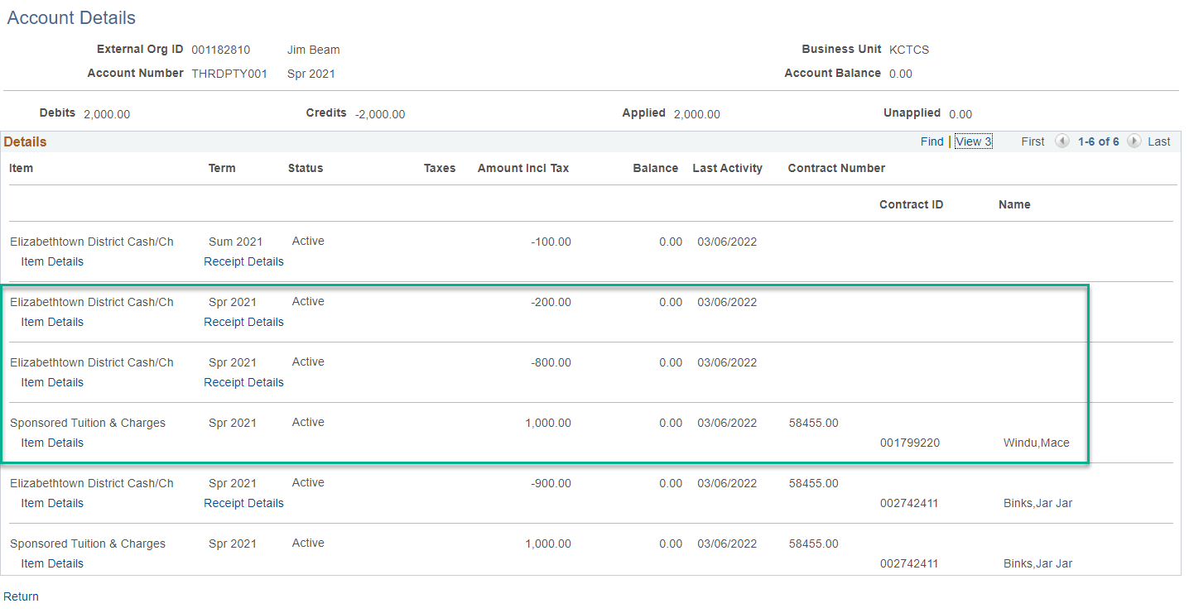
Payments not attached to Students
Notes:
Prior to changes

Slide 41
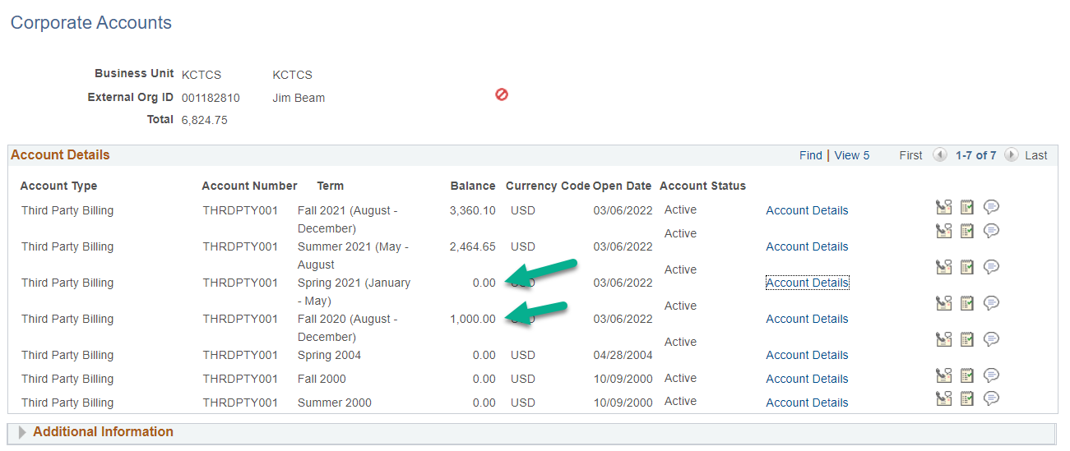
New Contract – Student Cancelled
Notes:
Changes we now have a balance due in Fall 2020 and Spring 2021 balance is zero.

Slide 42
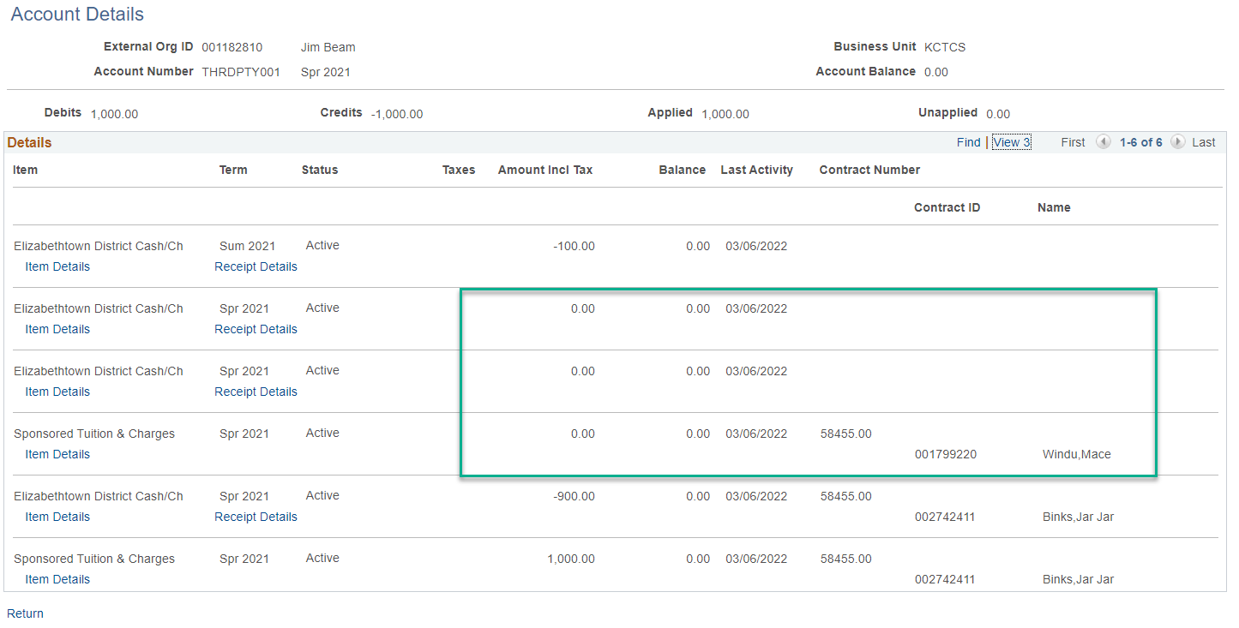
Spring 2021 Account Details
Notes:
Mace Windu was cancelled from the contract and the $200 payment and $800 payment went into excess pay; however a prior term contract was established, and the $1,000 payment dropped down and paid off the charges.

Slide 43
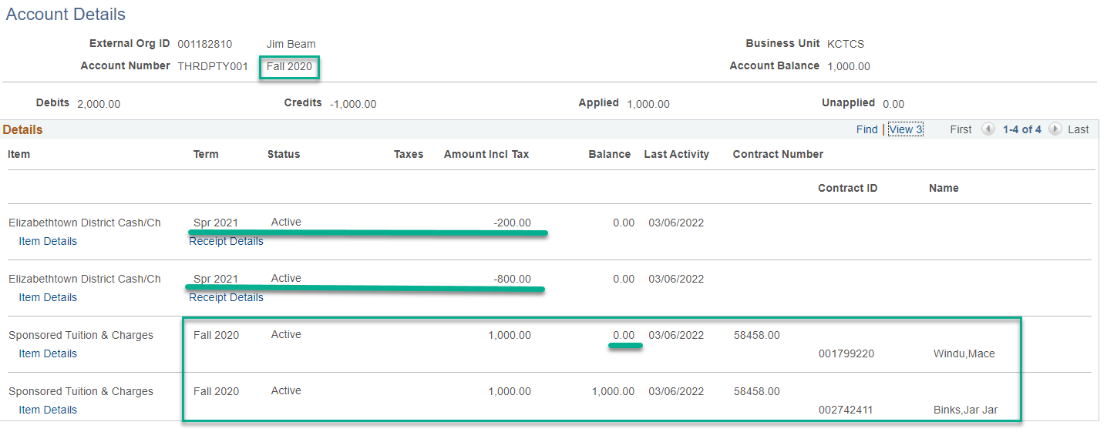
Fall 2020 – Account Details
Notes:
Contract 58458.00 was created after the contracts for spring 2021. Since there was excess payments from spring 2021 from the Select Charges to Pay and Selection Students to Pay these payments dropped down to pay off new charges. Our Charge Priority is set to pay term posted then prior terms however no future terms.

Slide 44
Alternative to Cashiering Corporate Payments
Charges and Payment > Mass Select Transactions
Population Selection (Equation Engine, External File, or PS Query) KCTCS opts for External File
Mass Select Transaction allows payment to stick to student and contract (Third Party Info link from Cashiering)

Slide 45
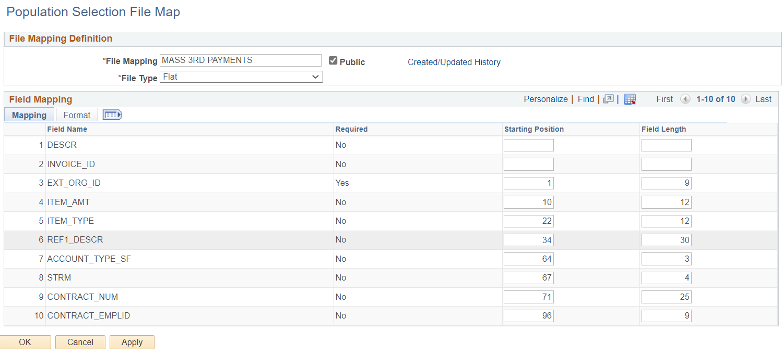
Population Selection File Map Setup

Slide 46
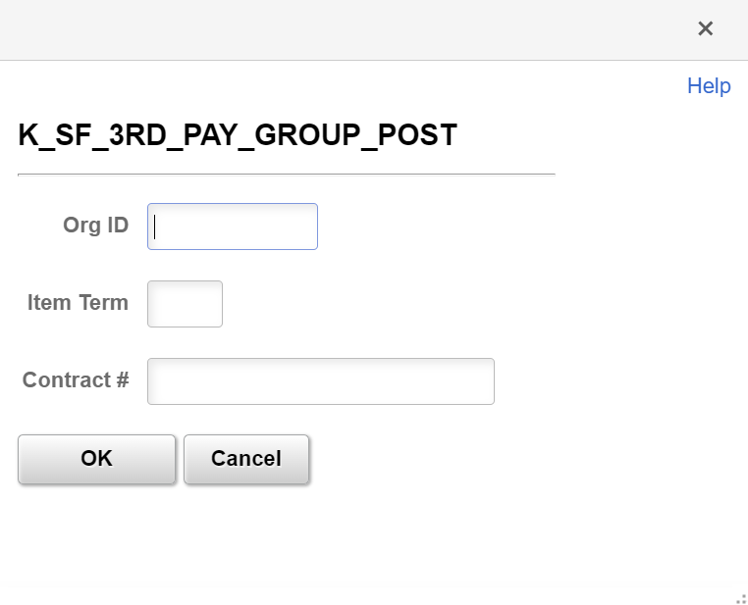
K_SF_3RD_PAY_GROUP_POST
Notes:
SELECT A.EXT_ORG_ID, ( A.ITEM_AMT- A.APPLIED_AMT), ' ', A.REF1_DESCR, 'PAY', A.ITEM_TERM, A.CONTRACT_NUM, A.CONTRACT_EMPLID FROM PS_ITEM_ORG_SF_VW A WHERE ( A.BUSINESS_UNIT = 'KCTCS' AND A.EXT_ORG_ID = :1 AND A.ITEM_TYPE LIKE '8%' AND A.ITEM_TERM = :2 AND A.CONTRACT_NUM = :3) ORDER BY 7

Slide 47
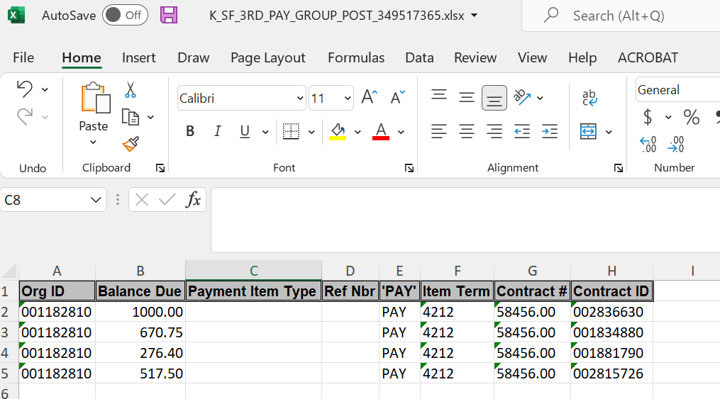
K_SF_3RD_PAY_GROUP_POST – Excel Edit
Notes:
We format the file at formatted text; however, I believe comma delimitated works best.

Slide 48
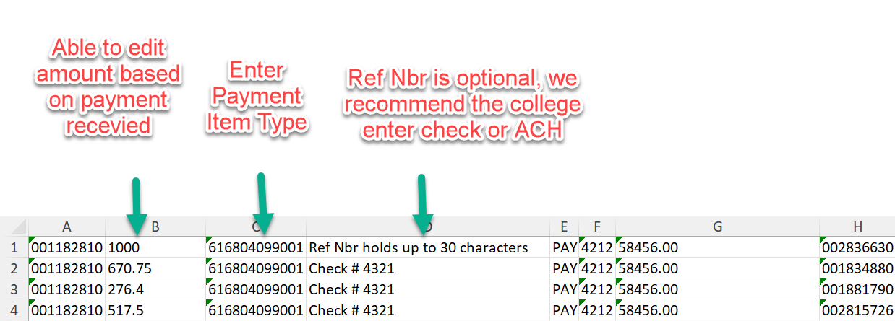
K_SF_3RD_PAY_GROUP_POST – Excel Edit

Slide 49
K_SF_3RD_PAY_GROUP_POST

Slide 50
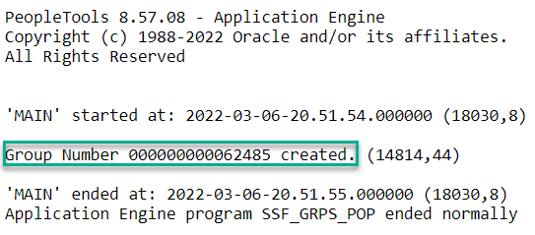
K_SF_3RD_PAY_GROUP_POST – View Log/Trace

Slide 52
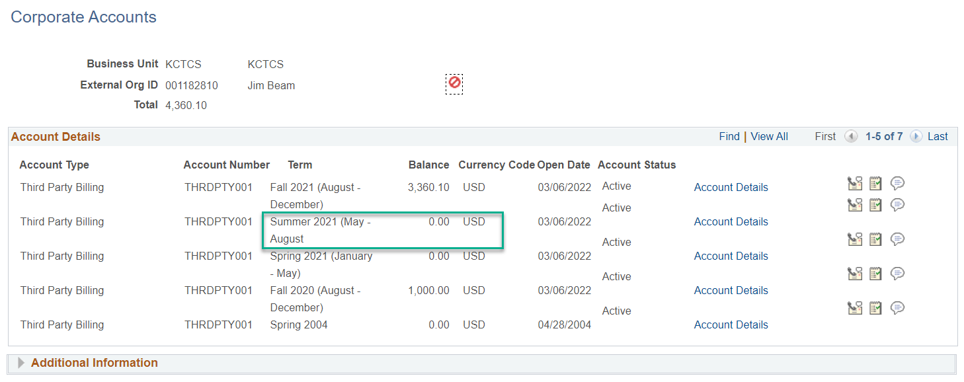
Corporate Account - K_SF_3RD_PAY_GROUP_POST

Slide 53
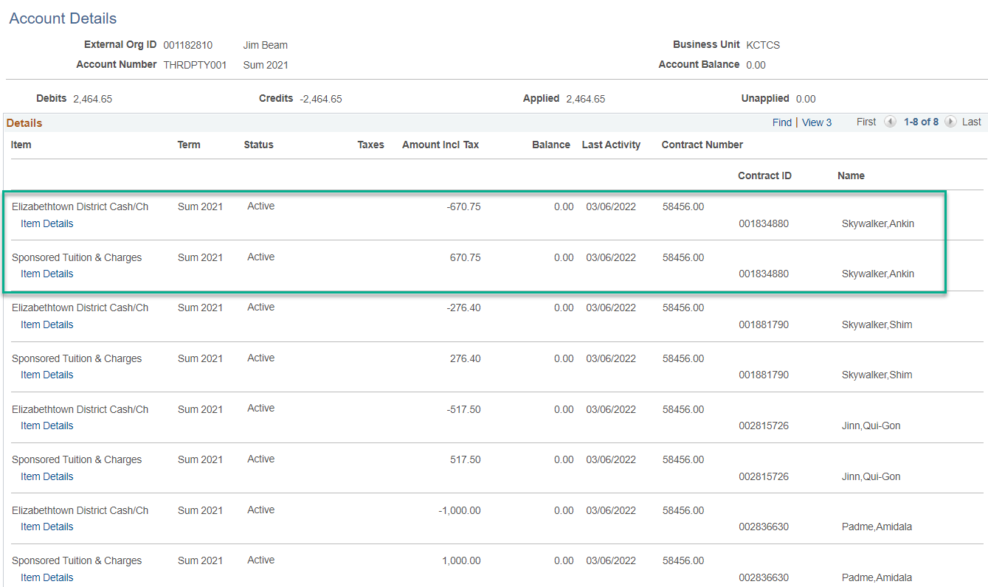

Slide 54
One Payment – Multiple Terms & Contracts

Slide 55
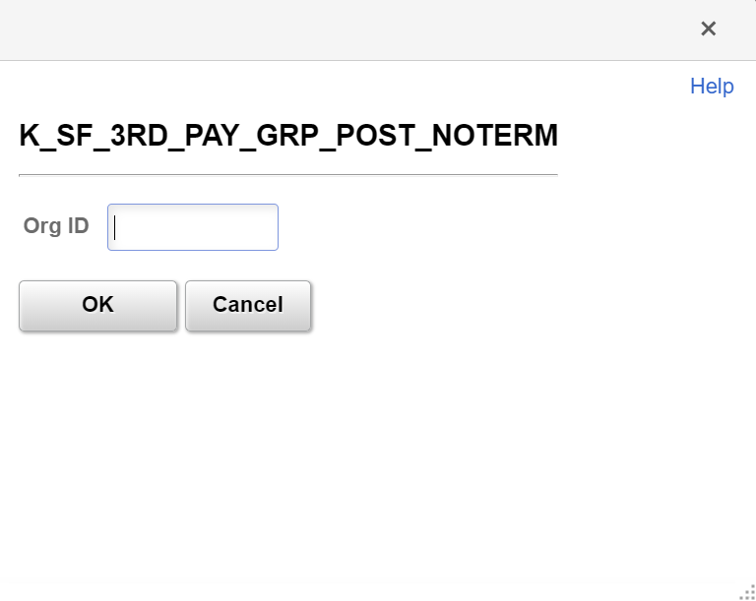
K_SF_3RD_PAY_GROUP_POST_NOTERM
Notes:
SELECT A.EXT_ORG_ID, ( A.ITEM_AMT- A.APPLIED_AMT), ' ', A.REF1_DESCR, 'PAY', A.ITEM_TERM, A.CONTRACT_NUM, A.CONTRACT_EMPLID FROM PS_ITEM_ORG_SF_VW A WHERE ( A.BUSINESS_UNIT = 'KCTCS' AND A.EXT_ORG_ID = :1 AND A.ITEM_TYPE LIKE '8%')

Slide 56
K_SF_3RD_PAY_GROUP_POST_NOTERM
Notes:
Before the last Group Post

Slide 57
K_SF_3RD_PAY_GROUP_POST_NOTERM
Notes:
After the Group Post we just posted item term 4212 is paid in full. We still have the 4204 term with the $1,000 for one of the students, the other student was paid off by a student who was cancelled, and that payment fell down paid the charge off.

Slide 58
Received a payment of $5,360.10 For Contract 58458.00 $2,000 For Contract 58457.00 $3,360.10

Slide 59
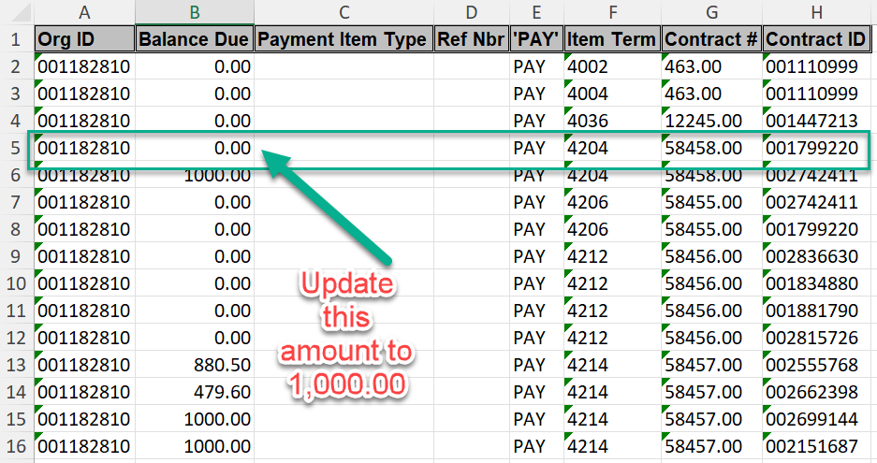

Slide 60
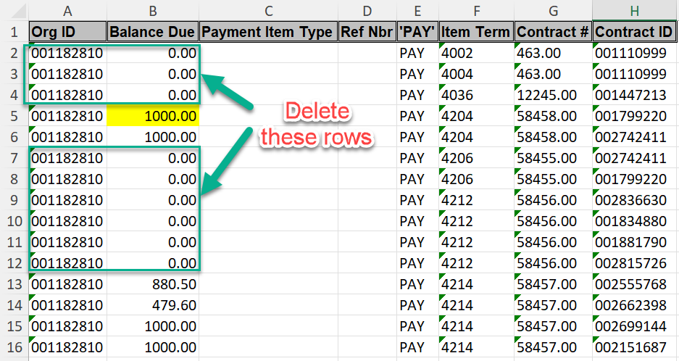

Slide 61
Format file and complete Mass Select Transactions
Notes:
Format your spread sheet and complete Mass Select Transactions

Slide 62
Poll Question
Show of hands
Do you use the delivered Sponsor Refund process?
Does your Sponsor ask you to use the credits on future students ?

Slide 63
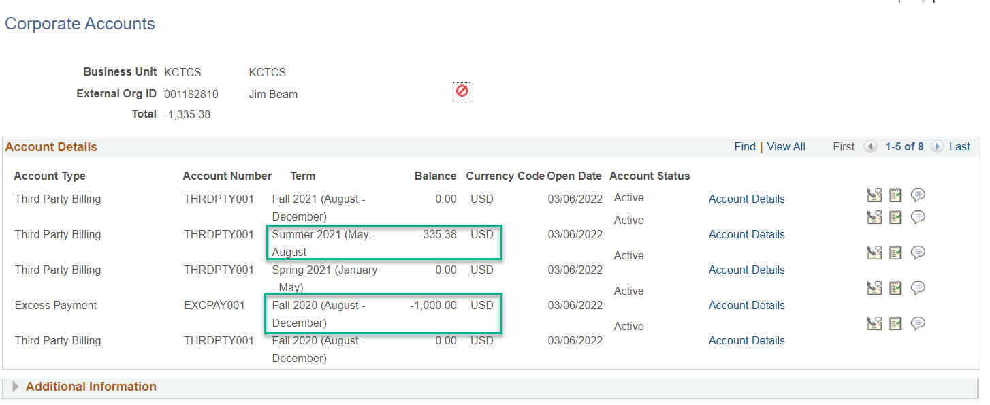
Corporate Accounts After Mass Group Post
Notes:
Now we have some credits, so we can drill down to review.

Slide 64
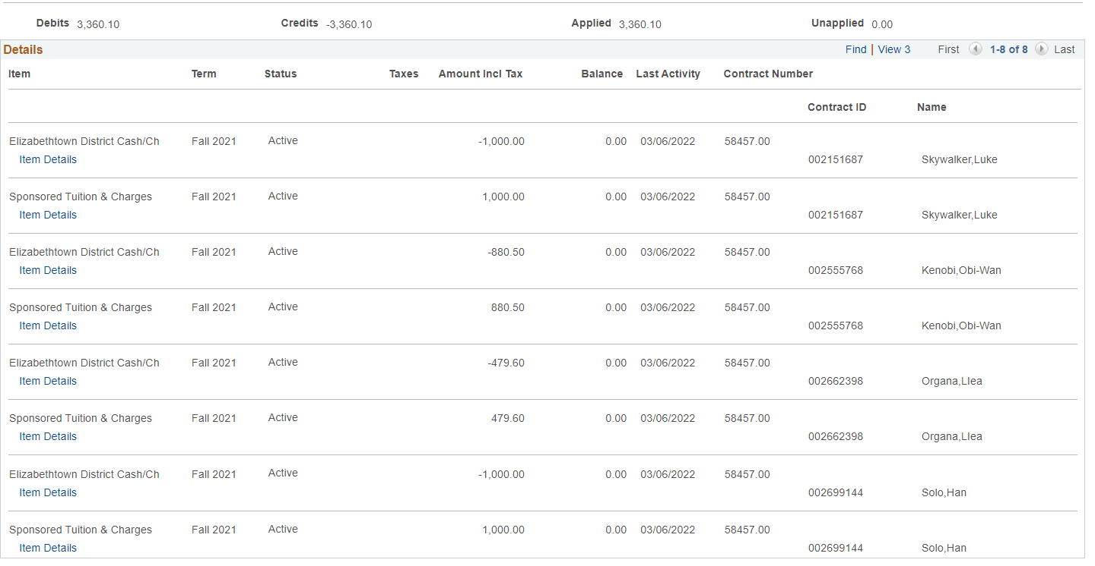
Fall 2021 Contract Nbr 58457.00
Notes:
For fall 2021 we are paid in full, and you can see the charge line per student and the payment applied.

Slide 65
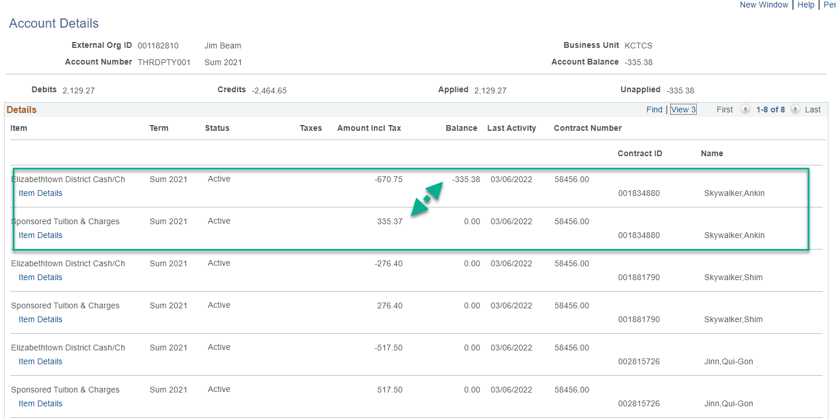
Summer 2021 Credit of $335.38 Payment Stuck
Notes:
For summer 2021 one student was dropped at 50% and you can see the details and know which student requires the refund.

Slide 66
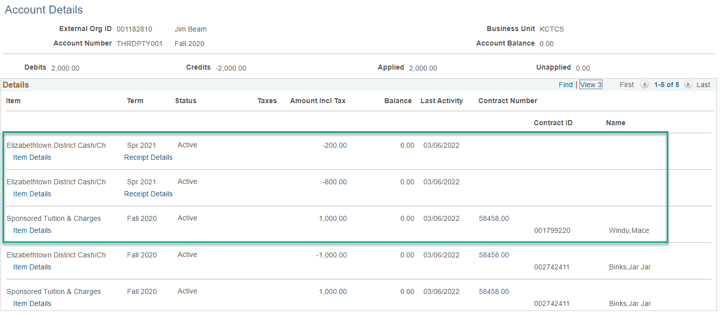
Fall 2020 Spring 2021 Payment Dropped
Notes:
However, if you drill down on the account details you can see this is a payment that was not attached to any student and the payment from the spring 2021 dropped down to pay off a new contract that was established after the spring 2021 contract.

Slide 67
Fall 2020 Excess Pay Line
Notes:
For the fall 2020 we have an excess line for one student. This student was paid by Cashier payments through Select Students and Select Charges

Slide 68
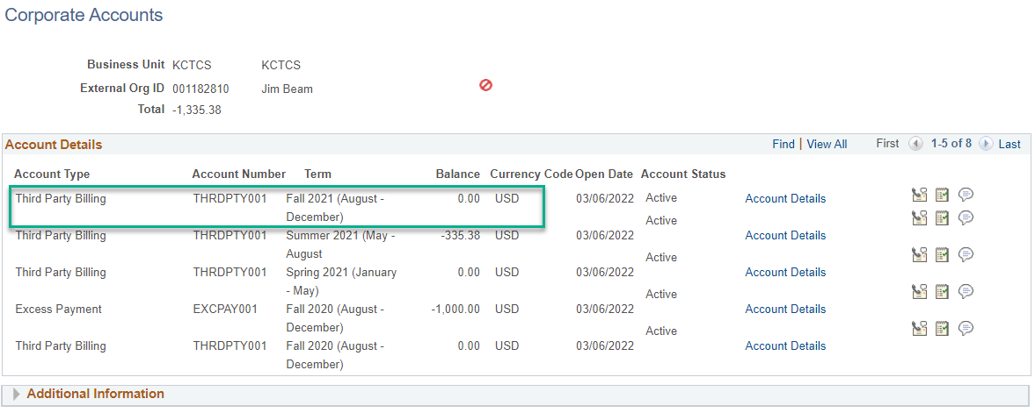
Once Contract Paid in Full – Inactive Contract

Slide 69
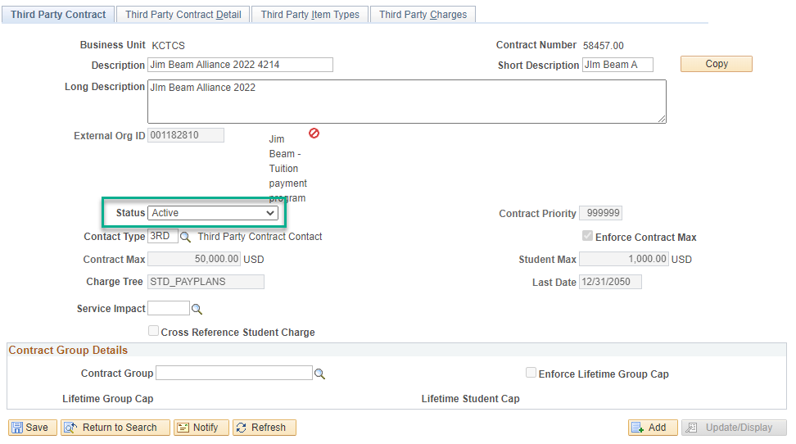
Once Contract Paid in Full – Inactive Contract
Notes:
Once a contract is paid in full, we update the Third Party Contract to Inactive. This helps with tuition calculation performance can prompt the end user that something on a contract has changed.

Slide 70
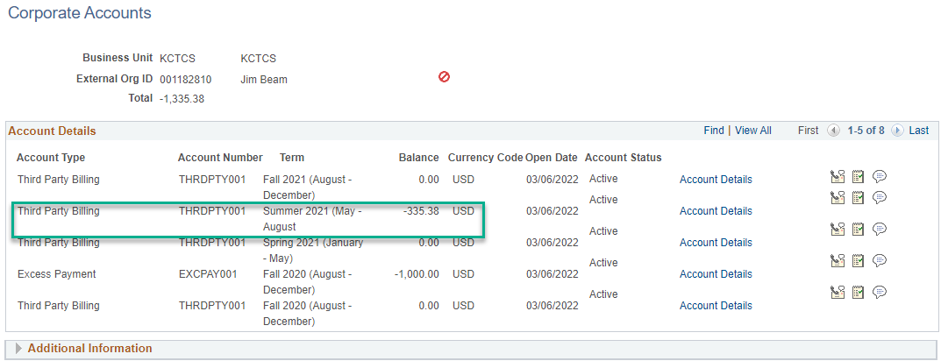
Refund Processing
Notes:
We process Thrid Party refunds via a voucher in Account Payable.

Slide 71
Notes:
We process Third Party refunds via a voucher in Account Payable.

Slide 72
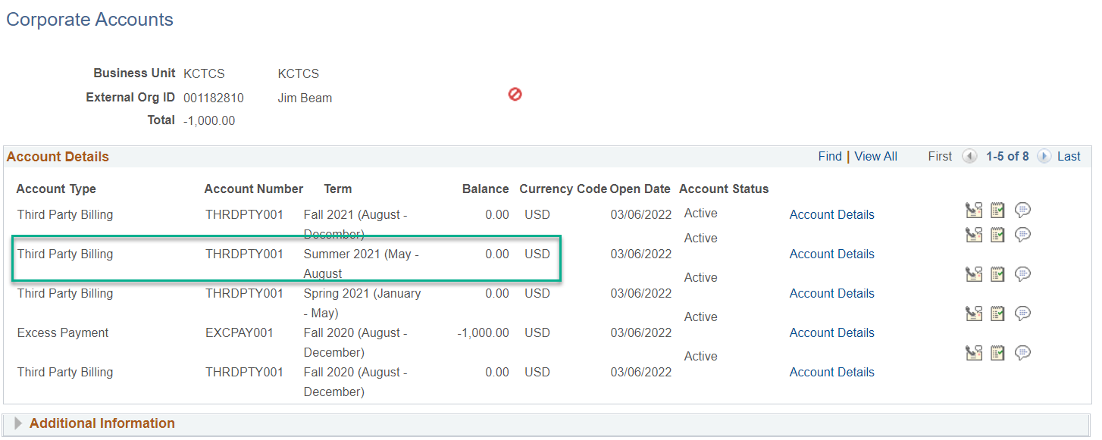
Refund Processing
Notes:
We process Thrid Party refunds via a voucher in Account Payable.

Slide 73
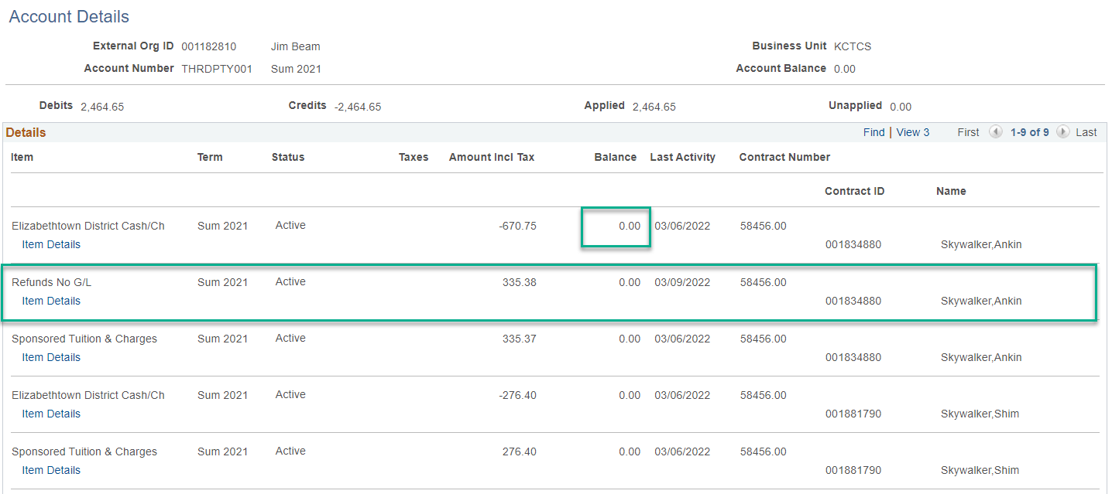
Refund Processing – Account Details
Notes:
We process Thrid Party refunds via a voucher in Account Payable.

Slide 74
Refund Processing
Notes:
We process Third Party refunds via a voucher in Account Payable. Query sql used for these screen shots.
SELECT A.EXT_ORG_ID, B.DESCR, A.CONTRACT_NUM, A.CONTRACT_EMPLID, C.NAME, A.ACCOUNT_TERM, A.ITEM_TYPE, A.ITEM_AMT, A.ITEM_NBR, A.ITEM_TERM, SUBSTR( A.ITEM_TYPE,3,5) FROM PS_ITEM_SF A, PS_EXT_ORG_TBL B, PS_PERSONAL_DTSAVW C WHERE ( B.EXT_ORG_ID = A.EXT_ORG_ID AND B.EFFDT = (SELECT MAX(B_ED.EFFDT) FROM PS_EXT_ORG_TBL B_ED WHERE B.EXT_ORG_ID = B_ED.EXT_ORG_ID AND B_ED.EFFDT <= SYSDATE) AND SUBSTR( A.ITEM_TYPE,8,5) <> '30001' AND A.COMMON_ID = B.EXT_ORG_ID AND A.SA_ID_TYPE = 'O' AND A.BUSINESS_UNIT = 'KCTCS' AND A.CONTRACT_EMPLID = C.EMPLID(+) AND A.EXT_ORG_ID = :2) UNION SELECT D.EXT_ORG_ID, E.DESCR, D.CONTRACT_NUM, D.CONTRACT_EMPLID, F.NAME, D.ACCOUNT_TERM, D.ITEM_TYPE, D.ITEM_AMT, D.ITEM_NBR, D.ITEM_TERM, SUBSTR( D.ITEM_TYPE,3,5) FROM PS_ITEM_SF D, PS_EXT_ORG_TBL E, PS_PERSONAL_DTSAVW F WHERE ( E.EXT_ORG_ID = D.EXT_ORG_ID AND E.EFFDT = (SELECT MAX(E_ED.EFFDT) FROM PS_EXT_ORG_TBL E_ED WHERE E.EXT_ORG_ID = E_ED.EXT_ORG_ID AND E_ED.EFFDT <= SYSDATE) AND D.CONTRACT_NUM = ' ' AND SUBSTR( D.ITEM_TYPE,8,5) <> '30001' AND D.COMMON_ID = E.EXT_ORG_ID AND D.SA_ID_TYPE = 'O' AND D.BUSINESS_UNIT = 'KCTCS' AND D.CONTRACT_EMPLID = F.EMPLID(+) AND D.EXT_ORG_ID = :2) ORDER BY 10, 3, 4

Slide 75
Final Thoughts
Cashiering is a fairly simple process
However only option in which payments stick is Third Party Info (but only one Contract and Student ID at a time)
Mass Select Transactions looks complicated and time consuming however after a couple of times the process is quick and accurate
Mass Select Transactions does not provide a receipt (but we have a Group Post Receipt query and looking at developing one via BI_Publisher)
Keeps Third Party Contract clean without Payment Swapping!

Slide 76
Questions
Buddy Combs
KCTCS
Buddy.combs@kctcs.edu
all Alliance presentations will be available for download from the Conference Site

Slide 77
Thank you!

